Slide 1

EPA Update
LLW Forum Fall Meeting
Baltimore, Maryland
Dan Schultheisz, EPA Office of Radiation and Indoor Air
October 12, 2022

Slide 2
Overview of Presentation
Waste Isolation Pilot Plant (WIPP) Recertification
Emergency Response
  Cobalt Magnet 2022
  Ukraine
Additional Updates
  Multi-Agency Radiation Site Survey and Investigation Manual (MARSSIM)
  Federal Guidance

Slide 3
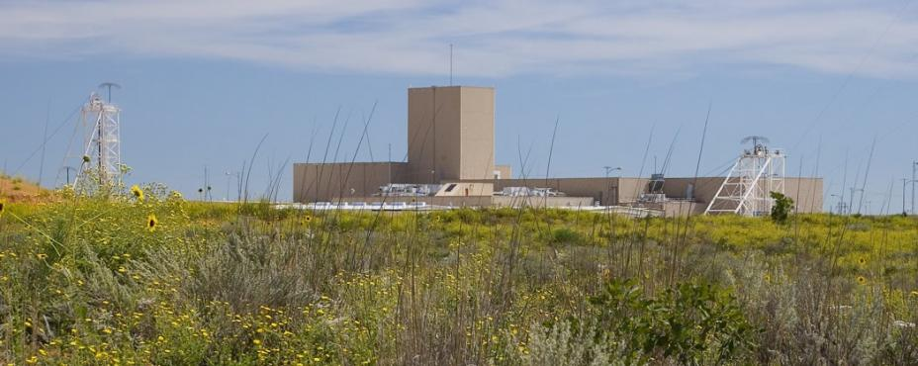
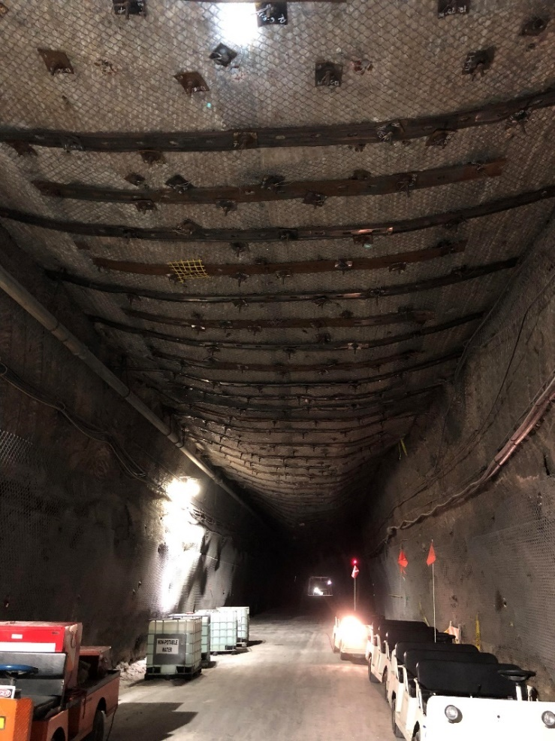
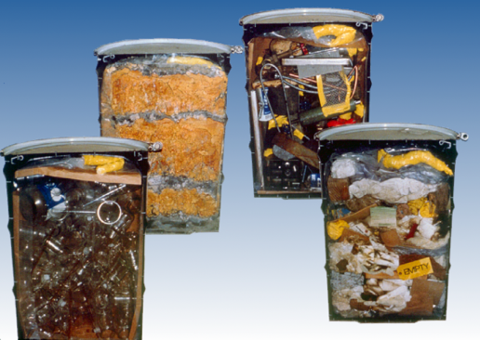
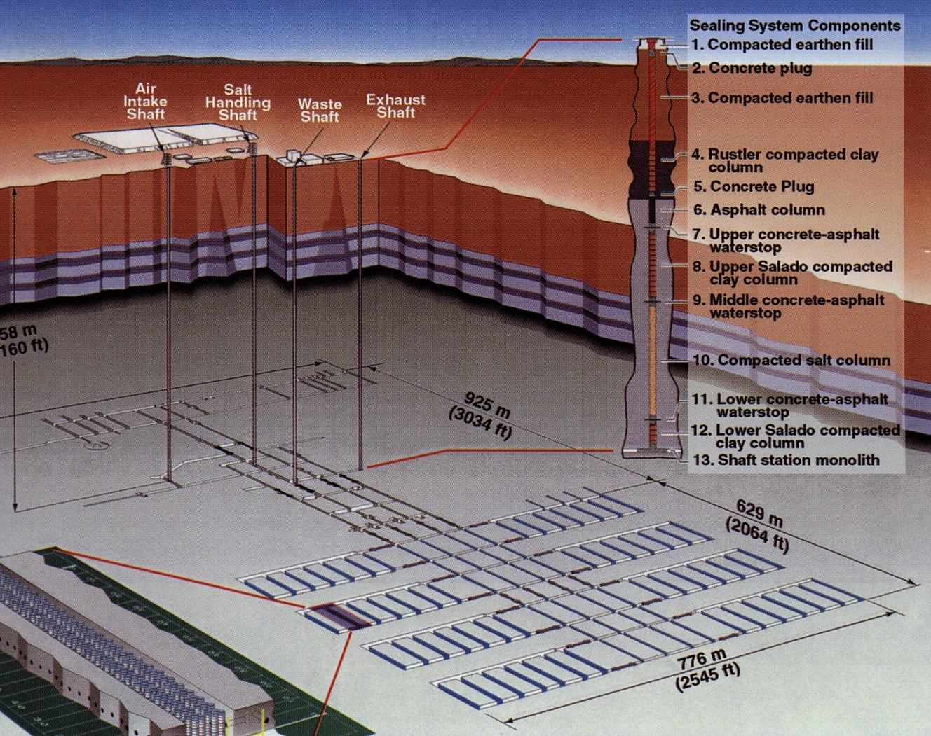
Background on WIPP
The Waste Isolation Pilot Plant and EPA’s Regulatory Authority
WIPP is a deep geologic repository near Carlsbad in southeastern New Mexico, located in bedded salt
The facility disposes transuranic (TRU) radioactive waste from the manufacture of atomic weapons and from DOE defense clean-up
EPA performs oversight for the radioactive portion of waste per the WIPP Land Withdrawal Act of 1992
  This includes a recertification every five years where DOE demonstrates WIPP meets the requirements of 40 CFR parts 191 and 194 for long-term disposal
    Recertification of 2019 Compliance Recertification Application (CRA) published in Federal Register on May 3, 2022 (87 FR 26126)
    Opportunity to identify changes/updates to information about disposal site and actual waste emplacement at WIPP, and incorporate new info in our compliance decision
    Recertification is not a rulemaking and is not subject to judicial review
  Recertification includes a performance assessment (PA) probabilistic model that calculates potential repository releases

Slide 4
Overview of EPA’s Review of CRA-2019
Performance Assessment
Key technical issues in the performance assessment
  Abandonment of Panel Closures in the South (APCS) Approach
  Geochemistry
    Plutonium (Pu) Oxidation State
    Geochemistry database and modeling assumptions
  Drilling Issues
    Plugging patterns
    Drilling rate
EPA conducted 6 sensitivity studies
Issues for future recertifications
Notes:
Joe

Slide 5
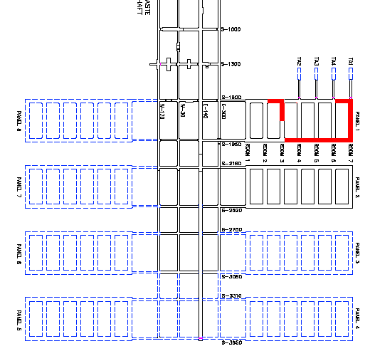
Key Technical Issues
Abandoned Panel Closure System (APCS) Approach
DOE abandoned the areas affected by the 2014 radiological incident: Panels 3-6 and 9
Panels 3-6 will not have panel closures and Panel 9 will not be used for waste but is retained in the modeling
DOE proposed the APCS modeling approach to account for the volume of waste that would have been in Panel 9, and the location of the replacement panel was unknown
  EPA approved this proposed approach that used Panel 9 as a proxy for another panel in an unknown location
  DOE’s intent was to model Panel 9 with waste but without closures and show that it would bound the results if waste were actually placed in a “Panel 9”
  Assumption was that calculated releases would be higher without panel closures
3
9
6
5
4
Area Abandoned
Notes:
Xinyue

Slide 6
Key Technical Issues
Geochemistry
Plutonium (Pu) oxidation state
  Assumptions of 50/50 split between Pu(III) & Pu(IV) unchanged since initial Compliance Certification Application (CCA)
  EPA finds that more recent literature evidence indicates dominance of Pu(III) due to repository physical and chemical conditions, i.e., Pu(III)>>Pu(IV)
    Pu(III) more soluble than Pu(IV), so a 50/50 split would underestimate releases
  Takes on new prominence with plans for additional volume of surplus plutonium
Geochemistry database and modeling assumptions
  Geochemistry database used to calculate actinide solubility contains multiple errors (e.g., in selection of organic ligand stability constants, inclusion of inappropriate lead data)
  Assumptions used to perform solubility calculations (e.g., calcite precipitation) do not reflect current WIPP data
    Results of this calculation are not represented in the rest of the PA and has implications towards repository water balance, magnesium oxide (MgO) backfill efficacy, and rock mechanics
Notes:
Jay

Slide 7
Key Technical Issues
Drilling
Drilling intrusions are the only mechanism leading to significant potential releases
The method used to plug boreholes influences release calculations
  Continuous plugs limit fluid flow in and out of repository and better protect against brine releases of radionuclides
  DOE changed frequency probability calculation methodology for PA simulations for CRA-2019
    EPA disagreed with justification for the change as inconsistent with actual practice
  New probabilities underestimate releases in comparison to prior approved approach
  DOE should utilize previously approved (CCA) methodology or propose an acceptable alternative
"Drilling rate" is the areal density of boreholes that would occur in the Delaware Basin after 10,000 years based on the average annual rate of drilling over the past 100 years
  Only deep boreholes (i.e., repository depth) used in PA calculations – rate increased over time
  Boreholes of unknown depth excluded from PA – historically 3 out of 4 are deep
    ~3,000 boreholes of unknown depth excluded from CRA-2019 calculations
Notes:
Jon

Slide 8
Sensitivity Studies
For the CRA-2019 review, EPA performed its own set of model calculations to determine the sensitivity of releases to the issues EPA identified in its review
The results are expressed as changes in mean total repository releases in EPA units as compared with DOE’s CRA-2019 results
In all cases, EPA calculations showed that WIPP would comply with regulatory standards
List of sensitivity studies:
  Sensitivity to Creep Closure of Empty Rooms (CRA19_COMP Analysis)
  Sensitivity to Borehole Plugging Frequency (PLG_PRB Analysis)
  Sensitivity to Actinide Solubility (GCHM_S0 Analysis)
  Sensitivity to Actinide Solubility and Colloid Parameters (GCHM_S2 Analysis)
  Sensitivity to Actinide Solubility, Colloid Parameters, and Actinide Oxidation State (GCHM_S3 Analysis)
  Sensitivity to Combined Geotechnical and Geochemical Parameter Changes (CRA19_COMB Analysis)
Notes:
Xinyue
QAPP; follow EPA QA

Slide 9
Sensitivity Studies
Combined Geotechnical and Geochemical Parameter Changes (CRA19_COMB) Analysis

Slide 10
Issues for Future Recertifications
New Waste Panels
DOE is working to add two new panels as part of longer-term expansion
  Two panels for existing waste inventory
  Additional panels expected for disposal of ~40 metric tons (MT) of downblended surplus plutonium (Pu)
DOE to submit request for approval to EPA
  NEPA documentation for two panels complete
  Also needs approval by State of New Mexico
Characterization information needed for areas not previously excavated (esp. panels 13+)
  Presence of pressurized brine
  Additional wells in Culebra Dolomite
Modeling of new waste panels
Source: DOE

Slide 11
Issues for Future Recertifications
Pu Increase and Adulterant
Surplus plutonium is the largest contributor to total EPA units in the inventory
  Increased importance of Pu solubility and radiolysis
  Need to ensure waste stream will not be concentrated in a single panel (radiolysis gas generation concerns)
Plutonium is downblended with a proprietary adulterant generally represented in the PA
  Composed of Fe-base metal alloys, inorganic materials, non-ferrous metals, and plastics
  Preliminary DOE experimental data shows it should not affect repository conditions
  EPA will continue to look at longer-term data as DOE develops it
Other Waste (combined)
Surplus Pu (29%)
Other Waste (combined)
Surplus Pu (42%)
*EPA units are units of activity normalized towards its release limits used for the PA
Notes:
Jay

Slide 12
Emergency Response Activities
Cobalt Magnet 2022
Latest in a series of exercises led by DOE/National Nuclear Security Administration
  Validate the concept of operations for technical and operational support for nuc/rad response
  Allow interagency partners to identify capability gaps and opportunities for improvement
  Provide an opportunity to establish relationships/understanding between response partners
Full-scale exercise replicating search, detonation, and early recovery activities
  Radiological dispersal device (RDD) in Austin, Texas
  Detonation at Camp Mabry during a 5K run
  12 Agencies with 54 subordinate entities (Federal, State, and Local)
  ~400 players and 120 exercise staff (37 from EPA)
After Action Report still in process, but some clear areas for improvement
  Notifications
  Communications/public information
  Data analysis and dissemination

Slide 13
Emergency Response Activities
Ukraine
Situation in Ukraine is evolving and uncertain
  Most attention on Zaporizhzhia nuclear power plant
    All six units shut down
    Power supply – utility lines and backup generators
    Military action – occupation and shelling/mines
    IAEA inspections
  More recent actions and statements introducing further uncertainty
U.S. working to provide assistance through bilateral and other mechanisms
  IAEA Request for Assistance Network (RANET)
    Monitoring equipment
    Protective equipment for NPP workers and others
    Initial request was 24 pages long (other countries also working to support requests)
  Newer diesel generators for power backup
EPA is lead coordinating agency for domestic response to foreign nuclear incidents
  Tracking reports and communications, coordinating with federal partners
  Reviewing policies and procedures

Slide 14
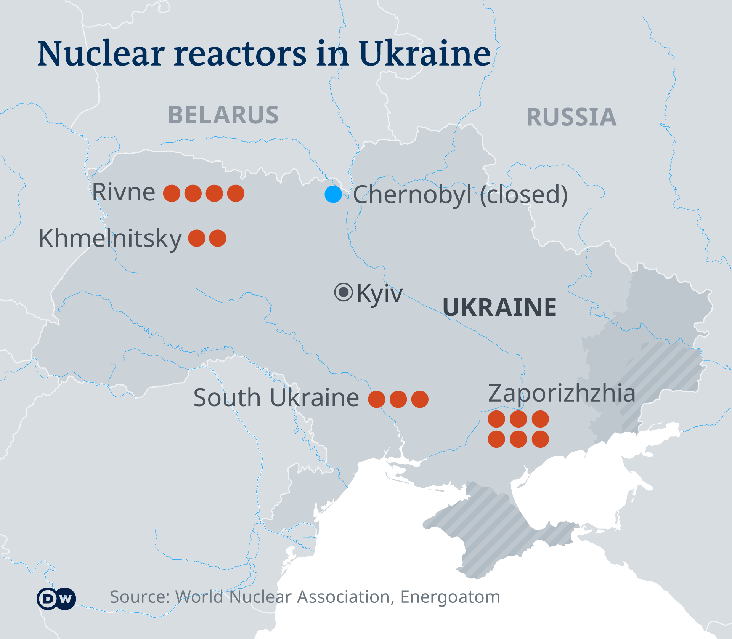
Emergency Response
Nuclear Reactors in Ukraine

Slide 15
Additional Updates
Multi-Agency Radiation Site Survey and Investigation Manual (MARSSIM)
  Provides a federal consensus approach for conducting radiation surveys
  Working to respond to comments to finalize Revision 2, with additional research on:
    Automated measurements – Measurement Quality Objectives (MQOs) and operational practice
    Discrete radioactive particles
    MQOs for aerial measurements
Federal Guidance Report No. 16
  Updated cancer risk coefficients for ingestion, inhalation, and external exposure
  Currently undergoing internal review prior to expected review by Interagency Steering Committee on Radiation Standards (ISCORS)
  Science Advisory Board review anticipated 2023

Slide 16
Questions?
https://www.epa.gov/radiation

