Slide 1

NRC Update
Protecting today, tomorrow, and
cleaning up the past
Low-Level Radioactive
Waste Forum
Fall 2022 Meeting
October 12-13, 2022
Stephen Koenick, Chief
Low-Level Waste and Projects Branch
Division of Decommissioning, Uranium
Recovery, and Waste Programs
Office of Nuclear Material Safety and Safeguards

Slide 2
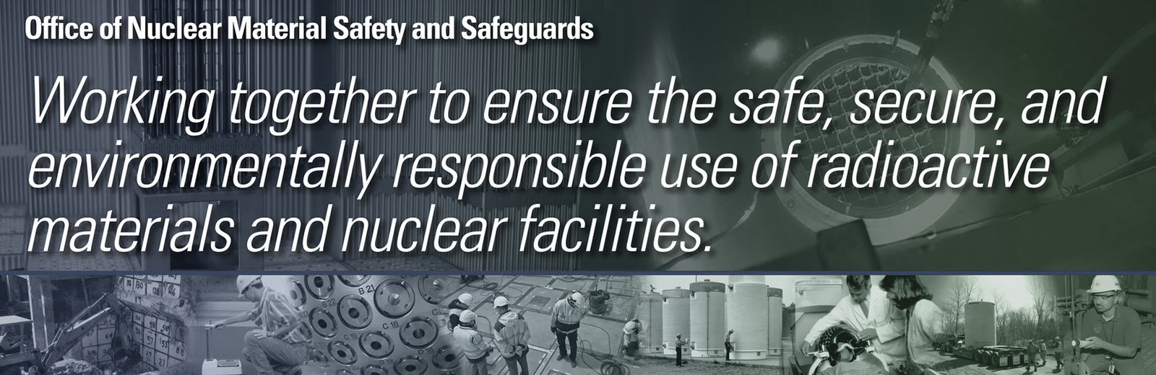
Regulatory Topics
  Low-Level Waste (LLW)
    LLW Programmatic Assessment
    Alternative Disposal Requests (ADRs)
    Radiation Source Protection and Security Task Force
    Rulemaking Status
  Decommissioning
    Process Improvements
    Rulemaking status

Slide 3
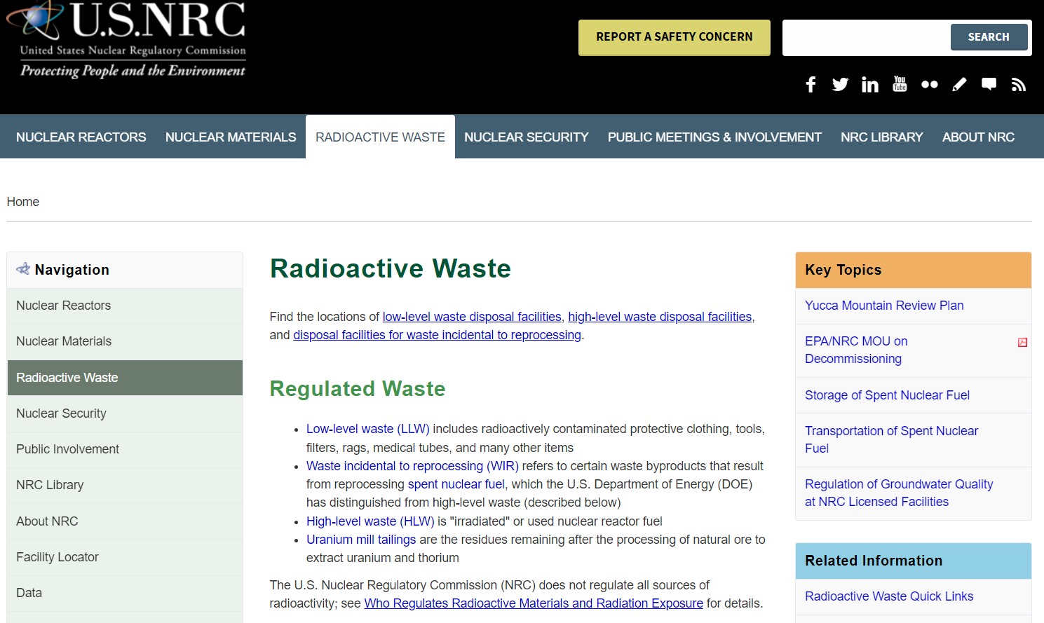
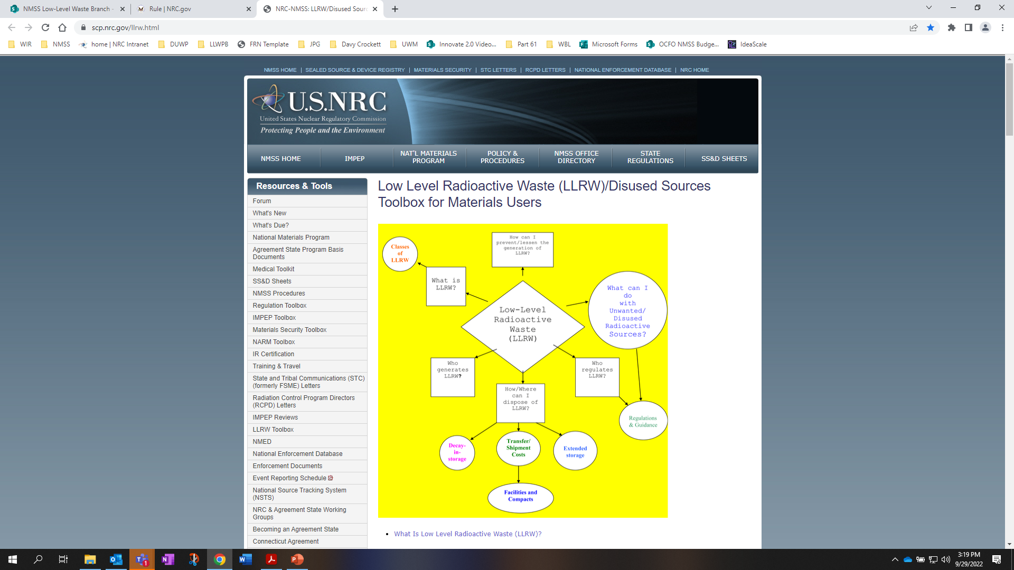
NRC’S LLW Program
https://www.nrc.gov/waste.html
https://scp.nrc.gov/llrw.html

Slide 4
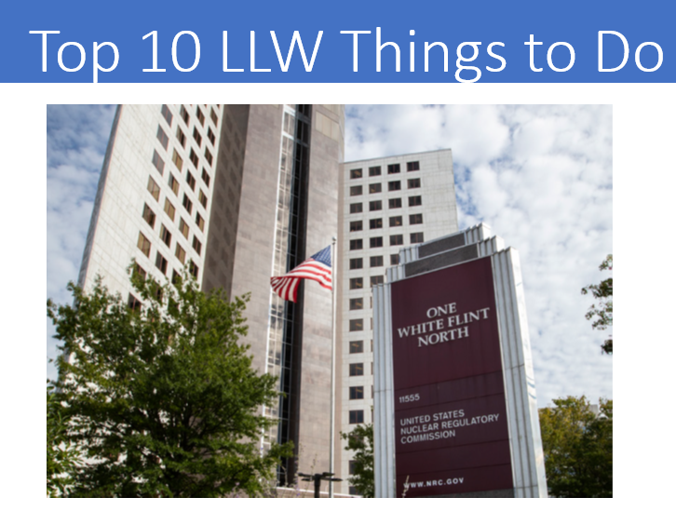
Updated Prioritized Tasks from the LLRW Programmatic Assessment
  LLW Programmatic Assessment
Task | Priority | Status
1. Complete and Implement Site-Specific Analysis Rulemaking | High | Active Integrated Low-Level Pt 61 Rulemaking – SRM SECY-20-0098
2. Address update to the 10 CFR Part 61 Waste Classification Tables | High | No action-(Awaiting task 1 completion)
3. Implement the Updated Concentration Averaging and Encapsulation BTP | High | Completed Training in March 2016 (https://www.nrc.gov/waste/llw-disposal/llw-pa/llw-btp.html)
4. Prepare a regulatory basis and conduct potential rulemaking for GTCC and transuranic waste disposal | High | Active Technical requirements for near surface disposal of GTCC and TRU have been integrated into the Pt 61 Rulemaking – SRM SECY-20-0098
5. Finalize internal procedure/Standard Review Plan for 10 CFR § 20.2002 requests to improve alternate disposal process | High | Completed-(https://www.nrc.gov/waste/llw-disposal/very-llw.html)
6. Update NUREG/BR-0204, Rev. 2 (July 1998), “Instructions for Completing NRC’s Uniform Low-Level Radioactive Waste Manifest” | High | Completed Published NUREG/BR-0204, Rev 3, (June 25, 2021) https://www.nrc.gov/waste/llw-disposal/llw-pa/llw-uwm.html
7. Perform VLLW Scoping Study | Medium | Completed- Issued SECY-21-0057 (June 1, 2021)
8. Update and consolidate LLRW guidance into one NUREG | Medium | No Action
9. Examine the need for guidance on defining when radioactive material becomes LLRW | Low | No Action
10. Develop and implement the national waste tracking system | Low | No Action

Slide 5
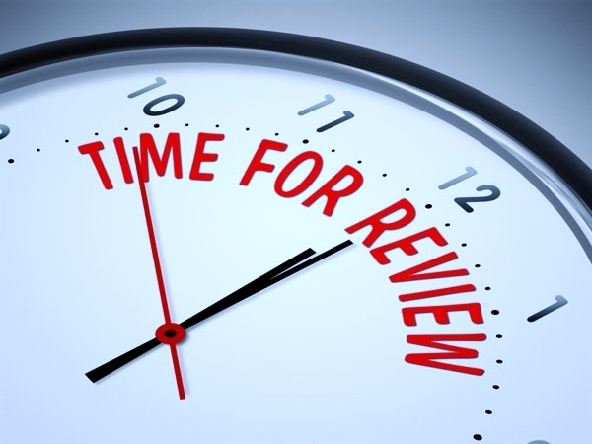
  Working with the Regions on Recent ADRs
Since January 1, completed two 20.2002s and are currently reviewing a third
Columbia Generating Station (request approval for onsite disposal)
  Submitted to the NRC – 12/21/2020
  Approved by the NRC – 3/11/2022
Columbia Fuel Fabrication Facility (request for disposal of material at US Ecology Idaho)
  Submitted to the NRC – 11/5/2021, 12/1/2021
  Approved by the NRC – 3/18/2022
South Texas Project (request disposal at a landfill located within Texas (Agreement State))
  Submitted to the NRC – 12/3/2021
  Provided RAIs and Responses – 7/8/2022
  Projected Completion of Review – 12/2022
*We are assisting Region IV in the review of the Qal Tek request which could lead to future ADRs

Slide 6
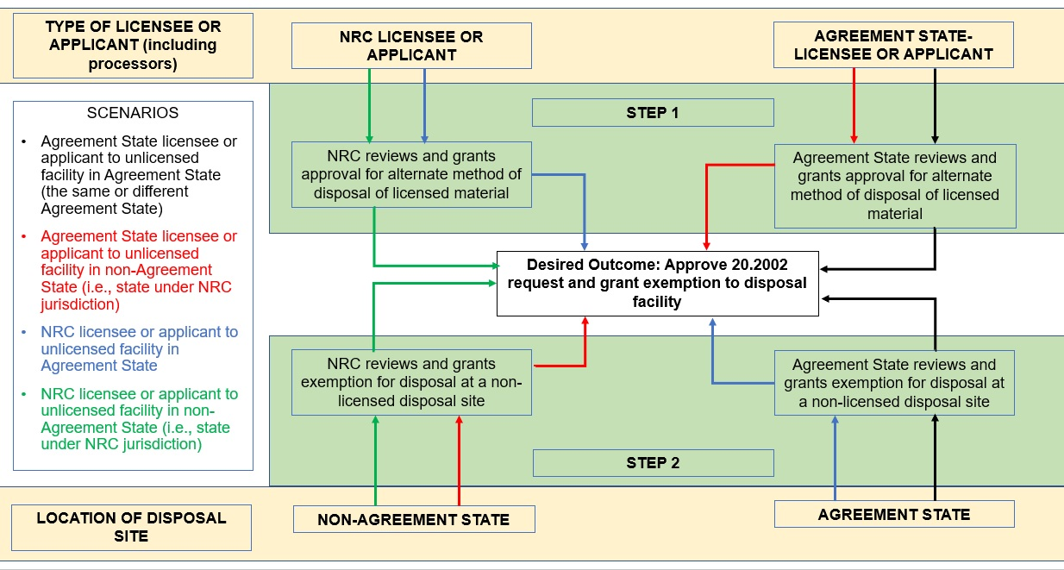
ADRs: Coordinating with Agreement States and Other Regulatory Authorities

Slide 7
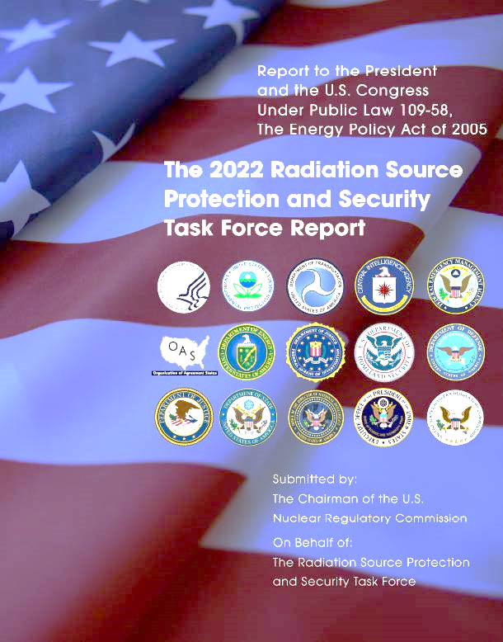
  Protecting and Securing Radiation Sources
  Radiation Source Protection and Security Task Force
    Composed of 14 Federal Agencies and
    1 State organization
    Chaired by NRC
    Evaluates and provides recommendations
    related to domestic security of radioactive sources
    2022 report to the U.S. President and Congress issued August 5th

Slide 8
Challenges to the Current Regulatory Framework in 10 CFR Part 61
1982 Assumption | Current Practice
Waste hazard duration Class A and B: 100 years Class C: 500 years | Some defaulted Class A wastes are being disposed of in greater quantities than assumed and could cause hazards past these periods (e.g., Depleted Uranium (DU))
Only DOE enriches uranium DU only commercially available in small quantities | Private sector enrichment facilities
Average disposed waste concentration expected to be well below Class limit | Blended wastes create wastes much closer to Class limit
Greater-than-Class-C (GTCC) waste disposal in geologic repository or by Commission approval | Considering near-surface disposal (in top 30 m) for certain GTCC waste streams
8

Slide 9
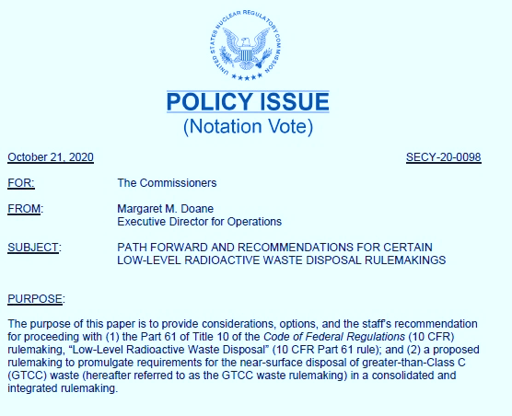
LLW Rulemakings
Part 61 and GTCC/TRU Rulemakings
Combine these efforts to address overlapping technical requirements, streamline stakeholder outreach, and gain efficiency in proceeding as one rulemaking activity (SECY-20-0098)
Commission issued Staff Requirements Memorandum (SRM-SECY-20-0098) on
April 5, 2022

Slide 10
Integrating the LLW Rulemakings
Depleted Uranium
GTCC
TRU Waste
NRC is preparing an integrated rulemaking to:
  Consolidate and integrate criteria for GTCC and 10 CFR Part 61 rulemaking
  Conduct site-specific analyses for all waste streams including DU and GTCC
  Include graded approach for compliance period
  Include TRU waste in the definition of LLRW
  Address physical protection and
  criticality concerns in GTCC
  waste streams
  Provide for Agreement State licensing of certain GTCC waste streams
Site-Specific Analyses
Integrated
Low-Level Radioactive Waste Disposal
Rulemaking
10

Slide 11
Commission Directed Changes
Directed Changes
Allow case-by-case application of new requirements
Include safety case and defense-in-depth considerations
Allow single regulator for GTCC waste streams containing strategic special nuclear material
Consider site-specific, graded compliance period
Flexibility for facilities to develop Site-Specific Waste Acceptance Criteria
Allow Agreement State licensing of certain GTCC waste streams
11

Slide 12
Approximate Schedule
Rulemaking
Develop Proposed Rule that Integrates GTCC and 10 CFR Part 61 Rulemaking
Submit to Commission for Approval
Publish Proposed Rule
Public Meetings and Comment Period
Develop Final Rule
Submit to Commission for Final Approval
Publish Final Rule
November 2023
November 2025
Guidance
Revise NUREG-2175 and Develop GTCC Guidance
Submit to Commission with Proposed Rule
Publish Draft Guidance
Public Comment Period
Develop Final Guidance
Hold for Commission Approval of Final Rule
Issue Final Guidance
12

Slide 13



Contacts
Irene Wu, Rulemaking PM
  Email: irene.wu@nrc.gov
  Phone: (301) 415-1951
Cardelia Maupin, GTCC Technical PM
  Email: cardelia.maupin@nrc.gov
  Phone: (301) 415-4127
Priya Yadav, Part 61 Technical PM
  Email: priya.yadav@nrc.gov
  Phone: (301) 415-6667
13

Slide 14
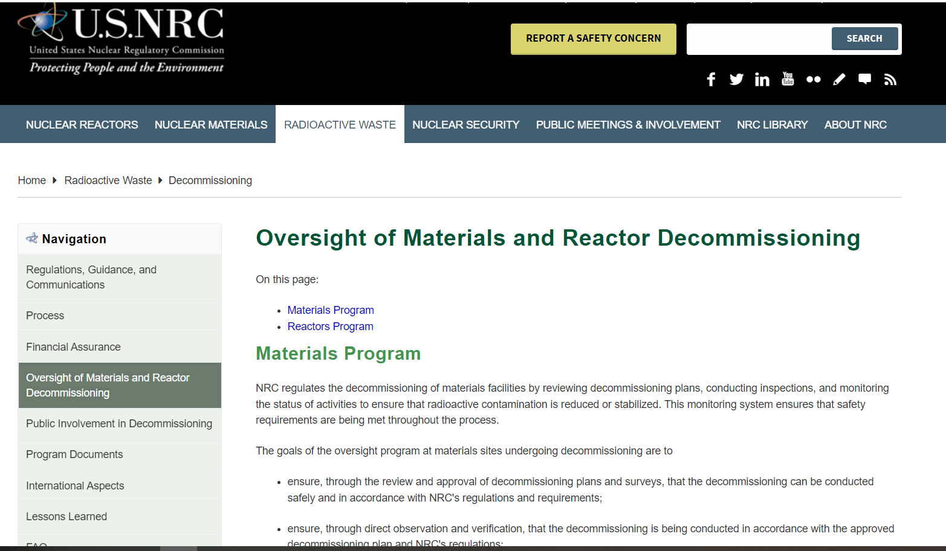
NRC’S Decommissioning Program
https://www.nrc.gov/waste/decommissioning/oversight.html

Slide 15
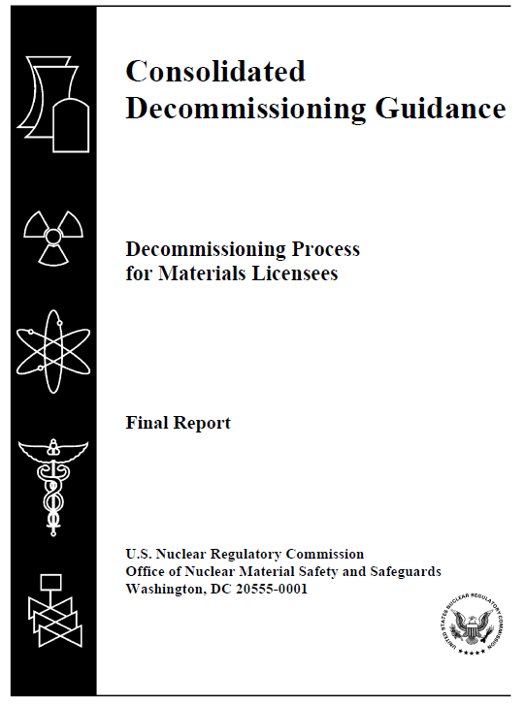
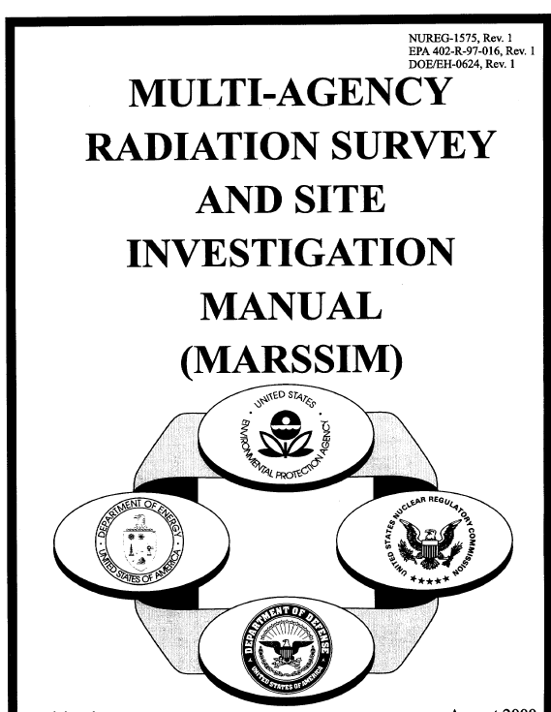
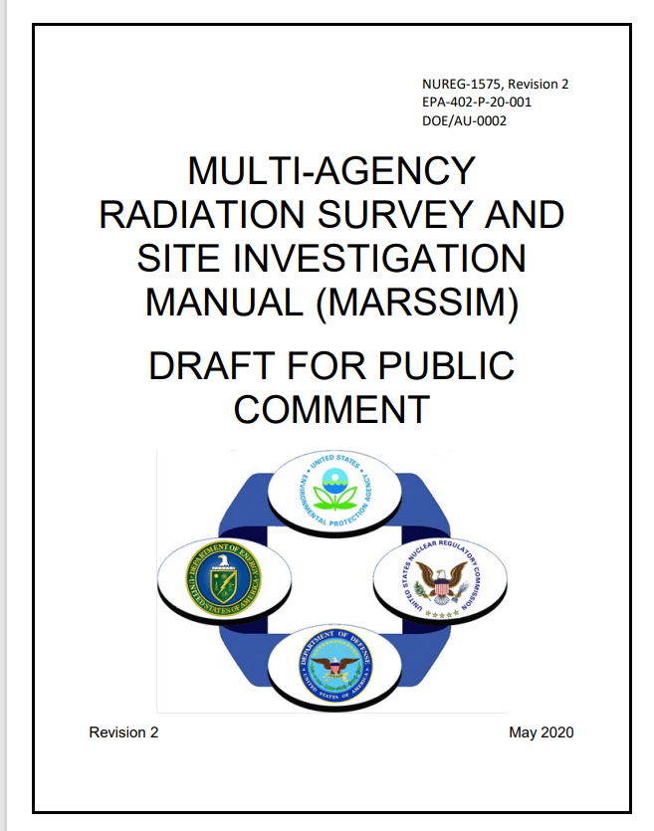
Improving Decommissioning Process – Guidance
NUREG-1757, “Consolidated Decommissioning Guidance,” Volume 2, Rev. 2, “Characterization, Survey, and Determination of Radiological Criteria”
  Final published July 19, 2022 (ML22194A859)
  FRN was published July 22, 2022 (87 FR 43906)
  Over 200 comments in nine comment letters (ML21299A032)
NUREG-1575, Rev. 2, “Multi-Agency Radiation Survey and Site Investigation Manual (MARSSIM)” (to be finalized in 2023)
  Issued for public comment in July 2021
  Over 60 comments in 17 comment letters
  Science Advisory Board peer reviewed
  MARSSIM Working Group is currently addressing comments
15

Slide 16
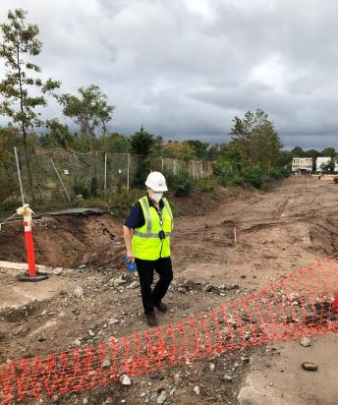
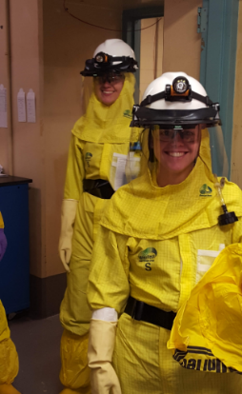
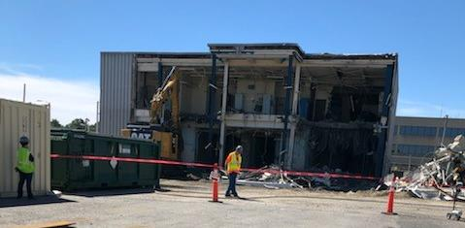
Risk-Informing Decommissioning Inspection Oversight Guidance
IMC 2561, “Decommissioning Power Reactor Inspection Program”
IMC 2602, “Decommissioning Oversight and Inspection Program for Fuel Cycle Facilities and Materials Licensees”
IMC 1248, Appendix F, “Training Requirements and Qualification Journal for Decommissioning Inspectors"
16

Slide 17
Decommissioning rulemaking update
Would implement specific regulatory requirements for different phases of the decommissioning process consistent with the reduced radiological risk. Topics include:
  Emergency preparedness
  Decommissioning funding assurance
  Environmental considerations
  Spent fuel management planning
  Record retention requirements
Proposed rule published March 3, 2022 (87 FR 12254)
Comment period closed August 30, 2022
Target date for submitting the draft final rule to the Commission is October 2023

Slide 18
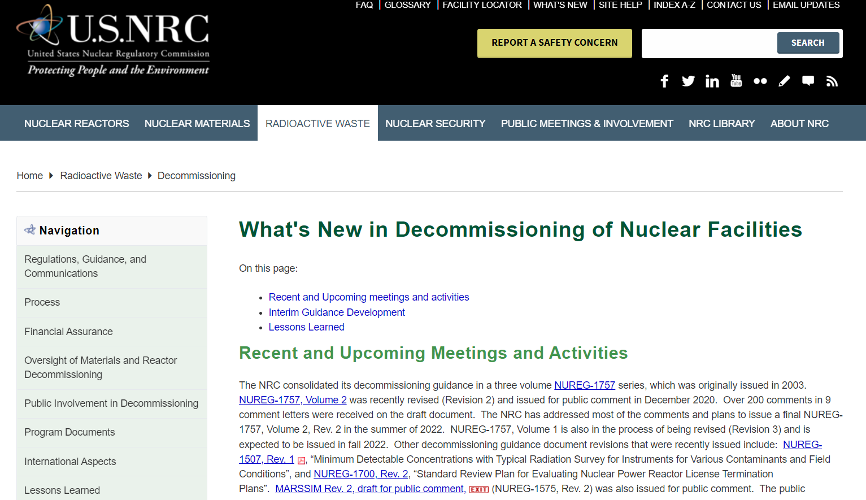

Enhancing Decommissioning Outreach
New webpage on NRC.GOV
Keep up-to-date on upcoming workshops and guidance releases
https://www.nrc.gov/waste/decommissioning/whats-new.html

Slide 19





Questions/Comments
Follow @NRCgov
To subscribe to e-mail updates: https://www.nrc.gov/public-involve/listserver.html#lyris

