Slide 1
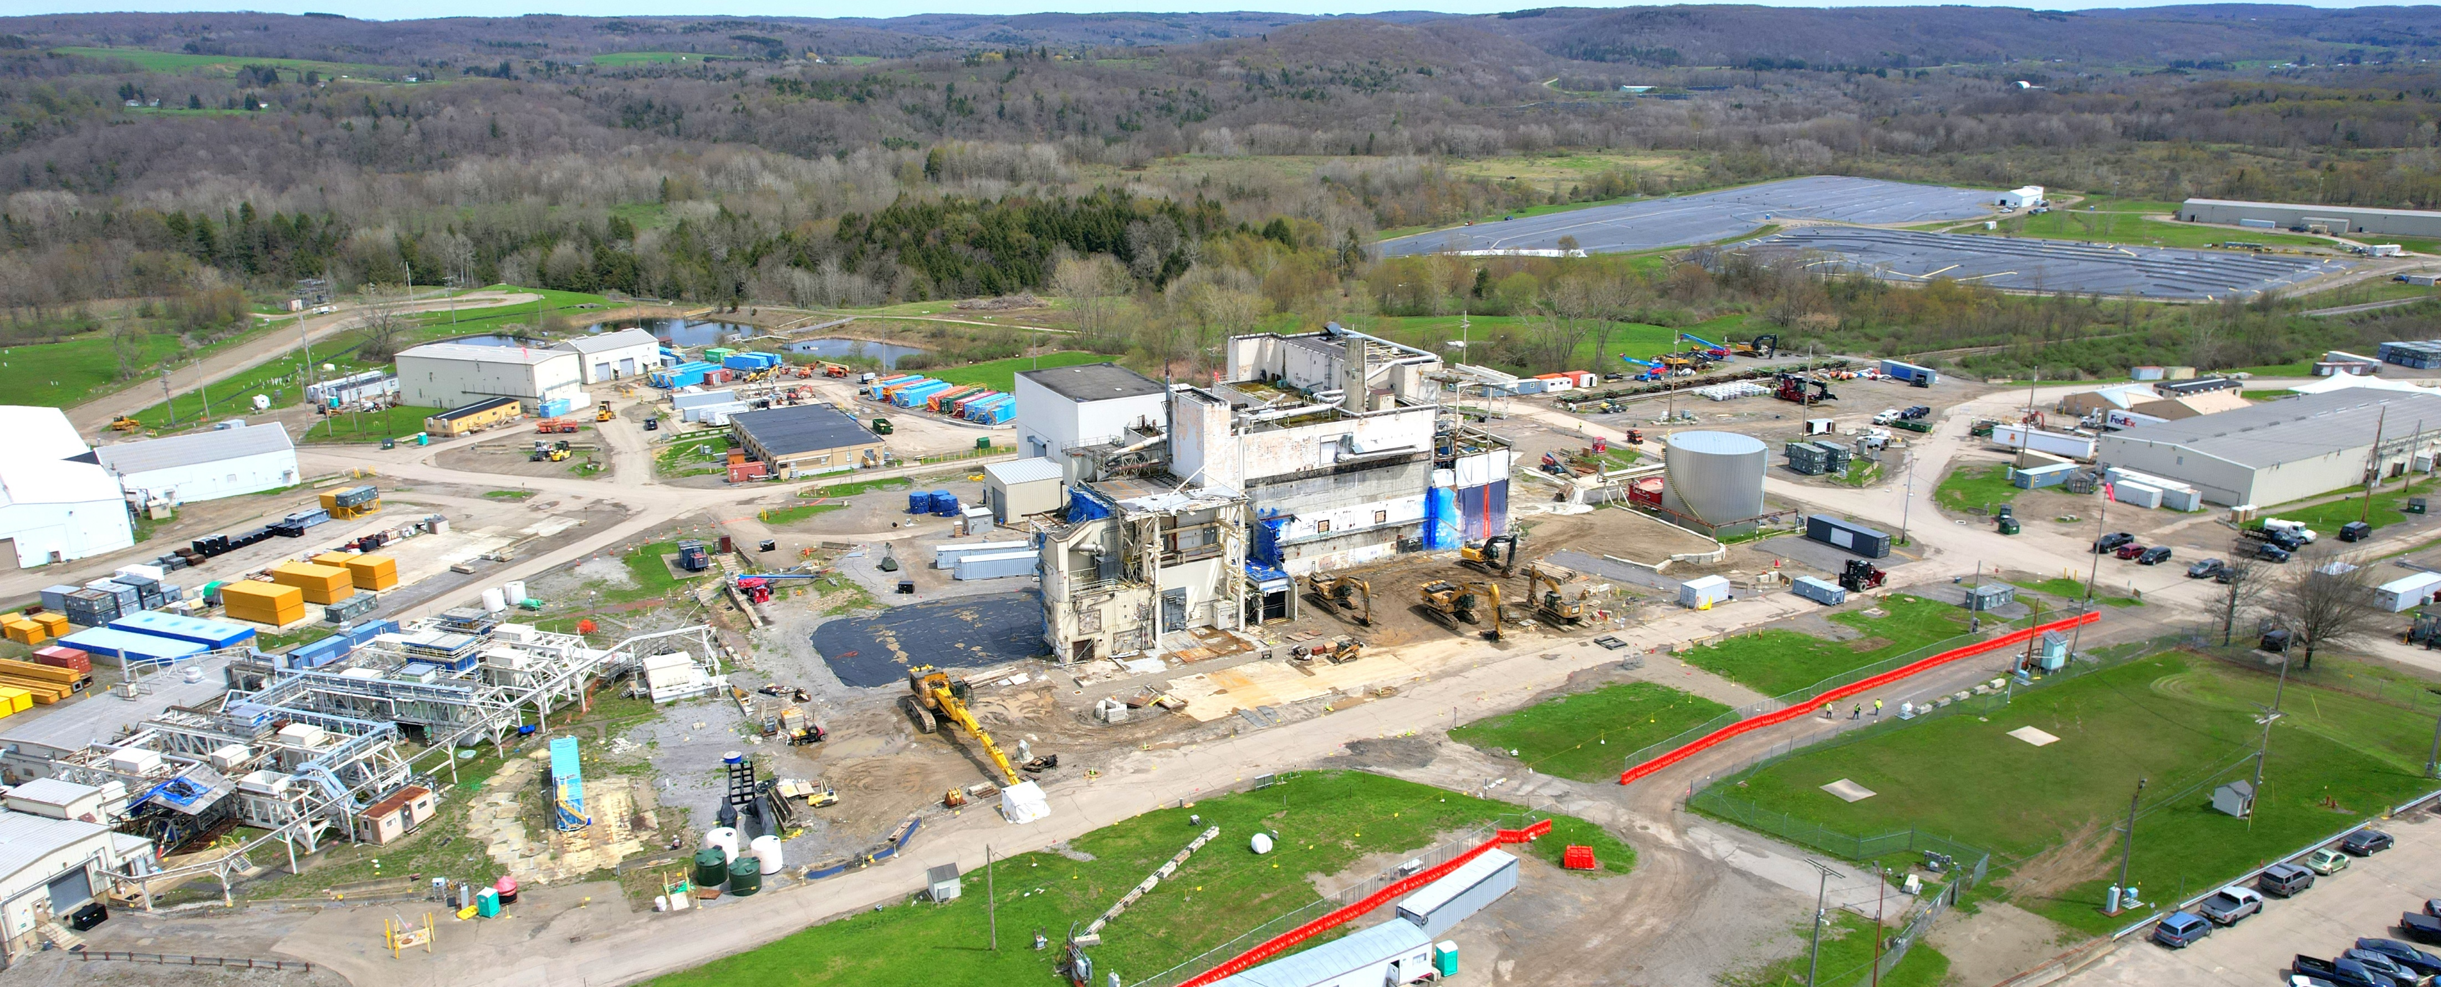
State Agency Perspectives on Performance Assessment
West Valley Demonstration Project, May 2022
Lee M. Gordon, PhD. – New York State Energy Research and Development Authority
LLW Forum, October 2022

Slide 2
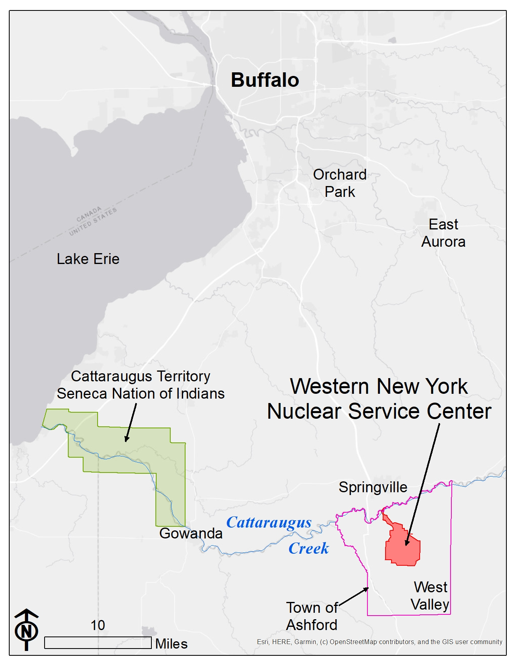
Overview
West Valley site background
West Valley PA past and path forward
PA challenges
Managing PA challenges

Slide 3
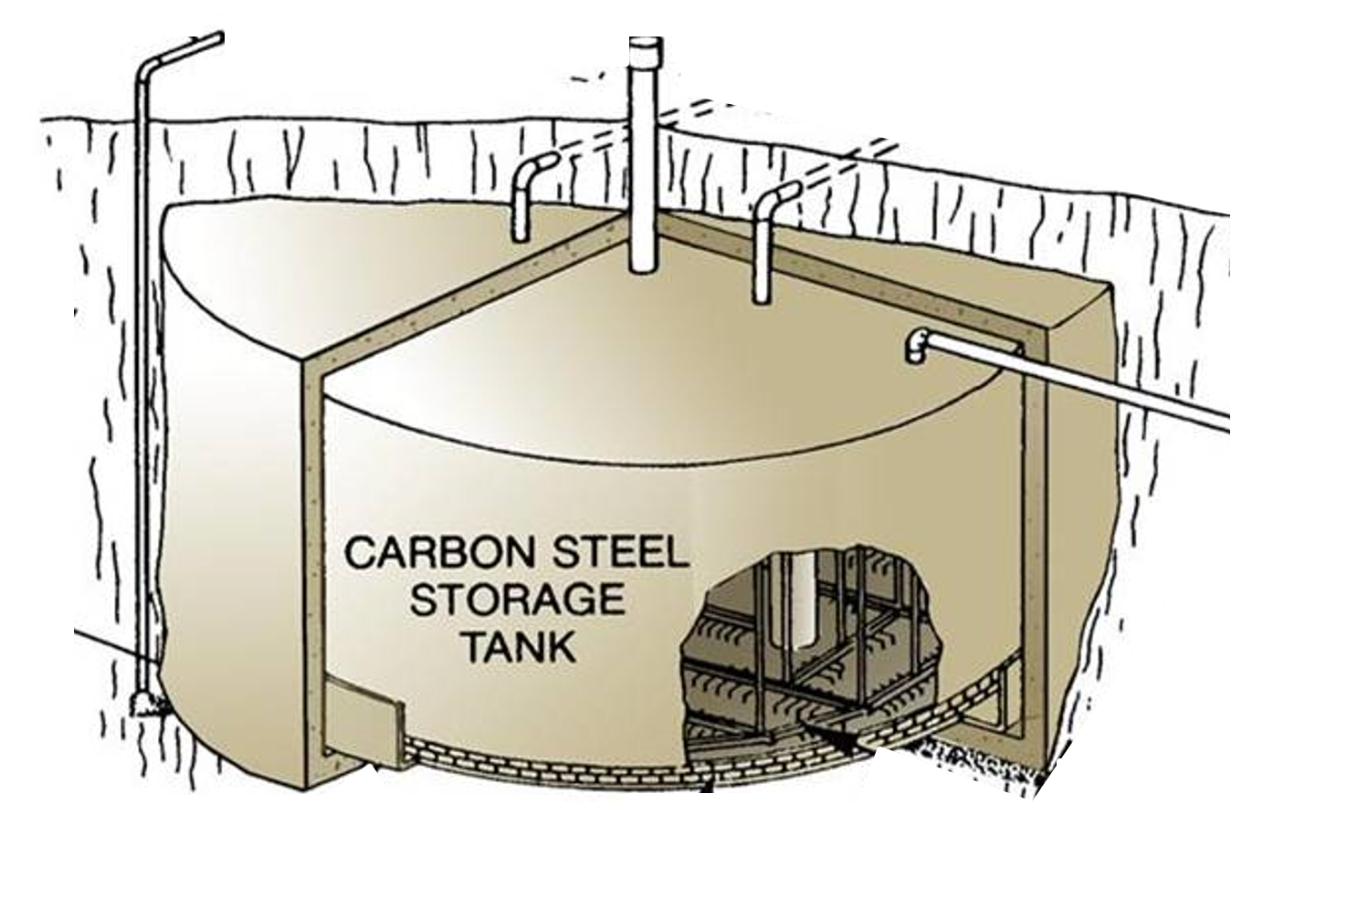
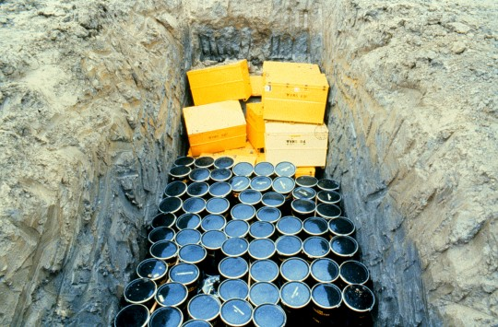
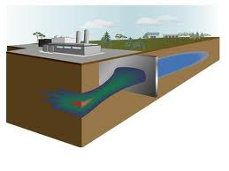
West Valley Background
Western New York Nuclear Service Center
      3300 acres - New York State owned
West Valley Demonstration Project (WVDP)
      200 acres – DOE managed
Complex site history (reprocessing, waste disposal, decommissioning)
Complex site (inventory, waste forms, facilities)
Humid site in northeastern US (weather extremes, erodible glacial soils)

Slide 4
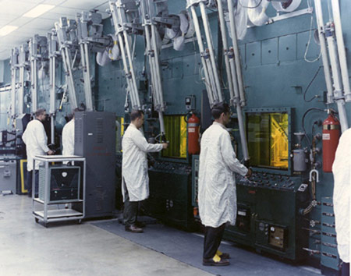
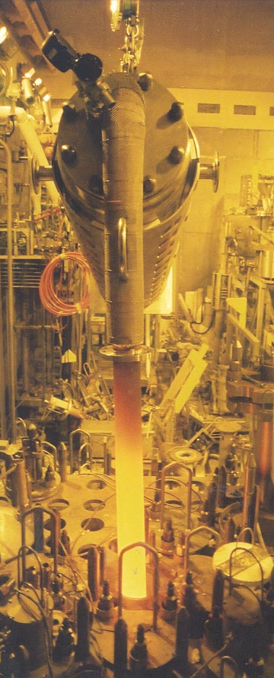
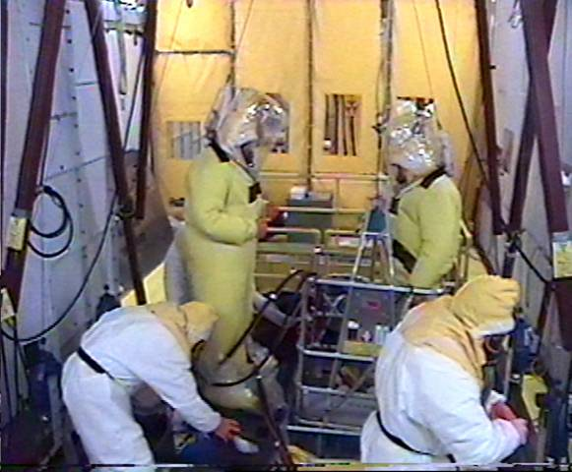
History
Spent Nuclear Fuel Reprocessing and Waste Disposal (1966-1972)
Contaminated facilities, 600k gallons high-level waste left behind (late 1970s)
WVDP Act, DOE responsibilities (1980)
Vitrification and decontamination (1990s)

Slide 5
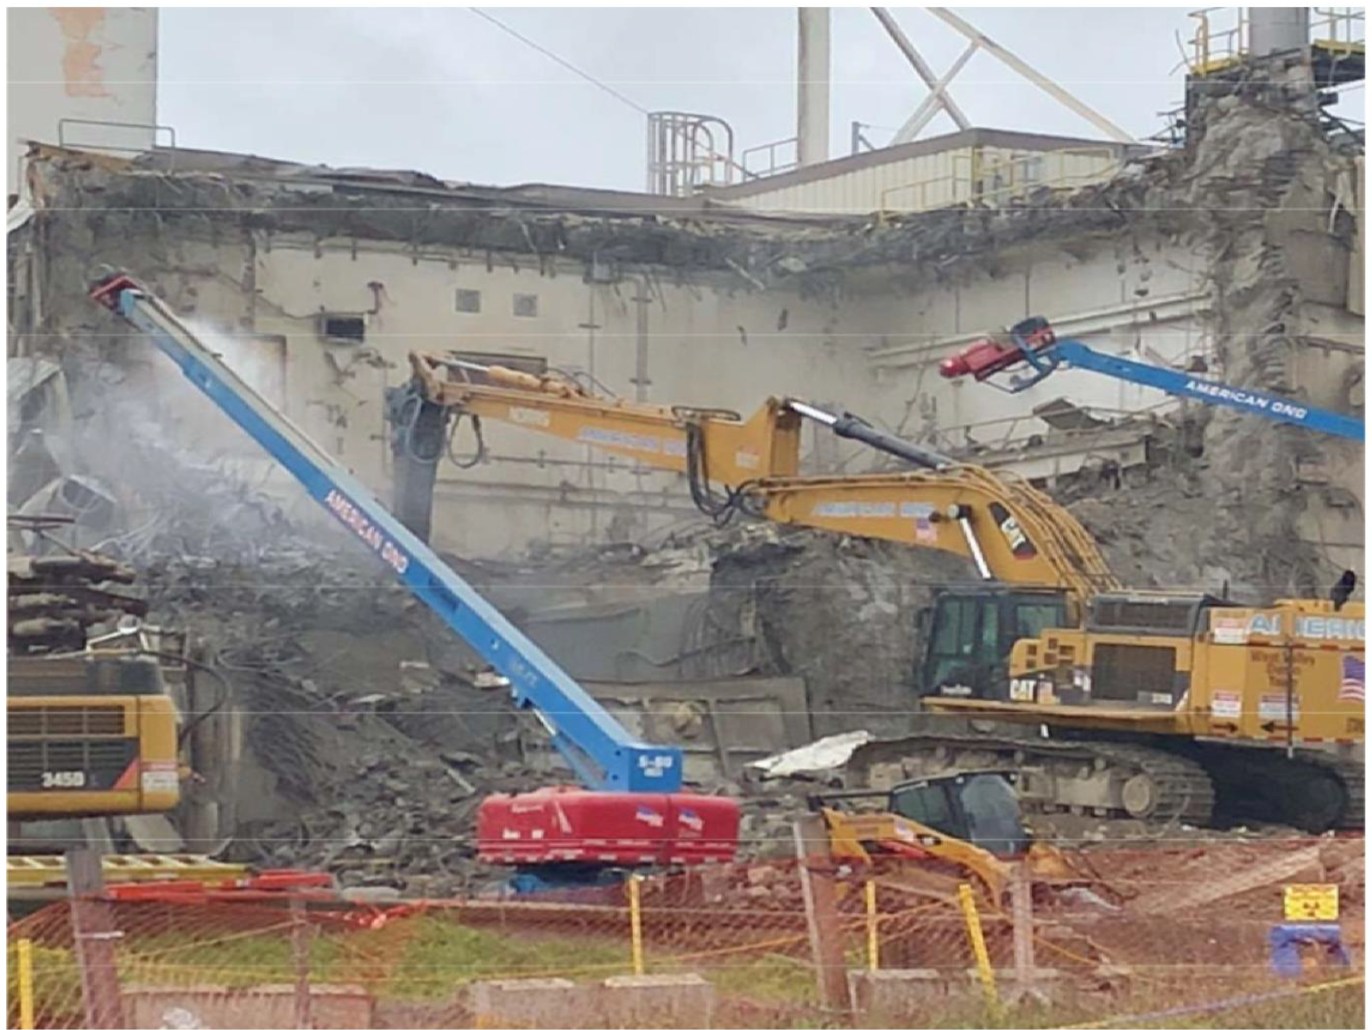
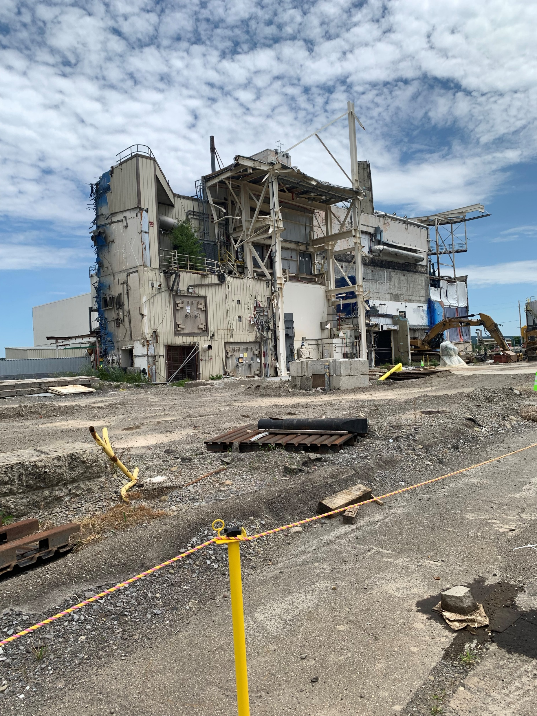
Phased Decommissioning
Phase 1 – All removal actions - ongoing
    Facility Demolition & Soil Remediation
    Off-site disposal
Vitrification Facility demolition, 2018
Main Plant Process Building demolition, begins this month

Slide 6
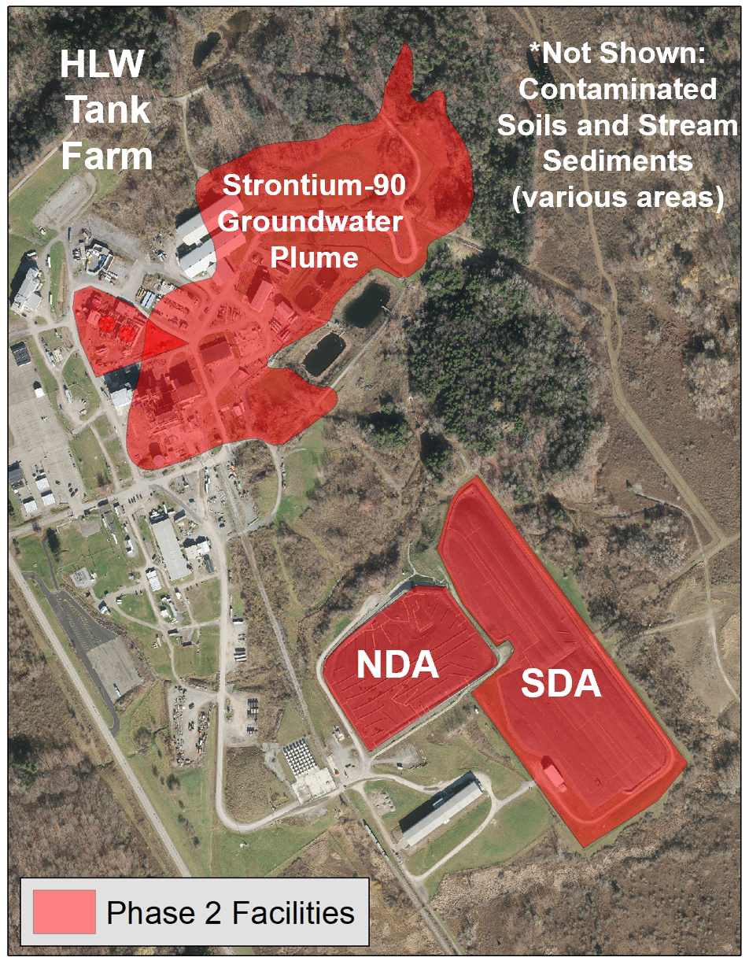
Phased Decommissioning
Phase 2 – Decisions not yet made
    Disposal Areas, HLW tanks, groundwater plume
    Subject of ongoing EIS and probabilistic performance assessment (PPA)
Phase 2 Alternatives
    Close in-place
    Full exhumation and removal
    Partial exhumation and partial in-place closure
      Footprint reduction?
      Risk reduction?
      To the extent technically and economically feasible?

Slide 7
PA at West Valley
Draft
EIS
1996
Decommissioning decisions for large facilities with long-lived hazards
Long EIS and PA history
    NYS concerns
      Adequacy for long-term decision making
      Site stability and predicting erosion impacts
      Conservatism
      Deterministic PA and uncertainty
Joint NYS/DOE Supplemental EIS
Probabilistic Performance Assessment (PPA)
Draft
EIS
2008
Final
EIS
2010
Supplemental
EIS
202?

Slide 8
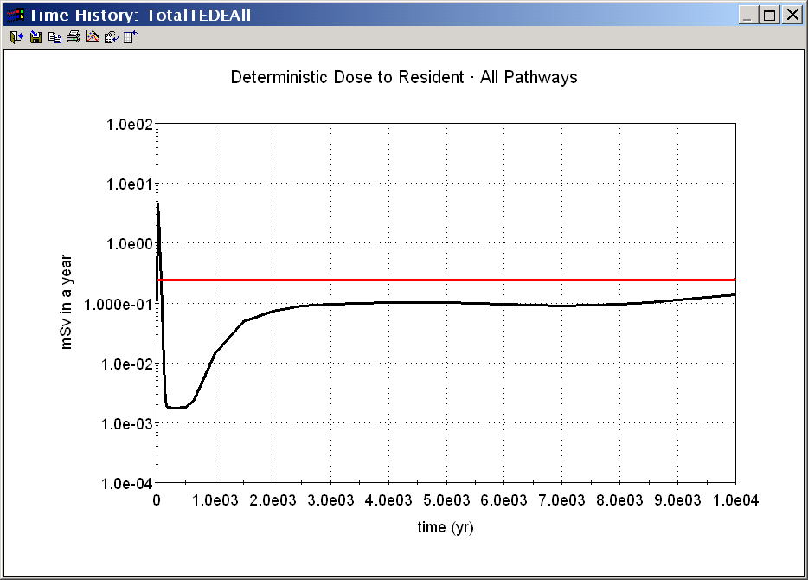
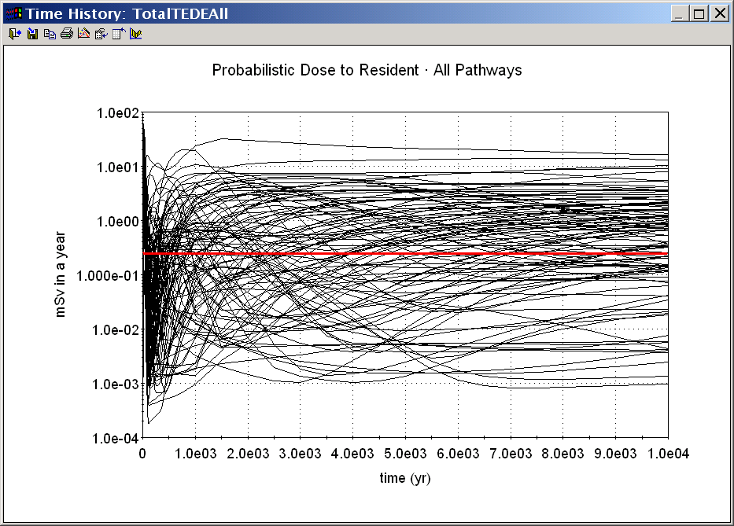
PA Challenges - Uncertainty
Appears to meet objective
Deterministic PA
      Single value input produces single value output, but is it really that simple in a natural system?
      Nature and magnitude of uncertainty unknown
      Strive for conservatism which can obscure model complexity
Probabilistic PA
      Probabilistic distribution input/output (collection of answers reflects our knowledge)
      Nature and magnitude of uncertainty explicit in model input and propagated through model
      Strive for realism, not conservatism
      Better-informed decisions
Mean exceeds objective

Slide 9
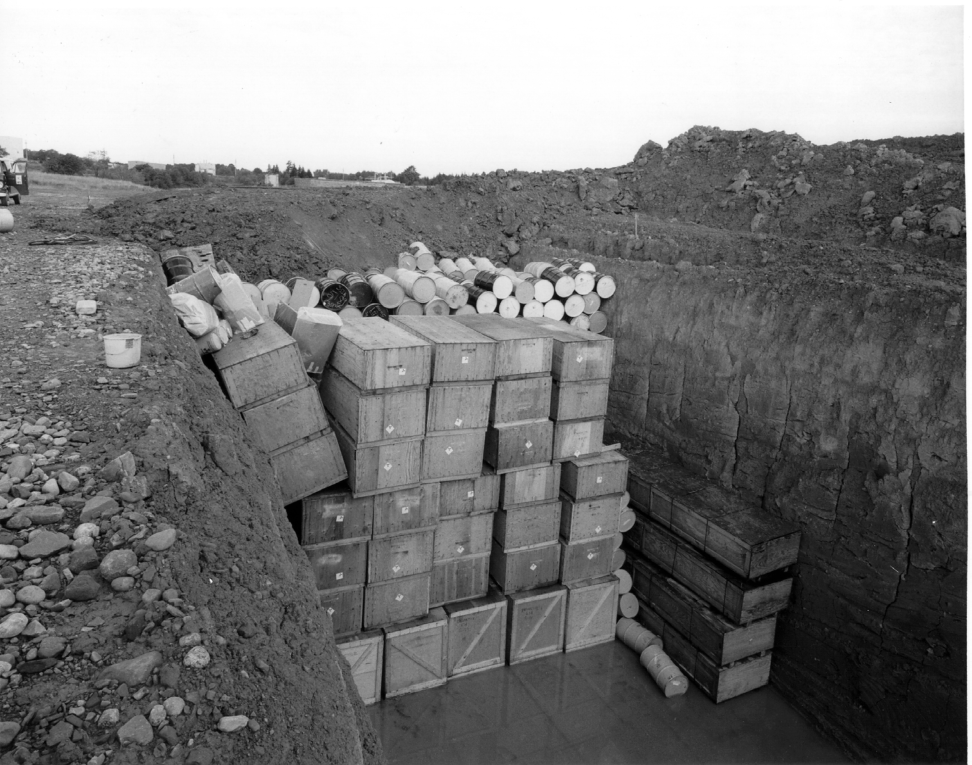
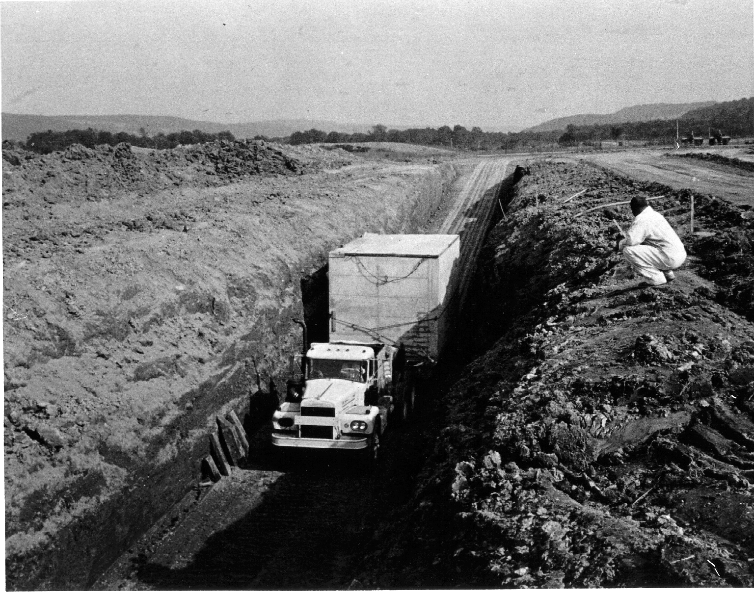
PA Challenges - Complex Site
Inventory
      Large source term of short- and long-lived nuclides
      Disposal records lack detail
      Spatial distribution
Facilities
      High-level waste tanks
      Shallow land burials
      Widespread soil contamination
Waste forms
      Animal remains, PPE, cardboard, building debris, activated metal, concrete casks, and cardboard
      Soil and groundwater
      Comingled

Slide 10
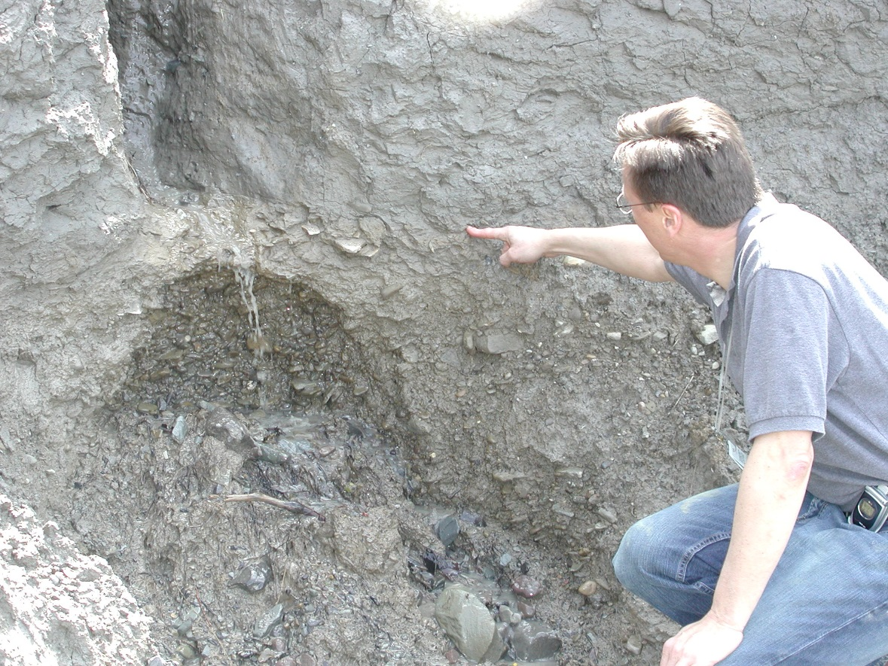
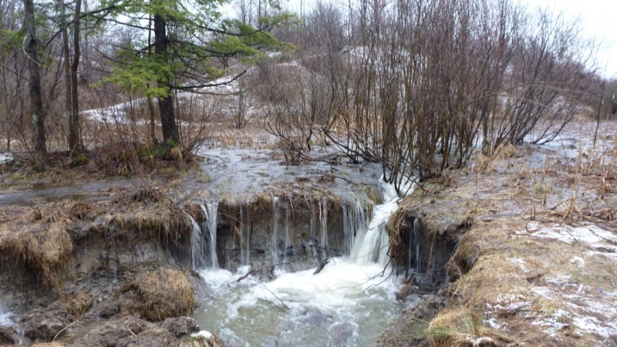
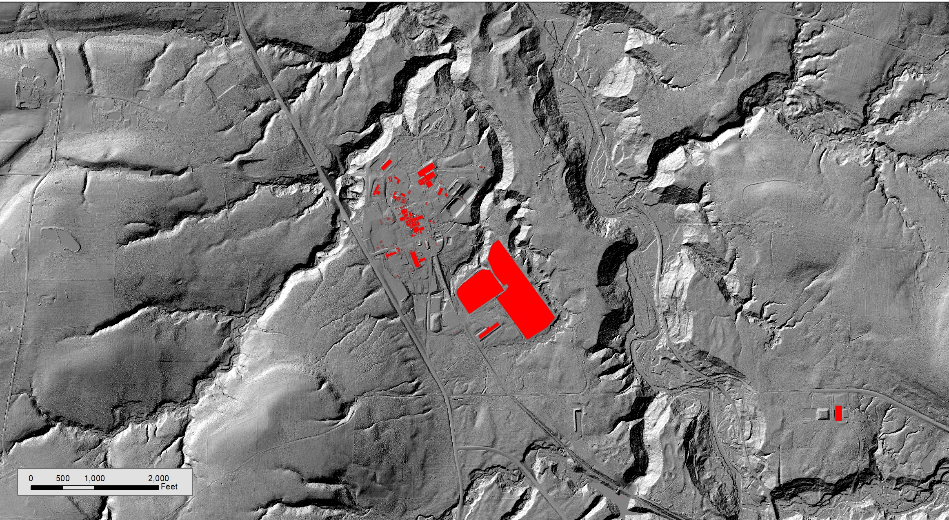
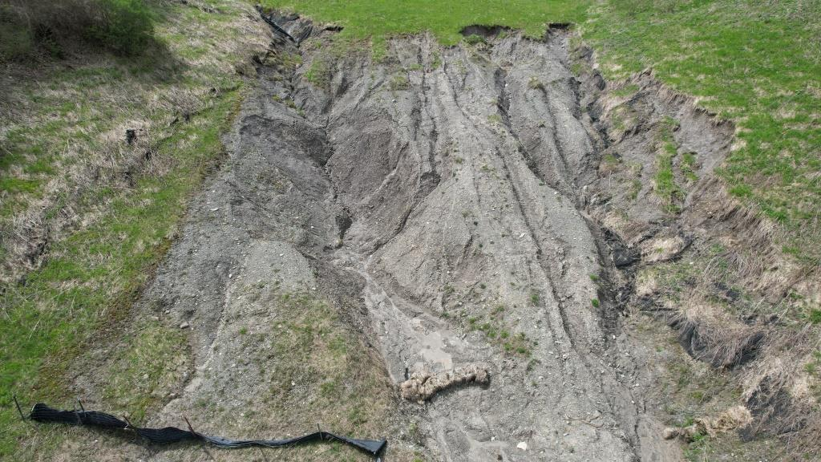
PA Challenges – Complex Environment
100s of feet of erodible glacial till
Humid environment - ~50” precip., 100+” as snow
Large topographic relief
Incised streams and gullies

Slide 11
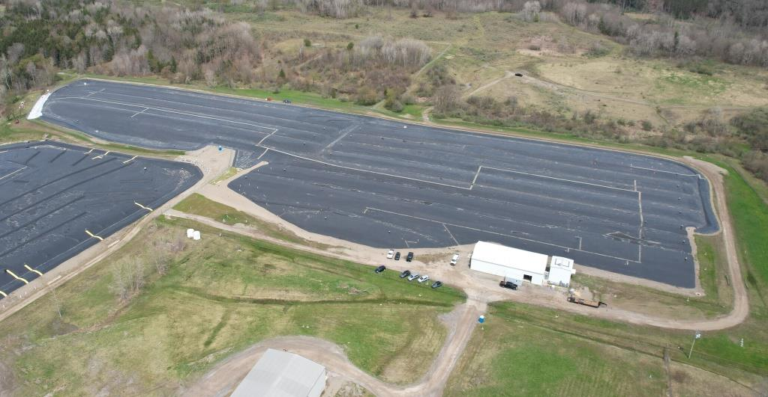
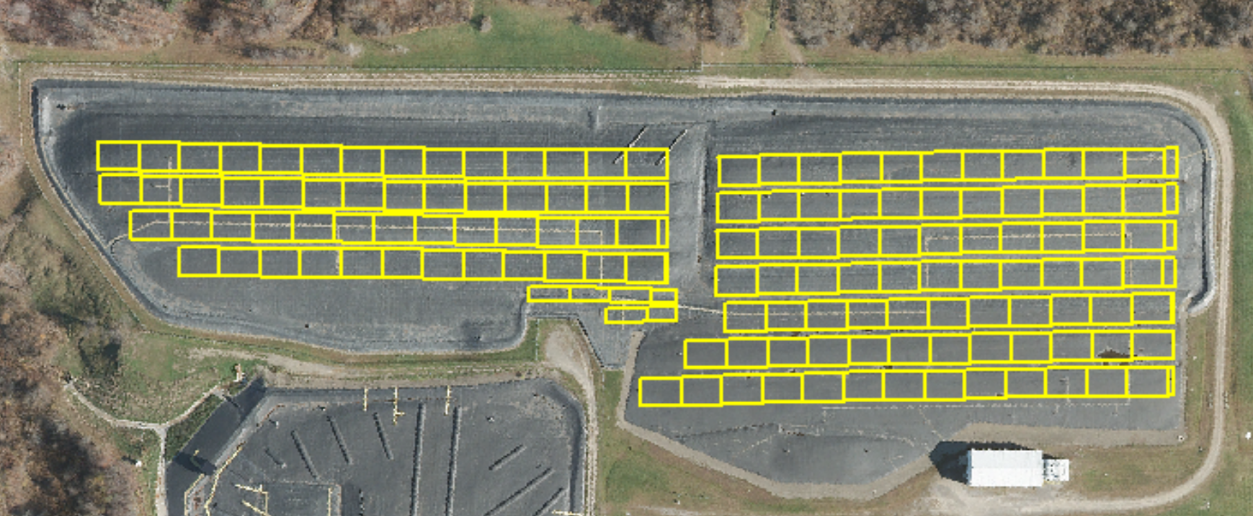
PA Challenges – Complex Facilities
State-Licensed Disposal Area (SDA)
    2.4M ft³ LLW in 14 unlined trenches
    Water accumulation in waste trenches and mobile radionuclides
    Wide variety of generators and waste profiles
    Limited disposal records
    PPA to evaluate partial exhumation – risk reduction
    Discretization of “decision units” – 50-foot trench sections

Slide 12
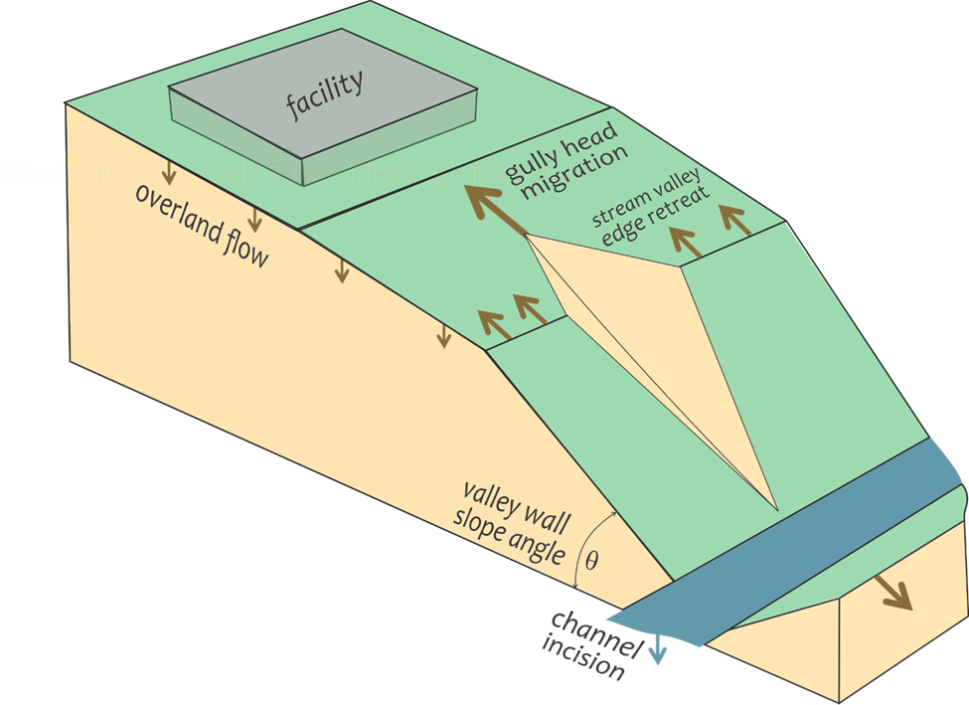
Assumptions and Abstractions
All models simplify
    Landscape evolves one raindrop at a time
Can be difficult to communicate
    Current topography a “real world” 14kya erosion model
    Episodic events captured in abstracted rates
    Low probability, high impact events garner attention
Abstracting complex physical process models to core components
Integration of release, transport, uptake/exposure

Slide 13
Abstracting Erosion
Complex, integrated physical processes
      Material physical characteristics, cohesion
      Rainfall, rainsplash, sheet flow, concentrated flow
      Sediment detachment and transport
      Mass wasting
      Seismically-induced erosion
      Freeze/thaw
      Seepage and piping
      Climate change
      Baselevel control
Simplified probabilistic rates
      Gully advance
      Valley widening
      Stream incision

Slide 14

Erosion Uncertainty in Space and Time
Previous PA erosion models
    Attempted to predict precise location and trajectory of erosion features such as gullies
    Which facilities are impacted? Some yes, some no.
PPA erosion model
    Recognize gully location and trajectory highly uncertain
    Assume facilities are impacted and estimate timing and magnitude of impacts
    Different facilities impacted at different times; uncertainty represented by probabilistic erosion rates
    Facilitates risk-informed decision making

Slide 15

Erosion Uncertainty in Space and Time
But…
    Uncertainty increases over time (and space) – how to account for in PA?
    When do results become meaningless?
    Caution against putting results on paper that have no basis in reality
    External wildcard factors
uncertainty
Erosion Impacts
uncertainty
still
useful
result?
useful result?
Time
(or Space)

Slide 16
PA Challenges – Result Drivers
Often unexpected, inconspicuous, and seemingly unimportant
Fundamental model construct and assumptions can drive results
Modeling tools (e.g., sensitivity analysis) can’t always identify drivers
Examples
    Receptor behavior and scenarios
    Predicting vs. assuming impacts
    Engineering natural systems
    Cost/benefit
    Level of detail at PA stage (feasibility)

Slide 17
PA Challenges – Deterministic Regulatory Framework
Deterministic vs. probabilistic regulatory criteria
    NRC LTR: not exceed 25 mrem/year
    WIPP: specific likelihoods of exceeding criteria are prescribed
Hypothetical PPA results
    70% confidence peak dose occurs between 4,000-10,000 years
    70% confidence that peak dose will be between 10-50 mrem/year
Acceptable level of uncertainty?
    Regulators?
    Decision makers?
    Stakeholders?

Slide 18
PA Challenges: Take-Aways
PAs can address complex problems, but require careful consideration of assumptions and abstractions that form integrated systems-level model
Probabilistic PAs can address nature and magnitude of uncertainties, but some uncertainty questions remain
PA result drivers are not always those you expect and can be missed altogether if assumptions and or model structure are wrong
Applying deterministic regulatory criteria to probabilistic PA results not straightforward
When do results become meaningless?
What level of uncertainty is acceptable?

Slide 19
Managing PA Challenges
Decision makers: PA is an evaluation tool and does not present a future “truth”
PPA, even with probabilistic inputs/results and information regarding uncertainty only as good as
    The data available and used
    Model documentation and transparency
    The context and manner in which the results are presented
End-users (regulators, decision makers, facility managers) must have a thorough working knowledge of
    Facilities, natural systems, and human behaviors represented in the model
    What is happening (computationally) when the model is used

Slide 20
Managing PA Challenges
Having an experienced scientist with modeling background for review and oversight during model development and implementation is something we view as “required”.
Sensitivity analysis is useful to identify what drives model results
    As a check on model inputs and structure
    As a step-back to consider how much is known about those parameters and processes to ensure assigned uncertainties are adequate and reasonable
    As a tool to understand the “confidence” we can have in the results
  These approaches to managing PA challenges help ensure those contemplating complex and consequential decisions can be better informed.

