Slide 1

The Art and Science of a Probabilistic Performance Assessment: West Valley
LLW Forum October 2022 Meeting
Sean McCandless
www.neptuneinc.org

Slide 2
Outline
Background on the site and decision context
Introduction to the GoldSim modeling platform
The West Valley Probabilistic Performance Assessment (PPA) Model
Art and Science in performance assessment
Notes:
Neptune appreciates the opportunity to discuss our work supporting DOE and NYSERDA on the West Valley PPA Model. I’ve been working with performance assessments for over 20 years; and this site and its model are unlike any I’ve dealt with before.

Slide 3
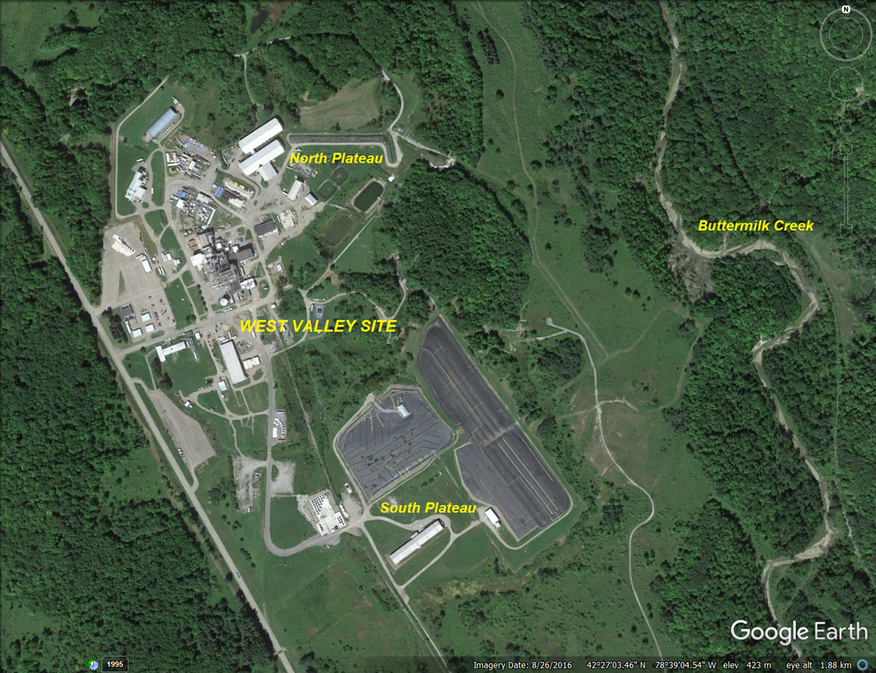
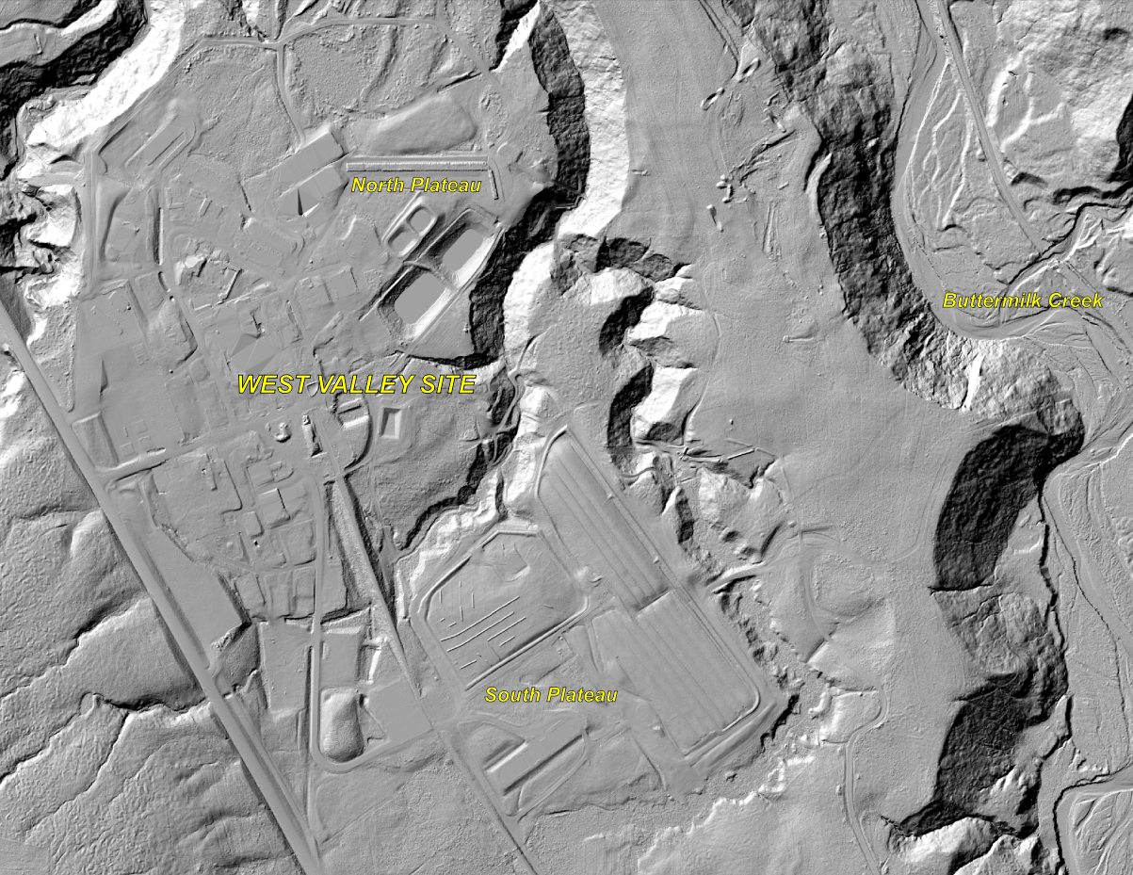
The West Valley Site
Notes:
The land is former farmland, now with industrialized areas, meadows, wetlands, and forests. The LiDAR figure on the right highlights the topographic relief provided by local creeks. The lion’s share of inventory is found in the WTF, NDA, and SDA.

Slide 4
What is the West Valley Site?
Nuclear Fuel Services (NFS) performed nuclear fuel reprocessing at West Valley from 1966 to 1972.
Reprocessing wastes were disposed in a Waste Tank Farm (WTF) and in an NRC-licensed Disposal Area (NDA).
NFS also operated a State-licensed Disposal Area (SDA).
There are several lagoons, transfer lines, and other associated contaminated areas.
New York State owns the property; and Congress assigned DOE responsibility for portions of decommissioning (1980 WVDP Act).
Notes:
Liquid wastes from the tank farm have been or will be removed; the PPA considers sludge, scale, and other residual contamination that remains in the tanks.

Slide 5
Decision Context
An Environmental Impact Statement (DOE 2010) identified a phased approach as the preferred alternative:
Phase 1 (now underway): Demolish the Main Plant Process Building and other structures; excavate certain soil contamination and former waste lagoons.
Phase 2 (focus of the PPA): Determine final decommissioning approach for the remainder of the site, including the NDA, SDA, WTF, and any residual contamination.
Options include no action, close-in-place, complete removal, and selective removal. Timing is also being considered.
Notes:
The PPA Model supports decisionmaking and analysis building to a Supplemental EIS.

Slide 6
Phase 2 Decisions
Reducing projected doses and risks to acceptable levels (as defined by regulation) may include...
excavating some or all contaminated areas,
adding engineered features such as covers, creek armoring, groundwater flow manipulation, grouting tanks, and/or
addressing temporal considerations.
These decisions will be made by DOE and NYSERDA, as regulated by NRC and NYSDEC.
Notes:
The first 2 options for reducing dose and risk will be familiar to anyone who’s worked in environmental remediation. The temporal considerations are somewhat unique for the West Valley site – some radionuclides present an immediate risk but decay quickly; some decay within relatively short times of a few hundred years; and others are long-lived enough that peak dose is a thousand years out or more.

Slide 7
GoldSim
Probabilistic simulation software for modeling complex systems in engineering, science, and business
Simulates future performance while quantitatively representing uncertainty and risk
Environmental applications - radioactive/hazardous waste, water resources, mining, energy
Business applications – strategic planning, finance, supply chain, risk management and insurance
Engineered systems – risk, failure and vulnerability; reliability and throughput; warranty and cost
Notes:
Before turning to the PPA Model itself, here’s a brief introduction to the software platform. GoldSim is well-known in radiological performance assessment; and its probabilistic simulation capabilities are also applied to other environmental problems, business applications, and engineered systems.

Slide 8
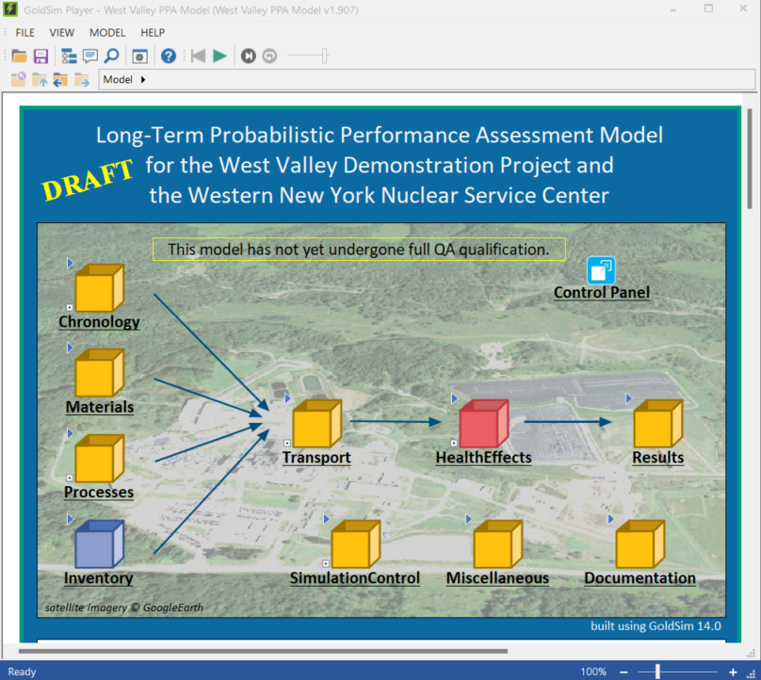
West Valley PPA Model
The West Valley Probabilistic Performance Assessment Model is a tool to inform Phase 2 decisions, built in GoldSim.
This is under development, so no results yet.
Notes:
Neptune has prepared and is actively working on a number of performance assessments in GoldSim for both Federal and Commercial facilities. The Browse Model screen shown on the left illustrates the hierarchical structure, with nested containers to organize different conceptual parts of the model. The Inventory container, for example, summarizes information about the waste; the Transport container holds calculations of contaminant fate and transport; etc.

Slide 9
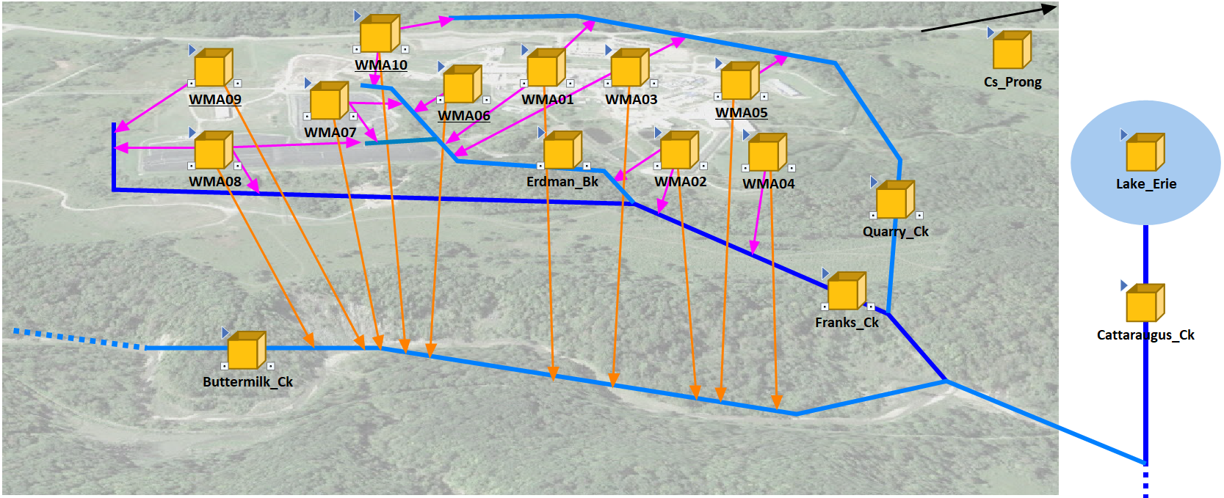
Model Organization - WMAs
The model is organized into 10 Waste Management Areas, which are connected by groundwater and erosion pathways to the creek system.
The orange boxes are GoldSim Containers, which hold the calculations for contaminant transport for the WMAs and creeks.
Notes:
The WMA structure carries forward historical site organization dating to the 1990s. WMA 3 is the WTF; WMA 7 is the NDA; and WMA 8 is the SDA. Not all WMAs have inventory. Note also containers representing contaminant transport in the creeks and ultimately to Lake Erie.

Slide 10
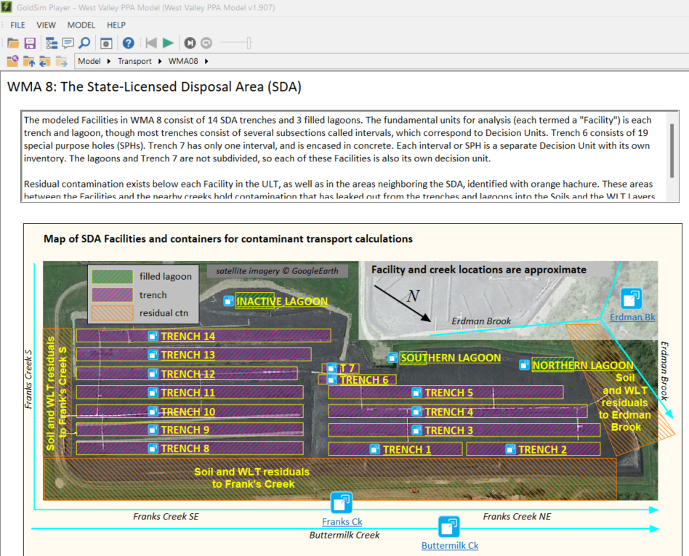
Model Organization - Facilities
WMAs such as the SDA are sub-divided into Facilities.
Notes:
A PPA Model Facility is a grouping of disposals or contamination with similar location and geology – i.e., the nearest path to surface water for Trench 2 is different than it is for Trench 14; so they are different Facilities. The SDA has 17 Facilities, one for each trench plus the 3 former lagoons. There are a total of 37 Facilities in the model.

Slide 11
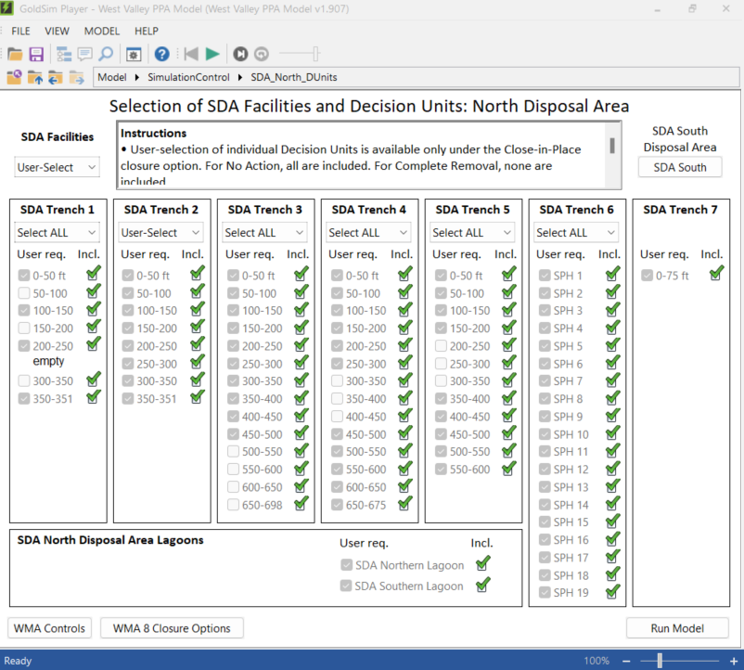
Model Organization – Decision Units
Facilities are further sub-divided into Decision Units. Each Decision Unit is assigned distinct waste inventory.
Notes:
The PPA Model has been designed to support selective removal scenario development – to identify what inventories drive risk and what are the consequences if any particular subset of inventory is removed. Decision Units are where the user may explore removal scenarios – if a DU is ”on”, the inventory remains on site in the model run. If a DU is “off”, the inventory is excavated for offsite disposal. There are about 425 individual Decision Units in the PPA Model.

Slide 12
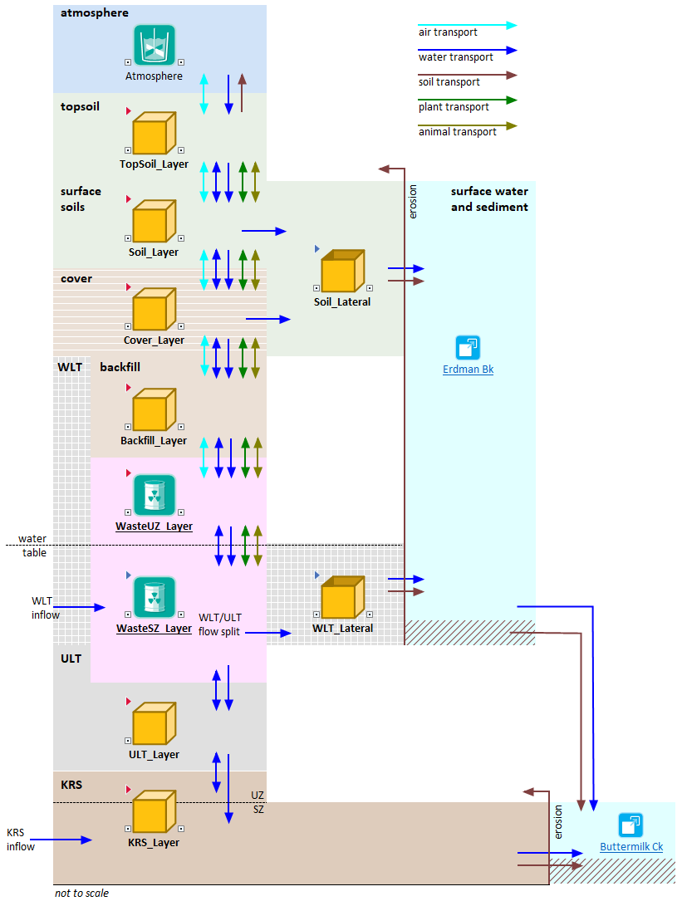
An Example Transport Column
cover (options)
A 1-D column extends from the atmosphere down through cover and backfill, waste and geologic strata to the water table.
Lateral flows represent groundwater flow to the creeks.
waste zone, with a water table
lower water table, with lateral transport to creeks
Notes:
This is a figure from the PPA Model’s internal documentation, to help the user visualize system components, directions of transport, and the media responsible for transport. Air, for example, is light blue; water, dark blue; etc.

Slide 13
Human Exposure Pathways
Exposure pathways to a resident farmer:
external exposure from soil (outdoor and indoor in a basement)
gas inhalation (indoor and outdoor)
dust inhalation (indoor and outdoor)
home-produced chicken ingestion
home-produced egg ingestion
home-produced dairy ingestion
home-produced vegetable ingestion
home-produced fruit ingestion
wild fish ingestion
drinking water ingestion
incidental soil, sediment, dust ingestion (e.g., via hand-to-mouth transfer)
acute exposure to wastes unearthed at the ground surface by erosion
Notes:
In addition to the traditional ingestion and inhalation pathways common to radiological PA, the West Valley PPA Model considers acute effects of wastes exposed by erosion.

Slide 14
Erosion
The area around the Site is undergoing active erosion, requiring active management and maintenance.
Erosion is the primary release mechanism for the Site.
We need to characterize erosion to model the performance of the Site though time.
Erosion in the PPA Model is informed by several lines of evidence, including aerial photographs, LiDAR data, and literature review.

Slide 15
Using Historical Imagery to Inform the Erosion Model
LiDAR Data
      Three different sets of LIDAR data: 2020, 2015 and 2010
      Aerial photograph paired with the LiDAR data
Historical Aerial Photographs
      Historical aerial photographs from 1939, 1955, 1961, 1965, 1977, 1984, 1989
Notes:
The current landscape captures the cumulative impact of all post-glacial erosion activity (i.e., ~13,000 years). Aerial photographs are used to derive the cumulative impact of all of the events (including extreme events) that have occurred in recent time. For example, information from the 1939 photo combined with 2020 LiDAR shows cumulative erosion from all events over 81 years.

Slide 16
Art and Science in PA
PA takes place in an inherently artificial construct – the exposure scenario.
Assume loss of institutional control
Assume loss of knowledge of the hazards
Assume a resident farmer lives on site and subsists largely on locally-grown food
PA is not a prediction of the future; but can be misinterpreted or misrepresented as such.
Notes:
When I first started working in this field, I thought it was goofy to think seriously about fate and transport thousands of years into the future; and the scenarios always seemed rather dystopian. Radiological performance assessment confronts questions of deep time in ways that no other environmental regulation does.

Slide 17
Art and Science in PA
Scenario choices influence results.
Regulations provide a general outline and leave many details to the analyst.
Different regulators can require different approaches – DOE, NRC, Agreement States.
What if…?
Even a probabilistic PA built on science will not provide a clear best choice for a complex site. The PPA has to be placed in a Decision Analysis context.
Notes:
In terms of risk-informed decision making, it’s appropriate to leave details to the analyst – in this way, site-specific considerations can be captured. As an example, for the WV PPA, we must define the residential water source. Historical data from the 1960s indicate that water supply wells were not in the near-surface aquifer immediately prior to site development. However, historical information from the most distant past does show use of the near-surface aquifer on the north plateau. A choice must be made for modeling purposes; and this choice directly affects dose results. It’s that third bullet where things can go off the rails quickly – the question might come from a regulator, a public stakeholder, or even a member of the analysis team. At the end of the day, PA provides one set of attributes in a decision context - there are plenty of others, including cost, worker safety, etc. This is where the Decision Analysis context comes in.

Slide 18
Decision Analysis
Calculate averted dose for each Decision Unit removed.
Optimize the sum of Decision Units’ averted dose to achieve dose limits.
Once dose limits are met, conduct ALARA analysis to assess further decision unit remediation; if any.
  Remediation costs
  Stakeholder values
  Non-market costs and benefits
Notes:
Optimizing averted public dose to meet dose limits will include cost, location, occupational dose, and other considerations.

Slide 19
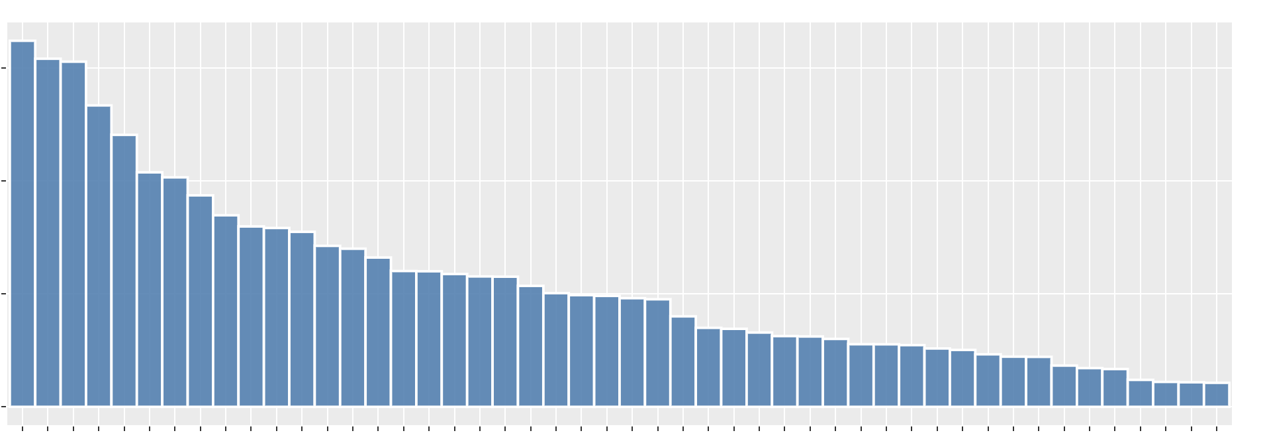
Decision Consequences
Decision Unit remediation prioritization based on present worth of averted dose
Present Net Worth ($) of averted dose
Decision Unit
Notes:
This is what we’re building toward – a risk ranking by Decision Unit. Those to the left would have the highest value in terms of averted dose, while those to the right would provide much more limited benefit.

Slide 20
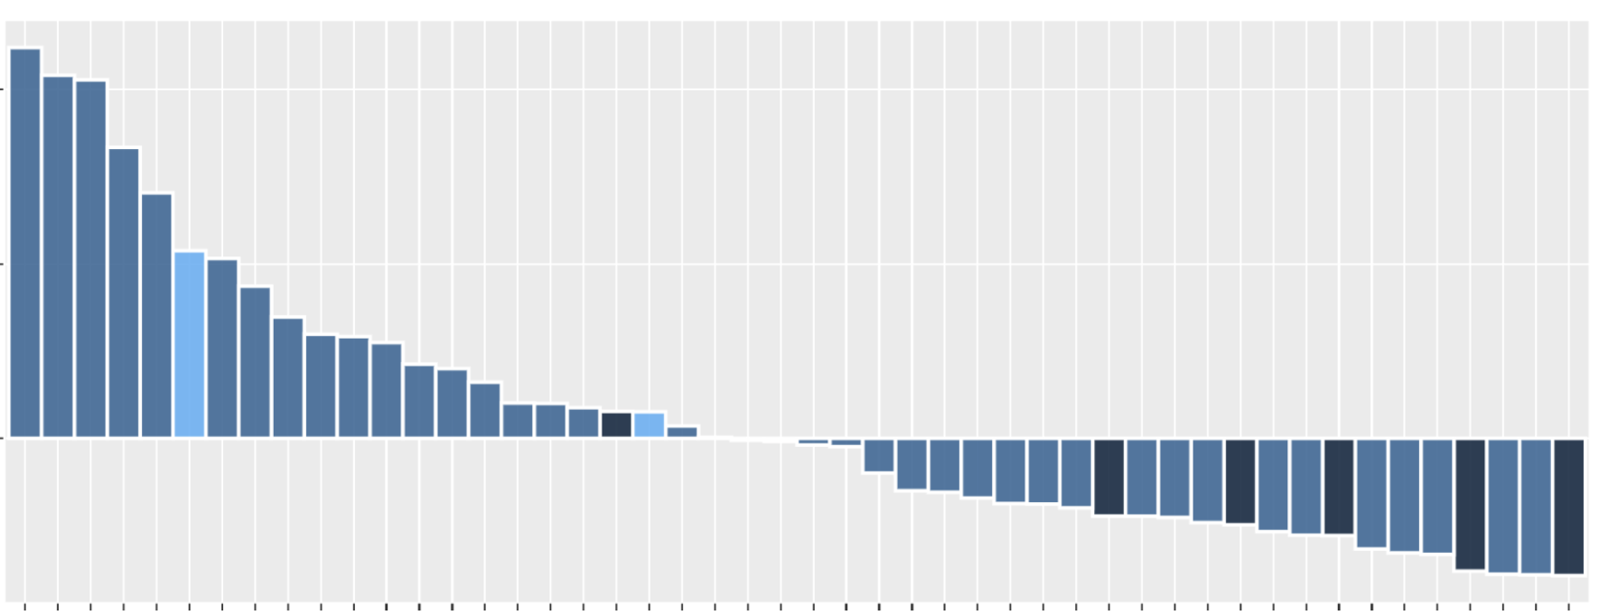
Decision Consequences
Decision Unit remediation prioritization based on present net worth (societal welfare)
Present Net Worth ($)
Decision Unit
Notes:
Then this slide represents the next step beyond a simple risk ranking. The Decision Units starting at the left of the graph would have the highest present net worth; decreasing to zero in the center; and imply a cost exceeding net benefits to the right. This is a conceptual presentation and does not reflect any actual PPA Model results.

Slide 21
Questions?

