Slide 1
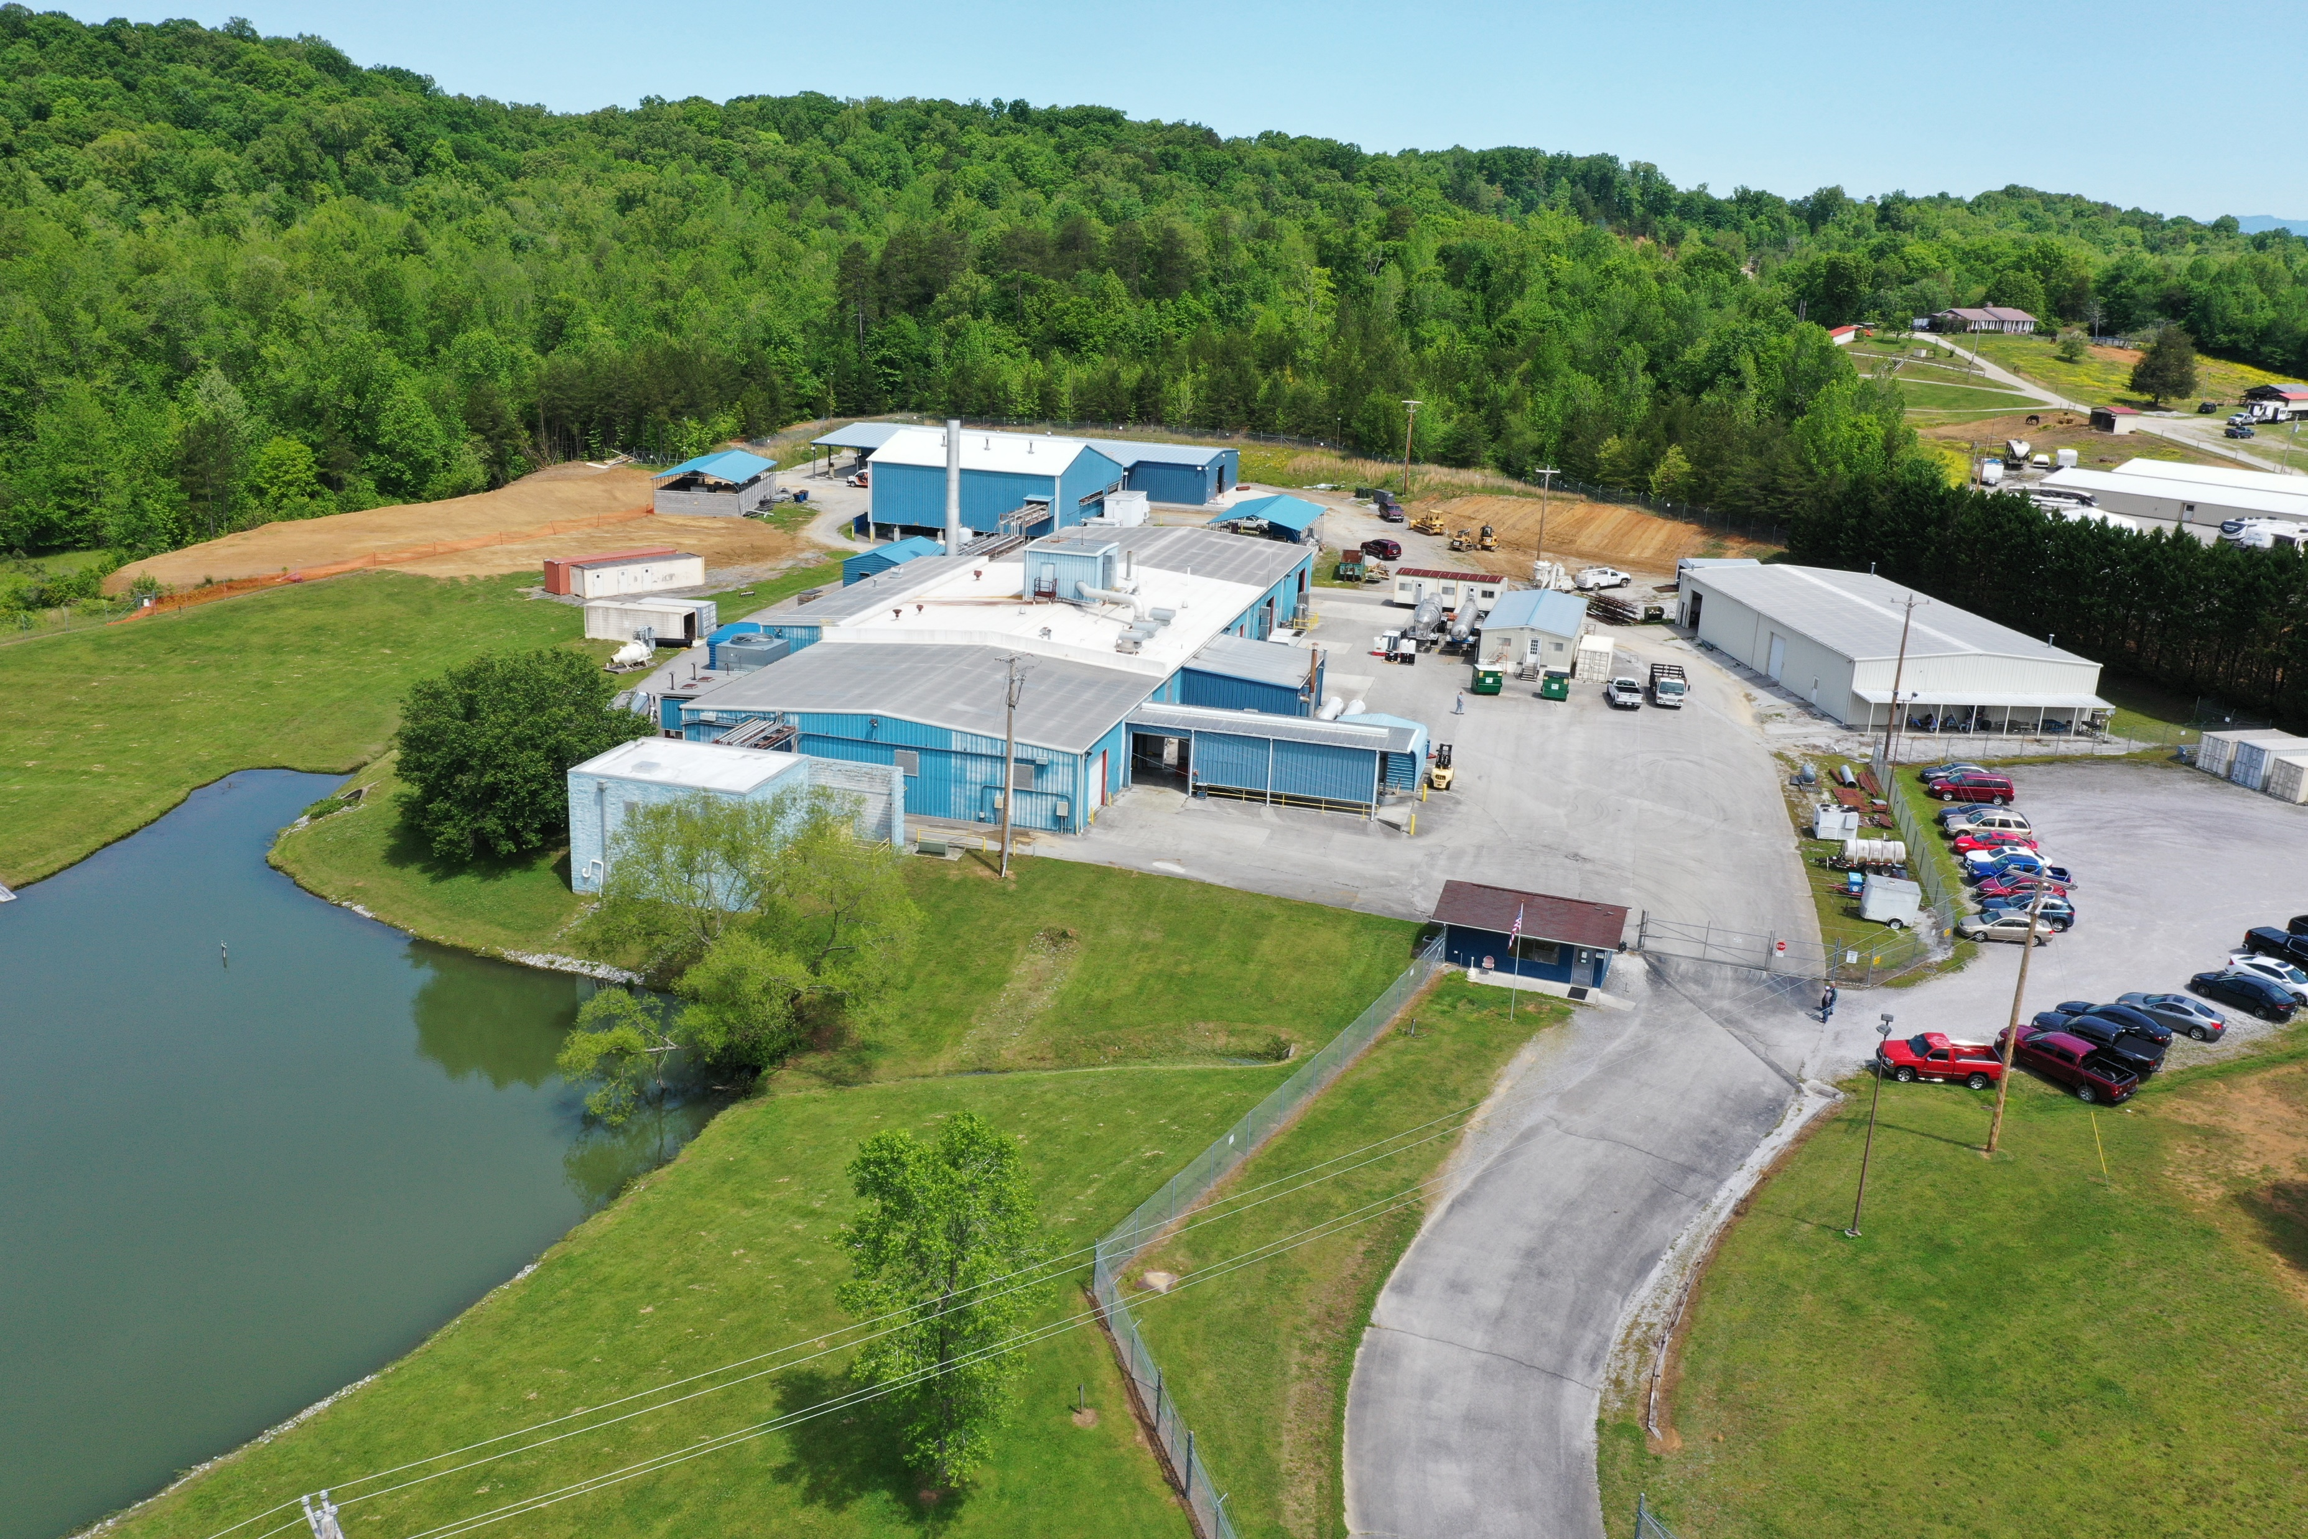
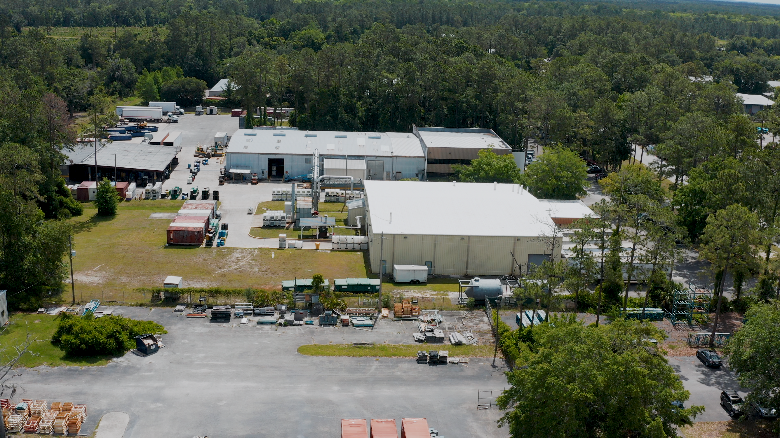
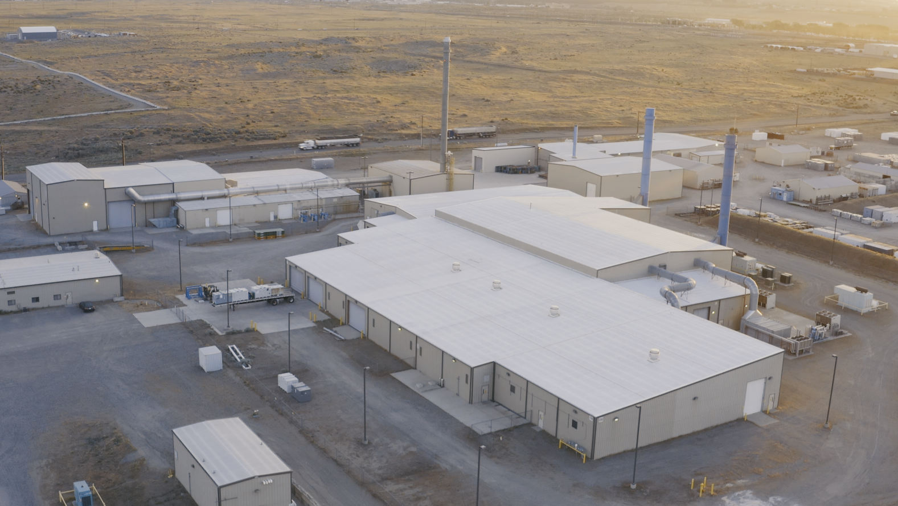
DSSI
Business Overview
Presented by: Brian Wood
October 12, 2022
PFF
PFNW

Slide 2
Introduction to Perma-Fix
Perma-Fix is a leading provider of nuclear waste treatment services
Specializing in the treatment of waste that is both radioactive and/or chemically hazardous
Perma-Fix will make the investment to solve a complex waste challenge
Waste generated by commercial customers, utilities, hospitals, research facilities, and the government
Established laboratories and R&D capabilities to solve problems quickly and efficiently
Nuclear services group provides onsite personnel and technologies for environmental protection and cleanup programs
Industry leader in radiological protection services to government and commercial clients
Environmental restoration and waste management services for complex cleanup projects including radiological and hazardous components
Perma-Fix
Waste Treatment Operations
Nuclear Services

Slide 3
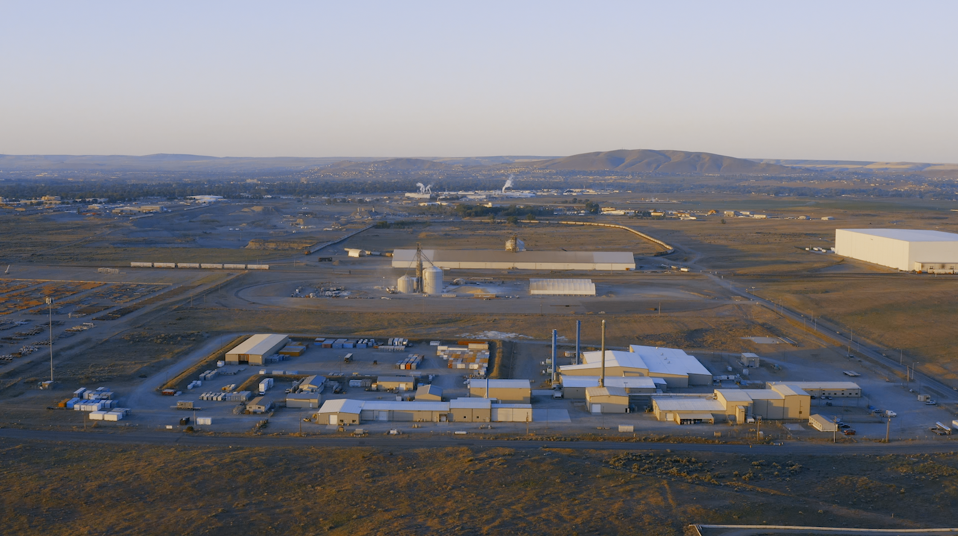
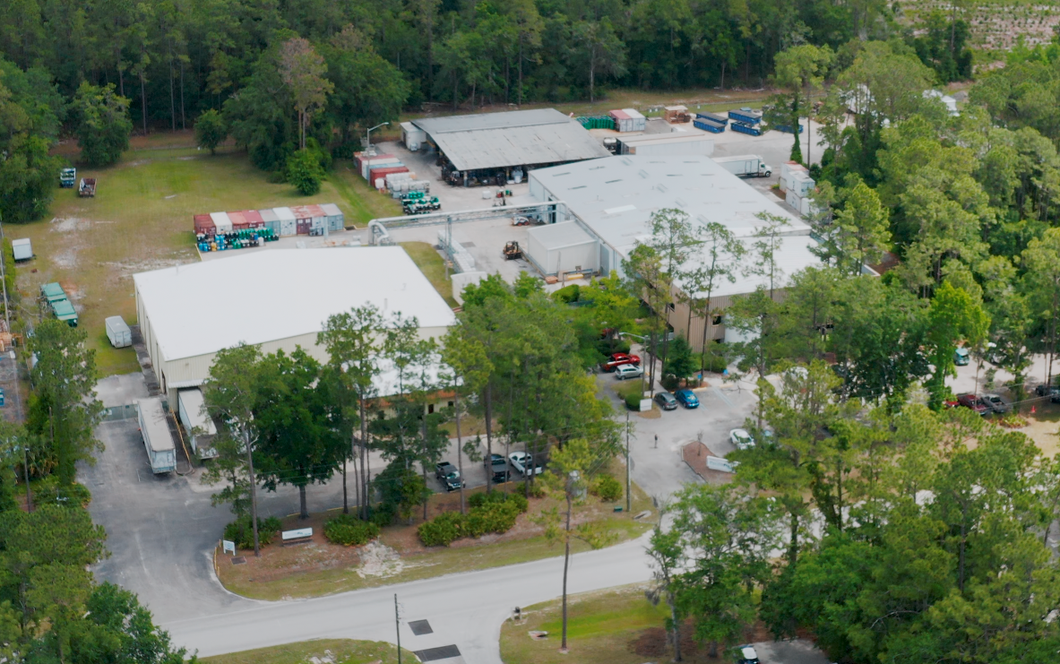
Waste Treatment Facilities
Three fixed-based facilities with active permits and licenses to treat most waste streams in the industry
Broad existing permits allow treatment and management of wastes for final disposition
Trained and experienced workforce with long tenure at Perma-Fix and strong safety record
Perma-Fix operates three facilities with substantial capital invested through the life of the plants
Perma-Fix Northwest - Richland, WA
Perma-Fix Florida - Gainesville, FL
DSSI - Kingston, TN
Radiological, transuranic, and large components
Rail Served
Industrial, radiological, R&D
Transfer station 90 miles from plant
Radiological, liquids, and PCB’s

Slide 4
Mixed wastes
RCRA components and characteristics
AII D codes; limited F,P, and U codes
Liquid scintillation vials
Low-level radioactive wastes
Industrial (non-nuclear) hazardous, non-hazardous and universal wastes
Chemotherapy and pharmaceutical wastes
Acceptable Waste at Perma-Fix Facilities

Slide 5
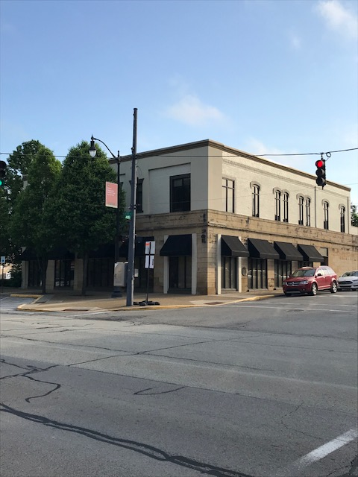
Nuclear Services
Perma-Fix is an industry leader in providing planning, characterization, and radiological control support to the nuclear industry:
Six Certified Health Physicists (CHPs) who develop radiological control programs, provide expert witness testimony, and support regulatory standards development
Supported by network of health physicists and technicians
Recent large hospital decon project included 140 staff and managers
Decontamination and Demolition experience dealing with a large variety of radiological and chemical constituents
23 years experience conducting radiological surveys in accordance with MARSSIM and MARSAME
Supported termination of U.S. Nuclear Regulatory Commission (NRC) radioactive material licenses at 35 facilities, completed > 300 MARSSIM final status surveys (FSSs), and executed > 20,000 open land and structural surveys
New Brighton, PA office includes center for health physics and radiological protection services

Slide 6
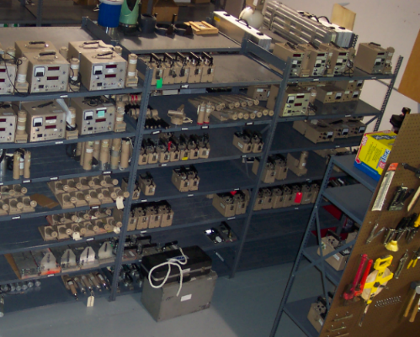
Instrumentation Services
Perma-Fix owns and operates a Commercial Radiological and Industrial Hygiene Instrumentation Laboratory (rental, repair, and calibration):
Lab Location – Knoxville, TN
Own and lease over 2,500 instruments generating approx. $1M/yr. in revenue (instrument value over $1.5M)
Calibration and repair of all makes and models up to 6,000 units annually
Professional consultation for custom instrumentation application and development

Slide 7
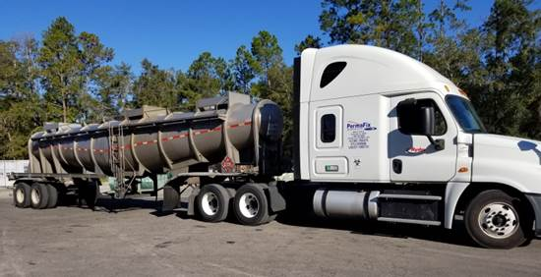
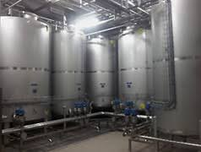
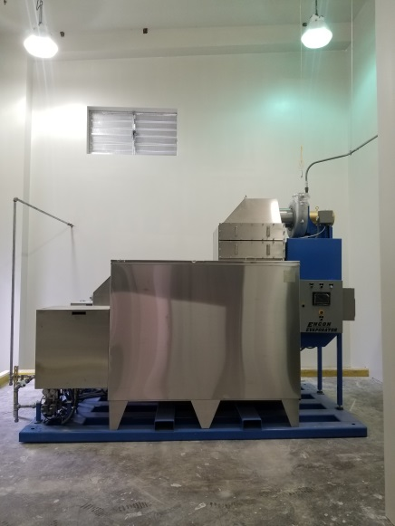
Technology Development
HYDROSOLV 165 PERMA-FIX’S WATER EVAPORATOR
Waste Delivery
24,000-gallon storage tank capacity
Acceptance capabilities from tankers, totes and drums
Achieve Volume Reduction > 100
If 5,000 gallons received, ~50 gallons residue for Disposal
Waste Disposal Volume ~15 ft³
Treats 165 GPH
Waste Storage
Waste Processing

Slide 8
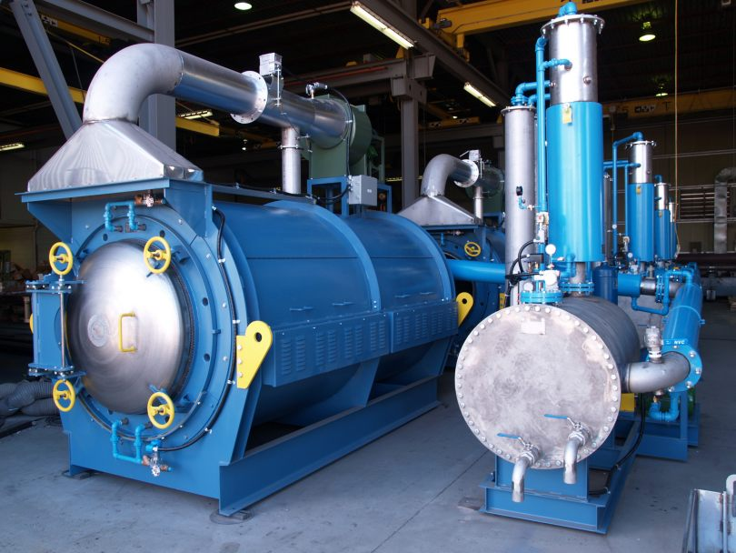
Technology Continued…
Vacuum Thermal Desorption (VTD)
Accepted Waste Streams for the VTD
WHAT IS VACUUM THERMAL DESORPTION?
Heats low level waste and mixed low-level waste to remove organics and recollects them as condensate. The vacuum allows lower temperatures to facilitate removal. Remaining solids are tested for LDR compliance and condensate is treated thermally.
Solids, soils & Sludges containing volatiles and semi-volatiles
Mercury Contaminated Wastes
Spent Carbon
Industrial Pipeline/ NORM Pigging Sludges

Slide 9
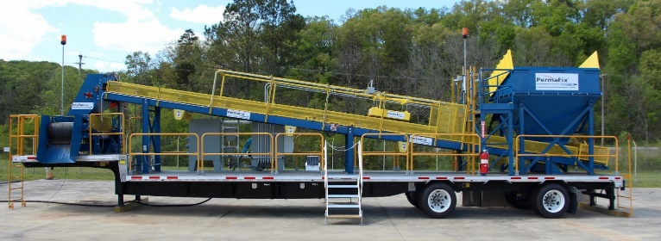
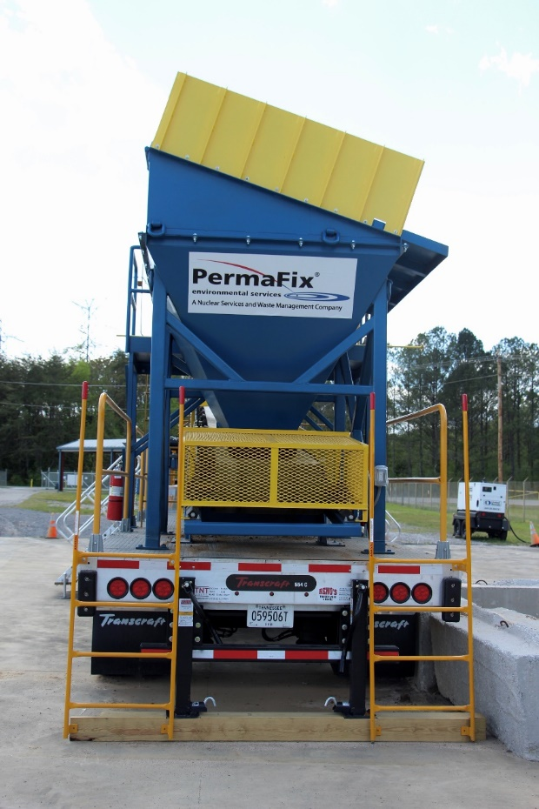
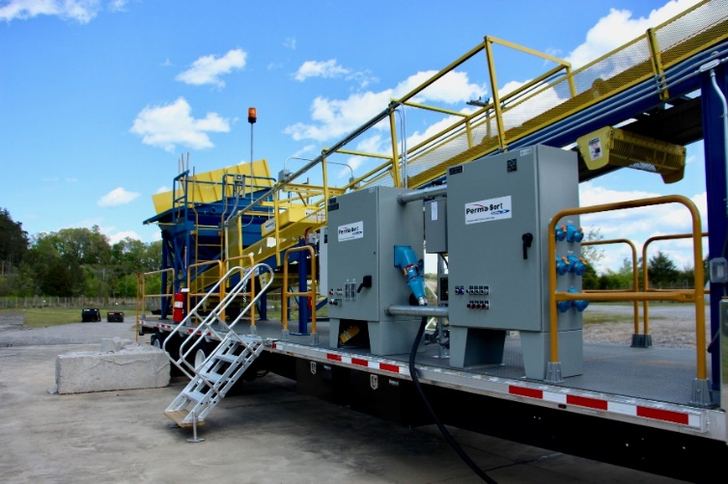
Technology Continued…
PermaSort
What is it?
The Perma-Sort is a new automated radiological characterization and segregation system for bulk materials
Perma-Fix built a customized conveyor-based radiological assay system designed to provide 100% characterization of material efficiently and with industry-leading Materials are loaded into measurement quality.
HOW PERMA-SORT WORKS:
a large feed hopper
Transported through the system with an electronically controlled conveyor survey belt.
While on the survey belt, the material is analyzed and tracked.
At the end of the survey belt, the material is transferred to a short reversing conveyor that spins in one direction for below criteria material and in the opposite direction for above criteria material.
The reversing conveyor transfers materials to standard stacking conveyors which can then create piles of material or transfer directly to trucks or waste containers.
PERMA-SORT CAPABILITIES:
Trailer mounted system for simple and rapid mobilization
Material can be discharged into virtually any container size or managed with multiple takeaway conveyors
Capable of processing > 200 tons of bulk materials per hour
Industry leading radiological measurement quality
Operating software supports multiple material profiles for varying bulk material types
Automated reporting supports MARSSIM and FSS

Slide 10
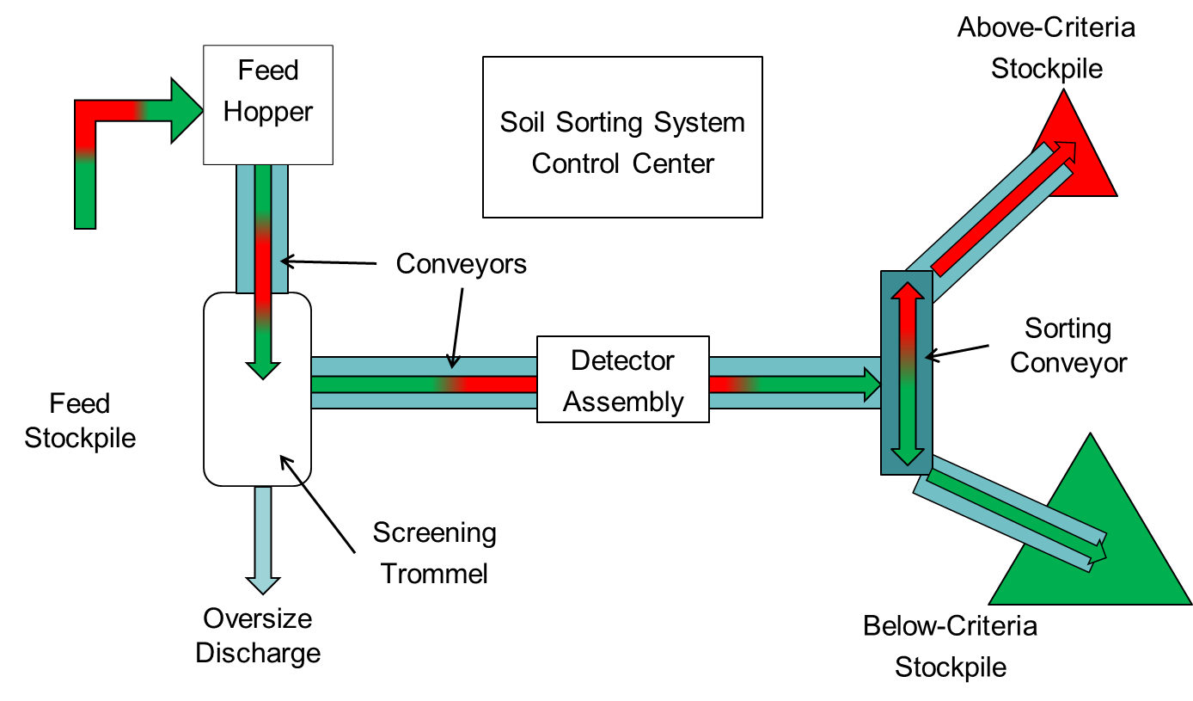
PERMA-SORT – CASE STUDY
What was the issue?
The site was having difficult in accurately determining the extent of soil contamination
*Case study at Painesville shows we excavated 46,932 tons of soil and were able to dispose 837 tons which gave a total costs savings of $6.2 Million

Slide 11
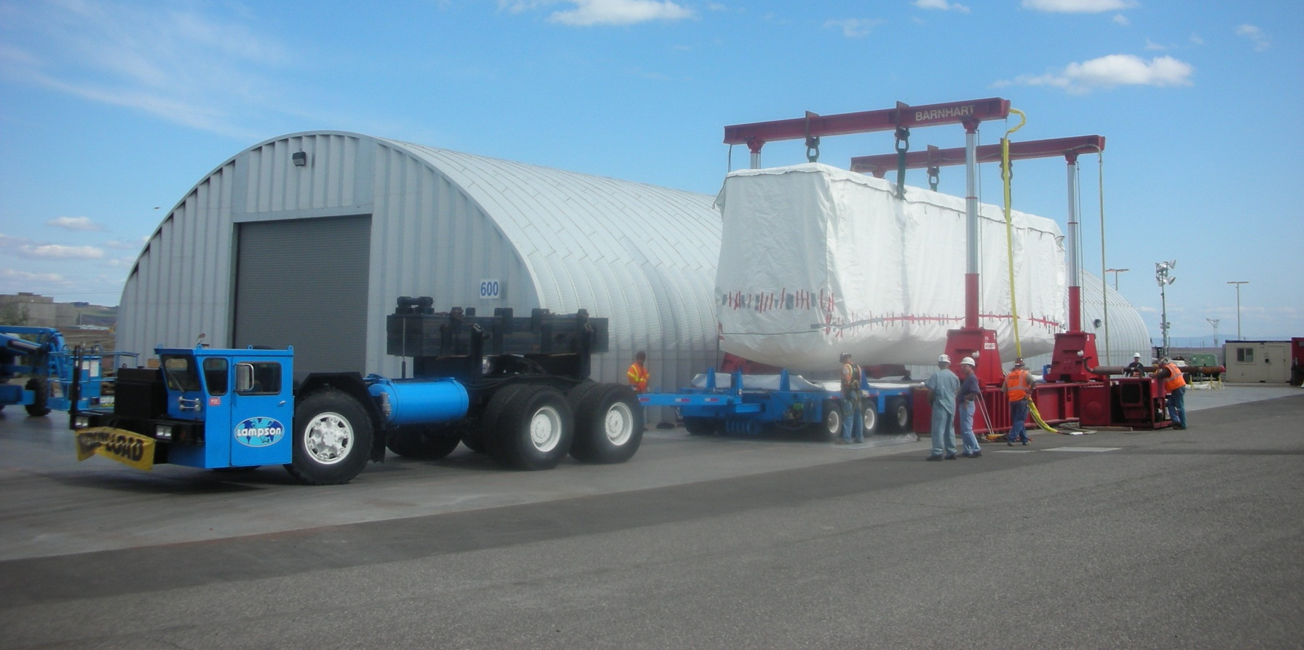
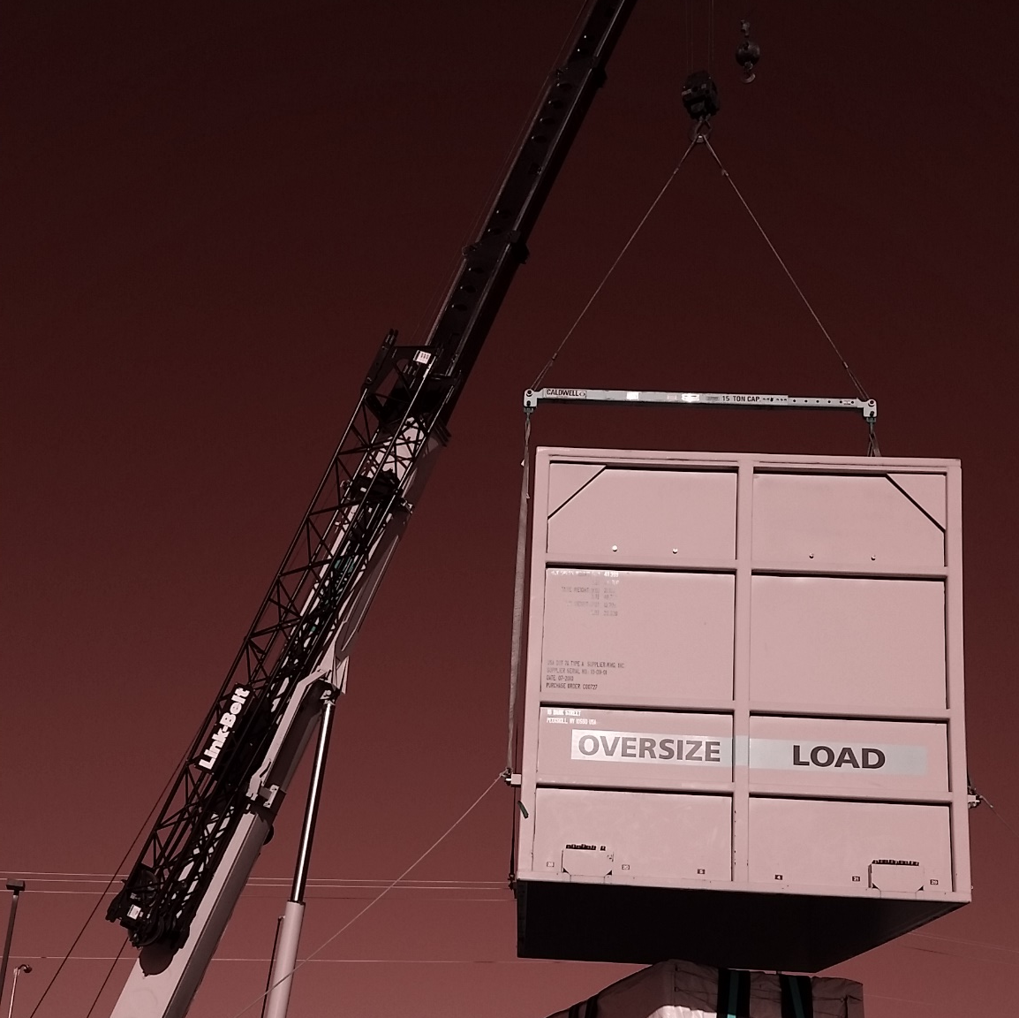
Large Components Management Capabilities
Metal decontamination and release processing
Release over 2,000,000 lbs. of metal in the past
Can handle heavy lift (250,000 lbs. and more)

Slide 12
QUESTIONS
In Closing
Perma-Fix facilities continue to maintain existing capabilities while working to develop new technologies to support industry needs
Customer feedback is imperative to us to help us grow and take care of your needs
Contact info:
Brian Wood
865-251-2071
bwood@perma-fix.com

