Slide 1


Brokers and
Processors
Panel
13 October, 2022
Low Level Waste Forum
Presented by Scott Baskett
Experts in waste management
and decommissioning

Slide 2
We Always Start With Safety
Safety culture is ingrained in our corporate governance, organizational goals, and work processes that
prioritize and improve safety
We are proud that our processing facilities carry the recognition of TN Voluntary Protection Program (VPP)

Slide 3
EnergySolutions at a Glance
International nuclear services company headquartered in Salt Lake City, Utah
Nuclear/Rad licenses and operations across the United States, Canada, and Japan
Primary customers include nuclear utilities, medical and research facilities, U.S. Department of Energy, and U.S. Department of Defense
Major business segments include solid and liquid waste management, reactor D&D, nuclear transportation and logistics, and integrated remediation services
Regulators include Canadian Nuclear Safety Commission, U.S. Nuclear Regulatory Commission, Environmental Protection Agency, Occupational Safety and Health Administration, and various state agencies

Slide 4





How Did EnergySolutions Come to Be?
SEAMLESSLY INTEGRATED
OPERATING PLANT ONSITE SERVICES
LOGISTICS
PROCESSING &
DISPOSAL
TURNKEY DECOMMISSIONING
  Liquid Waste Processing & Fuel Pool
  Technicians & Brokers
  Characterization
  Containers
  Casks
  Road, rail & barge Transport
  Large Components
  Recycling
  Volume Reduction
  All waste classes
  Permanent Disposal
  Commercial and Government
  Spent Nuclear Fuel Management
  License Termination

Slide 5
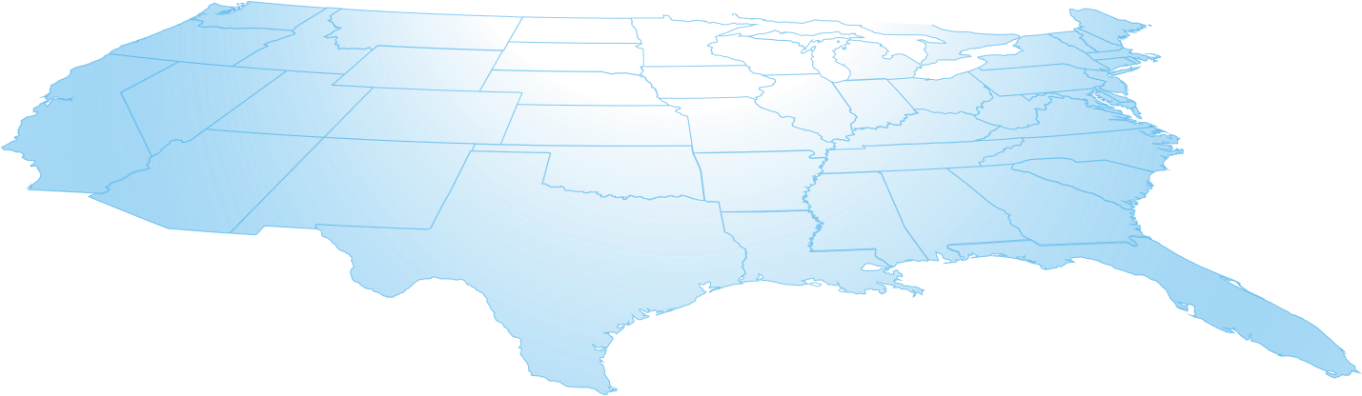
EnergySolutions Major North American Facilities*
Walker Ops (Canada)
Hittman
MHF Packaging
Bear Creek
Compaction
Incineration
Metal Melt
Erwin
Spent IX Processing
Hittman West
Clive
Disposal
Transload
Transload
Transload
Barnwell
Processing
Memphis
Logistics Center
Barnwell
Disposal
*Project operations at multiple DOE/DoD/Canadian locations
5

Slide 6
EnergySolutions Decommissioning Projects
La Crosse
Zion
Fort Calhoun
Kewaunee
TMI-Unit 2
SONGS
SEFOR
Research Reactor
6

Slide 7
Overview of Licensed Processing Options Offered at EnergySolutions’ Processing Facilities
Decontamination
Survey & Free Release
Bulk Survey for Release (BSFR), and Low Activity Wastes (LAW)
Sorting & Segmentation
Dry Active Waste, Metals (DAW) Commercial Certification
High Activity Filters/DAW
Shredding
Solidification
Water dispositioning
Oils, liquids and sludges
Metal Melt (recycling)
Incineration
Super Compaction
Resin Dewatering
Resin Volume Reduction (Steam Reforming)
Resins & Filters NRC BTP Blending
Mixed Wastes
Large Components
Container Management
Basic Rad/TCLP Laboratory
Instrumentation/Rental
Equipment and Waste Storage

Slide 8
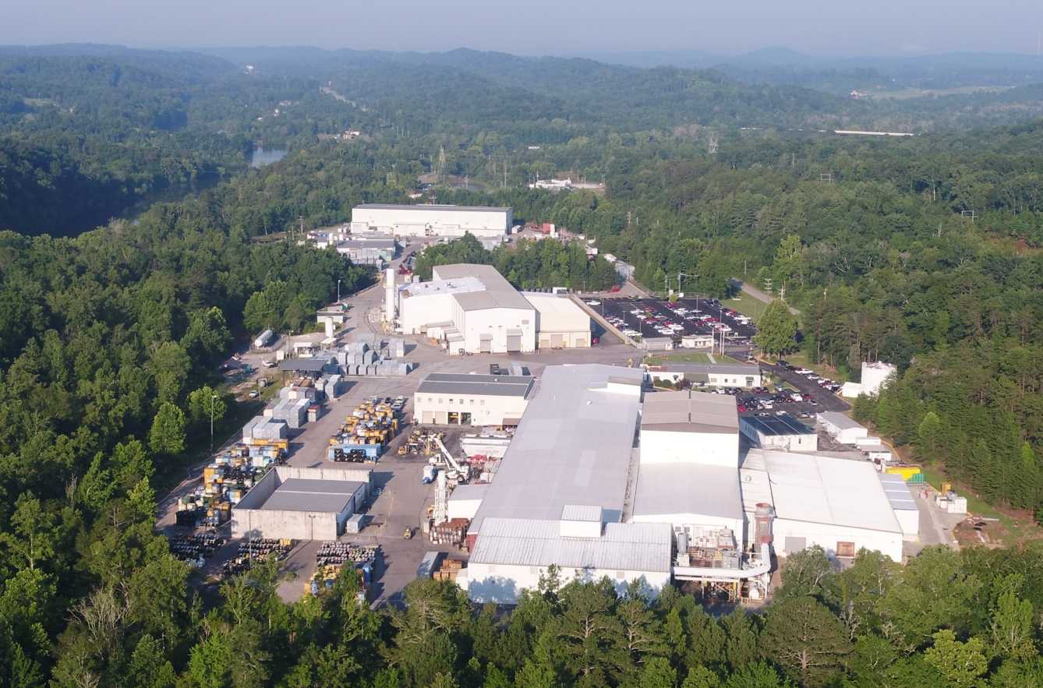
Bear Creek & Gallaher Road Operations
Bear Creek near Oak Ridge, TN provides volume reduction and repackaging for disposal of radioactive material and recycling of contaminated metal into beneficial products for the nuclear industry. The nearby Gallaher Road facility processes materials via Bulk Survey for Release.
SORTING :: INCINERATION :: COMPACTION :: RECYCLING/METAL MELT :: HIGH ACTIVITY FILTER PROCESSING
CONTAINER REFURBISHMENT :: DECONTAMINATION :: BSFR :: HERITAGE RR TRANSFER STATION :: INSTRUMENTATION SERVICES

Slide 9
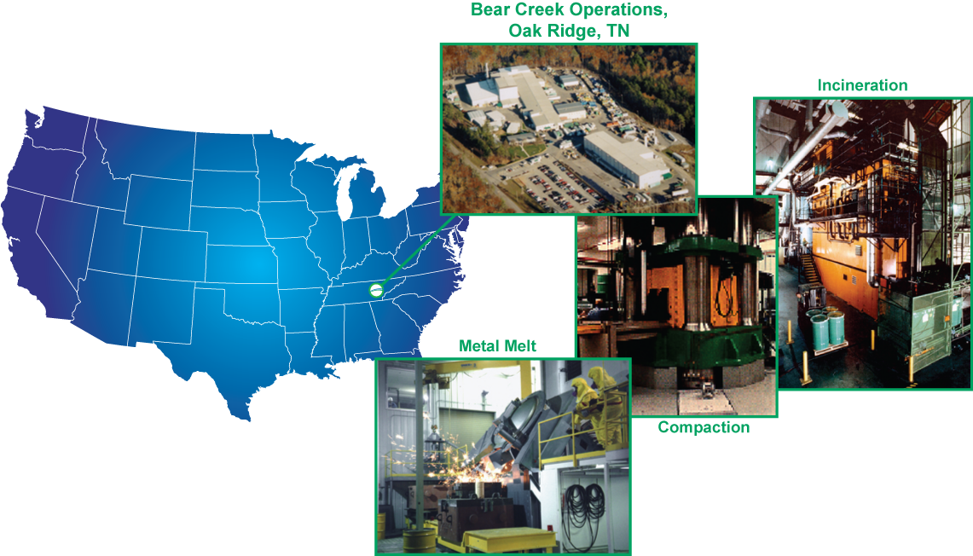

Bear Creek Operations Overview
Incineration
  2 commercial low-level radioactive units
  Solids, liquids, oils and sludges
Super Compaction
Instrumentation Services
Metal Melt Furnace/Recycle
Lead Casting/Recycle
Commercial Certification
Mixed Waste Treatment
TN-OSHA VPP SITE since 2008

Slide 10
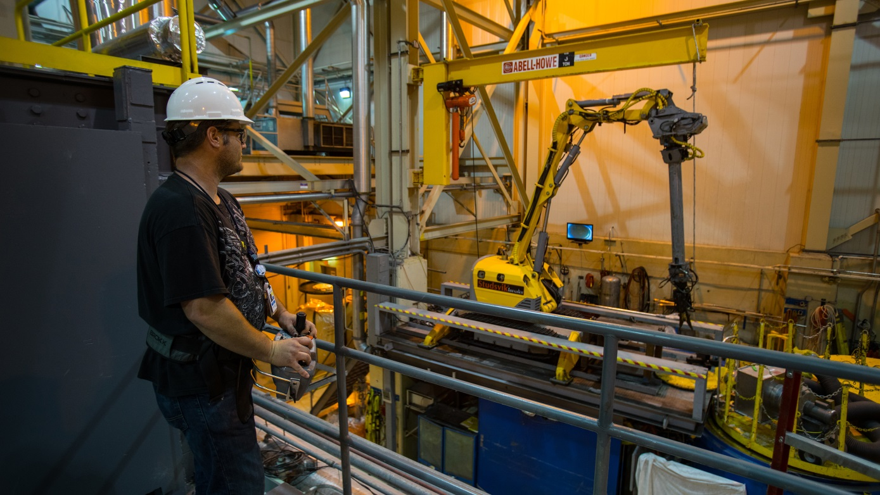
Erwin ResinSolutions
The Erwin Facility in Tennessee safely dewaters, chemically reforms, homogenizes, and reduces the volume of spent ion-exchange resins into a solid-phase, stable waste form that can be disposed at EnergySolutions’ Clive Facility in Utah.

Slide 11
Memphis Logistics Center
This facility, located near Memphis, Tennessee, offers storage and workshop space for nuclear and non-nuclear industries. The center is ideally located on the Mississippi River.

Slide 12
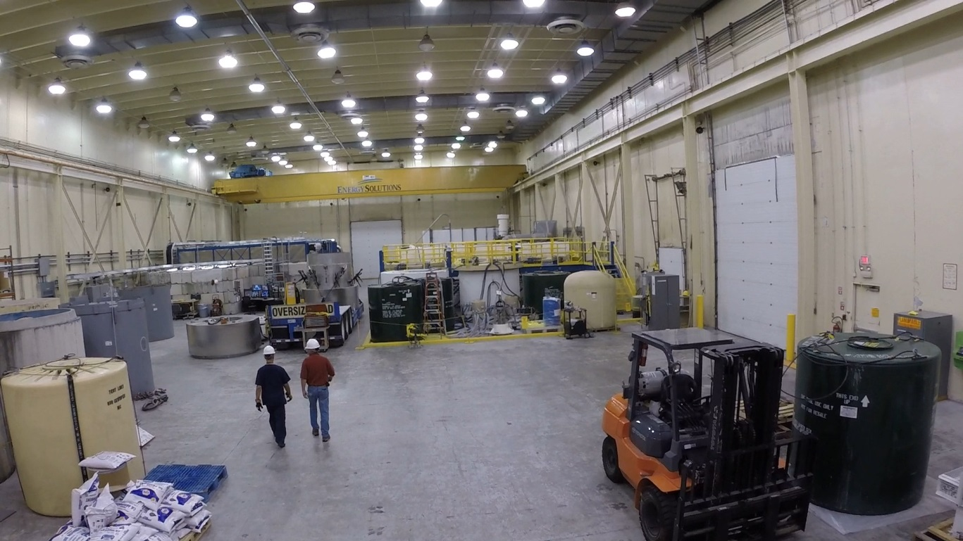
Barnwell Processing Facility
The Barnwell South Carolina processing facility performs resin dewatering, waste solidification, and evaporation processes.

Slide 13
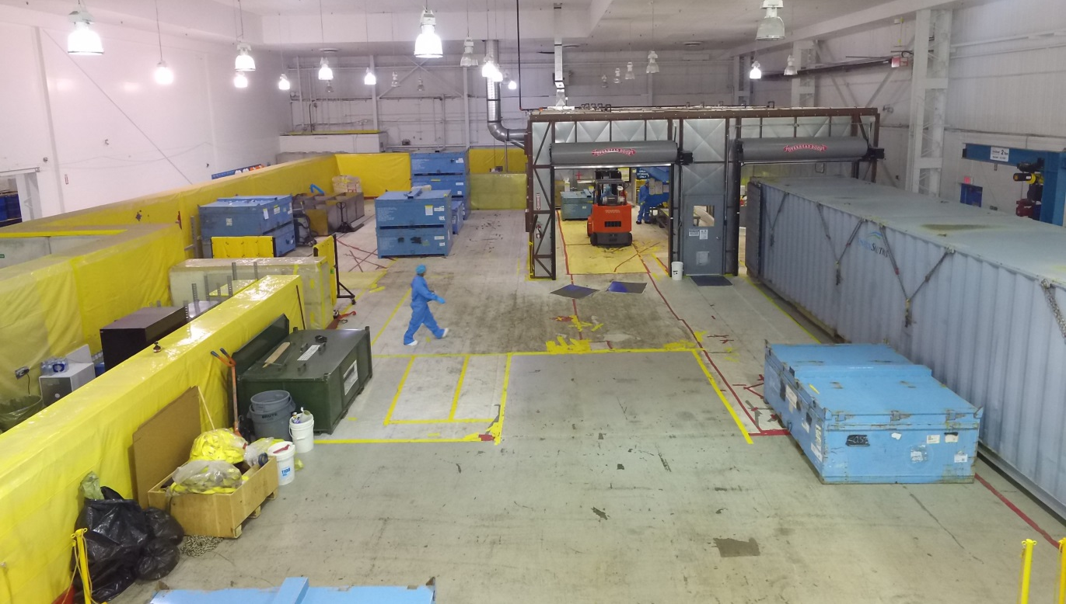
EnergySolutions Canada
EnergySolutions Canada’s (ESC’s) headquarters are in Brampton, Ontario. ESC manages two licensed radioactive waste and materials management facilities providing reactor tooling storage and refurbishment and low-level radioactive waste management services

Slide 14
EnergySolutions Processing Facilities

Slide 15
www.energysolutions.com

