Slide 1
TCEQ Certification Process for Nonparty Low-Level Radioactive Waste Import Applications

Slide 2
Ashley Forbes
Deputy Director
Office of Waste
Radioactive Materials Division
ashley.forbes@tceq.texas.gov
512.239.0493

Slide 3
Authority for Certification
Texas Health and Safety Code §401.207(d) requires that TCEQ must certify through a written evaluation that the waste is authorized for disposal under the license.
The TCEQ reviews applications for importation of nonparty compact waste for disposal at the Compact Waste Disposal Facility.

Slide 4
TCEQ Review Process
The following items are reviewed for each import application:
Waste classification (Class A, B, C)
Waste volume (cubic feet) and radioactivity (curies) – no more than 30% of the initial licensed capacity
Waste is not of international origin
Waste meets the Waste Acceptance Criteria under radioactive material license R04100

Slide 5
Waste Certification
After certifying that the waste proposed for import meets all requirements in statute, rule and the R04100 license, the TCEQ generates a letter to certify that the waste is authorized for disposal under R04100. A copy of the letter is sent to WCS and the TLLRWDCC.

Slide 6
Additional information
Waste Generator Disposal Guide on TCEQ’s webpage.
https://www.tceq.texas.gov/permitting/radmat/licensing/generator-site-access#summary

Slide 7
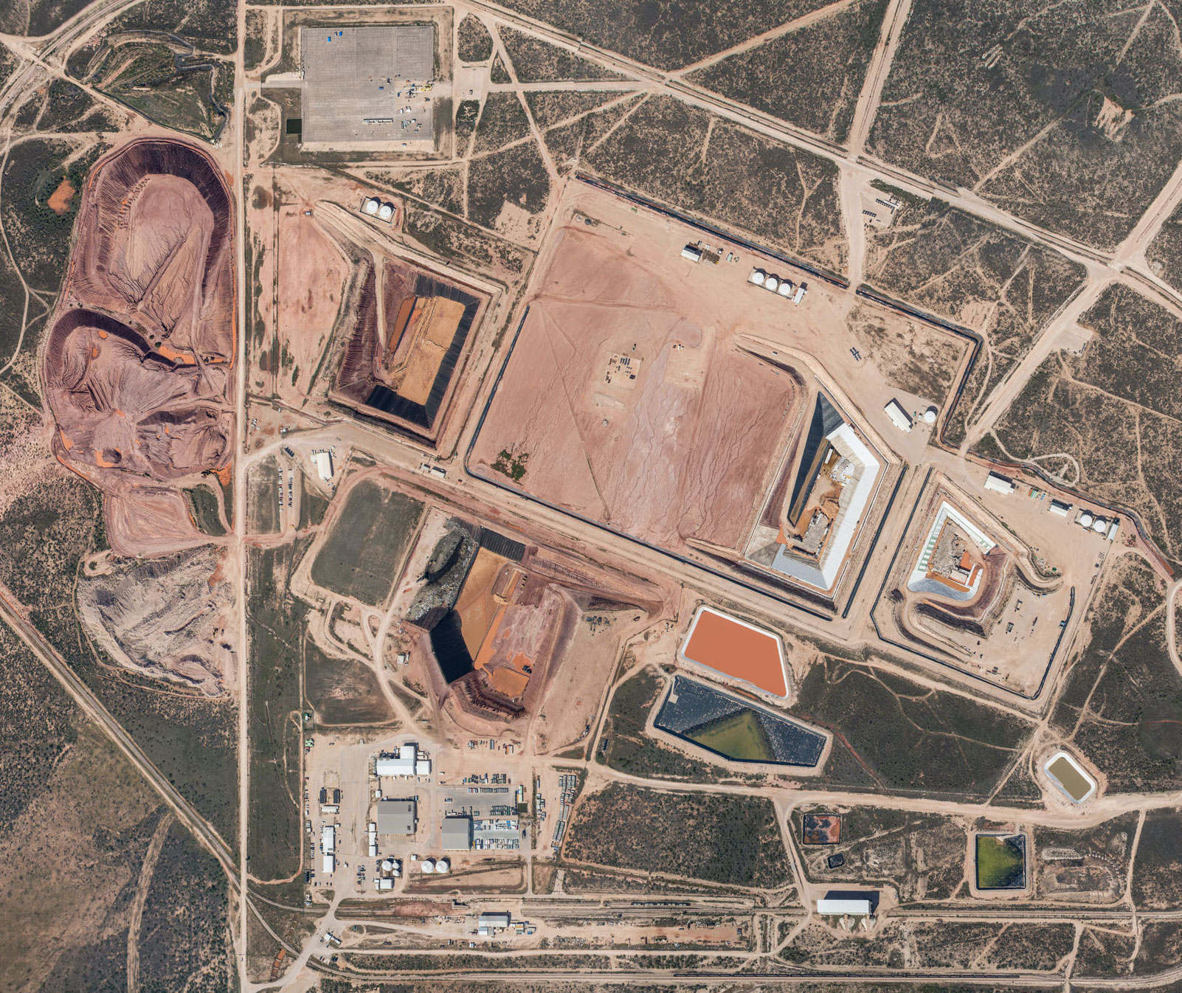
Contracts for Nonparty Compact Waste Disposal
In accordance with Texas Health and Safety Code Sec. 401.2456, rates and contract terms negotiated for nonparty compact waste disposal are subject to review and approval by TCEQ.

Slide 8
Contracts for Nonparty Compact Waste Disposal cont.
Negotiated rates must be set both by a price per curie and a price per cubic foot.
Fees resulting from the negotiated rates must be greater than the compact waste disposal fees as set by TCEQ that are in effect at the time the rates are negotiated.
A contract must:
  Be negotiated in good faith;
  Conform to applicable antitrust statutes and regulations; and
  Be nondiscriminatory.

Slide 9
Questions?

