Slide 1
Overview of the LLW Forum’s Disused Sources Working Group Michael Klebe April 6, 20221

Slide 2
DSWG Current Membership
Members:
Joseph Klinger, CMCC – Chair Earl Fordham, WA
Rich Janati, PA John Williamson, FL
Kevin Siebert, WA Michael Kurth, US Army
Organizational Liaisons
Denny Galloway, CRCPD Craig Little, HPS
Augustinus Ong, OAS
Staff
Dan Shrum Michael Klebe Cecilia Snyder
Lori Beagles

Slide 3
Disused Sources Working Group Origin
DSWG formed in 2011 at the request of the NNSA/GTRI to address the problem of disused radioactive sealed sources
Approximately 2 million sealed sources in use
Tens of thousands disused sources with no exact knowledge of number, activity, and storage security

Slide 4
Disused Source Problem Contributing Factors
Life-cycle costs for managing and disposing of sources not internalized
Inconsistent view of which sources pose a security threat
Regulatory system inadequacies for a post-9/11 threat environment
No financial incentive for reuse, recycle, or disposal
Opportunities for recycling and reusing sources are underutilized
Type B shipping container availability and cost

Slide 5
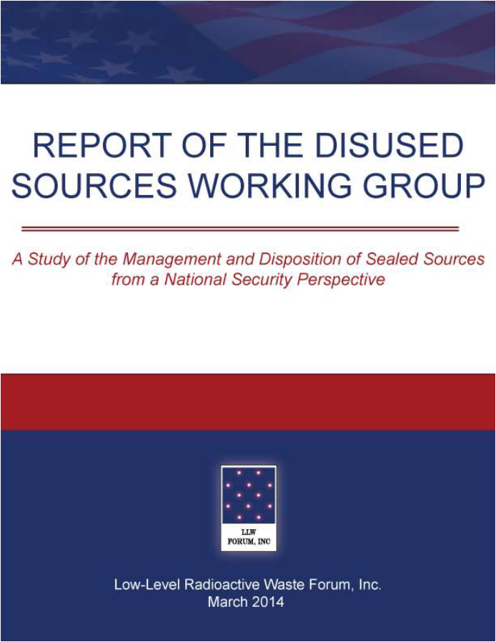
DSWG Report
Report published – March 2014
24 recommendations for improving the security of sealed sources
Several recommendations have been completed
Currently revising the priority of the remaining recommendations
Notes:
19 meetings
30 months
Stakeholder engagement
Report preparation
Technical Review
Report published – March 2014
24 recommendations for improving the security of sealed sources

Slide 6
US NRC BTP on Concentration Averaging and Encapsulation
BTP provides:
Guidance for proper classification of waste for disposal
Acceptable methods for averaging radionuclide concentrations over the volume or mass of waste
Original in 1995
Revised in 2015:
Improve clarity
Update position on LLRW blending
Align the BTP with the NRC’s risk-informed performance regulatory approach

Slide 7
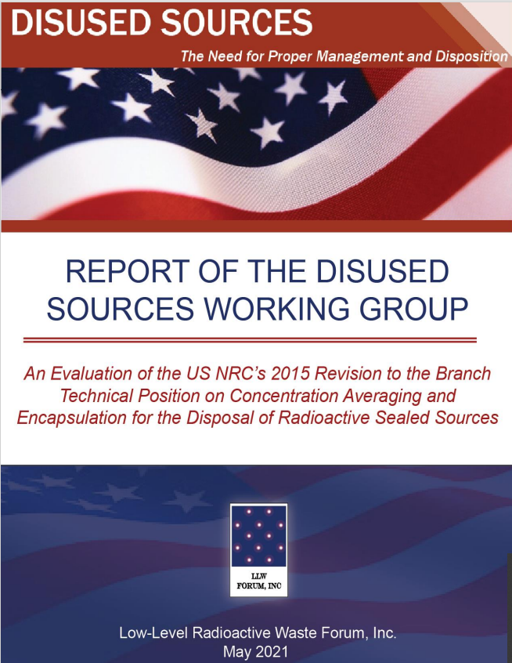
DSWG Report
Report published – May 2021
Evaluates the revised BTP as it relates to sealed sources
Describes classification process for encapsulated sealed sources
Provide a classification example
Discusses alternative approach for waste classification
Identifies some BTP related obstacles for sealed source disposal

Slide 8
US NRC BTP on Concentration Averaging and Encapsulation
Revised BTP does not appear to have increased the disposal of sealed sources.
General industry consensus is the revised BTP has improved the classification process
Adds clarity
Reduced interpretation
Allows for the use of larger containers
Provides flexibility to apply the least restrictive classification

Slide 9
Obstacles for Sealed Source Disposal
Type B shipping cask
Cost and availability
Commercial fleet (EnergySolutions and WCS)
NNSA designed
NAC International Optimus
Incentive

Slide 10
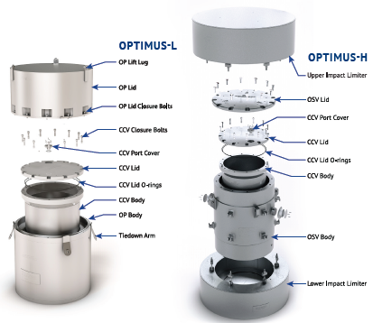
NAC International Inc. – Optimus L & H
Cavity dimension:
32.5” dia. x 47”
Optimus L
49” dia. x 70”
Weights:
Contents – 3,150 lbs.
Gross – 9,200 lbs.
Optimus H
74.2” dia. x 83.2”
Weights
Contents – 7,300 lbs.
Gross – 32,000 lbs.

Slide 11
NAC International Inc. – Optimus L & H
Optimus L
Certificate of Compliance issued December 2021
2 constructed and delivered in June 2022
2 to be constructed and delivered in December 2022
Additional casks constructed in 2023 and 2024
Optimus H
Submitted to NRC for approval
Certificate of Compliance anticipated in December 2022

Slide 12
Obstacles for Sealed Source Disposal
Lack of an incentive for licensees to dispose of unused sources
Not a priority for regulatory programs
Possible options:
Possession limit (2-year)
Possession fee (annual source fee)
Management awareness
Use of the inspection entrance and exit interview process
Discussed at the Friday’s DSWG meeting

Slide 13
Additional Information:

