Slide 1
LLW Forum
San Antonio, Texas
April 6-7, 2022

Slide 2
ARDT Est. 1994
Formed by LLRW generators to support the Texas Low-Level Radioactive Waste Disposal Authority
Served as a platform to voice support at city, county, state, and federal levels for the development and construction of a LLRW disposal facility
Played a major role in the public hearings on the proposed disposal facility in Sierra Blanca, TX
Deployed highly credentialed experts to speak out on specific topics at the Texas Capitol, including:
Members of ARDT’s Advisory Board, such as Dr. Lee Peddicord, Dr. Dale Klein, Dr. Robert Bernstein; and
ARDT’s Student Chapter, comprised of nuclear engineering students
Recipient of the Richard S. Hodes Honor Lecture Award from the Southeast Compact Commission

Slide 3
Goals and Principles
Support the State of Texas as it provides for the permanent disposal of LLRW
Provide information about LLRW disposal to:
The general public
Decision-makers, including state leadership and the Texas Legislature
Local governments
Guiding Principles
It is in the best interest of the public to provide permanent disposal of LLRW within a safe and technologically sound system
It is in the best interest of LLRW generators to develop a viable option for disposal with fair rates

Slide 4
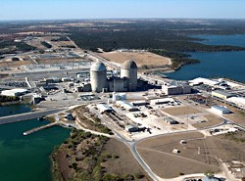
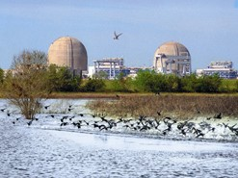
ARDT’s Commitment
Help scientists and engineers share their expertise in radiation issues with legislators, decision-makers, local governments and the public

Slide 5
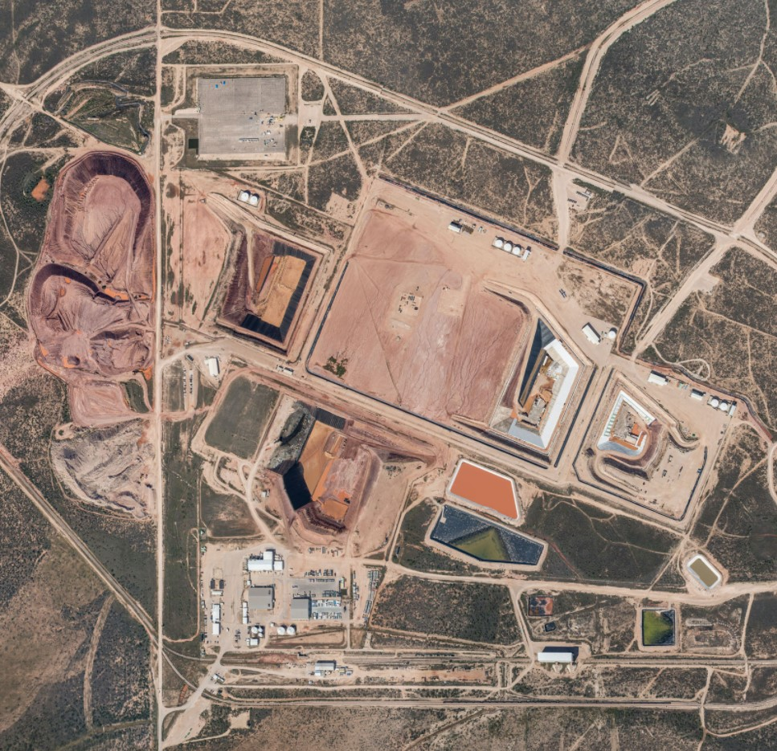
Role in Licensing the WCS Compact Waste Disposal Facility
Utilizing experts from the nuclear plants, hospitals, and health physics society, we focused on technical issues related to the Texas Commission on Environmental Quality’s (TCEQ’s) license conditions
ARDT provided a coordinated technical critique on important facets, such as waste acceptance criteria
ARDT served as a central unifying organization to analyze proposed disposal rates
Expert witnesses reviewed the proposed rate package with a critical eye on issues such as rate of return
Shared costs of experts made the review very economical
Photo source: WCS Media Kit, wcstexas.com/media-kit/

Slide 6
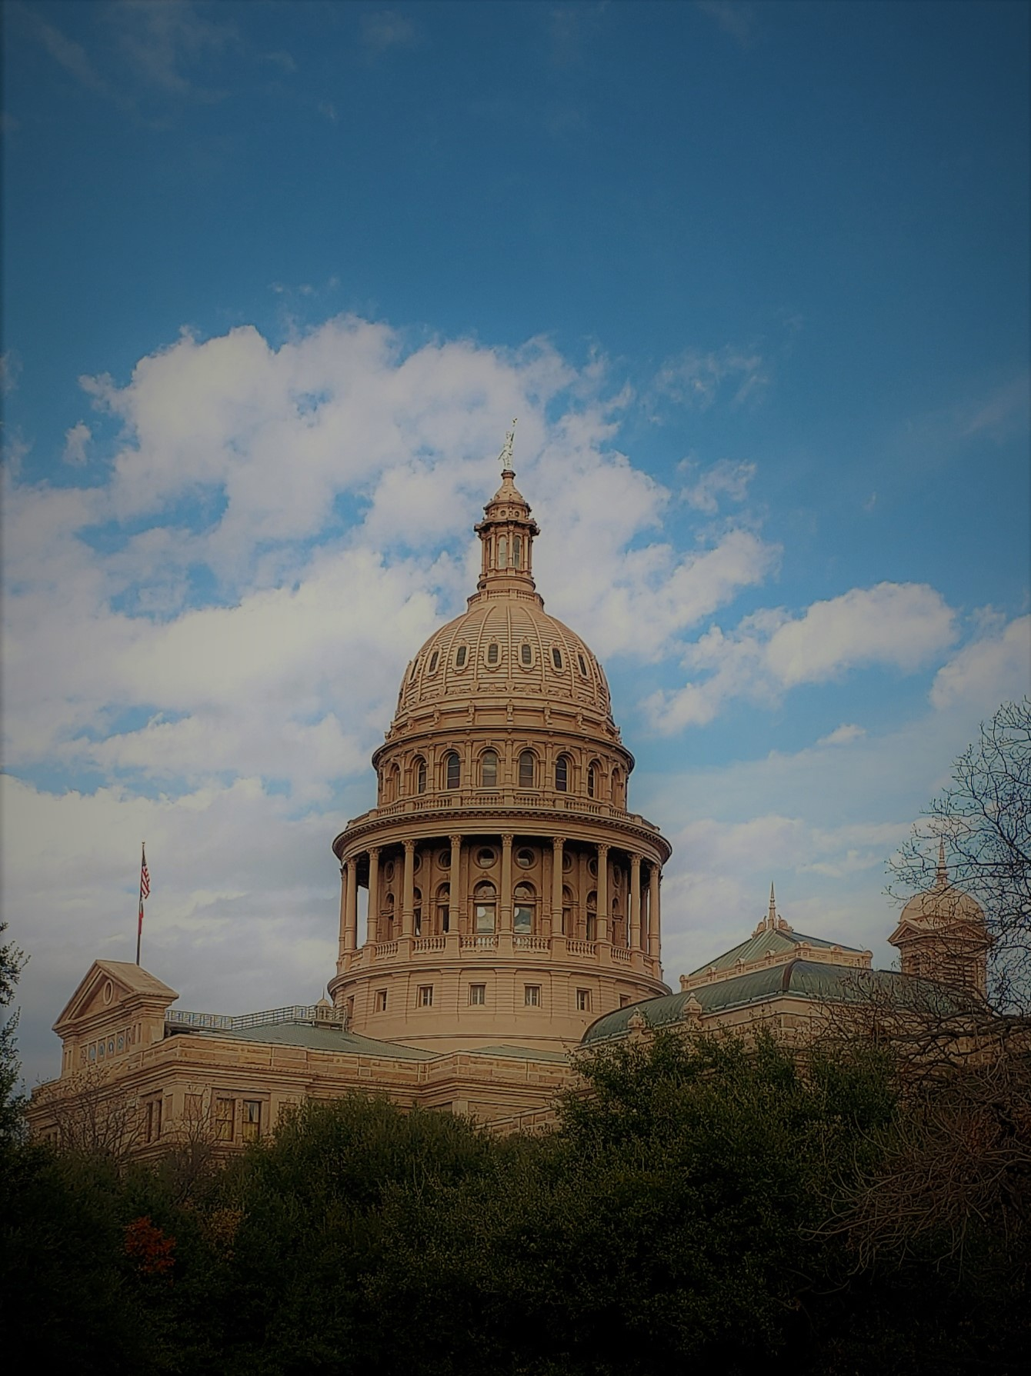
Capitol Advocacy
During legislative sessions, ARDT serves as a central clearinghouse for generators to:
Collaborate on policy issues
Analyze and develop positions on proposed legislation
Provide support and direction to governmental affairs teams

Slide 7
Texas Sunset Review
Regularly scheduled, periodic review of Texas State regulatory agencies
Designed to make sure an agency is still needed and/or is not duplicating the functions of another agency or entity
Overseen by a 12-member Sunset Commission (10 legislators and two members of the public)

Slide 8
Why We Care
TCEQ and the Texas Low-Level Radioactive Waste Disposal Compact Commission are both up for review
Both agencies have elevated LLRW issues for examination
TCEQ’s role in rate-making and disposal contracts
TLLRWDCC’s enforcement authority and contingency plan for the WCS site
Opportunity for stakeholders to engage
ARDT is a stakeholder for both agencies
Confidential input between now and May
Public comment during the Sunset Commission’s deliberations this summer

Slide 9
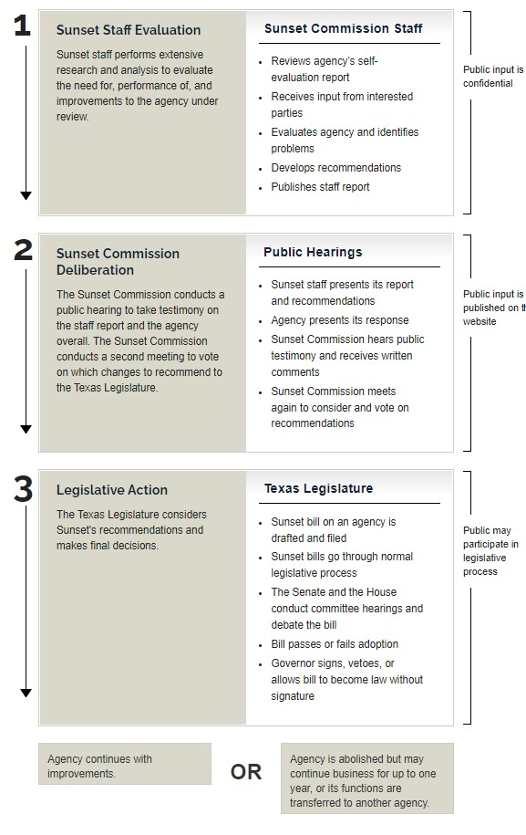
Sunset Timeline
Staff-level reviews are being conducted now through next May
Summer/Fall 2022 Sunset Commission Deliberation
88th Texas Legislature Convenes January 10, 2023
“Sunset Bills” filed to address statutory changes
Agency implementation 2023-2024

Slide 10
But That’s Not All…
Monitoring
Monitoring emerging issues at Federal and State Regulatory Agencies
NRC and DOE (LLRW Forum an indispensable resource for this)
TCEQ and TLLLRWDCC regulatory initiatives and WCS License amendments
Partnering
Partnering with Higher Education
Long-standing relationships with UT-Austin and TAMU
Develop a new relationship with Abilene Christian University
Developing
Developing Educational Materials
LLRW “Primer” in 2021
Focused materials on GTCC, etc.

Slide 11
Connect with ARDT
www.ardt.org
Edward Selig
Government Relations Consultant
eselig@ardt.org
512.413.0902
Brian Christian
Environmental Policy Specialist
bchristian@ardt.org
512.937.2490

