Slide 1
Southwest Research Institute®
Benefiting government, industry, and the public
through innovative science and technology
Miriam R. Juckett
Senior Program Manager
April 2022

Slide 2

SwRI Core Values
Integrity: Fulfilling our mission and serving our clients with excellence, honesty, and accountability.
Innovation: Solving problems and creating value with novel ideas and multidisciplinary collaborations.
People: Fostering an employee-centric culture in a safe, inclusive, healthy, and supportive workplace.
Stewardship: Caring for our communities and protecting the environment now and for the future.

Slide 3
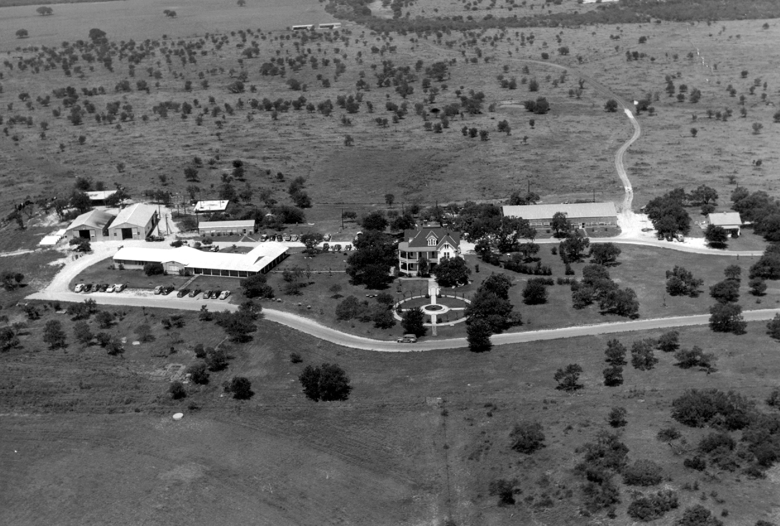
SwRI in the 1950s
Nonprofit
1947 Tom Slick signed charter
Initial budget <$100,000
Fewer than 20 employees
64 projects in the first year
By 1958
  Revenue exceeding
  $4.5 million
  437 employees

Slide 4
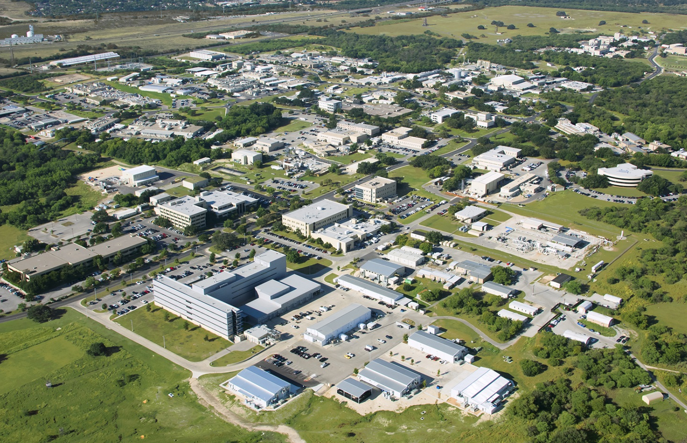
SwRI Today
  Nonprofit
  More than 2,700 employees
  More than 1,500 acres /6.1 km²
  facility in San Antonio, Texas
  More than 2.3 million ft² /
  214,000 m² of laboratories,
  workshops & offices
  More than 1400 patents
  50 R&D 100 awards

Slide 5
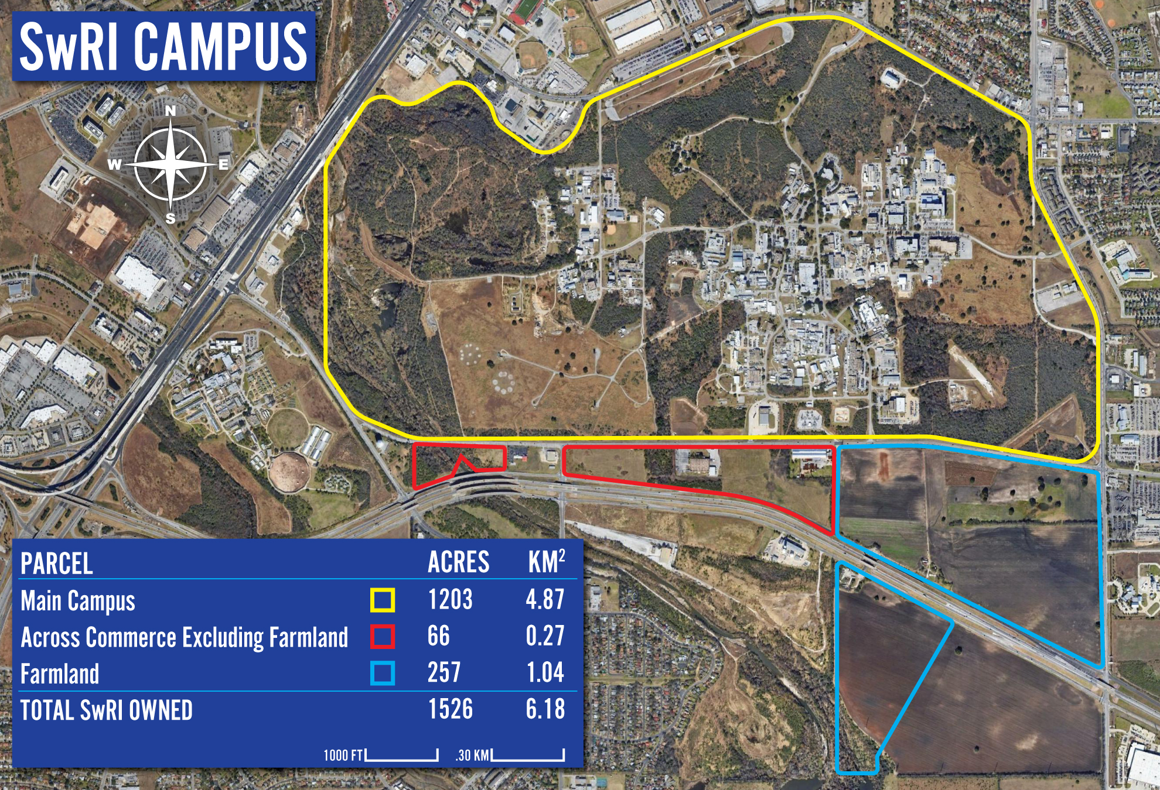

Slide 6
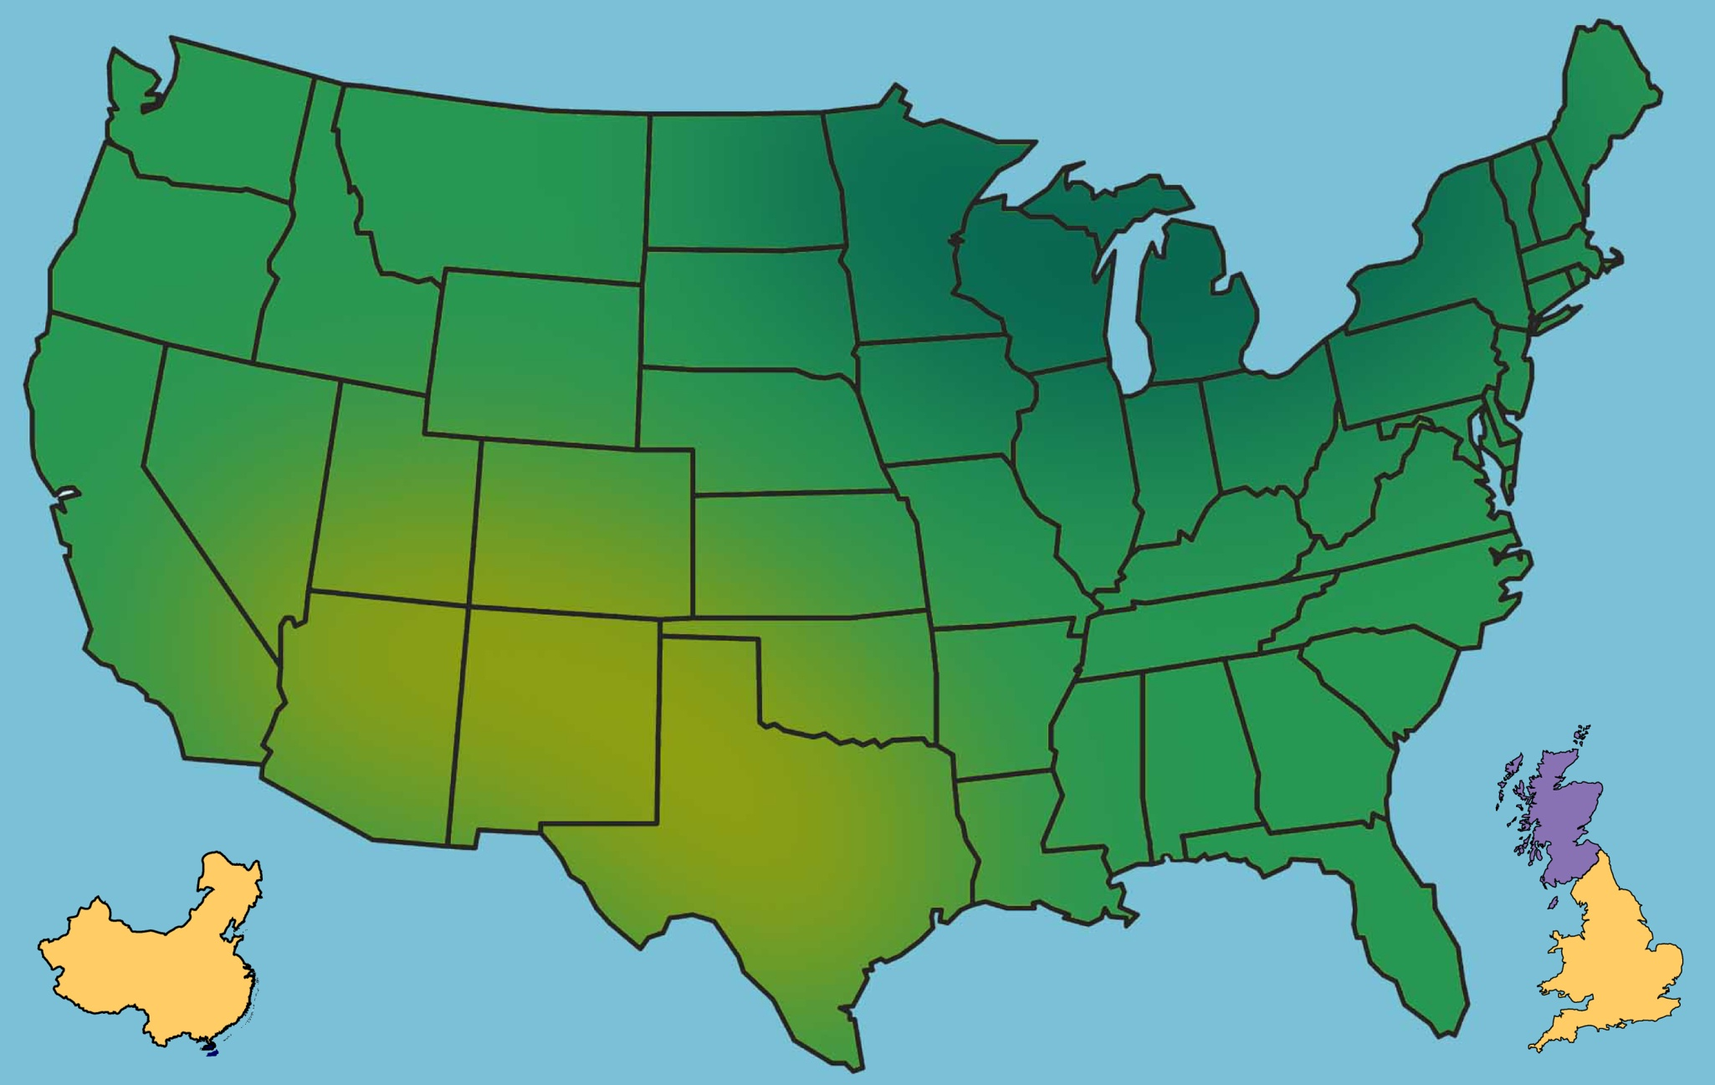
SwRI Sites Worldwide
Minneapolis, MN
Div. 18
Durham, NH
Div. 15
Ann Arbor, MI
Div. 03
Hanover, MD
Div. 16
Boulder, CO
Div. 15
Ogden, UT
Div. 18
Dayton, OH
Div. 16
Midwest City, OK
Div. 14/16
Rockville, MD
CNWRA®
Warner Robins, GA
Div. 16
Beijing, China
Div. 03/08/18
SwRI Headquarters
San Antonio, TX
Austin, TX
Sig. Science
Tianjin City, China
SwARC
United Kingdom
Div. 03

Slide 7
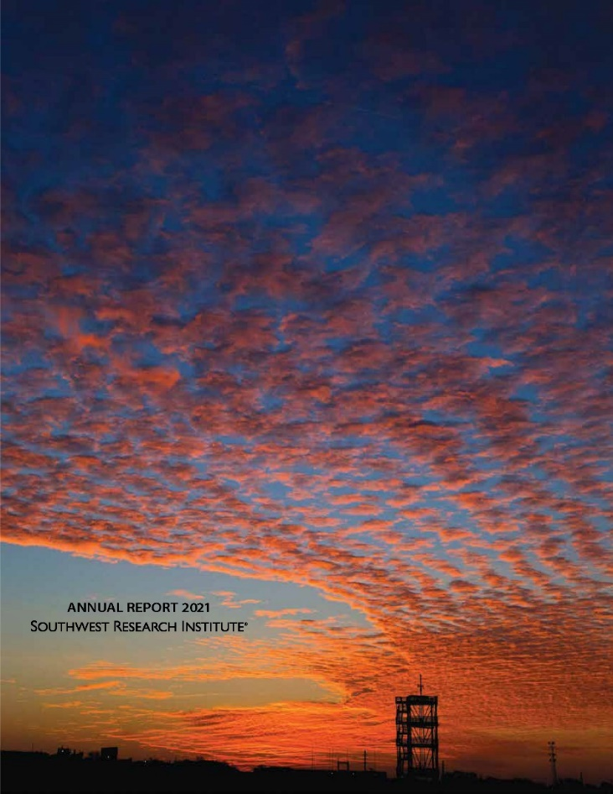
Operational Characteristics
Nonprofit
Revenue from contracts
Applied RDT&E services
Physical sciences & engineering
Broad technological base
Capital-intensive operation
Internal Research program
  $8 million in FY 2021
  98 projects

Slide 8
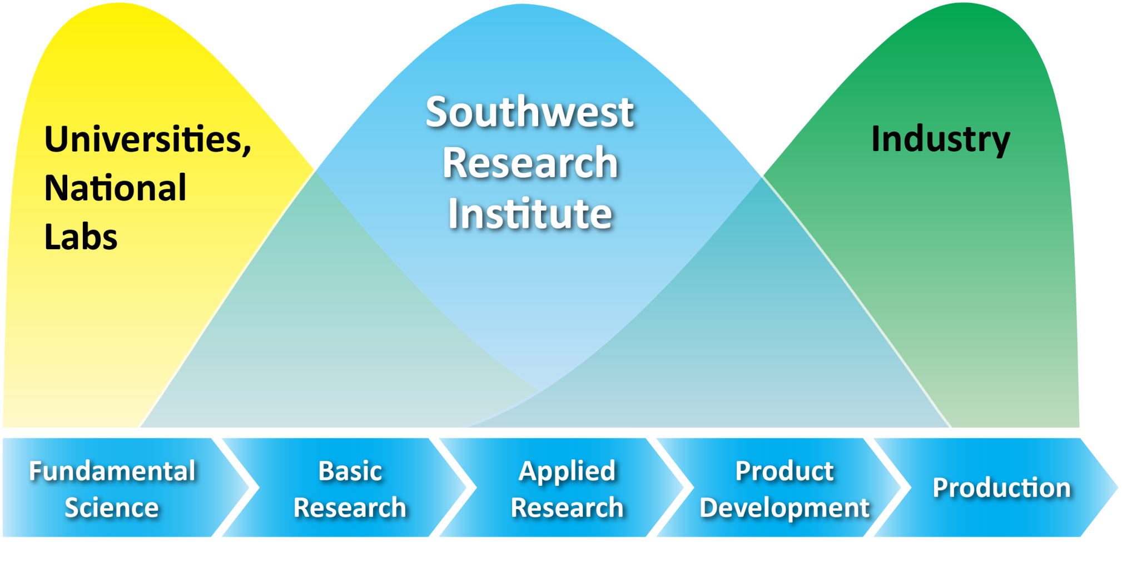
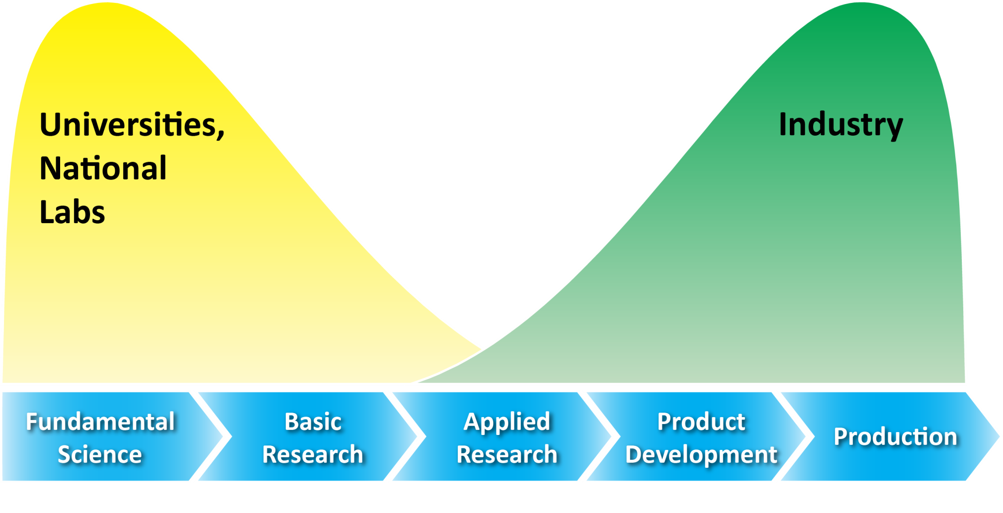
SwRI in the Technology Spectrum
← Bridging the Technology Spectrum →

Slide 9
Professional Education Mix,
All Degrees Held
Physics
7%
Computer Science
& Math
9%
Chemistry &
Chemical
Engineering
6%
Other
49%
(over 150
fields of study)
Electrical
Engineering
12%
Mechanical Engineering
17%
FY2020
Rev. 02/21

Slide 10
Revenue and Staff Growth
800
4000
FY 2021
As of Sept. 24, 2021
$
726M
700
$
581M
600
3000
500
Total Revenue, $M
400
2000
Regular Staff
$
319M
300
$
228M
200
1000
100
$
95M
$
21M
0
0
1971
1981
1991
2001
2011
2021
Year

Slide 11
Revenue Distribution by
Funding Source
Government Subcontracts
(29%)
Commercial
(34%)
Government
(37%)
FY2021
Rev. 02/22

Slide 12
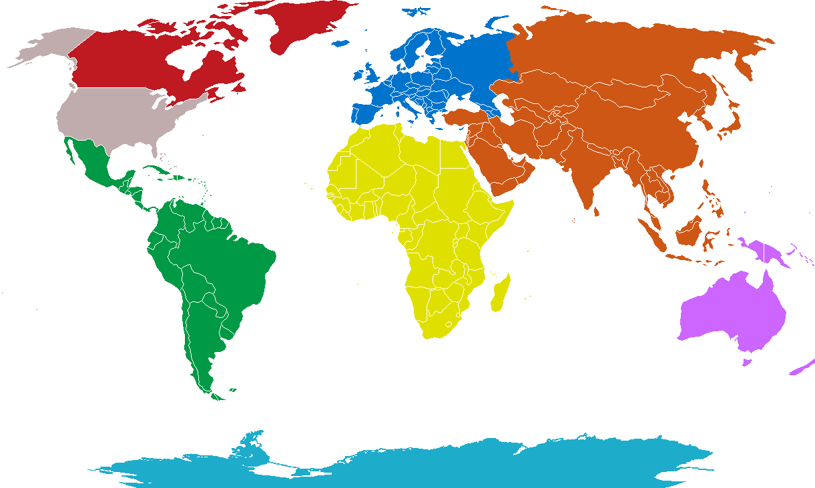
International Revenue Distribution by Continent
35%
10%
12%
<1%
<1%
<1%
41%

Slide 13
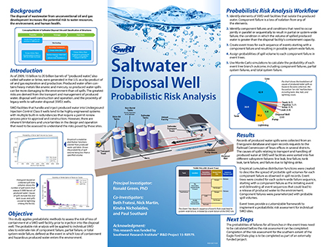
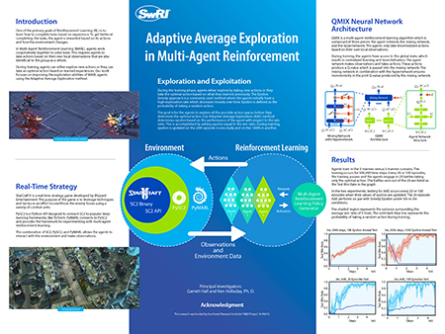
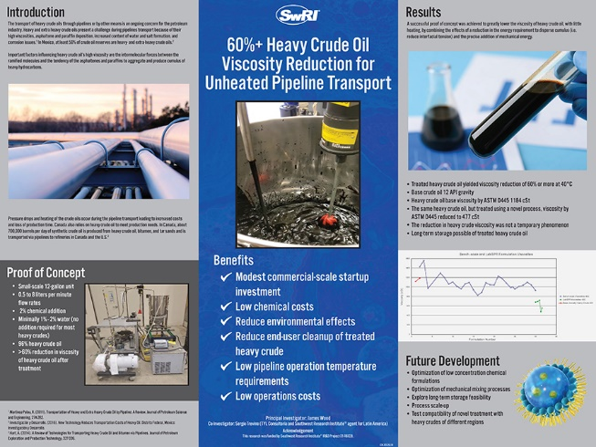
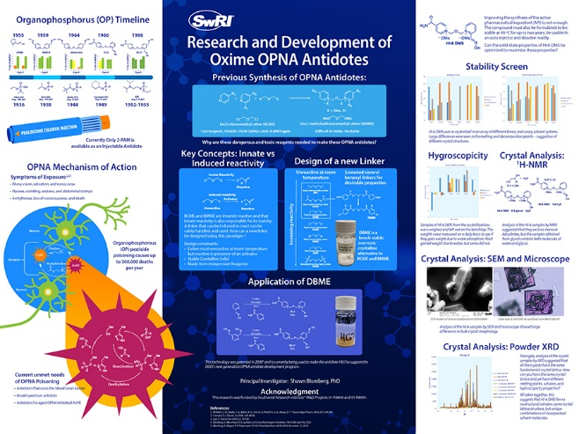
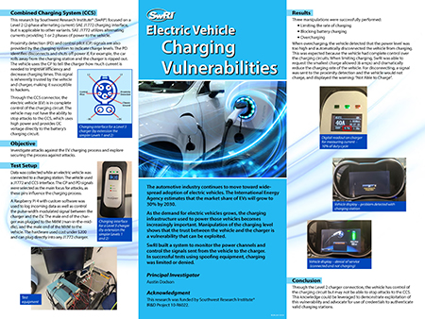
2021 Internal Research &
Development Program
Turning Innovative Ideas into Advanced Technologies
98 New Internal Research Projects
Expenditure – More than $8M

Slide 14
SwRI R&D Organizations
Applied Physics
Applied Power
Chemistry and Chemical
Engineering
Defense and Intelligence
Solutions
Center for Nuclear Waste Regulatory Analyses - FFRDC
Fuels and Lubricants Research
Intelligent Systems
Mechanical Engineering
Powertrain Engineering
Space Science and Engineering

Slide 15






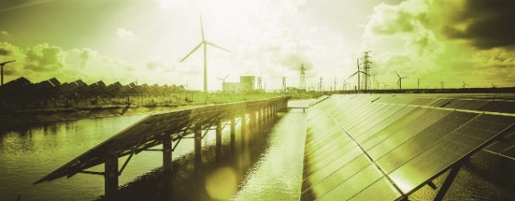
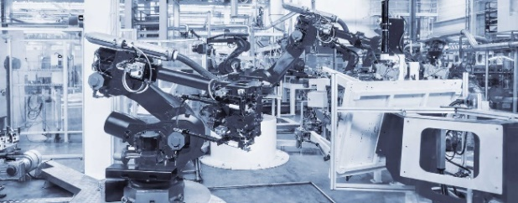
Market Segments We Serve
Automotive
& Transportation
Biomedical
& Health
Chemistry
& Materials
Defense
& Security
Earth
& Space
Electronics
& Automation
Energy
& Environment
Manufacturing
& Construction

Slide 16
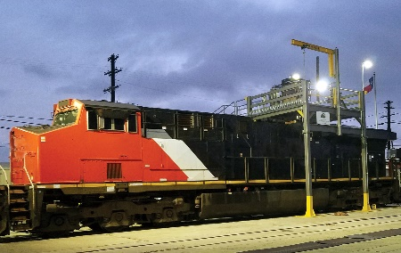
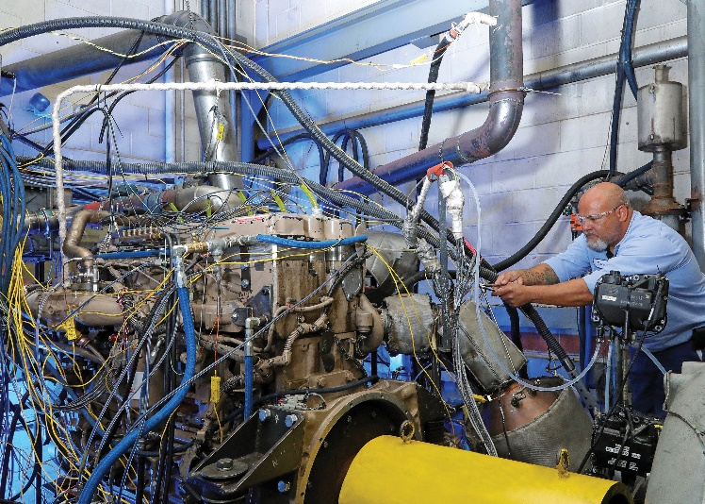
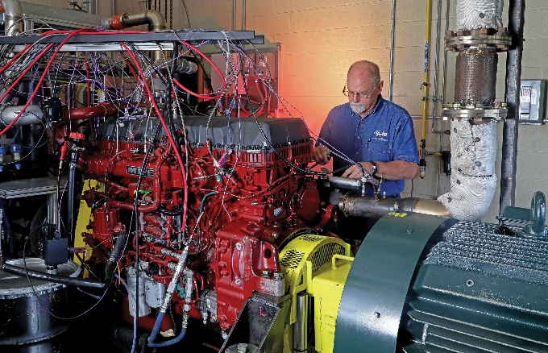
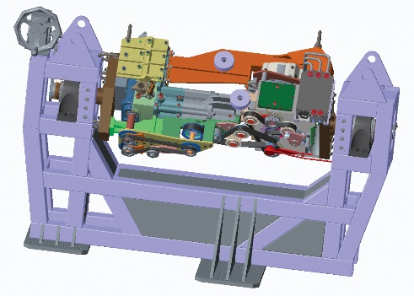
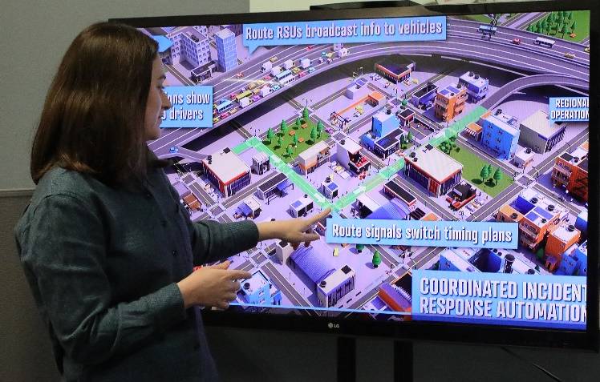
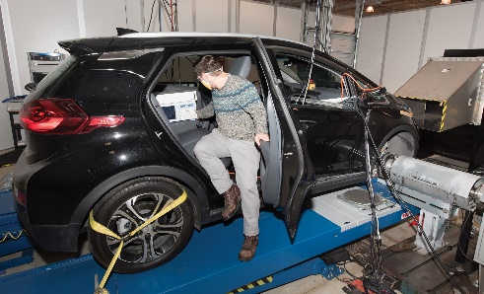
Automotive & Transportation
1
4
2
5
3
6
○ Aerospace ○ Automotive ○ Fuels & Lubricants ○ Locomotive

Slide 17
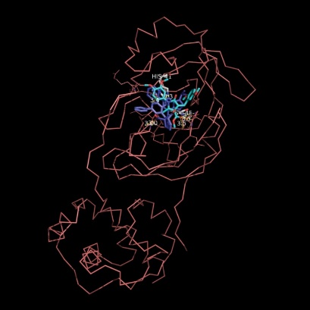
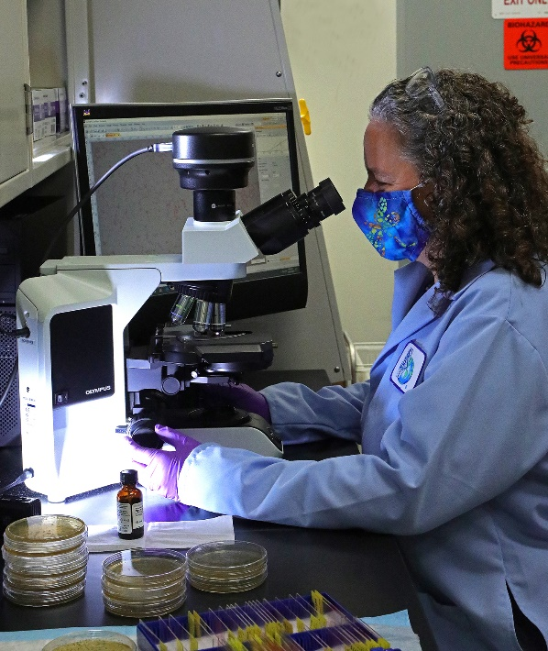
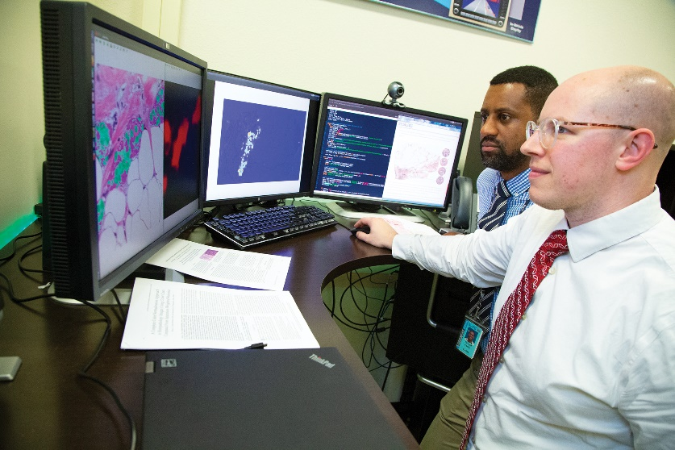

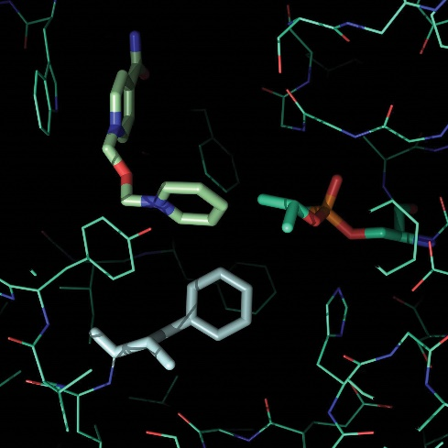
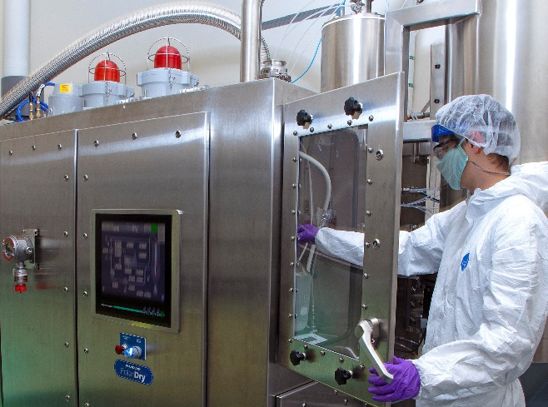
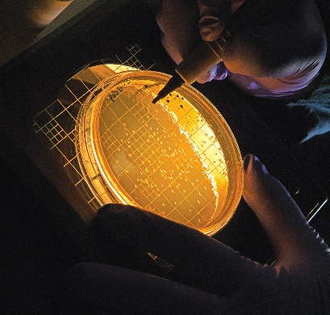
Biomedical & Health
1
5a
3
5b
4
2
5c
○ Biomedical Devices ○ Computational Biomedicine ○ Food Safety
○ Pharmaceutical Development ○ Human Performance

Slide 18
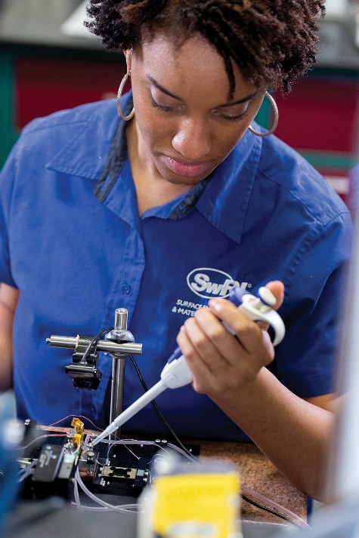
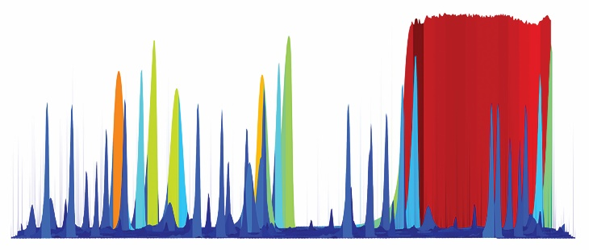
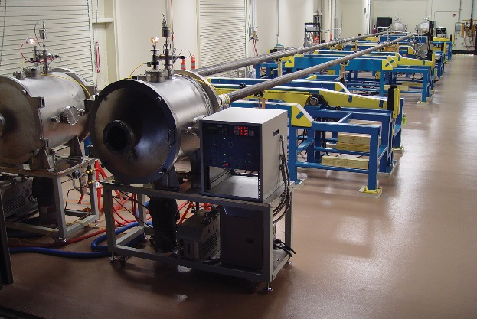
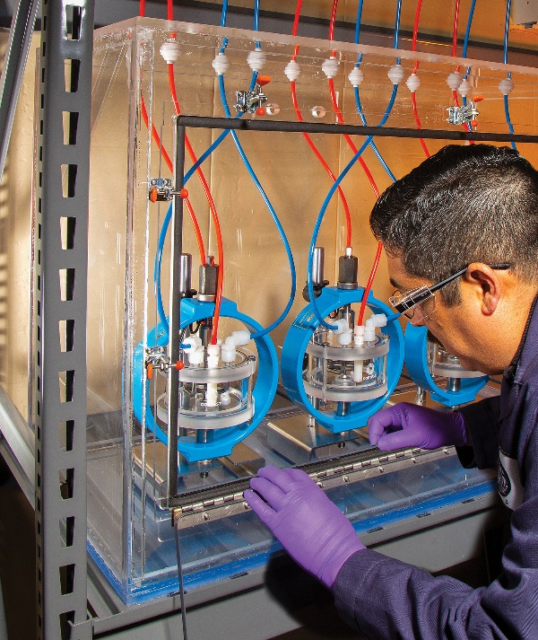
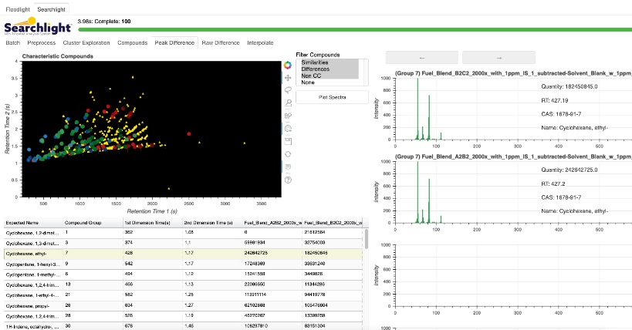
Chemistry & Materials
4
1
2
5
5
3
Chemical Engineering ○ Fire ○ Materials ○ Analytical
Corrosion ○ Surface Coatings

Slide 19
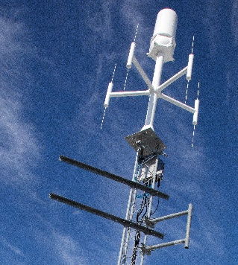
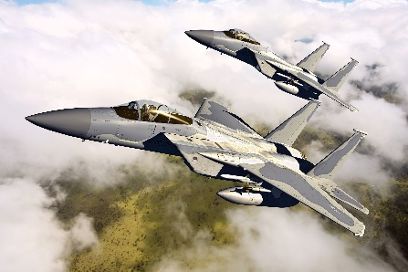
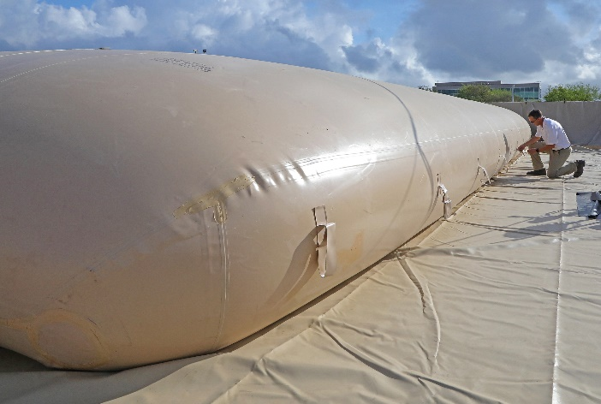
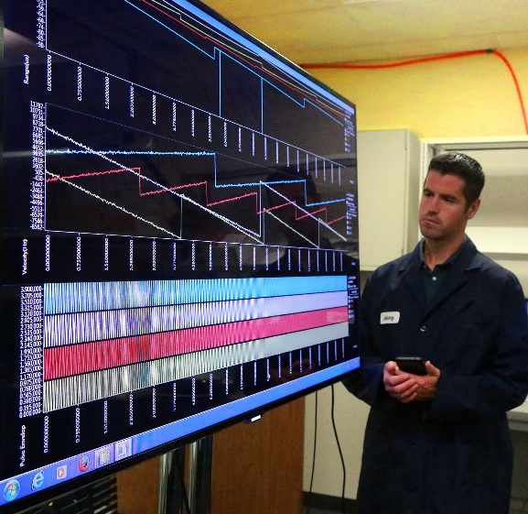
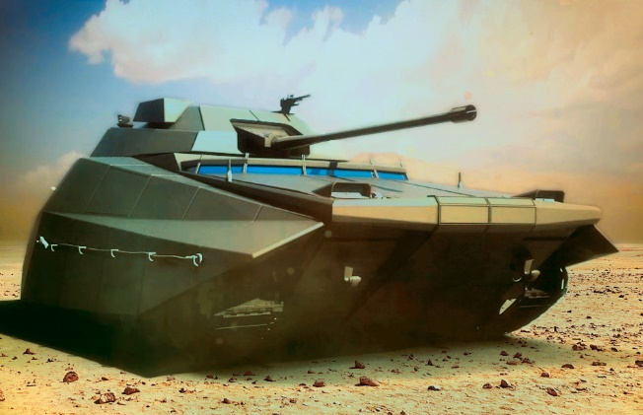
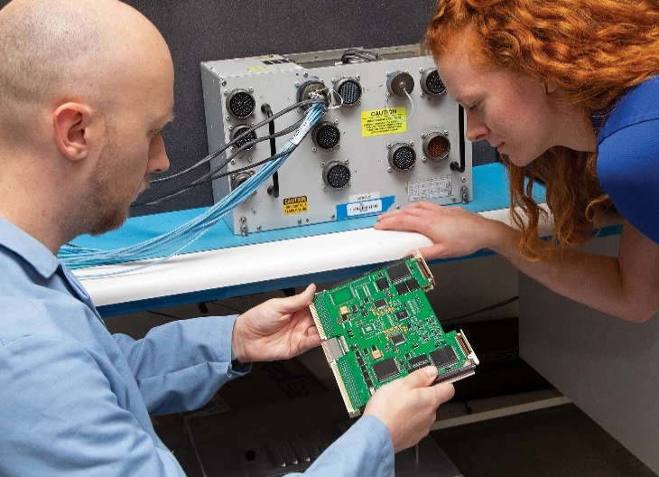
Defense & Security
1
5
4
2
6
3
○ Blast & Impact ○ Defense Aerospace & Aircraft
○ Software Electronics & Cyber Technology ○ Unmanned Systems

Slide 20
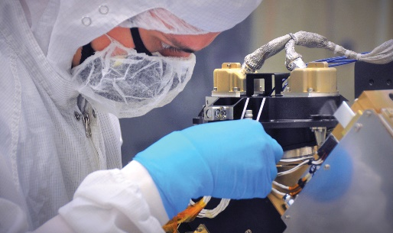
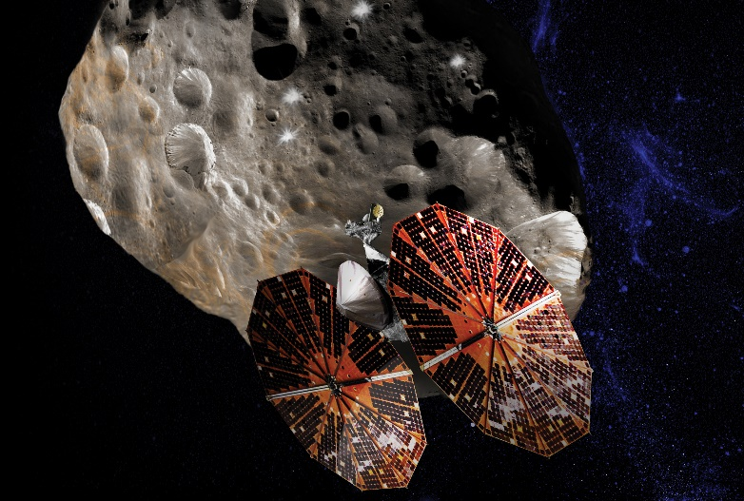
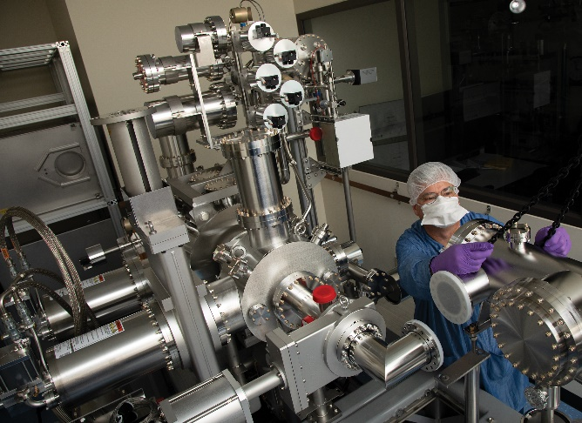
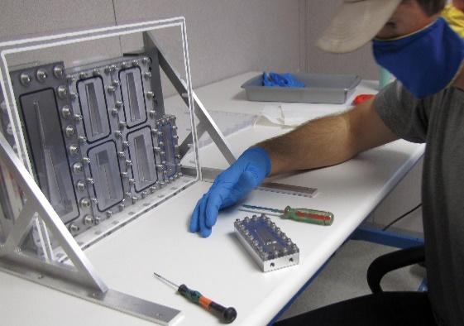
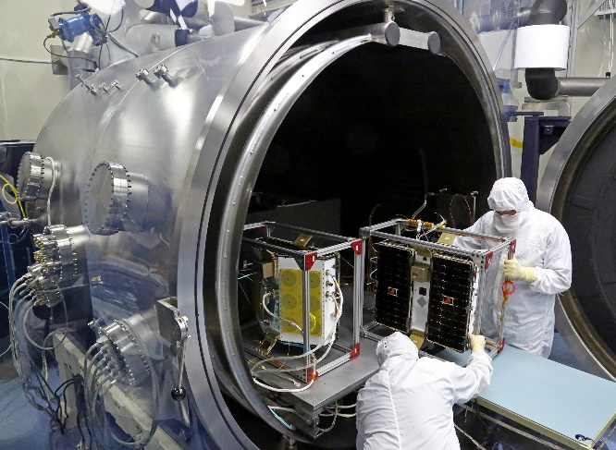
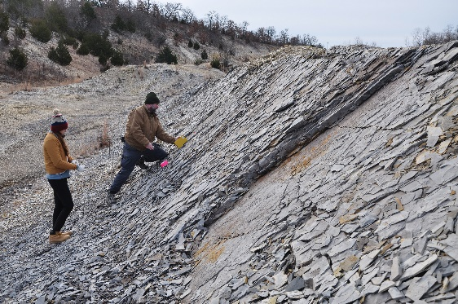
Earth & Space
1
2
4
5
6
3
○ Earth Science ○ Space Research & Technology

Slide 21
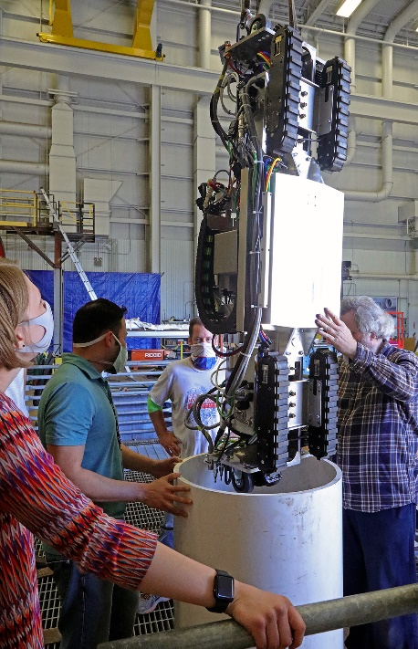
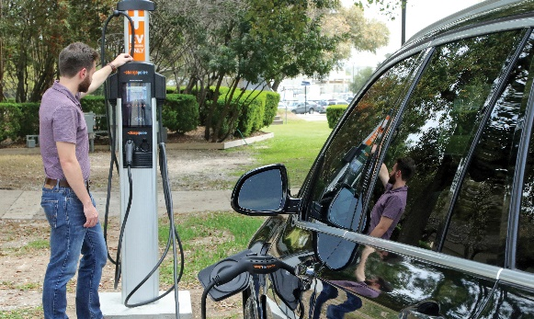
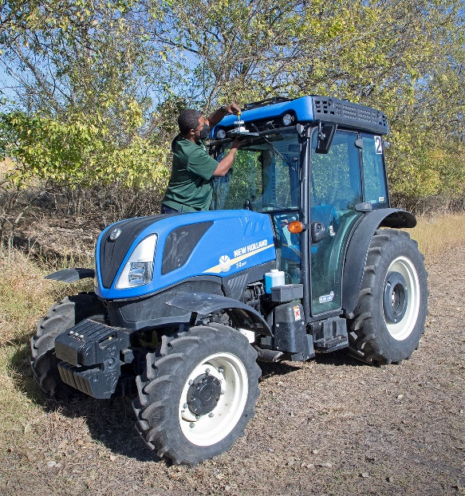
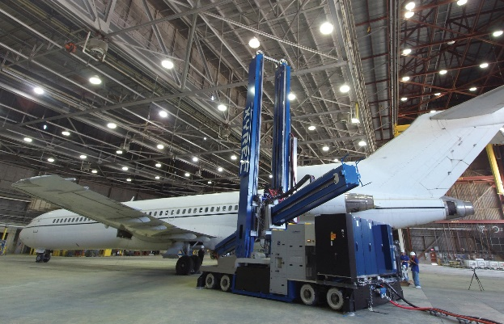
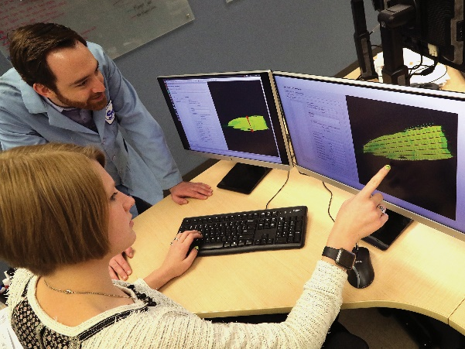
Electronics & Automation
4
1
2
3
5
Computational Modeling & Simulation Tools ○ Electronics
○ Machine Learning Technologies ○ Software ○ Robotics

Slide 22
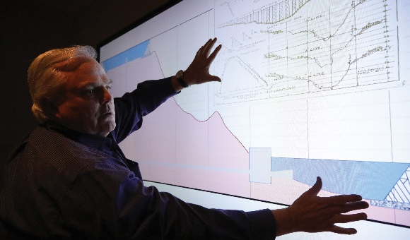





Energy & Environment
1
4
2
5
6
3
Environment ○ Machinery ○ Oil & Gas
○ Power Generation & Utilities ○ Battery Technology

Slide 23





Manufacturing & Construction
1
4
2
3
5
Manufacturing Technologies ○ Reliability Engineering Services
Standardized Testing ○ Structural Integrity ○ Performance Assessment

Slide 24

Radiological Facilities and Projects

Slide 25

Radiation Testing and Off-Site Source Recovery Program
SwRI has a High-Level Radiation-Effects Facility that provides clients with high-intensity gamma radiation for research and testing. This facility consists of two irradiation cells that can be used for studying radiation effects on equipment, animals, plants, and food. With a Specific Radioactive Materials License issued by the Texas Department of State Health Services, we can possess, use, and store Category 1 and 2 Cesium and Cobalt sealed sources to support the Off-Site Source Recovery Program to remove excess, unwanted, or disused radioactive sealed sources that pose a potential risk to national security, health, and safety.

Slide 26

Radioactive Tracer Capabilities
Used for highly accurate real-time wear measurements for engine components

Slide 27

Radiochemical Analysis Services
Alpha Spectrometry: Identifies and measures alpha particles emitted by radionuclides during decay
Gamma Spectrometry: Identifies and quantifies gamma-emitting radionuclides
Liquid Scintillation Counting: Quantifies low energy beta particles emitted by radionuclides
Gas Flow Proportional Counting: Quantifies alpha and beta particles emitted by radionuclides
Inductively Coupled Plasma – Mass Spectrometry (ICP-MS): Measures most elements in the periodic table, including individual isotopes
Radioactive materials and constituents are understood through radiochemistry. To meet growing concerns about the radioactive levels in mixed wastes and other types of samples, we have a dedicated facility to identify and quantify more than 400 isotopes. With a Broad Scope Radioactive Materials License issued by the Texas Department of State Health Services, we can possess, use, and store any radioisotope (atomic numbers 1 through 110) in any physical form, as long as the total activity of the sample does not exceed 1 millicurie per gram. This unique, open-ended license allows SwRI to receive many samples that ordinary laboratories cannot handle. We provide environmental analysis, radioactive tracer studies, nuclear medicinal analysis, and method development.

Slide 28


Center for Nuclear Waste Regulatory Analyses (CNWRA)
Established in 1987 by U.S. Nuclear Regulatory Commission (NRC) as a Federally Funded Research and Development Center (FFRDC)
Chartered to assist NRC with Yucca Mountain licensing review
Significant support for NRC Safety Evaluation Report
Independent testing and analysis on behalf of NRC
Environmental adoption review and supplement support

Slide 29



Evaluating a Geologic Repository
Safety, Environmental, & Regulatory
  Transportation
  Waste handling failure modes
  Geomorphology/Geology
  Seismology
  Volcanology
  Hydrology
  Geochemistry
  Corrosion
  Biosphere (Health Physics)
  Performance Assessment
Laboratory, Field, Modeling

Slide 30
Recent Work on Low-Level Waste
Dose calculations to support NRC technical basis document on disposal of greater-than-Class C (GTCC) and transuranic (TRU) waste under 10 CFR Part 61
  Acute and chronic doses under intruder and accident scenarios; CNWRA-developed BDOSE™ (ADAMS ML19192A200)
  Offsite groundwater pathway dose; GoldSim® (ADAMS ML19191A019)
Insights into how the radiological properties of various GTCC waste streams and exposure scenario considerations may affect required compliance demonstrations for disposal of GTCC waste streams

Slide 31

Enhancing Radiological Dose Models

Slide 32


Work on Wastes Incidental to Reprocessing
Many years of technical assistance for NRC’s consultation and monitoring role with respect to DOE non-high-level waste determinations at legacy sites
Technical reviews of reports on tank cleanup and closure, as well as saltstone waste disposal, with emphasis on compliance with 10 CFR Part 61 performance objectives
Independent research on cementitious material physical behavior and grout waste form performance (e.g., Tc-99 leaching from saltstone)

Slide 33




Baseline and Operational Monitoring
MCNP shielding and criticality analyses for anticipated operations
Evaluated conditions and contamination at commercial and defense program sites
Radiological surveys from ground-based and aerial platforms
Field sampling and laboratory analyses for gaseous, liquid, and solid effluents
Modeled release and transport of contaminants
Assessed airborne releases and indoor resuspension
Calculated dose and risk for workers and the public under normal and accident conditions

Slide 34




Related Work Areas
Nuclear Power Plant Safety Reviews
Spent Fuel Storage and Transportation
Hazard Assessment
Fire Protection
34

Slide 35

Environmental Evaluations
NEPA and regulatory documentation
Site characterization
Facilities across the nuclear cycle
  Uranium mining and milling
  Fuel fabrication
  Spent fuel storage
  Disposal
  Reprocessing
  Legacy sites

Slide 36



Public Outreach and Stakeholder Engagement
Needed because of increased public scrutiny and awareness; strong influence of social media
Concerns often related to “perceived risk”
Need proactive, holistic approach

Slide 37


Public Outreach and Stakeholder Engagement
Communication planning
Identification of key stakeholders
Effective public engagement (meetings, workshops) to collect and distribute meaningful information
Plain-language materials explaining technical content
Public comment response
FAQs and recovery planning

Slide 38

Independent, advanced science and applied technology.

Slide 39

Advanced science. Applied technology.
Miriam Juckett
Senior Program Manager
mjuckett@swri.org
210.522.3266
www.swri.org

