Slide 1
Innovation in radioactive waste disposal
A perspective from Deep Isolation

Slide 2
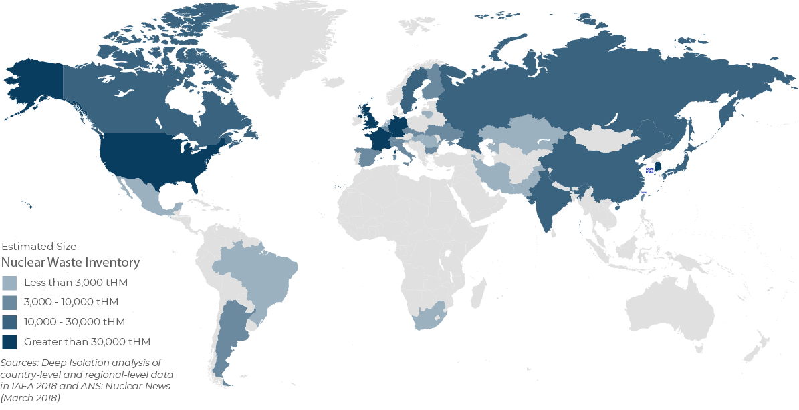
The world has not yet disposed any of the spent fuel it has created over the last seventy years
Estimated size of spent fuel inventories
…. and the current model for geological disposal is simply not scalable

Slide 3
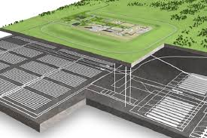
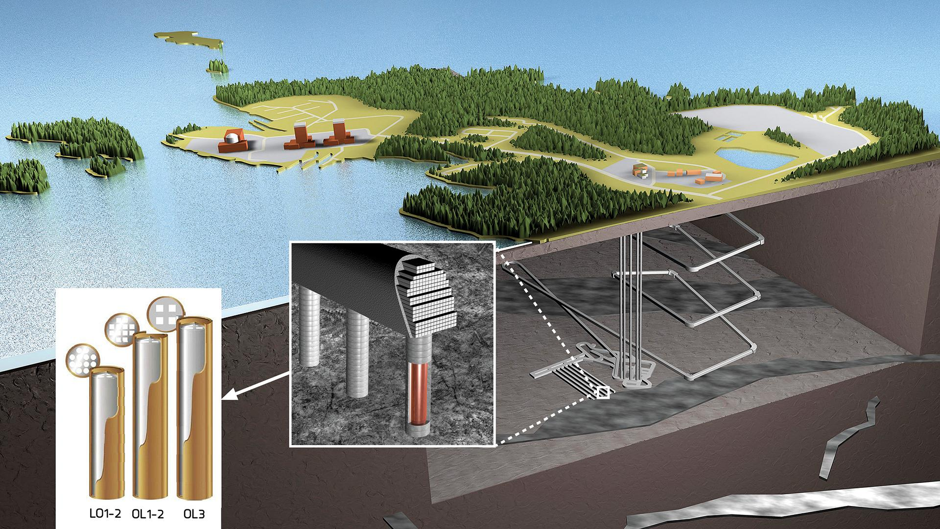

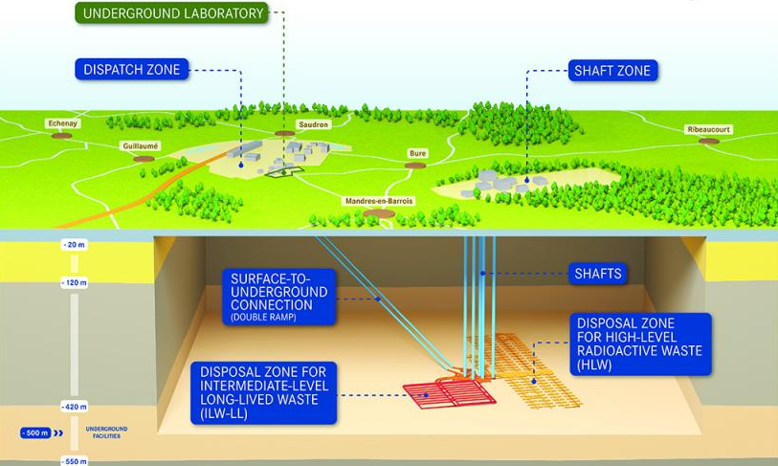
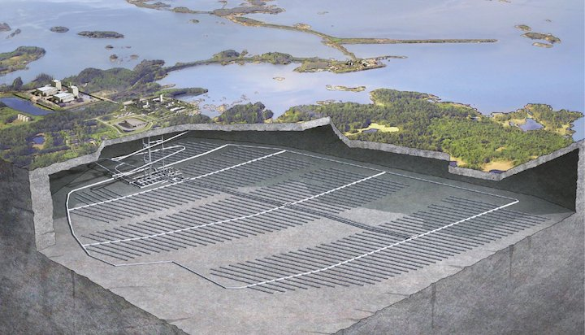
The challenge
In Europe, for example, only a few nuclear countries have advanced plans for disposal of spent fuel
Planned Geological Disposal Facility
The Onkalo spent fuel repository
UK €16 billion
Finland €1.8 billion
Estimated size of spent fuel inventories
CIGEO facility in in Meuse/Haute-Marne
The Forsmark spent fuel repository
France €20-35 billion
Sweden €3.7 billion
….. and these are projects that take decades to plan and deliver, and cost billions of Euros
Source for cost estimates: The costs of geological disposal, Professor Neil Chapman ERDO Working Group and Arius Association, IFNEC Workshop, Paris 11th December 2018

Slide 4

Key features of Deep Isolation’s solution
Multiple engineered barriers
Mature technologies
Repository performance modelling
Safety in the deep geosphere
Speed of implement-ation
Siting flexibility
Minimal repackaging
Retrievability

Slide 5
Safety in the deep geosphere
Isolated rock formations, at depths of 1-3 km, provide a safe, secure and permanent disposal solution:
Safety in depth: Protection from the long-term effects of climate change and other natural processes; reduced risk of human intrusion
Reducing conditions: low oxygen environment at depth inhibits canister corrosion and slows release of radionuclides
Radioactivity trapped safely in deep rock: the inherent properties of many rock formations, coupled with long travel paths to the surface, mean the great majority of radionuclides never get near the biosphere - and peak dose at the surface is orders of magnitude lower than regulatory safe limits
Future safety guaranteed by past performance: we look for isotopic markers showing that host rocks have been isolated for millions to tens of millions years
Multiple engineered barriers
Mature technologies
Repository performance modelling
Safety in the deep geosphere
Speed of implement-ation
Siting flexibility
Retrievability
Minimal repackaging

Slide 6
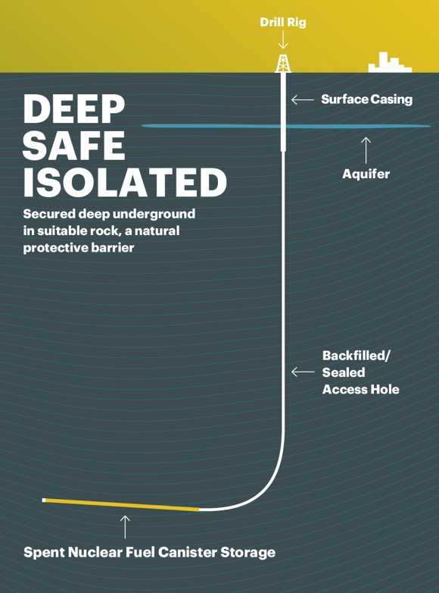
Overview of Deep Isolation
Deep Isolation offers safe, equitable and affordable disposal of nuclear waste
Our solution:
  Places corrosion-resistant canisters containing spent fuel into borehole repositories deep underground (far deeper than feasible with a mined repository)
  Uses directional drilling technology to drill into suitable host rocks that have remained isolated from the environment for millions of years
  Leverages mature technologies that are widely used in industry and that we have integrated and enhanced with our own patented innovations

Slide 7

Directional drilling opens up new opportunity
Directional drilling allows us to tailor repository design for the needs of a specific inventory and specific geology
Options include vertical, slanted or horizontal – our partnerships, supply chain and our IP support all of these
Horizontal boreholes:
Deliver high levels of safety combined with cost benefits
Enhance performance compared to vertical for larger numbers of canisters per borehole

Slide 8
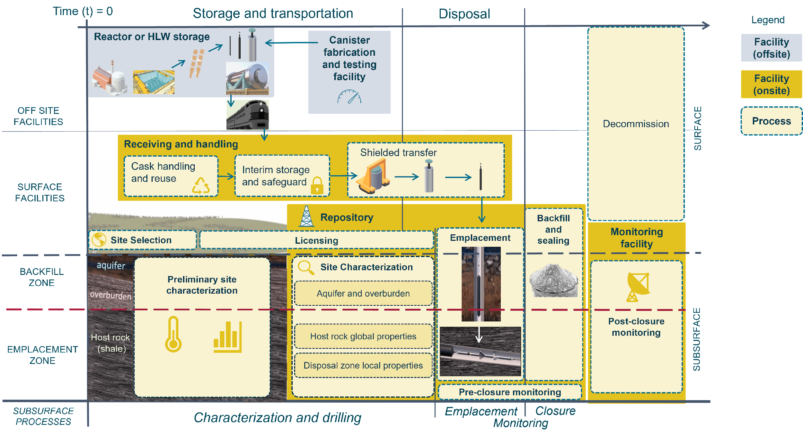
Concept of Operations
Post-closure

Slide 9
Technology Readiness Level (TRL) Definitions
TRL | TRL Definition
9 | Actual system operated over the full range of expected mission conditions.
8 | Actual system completed and qualified through test and demonstration.
7 | Full-scale, similar (prototypical) system demonstrated in relevant environment
6 | Engineering/pilot-scale, similar (prototypical) system validation in relevant environment
5 | Laboratory scale, similar system validation in relevant environment
4 | Component and/or system validation in laboratory environment
3 | Analytical and experimental critical function and/or characteristic proof of concept
2 | Technology concept and/or application formulated
1 | Basic principles observed and reported
Purpose:
  Clear understanding of the baseline technological maturity of all elements of the system to assess the magnitude and scope of a development program
Assessment Method:
  Functional, top-down approach (based on the concept of operations and goals)

Slide 10
Repository Construction
Technologies | TRL | Comments
Drilling | 5 | Deep horizontal drilling is common, but there are limited examples where large-diameter (> 0.4 m) and deep (>1.5 km) horizontal holes have been drilled
Site characterization of EDZ¹ | 6 | EDZs have been characterized for mined repositories (i.e., a relevant environment). The necessary level of detail in characterizing the EDZ will likely be lower [22] for deep boreholes
Site characterization of thermo-mechanical properties of host rock | 7 | Proven successfully at a full scale in mined repositories (i.e., a relevant environment) [29]. Relative importance of local thermo-mechanical phenomena (e.g., fracturing) in disposal zone for long term safety is likely to be lower for deep boreholes than mined repositories
Monitoring system insertion | 9 | Monitoring systems have been inserted for drilling applications
Borehole stability | 4 | Long term stability (>50 years) for horizontal holes at size required for PWR assemblies (~0.34 m) has not been demonstrated (additional study is needed)
Thermal management | 9 | Proven successfully in drilling industry
Waste management | 7 | Proven successfully in drilling industry, but not in presence of spent nuclear fuel
¹Excavation disturbed zone

Slide 11
Technical Readiness Level
Overall, the deep borehole concept is at a sufficient technical maturity (TRL>4) to proceed to the conceptual level of design
Fuel storage and processing and site characterization are relatively mature
TRLs expected to change as the design is detailed and technical specifications are developed.
Key items identified for technology demonstration and regulatory clarification:
  Drilling and long-term borehole stability
  Pre-closure monitoring and natural barriers (e.g., EDZ)
  Emplacement and retrieval of canisters and axial plugs
  Closure

Slide 12
Some European case studies
ERDO:
  Preliminary estimates, based on a high-level generic design for an integrated multi-national repository using horizontal boreholes to dispose of all HLW and long-lived ILW for Croatia, Denmark, Netherlands, Norway and Slovenia suggest that delivery of such a repository would cost between €418 million and €560 million. On top of this, we estimate that the costs of regulatory compliance (including site characterization, licensing and post-closure monitoring) might cost a further €124 million – although these estimates are considerably more uncertain.
  This total cost range of €542 – 684 million represents a saving of half to two-thirds of the likely cost of disposal in a mined deep geological repository, based on ERDO’s earlier assessment of such costs
UK:
  Preliminary estimates suggest that all of UK’s current and future high-heat generating waste could be disposed of for between £2.98 and £4.45 billion
  Equates to 15% - 23% of budget for the UK Geological Disposal Facility (in 2020 prices)

Slide 13

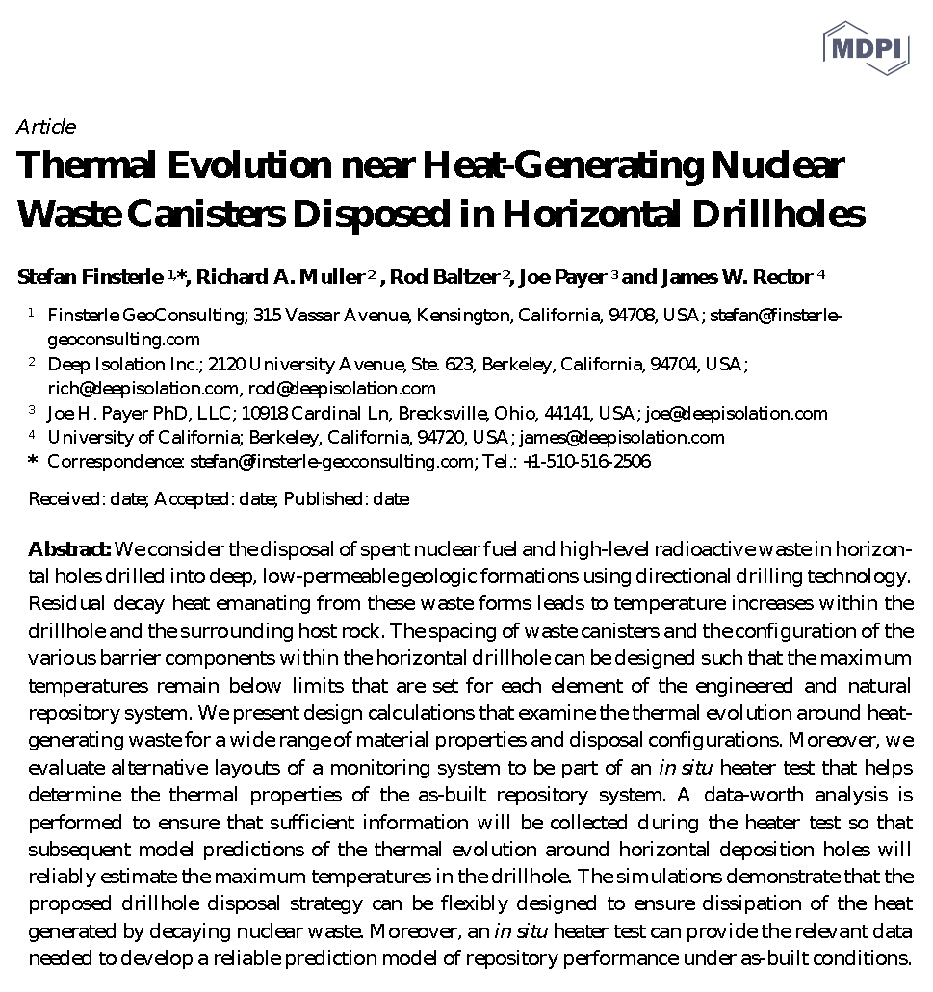

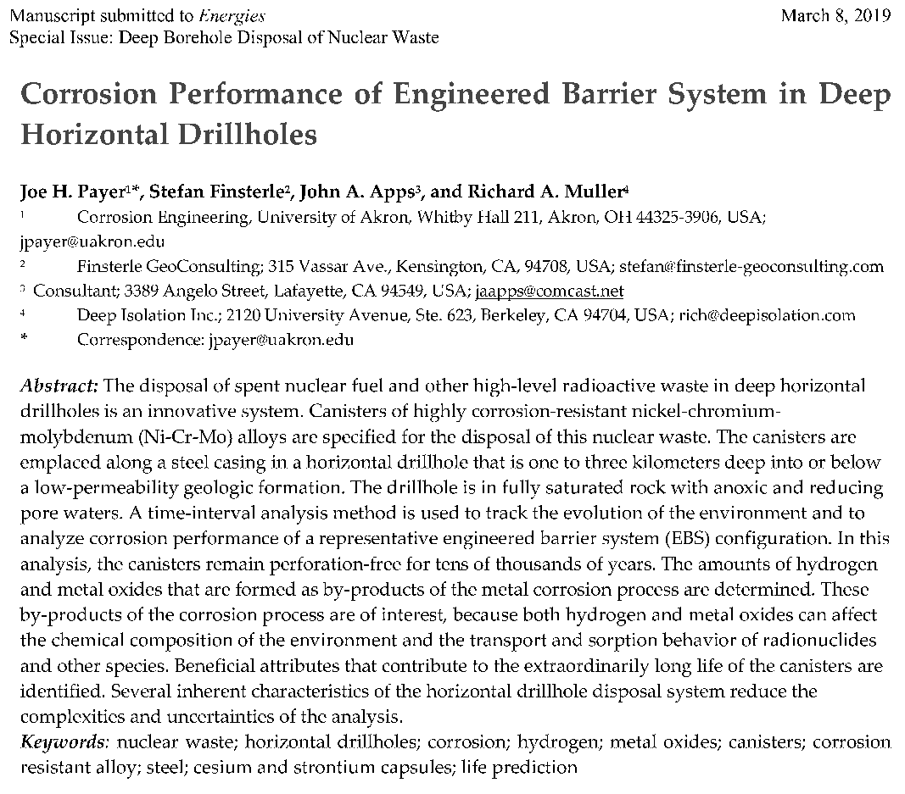
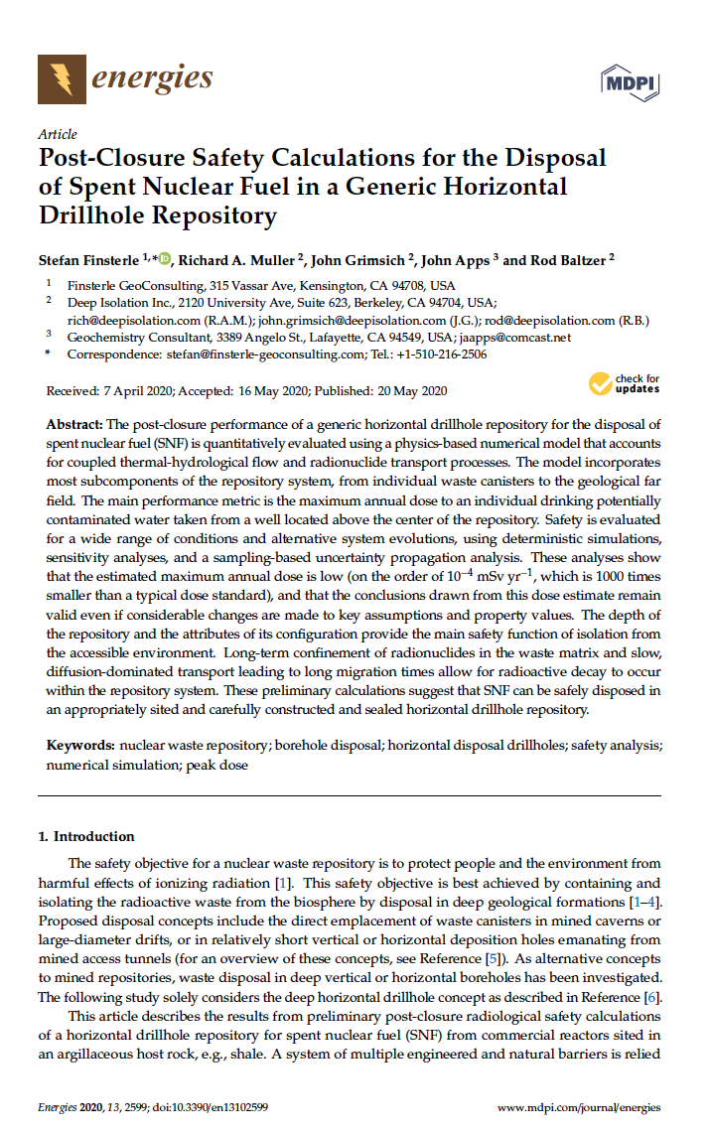

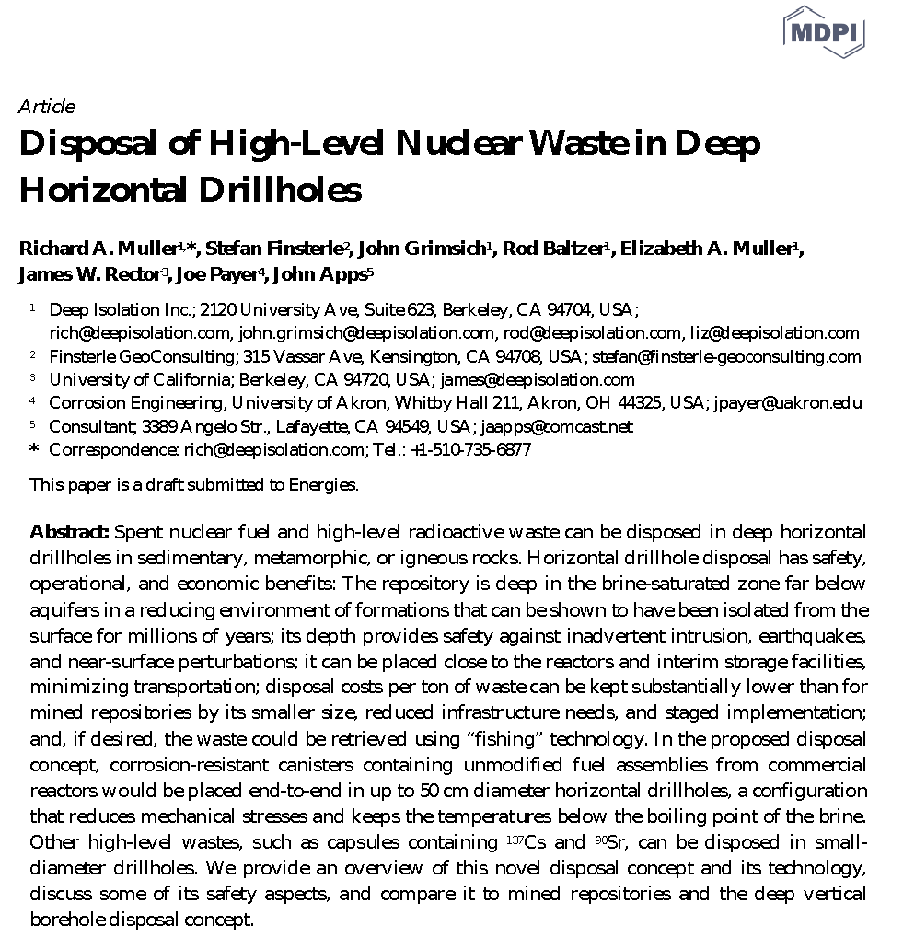

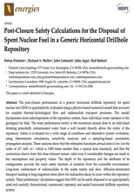
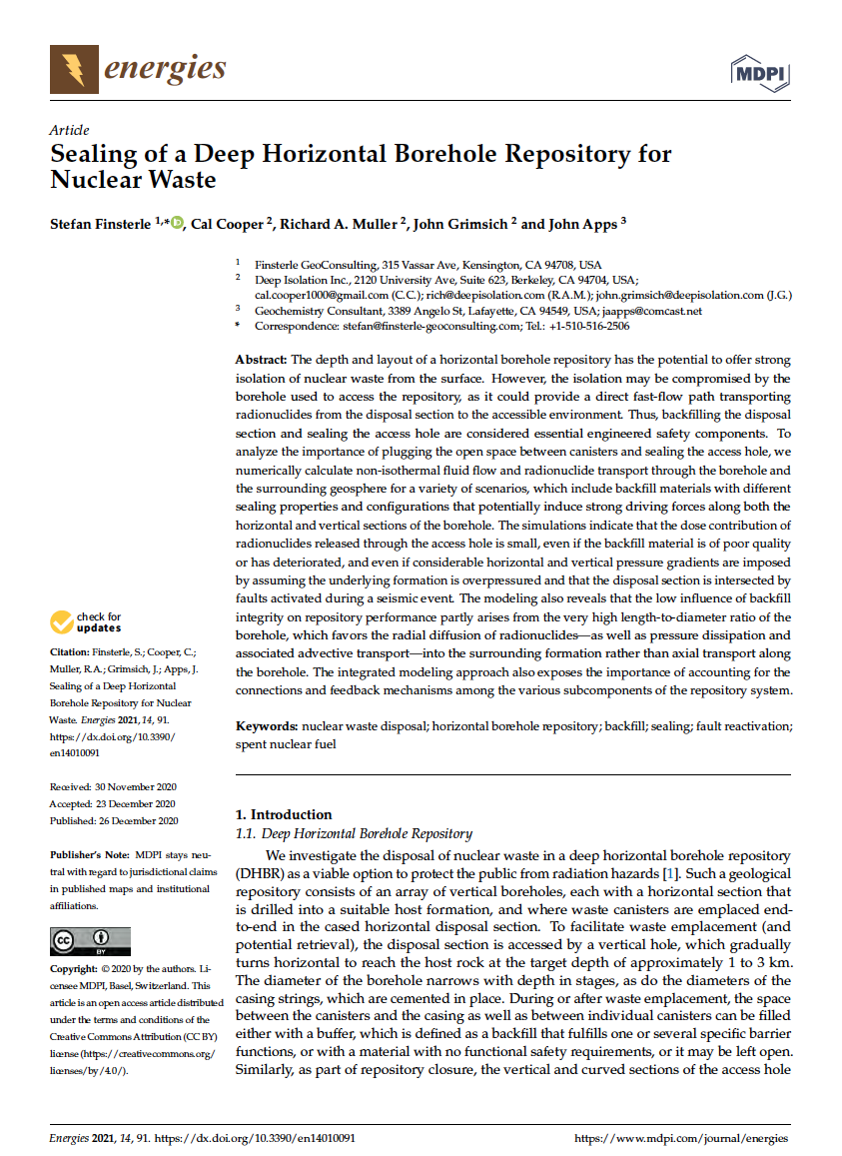


A global delivery and innovation partnership
1
Innovation
2
3
4
Inter-disciplinary, cross-sector stakeholder engagement
5
Client collaboration
Open and peer-reviewed science
World-class supply chain
40+ inventions, with 38 US and international patents granted and in development:
Perhaps most importantly, we are now deeply engaged with potential clients and partners around the world – including many national radioactive waste management organizations
Key focus of this engagement:
Waste inventory review
Geological suitability
Regulatory pathways
Local economic development impacts
Stakeholder engagement processes
Nuclear waste handling
universities
Formation suitability
NGOs
collaboration
partners
Drilling
communities
Repository Design
local government
civil society
Canister Design
green energy
citizens
Handling, Emplacement,
& Retrieval
municipalities
oil & gas
Monitoring
environment
research institutes
schools
nuclear
Most support all borehole architectures, some are specific to vertical or horizontal
National Geological Surveys

Slide 14
What do stakeholders in the radioactive waste management sector think about deep borehole disposal?
"After years of seeing largely unstructured commentary on the potential role of deep borehole disposal in national waste management programmes, this work has at last focused light on what a wide range of policy and decision-makers really think."
Professor Neil Chapman
University of Sheffield

Slide 15
38 participants from 18 countries, covering all sizes of inventory
Policymaker
Researcher
Americas
Large
Waste Management Organization officer
International agencies that influence national policies
Europe
Medium
Asia-Pacific
Small
Regulator
Other
Notes:
Large (12): China, India, South Korea, UK (5), USA (4)
Medium (9): Czech Republic, Finland (4), Italy (2), Pakistan, Sweden
Small (14): Austria, Croatia (7), Denmark, Norway, Philippines, Portugal, Slovenia, UAE

Slide 16
Methodology
7-step process, integrating qualitative and quantitative research
Target stakeholders
The target research group was senior-level stakeholders whose role involves specific responsibilities for geological disposal of higher activity radioactive waste, in the following five categories:
Policymakers in national governments
Waste Management Organizations
Nuclear and environmental regulators
International agencies that influence national policies
Researchers in universities, national laboratories and other research institutions with a specific focus on radioactive waste disposal.

Slide 17
The largest challenge is the need for end-to-end demonstration
Respondents were asked to rank 26 potential challenges across three categories: policy/regulatory, technical/operational and societal issues – this chart shows the top ten
3 focus on lack of evidence about societal attitudes to DBD
3 focus on need for the operational process and overall safety case for DBD to be demonstrated on whole-system basis
///
…. and 4 focus on lack of policy/ regulatory clarity
///

Slide 18
The interview results gave a similar picture in terms of perceived challenges for DBD
Literature is available to show that this is a mature technology, that deep borehole disposal is building on the experience from our oil and gas industry.
Key themes from interviews:
  DBD is seen as increasingly mature…
The drilling techniques are mature and SF/HLW handling techniques are mature.
…. but faces 3 main challenges before first licensed DBD disposal:
  Need for large-scale DBD demo on whole-system basis to validate safety case
  Lack of understanding and evidence about societal attitudes
  Relative immaturity of international guidance on developing and assessing the DBD safety case
Somebody just needs to do it. Several studies that show that … the actual operation is feasible, the safety assessment is feasible, compliance with existing standards is feasible. The problem is that no one has done it.
We haven't done much outreach [on DBD], so I don't really think people know anything about it.
International guidance or some kind of standardized ‘way of doing’: that would help in the licensing and development of the concept in different countries.

Slide 19













Historic and global advances in DBD interest in the last 2 years from Deep Isolation’s awards and contracts
CONTRACTS
Key Findings and Achievements
Established the feasibility of modular onsite disposal using deep boreholes in the United States, and cost savings of (69-76%) compared to mined repositories
“Deep borehole disposal is an important alternative option for us to consider in Slovenia…[the study is] helpful in highlighting the potential benefits, the increasing maturity of, and required next steps for deep borehole disposal” said Leon Kegel, Head of Planning and Development at ARAO
“EU Nuclear Waste Organizations Conclude Deep Borehole Disposal Great Option For Nuclear Waste” (see Forbes article by Jim Conca)
(Croatia, Denmark, Italy, Netherlands, Norway, Poland, and Slovenia)
Two awards granted in 2022 ($3.6M for Deep Isolation led project) – expands the capabilities of deep borehole disposal to small modular reactors, advanced reactors, and reprocessed fuels

Slide 20
Thank you!
Deep Isolation, Inc.
Betsy Madru, VP Global Affairs and Policy
betsy@deepisolation.com
info@deepisolation.com | deepisolation.com
BERKELEY CA USA | WASHINGTON DC USA | LONDON UK | TOKYO JAPAN

