Slide 1
DoD
Low Level Radioactive Waste
Lead Agent
Mike Kurth
HQ Joint Munitions Command
Rock Island Arsenal
Rock Island, IL

Slide 2
Mission
Safe, compliant, and cost-effective disposition of LLRW and mixed waste for DOD and other Federal agencies
Vision
The provider for DOD LLRW disposition, providing users with a seamless end of life cycle (treatment and disposal) for excessed low-level radioactive materials
Governing Instruction
DoD Instruction 4715.27 – DoD Low Level Radioactive Waste (LLRW) Program - DOD Lead Agent (DODLA) for LLRW (Deputy Assistant Secretary of the Army for Environment, Safety and Occupational Health)

Slide 3
LLRW Scope
DoD LLRW Lead Agent program services all military property or assets containing source, special nuclear, or byproduct material that is acceptable for disposal in a land disposal facility, in accordance with the U.S. Nuclear Regulatory Commission (NRC) Regulations.
The program also includes:
- Mixed waste (hazardous and radioactive)
- Naturally occurring radioactive material waste (NORM)
- Naturally occurring and accelerator-produced radioactive material waste (NARM)

Slide 4
LLRW Limitations
LLRW under our program does not include:
  Generated by the Naval Nuclear Propulsion Program in accordance with Executive Order 12344 and Section 7158 of Title 42, U.S.C.
  Related to nuclear weapons programs
  Decommissioning of former Army Deactivated Nuclear Power Program facilities.
  Formerly Utilized Defense Sites (FUDS)
  Decay in storage, release in effluents, disposal by release into sanitary sewage treatment or disposal by incineration, and disposal of specific wastes in accordance with Sections 20.2002-20.2005 and 20.2108 of Title 10 Code of Federal Regulations (CFR)

Slide 5
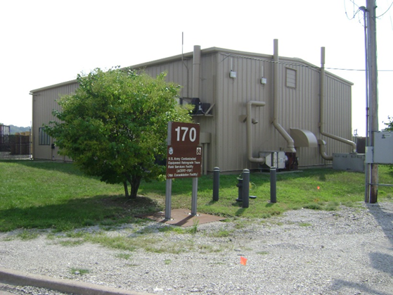
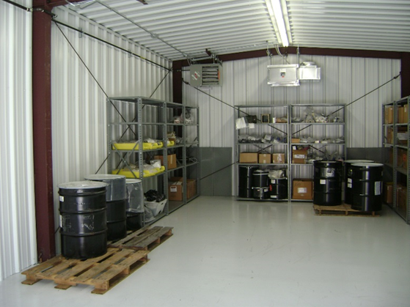
JMC LLRW Program Office
  Government Staff
    Technical Team – 7 Health Physicists (4 are Emergency Essential for Contingency Operations)
Morris Consolidation Facility (MCF)
    Unique Capabilities within all of DoD
    Allows In-House Acceptance of Most Types off Radioactive Material for Reuse, Recycle or Disposal
  Contractors
    Fixed Price - Pack and Ship Contracts
    Rapid Response

Slide 6





LLRW Program Customers
Support to DOD – Army, Navy/Marine Corps, Air Force, Army Corps of Engineers, Defense Logistics Agency, Defense Health Agency
Unique, Worldwide Response Team for Combat/Noncombat Low-Level Radioactive Materials Incidents
  Army Contaminated Equipment Retrograde Team (ACERT)
    Rapid response for radiological clean-up and disposal

Slide 7
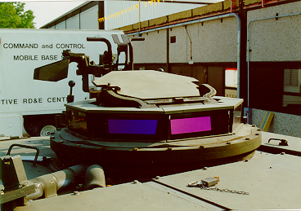
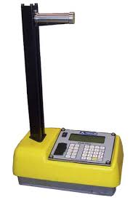
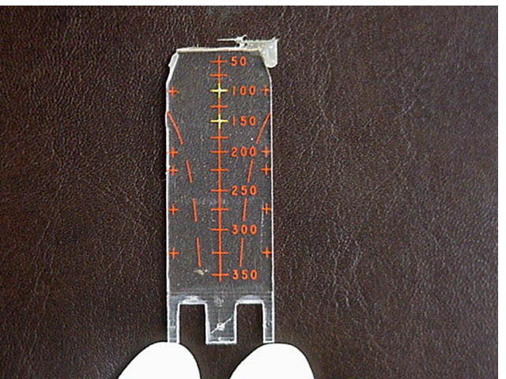
Common Waste Streams
Operations Research &
Development
Testing
Medical
Clean ups
  Ranges
  Base closures
  Reorgs
Depleted Uranium
  Munitions, armor
Radium/Tritium
  Luminescence
Sealed sources
  Chemical detection
Thorium
  Engines, optical lenses

Slide 8
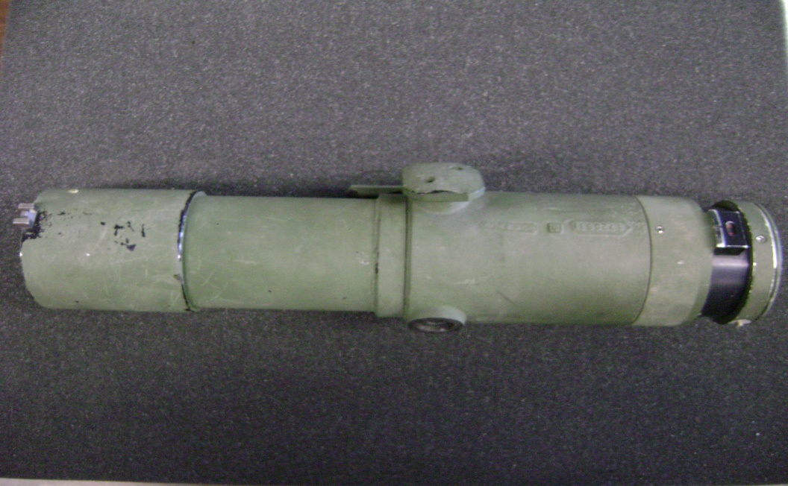
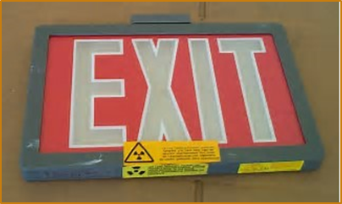
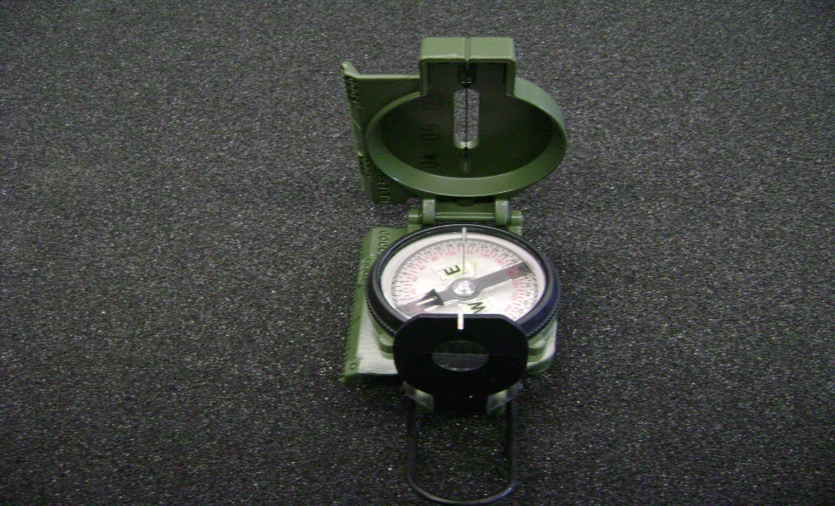
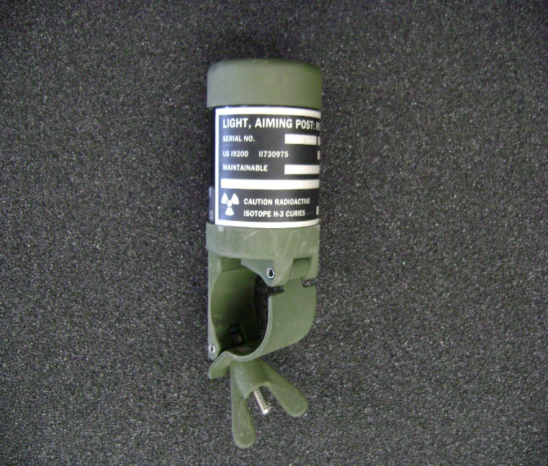
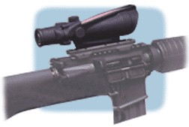

Slide 9
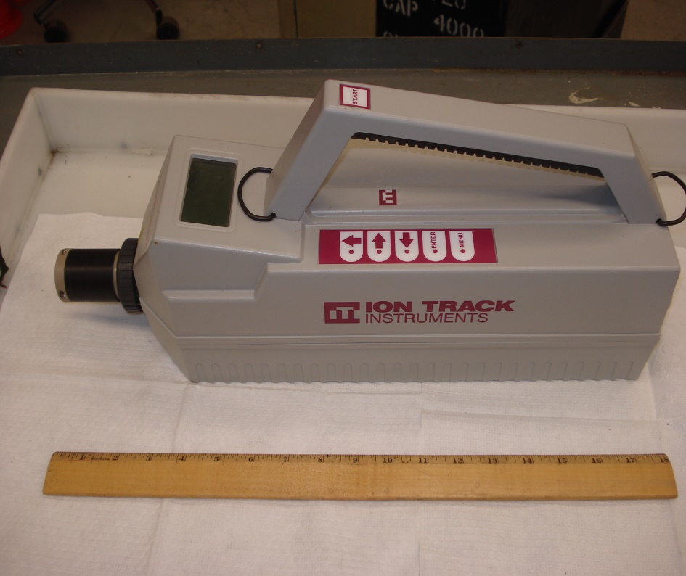
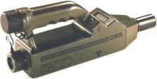
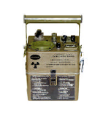

Slide 10
Partners
Army Test, Measurement, and Diagnostic Equipment (TMDE)
      Operate Consolidation Facilities in Germany and Korea
  Wright-Patterson Air Force Base
      Recycle of Smoke Detectors and Exit Signs
  Department of Energy (DOE)
      Recovery of Tritium for Reuse in DOE
        National Ignition Facility, LLNL
      Classified Waste Disposal

Slide 11
Program Complexities
Customer locations
  Approximately 500 U.S. military bases
    States with the most bases
      California, Texas, Florida, and Virginia
  Numerous U.S. military overseas locations
Military radioactive commodities
  1000’s of military radioactive items
Regulatory licenses
Army – 60 NRC licenses
Air Force and Navy – Master Material Licenses
Permits
  State of Washington – over 200 permits renewed annually
Large scale/Long term projects
  Depleted Uranium Munitions Demilitarization
  Chemical Detection Equipment (Ni-63 foil source)

Slide 12
ACERT Team
Army Contaminated Equipment Retrograde Team
Mission: Worldwide combat/non-combat response team to retrograde radioactively contaminated vehicles and equipment
Personnel: Four emergency essential health physicists with support from staff, contractors, Army Corps, and Public Health Command
Equipment: Three rapid response milvans

Slide 13
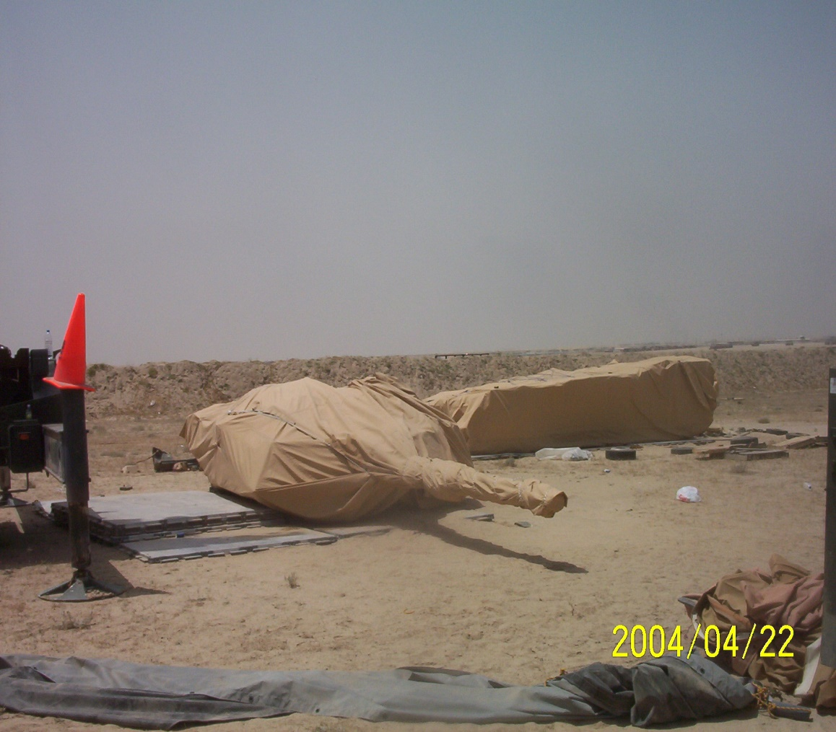
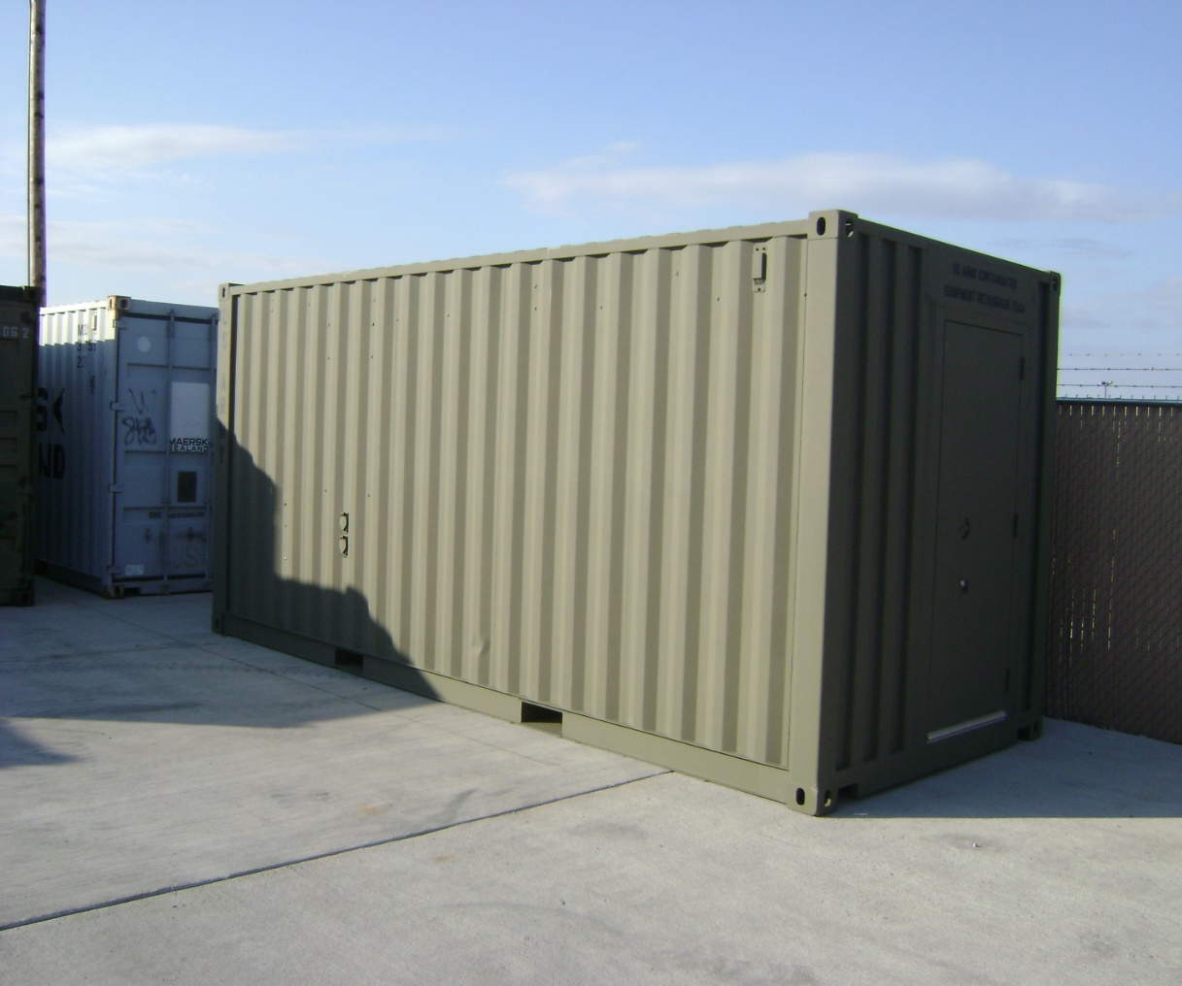
ACERT Mission

Slide 14
Questions?
Mike Kurth
US Army, HQ JMC
Rock Island Arsenal
Rock Island, IL
Michael.f.kurth.civ@army.mil
Cyrus Turner
US Army, HQ JMC
Rock Island Arsenal
Rock Island, IL
Cyrus.e.turner.civ@army.mil

