Slide 1
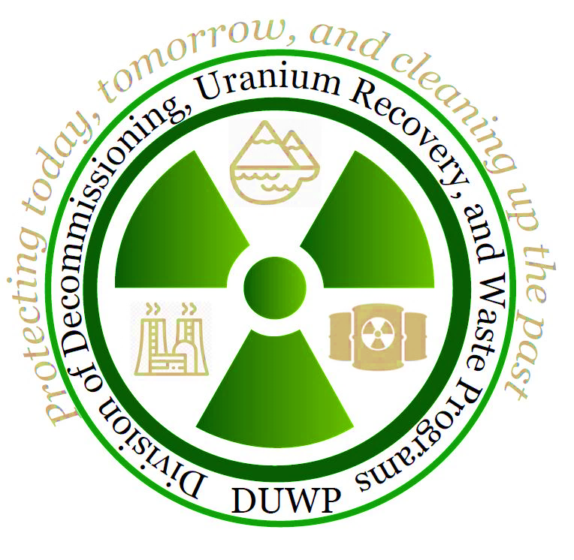
NRC Update
Protecting today, tomorrow, and
cleaning up the past
Low-Level Radioactive
Waste Forum
Spring 2022 Meeting
April 6-7, 2022
Stephen Koenick, Chief
Low-Level Waste and Projects Branch
Division of Decommissioning, Uranium
Recovery, and Waste Programs
Office of Nuclear Material Safety and Safeguards

Slide 2
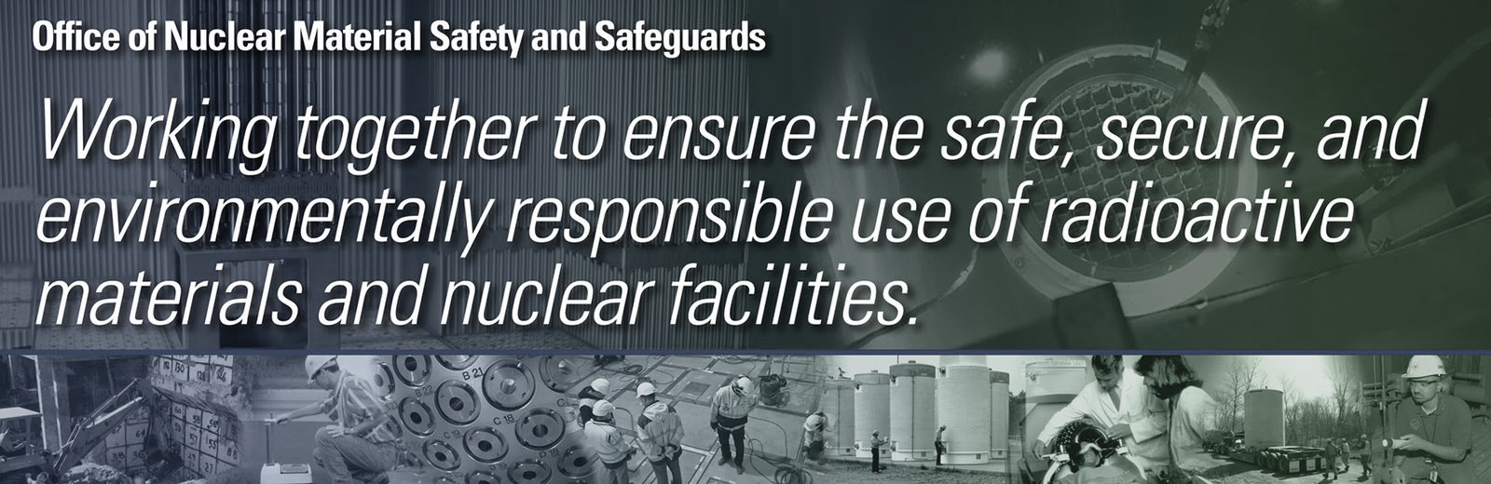
Regulatory Topics
  Low-Level Waste (LLW)
  Decommissioning

Slide 3
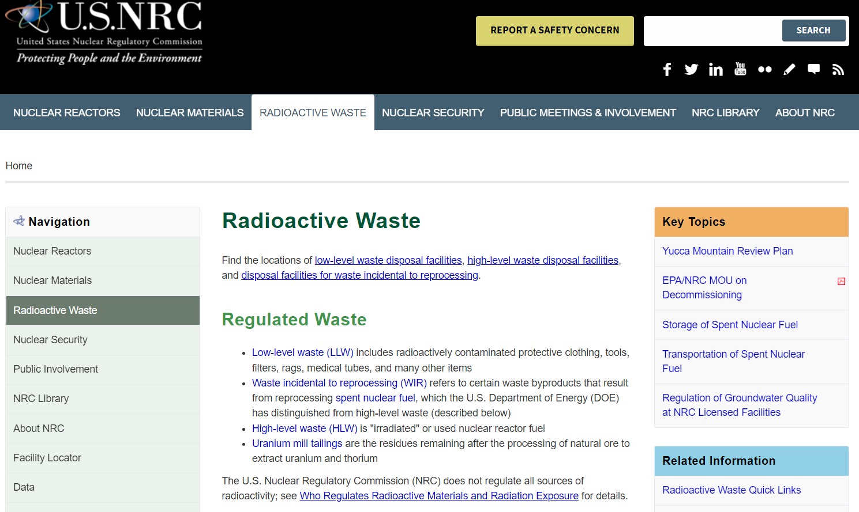
NRC’S LLW Program
https://www.nrc.gov/waste.html

Slide 4
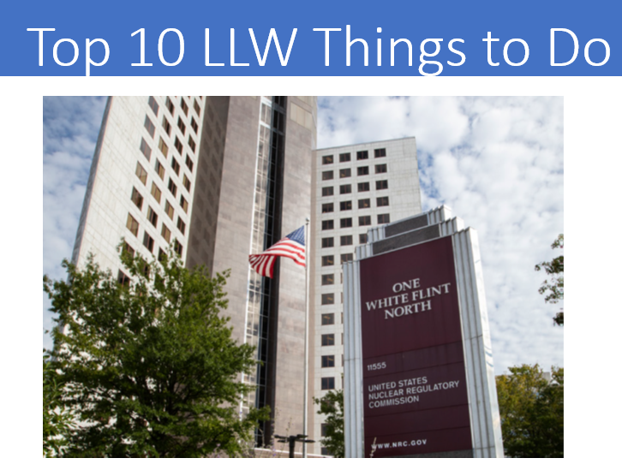
Updated Prioritized Tasks from the LLRW Programmatic Assessment
  LLW Programmatic Assessment
Task | Priority | Status
1. Complete and Implement Site-Specific Analysis Rulemaking | High | On Hold-SECY-20-0098-(Awaiting Commission Direction)
2. Address update to the 10 CFR Part 61 Waste Classification Tables | High | No action-(Awaiting task 1 completion)
3. Implement the Updated Concentration Averaging and Encapsulation BTP | High | Completed Training in March 2016 (https://www.nrc.gov/waste/llw-disposal/llw-pa/llw-btp.html)
4. Prepare a regulatory basis and conduct potential rulemaking for GTCC and transuranic waste disposal | High | Regulatory Basis Completed/ Rulemaking On Hold (See Task 1)
5. Finalize internal procedure/Standard Review Plan for 10 CFR § 20.2002 requests to improve alternate disposal process | High | Completed-(https://www.nrc.gov/waste/llw-disposal/very-llw.html)
6. Update NUREG/BR- 0204, Rev. 2 (July 1998), “Instructions for Completing NRC’s Uniform Low-Level Radioactive Waste Manifest” | HIgh | Completed Published NUREG/BR-0204, Rev 3, https://www.nrc.gov/waste/llw-disposal/llw-pa/llw-uwm.html
7. Perform VLLW Scoping Study | Medium | Completed- Issued SECY-21-0057 (June 1, 2021)
8. Update and consolidate LLRW guidance into one NUREG | Medium | No Action
9. Examine the need for guidance on defining when radioactive material becomes LLRW | Low | No Action
10. Develop and implement the national waste tracking system | Low | No Action

Slide 5
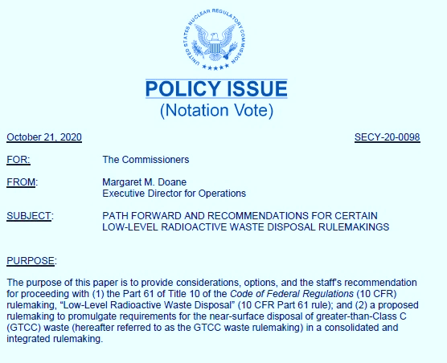
LLW Rulemakings
Part 61 and GTCC/TRU Rulemakings
Combine these efforts to address overlapping technical requirements, streamline stakeholder outreach, and gain efficiency in proceeding as one rulemaking activity
Waiting for Commission Direction on SECY-20-0098

Slide 6

VLLW Developments
VLLW Scoping Study (SECY-21-0057)
  Issued on June 1, 2021
  Concludes that NRC plans to continue with the current regulatory framework and will continue to evaluate potential enhancements within the existing VLLW regulatory framework
Alternative Disposal Requests (ADRs) Guidance
  Issued revised guidance on April 9, 2020 (ADAMS Accession No. ML19295F109)
Proposed interpretive rule related to 10 CFR 20.2001 “authorized recipient”
  Withdrawn on December 17, 2020, (85 FR 81849)

Slide 7

Recent ADRs
Since January 1, completed two 20.2002s and are currently reviewing a third
Columbia Generating Station (request approval for onsite disposal)
  Submitted to the NRC – 12/21/2020
  Approved by the NRC – 3/11/2022
Columbia Fuel Fabrication Facility (request for disposal of material at US Ecology Idaho)
  Submitted to the NRC – 11/5/2021 (Updated version containing missing information submitted 12/1/2021)
  Approved by the NRC – 3/18/2022
South Texas Project (request disposal at a landfill located within Texas (Agreement State))
  Submitted to the NRC – 12/3/2021
  Review ongoing

Slide 8
Uniform Waste Manifest
NUREG/BR-0204,
Revision 3
Instructions for Completing NRC's Uniform Low-Level Radioactive Waste Manifest
Provides instructions to prepare NRC Form 540, Form 541, and Form 542
Issued Revised Forms on June 25, 2021
(86 FR 33783)
22 detailed answers to Frequently Asked Questions (FAQs)
Effective on September 23, 2021
See NRC Forms Library
and
NRC UWM webpage for FAQs
SECY-21-0110, Retrospective Review of Administrative Requirements Evaluation (RROAR)
Possible industry initiatives related to characterization methods for hard to detect radionuclides (e.g., scaling factors?)

Slide 9
  Radiation Source Protection and Security Task Force
  Chaired by NRC
  Composed of 14 Federal Agencies and one State organization
  Evaluates and provides recommendations related to security of radioactive sources in the U.S.
  Currently preparing 2022 report to the President and Congress
  Additional information at: www.nrc.gov/security/byproduct/task-force.html

Slide 10
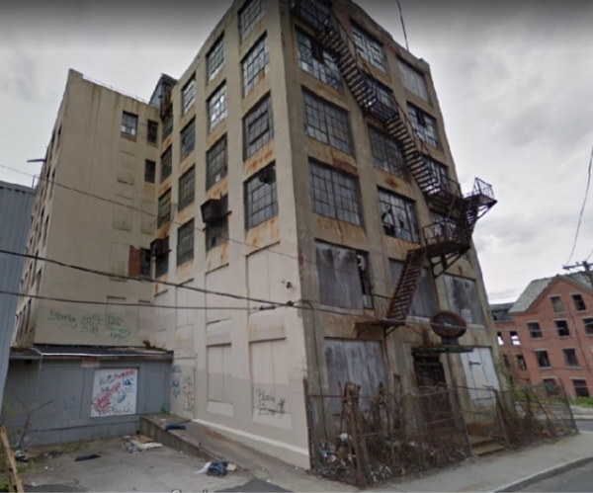
Cleaning Up Non-Military Radium
  Focus on cleanup of remaining sites with Radium-226 contamination in Non-Agreement States
  Current Status
  Implementing risk-informed approach
    58 sites assessed
    5 sites had residual radium activity requiring remediation
    2 sites have been cleaned up
  Coordinating with other Federal agencies in their cleanup efforts
  Sharing lessons learned
  Extensive stakeholder communication and coordination – reaching out to Agreement States with radium sites

Slide 11
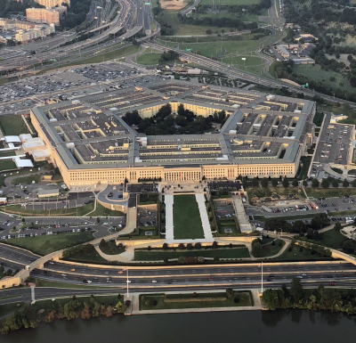
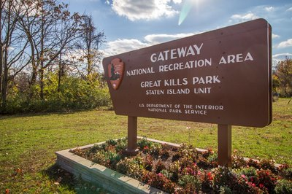
Cleaning Up Federal Radium Sites
  Objective: Ensure unlicensed sites with discrete sources of radium or associated contamination do not pose a risk to public health and safety and the environment.
  NRC has MOUs with the Department of Defense (DoD) and the National Park Service describing roles in the cleanup of radium and other unlicensed radioactive materials at these sites.
  Current Status
  Annual inventory of DoD sites for NRC involvement
    Monitoring (9 sites)
    Stay informed (8 sites)
  Monitor three NPS sites in Gateway National Recreation Area

Slide 12
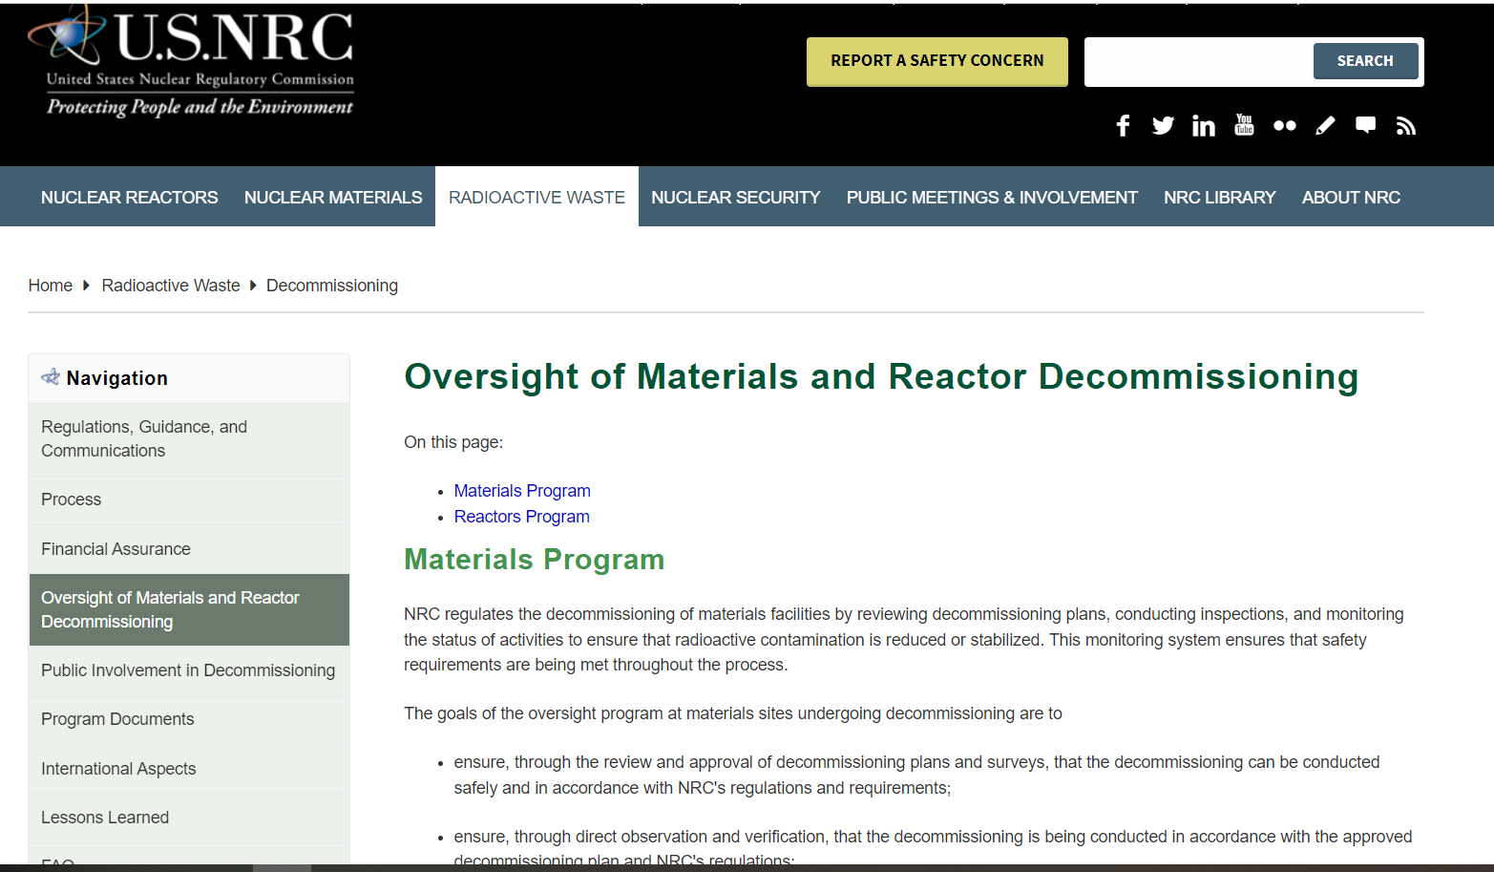
NRC’S Decommissioning Program
https://www.nrc.gov/waste/decommissioning/oversight.html
12

Slide 13
Seeking Public Comment on a Proposed Rule for Decommissioning Nuclear Facilities
Would implement specific regulatory requirements for different phases of the decommissioning process consistent with the reduced radiological risk. Topics include:
  Emergency preparedness
  Decommissioning funding assurance
  Environmental considerations
  Spent fuel management planning
  Record retention requirements
Published March 3, 2022 (87 FR 12254)
Four draft regulatory guides available for comment in parallel with the proposed rule
Comment period is open until May 17, 2022
Comments can be submitted at https://www.regulations.gov/
by searching for Docket ID
NRC-2015-0070
13

Slide 14
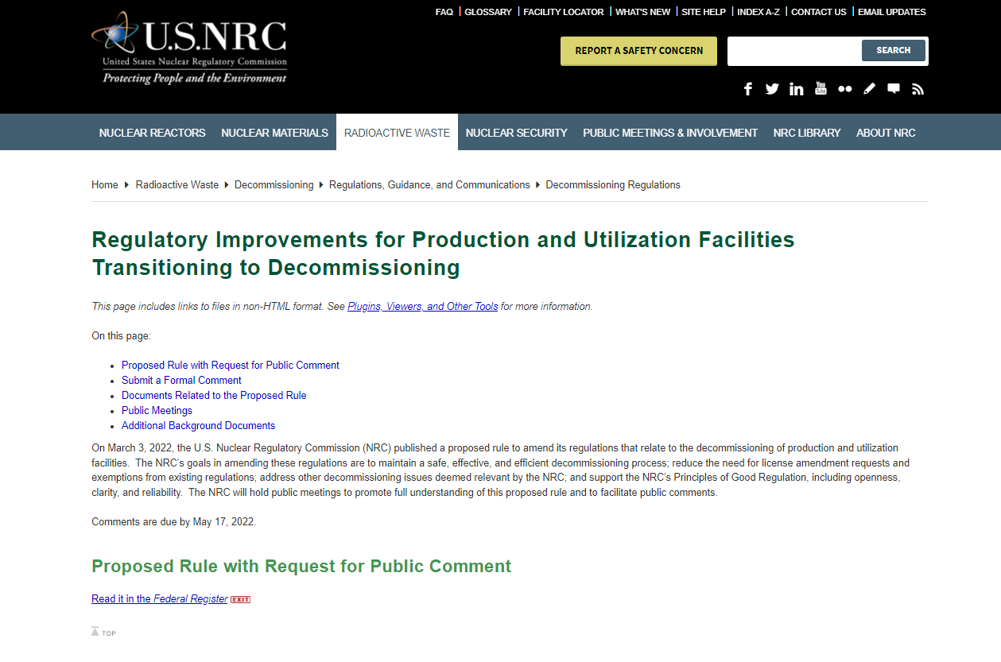
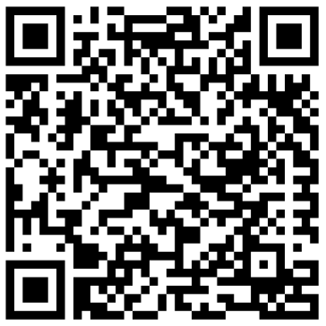
Additional information on the NRC Public Website
https://go.usa.gov/xzksC
Questions?
Contact Dan Doyle
Dan.Doyle@nrc.gov, 301-415-3748
14

Slide 15
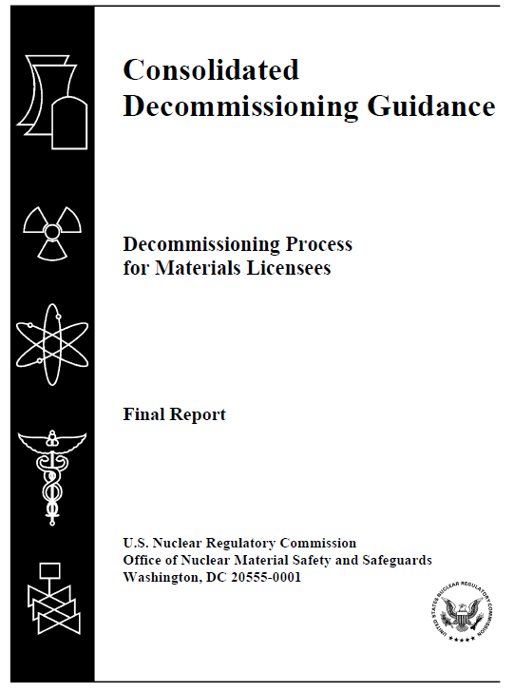
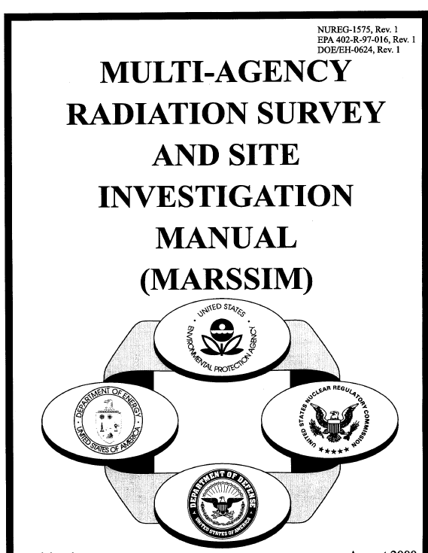
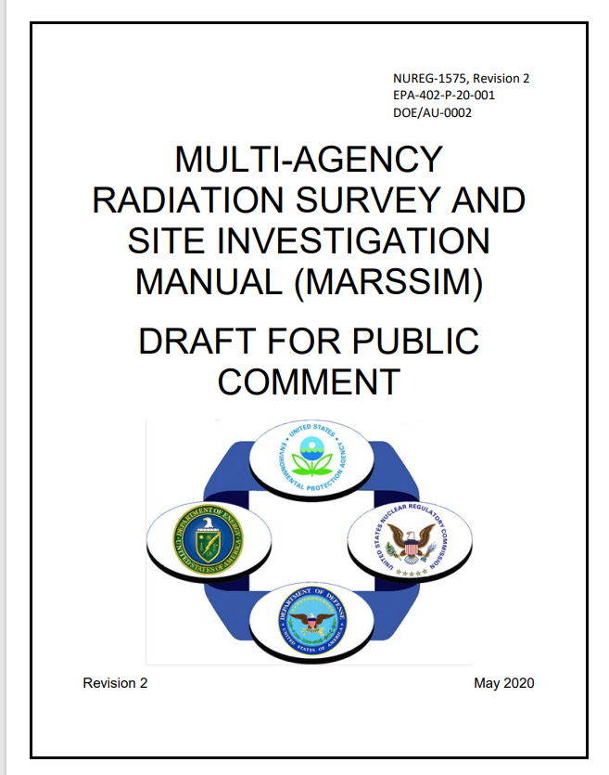
Improving Decommissioning Process – Guidance
NUREG-1757, “Consolidated Decommissioning Guidance”
  Volume 1, Rev. 3, “Decommissioning Process for Materials Licensees” (to be issued as draft for public comment)
  Volume 2, Rev. 2, “Characterization, Survey, and Determination of Radiological Criteria” (to be finalized summer 2022)
NUREG-1575, Rev. 2, “Multi-Agency Radiation Survey and Site Investigation Manual (MARSSIM)” (to be finalized)
15

Slide 16
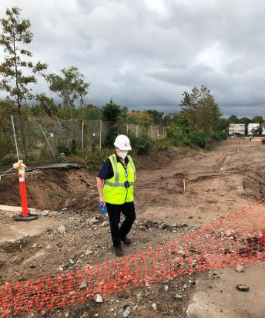
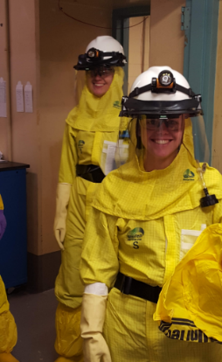
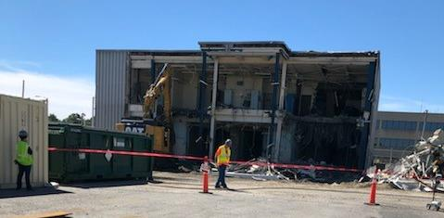
Risk-Informing Decommissioning Inspection Oversight Guidance
IMC 2561, “Decommissioning Power Reactor Inspection Program”
IMC 2602, “Decommissioning Oversight and Inspection Program for Fuel Cycle Facilities and Materials Licensees”
IMC 1248, Appendix F, “Training Requirements and Qualification Journal for Decommissioning Inspectors"
16

Slide 17
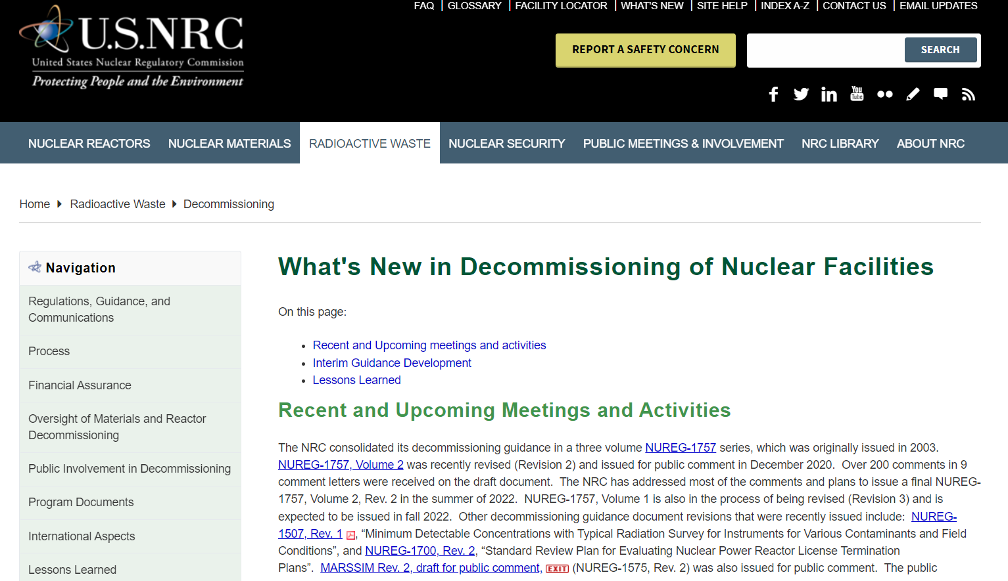

Enhancing Decommissioning Outreach
New webpage on NRC.GOV
Keep up-to-date on upcoming workshops and guidance releases
https://www.nrc.gov/waste/decommissioning/whats-new.html

Slide 18





Questions/Comments
Follow @NRCgov
To subscribe to e-mail updates: https://www.nrc.gov/public-involve/listserver.html#lyris

