Slide 1

EPA Update
LLW Forum Spring Meeting
San Antonio, Texas
Dan Schultheisz, EPA Office of Radiation and Indoor Air
April 7, 2022

Slide 2
Overview of Presentation
Waste Isolation Pilot Plant (WIPP) Recertification
Multi-Agency Radiation Site Survey and Investigation Manual (MARSSIM)
Federal Guidance
Phosphogypsum (TENORM)

Slide 3
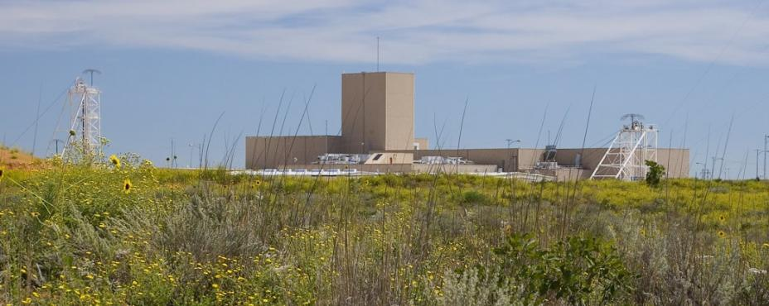
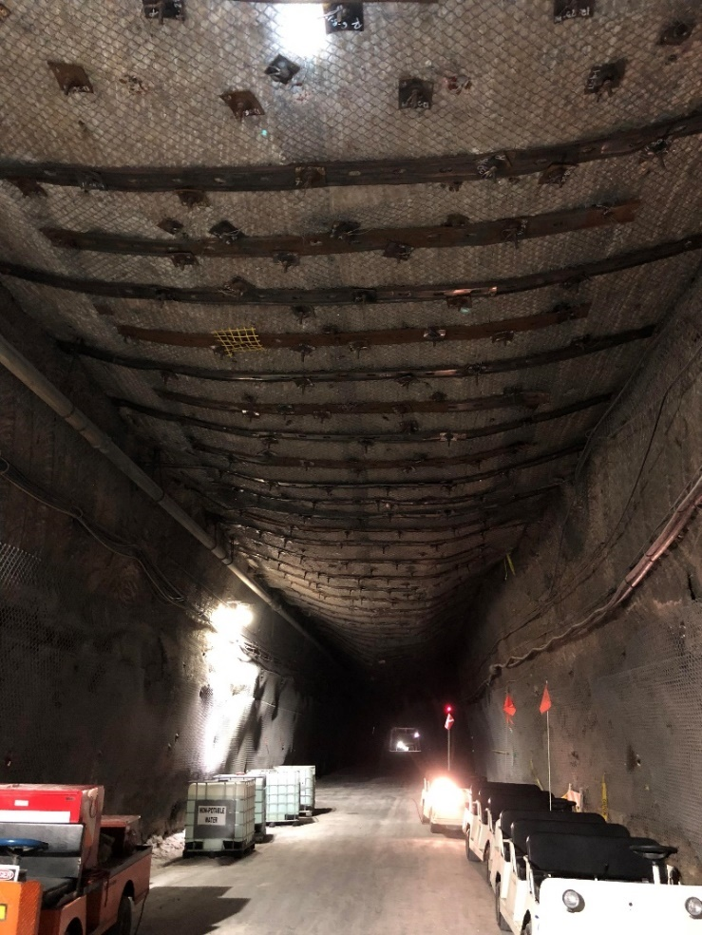
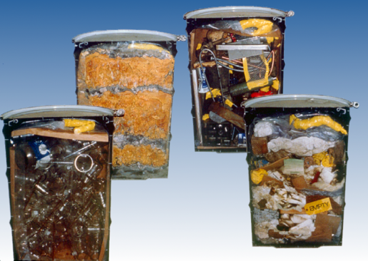
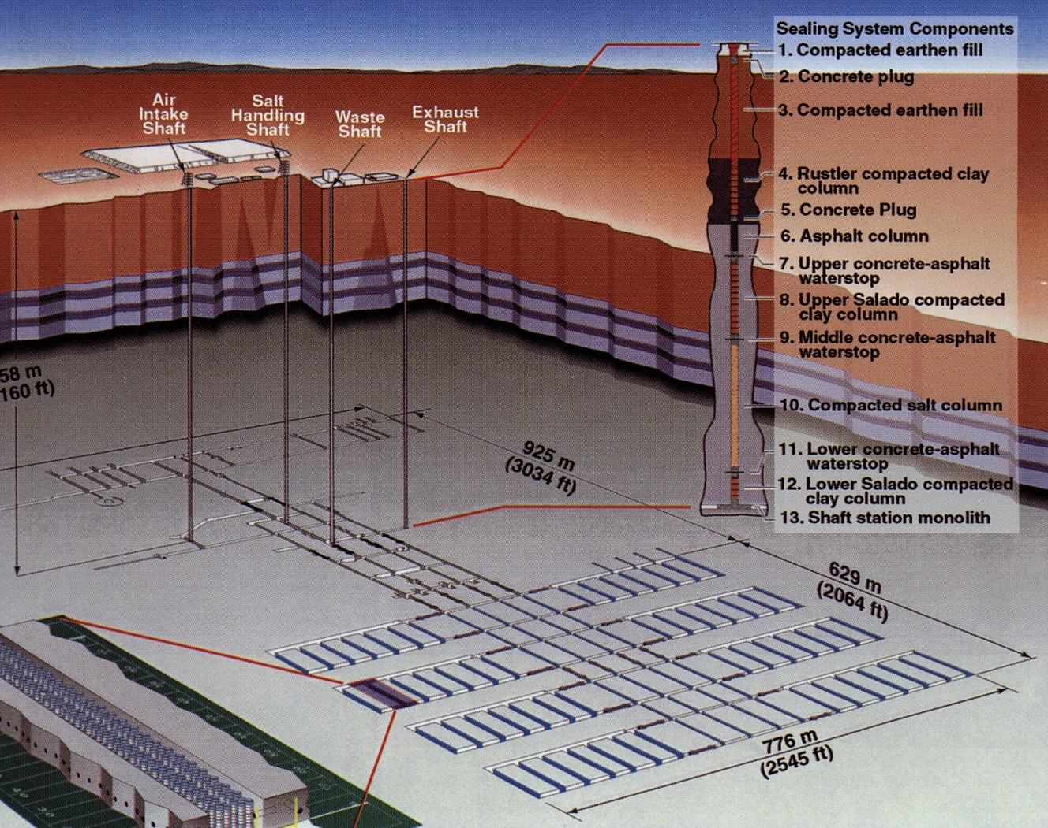
Background on WIPP
The Waste Isolation Pilot Plant and EPA’s Regulatory Authority
WIPP is a deep geologic repository near Carlsbad in southeastern New Mexico, located in bedded salt
The facility disposes transuranic (TRU) radioactive waste from the manufacture of atomic weapons and from DOE defense clean-up
EPA performs oversight for the radioactive portion of waste per the WIPP Land Withdrawal Act of 1992
  This includes a recertification every five years where DOE demonstrates WIPP meets the requirements of 40 CFR parts 191 and 194 for long-term disposal
    Most recent recertification was in 2017 for the 2014 Compliance Recertification Application (CRA)
    Opportunity to identify changes/updates to information about disposal site and actual waste emplacement at WIPP, and incorporate new info in our compliance decision
    Recertification is not a rulemaking and is not subject to judicial review
  Recertification includes a performance assessment (PA) probabilistic model that calculates potential repository releases

Slide 4
Background on WIPP
Activities at the WIPP
2014 radiological event has had long-term repercussions
  In February 2014, two separate incidents in the repository, a truck fire and a radiological release, halted operations
    Radiological contamination from February 14 incident forced DOE to abandon waste Panels 3-6 and 9
    DOE resumed waste emplacement in 2017 after instituting new procedures, addressing NMED violations
  DOE’s CRA-2014, submitted in March 2014, did not reflect the incident
Anticipated activities (post CRA-2019) in response to the incident and new inventory
  Excavation and completion of a new utility shaft and ventilation system to increase underground air circulation
  Mining additional waste panels outside the initial repository footprint
    EPA expects notice of two initial panels in early 2023
    DOE plans a total of nine additional panels
  Addition of 40 metric tons (MT) of downblended surplus Pu waste
    6 MT currently in waste inventory and included in CRA-2019

Slide 5
WIPP Recertification
EPA’s Review of 2019 Compliance Recertification Application
DOE submitted the first portion of the recertification application on March 29, 2019, and the remaining section, which included the deferred performance assessment, on December 20, 2019
  EPA review started in earnest in January 2020
EPA has spent the past roughly 2 years reviewing the DOE application for completeness and technical content
  DOE had 13 responses to EPA’s 6 letters of completeness questions
  Several smaller items of correspondence for individual questions
  Several technical exchanges between EPA and DOE staff to allow EPA to better understand specific sections of the recertification application
  Additional calculations requested from DOE to expand sections of the recertification application that EPA found needed further development
  Application declared complete via letter to DOE on November 17, 2021 (86 FR 67424, Nov. 26)

Slide 6
Next Steps
Looking to the Future of WIPP
Recertification decision expected April 2022 in Federal Register
Interaction with DOE on technical issues for future recertifications
  Disposition of surplus plutonium
  Characterization of previously unexcavated areas (e.g., pressurized brine)
  Excavation of new waste panels
  New performance assessment model under development
  Approval of new waste panels may require rulemaking
Continuing compliance activities
  Site inspections (typically annual, not conducted in 2020-2021)
  Waste characterization inspections and audits at waste generator sites
  Review of change notices/requests

Slide 7
Recent WIPP Technical Publication
Provides a basic overview of various geochemical concepts incorporated in WIPP performance assessment, e.g.,
  Solution chemistry
  Mineral precipitation and dissolution
  Complexation
  Oxidation-reduction
Relates PA concepts to specific conditions and experimental and observed data
Sections can be stand-alone or combined for context on PA model elements
https://www.epa.gov/system/files/documents/2022-02/the-geochemistry-of-the-waste-isolation-pilot-plant_final.pdf

Slide 8
Multi-Agency Radiation Site Survey and Investigation Manual (MARSSIM)
MARSSIM provides a federal consensus approach for conducting radiation surveys
  Final status surveys at sites, particularly of buildings and soils
  Revision 1 of MARSSIM issued in August 2000
  Companion documents
    MARSAME – survey of materials and equipment
    MARLAP – laboratory radioanalytical protocols
MARSSIM Workgroup includes four federal agencies:
  Environmental Protection Agency
  Department of Defense
  Department of Energy
  Nuclear Regulatory Commission

Slide 9
MARSSIM
Revision 2
Revision 2 will update science and implement lessons learned, such as:
  Statistical approaches when release criteria are effectively zero (or zero above background);
  Using scanning methods for proving compliance with release criteria;
  Use of measurement quality objectives in MARSSIM surveys.
Draft for public comment issued May 2020
EPA Science Advisory Board (SAB) review initiated in late 2020
  MARSSIM workgroup addressing comments, working to clear through workgroup agencies
  Final SAB report anticipated April 2022
More information at https://www.epa.gov/radiation/multi-agency-radiation-survey-and-site-investigation-manual-marssim

Slide 10
Federal Guidance
Reorganization Plan No. 3 of 1970 transferred to EPA responsibility to “…advise the President with respect to radiation matters, directly or indirectly, affecting health, including guidance for all Federal agencies in the formulation of radiation standards”
  Previously exercised by the Federal Radiation Council
Guidance has been issued to cover technical information and policy recommendations
  Guidance applies to Federal agencies, but often considered or adopted more widely
  Considered “Presidential” guidance if signed by the President (most recent in 1987)
  Most recent report was FGR 15, which updated and expanded Report No. 12
    External Exposure to Radionuclides in Air, Water and Soil (2019)
  Technical work by Oak Ridge National Lab, Center for Radiation Protection Knowledge
    Work has historically received financial support by DOE and NRC, as well as EPA
See https://www.epa.gov/radiation/federal-guidance-radiation-protection

Slide 11
Federal Guidance Report No. 16
Risk Coefficients
FGR 16 will provide updated cancer risk coefficients for ingestion, inhalation, and external exposure for more than 1000 radionuclides
  Update of FGR 13, “Cancer Risk Coefficients for Environmental Exposure to Radionuclides,” published in 1999
  Technical work ongoing for several years
EPA anticipates submitting the draft report for peer review this year
  Interagency review, possibly through Interagency Steering Committee on Radiation Standards
  SAB review starting later in the year
    SAB requesting nominations for an expert panel by April 11
    https://www.govinfo.gov/content/pkg/FR-2022-03-21/pdf/2022-05871.pdf

Slide 12
Phosphogypsum
TENORM and the “Circular Economy”
Phosphogypsum regulated under the Clean Air Act (40 CFR part 61, subpart R)
  Managed in stacks, limited agriculture and research uses approved by rule
  Process for requesting approval of other uses (risk assessment required)
  EPA review of road construction proposal presented at previous LLW Forum meetings
Continuing interest in alternate uses of phosphogypsum and other TENORM materials
  Growing emphasis on “circular economy” to reuse, recycle, repurpose presents challenges
  Research on extracting rare earths and other critical minerals from PG, red muds
  White Mesa uranium mill has established a circuit to produce mixed rare earth concentrate
  NORM X conference theme: “Residues Applied in a Circular Economy” (May 2022)
Continuing in radioactivity associated with the oil and gas sector
  Management of large liquid and other waste streams
  Worker exposure hazards
  What are radon emissions from wellhead and flaring?

Slide 13
QUESTIONS?
https://www.epa.gov/radiation

