Slide 1
Experts in operational waste management and nuclear decommissioning
Updates for Clive and Barnwell Disposal Facilities
presented by Vern Rogers LLW Forum – Spring 2022
Director of Regulatory Affairs April 7, 2022

Slide 2
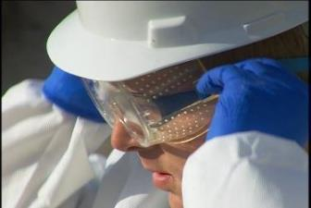
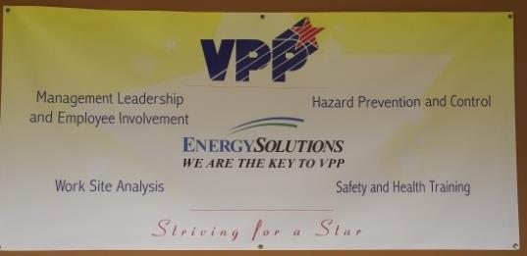
Fundamental Focus on Safety
Industrial
  VPP Star - 2017
  Behavior Based/HPI
  Between 2011 & 2021, over 6.8 million hours worked without a lost-time injury
  Utah Safety Council Award of Merit
    2006, 2007, 2008, 2009, 2012, 2013, 2015, 2016, 2018, 2020, 2021
  Utah Safety Council Perfect Record Award
    2011, 2012, 2013, 2015, 2016, 2017
  Utah Safety Council 1 Million Man Hour Award
    2013, 2016, 2020
  Utah Safety Council Award of Honor
    2017, 2019
  National Safety Council Perfect Record Award
    2005, 2006, 2007, 2008, 2010, 2015, 2017
  National Safety Council Million Man Hour Award
    2006, 2008, 2013, 2017, 2020
Radiological
  ALARA
  Personnel exposures very low
  41 mrem average annual employee exposure

Slide 3
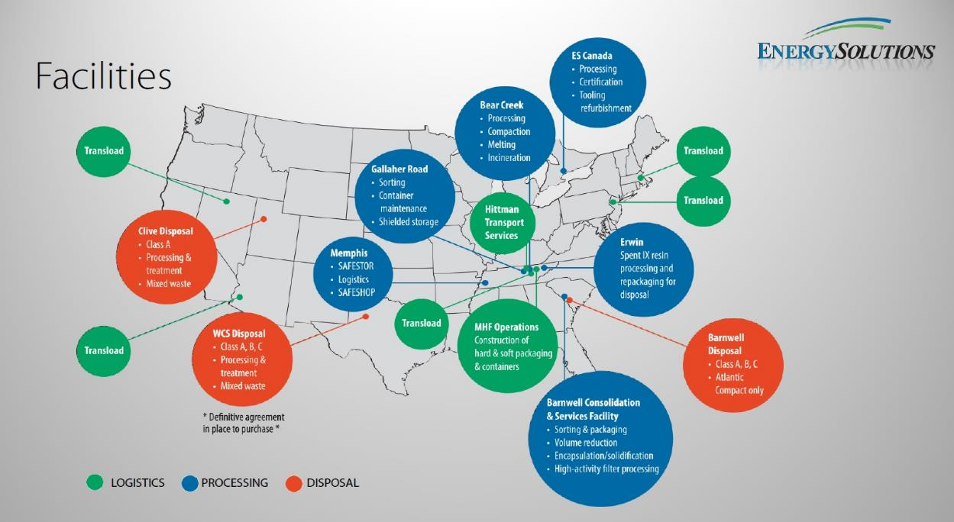
Broad Range of Industry-Critical Services
Furthering a legacy of continuous innovation in protection of the environment by efficiently and cost effectively managing radioactive and mixed waste in revolutionary, engineered disposal systems

Slide 4
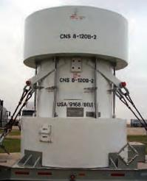
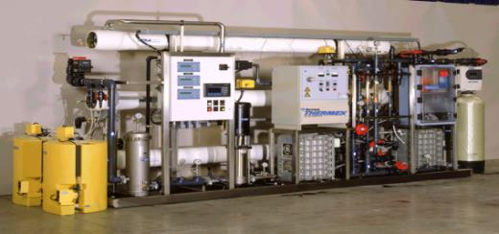
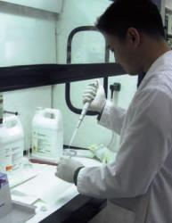
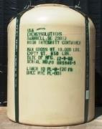
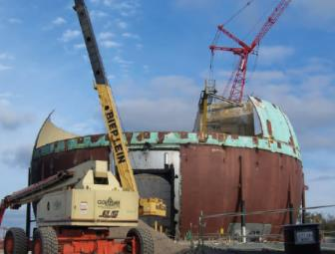
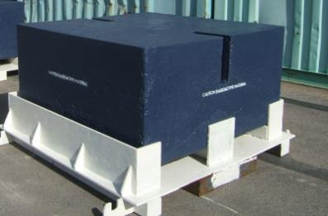
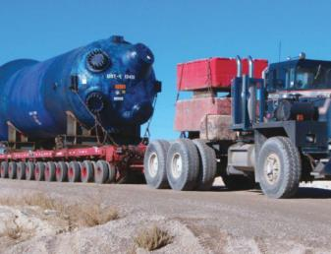
Logistics, Processing and Disposal
Casks and Containers
Liquid Processing Equipment
Analytical Services
Decontamination and Decommissioning
Metal Melt & Beneficial Reuse
Large Component Transportation

Slide 5
Presentation Outline
Change in company ownership
Clive Enhancements
  Correct licensed volume
  Propose an Exempted Waste Cell
  Propose a Federal Cell (depleted uranium)
  Request authority for sealed source disposal
  Capital Improvements
  Ample Capacity
Barnwell Operations

Slide 6
Change in Ownership
Energy Capital Partners
(2013 – 2022)
TriArtisan Capital Advisors
TriArtisan Capital Advisors
(2018-2022)
EnergySolutions CEO Ken Robuck, said “We are delighted that TriArtisan has made a substantial additional investment in the Company to become our majority owner, and we look forward to continuing our close partnership with them. Our management team and I are excited to continue seamlessly executing on the current business plan.”

Slide 7
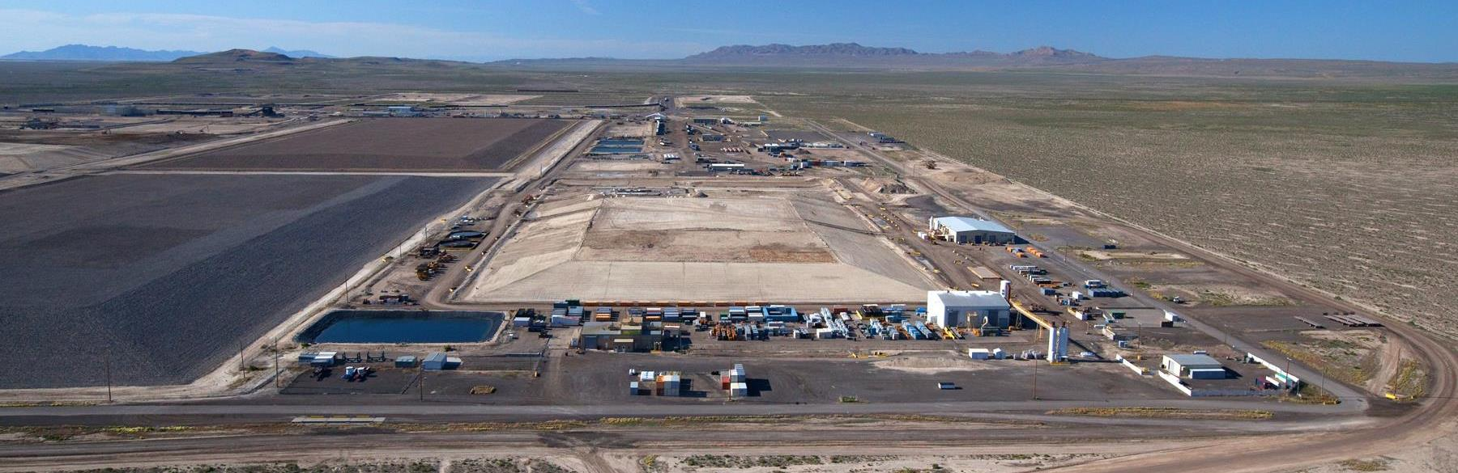
Clive Facility Disposal Developments

Slide 8

Clive Facility Disposal Developments

Slide 9



Stable Embankment Construction
Rip Rap 18 in (48 cm)
Type A Filter 6 in (15 cm)
Sac. Soil 12 in (30 cm)
Type B Filter 6 in(15 cm)
Install Engineered Cover
Layers of Waste Compacted and Disposed
Install Radon Barrier (Clay Cap)
2 ft (61 cm)
9
Install and Approve Clay Liner
Excavate ~ 10 ft.

Slide 10
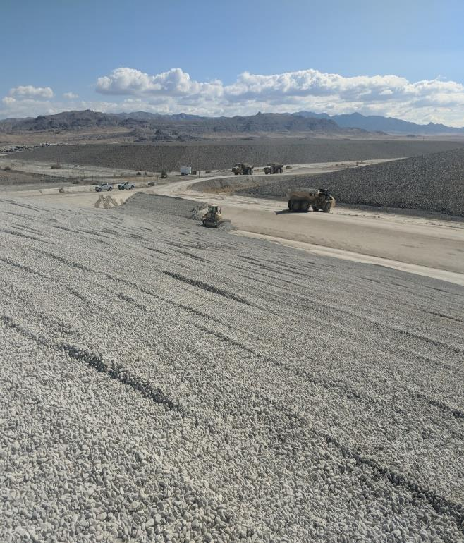
Correct Licensed Volume
LICENSE AMENDMENT 26
Class A West engineering design for 8,724,097 yd³ Class A LLRW waste volume.
Class A West modeled (performance assessment) of 8,724,097 yd³ Class A LLRW waste volume.
Different licensed volume limit unrelated to engineering design or performance assessment modeling results

Slide 11
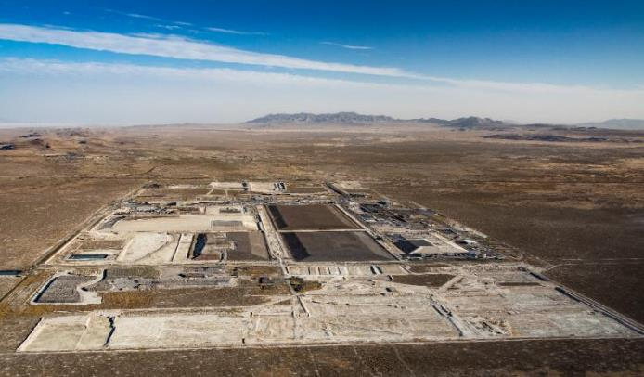
Exempted Waste Cell
Significant volumes of non-impacted/suspect waste generated by D&D projects
Clive facility has a long history of managing this type of waste
Waste shipped to Clive must be Class A LLRW - screened to determine if it can be exempted from some of the controls w/o increasing risk to human health
Exemption is being evaluated by Utah Division of Waste Management and Radiation Control
Tracking and reporting to compacts will continue

Slide 12
Federal Cell Facility
Public
Politicians
19-3-103.7(3)
Industry
Regulators
Site-specific Performance Assessment
Designation of a Federal Cell Facility
Perpetual stewardship agreement with DOE

Slide 13
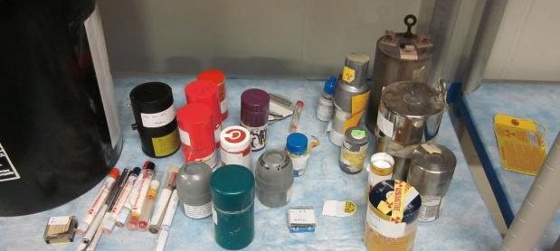
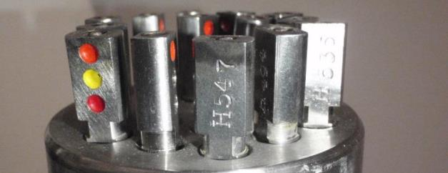
Sealed Source Disposal
2013 Joint effort with CRCPD and State of Utah
License exemptions granted for disposal of Class A sealed sources on a per-source basis
Received and managed 41,190 sealed sources between 2013 and 2015
2020 permanent license amendment requested and is under consideration

Slide 14
Capital Improvements
East Side Rotary
Railyard Maintenance and Storage Facility
Mobile equipment fleet upgrades
Evaporative storage expansion
Operational safety enhancements

Slide 15
Ample Capacity
Exempted Waste
Cell
Federal
Cell
Class A West
(3,374,858 yd³)
Rail Yard
Facility
11e.(2)
(2,120 yd³)
LARW
(closed)
VITRO
(closed)
Mixed Waste
(347,475 yd³)
ESR
North
15

Slide 16
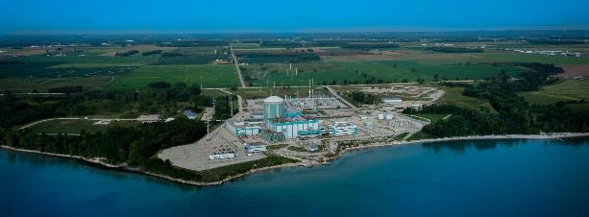
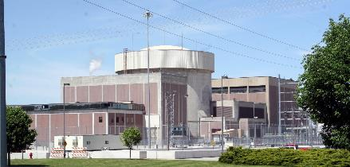
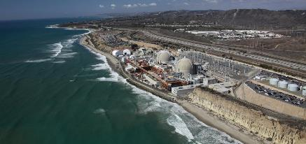
Significant D&D Pipeline
Three Mile Island Unit-2 Nuclear Power Plant
Kewaunee Nuclear Power Station
Fort Calhoun Nuclear Generating Station
San Onofre Nuclear Generating Station

Slide 17
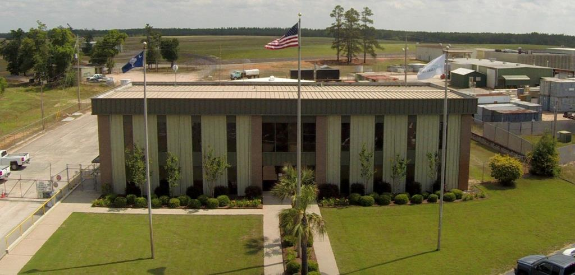
Barnwell Disposal Facility

Slide 18
Barnwell Disposal Facility

Slide 19
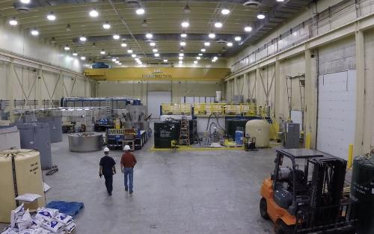
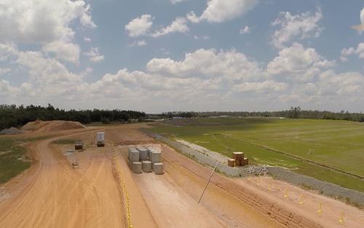
Barnwell Facility
The Barnwell Disposal Facility is owned by the state of South Carolina and operated by EnergySolutions. The facility is the host disposal site for the Atlantic Compact which is comprised of South Carolina, New Jersey, and Connecticut.
The Facility began operations in 1971 and has provided continuous disposal operations for over 45 years. The site is licensed to dispose of Class A, B and C low-level wastes, including irradiated hardware and large components, steam generators, resins, and reactor pressure vessels.

Slide 20
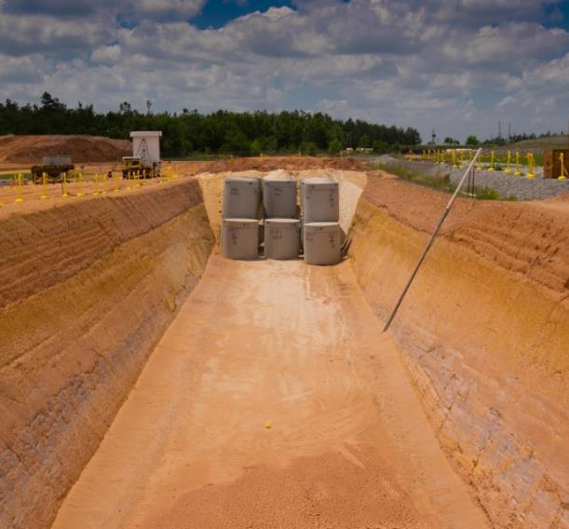
Barnwell Disposal Facility
> 90% of facility in closed condition, under institutional monitoring
Following 2019 litigation, SC DHEC requested an application for license renewal.
September 2019 – Renewal application submitted
Radioactive Material License under timely renewal

Slide 21
Barnwell Disposal Operational Updates
Large Component Disposal
  Campaign 1 – 3 Oconee rotors and 42 diaphragms disposed
  Campaign 2 – 3 Oconee rotors and 42 diaphragms disposed
  Campaign 3 – 3 Oconee rotors and 42 diaphragms disposed
License 097 Renewal Application (2019)
Ongoing Operational Efficiencies
21

Slide 22
Rotor and Diaphragm Disposal

Slide 23
Thank You

