Slide 1
Overview of the LLW Forum’s Disused Sources Working Group Michael Klebe April 7, 2021

Slide 2
Disused Sources Working Group Origin
DSWG formed in 2011 at the request of the NNSA/GTRI to address the problem of disused radioactive sealed sources
Approximately 2 million sealed sources in use
Tens of thousands disused sources with no exact knowledge of number, activity, and storage security

Slide 3
Disused Source Problem Contributing Factors
Life-cycle costs for managing and disposing of sources not internalized
Inconsistent view of which sources pose a security threat
Regulatory system inadequacies for a post-9/11 threat environment
No financial incentive for reuse, recycle, or disposal
Opportunities for recycling and reusing sources are underutilized
Type B shipping container availability and cost

Slide 4
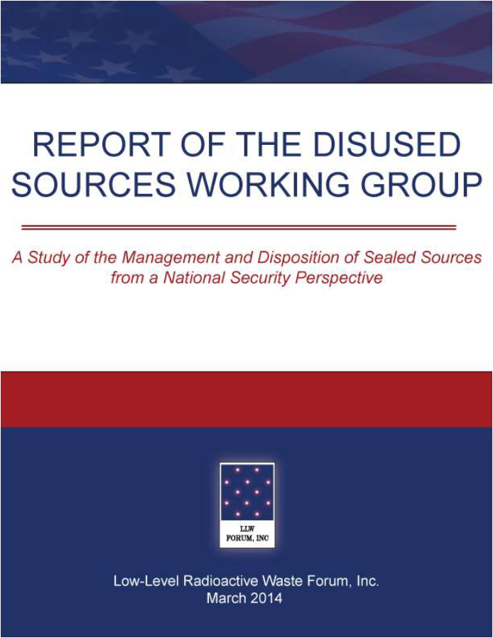
DSWG Report
Report published – March 2014
24 recommendations for improving the security of sealed sources
Several recommendations have been completed
Currently revising the priority of the remaining recommendations
Notes:
19 meetings
30 months
Stakeholder engagement
Report preparation
Technical Review
Report published – March 2014
24 recommendations for improving the security of sealed sources

Slide 5
Resources: Disposition Options and Costs
Availability and Constraints
Reuse – Recycle - Disposal
Industry specific
Generic cost estimate

Slide 6
Resources: Disposition Options and Costs
Simplified and separated into industry specific
Industrial Radiography Well Logging
Teletherapy Bracytherapy
Fixed Industrial Gauges Irradiators
Portable Gauges
Available on the DSWG website:
www.disusedsources.org/resources

Slide 7
US NRC BTP on Concentration Averaging and Encapsulation
BTP provides:
Guidance for proper classification of waste for disposal
Acceptable methods for averaging radionuclide concentrations over the volume or mass of waste
Original in 1995
Revised in 2015:
Improve clarity
Update position on LLRW blending
Align the BTP with the NRC’s risk-informed performance regulatory approach

Slide 8
US NRC BTP on Concentration Averaging and Encapsulation
DSWG draft report:
Evaluates the revised BTP as it relates to sealed sources
Describes classification process for encapsulated sealed sources
Provide a classification example
Discusses alternative approach for waste classification
Identifies some BTP related obstacles for sealed source disposal

Slide 9
US NRC BTP on Concentration Averaging and Encapsulation
Revised BTP does not appear to have increased the disposal of sealed sources.
General industry consensus is the revised BTP has improved the classification process
Adds clarity
Reduced interpretation
Allows for the use of larger containers
Provides flexibility to apply the least restrictive classification

Slide 10
Additional Information:

