Slide 1
NRC Update
Low-Level Radioactive Waste Forum
Spring 2021 Meeting
April 7, 2021
Stephen Koenick, Chief
Low-Level Waste and Projects Branch
Division of Decommissioning, Uranium Recovery, and
Waste Programs
Office of Nuclear Material Safety and Safeguards

Slide 2
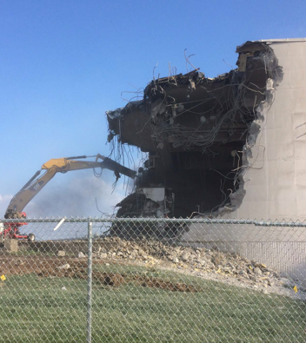
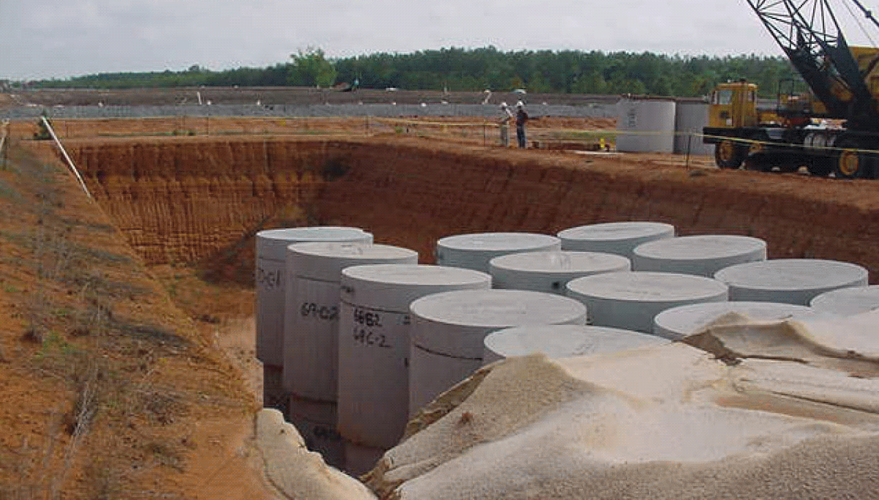
Status of 2016 Programmatic Assessment
Greater-than Class C (GTCC), Transuranic Waste (TRU), and Part 61 Rulemakings ​
Very Low-Level Waste (VLLW) Developments
Uniform Waste Manifest
Continuous Decommissioning Process Improvements​
Protecting today, tomorrow, and cleaning up the past

Slide 3
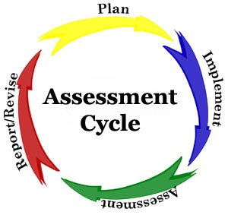
2016 LLW Programmatic Assessment
Q: Why we performed this assessment?
A: To address the constantly evolving nature of low-level waste (LLW) issues building on the 2007 Strategic Assessment (20 Tasks)

Slide 4
Walk Down Memory Lane – 2007 Strategic Assessment
2007 Assessment 20 Tasks | Rank | Status | Reference
Review and update guidance on extended storage of LLW | High | Complete | ML111520042
Develop guidance on 10 CFR 20.2002 Alternate Disposal Requests. | High | rolled into 2016
Determine if disposal of large quantities of depleted uranium would change the waste classification tables. | High | rolled into 2016
Update Branch Technical Position on Concentration Averaging and Encapsulation. | High | Complete | ML12254B065
Develop procedures for Import/Export Review. | High | Complete | ML16063A260
Develop guidance on alternate waste classification (10 CFR 61.58). | High | rolled into 2016
Perform scoping study of the need to revise/expand byproduct material financial assurance to account for life-cycle. | High | Complete | ML16200A223
Develop licensing criteria for greater than Class C (GTCC) disposal facility. | Medium | rolled into 2016
Consolidate LLW guidance. | Medium | rolled into 2016
Develop guidance that summarizes disposition options for low-end materials and waste. | Medium | rolled into 2016
Coordinate with other agencies on consistency in regulating low activity waste disposal. | Medium | rolled into 2016
Identify new waste streams. | Medium | Complete | part of Pt 61 RM
Develop information notice on waste minimization. | Medium | Complete | ML15023A098
Evaluate potential changes to LLW regulatory program as a result of severe curtailment of disposal capacity. | Low | No action
Promulgate rule for disposal of low-activity waste. | Low | rolled into 2016
Identify and evaluate potential legislative changes. | Low | No action
Implement major revisions to 10 CFR Part 61. | Low | rolled into 2016
Develop waste acceptance criteria for LLW disposal in uranium mill tailings impoundments. | Low | No action
Examine need for guidance on defining when radioactive material becomes LLW. | Low | rolled into 2016
Develop and implement national waste tracking system. | Low | rolled into 2016

Slide 5
2016 Programmatic Assessment Status
6 High Priority Tasks
Complete and Implement Site-Specific Analysis Rulemaking
(Part 61 rulemaking)
--
On Hold
SECY-20-0098
(Awaiting Commission Direction)
2. Address update to the 10 CFR Part 61 Waste Classification Tables
--
No action
(Awaiting task 1 completion)
3. Prepare a regulatory basis and conduct potential rulemaking for GTCC and transuranic waste disposal
--
Regulatory Basis Completed/ Rulemaking On Hold
See Task 1

Slide 6
2016 Programmatic Assessment Status
6 High Priority Tasks Cont’d
4. Implement the Updated Concentration Averaging and Encapsulation BTP
--
Completed
Training in March 2016 (https://www.nrc.gov/waste/llw-disposal/llw-pa/llw-btp.html)
Finalize internal procedure/ Standard Review Plan for 20.2002 requests to improve alternate disposal process
--
Completed
(https://www.nrc.gov/waste/llw-disposal/very-llw.html)
6. Update NUREG/BR-0204, Rev. 2 (July 1998), “Instructions for Completing NRC’s Uniform Low-Level Radioactive Waste Manifest”
--
Completed
Published NUREG/BR-0204, Rev 3, however, use of Rev 3 has been delayed –
https://www.nrc.gov/waste/llw-disposal/llw-pa/llw-uwm.html

Slide 7
2016 Programmatic Assessment Status
2 Medium Priority Tasks
Perform LAW (VLLW) Scoping Study
--
Ongoing
https://www.nrc.gov/waste/llw-disposal/very-llw.html
Update and consolidate LLW guidance into one NUREG
--
No Action

Slide 8
2016 Programmatic Assessment Status
2 Low Priority Tasks
9. Examine the need for guidance on defining when radioactive material becomes LLW
10. Develop and implement the national waste tracking system
No Action

Slide 9
Draft Regulatory Basis for Disposal of GTCC and TRU
Received over 50 individual letters; and over 5,000 form letters
Comments support near surface disposal of GTCC waste and removal of TRU exclusion in 10 CFR Part 61 definition
Comments also support disposal in deep geological repository
Most GTCC waste analyzed potentially suitable for near-surface disposal provided appropriate controls and site-specific analysis (that may result in differing quantities of GTCC)
Agreement States can effectively regulate the majority of GTCC waste
Draft regulatory basis provides sufficient detail on actions

Slide 10
SECY-20-0098 – “Path Forward and Recommendations for Certain Low-Level Radioactive Waste Disposal Rulemakings”
GTCC, TRU and Part 61 Rulemakings
Combining these efforts to address overlapping technical requirements, streamline stakeholder outreach, and gain efficiency in proceeding as one rulemaking activity
Waiting for Commission Direction

Slide 11
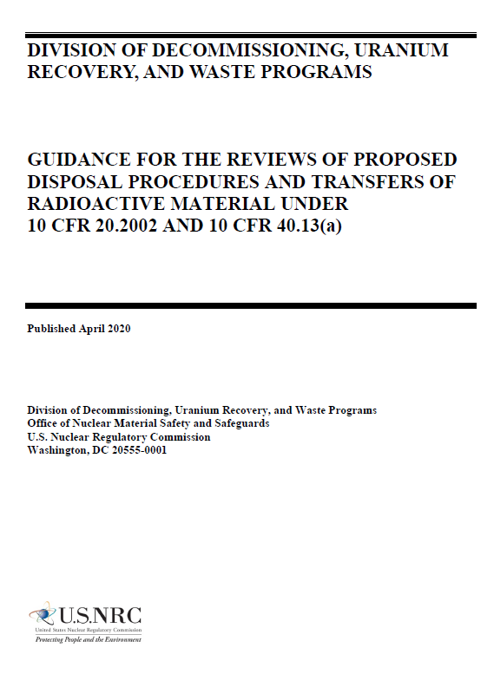
Alternative Disposal Requests Guidance
Provides guidance and the NRC staff process for documenting, reviewing, and dispositioning requests received for alternative disposal of licensed material
Incorporates changes made in response to comments received on the draft guidance document, as well as interactions with NRC stakeholders
Issued revised guidance on April 9, 2020
Available in ADAMS at ML19295F109

Slide 12
Proposed Interpretive Rule
Solicited public comments to better inform decision
Staff initiative to explore other regulatory options for safe VLLW disposal
Proposal involved facility-specific regulatory decision
Proposed interpretive rule related to 10 CFR 20.2001 “authorized recipient”
Rule
Withdrawn
85 FR 81849

Slide 13
VLLW Scoping Study
Best practices in VLLW disposal
Lessons learned from previous initiatives
Identify the actions that the NRC should take to strengthen its VLLW regulatory framework.
Plan to issue report April 2021
Public Engagement

Slide 14
Uniform Waste Manifest
Announced September 2020, licensees should continue to use NUREG/BR 0204, Rev 2 and the versions of NRC Forms 540, 541 and 542 that were renewed in January 2020, or equivalent, as defined in NRC's regulations
Issued
NUREG/BR-0204, Revision 3, in June 2020
85 FR 39936
NUREG/BR-0204 provides instructions to prepare NRC Form 540, NRC Form 541, and NRC Form 542
Revision 3 Includes updated instructions to reflect changes to the Uniform Manifest forms; updated references to DOT regulations to reflect the current DOT regulations; and overall improvements to the clarity of the document
Tentatively NUREG/BR-0204, Revision 3, scheduled for June 2021 with 90 day implementation
Stakeholder outreach on implementation
ongoing
14

Slide 15
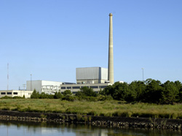
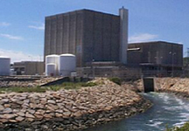
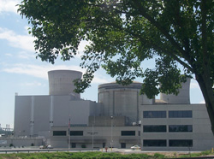
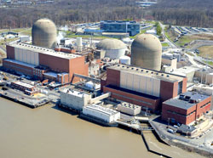
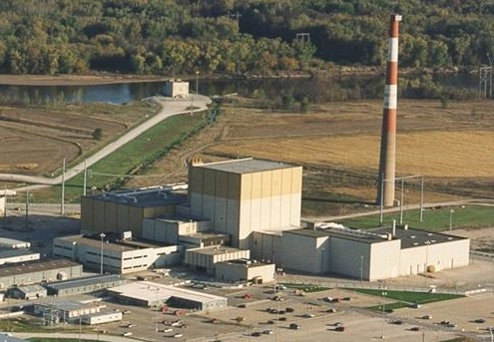
Continuous Decommissioning Process Improvements
Proactively assessing the challenges to the reactor decommissioning program with the increasing number of plants and the accelerated decommissioning schedules
Enhancing and clarifying coordination for transitioning sites through issuance of updated guidance
Effective transition of recently shut down reactors
15

Slide 16
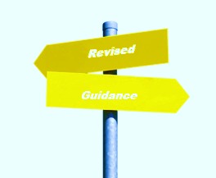
Continuous Decommissioning Process Improvements, Guidance
Guidance improvements to further risk-inform processes
NUREG-1507, Rev. 1: Minimum Detectable Concentrations with Typical Radiation Survey Instruments for Various Contaminants and Field Conditions; August 2020
NUREG-1757, Consolidated Decommissioning Guidance
Volume 1, Rev. 3: Decommissioning Process for Materials Licensees, Anticipated 2021
Volume 2, Rev. 2 Characterization, Survey and Determination of Radiological Criteria (draft for public comment); December 2020
NUREG-1575, Rev. 2, Multi-Agency Radiation Survey and Site Investigation Manual (to be issued for public comment); Anticipated 2021

Slide 17
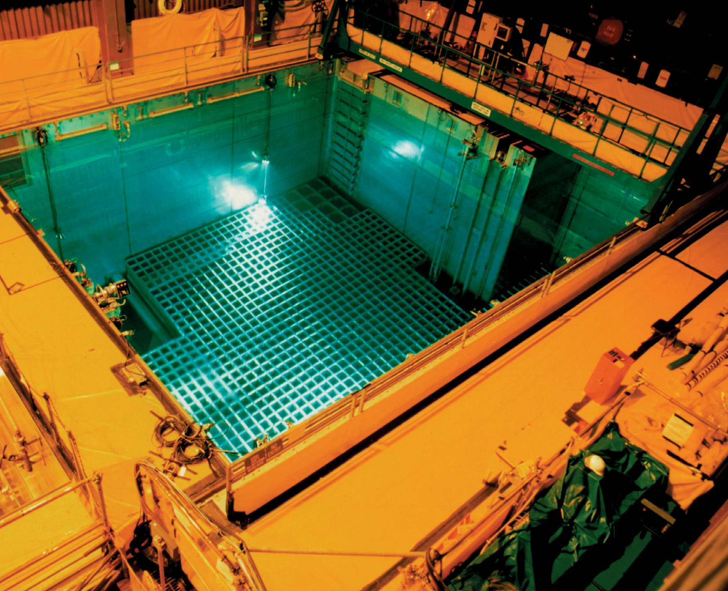
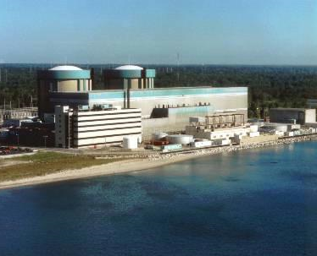
Continuous Decommissioning Process Improvements, Inspection Procedures
IMC 2561 was revised holistically to risk-inform inspections at decommissioning power reactors
IMC 2602 is being looked at in a similar fashion for other facilities

Slide 18
Reactor Decommissioning References
Proposed Decommissioning rule submitted to Commission, SECY-18-0055, May 7, 2018 (ML18012A019)
Report to Congress on Best Practices for Community Advisory Boards (NEIMA Section 108), July 1, 2020 (ML20113E857)
Reactor Decommissioning Financial Assurance Working Group, May 2020 (ML20120A550)

Slide 19
? ? ? ? Questions ? ? ? ?
What’s next?
Additional tools/guidance to be developed ?
How should we engage?
Some feedback we’ve heard – coordination across NRC business lines as they relate to LLW and Decommissioning.

