Slide 1
Risk-Informed Approaches for Low-Level Waste Reasonable Assurance & riskSMART
Patricia K. Holahan, Ph.D., Director
Division of Decommissioning, Uranium Recovery, and Waste Programs
Office of Nuclear Material Safety and Safeguards
U.S. Nuclear Regulatory Commission
Low-Level Waste Forum
October 14, 2020

Slide 2
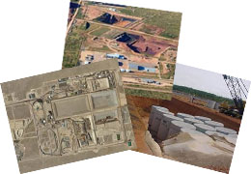
Contents
General Concepts
Current Part 61
Where we’re headed

Slide 3
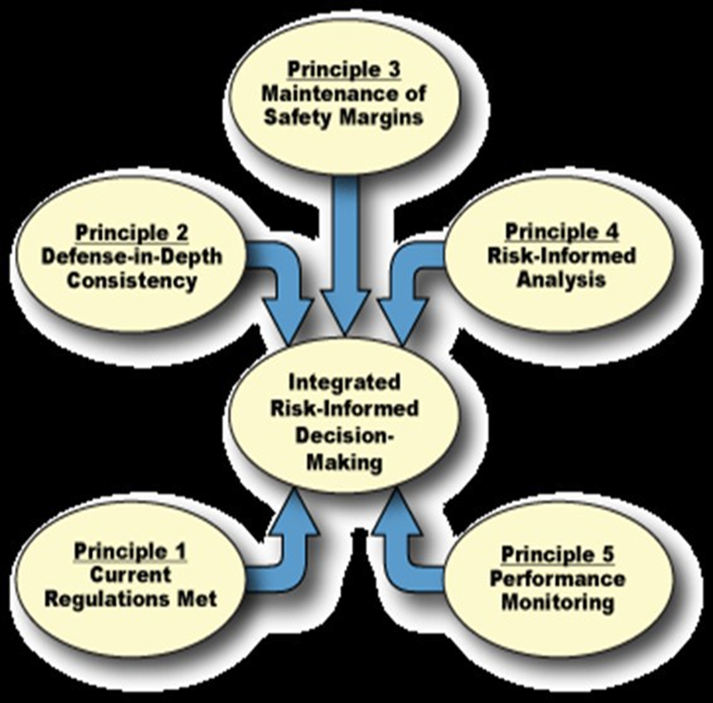
Risk Assessment Supports Integrated Risk-Informed Decision-Making
Risk Triplet: “what can go wrong?,” “how likely it is?,” and “what its consequences might be?”
The conceptual models used to assess risk and inputs describing the source, its release and transport, and receptor’ exposure pathways are uncertain.
Probabilistic analysis is used as a process to explicitly represent this uncertainty by describing models and associated inputs as probability distributions.

Slide 4
Risk-SMART Elements
SPOT what can go wrong or right, what are the consequences, and how likely it is (e.g.; Risk Triplets);
MANAGE what you can;
ACT on a decision;
REALIZE the result; and
TEACH others what you learned.

Slide 5
Central Safety Limits for LLW: Part 61 Subpart C Performance Objectives
§ 61.40 General requirement: Land disposal facilities must be sited, designed, operated, closed, and controlled after closure so that reasonable assurance exists that exposures to humans are within the limits established in the performance objectives in §§ 61.41 through 61.44.
§61.41 Protection of the general public
§61.42 Protection of individuals from inadvertent intrusion
§61.43 Protection of individuals during operation
§61.44 Stability of disposal site after closure

Slide 6
Performance Assessment Methodology
Site Assessment
Site Selection and Characterization
Overview of Performance Assessment
What is Performance Assessment?
Systematic analysis of what could happen at a site
What is assessed?
What can happen?
How likely is it?
What can result?
Collect Data
Site Characteristics
Design and Waste Form
Performance Assessment: a learning process
How is it conducted?
Collect data
Develop scientific models
Develop computer code
Analyze results
Combine Models and
Estimate Effects
Develop Conceptual Models
Why use it?
Complex system
Systematic way to evaluate data
Develop Numerical and
Computer Models
NRC would require a Performance Assessment to:
Provide site and design data
Provide technical basis for models and inputs
Account for variability and uncertainty
Evaluate results from alternative models, as needed
Describe barriers that isolate waste
Evaluate features, events, and processes that affect safety
16

Slide 7
Improving the Low-Level Waste Approach
Part 61 Proposed Changes
More Leveraging of Site-Specific Analyses
Alternate Waste Acceptance Criteria
Greater than Class C disposal
Published Alternate Disposal Request guidance
Extended Compliance Date for Uniform Waste Manifest
20.2001 Proposed Approach for Addressing VLLW
VLLW Scoping Study

Slide 8
Assumptions, Considerations, and Decisions

Slide 9
Conclusions
Part 61 is structured to be risk-informed, performance-based
Proposed Changes would make the rule more site-specific
VLLW Scoping Study will be released within the next year
Compliance evaluation by the regulator is only part of overall risk assessments

