Slide 1
Licensing and Activities Update
EnergySolutions’ Clive, Utah Facility presented by Vern Rogers Low-Level Radioactive Waste Forum
Director of Regulatory Affairs October 14-15, 2020

Slide 2
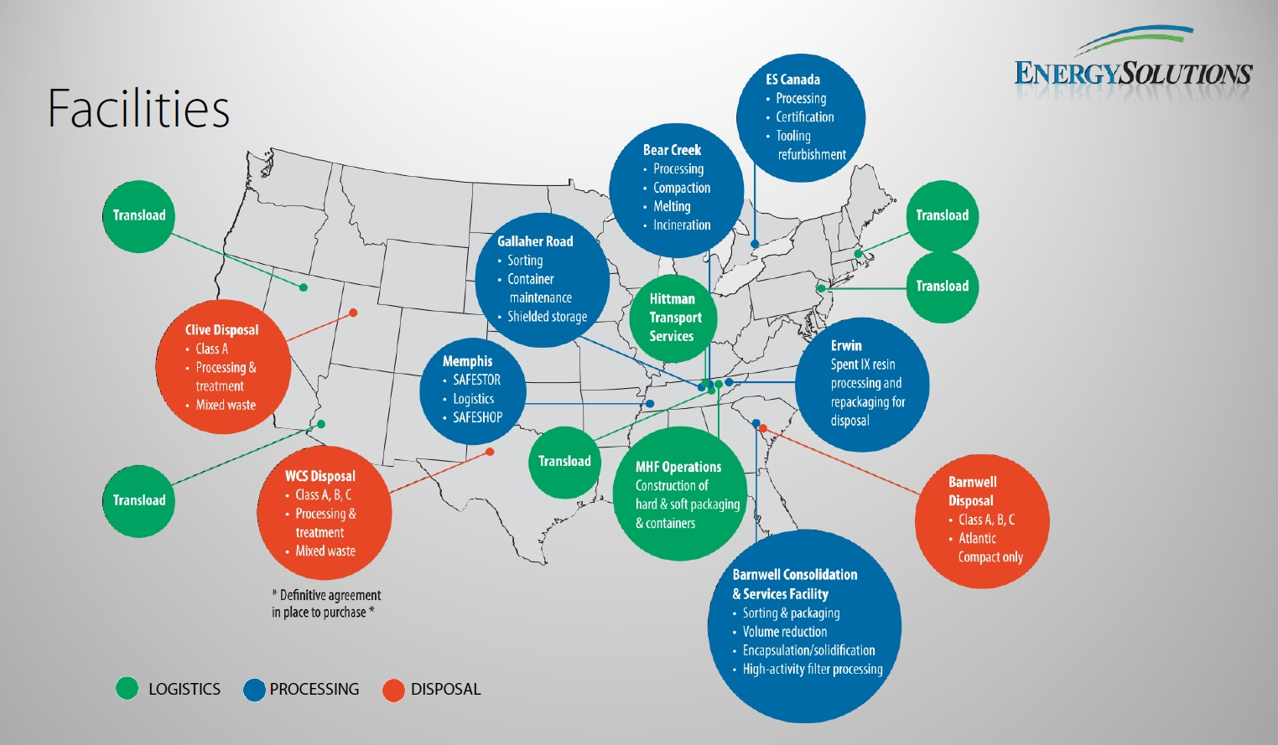
EnergySolutions’ Waste Acceptance and Customer Portal Overview
Facility Overview – Site Locations
Furthering a legacy of continuous innovation in protection of the environment by efficiently and cost effectively managing radioactive and mixed waste in revolutionary, engineered disposal systems

Slide 3
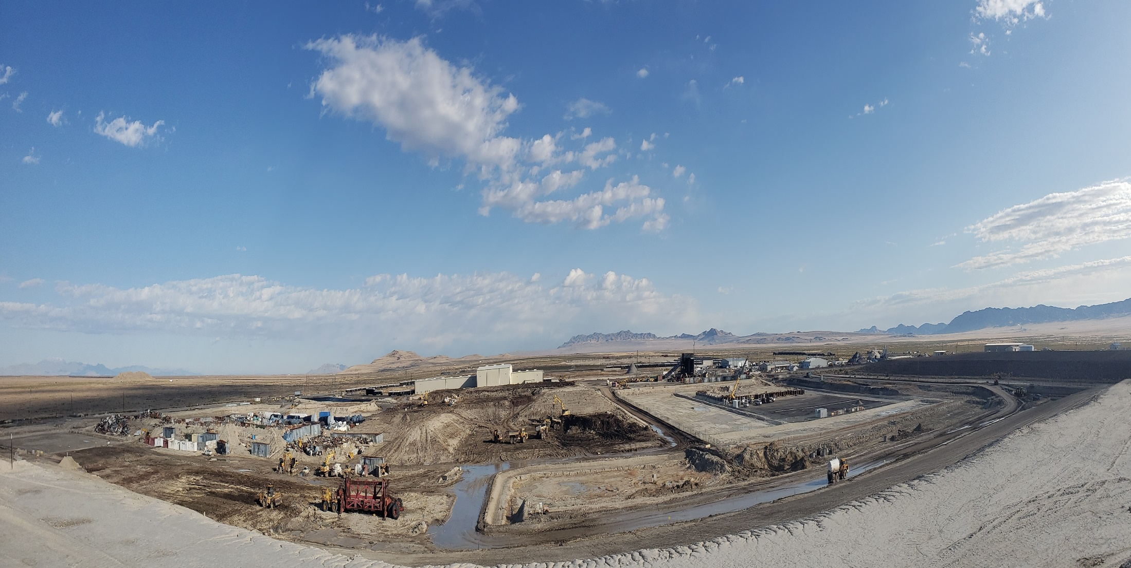
Clive Utah
Commercial Radioactive Waste Disposal Facility
Ideally location in area perpetually zoned for industry (no residential), without oil, mineral or groundwater resources
Extreme arid environment ideal for waste isolation
Near surface disposal allows low cost disposal savings to be passed to generators

Slide 4
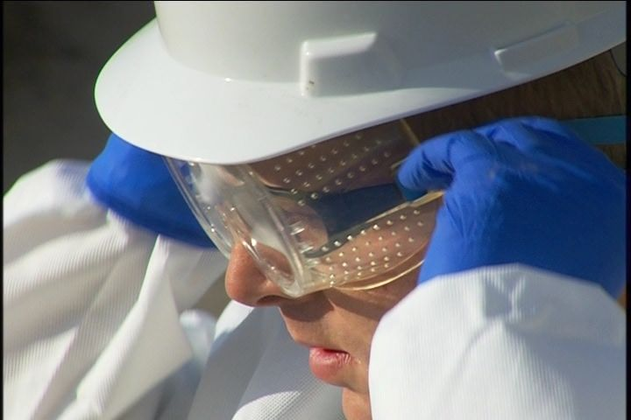
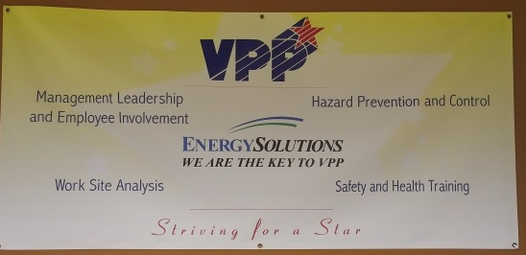
Safety
Industrial
  Behavior Based/HPI
  VPP Star - 2017
  Over 6.8 million hours worked without a lost-time injury
  Utah Safety Council Award of Merit
    2006, 2007, 2008, 2009, 2012, 2013, 2015, 2016, 2017, 2018, 2019
  Utah Safety Council Perfect Record Award
    2011, 2012, 2013, 2015, 2016, 2017
  Utah Safety Council 1 Million Man Hour Award
    2013, 2016
  Utah Safety Council Award of Honor
    2017, 2019
  National Safety Council Perfect Record Award
    2005, 2006, 2007, 2008, 2010, 2015, 2017
  National Safety Council Million Man Hour Award
    2006, 2008, 2013, 2017
Radiological
  ALARA
  Personnel exposures very low
  41 mrem average annual employee exposure

Slide 5
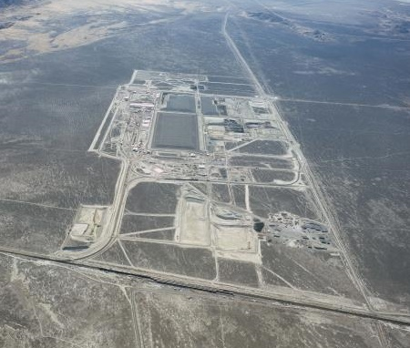
Facility Overview – Clive Operations
Over 30 years of proven experience treating and disposing of radioactive waste
Bulk waste (soil, resin, filters, operational waste, large components, decommissioning, real-time processing liquids) – 90% LLWR is class A – option to expand
Containerized waste (SNM Exemption – conc. based limits)
Mixed Waste (Stabilization, Amalgamation, Thermal Desorption, Macroencapsulation, Solidification, lead shielding and acid batteries, solvent contaminated waste, PCB/Radioactive Waste)
11e.(2)
Depleted Uranium and other Federal Waste
Low Activity Radioactive Waste
2019
2004

Slide 6
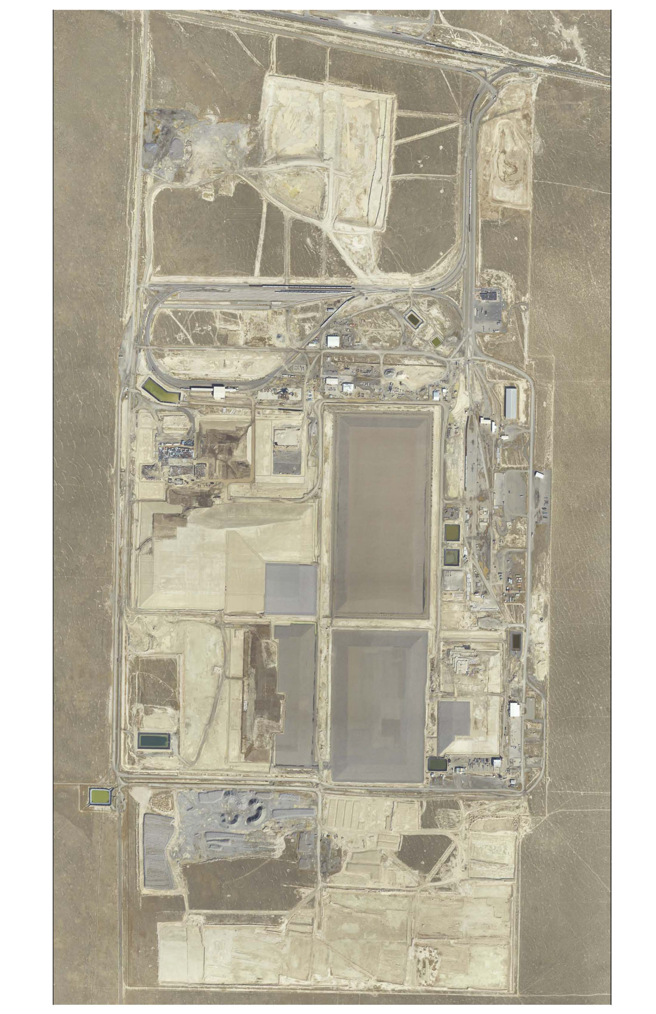
Clive’s Disposal Available Capacity
Federal Cell
(future)
Low Activity
Waste
(future)
Class A West
(3,598,698 yd³)
CRF
11e.(2)
(345,115 yd³)
LARW
(Closed)
VITRO
Dept. of Energy
from Salt Lake County
(Closed)
Rail Yard Facility
Mixed Waste
(350,459 yd³)
Container
Handling

Slide 7



Long-term Stable Embankment Construction
Rip Rap 18 in (48 cm)
Type A Filter 6 in (15 cm)
Sac. Soil 12 in (30 cm)
Type B Filter 6 in(15 cm)
Install Engineered Cover
Layers of Waste Compacted and Disposed
Install Radon Barrier (Clay Cap)
2 ft (61 cm)
Install and Approve Clay Liner
Excavate ~ 10 ft.

Slide 8
Clive Disposal Volume History

Slide 9
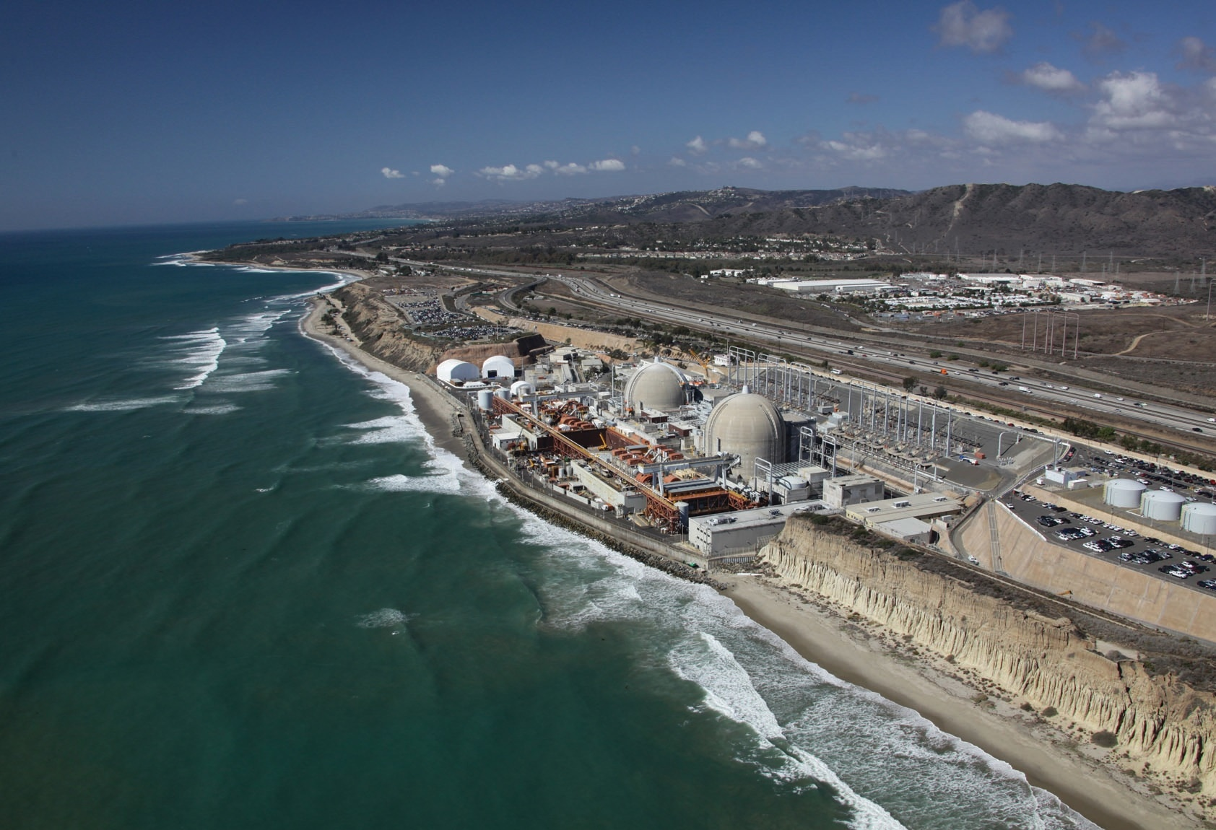
San Onofre Nuclear Generating Station
December 20, 2016 - EnergySolutions selected to decommission San Onofre Nuclear Generating Station Units 2 and 3

Slide 10
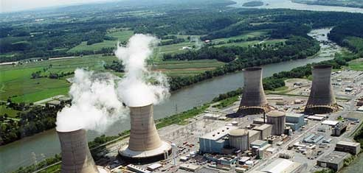
Three Mile Island Unit-2 Nuclear Power Plant
October 15, 2019 - EnergySolutions selected to decommission Three Mile Island Nuclear Generating Station Unit 2

Slide 11
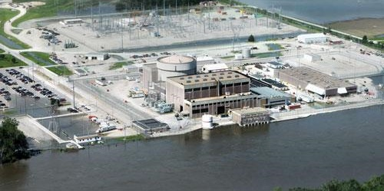
Fort Calhoun Nuclear Generating Station
April 29, 2019 - EnergySolutions selected to decommission Fort Calhoun Nuclear Generating Station Unit 2

Slide 12
History of EnergySolutions’ Low-Activity Radioactive Waste Disposal
1988 – Clive receives first Radioactive Material License (RML) for disposal of NORM
1990 – RML amendment to dispose of LARW at specified concentration limits
2001 – RML amendment to dispose of Class A LLRW
2006 – Acquisition of Duratek with BSFR disposal in TN
In past few years, NRC addressing regulatory approach to non-licensed “VLLW” disposal options

Slide 13
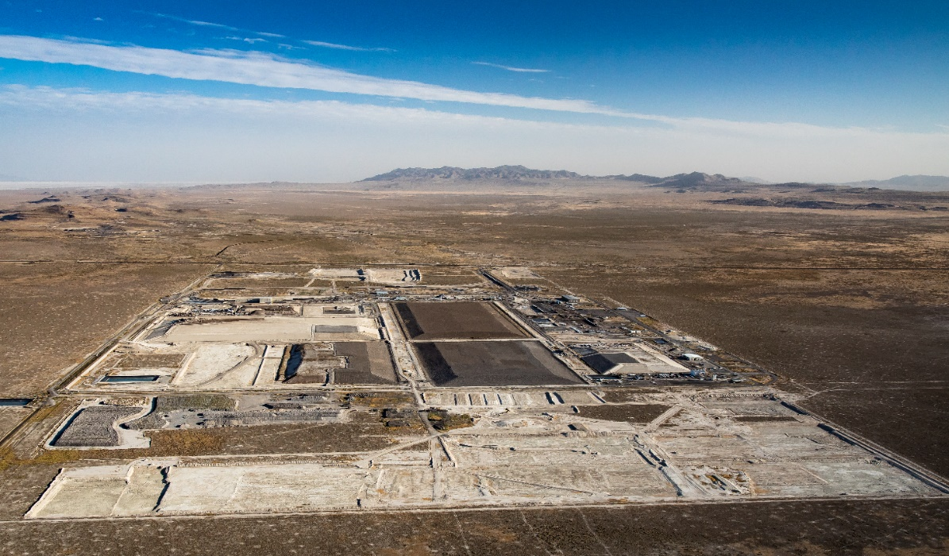
Plans for Ongoing
LARW Disposal at Clive
Significant volumes of non-impacted/suspect waste generated by D&D projects
ES owned Section 5 at Clive site ideal for this type of waste
Waste shipped to Clive will be screened to ensure compliance with new landfill WAC
WAC process and limits being evaluated by Utah Division of Waste Management and Radiation Control
Evaluation of life-cycle costs and risks by generators to determine optimal waste streams/projects

Slide 14
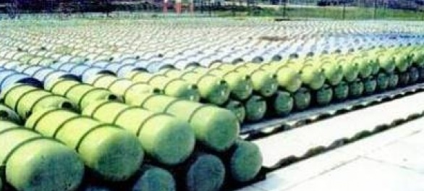
Depleted Uranium Disposal in Utah
[COMPLETE] - DOE must agree, in a legally-binding manner, to become the long-term governmental custodial agency;
[UNDER REGULATORY REVIEW] - As required by Utah Administrative Rule R313-25-9, a Performance assessment must demonstrate human health and the environment are protected following disposal of depleted uranium; and
[UNDER REGULATORY REVIEW] – Radioactive Material License granted for Federal Cell Facility

Slide 15
Thank You

