Slide 1
Licensing and Activities Update
EnergySolutions’ Clive, Utah Facility presented by Vern Rogers 2020 Spring LLW Forum Meeting
Director of Regulatory Affairs March 25-26, 2020

Slide 2
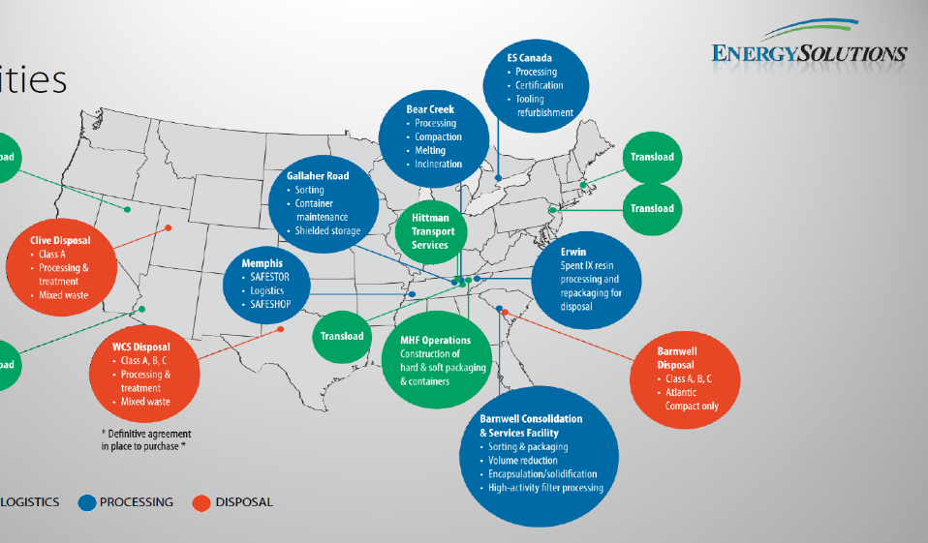
EnergySolutions’ Waste Acceptance and Customer Portal Overview
Facility Overview – Site Locations
Protect the Environment by safely disposing of Low Level Radioactive Waste (LLRW) and Mixed LLRW in regulated, engineered disposal embankments

Slide 3
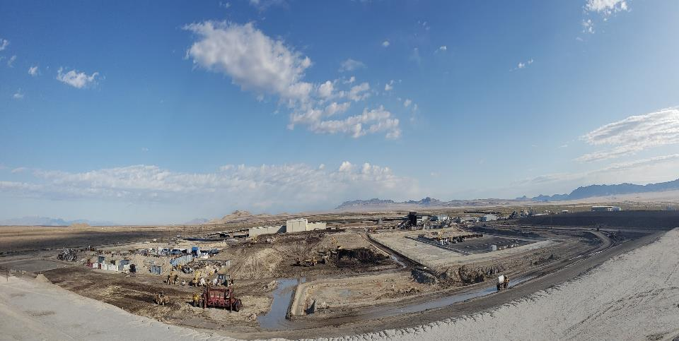
Clive Utah
Commercial Radioactive Waste Disposal Facility

Slide 4
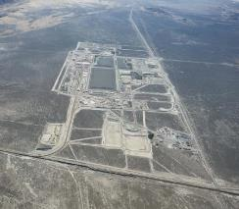
Facility Overview – Clive Operations
Over 30 years of proven experience treating and disposing of radioactive waste
Bulk waste and containerized waste facilities with unique licenses and permits
  Radioactive Material Licenses - LLRW & 11e(2)
  RCRA Permit (Treatment & Disposal of MW)
  TSCA Approvals (PCB waste streams)
  SNM Exemption (Concentration based limits)
Long-term federal and commercial contracts.
2019
2004

Slide 5
Clive Waste Acceptance Capability
Class A LLRW and NORM
  Soil, resin, filters, operational waste, large components, decommissioning
Radioactive Liquids
  Two 10,000 gallon tanks to process real-time
  Processing up to 20,000 gallons per week
Mixed Waste (Radioactive and RCRA Hazardous)
MW Treatment
  Stabilization, Amalgamation, Thermal Desorption, Macroencapsulation, Solidification
  Lead shielding, lead acid batteries, solvent contaminated waste
PCB/Radioactive Waste
Large Component Logistics
UCNI and Export Controlled Waste
Other hazardous substances (e.g., asbestos, beryllium)

Slide 6
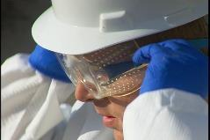
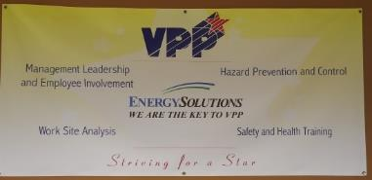
Safety
Industrial
  Behavior Based/HPI
  VPP Star - 2017
  Over 6.5 million hours worked without a lost-time injury
  Utah Safety Council Award of Merit
    2006, 2007, 2008, 2009, 2012, 2013, 2015, 2016, 2017, 2018,2019
  Utah Safety Council Perfect Record Award
    2011, 2012, 2013, 2015, 2016, 2017
  Utah Safety Council 1 Million Man Hour Award
    2013, 2016
  Utah Safety Council Award of Honor
    2017, 2019
  National Safety Council Perfect Record Award
    2005, 2006, 2007, 2008, 2010, 2015, 2017
  National Safety Council Million Man Hour Award
    2006, 2008, 2013, 2017
Radiological
  ALARA
  Personnel exposures very low
  41 mrem average annual employee exposure

Slide 7
Expanding Clive’s Operating Capacity
 | Today | Future Development
Remaining Licensed Capacity (million cf) | 115 | 250
Railcar storage (cars) | 460 | 460
Unloading railcars (cars per day) | 60 | 140
Unloading Truck Shipments (trucks per day) | 30 | 50
Waste Placement (cf per day) | 60,000 | 60,000
Evaporative Storage (million gallons) | 20 | 30
Notes:
Does not account for ~5 million cf MW expansion capacity

Slide 8
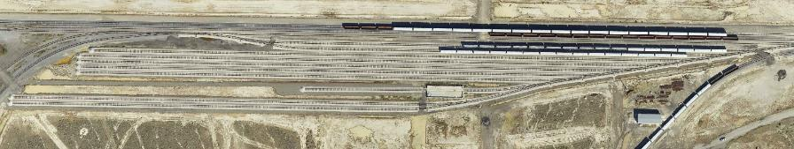
Clive’s Expanded Rail Repair and Storage
Railcar Storage & Staging
  10 Ladder Tracks (Approximately 3 Miles)
  Storage Capacity – Approximately 300 Railcars
Empty Railcar Maintenance and Repair In Accordance for Federal Railroad Administration Regulations
Transloading of Intermodals, SeaLands and Other Bulk Containers
Total Site Track – 16 Miles ( 2 Locomotives)

Slide 9
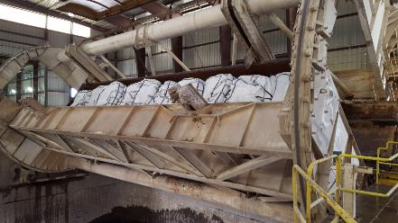
Clive’s Secondary Rotary Facility

Slide 10
Clive’s Disposal Available Capacity
Subtitle
D Cell
(proposed)
Federal
Cell
(proposed)
Class A West
(3,598,698 yd³)
11e.(2)
( 3,401,048yd³)
LARW
(closed)
VITRO
(closed)
Mixed Waste
(350,459 yd³)
North

Slide 11
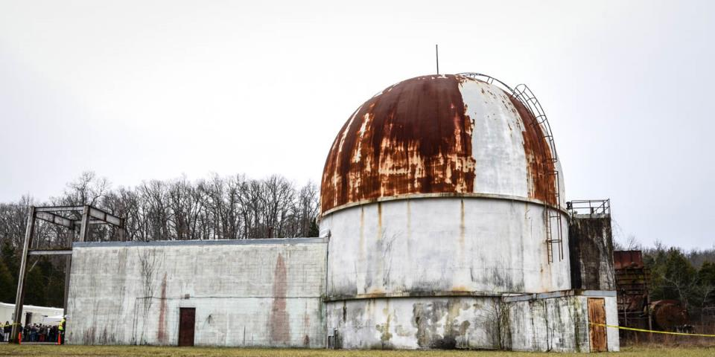
SEFORE Decommissioning Completed

Slide 12
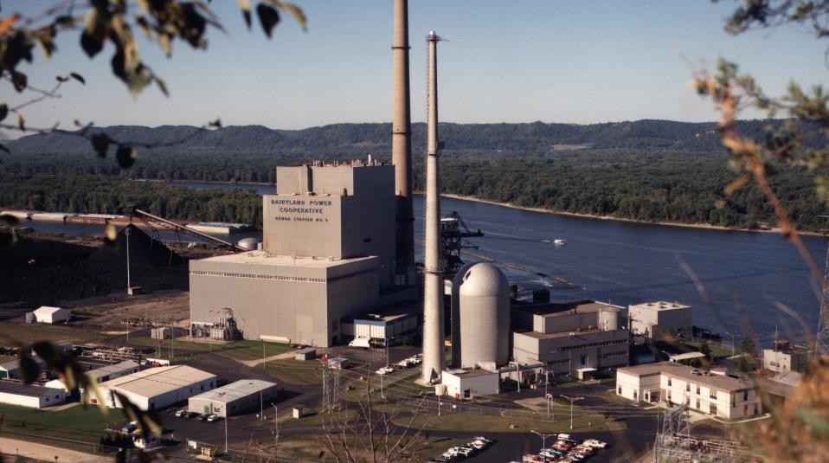
La Crosse Decommissioning Completed

Slide 13
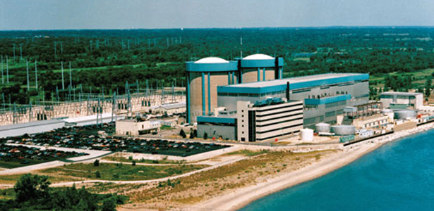
Zions Decommissioning Completed

Slide 14
Clive Disposal Volume History

Slide 15
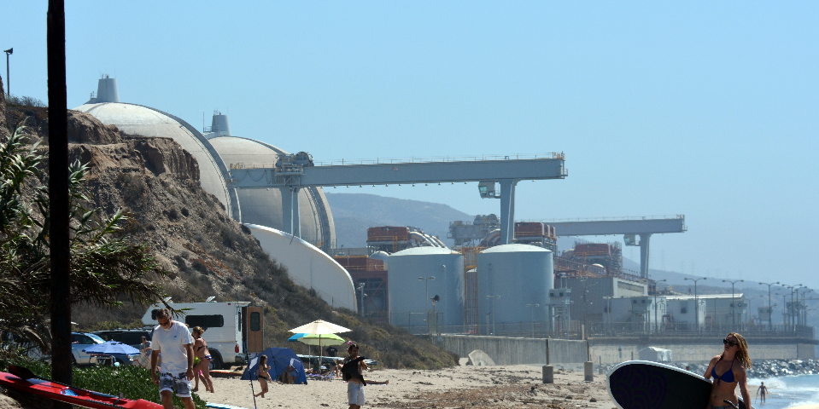
San Onofre Nuclear Generating Station

Slide 16
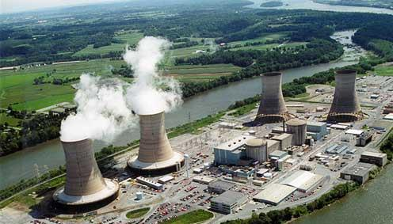
Three Mile Island Unit-2 Nuclear Power Plant

Slide 17
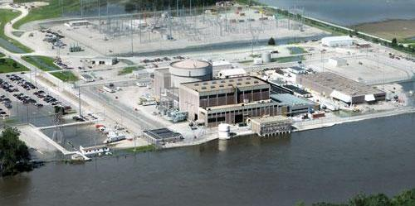
Fort Calhoun Nuclear Generating Station

Slide 18
Depleted Uranium Disposal in Utah
[COMPLETED] - Clarify Utah’s policy that prohibits the disposal of classes B and C waste;
[NEAR COMPLETE] - As required by Utah Administrative Rule R313-25-9, a Performance assessment must demonstrate human health and the environment are protected following disposal of depleted uranium;
[NEAR COMPLETE] - DOE must agree, in a legally-binding manner, to become the long-term governmental custodial agency; and
[NEAR COMPLETE] – Radioactive Material License granted for Federal Cell Facility
Expected completion 2020

Slide 19
Thank You

