Slide 1
Barnwell LLRW Disposal Facility
Low Level Waste Forum Meeting
March 25-26, 2020

Slide 2
Barnwell Disposal Facility (BDF)
BDF Location and History
Atlantic Compact History and Membership
Regulatory Oversight
Disposal Site Access and Rates
Disposal Facility Capabilities

Slide 3
BDF’s Location
235 acres licensed for disposal
122 acres in closed condition
28.3 million cubic feet and 14.3 million curies buried

Slide 4
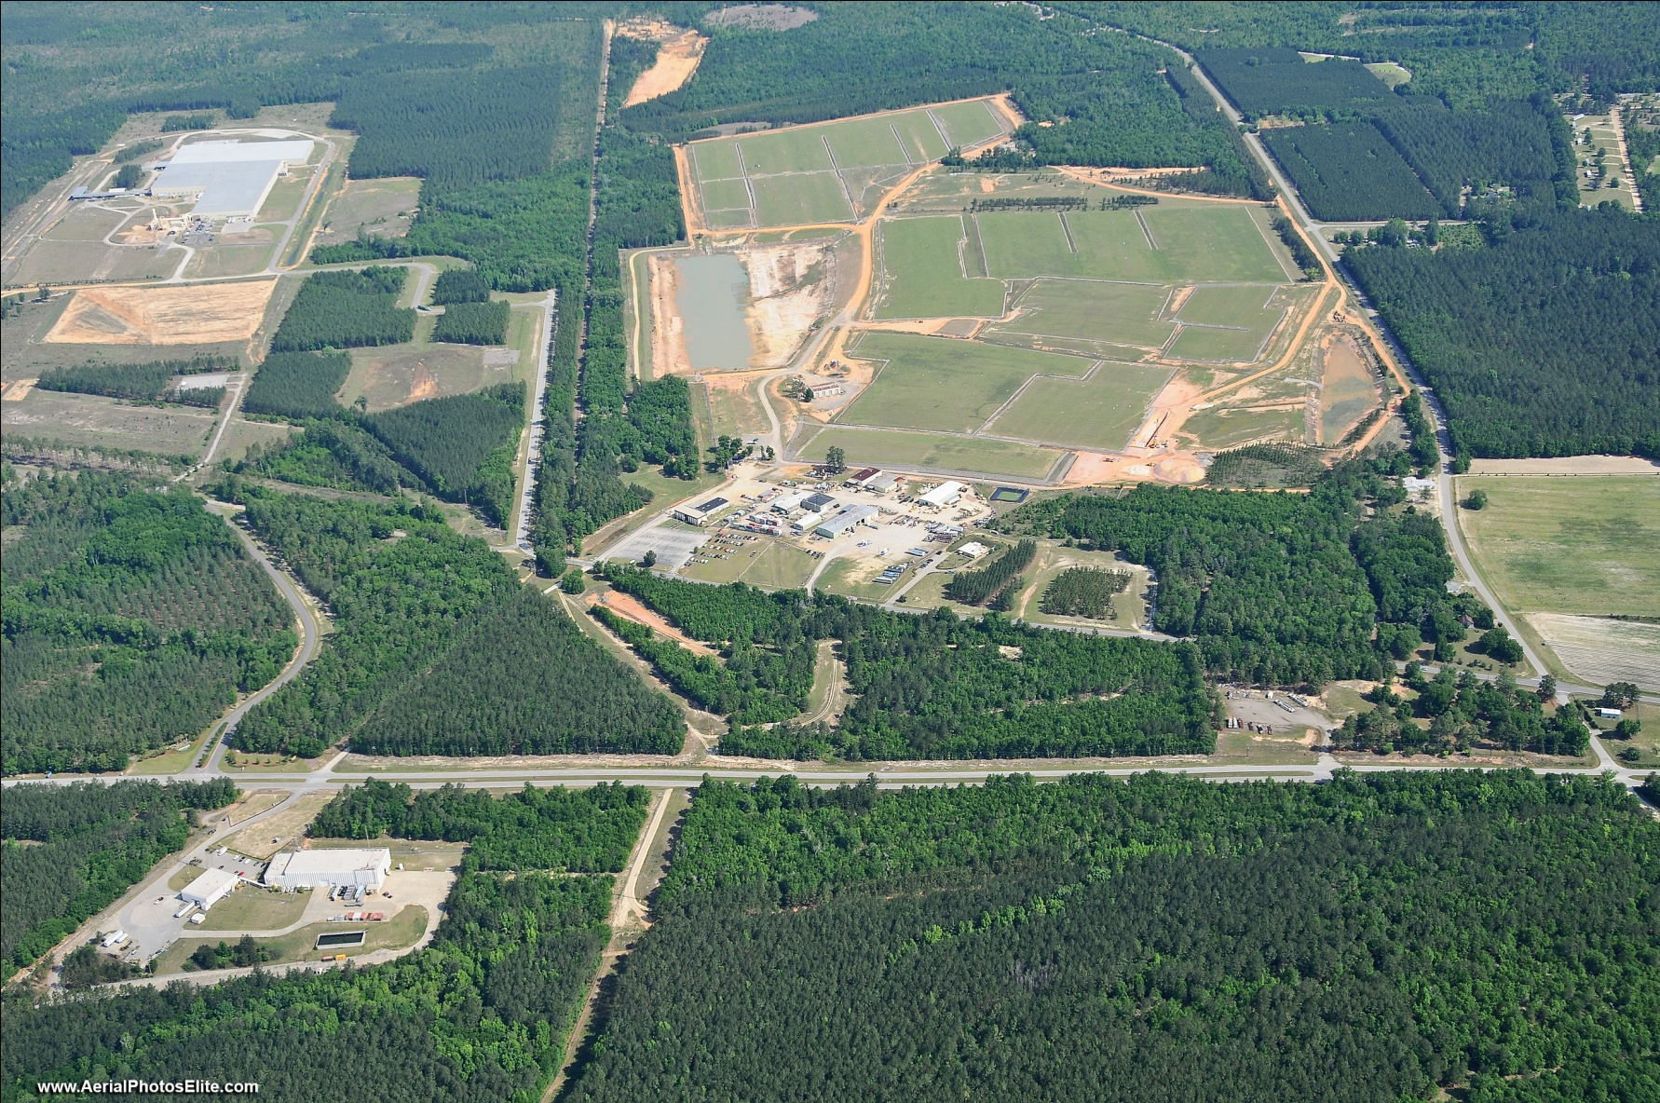
Barnwell Complex

Slide 5
BDF History
Barnwell Disposal Facility has operated uninterrupted from 1971 to present
Received waste from across the US until 2008
Atlantic Compact only operations since 2008

Slide 6
Atlantic Compact History and Membership
2000 Atlantic Compact Act
Atlantic Compact only operations started July 1, 2008 after 8 year transition
Membership
  South Carolina
  New Jersey
  Connecticut
Receive about 9,000 cubic feet average yearly volume (excluding large component and IH volume)
Average 60-70 containerized (only) shipments per year

Slide 7
Barnwell Site Regulatory Agencies
SC Office of Regulatory Staff (ORS)
  Detailed audits of actual costs
  Sets prices for waste disposal
SC Public Service Commission (PSC)
  Determines allowable costs
  Annual hearing process
SC Dept. of Health & Environmental Control (DHEC)
  Licenses radioactive materials - disposal

Slide 8
DHEC Oversight
Licensed by the State of South Carolina Department of Health and Environmental Control (DHEC) for the receipt and disposal of Class A, B, and C low-level radioactive wastes
DHEC provides
  On-site Inspector
  Weekly engineering inspections
  Minimum twice a year license inspections

Slide 9
Atlantic Compact Disposal Rates
Rate Schedule approved by SC Office of Regulatory Staff every Fiscal Year
Provides 2 Options
  Option A –Maximum Uniform Rate Schedule
  Option B – Access Fee Customer, Volume Allocation

Slide 10
Atlantic Compact Disposal Rates
  Five utilities/customers with 13 reactors in Atlantic Compact use Option B
    Pay quarterly access fee for disposal
    Each reactor allocated 538.46 cubic feet
    $133 per cubic foot over allocated volume
  Non-utilities pay calculated rate (Option A) based on several factors including:
    Density and weight
    Dose rate
    Radioactivity
    Biological waste

Slide 11
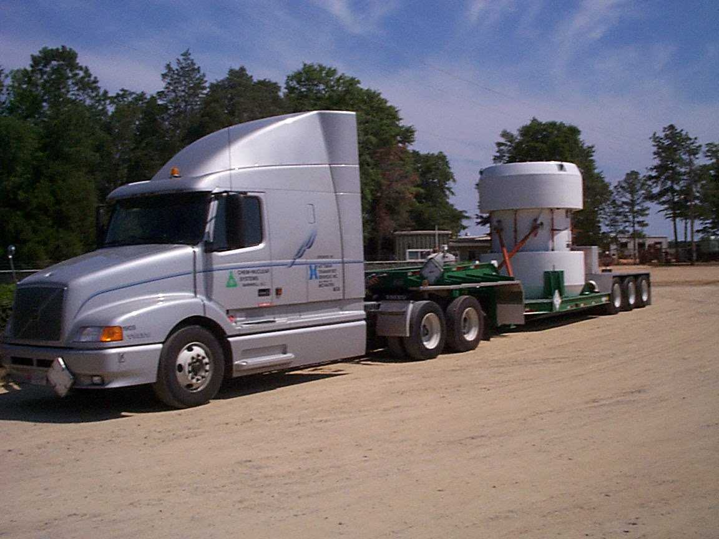
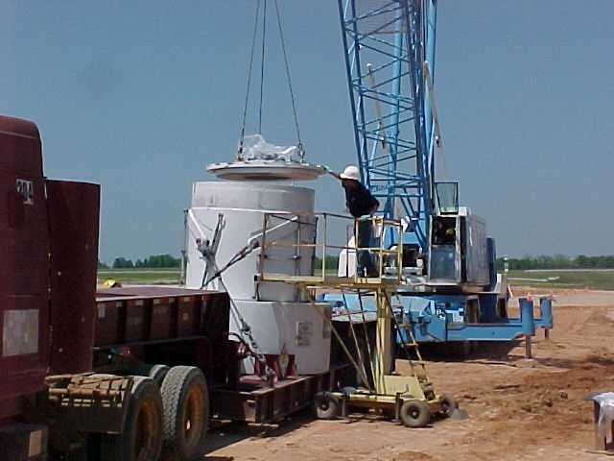
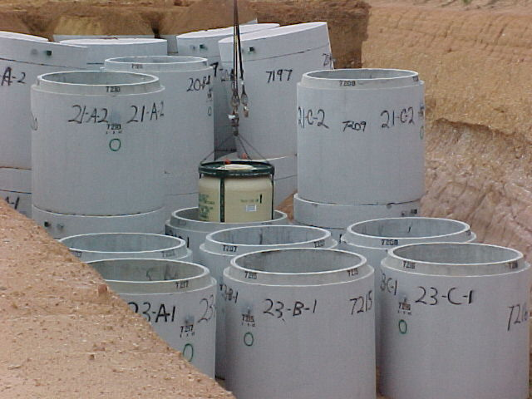
Class A/B/C Waste Disposal
All waste arrives by truck
Most shipments are HIC liners
Vertical crane lift to place liner in prepositioned DHEC approved vault
All waste classes in same trench - Separate vaults for stable/unstable

Slide 12
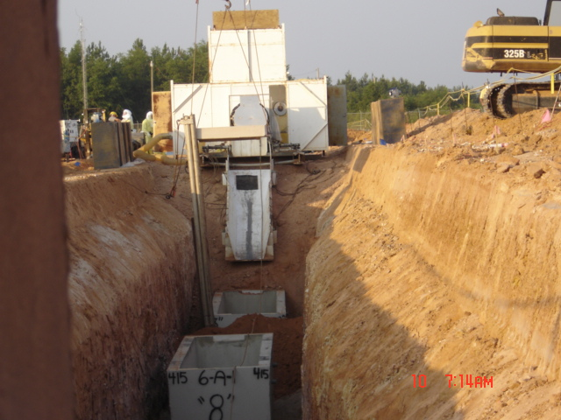
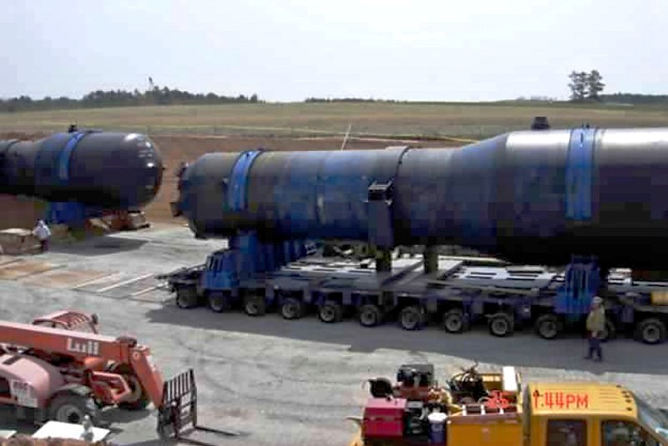
Large Component /
Irradiated Hardware Disposal
Irradiated Hardware and Large Component Shipments
  Pricing based on Cost Plus

Slide 13
Institutional Activities
>90% of facility in closed condition and under institutional monitoring and maintenance
Extended Care Fund
  Balance as of December 31, 2019 $151,337,631.82
Projected Cost of Phase II Decommissioning $7,169,066

Slide 14
Status of BDF Operating License
SC Supreme Court issued decision March 27, 2019
Reversed COA conclusion of noncompliance with one subsection of the regulations
Affirmed Court of Appeals (COA) conclusion that compliance was not demonstrated for three subsections of the regulations
  Modified COA opinion that the COA can mandate specific actions be taken in accomplishing technical requirements of the regulations
  Modified COA opinion that the concept of ALARA could be ignored when satisfying technical requirements of regulations
  Remanded to SC DHEC with no limitations to the record

Slide 15
What Happened Next?
SC DHEC requested Chem-Nuclear submit a comprehensive license renewal application
September 2019 Chem-Nuclear submitted comprehensive license renewal application
  Seven 4” binders
  Included Compliance Evaluation focused on demonstration of compliance for the three subsections of the regulations
  SC DHEC has renewal application under timely renewal

Slide 16
Questions!

