Slide 1
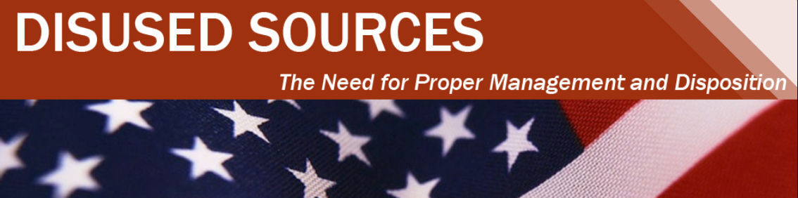
Overview of the LLW Forum’s Disused Sources Working Group Michael Klebe March 25, 2020

Slide 2
Disused Sources Working Group Origin
DSWG formed in 2011 at the request of the NNSA/GTRI to address the problem of disused radioactive sealed sources
Approximately 2 million sealed sources in use
Tens of thousands disused sources with no exact knowledge of number, activity, and storage security

Slide 3
Disused Source Problem Contributing Factors
Life-cycle costs for managing and disposing of sources not internalized
Inconsistent view of which sources pose a security threat
Regulatory system inadequacies for a post-9/11 threat environment
No financial incentive for reuse, recycle, or disposal
Opportunities for recycling and reusing sources are underutilized
Type B shipping container availability and cost

Slide 4
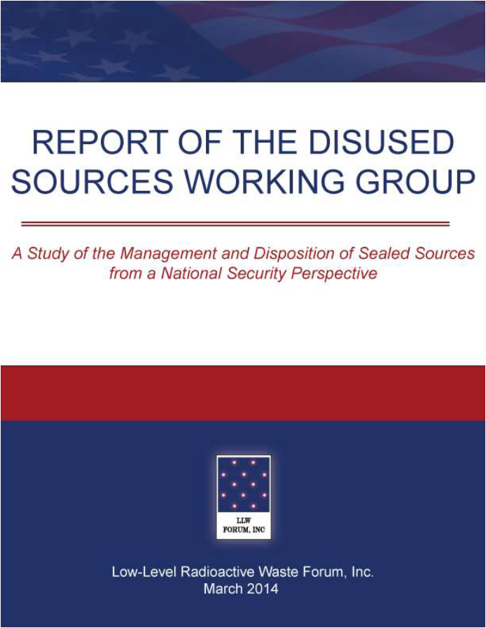
DSWG Report
Report published – March 2014
24 recommendations for improving the security of sealed sources
Several recommendations have been completed
Currently revising the priority of the remaining recommendations
Notes:
19 meetings
30 months
Stakeholder engagement
Report preparation
Technical Review
Report published – March 2014
24 recommendations for improving the security of sealed sources

Slide 5
Source Exchange Pilot Study
The CRCPD has conducted an informal source exchange program based on staff knowledge and contacts.
The DSWG evaluated the merit of establishing a formal computer-based exchange where sources not in use could be matched with users who need a source.
Based on a questionnaire there was licensee interest in such a program.
However, when attempts were made to identify willing participants to pilot a program, interest waned.
DSWG has suspended further activities related to a source exchange.

Slide 6
Resources: Disposition Options and Costs
Availability and Constraints
Reuse – Recycle - Disposal
Industry specific
Generic cost estimate
Current revision
Simplified
Segregated by industry

Slide 7
US NRC BTP on Concentration Averaging and Encapsulation
BTP provides:
Guidance for proper classification of waste for disposal
Acceptable methods for averaging radionuclide concentrations over the volume or mass of waste
Original in 1995
Revised in 2015:
Improve clarity
Update position on LLRW blending
Align the BTP with the NRC’s risk-informed performance regulatory approach

Slide 8
US NRC BTP on Concentration Averaging and Encapsulation
Revised BTP does not appear to have increased the disposal of sealed sources.
DSWG plans to:
Study the original and revised BTP as it relates to sealed sources
Identify methods to identify BTP related obstacles for sealed source disposal
Consider developing implementation guidance specific to the disposal of sealed sources

Slide 9
Additional Information:

