Slide 1
Low-Level Radioactive Waste Forum Part 61 Working Group -- Update
Chicago, IL
October 31, 2019

Slide 2
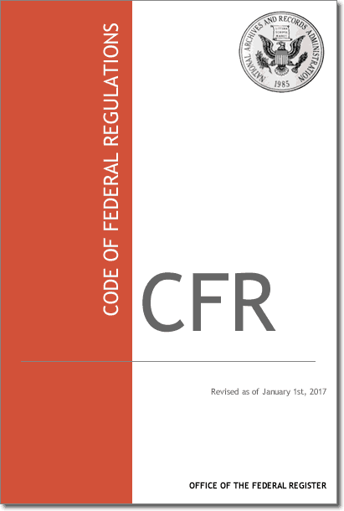
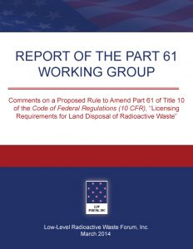
Background
Organized in 2012 to provide input to the NRC’s Part 61 rulemaking initiative
Title 10 - Energy
Part 61

Slide 3
Background (cont.)
Original members represented sited states, including Pennsylvania

Slide 4
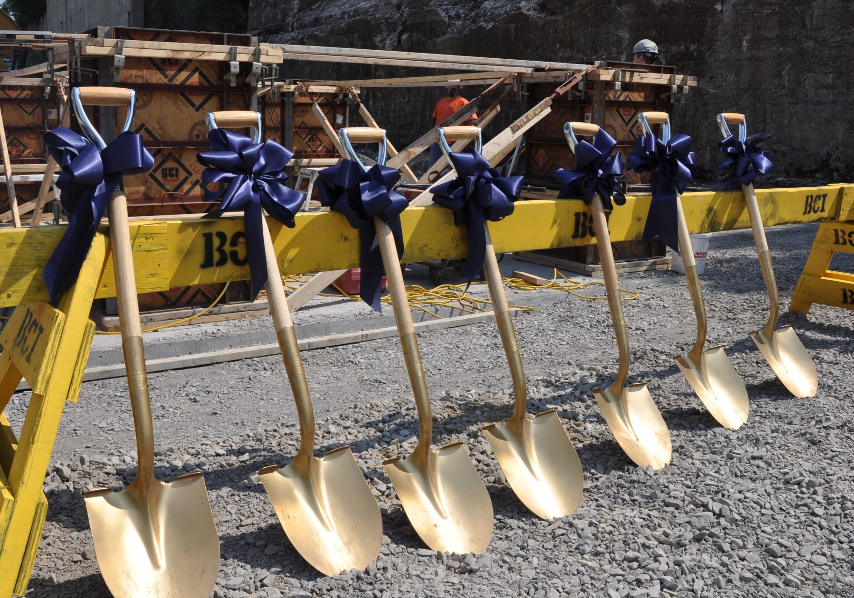
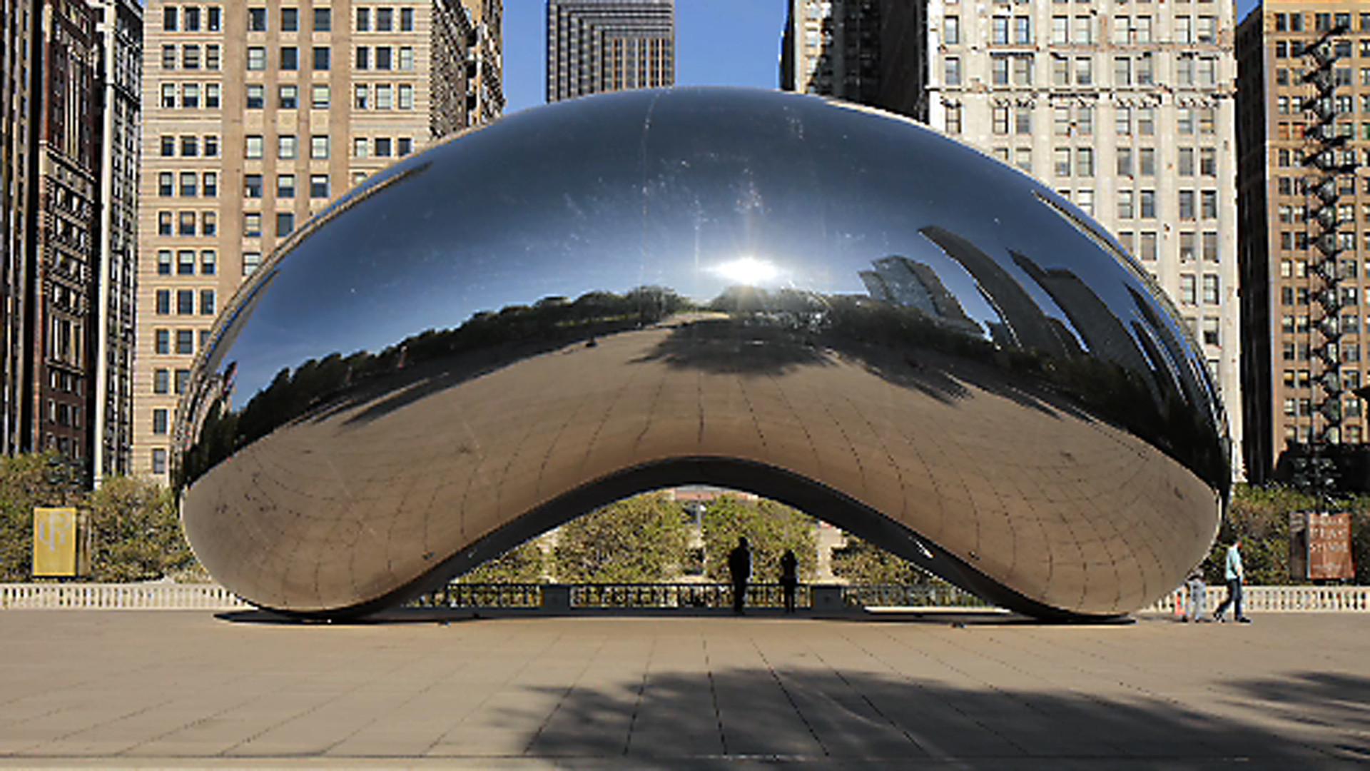

Slide 5
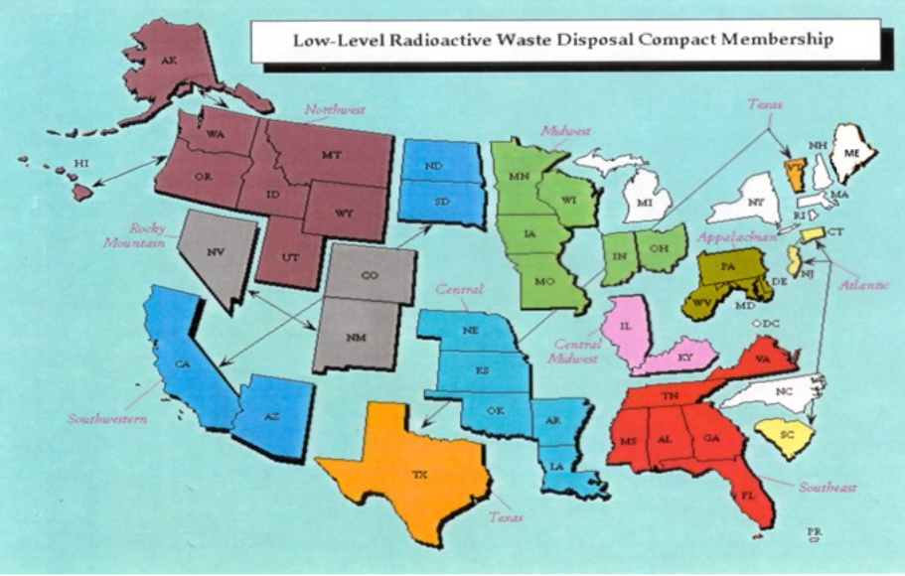

Slide 6
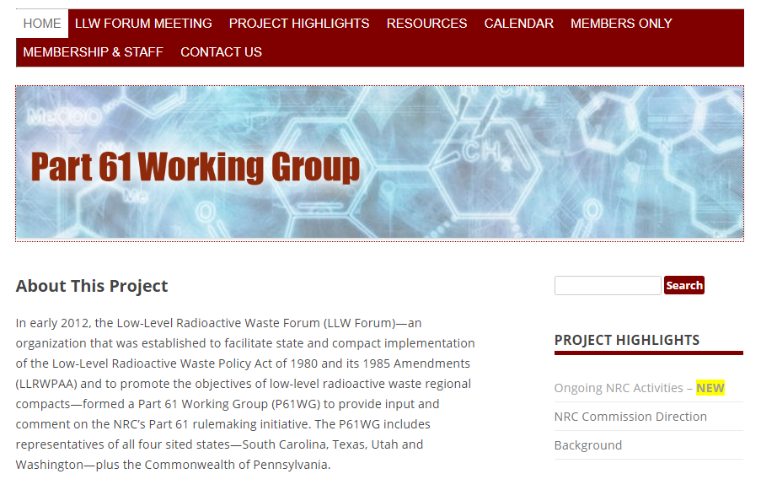
Web site created
(www.part-61.org)

Slide 7
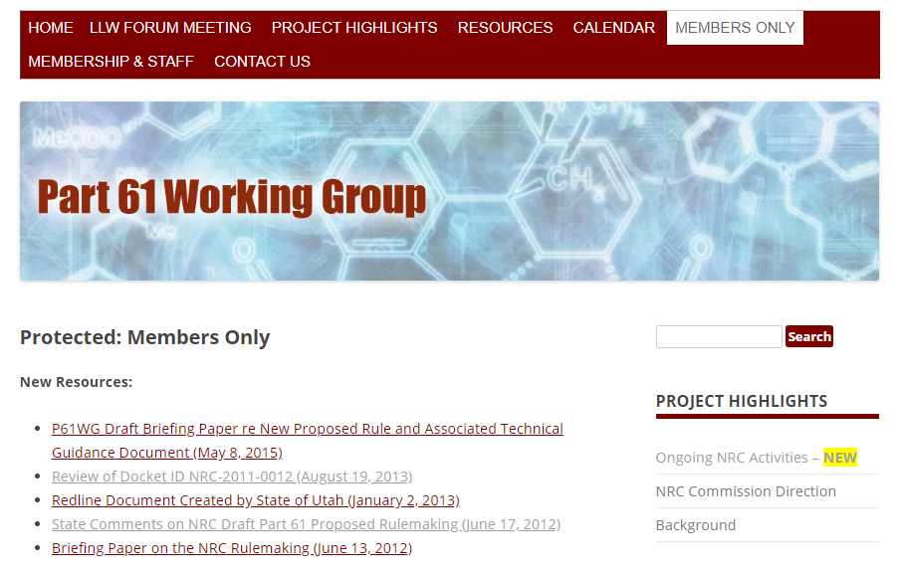
Web site created
(www.part-61.org)
Members Only page
(PW required)

Slide 8
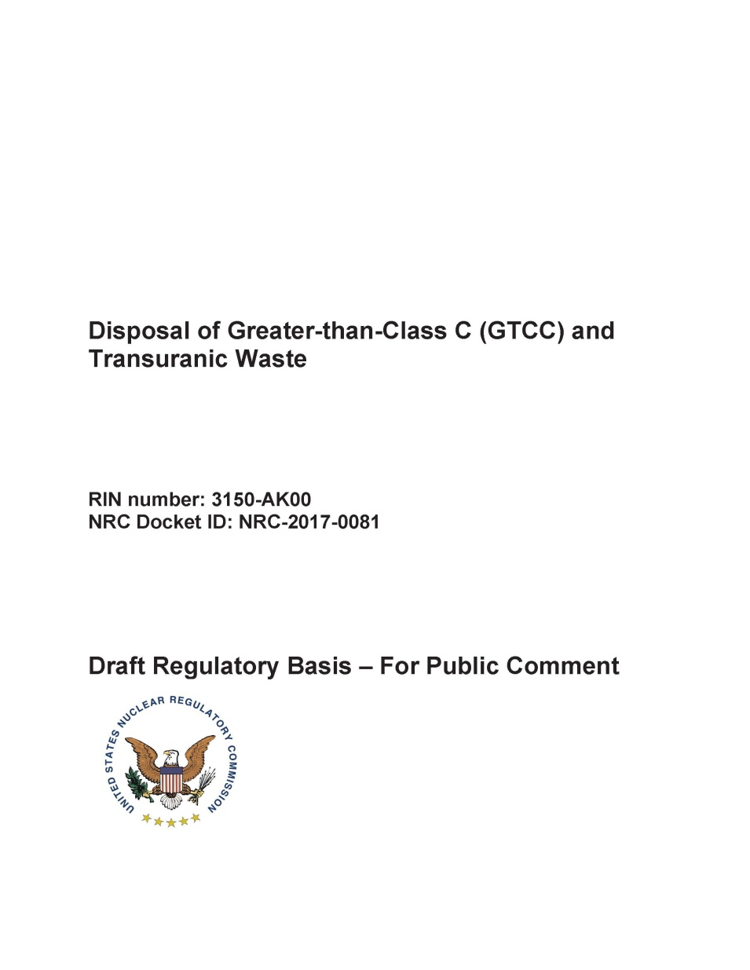
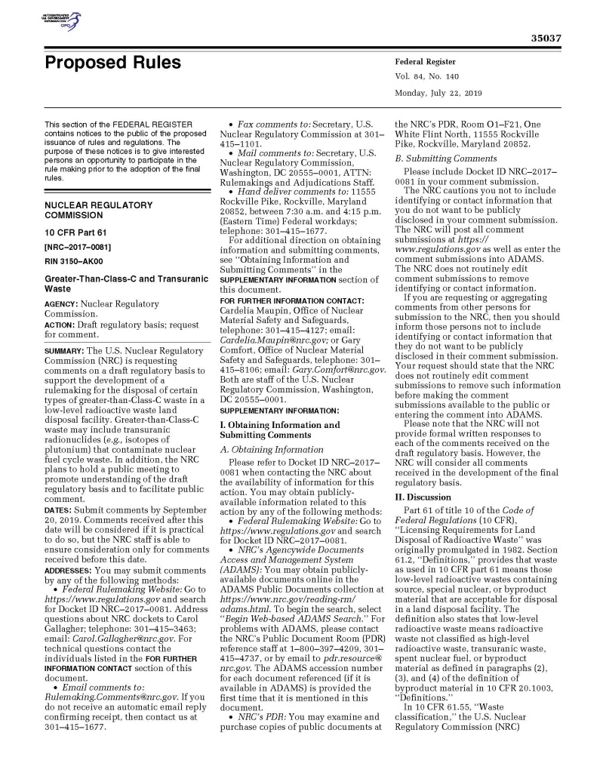
CURRENT ACTIVITY
Review & comment
July 22, 2019
Comment Period Ends: 11/19/2019

