Slide 1
Innovation in
Decommissioning
Business Models
Bruce Montgomery
Low Level Waste Forum
October 31, 2019

Slide 2
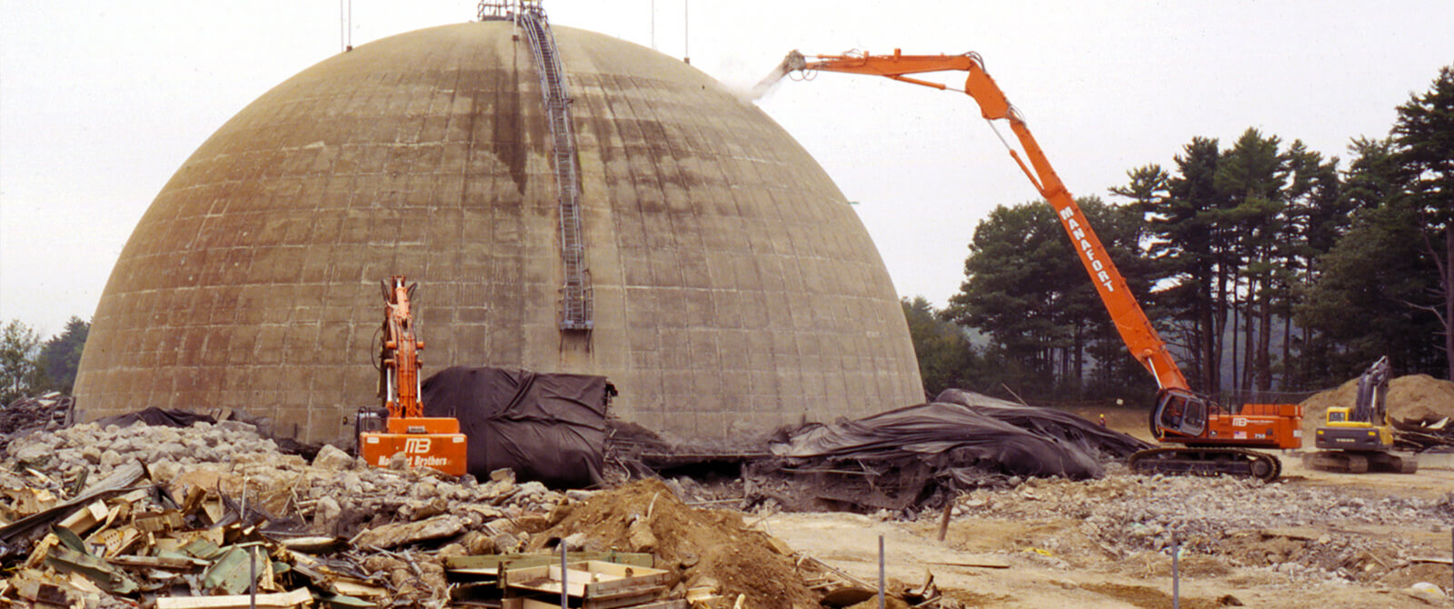
Decommissioning: “This doesn’t mean we are saying Goodbye”

Slide 3
Celebrate the reality of our uniqueness
We don’t arrive at the “beginning of the end of life” unprepared:
Ours is the only major industry that must have a plan for and means to fund end-of-life before a license to operate is even granted.
In the nuclear decommissioning business our member suppliers are competitive:
Healthy market competition breeds innovation.
Yet we are all still hostages of each other.

Slide 4
Success is Critical to the Industry
NEW: NEI Board-Level Task Force (Owners and Suppliers)
Monitor federal and state legislative activity
Establish executive level of communication across D&D community
Influence NRC to establish regulatory framework
NEI Decommissioning Working Group
22 Supplier companies
13 Utility/Owner companies
Eight topical “swim lanes” to deliver common solutions

Slide 5
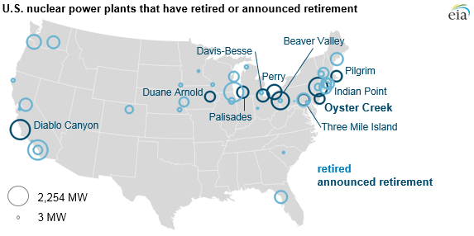

Slide 6
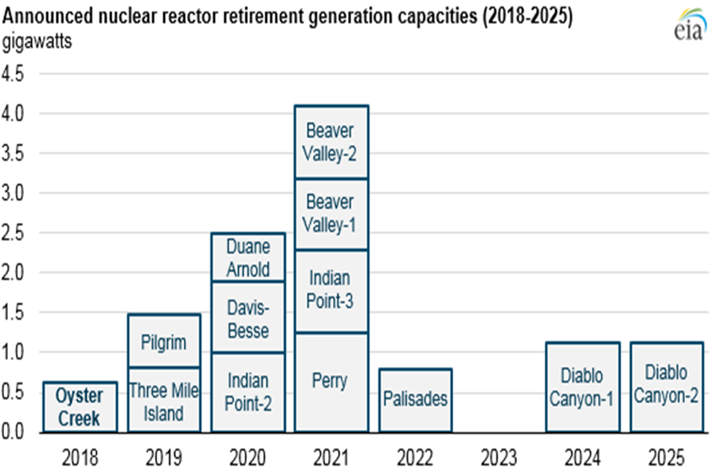

Slide 7
Forecast of Decommissioning Completion*
Vermont Yankee
Oyster Creek
Pilgrim
TMI-1
Indian Point 2&3
Duane Arnold
Palisades
TMI-2
Crystal River 3
San Onofre 2&3
Beaver Valley 1&2
Diablo Canyon 1&2
Decommissioning
ISFSI Only
*Assume 8 years to ISFSI Only
2019 2021 2023 2025 2027 2029 2031 2033 2035

Slide 8
Looking Ahead: US Plant Retirements in the 2030’s
Sources: U.S. Nuclear Regulatory Commission; U.S. Energy Information Administration | Updated: June 2019

Slide 9
Forecast: Estimated Annual Cash Flow
$ Millions

Slide 10
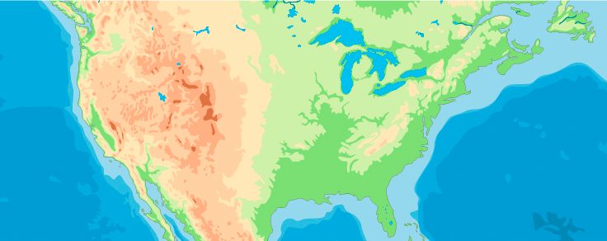
Completed Decommissionings
Trojan
Big Rock Point
Maine Yankee
Pathfinder
Yankee Rowe
Shippingport
Connecticut Yankee
Fort St. Vrain
Saxton
Shoreham
Rancho Seco
San Onofre Unit 1
Notes:
US has more decommissioning experience than any other country
Most references would credit 11 completions
I would argue 12 crediting SCE with SONGS Unit 1

Slide 11
Active Decommissionings
La Crosse
Vermont Yankee
Pilgrim Unit 1
Humboldt Bay
Zion Units 1 & 2
Fort Calhoun
Oyster Creek
San Onofre Units 2 & 3
Crystal River Unit 3
Notes:
11 Active
4 nearing completion

Slide 12
Nuclear Plants in SAFSTOR
Fermi Unit 1
Kewaunee
TMI Units 1 & 2
Peach Bottom Unit 1
Millstone Unit 1
Dresden Unit 1
Indian Point Unit 1
GE Vallecitos (2)
NS Savannah
Notes:
11 SAFSTOR
Anticipate at least 3 will move into active D&D over the next few years

Slide 13
Committed Shutdowns
Palisades
Duane Arnold
Indian Point Units 2 & 3
Diablo Canyon Units 1 & 2
Notes:
v

Slide 14
Nuclear Plants in Various Stages of D&D
Completed D&D: 12 units
Active D&D: 11 units
SAFSTOR: 11 units
Committed Shutdown: 6 units
Completed D&D: 12 units
Active D&D: 11 units
SAFSTOR: 11 units
Committed Shutdown: 6 units
Notes:
40 Reactors
34 shutdown
with an addition 6 committed to close over the next 3 years

Slide 15
Decommissioning Business Models
Self Perform
General Contractor
Shared License Stewardship
Asset Acquisition/Transfer

Slide 16
Back to 2019 — An Evolving Decommissioning Market
Owner Risk Transfer
1
Self-Performance
Managed and Performed by Utility
Some SOW distributed to specialty subcontractors
Site Examples: Maine Yankee, Humboldt Bay
Min
2
DGC
Decommissioning General Contractor
Majority of D&D tasks contracted
Site Example: SONGS
3
License Stewardship
Risk Optimized Model
Transfer 10CFR50 License, comprehensive D&D, Owner retains fuel
Site Examples: Zion, La Crosse (with Fuel Co)
4
Max
Asset Transfer
Transfer License, Equity and Assets
Full turnover of plant, fund, and SNF
Site Example: Vermont Yankee, Oyster Creek, Pilgrim
January 2019

Slide 17
Self Perform Sites
Trojan
Maine Yankee
Fort Calhoun
Yankee Rowe
Humboldt Bay
Shippingport
Connecticut Yankee
Shoreham
Rancho Seco
Saxton
San Onofre Unit 1
Notes:
SELF PERFORM (11)
Note 2 of these projects started as DGC but were eventualy completed as Self-Perform: 1 contract issues, 1 DGC bankruptcy
Completed D&D
Connecticut Yankee
Maine Yankee
Rancho Seco
Shippingport
Shoreham
Saxton
Trojan
Yankee Rowe
San Onofre 1
Active D&D
Fort Calhoun
Humboldt Bay

Slide 18
General Decommissioning Contractor Sites
Big Rock Point
Pathfinder
Fort St. Vrain
San Onofre Units 2 & 3
Notes:
General D&D Contractor (5)
Completed D&D
Big Rock Point
Fort St. Vrain
Pathfinder
Active D&D
San Onofre Units 2 & 3

Slide 19
License Stewardship Sites
La Crosse
Zion Units 1 & 2
Crystal River Unit 3
Notes:
License Stewardship (4)
Active D&D
Crystal River Unit 3
La Crosse Boiling Water Reactor
Zion Units 1 & 2

Slide 20
Asset Transfer Sites
Vermont Yankee
Palisades
Pilgrim Unit 1
Indian Point Units 1, 2 & 3
TMI Unit 2
Oyster Creek
Notes:
Asset Transfer (8)
Active D&D
Indian Point Units 1, 2 & 3
Palisades
Pilgrim 1
Oyster Creek
TMI 2
Vermont Yankee

Slide 21
Drivers that are Changing the D&D Market
Little upside for owners if project underruns NDT
Transfer downside risk of cost overruns
Focus on the core business of operations
NDT balances have grown, facilitating asset transfers
More D&D experience equals more cost predictability
More Joint Ventures willing to assume and manage D&D risks
Notes:
Little upside – why take the financial risk of a complex project if any underrun is returned to ratepayers and they may not be able to recover overruns
Focus on core business – Fleet – operations, Single unit – exit nuclear all together and eliminate any required nuclear infrastructure

Slide 22
Marketplace Transformation
Suppliers are Building More Efficient Business Models
Decommissioning Experience/Expertise
Nuclear
Non-Nuclear
Domestic and International
Decommissioning Plant Ownership
Used Fuel Ownership
Transportation
LLW Disposal
Used Fuel Consolidated Interim Storage

Slide 23
Acknowledgements
AECOM
EnergySolutions

Slide 24
Solutions Enable Clean Energy
…We’ve only just begun

