Slide 1
Decommissioning San Onofre
Low-Level Radioactive Waste Forum
Stevie Vaughan
Oversight Manager
Radiation Protection & Waste
October 31, 2019

Slide 2
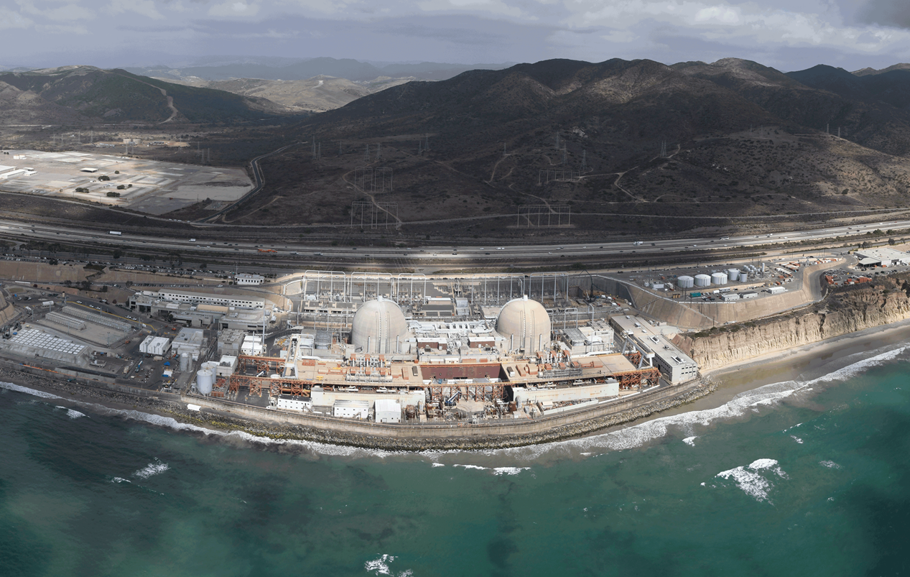
San Onofre Plant

Slide 3
Goal & Principles
Safety
Engagement
Stewardship
Complete decommissioning in a safe, timely, transparent, & cost-efficient manner while maintaining high standards of environmental protection

Slide 4
San Onofre Plant History
Unit 1
Online January 1968
Retired 1992, partially decommissioned
Units 2 and 3
Online November 1983, April 1984
Retired June 7, 2013
Spent Fuel Storage
Over 50 years
Dry Cask Storage since 2003
4

Slide 5
SONGS Decommissioning Plan

Slide 6
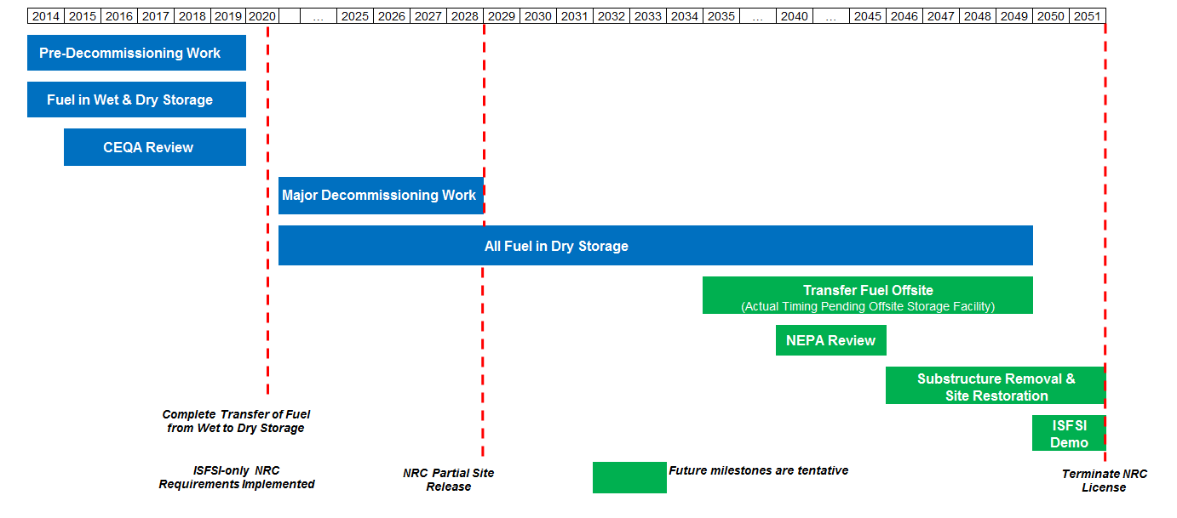
Decommissioning Plan Subject to Change
Future milestones are tentative

Slide 7
Project Milestones

Slide 8
Milestones 2014 - 2017
2014
Submitted Post-Shutdown Decommissioning Activities Report, Decommissioning Cost Estimate, Irradiated Fuel Management Plan to NRC
Staffing transitions and down sizing
2015-2017
Spent Fuel Pool Island
Cold and Dark
Construct Independent Spent Fuel Storage Installation (ISFSI) Pad
Decommissioning General Contractor (DGC) selection and mobilization

Slide 9
Milestones 2018 - Present
2018 – Present
ISFSI Only NRC License Amendments
Technical Specifications
Emergency Plan
Security Plan
Obtain Environmental Permits
Safely transfer used fuel to ISFSI

Slide 10
California Environmental Quality Act (CEQA)
Two state permits required to start decontamination & dismantlement
MILESTONE | TIMING
Final EIR and lease certified by CSLC at public meeting | Approved March 21, 2019
CDP application for onshore work from CCC to be considered at public meeting in San Diego | Approved October 17, 2019
Offshore work requires a CDP from CCC with a public meeting anticipated mid-2021

Slide 11
Used Fuel Management

Slide 12
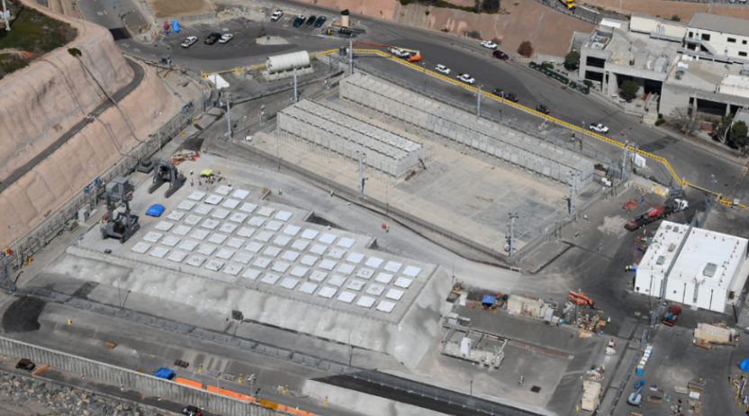
SONGS Independent Spent Fuel Storage Installation
AREVA System
(50 spent fuel canisters)
Holtec System
(73 spent fuel canisters)

Slide 13
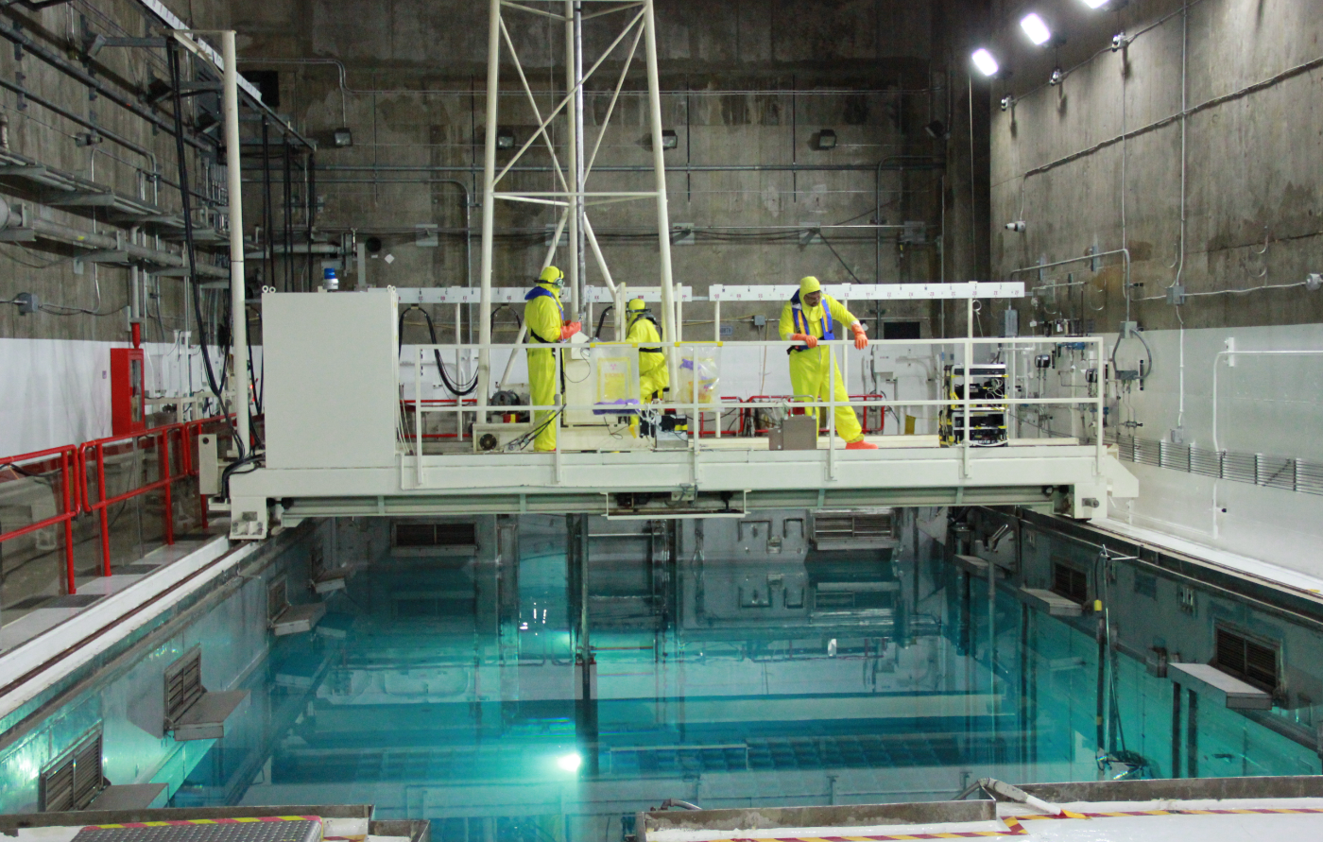
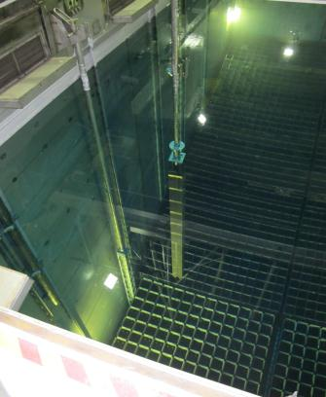
Spent Fuel Pool “Wet” Storage

Slide 14
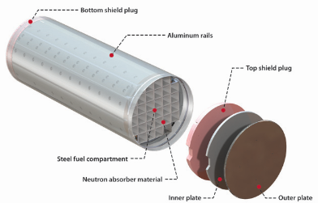
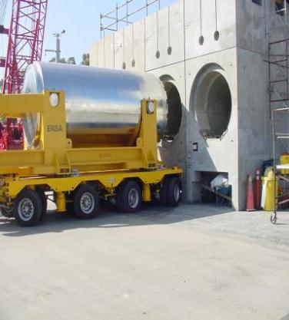
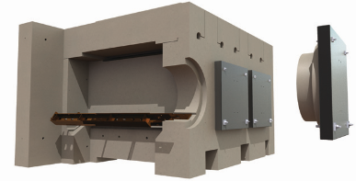
Areva Nuhoms

Slide 15
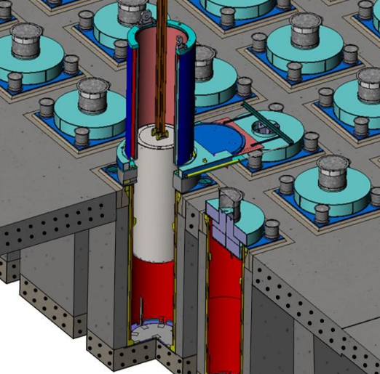
Holtec HI-STORM UMAX
Stainless Steel Lid
Corrosion-Resistant Stainless Steel Multipurpose Canister
Corrosion-Resistant Stainless Steel Cavity Enclosure Container
Reinforced Concrete Pad (Top/Bottom)

Slide 16
On-site Used Fuel Storage
INITIAL STATE
EXPANDED ISFSI
FUTURE STATE
Spent Fuel Pools 2668 fuel assemblies
73 canisters (2668 fuel assemblies)
+
existing 50 canisters (1187 fuel assemblies)
3855 fuel assemblies in 123 canisters
Existing ISFSI
50 canisters (1187 fuel assemblies)
CANISTERS ARE BEING LOADED ONTO THE ISFSI
16

Slide 17
Used Fuel Transportation Readiness
Some fuel qualified for transport now
Remaining fuel qualifies over time
 | NOW | ‘20 | ‘21 | ‘22 | ‘23 | ‘24 | ‘25 | ‘26 | ‘27 | ‘28 | ‘29 | ‘30 | TOTAL
Units 2/3 AREVA NUHOMS 24PT4
Unit 1 AREVA NUHOMS 24PT1
Units 2/3 HOLTEC MPC-37
6
33
33
2
1
5
9
17
67
2
2
1
1
73

Slide 18
Decommissioning Cost Estimate

Slide 19
Decommissioning Cost Estimate
Total estimate = $4.411 Billion (100% share, 2014$$)
Current trust fund balances expected to fully fund decommissioning

Slide 20
Estimated Waste Types/Amounts (Volumes noted from DCE)

Slide 21
Community Engagement

Slide 22
San Onofre Community Engagement Panel
Created in 2014 to serve as an open conduit between the public and the utility
Eighteen representatives from surrounding cities and counties, including:
Elected officials and agency representatives | Local law enforcement
Representatives of the U.S. military | Business and labor communities
Local environmental organizations | Local schools and academic institutions

Slide 23
Visitors
Since 2014, 3000+ visitors including:
The Public - walking tours twice monthly
High school students, teachers and parents
California Energy Commission
Members of Congress: Harley Rouda (D-48), Mike Levin (D-49), Scott Peters (D-52), Katie Porter (D-45); John Shimkus (R-IL)
City Council members from San Clemente, San Juan Capistrano, Dana Point, Encinitas
San Diego Regional Water Quality Board
Native American Tribal Nations
City of San Diego Fire Department
Orange County Coastkeepers
Ocean Institute
San Diego Union Tribune
Sierra Club, Los Angeles and San Diego Chapters
Surfrider Foundation
23

Slide 24
Public Engagement
Keep the public informed
Quarterly updates and annual progress reports
Advance notice of regulated ocean discharges
More frequent reporting of environmental monitoring program results
Live-time radiological monitoring for spent fuel storage facility
Designated liaison as public point of contact
Website: www.SONGScommunity.com
24

Slide 25
Framework of Oversight

Slide 26
Framework of Oversight
A Graded Approach to Oversight:
Risk weighted, management prioritized, and resourced leveled
Clearly Define Organizational Responsibilities:
Oversight Specialist complete a qualification guide prior to independent field oversight
Multiple Desktop Guides created to provide guidance and expectations
Comment Resolution Methodology:
Predictable methodology for mediating disagreements on the issues
Defined Behaviors and Expectations:
One voice and one standard
Promote a healthy relationship with the Contractor
High quality oversight
Maintain and protect credibility
Maintain Independence
Comments grounded (Compliance based & the 3 R’s)
9 of 35
26
Notes:
3

Slide 27
Lessons Learned

Slide 28
Lessons Learned
Regulatory
Open and frequent communication with Region and Headquarters
Maintain close cooperation with other utilities
Do not under estimate amount of time and effort that maybe required for various permits or permitting agencies that may be involved
Contractors
Know vendor’s capabilities (technical rigor, regulatory, PR, etc.)
Know design basis
Take caution in “Turn Key” operations

Slide 29
Lessons Learned
Community Engagement
Transparent, “plain English”
Community Engagement Panel
Broader use of experts – include all different perspectives
Tours to key stakeholders, local high schools and public
External Engagement
Pro-active approach to challenging mis-information
Active Social Media Presence
Identify and engaging “Influencers”

Slide 30
More information on www.SONGScommunity.com

