Slide 1
LOW-LEVEL RADIOACTIVE WASTE FORUM, INC.
Monday, October 21, 2019

Slide 2
Survey Goals
Capture issues facing Low-Level Waste Forum
Opportunity for feedback from membership
What products are providing benefit
Should the LLWF maintain two meetings per year
Status on membership renewals
Open ended questions

Slide 3
Survey Information
Critical information during transition to new ED
Maintain valued products
Understanding of what the LLWF is doing well
Understanding of where the LLWF needs to improve

Slide 4
The Survey
Rolled-out at as paper based survey to attendees at Spring Meeting in April 2019
Followed-up with a web based survey
Had two surveys: current membership and past membership
Survey Monkey

Slide 5
Survey Participation
60 Responses
20 Spring Meeting
38 Current Membership
2 Past Membership

Slide 6
Summary Results
Majority respondents from compacts and involved with LLWF great than 8 years
About 50% fees appropriate versus too high
Members value the meetings, and prefer 2 meetings per year
Renewing Membership: Yes 62 %; No 9%; Not Sure 38%

Slide 7
Summary Results
Transparency!
Fiscal management, costs/fees, funding
Allow for more discussion opportunities during meetings
Allow for more evening networking opportunities during meeting
Modernize meetings/handouts/newsletters
Develop new LLWF Mission
Maintain/enhance relationships

Slide 8
Incorporation of Results
Maintained Fall Meeting, 1.5 days
Added transparency sessions to meeting agenda
Added discussion time to meeting agenda
Added networking opportunities to meeting
Modernize

Slide 9
Survey Results

Slide 10
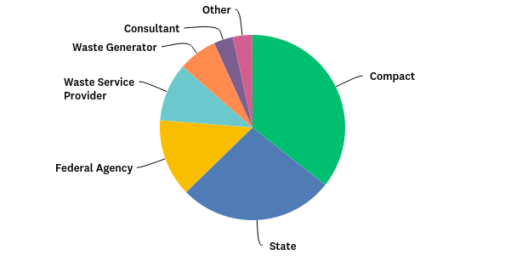
Q1: Please indicate the member category that best describes the organization you represent:
Answered: 59 Skipped: 1

Slide 11
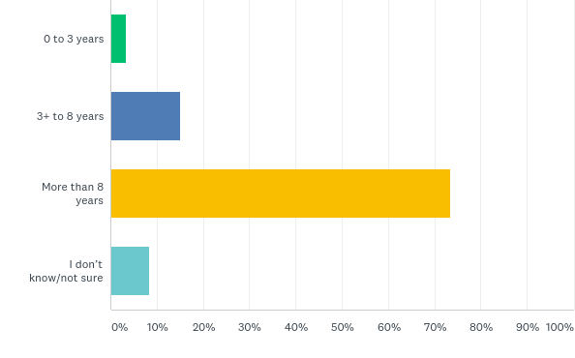
Q2: How long has your organization been a member of the Forum?
Answered: 60 Skipped: 0

Slide 12
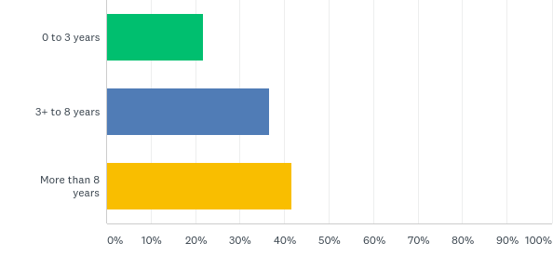
Q3: How long have you personally been involved with the Forum?
Answered: 60 Skipped: 0

Slide 13
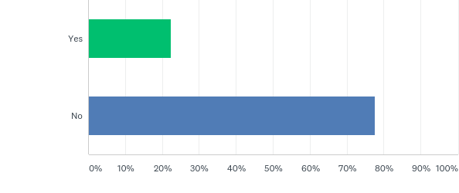
Q4: Are you a member of the Executive Board?
Answered: 58 Skipped: 2

Slide 14
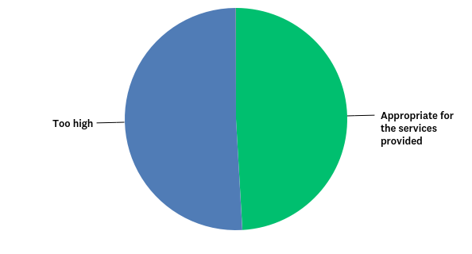
Q5: The Forum membership fees are:
Answered: 55 Skipped: 5

Slide 15
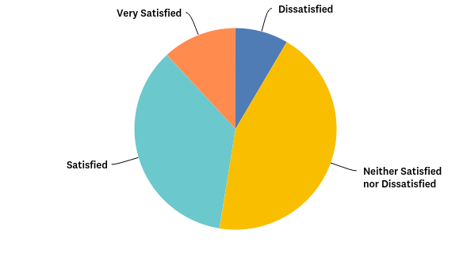
Q6: What is your general level of satisfaction with the Forum?
Answered: 59 Skipped: 1

Slide 16
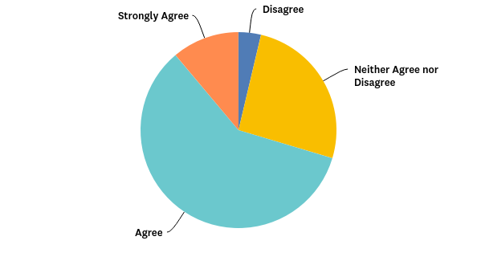
Q7: The Forum provides a benefit to my organization for purposes of addressing low-level radioactive waste matters:
Answered: 54 Skipped: 6

Slide 17
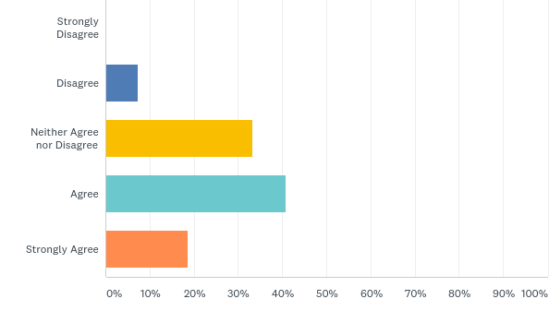
Q8: The forum is an important venue for communicating my organization's concerns to the appropriate regulatory agencies (e.g. commenting on NRC proposed rulemaking):
Answered: 54 Skipped: 6

Slide 18
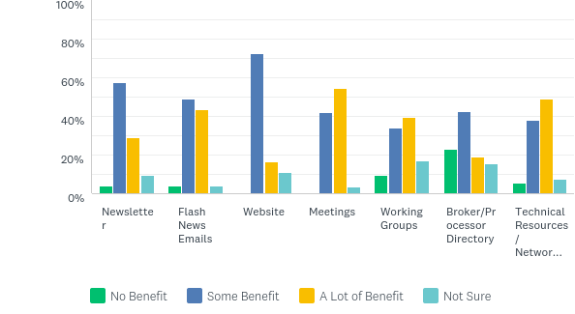
Q9: Please rate the benefit level to your organization of the following services provided by the Forum:
Answered: 56 Skipped: 4

Slide 19
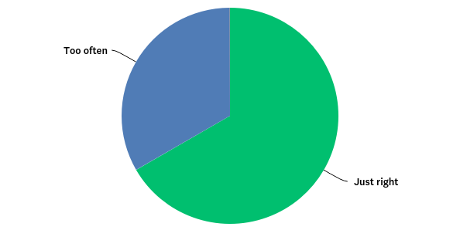
Q11: The Forum currently holds two meetings annually. This frequency is:
Answered: 54 Skipped: 6

Slide 20
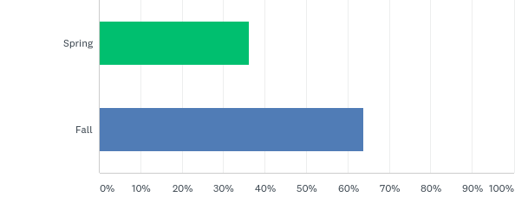
Q12: If the meetings frequency were changed to once per year, would you prefer a fall meeting or a spring meeting?
Answered: 47 Skipped: 13

Slide 21
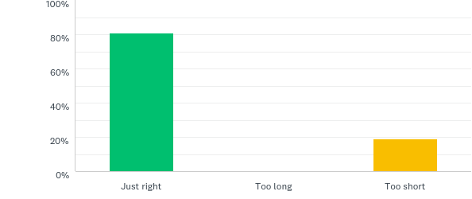
Q13: The meeting currently lasts 1.5 days. This length is:
Answered: 52 Skipped: 8

Slide 22
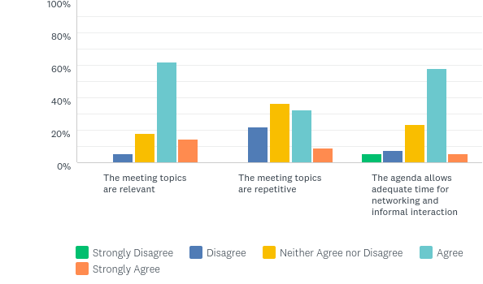
Q14: Please rate your level of agreement with the following statements:
Answered: 56 Skipped: 4

Slide 23
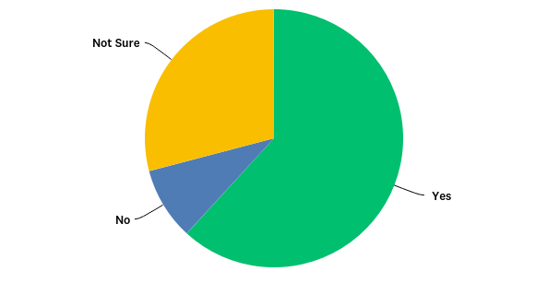
Q15: Is your organization currently planning on renewing its membership?
Answered: 55 Skipped: 5

