Slide 1
Proposed Changes to Improve and Risk Inform LLW Disposal Thomas E. Magette, P.E. President, Talisman International LLC
April 17, 2019

Slide 2
The U.S. can improve the regulatory framework for the disposal of low level radioactive waste by being more risk informed.
Ongoing Part 61 rulemaking can provide risk informed basis
The role of the classification tables
Incorporating VLLW into Part 61
Addressing the disposal of GTCC waste

Slide 3
How well does the current regulatory regime balance risk?
VLLW
Class A, B, and C waste
GTCC
Less significant
More significant

Slide 4
And how might an improved regulatory regime balance risk?
VLLW
Part 61 waste
Some GTCC
Less significant
More significant

Slide 5
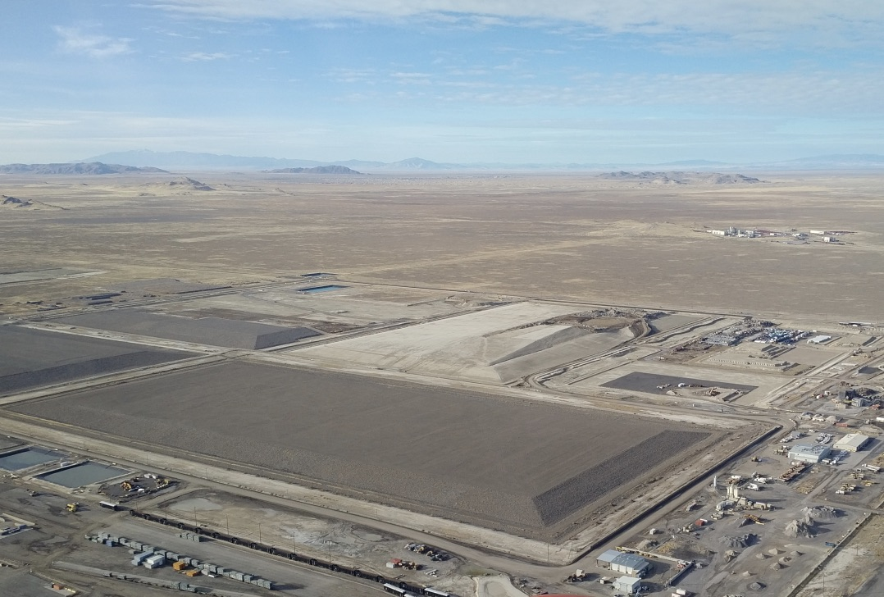
The ongoing Part 61 rulemaking should result in a LLW disposal scheme that is more risk informed.
The use of a performance assessment to derive waste acceptance criteria would represent a significant advancement.
It would represent a drastic improvement over the use of the classification tables.
The proposed approach has the prospect of rendering the tables obsolete.

Slide 6
What have we learned from EPRI investigation of the technical basis for the classification tables?
Classification limits based on outdated science
Dose conversion factors based on ICRP-2 (1959)
Using updated dose conversion factors would significantly affect the waste classification tables
Current tables place emphasis on the wrong nuclides
Classification tables should be updated or deleted

Slide 7
Using updated dose conversion factors (w/o changing waste classification process) puts focus on different radionuclides.¹
Nuclide | Part 61 Table | ICRP 60/72 | Limiting Concentration
C-14 | 1 | 3.78E+00 | 3.8 times lower
Cs-137 | 2 | 6.44E-01 | 1.6 times higher
I-129 | 1 | 3.39E-01 | 2.9 times higher
Ni-63 | 2 | 1.35E-01 | 7.4 times higher
Pu-241 | 1 | 1.15E-01 | 8.7 times higher
Sr-90 | 2 | 5.59E-02 | 17.9 times higher
Tc-99 | 1 | 1.36E+02 | 136 times lower
¹Edwards, Lisa, EPRI Perspectives on 10CFR61 Revision, Waste Management Symposia, March 6, 2019.

Slide 8
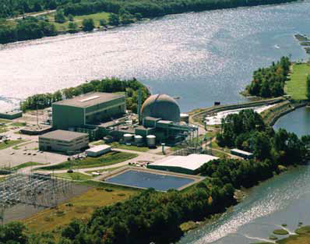
VLLW waste disposal should be regulated based on the disposal site, not the disposal action.
NRC should incorporate requirements into Part 61 that address the disposal of VLLW.
May or may not result in a change to the classification tables.
Should be risk informed, i.e., rely on a site-specific performance assessment.
Should leverage analyses previously done ,e.g., to permit RCRA Subtitle C and D facilities.

Slide 9
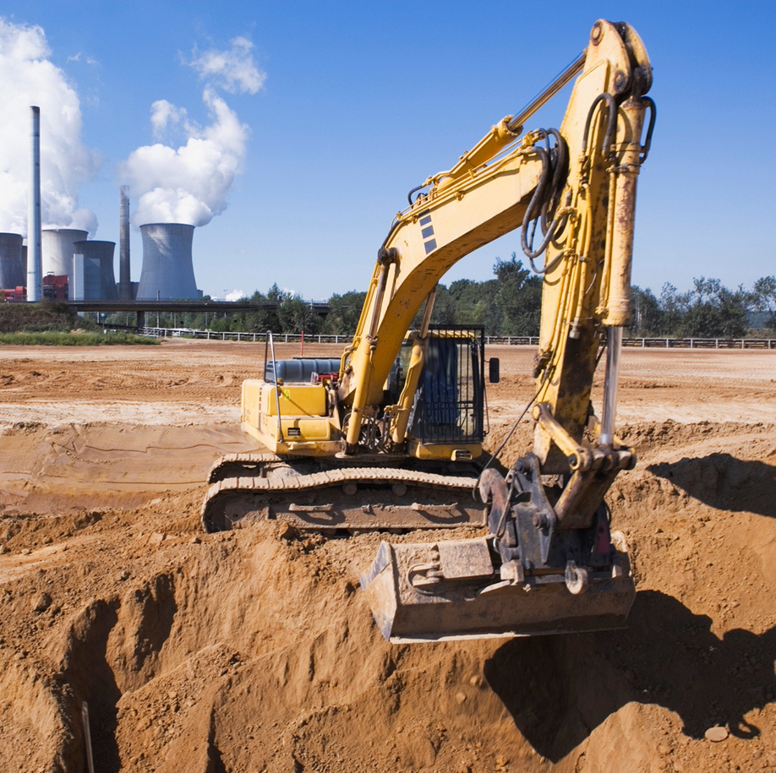
The NRC should create a category of radioactive waste in its regulations to explicitly define higher activity wastes suitable for disposal in a Part 61 facility.
Including these wastes into Part 61 would enable the disposal of currently stranded wastes.
This will require the consideration of factors other than radioisotopic concentration.
Thermal output
Gas generation
Criticality safety
Security
It is the role of the Federal government (NRC) to define the limits of which wastes can be disposed of in a Part 61 facility.

Slide 10
Thank You.

