Slide 1
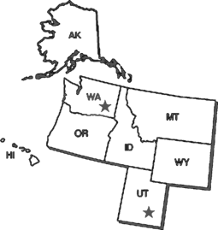
US Ecology Washington Disposal Site Update
Joseph J. Weismann, CHP
VP, Government and Radiological Affairs
LLW Forum - Spring 2019, Alexandria, VA

Slide 2
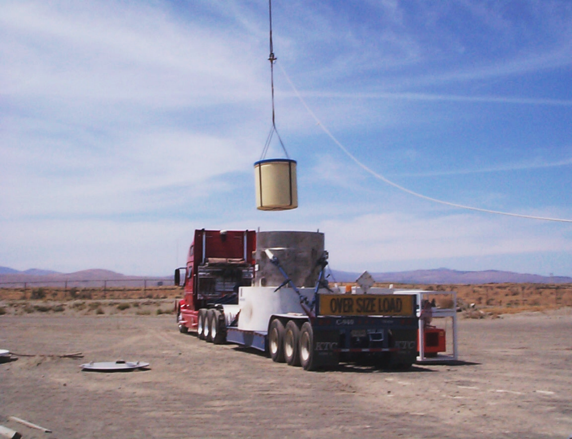
Agenda
Company & USEW Overview
Site Status Update
New Trench 12
Rate Requirement Primer
Operations & Shipment Case Studies

Slide 3
US Ecology Overview
Vision: To be the Premier Provider of Comprehensive Environmental Services
Québec
Leading N. American provider of Environmental Services
5 Haz/Non-Haz Landfills, 1 Radioactive Waste Landfill (Class A, B, C)
22 Treatment & Recycling Facilities ¹
Rail-accessible Facilities & Infrastructure
24 Field Service Centers & Retail Satellites
Over 4,000 Customers covering diverse mix of industries and segments
Ontario
(2)
(2)
(4)
United States
Mexico
(2)
Headquarters
Landfills
Treatment & Recycling
Service Centers
Retail Satellites

Slide 4
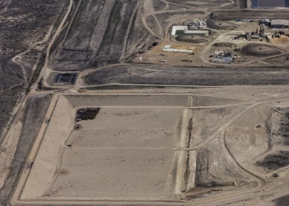
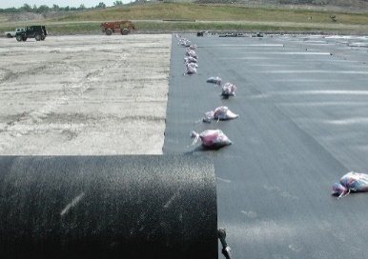
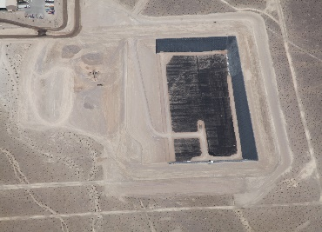
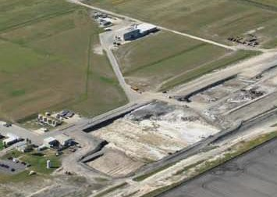
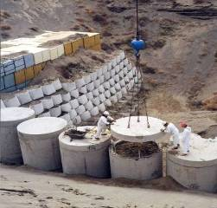
Coast to Coast Disposal Network
6 Facilities Positioned throughout North America (5 RCRA Hazardous/Non-Haz, 1 LLRW Class A/B/C)
Located near Industrial Centers in the West, Northeast, Midwest and Gulf Regions
Broad Range of Permits and Acceptance Criteria
Infrastructure to Support High Volume Transfer
Rail and Truck Access
Idaho (Grand View)
Haz / Non-Haz Landfill
Michigan (Belleville)
Haz / Non-Haz Landfill
Nevada (Beatty)
Haz / Non-Haz Landfill
Quebec (Stablex - Blainville)
Haz / Non-Haz Landfill
Texas (Robstown)
Haz / Non-Haz Landfill
Washington (Richland)
Radioactive Landfill (Class A,B,C)

Slide 5
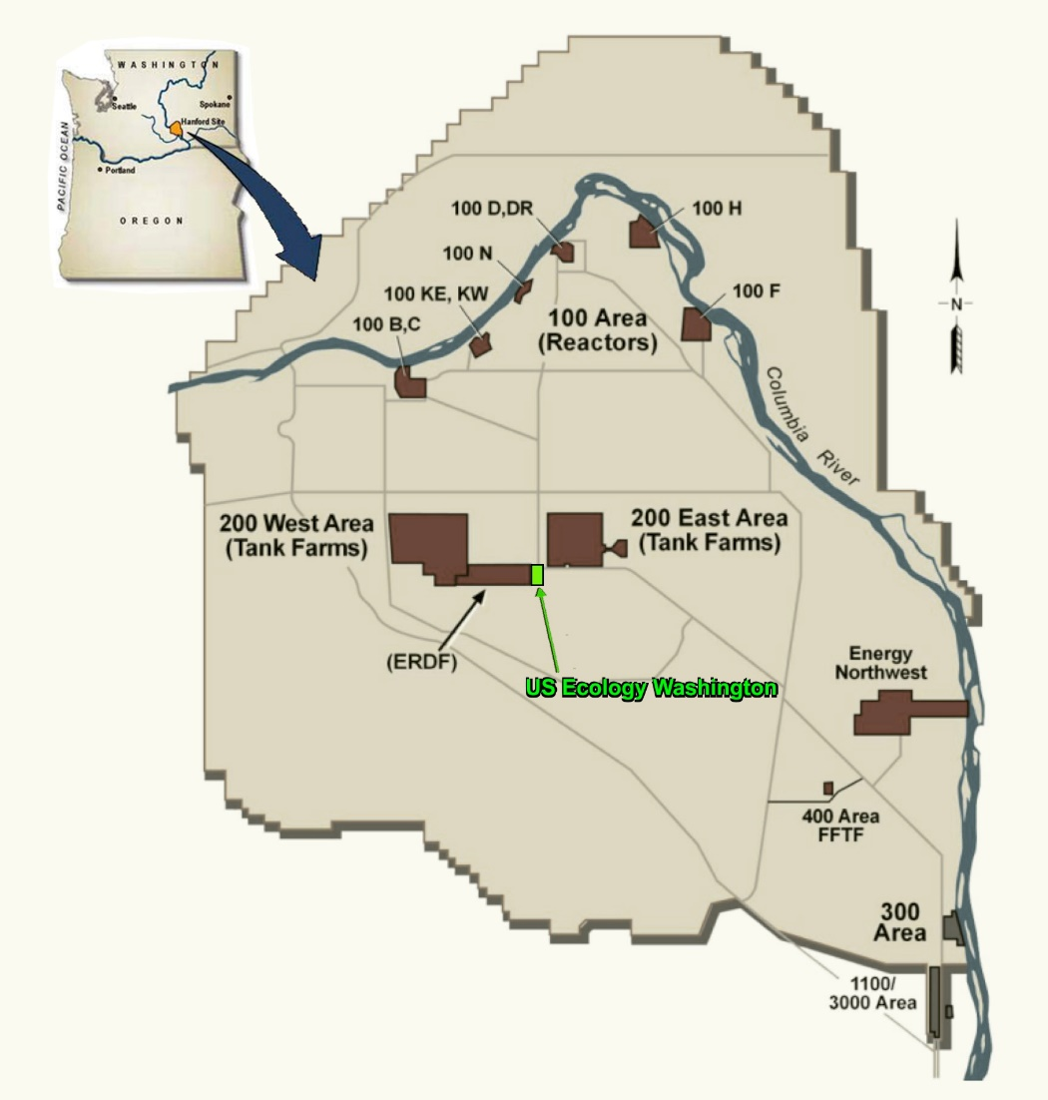
US Ecology - Washington
Part 61 LLRW Facility – 1 of 4 in United States
Located on 100 acres within the DOE Hanford Reservation near Richland, WA
Originally Licensed in 1965
Designated NWIC Facility (Accessible to 11 states in NW & RM Compacts - January 1, 1993)
Operates through lease agreement with State of WA
Rate-regulated by WA Utility & Transportation Commission
Notes:
USEW Low Level Radioactive Waste (LLRW) Disposal Facility is located in north-central Benton County about 20 miles northwest of the city of Richland, Washington. The facility address is ¼ mile west of 200 East, Hanford reservation, Richland, Washington. The facility is situated within the US Department of Energy (DOE) Hanford Site on 100 acres of land (see Figure 2.1). DOE leases the site to the state of Washington and the State subleases to USEW. The facility is entirely within the Hanford separations area, which covers approximately 82 square miles in the center of the Hanford Site. The facility is located just southwest of 200 East and about 2.5 miles east of 200 West. The Hanford 200 Areas contain irradiated uranium fuel processing facilities, plutonium separation facilities, and the major radioactive waste storage and disposal facilities

Slide 6
Types of Waste Accepted
Compact Class A/B/C LLRW
NARM Waste Nationwide (includes Radium sources)
Exempt Waste Nationwide

Slide 7
USEW Aerial Photograph
N
Notes:
Aerial Photograph - US Ecology Washington is a shallow land burial facility for low level radioactive waste. There is no water above ground, and the ground water is about 300 feet below ground surface. All water used on site is from the Columbia River via the Hanford site water system. Water is used for domestic purposes and for dust control. The disturbed area is approximately 100 acres, which includes the filled and partially filled waste trenches. Shows new Trench 12 at bottom left.

Slide 8
Site Footprint
Trench 18
Trench 19
New Trench 12
Trojan Rx Vessel
Notes:
Approximately 14 million cubic feet of low-level waste has been received. This waste contains solid or solidified materials, contaminated equipment, cleaning wastes, tools, protective clothing, gloves, laboratory wastes, and naturally occurring or accelerator produced radioactive material (NARM). The waste is from any source other than nuclear fuel, and contains limited amounts of Special Nuclear Material. The manifested activity of the buried waste is approximately 4 million curies (Ci). The total radioactivity actually contained on site is considerably less than the manifested activity due to radioactive decay and conservatism of manifested quantities.
Top left shows future Trench 15 – for Class A-Unstable waste.

Slide 9
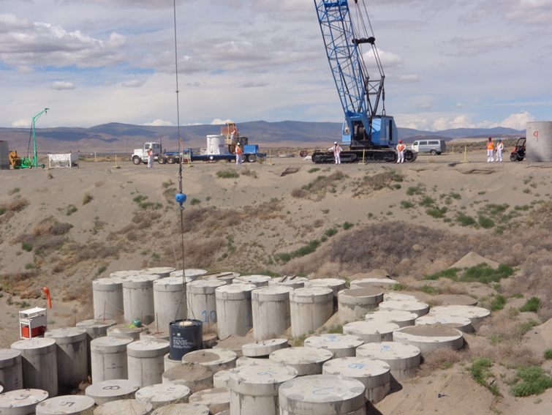
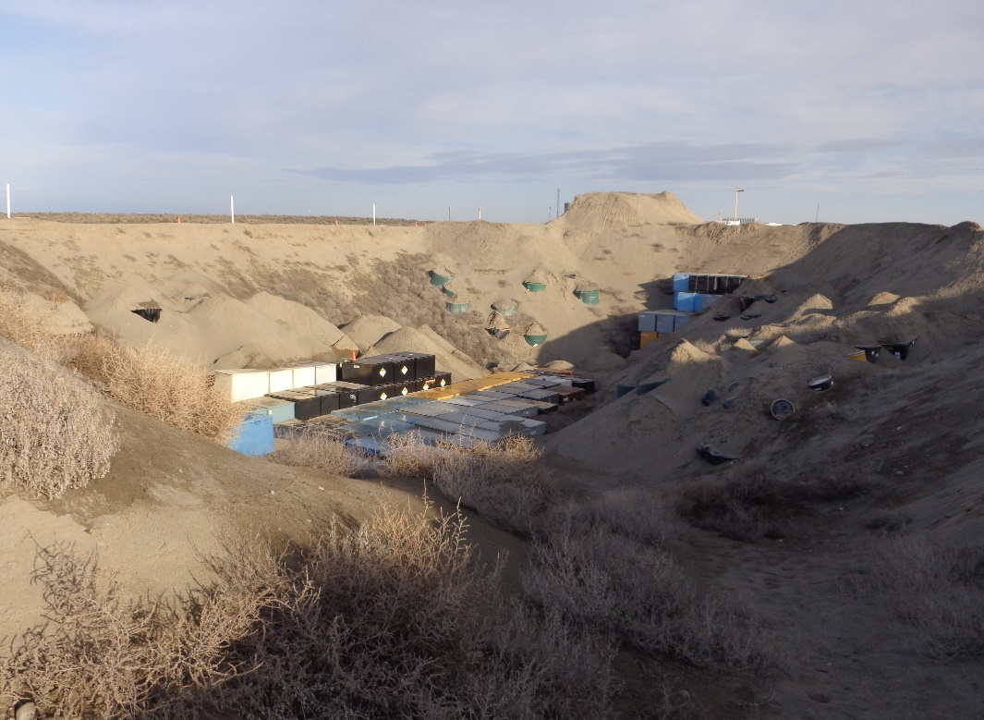
Active Disposal Trenches
Trench 19
Class A/B/C - Stable
Trench 18
Class A - Unstable
Notes:
Active Disposal Trenches
Trench 19 - Class A/B/C - Stable
Trench 18 - Class A Unstable – Almost at capacity

Slide 10
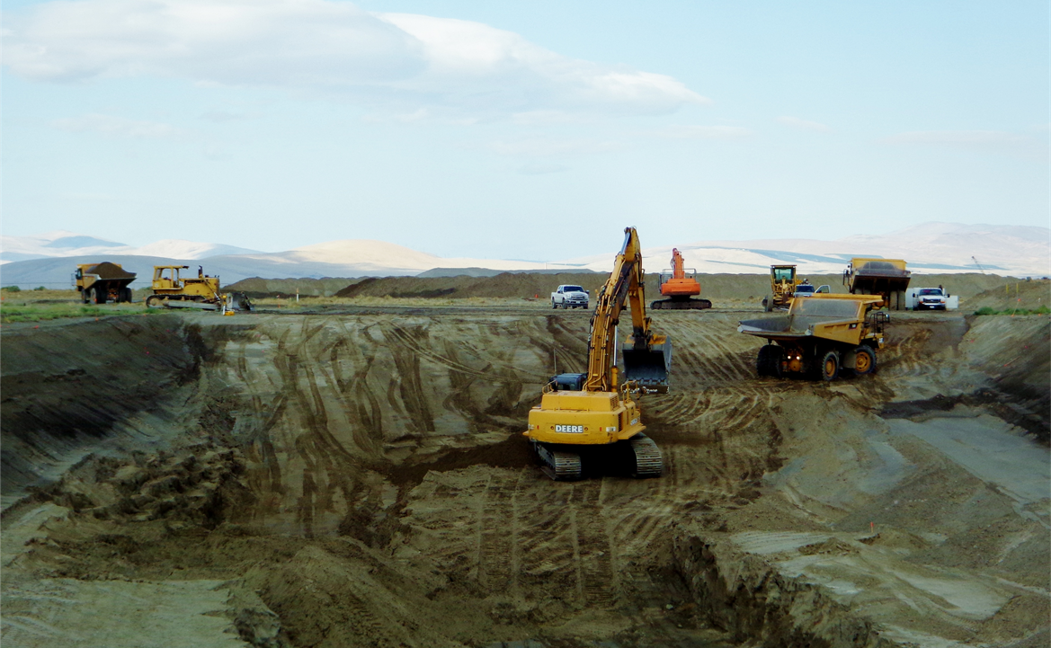
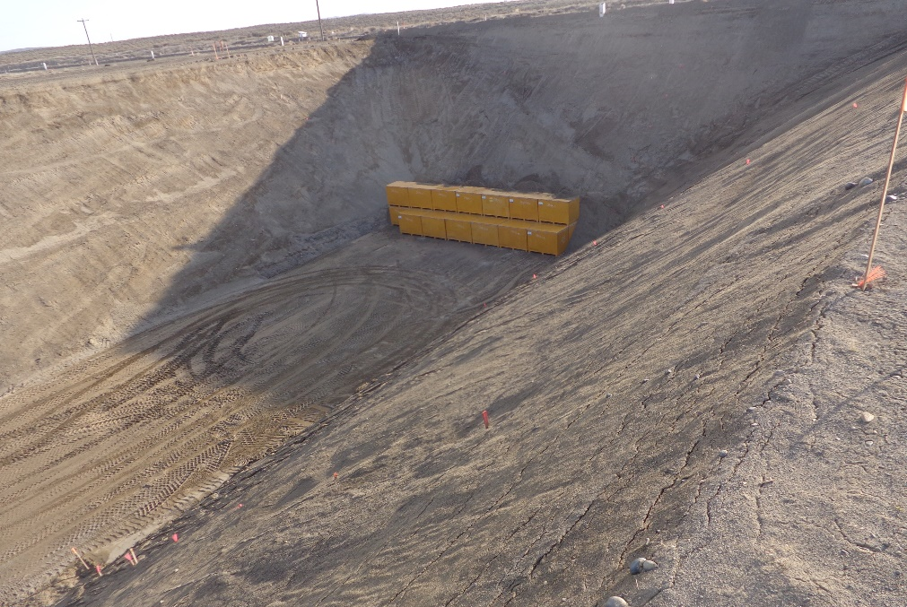
New Trench 12
Class A Unstable Waste
150’x150’ (at top) with 1.5x1 side slopes
35’ deep (27’ for waste)
Constructed capacity of 270,000 ft³, will expand as needed
Notes:
Trench 12 – Constructed in 2018 – In use March 2019
Class A – Unstable. With current projections we expect to construct one more unstable trench after 12 until site closure. Trench 19 is expected to be in use for stable waste until site closure.

Slide 11
Annual Disposal Volumes
2012: 23,233.4 ft³
2013: 24,959.4 ft³
2014: 20,466.8 ft³
2015: 27,400.1 ft³
2016: 21,218.1 ft³
2017: 13,809.7 ft³
2018: 15,285.5 ft³
Site has ample capacity to last through life of lease. (2056)

Slide 12
USEW License Renewal
WDOH issued license expired 12/31/2018
Renewal Application submitted October 2018
License Currently in Timely Renewal

Slide 13
USEW Revenue Requirement
USEW Operates Under a Base Revenue Requirement
Set by WUTC every 6 years
Facility Cost of Operation + 29% margin
Adjustments to Rev Req are allowed based on over/under collection
Overcollection in any category results in generator refunds
Uncollected amounts may be rolled over into next year's Rev Req

Slide 14
USEW Revenue Requirement
Rates are set using generator supplied volume estimates
Total Rate = Rev Req / Volume Estimates*
Rate Total is then split into 5 categories
Rev Req is split into 5 categories
Site Availability (22%)
Volume (31.6%)
Shipments (10.7%)
Containers (21.5%)
Dose Rate (14.2%)
*may be adjusted using a safety margin

Slide 15
Revenue Requirement Last 5 yrs
Year | Base RR | Total Adjustments | Final RR
2015 | $5,730,577 | $68,407 | $5,798,984
2016 | $5,787,001 | $102,382 | $5,889,383
2017 | $5,859,534 | $370,747 | $6,230,381
2018 | $5,976,482 | $1,895,058* | $7,871,540
2019 | $6,151,681 | $1,727,783* | $7,879,464
*Unusually large carryovers due to fewer shipments from Energy NW

Slide 16
2019 Revenue Requirement
 |  | RR Rate Components
 |  | Site Availability Charge (SAC) | Volume | Shipments | Containers | Dose Rate |  | TOTAL
Year | Revenue Requirement Component | 22.0% | 31.6% | 10.7% | 21.5% | 14.2% |  | 100%
2019 | Base Revenue Requirement | $1,353,370 | $1,943,931 | $658,230 | 1,322,611 | $873,539 |  | $6,151,681
2018 | Carryover/(Refunds) | $21,394 | $473,089 | $22,708 | $772,485 | $438,107 |  | $1,727,783
2019 | SAC Under-recovery Allocated to Other Rate Components | $(674,232) | $273,151 | $92,491 | $185,846 | $122,744 |  | -
2019 | Final Revenue Requirement | $700,532 | $2,690,171 | $773,429 | $2,280,942 | $1,434,390 |  | $7,879,464

Slide 17
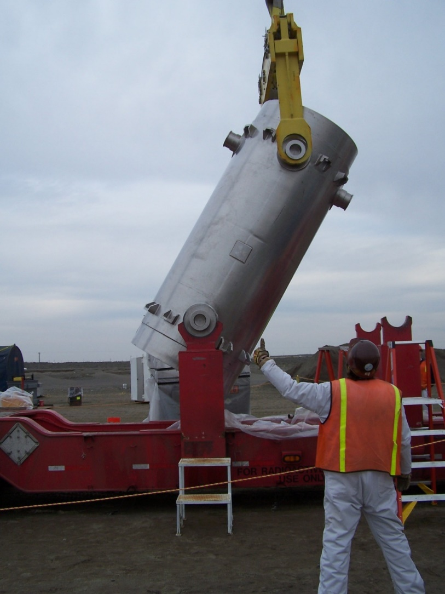
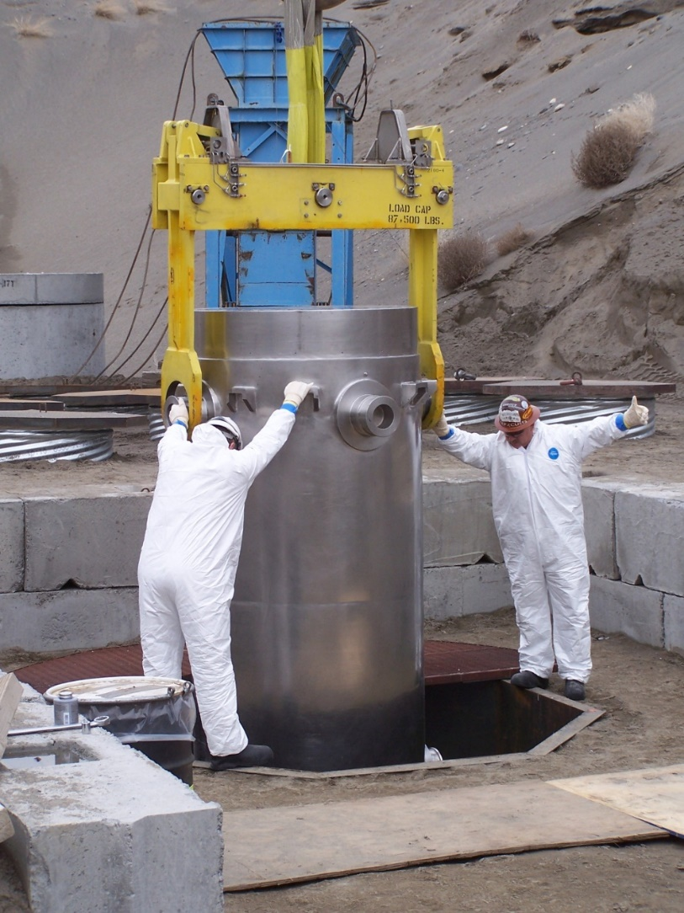
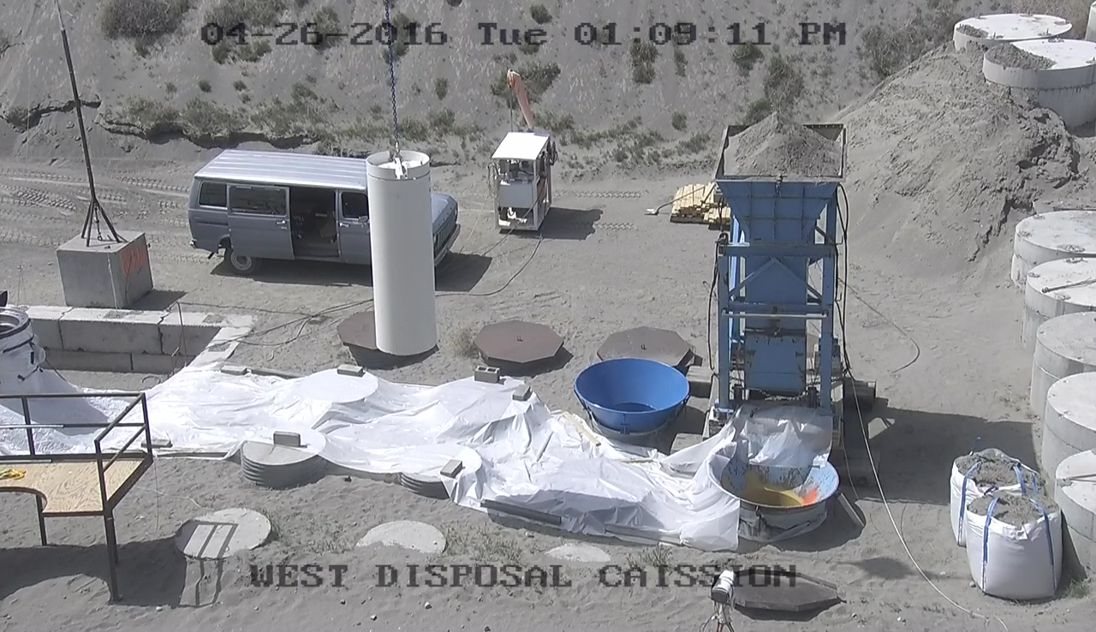
Irradiated Hardware in TN-RAM Cask
Notes:
Irradiated Hardware
We supported a spent fuel pool cleanout campaign from April to June in 2016. If disposal caissons have to be constructed in the disposal trench, at least two years prior to the shipment is needed. For this campaign US Ecology had nine available caissons from the construction for the 2010 campaign. A Caisson is a disposal vault dug into the bottom of a trench allowing complete entombment. USEW uses caissons for irradiated hardware and other very high dose rate shipments.
At the end of March a much bigger crane, capable of lifting the TN RAM cask to the center of Trench 19, was setup. Also in March a liner mockup was designed and built to practice hooking the liner in the cask. In April training was held for all personnel involved from US Ecology, Babcock Services, and AREVA. A “dry-run” was performed with the TN RAM cask. This cask is radioactively contaminated but no high dose liner was inside. On April 18th the first TN-RAM shipment arrived.
Cask is removed from the trailer. Cask is placed in the working caisson. The lid is removed and then the liner hooked by personnel below the lip of the cask using a camera and a monitor. The lift is done using tv cameras as the liner is ~150 Gy/hr (15,000 R/hr). In this picture you can see the backup caisson is also setup in case something were to fail going into the primary selected caisson.
USEW staff completed irradiated hardware shipment for collective 25mrem.

Slide 18
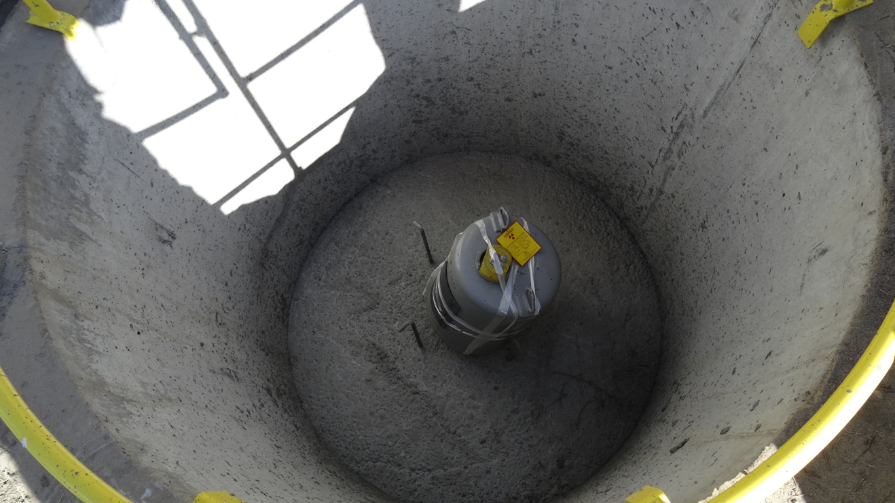
Lovelace Blood Irradiator
Notes:
Lovelace Irradiator - US Ecology supported the CRCPD in developing the request for disposal of the Gamma Cell 1000 (GC1000) containing ~563 Ci of Cs-137 and then provided supplementary information requested by the Washington Department of Health. This was the first-time using the alternative approach provisions included in Section 3.8 of the 2015 NRC Branch Technical Position on Concentration Averaging and Encapsulation. Project started in 2015 and ended September 2017 with disposal of the (2) Cs-137 sources. Pig was placed in ECB and completely filled with concrete.

Slide 19
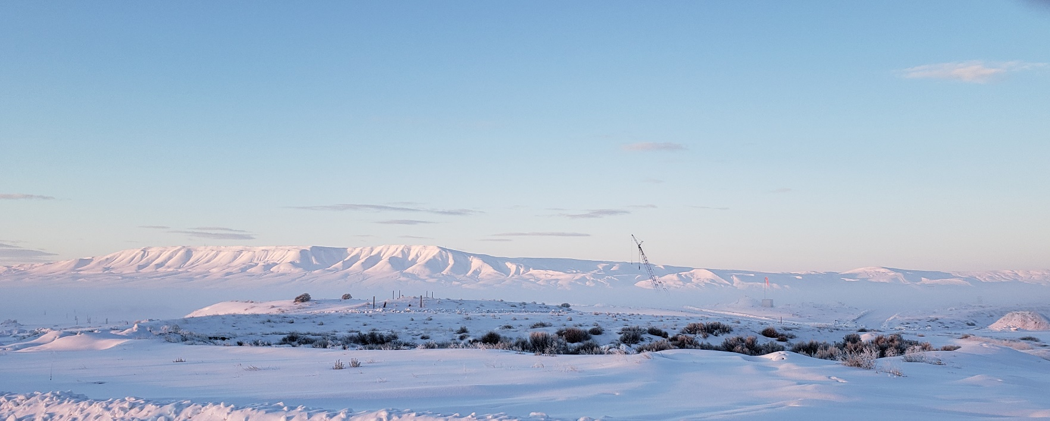
Questions?
Notes:
Thank you for your time and attention. I would be happy to answer any questions you may have.

Slide 20
Contact Information
Joseph J. Weismann, CHP
Vice President, Government and Radiological Affairs
208.319.1634
Joe.Weismann@Usecology.com
Mike Ault
General Manager, US Ecology Washington
509-541-5409
Mike.Ault@Usecology.com

