Slide 1
Status of Supplemental Environmental Impact Statement for Disposition of Depleted Uranium Oxide Conversion Product Generated from DOE’s Inventory of Depleted Uranium Hexafluoride
LLW Forum Meeting, April 2019
Jaffet Ferrer-Torres
Office of Waste Disposal
Office of Environmental Management

Slide 2
Background
DOE operates depleted uranium hexafluoride (DUF₆) conversion facilities at Portsmouth and Paducah sites.
Stored DUF₆ is converted to depleted uranium (DU) oxide, a more stable form for reuse or disposal.
DOE has over 760,000 metric tons of DUF₆ stored at Portsmouth and Paducah sites.
At the start of conversion in 2011:
  Portsmouth Site had approximately 21,000 DUF₆ cylinders, and
  Paducah Site had approximately 46,000 DUF₆ cylinders
Portsmouth inventory is expected to be processed in ~18 years and Paducah’s ~30 years.

Slide 3
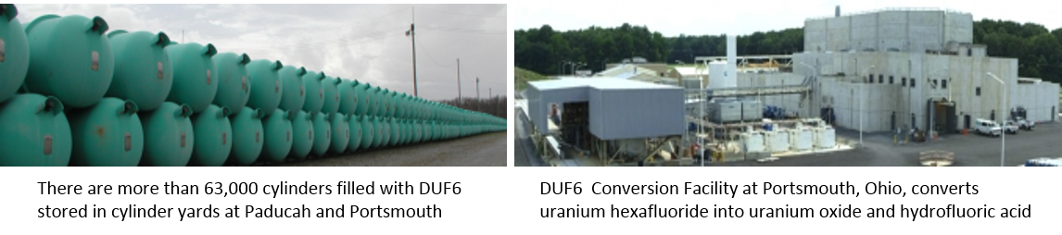
Background (cont’d)

Slide 4
Goal & Need
Purpose and Need: To dispose of DU oxide (a more stable chemical form) and other low level radioactive waste (LLW) and mixed LLW generated during the conversion process.
This need follows from the decisions presented in the Record of Decision for the 2004 Environmental Impact Statement (EIS) that deferred DOE’s decision related to the transport and disposition of DU oxide at potential off-site disposal facilities.

Slide 5
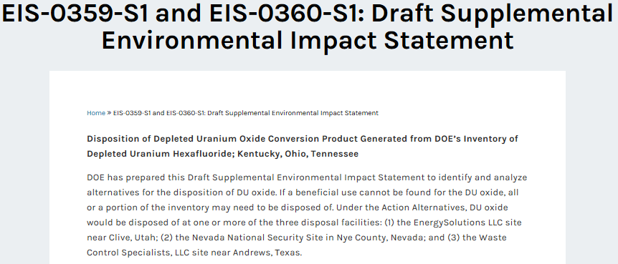
Supplemental Environmental Impact Statement (SEIS)
https://www.energy.gov/nepa/downloads/eis-0359-s1-and-eis-0360-s1-draft-supplemental-environmental-impact-statement

Slide 6
Timeline on DU Oxide SEIS
2004
2007
2014
2016
2018
EISs for Paducah, Kentucky and Portsmouth, Ohio Sites Finalized
Records of Decision (ROD) published
Decision on transportation and disposition of the conversion product deferred
Draft Supplement Analysis released for public comments
DOE determined time needed for resolution of regulatory inquiry on analyzing Waste Control Specialists, LLC (WCS) as alternative
WCS granted license allowing for disposal of bulk uranium
DOE determined an SEIS was warranted in order to analyze disposal options including WCS
Notice of Intent (NOI) released announcing preparation of Draft SEIS
DOE issues Draft SEIS
2019
Public Hearings 2019
Public Comment Period 45-days, December 28- 2018 through February 11, 2019
Public Comment Period concluded on March 04, 2019

Slide 7
No Action Alternative
DU oxide would continue to be stored indefinitely at the Paducah and Portsmouth sites.
DU oxide would not be disposed of as LLW.
Empty and heel cylinders, calcium fluoride, and ancillary LLW and MLLW would be shipped to off-site disposal facilities.

Slide 8
Analyzed Alternatives
Three disposal location alternatives are proposed:
DOE-owned LLW disposal facility at Nevada National Security Site, Nye County, Nevada.
  Rail transportation requires intermodal transfer to truck for last leg
EnergySolutions, LLW disposal facility, Clive, Utah.
  Transportation options include both rail and truck routes
  Requires licensing by Utah, post closure stewardship agreement
WCS LLW disposal facility, Andrews, Texas.
  Transportation options include both rail and truck routes
  Currently licensed for DU oxide disposal by Texas

Slide 9
Analyzed Rail and Truck Routes
to Potential Disposal Sites
Note:
Blue shows truck route
Green shows rail route

Slide 10
Cumulative Impacts Considered
Section 3113(a) of the United States Enrichment Corporation (USEC) Privatization Act and Section 66 of the Atomic Energy Act of 1954 (as amended), requires DOE to accept commercial DUF₆, that has been determined to be LLW
An estimated amount of commercial DUF₆ was analyzed under Cumulative Impacts for both No Action and Action Alternatives

Slide 11
Preferred Alternative
Draft SEIS did not include a Preferred Alternative at this time.
Final SEIS will include a Preferred Alternative.
Public comments submitted will be taken into consideration in the development of a Preferred Alternative.

Slide 12
Web-based Public Hearings
The Department conducted web-based public hearings to allow for interested persons throughout the U.S. an opportunity to participate.
Allowed a broader participation, e.g., for those with difficulties in attending on-site.
Cooperation and patience by the moderator, the SEIS team and the public.

Slide 13
Current Place in Process
Analysing options, alternatives and potential impacts from proposed activities
Notice of Intent to Prepare SEIS
Human & environmental impacts studied for Draft SEIS
Draft SEIS published & available for 45-day public comment
SEIS
finalized
Records of Decision (ROD) amended
Now

Slide 14
Draft SEIS Comment period concluded on March 04, 2019.
DOE will consider all comments as it finalizes the SEIS.
A Federal Register Notice will be published that announces the issuance of the Final SEIS (date is TBD).
Using applicable information, DOE will amend the ROD no sooner than 30 days from the issuance of the Final SEIS.
For more information about this SEIS: https://www.energy.gov/em/disposition-uranium-oxide-conversion-depleted-uranium-hexafluoride
Next Steps

