Slide 1
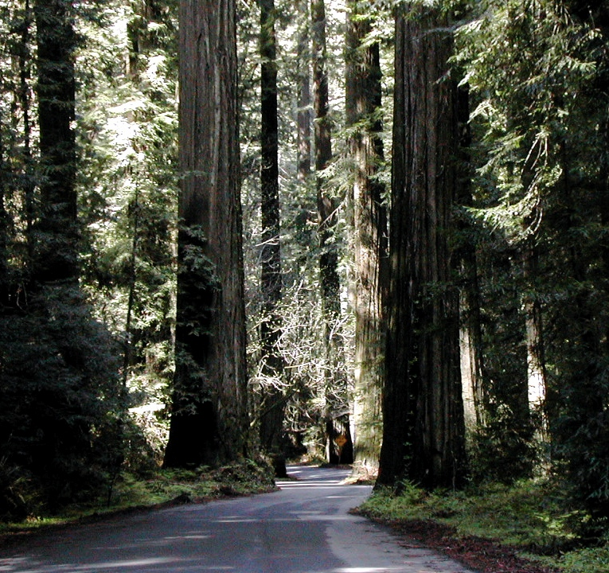

What Have Inappropriately Low Radiation Limits Done To Our Nuclear Waste Disposal Program?
Dr. James Conca LLW Forum Meeting
UFA Ventures/Herbert M. Parker Foundation Richland, WA
Richland, WA October 2018

Slide 2
Revised DOE 2006 Estimate of Savings for Adjusting Cleanup Costs to more Reasonable Alternative Standards for U.S. DOE sites
400
350
300
250
Clean-up Costs ($billions)
200
150
100
$420 billion in savings
50
0
0
15
20
40
60
80
100
Radiation Level Standards (mrem/yr;1/100thmSv/yr)

Slide 3
The Problem As It Stands
Radiation risks to humans and the environment are assumed to exist as a result of any exposure, no matter how small (LNT)
Exposure to natural background is, on average, about 3 mSv/yr (300 mrem/yr), although global regional averages range from 0.03 mSv/yr to over 100 mSv/yr
It is not possible to see statistical evidence of public health risks at exposures less than 100 mSv/yr because any risk is well below the noise level of all other risks faced by humans or the environment
Regulations require nuclear waste disposal systems to meet release criteria less than 0.04 mSv/yr to downgradient drinking water supplies with no regard to cost or unintended effects

Slide 4
What are the costs of regulating radiation doses to such low levels?
How Much Do We Consider the Value of a Human Life to be?
$7 million is the value of a human life according to EPA
$316,000 is the average paid out in health care over a life
$129,000 is the average historic legal value of a human life
$12,420 (death benefit to families of deceased soldiers)
$45 million (value of a single healthy human life when chopped up and sold on the black market for body parts)
$2.5 billion per theoretical human life saved (LNT vs 0.1 Sv/yr)
$100 per human life saved by immunization against measles, diphtheria, and pertussis in developing countries

Slide 5
LNT
Small chronic doses of radiation, < 10 rem(cSv)/yr, appear to be easily handled by cellular repair mechanisms that evolved as a normal adaptive response with the emergence of the eukaryotic cell 2.3 billion years ago.
Risk
{
death
{
cancer
ARS
{
Few, if any, long-term health effects observed
threshold
Earth
background
0
0
0.1
1.0
10
100
1000
Dose (rem;cSv)

Slide 6
What Are Some Of The Costs Associated With
Exceptionally-Low Radiation Limits?
Our regulatory limits are so far down in the noise as to be meaningless from a public health standpoint
the noise of background radiation levels
the noise of everyday risks
LNT demands that there be an observable effect
as a function of dose
Notes:
Even when looking at non-lethal injuries, nuclear is the safest job you can have, safer than sitting at a desk trading stocks, safer than being a realtor.

Slide 7
Background Radiation Differences on Annual Cancer Mortality Rates/100,000 for each U.S. State over a 17-Year Period (adapted from Frigerio and Stowe, 1976 with correction for dose using more recent background data from radon).
Where is LNT? The hypothesis demands an expression whenever there is a spectrum of doses in a large population.
190
180
170
160
U.S. average
150
Mortality Rate/100,000
140
130
120
110
(270 mrem/y)
100
2.4
2.6
2.8
3.0
3.2
3.4
3.6
Background Dose (mSv/y)

Slide 8
812 excess cancers
for 16,716 people, > 100 mGy
25,239 people
35,978people
27,511people
Source: Hargraves

Slide 9
Radiation risks are best considered relative to more common risks

Slide 10
Some behavioral risks facing Americans over the past 5 yrs
alcohol consumption
automobile driving
coal industry
construction
food poisoning
iatrogenic
murder
mining
nuclear industry
opioid deaths
police work
smoking tobacco
accidental falls (> 65 yrs old)
Notes:
How would you rank these activities in terms of most dangerous to least dangerous?

Slide 11
Number of Deaths in U.S.
Activity over the past 5 years
iatrogenic 950,000
smoking 760,000
alcohol 500,000
automobile accidents 180,000
opioid deaths 170,000
accidental falls (> 65 yrs old) 140,000
coal use (32% of U.S. power) 60,000
murder 80,000
food poisoning 25,000
construction 5,000
police work 800
mining 360
nuclear industry (19% of U.S. power) 1
(medicine gone wrong)

Slide 12
Relative
Number of Deaths in U.S. Danger
Activity Normalized to Sub-Population Index
1) smoking (43.4 million smokers) 760,000 0.01751
2) alcohol (60 million impacted Americans) 500,000 0.00833
3) iatrogenic (180 million receive medical treatment) 950,000 0.00527
4) accidental falls (46 million over 65 yrs) 140,000 0.00304
5) police work (680,000 police officers) 800 0.00118
6) mining (350,000 miners) 360 0.00103
7) automobile accidents (190 million drivers) 180,000 0.00094
8) construction (7.7 million workers) 5,000 0.00065
9) opioid deaths (100 million prescribed) 170,000 0.00043
10) murder (300 million impacted) 80,000 0.00027
11) coal use (240 million impacted) 60,000 0.00025
12) food poisoning (304 million eat every day) 25,000 0.00008
13) nuclear industry (60 million) 1 0.0000001

Slide 13
What Are Some Of The Costs Associated With
Exceptionally-Low Radiation Limits?
Commercial Nuclear Industry – increases costs and increases fear of nuclear power in the public
Environmental Concerns – fear prevents nuclear power from addressing climate change, human health and the environment
Nuclear Waste – increases cost of repositories and prevents siting at most optimum geographic and geologic locations
Medicine - causes radiation phobia that prevents certain medical diagnostics and treatments involving radiation
Emergency Preparedness - causes extreme radiation phobia after nuclear/radiological accidents that have harmed or killed more people than the incident itself (Fukushima, Chernobyl, future dirty bomb attack) and that prevents reasonable emergency planning and execution in future disasters
Notes:
Even when looking at non-lethal injuries, nuclear is the safest job you can have, safer than sitting at a desk trading stocks, safer than being a realtor.

Slide 14
What Are Some Of The Costs Associated With
Exceptionally-Low Radiation Limits?
Causes extreme radiation phobia following nuclear or radiological incidents and accidents
Loss of lives and severe injuries associated with frantic evacuations
Increased suicides and psychosomatic disorders
- Increased drug/alcohol/cigarette abuse
Unnecessary permanent abandonment of properties for contamination well within the levels of natural Earth background
Extreme costs of clean-up relative to actual risk
Notes:
Even when looking at non-lethal injuries, nuclear is the safest job you can have, safer than sitting at a desk trading stocks, safer than being a realtor.

Slide 15
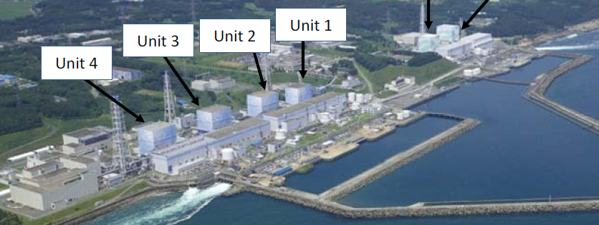
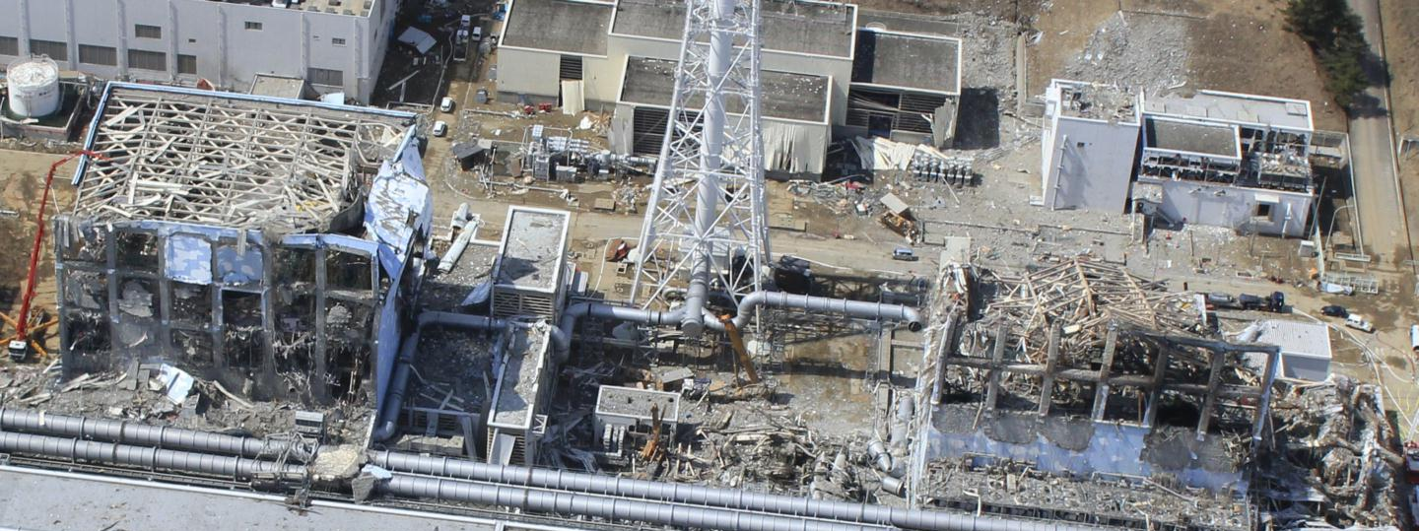

After the hydrogen explosions
Unit 3
Unit 4

Slide 16
What Are Some Of The Costs Associated With
Emergency Preparedness and Execution?
Forced evacuation of 160,000 from provinces surrounding Fukushima resulted in about 1,600 deaths mainly of elderly and disabled. Most adults could have returned after 2 months (I-131)
According to the World Health Organization -
no acute radiation injuries or deaths among workers or public from exposure to radiation resulting from Fukushima accident.
the lifetime radiation-induced cancer risks are much smaller than the lifetime baseline cancer risks.
For about 160 workers who received whole body effective doses over 100 mSv, expected increased cancer risks will not be detectable against the normal statistical fluctuations in cancer incidence for this population.
Notes:
Even when looking at non-lethal injuries, nuclear is the safest job you can have, safer than sitting at a desk trading stocks, safer than being a realtor.

Slide 17
What Are Some Of The Costs Associated With
Emergency Preparedness and Execution?
Over 50% of residents have finally returned, mostly older citizens, but the damage has been done – Government estimates the cost at over US$200 billion.
at an average of $39,000 per capita GDP, revenue losses since 2011 exceed $40 billion for that cohort
$12 billion in compensation paid to displaced residents
Unnecessary shutting of all nuclear plants, most were not at risk
  increased fossil fuel use by about 25%
  increased energy prices by about 20%
  lowered air quality (estimates of > 15,000 additional premature deaths from fossil fuel particulate emissions)
Notes:
Even when looking at non-lethal injuries, nuclear is the safest job you can have, safer than sitting at a desk trading stocks, safer than being a realtor.

Slide 18
What Are Some Of The Costs Associated With
Emergency Preparedness and Execution?
Japan’s Government foolishly lowered the radiation limits on food after Fukushima thinking that would appear as proactive
Regulatory Limits On Radioactivity In Foods (in Bq/kg)
Country Water Milk Foodstuffs Babyfoods
Japan 10 200 100 50
U.S. 1,200 1,200 1,200 1,200
E.U. 1,000 1,000 1,250 400
Notes:
Even when looking at non-lethal injuries, nuclear is the safest job you can have, safer than sitting at a desk trading stocks, safer than being a realtor.

Slide 19
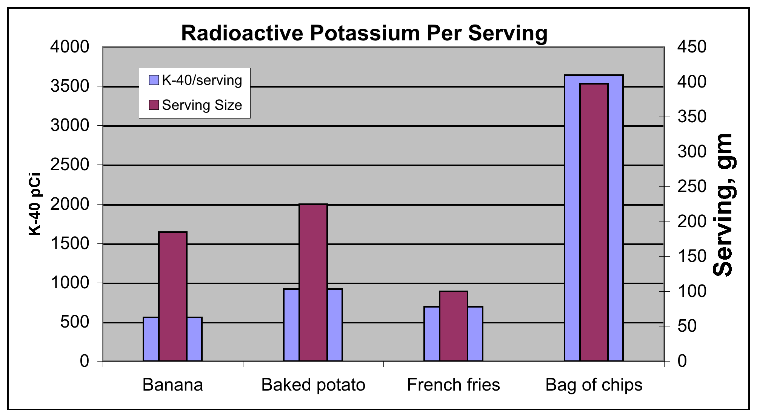
Source: Dan Yurman, 2011

Slide 20
What Are Some Of The Costs Associated With
Emergency Preparedness and Execution?
Japan’s Government foolishly lowered the radiation limits on food after Fukushima thinking that would appear as proactive
destroyed much of the farming and fishing industry in northern Japan, even in areas unaffected by any radiation: >$10 billion losses
But with its own Chernobyl effect, the Fukushima disaster proved to make the fisheries off the coast a de facto marine protected area and fish stocks have tripled in these waters since 2011
Regulatory Limits On Radioactivity In Foods (in Bq/kg)
Country Water Milk Foodstuffs Babyfoods
Japan 10 200 100 50
U.S. 1,200 1,200 1,200 1,200
E.U. 1,000 1,000 1,250 400
Notes:
Even when looking at non-lethal injuries, nuclear is the safest job you can have, safer than sitting at a desk trading stocks, safer than being a realtor.

Slide 21
What Are Some Of The Costs Associated With
LNT for The Nuclear Industry?
A NPP spends about $20 million/yr in rad protection, waste handling and emergency prep, in large part to address the fear and regulatory requirements associated with LNT-based limits
>$1 billion/year for the industry
Premature closings/planned shutdowns of nuclear reactors within the U.S. by 2025, with no safety or engineering reasons, just short-term profits, fear and politics, presently stands at 25, losing –
5 trillion kWhs of low-carbon power worth over $800 billion
600,000 man-years of direct labor worth $70 billion in salaries
2 million man-years of indirect jobs worth over $100 billion
over $6 billion in local and state taxes
15,000 tons of SNF orphaned onsite
Notes:
Even when looking at non-lethal injuries, nuclear is the safest job you can have, safer than sitting at a desk trading stocks, safer than being a realtor.

Slide 22
What Are Some Of The Costs Associated With
LNT for Nuclear Waste Disposal?
Main effect has been to completely stop our nuclear waste disposal program because of fear, preventing science-based decisions:
  gave us glass over grout for HLW, even thought grout is better, and cheaper, for most HLW
    the Hanford vitrification program, not including repository costs, will exceed $90 billion versus $30 billion for grouting and disposal elsewhere (not including repository costs), versus $30 billion for grouting in-place, even though there is no statistical difference in their risks.
  has made it impossible to site a repository and has prevented us from correctly reclassifying HLW at Hanford to RH-TRU
  unnecessary engineered barriers at Yucca Mt, such as Ti-drip shields ($30 billion), increasing total disposal costs by over $200 billion
Notes:
Even when looking at non-lethal injuries, nuclear is the safest job you can have, safer than sitting at a desk trading stocks, safer than being a realtor.

Slide 23
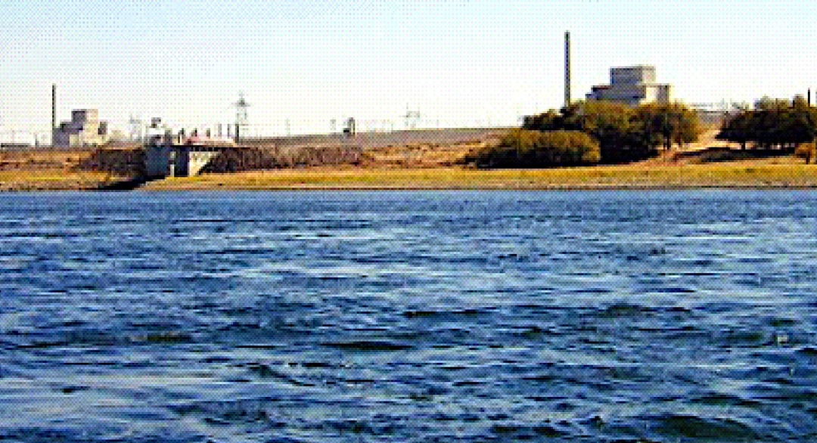
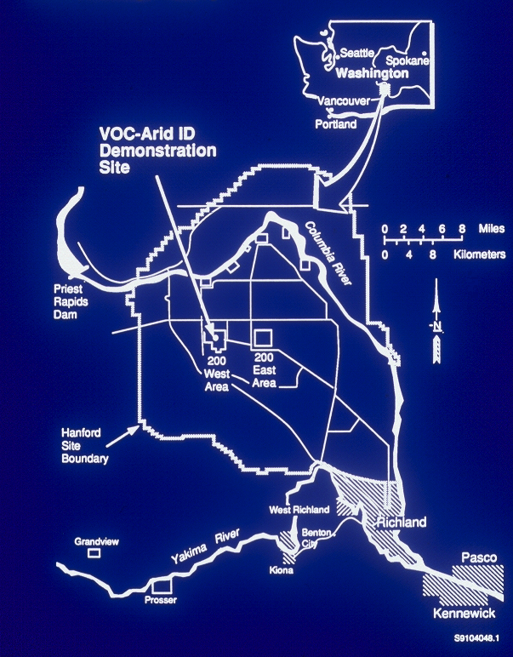
What Are Some Of The Costs Associated With
LNT for Nuclear Waste Disposal?
The Hanford Nuclear
Reservation
Tank Farms
Notes:
Even when looking at non-lethal injuries, nuclear is the safest job you can have, safer than sitting at a desk trading stocks, safer than being a realtor.

Slide 24

FUEL
ASSEMBLIES
What is HLW or nuclear bomb waste?
- 57 million gallons at Hanford
- 1.4 million is CH-TRU
What is HLW or nuclear bomb waste?
- 57 million gallons at Hanford
- all is now RH-TRU or CH-TRU
CLADDING REMOVAL
(Coating Dissolution)
COATING REMOVAL WASTE
SPENT FUEL
REPROCESSING
PLUTONIUM DECONTAMINATION
PLUTONIUM
CONCENTRATION
PLUTONIUM PRODUCT
URANIUM
DISSOLUTION
URANIUM
SEPARATION
1ST DECON
CYCLE
2ND DECON
CYCLE
IN 224 B & T
PROCESSING PLANTS
METAL WASTE
DECONTAMINATION CYCLE
WASTES
BUILDING 224 CONCENTRATION WASTES
Since 1970, most Cs/Sr has been removed, others mostly decayed, so now tanks are TRU
HLW
TRU
Other SSTs
SSTs B-201 through B-204,
T-201 through T-204,
and T-104, T-110, & T-111

Slide 25
TIMEFRAME
EPA 40 CFR 191
1,000-year requirement
  4 mrem/year whole body (water)
  25 mrem/year whole body (all pathways)
  75 mrem/year critical organ
10,000-year requirement
  Curie release limits
    1-in-10 chance of exceeding the limit
    1-in-1000 chance of exceeding 10x the limit

Slide 26
  4 mrem/year whole body (water)

Slide 27
Tank Closure Alternatives For The DOE Environmental Impact Statement

Slide 28
RH-TRU and HLW have different disposal pathways, an EIS for grouting is more applicable and was actually performed. Comparing with the recent tank EIS, w/1G as Grouting in Place:
Table S-10. tank Closure Alternatives - Summary of Radiation Dose and Hazard Index at
Year of Peak Dose/Hazard Index for the Drinking-Water Well User
Note: Calendar year of peak impact shown in parentheses
Tank Closure Alternative | Core Zone Boundary |  | Columbia River Nearshore
 | Radiation Dose (millirem per year) | Hazard Index | Radiation Dose (millirem per year) | Hazard Index
1 | 58.88 (4313) | 9.20 (2500) | 4.37 (4978) | 1.01 (4498)
2A | 8.64 (2069) | 5.26 (2068) | 0.941 (2317) | 1.01 (2079)
4\2B, 3A, 3B, 3C, 6C | 7.58 (2056) | 4.81 (2050) | 0.885 (2242) | 0.971 (2076)
4 | 7.41 (2056) | 4.80 (2050) | 0.882 (2242) | 0.971 (2076)
5 | 7.57 (2056) | 4.81 (2050) | 0.894 (4809) | 0.971 (2076)
6A, Base Case | 7.37 (2056) | 4.80 (2050) | 0.876 (2251) | 0.971 (2076)
6A, Option Case | 7.64 (2066) | 5.22 (2051) | 0.899 (2251) | 0.912 (2076)
6B, Base Case | 7.35 (2056) | 4.80 (2050) | 0.822 (2218) | 0.972 (2076)
6B, Option Case | 7.92 (2065) | 5.23 (2083) | 0.807 (2218) | 0.830 (2074)

Slide 29
RH-TRU and HLW have different disposal pathways, an EIS for grouting is more applicable and was actually performed. Comparing with the recent tank EIS, w/1G as Grouting in Place:
Table S-10. tank Closure Alternatives - Summary of Radiation Dose and Hazard Index at
Year of Peak Dose/Hazard Index for the Drinking-Water Well User
Note: Calendar year of peak impact shown in parentheses
Tank Closure Alternative | Core Zone Boundary |  | Columbia River Nearshore
 | Radiation Dose (millirem per year) | Hazard Index | Radiation Dose (millirem per year) | Hazard Index
1 | 58.88 (4313) | 9.20 (2500) | 4.37 (4978) | 1.01 (4498)
1G | 8.10 (2400) | 5.10 (2300) | 0.910 (2700) | 0.990 (2080)
2A | 8.64 (2069) | 5.26 (2068) | 0.941 (2317) | 1.01 (2079)
4\2B, 3A, 3B, 3C, 6C | 7.58 (2056) | 4.81 (2050) | 0.885 (2242) | 0.971 (2076)
4 | 7.41 (2056) | 4.80 (2050) | 0.882 (2242) | 0.971 (2076)
5 | 7.57 (2056) | 4.81 (2050) | 0.894 (4809) | 0.971 (2076)
6A, Base Case | 7.37 (2056) | 4.80 (2050) | 0.876 (2251) | 0.971 (2076)
6A, Option Case | 7.64 (2066) | 5.22 (2051) | 0.899 (2251) | 0.912 (2076)
6B, Base Case | 7.35 (2056) | 4.80 (2050) | 0.822 (2218) | 0.972 (2076)
6B, Option Case | 7.92 (2065) | 5.23 (2083) | 0.807 (2218) | 0.830 (2074)

Slide 30
What Are Some Of The Costs Associated With
LNT for Nuclear Waste Disposal?
For the Hanford tanks, vitrification and shipment to Yucca Mt ($250 billion) costs an extra $200 billion to save 3.3 mrem/yr in the year 4978 relative to reclassification, stabilization and shipping to WIPP ($60 billion), or to grouting in place ($30 billion).
For all other decommissioning and clean-up activities at DOE sites, raising limits to 40 to 100 mrem(1 mSv)/yr would save another $100 billion or so.
Globally, the cost for compliance to LNT-based standards is upwards of US$1 trillion
Notes:
Even when looking at non-lethal injuries, nuclear is the safest job you can have, safer than sitting at a desk trading stocks, safer than being a realtor.

Slide 31
New Estimate of Savings for Adjusting Cleanup Costs to more Reasonable Alternative Standards for U.S. DOE sites
400
350
300
250
Clean-up Costs ($billions)
200
150
100
$420 billion in savings
50
0
0
15
20
40
60
80
100
Radiation Level Standards (mrem/yr;1/100thmSv/yr)

Slide 32
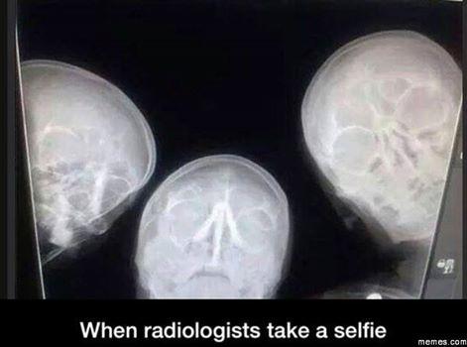
Thank You!
Questions?

Slide 33
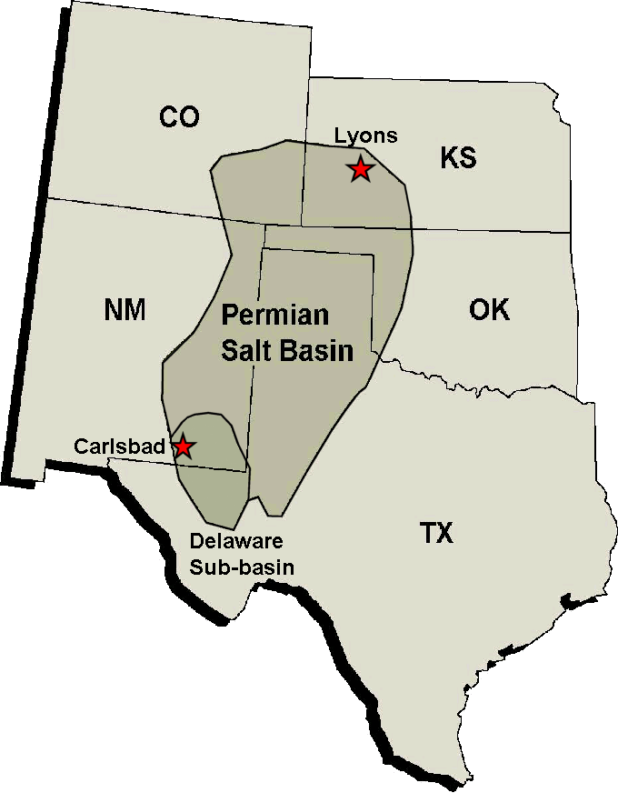
National Academy of Sciences (NAS) concludes in 1957 that the most promising disposal option for all radioactive waste is in massive Permian salt deposits
1957
“Salt at great depth ‘flows.’ It will encapsulate any waste placed at depth and isolate it from the surface environment for eons.” - NAS
“The great advantage is that no water can pass through this salt. Fractures are self healing..” - NAS

Slide 34
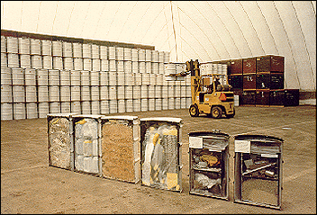
1957 - deep geologic disposal adopted; salt chosen as best
1959 – LNT adopted
1970s - AEC establishes new category for transuranic waste, distinct from low- and high-level radioactive waste but with significant overlap in radioactivity. EPA formed.
1976 – reprocessing of commercial spent fuel put on hold; retrievable disposal concept born for SNF/HLW; salt is out; separate HLW disposal site is sought. TRU still to go into salt.
1982 – Nuclear Waste Policy Act
Disposal options for different waste streams begins to diverge in the 1970s
2015
1970
Spent Nuclear Fuel (SNF)
High Level Waste (HLW)
Transuranic Waste (TRU)
Low Level Waste (LLW)
TRU
HLW
RH
Radioactivity
Radioactivity
CH
RH
CH
Dose Rate
Volume
Contact Handled (CH) < 200 mrem/hr < Remote Handled (RH, up to 23 Ci/L)

Slide 35
….seventeen candidate sites for two high-level and commercial waste sites selected in 1982 after the NWPAct
⬅ Sites considered for the first repository
Sites considered for ➔ a second repository

Slide 36
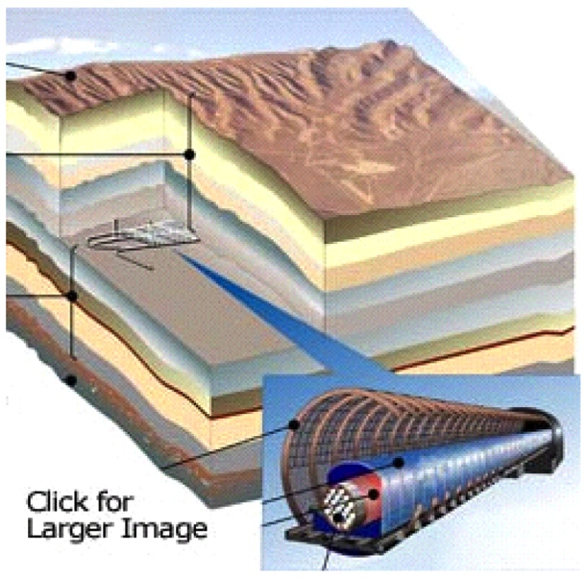
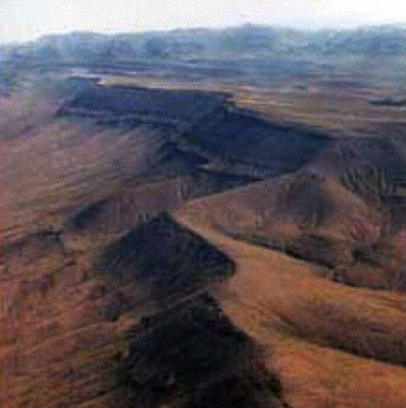
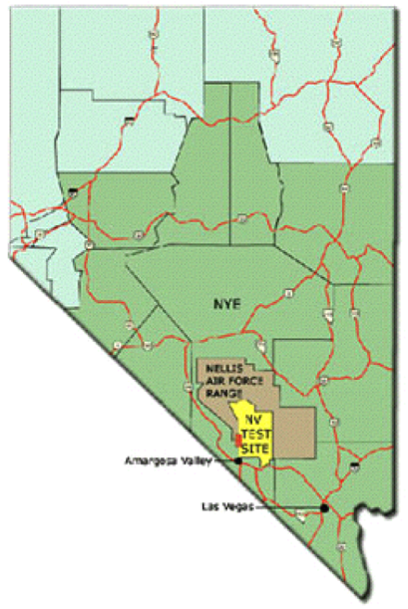
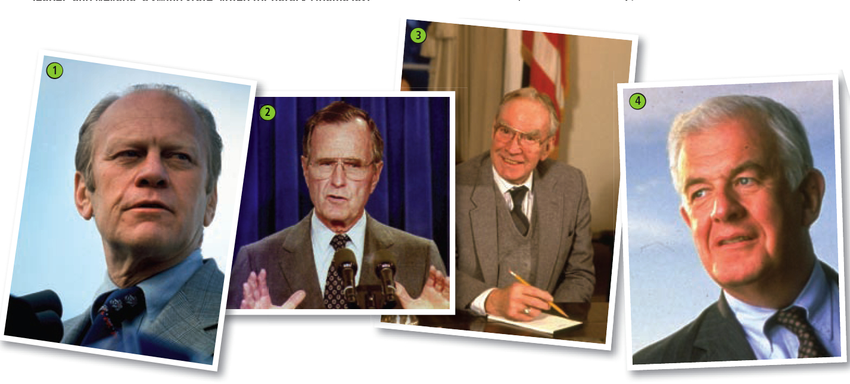

In 1987, Speaker of the House was Jim Wright from Texas, House majority lead was Tom Foley from Washington State. The new junior senator, Harry Reid, was from Nevada.
Harry Reid became Senate Majority Leader and led the effort to shut down the Yucca Mountain project. In 2010, President Obama put a Blue Ribbon Commission together to develop a new strategy.
….powerful eastern politicians removed all eastern sites, and the remaining sites were narrowed to three by 1987
- Yucca Mt, Nevada
- Hanford, Washington State
- Deaf Smith, Texas

Slide 37
Extreme re-engineering required to counteract the choice of such a wrong rock – a fractured, dual porosity, variably saturated, oxidizing volcanic tuff on the edge of the Las Vegas Shear Zone
reducing inverts
shotcrete
ceramic coating
titanium drip shield
vitrified waste
package supports
gravel backfill

Slide 38
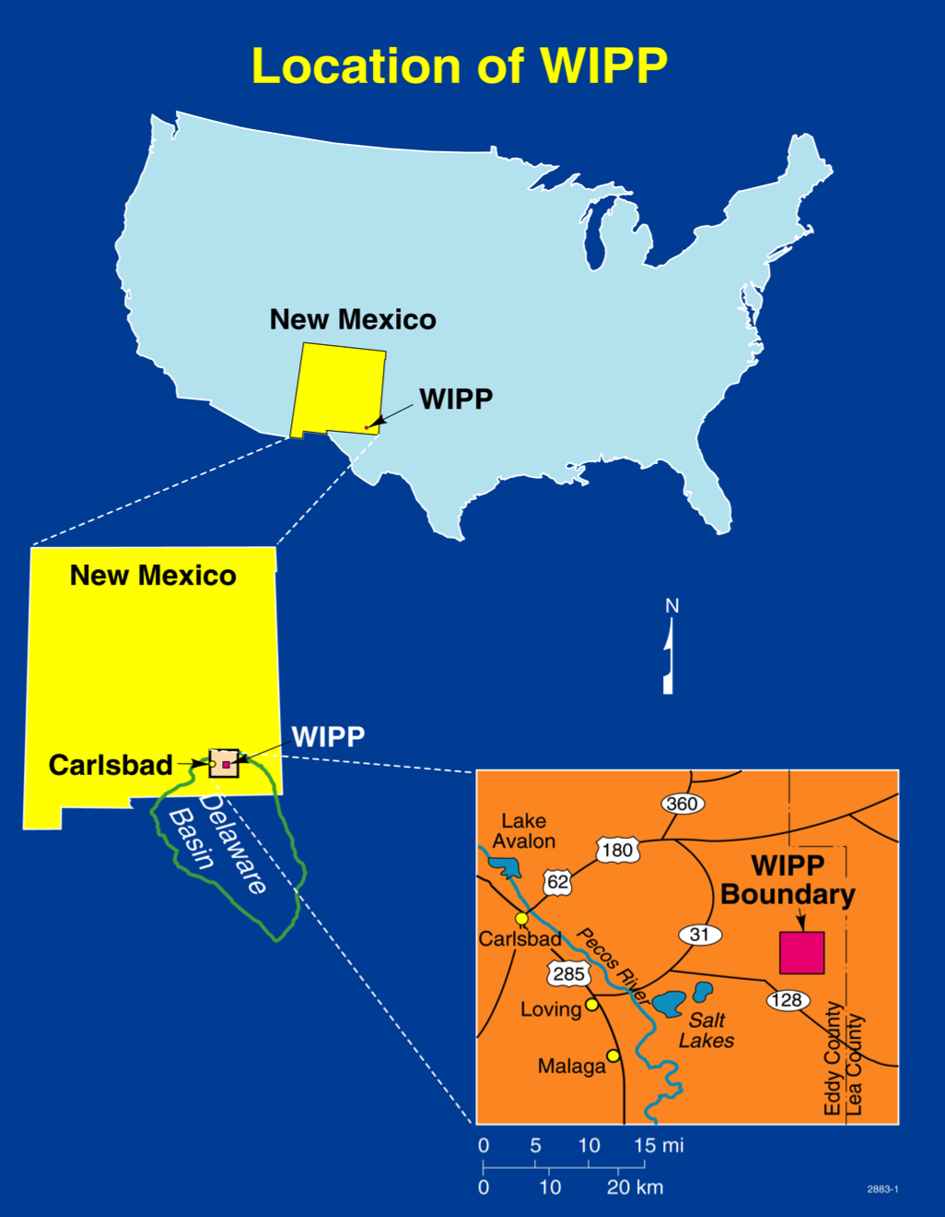
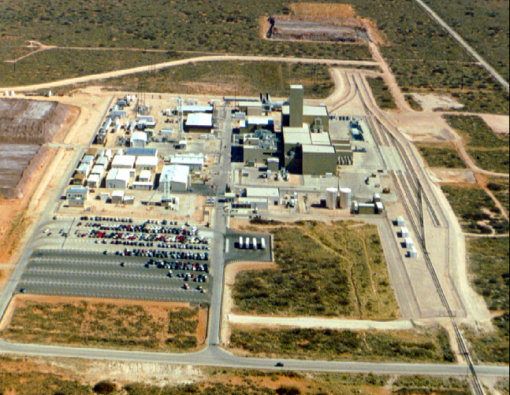
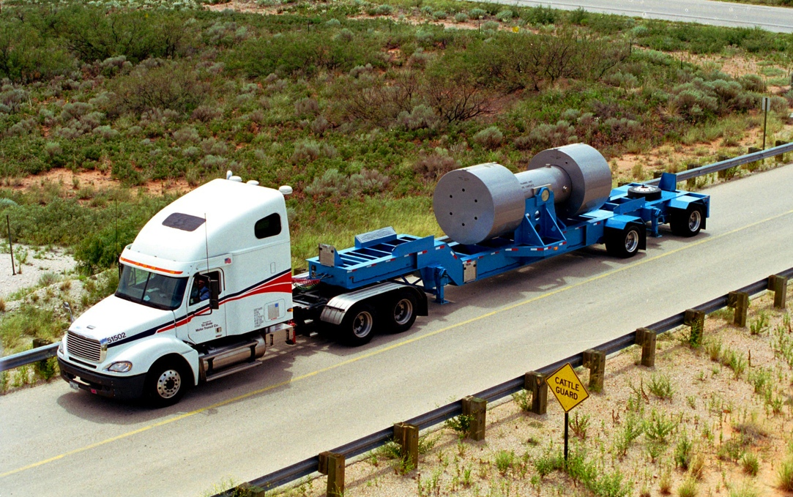
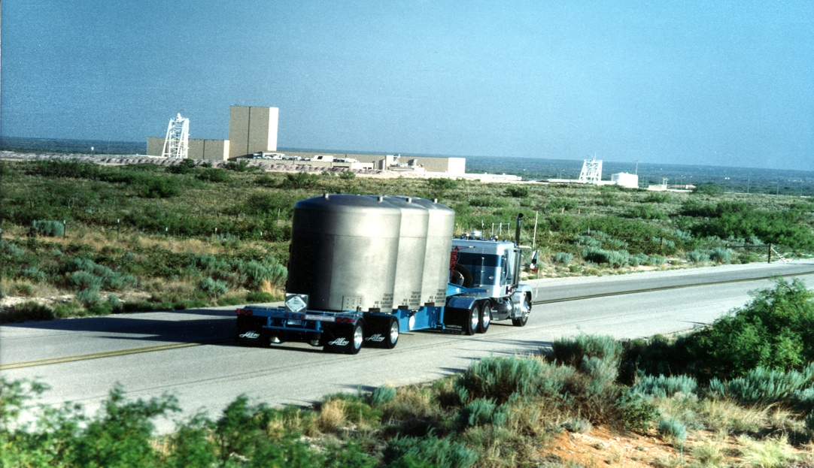
Unknown to most, transuranic waste (bomb waste) continued on into the salt as planned, leading to the Waste Isolation Pilot Plant.
WIPP has shown that geologic disposal of nuclear waste is safe and cost-effective
Unknown to most, transuranic waste (bomb waste) continued on into the salt as planned, leading to the Waste Isolation Pilot Plant.
Even with the Valentine’s Day event, WIPP is still ahead of schedule and under-budget
Only defense-generated TRU waste
presently permitted: 100 nCi/g to 23 Ci/L
of alpha-emitting ²³⁹Pu equivalents
but WIPP was originally designed
to handle all nuclear waste
16 miles² set aside in the 1992 Land Withdrawal Act
- when WIPP is full, only 1/2 mile² will have been used
Notes:
Third there’s WIPP - the Waste Isolation Pilot Plant in southeastern New Mexico.

Slide 39
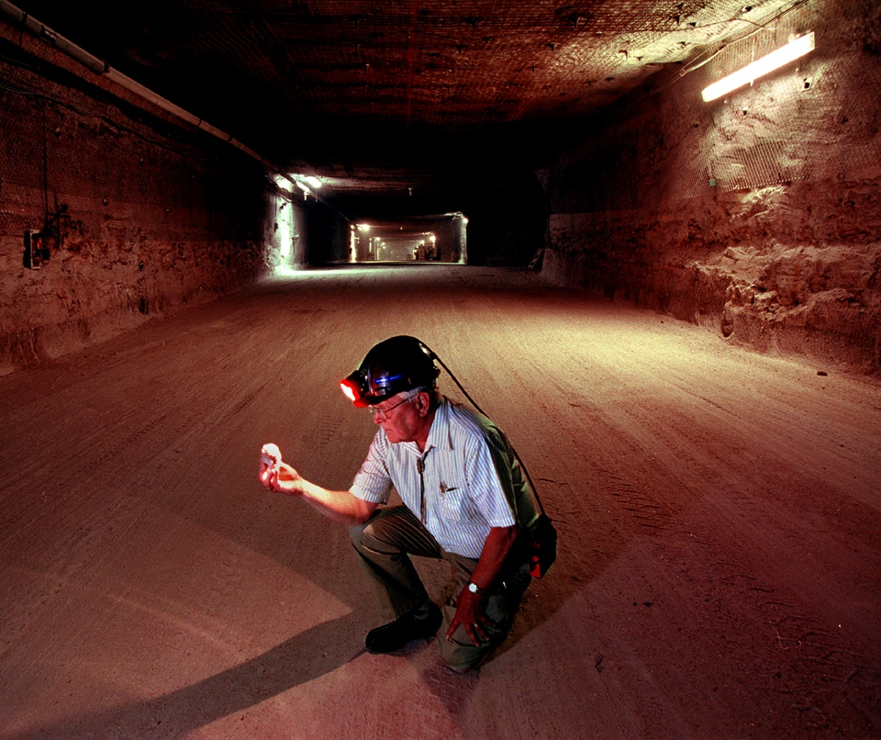

Slide 40
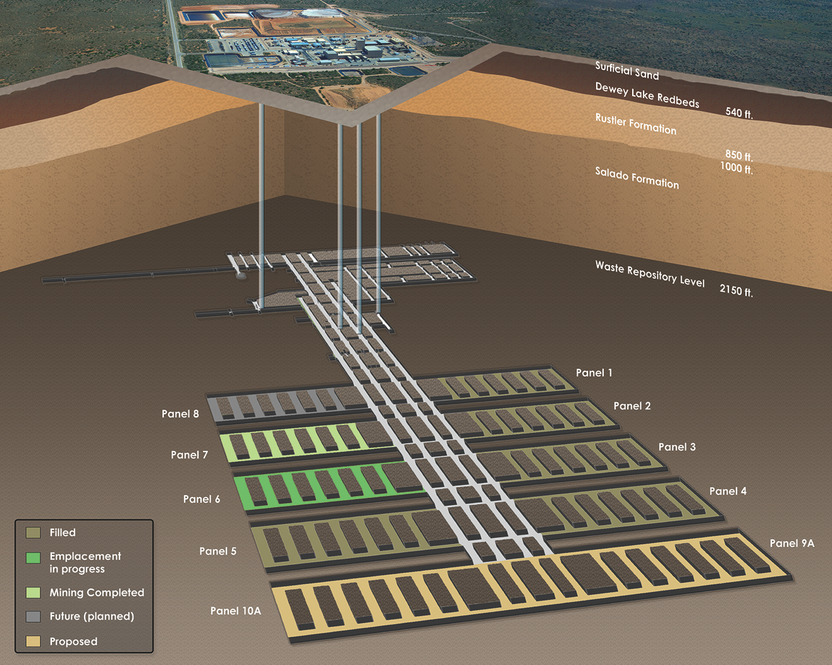
Waste Isolation Pilot Plant
U.S. Department of Energy
2,130 feet below the surface
Ventilation system:
425,000 ft³/minute
Constantly monitored
HEPA filtered

Slide 41
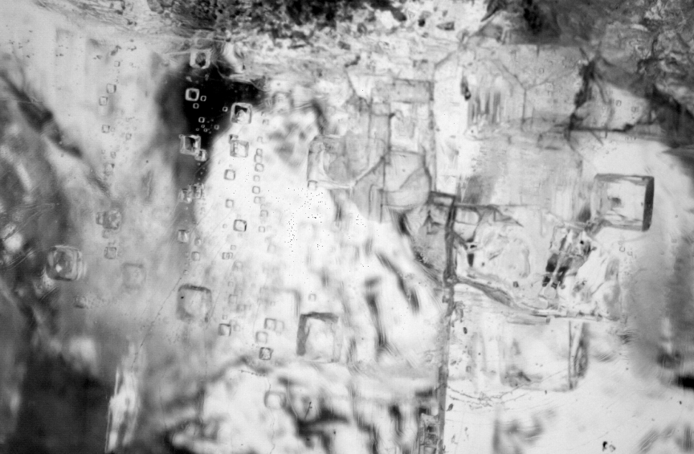
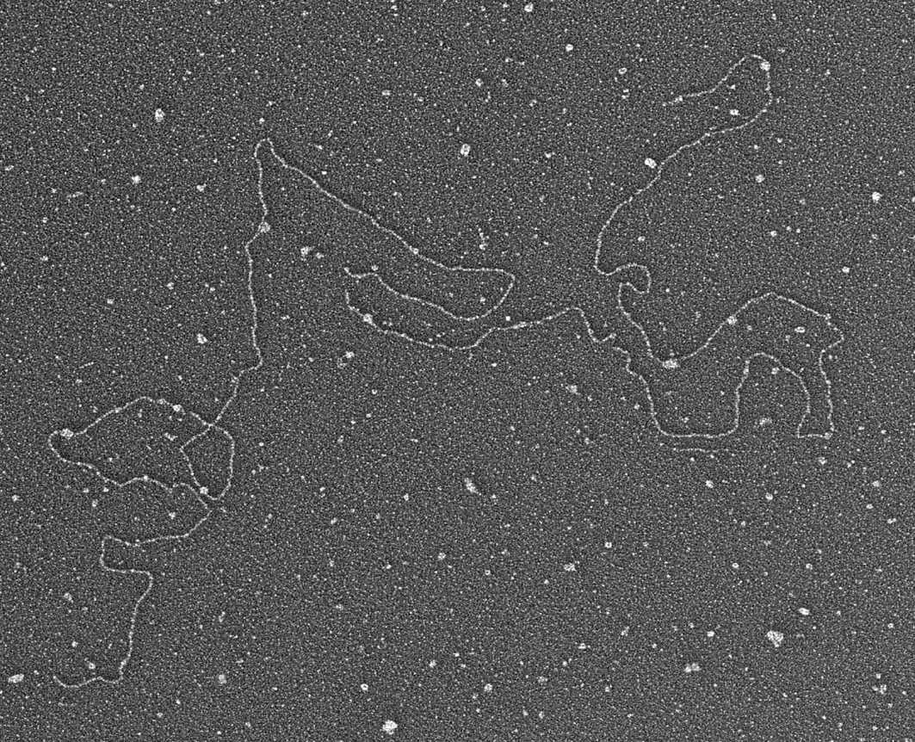
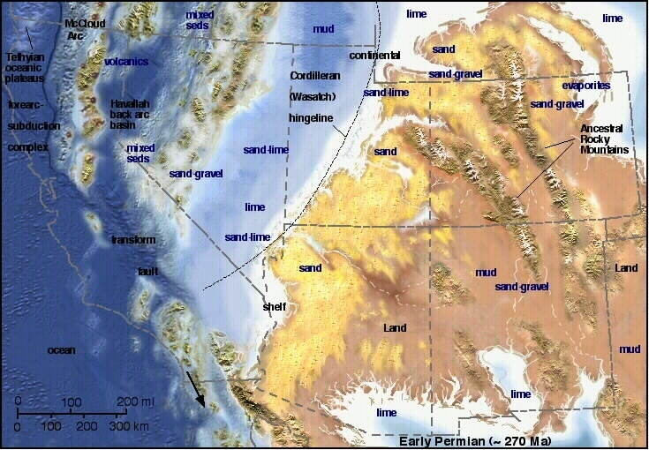
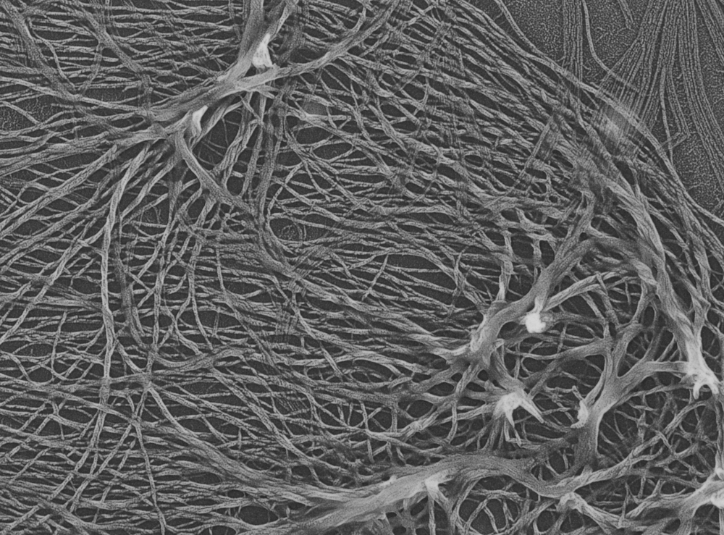
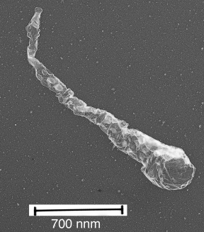
1 cm
Length: 4136 nm = ~12, 100 base pairs (similar to modern halophilic bacterial DNA)
WIPP Salado Formation salt was deposited by repeated evaporation of shallow marine incursions into the Permian Basin of New Mexico
200 nm

Slide 42
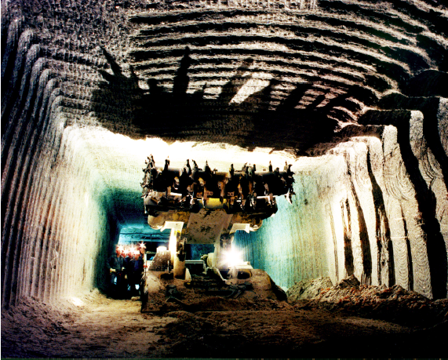
Mining the Salado is the easiest and safest mining operation in the world

Slide 43
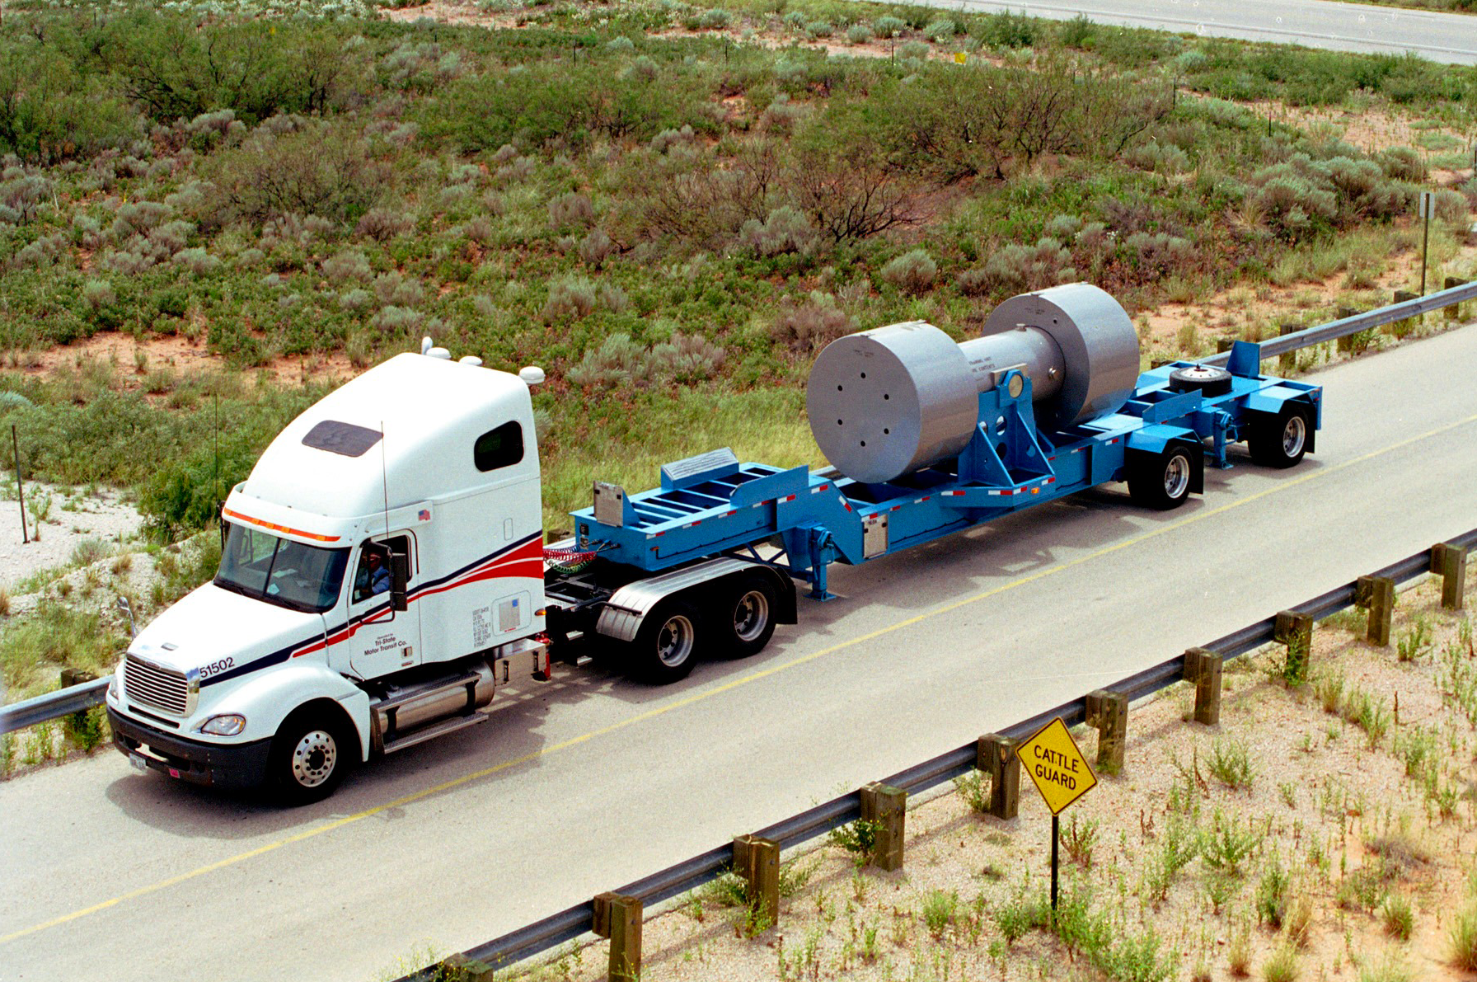
January 2007, high activity waste began shipping to WIPP;
up to 1000 R/hr surface and 23 Curies/liter (87 Curies/gallon)

Slide 44
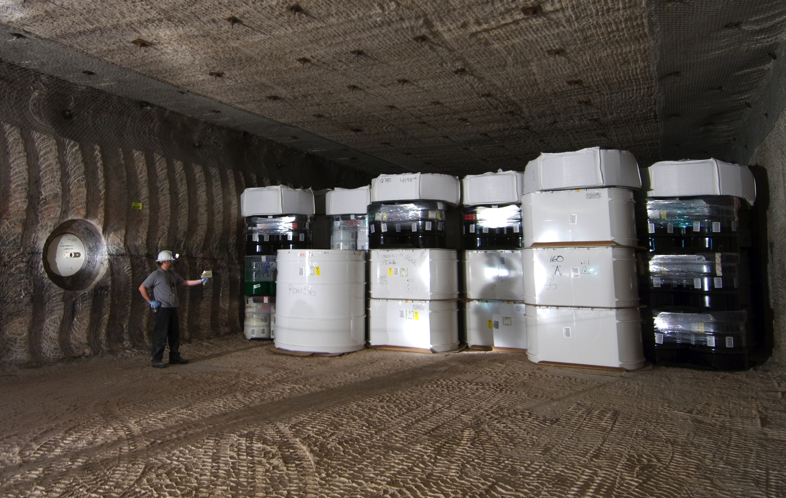
At the 2000 lbs/inch² pressure at this depth, the salt exhibits significant creep closure, i.e., the salt completely closes all fractures and openings, even micropores, making the salt extremely tight, such that water cannot move even an inch in a billion years
15 years of operation – 100,000 cubic meters of TRU waste disposed
500,000 fifty-five gallon drum equivalents
21 storage sites cleaned of legacy waste
1 minor release to the environment
0 deaths 0 people contaminated

Slide 45
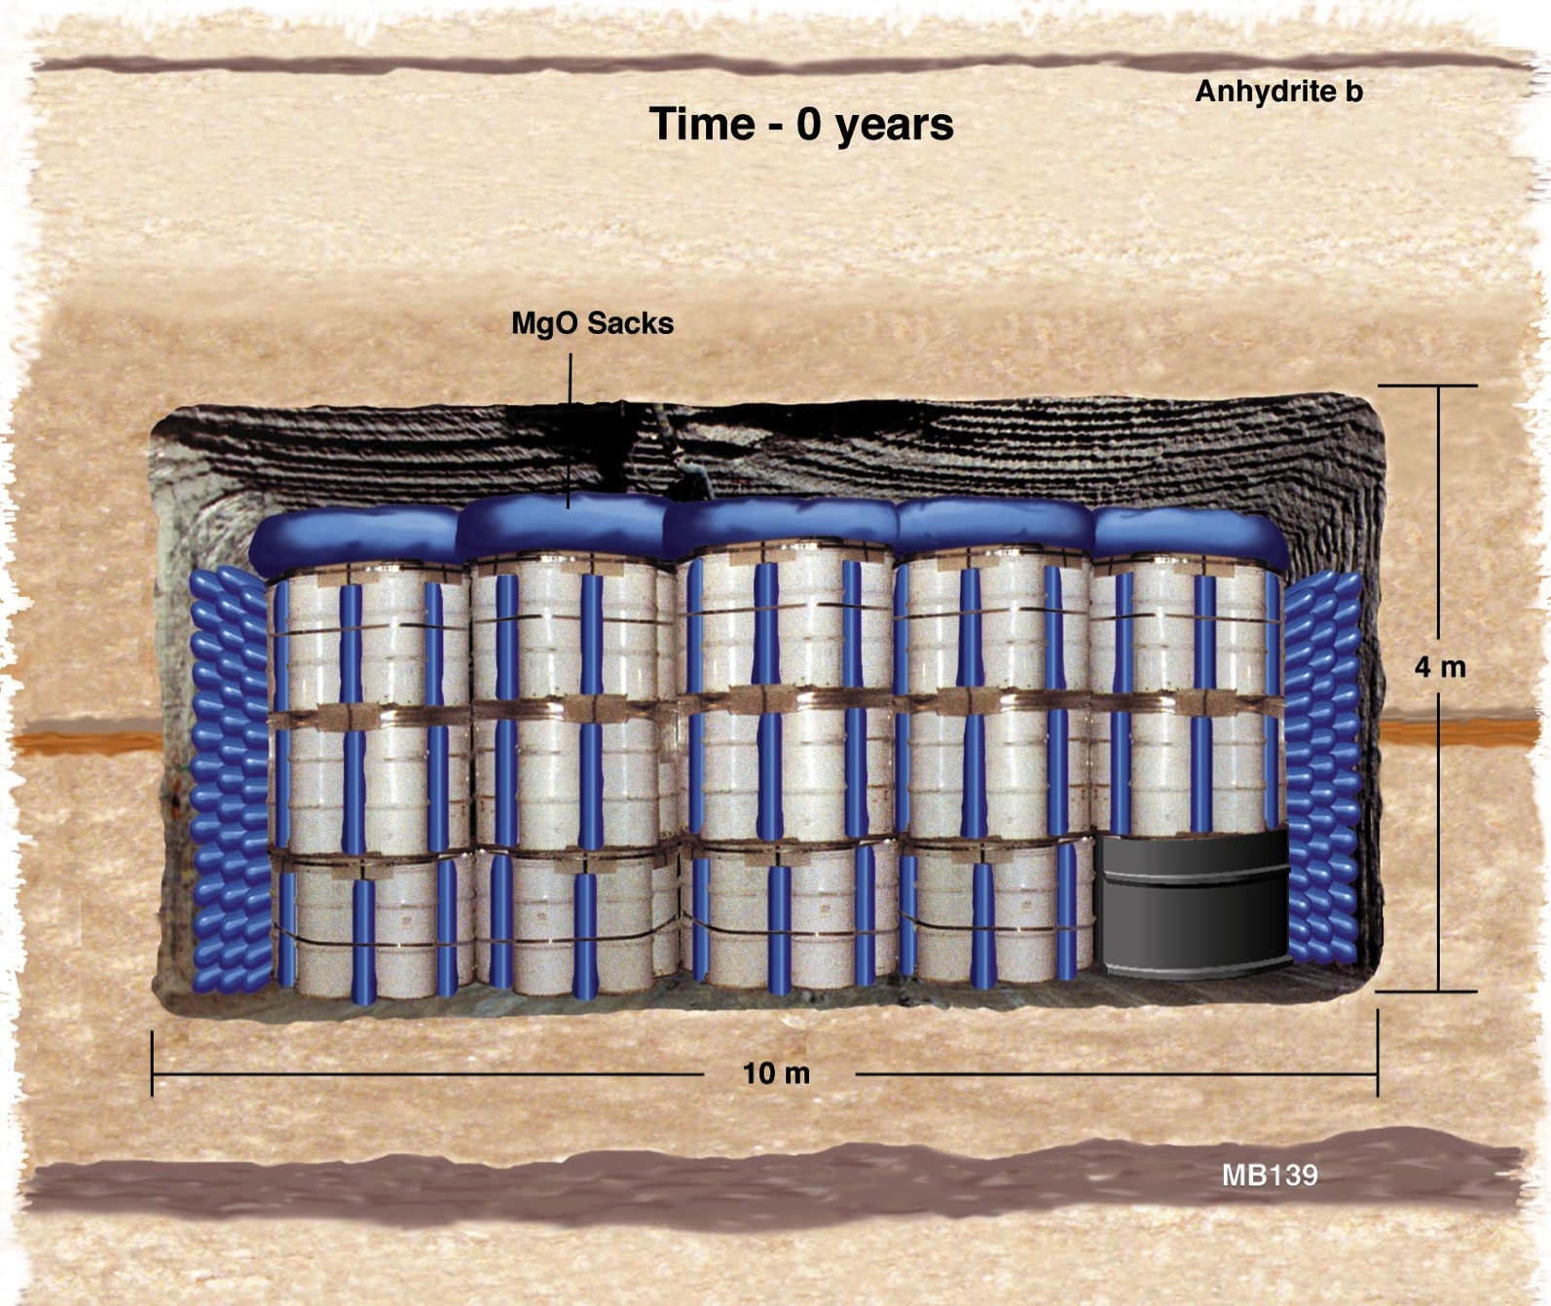
Evolution of the WIPP Disposal Rooms (t = 0 yrs)
Courtesy of Frank Hansen, SNL

Slide 46
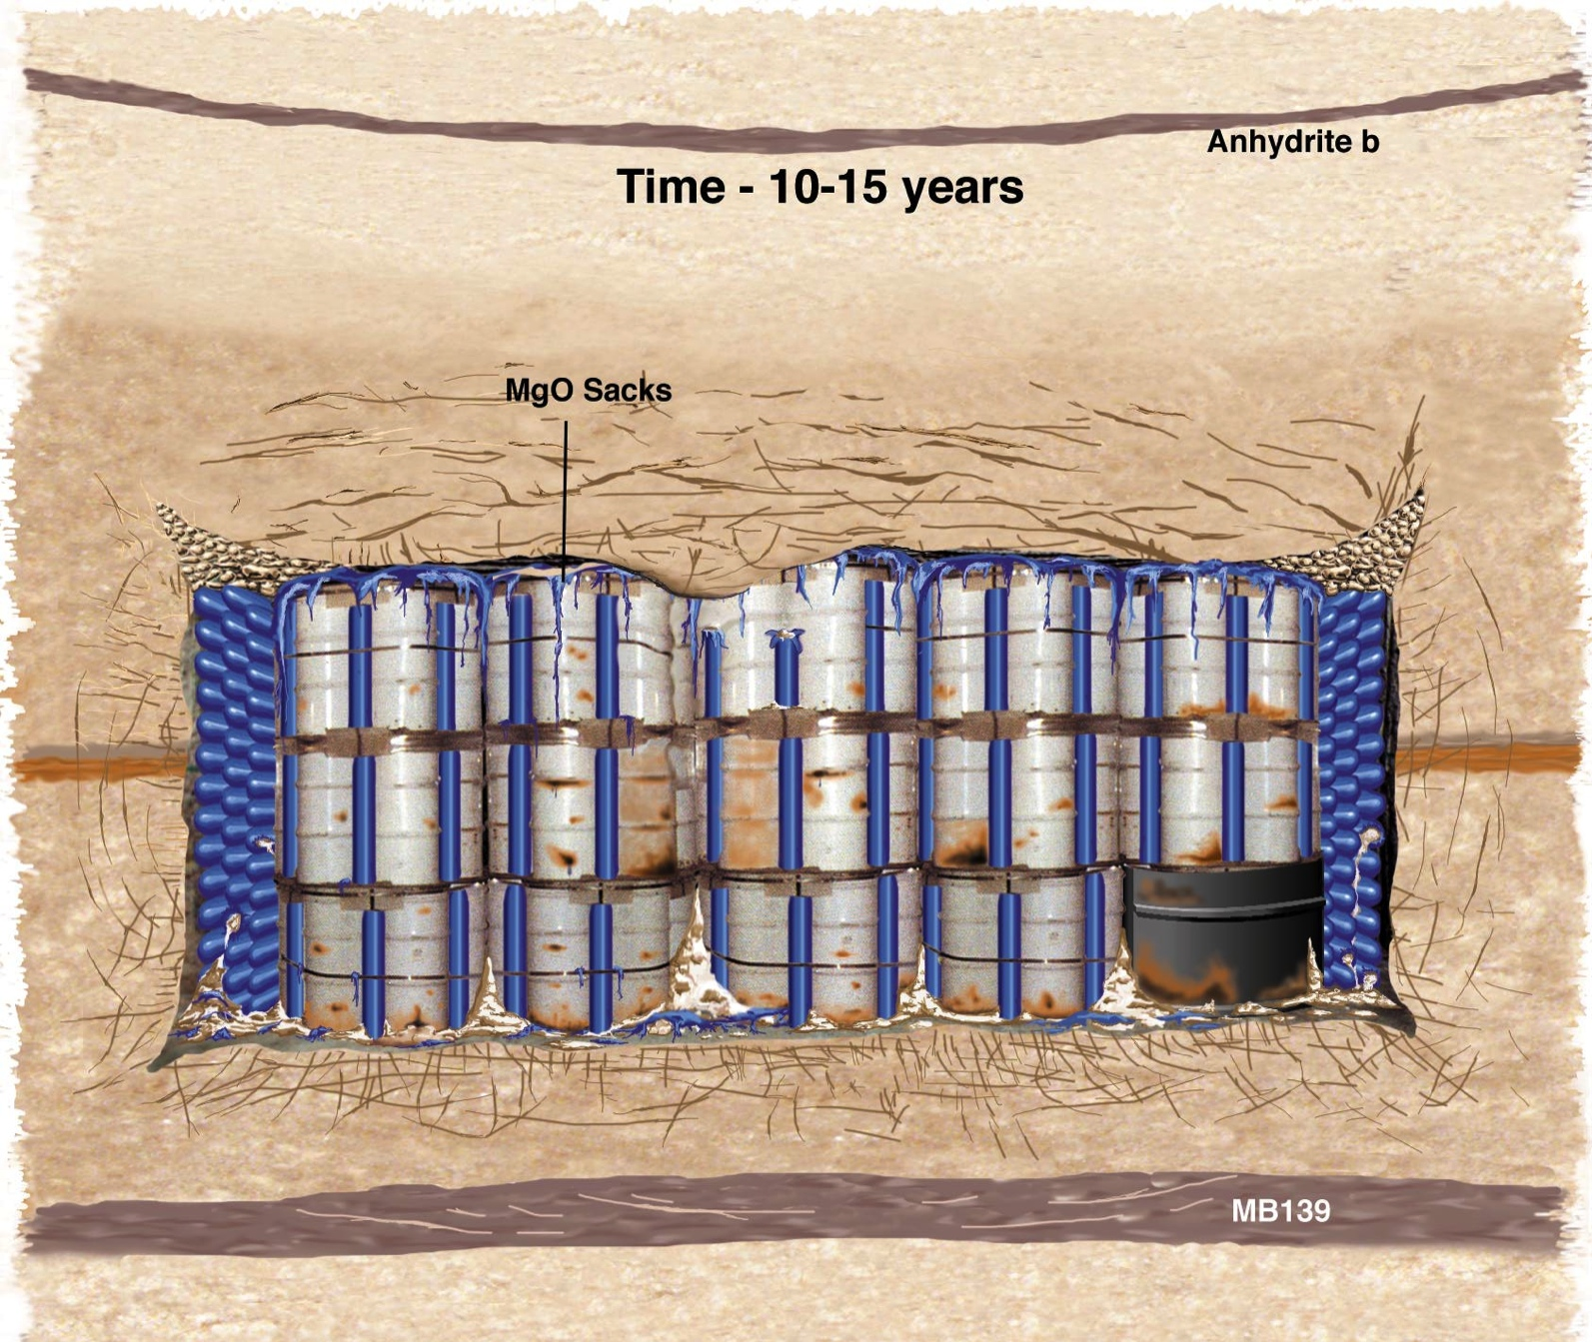
Evolution of the WIPP Disposal Rooms (10-15 yrs)
Courtesy of Frank Hansen, SNL

Slide 47
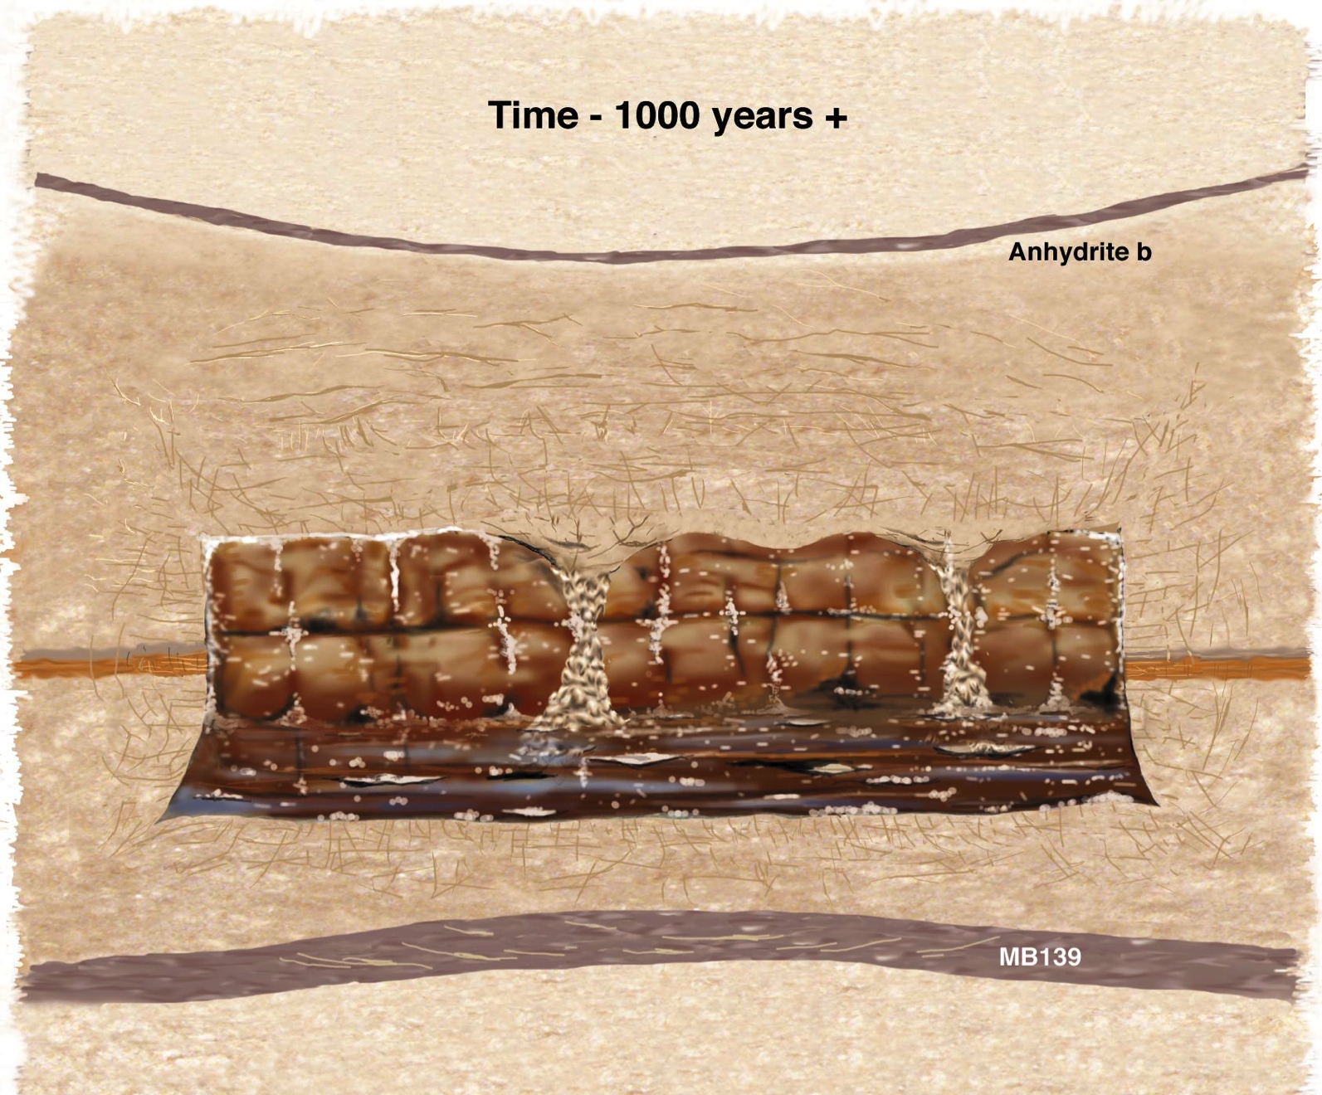
Evolution of the WIPP Disposal Rooms (1000 yrs)
K ≤ 10⁻¹⁴ m/s
D ~ 10⁻¹⁵ m²/s
(water and contaminants move less than an inch in a billion years)
1% - 1.5% porosity pH = 8.6 - 9.2 Eh < -500 mV
K_{τsalt} ~ 15 kcal/m/hr/deg @ 200°C = 5 x K_{τcrystalline}
annealing of disturbed salt ~ ƒ(T^{x}) where 6 < x < 9 ⇒ closes in < 3 years for HLW
at these values, LNT-based limits don’t matter, no limit matters
performance period - 200,000,000 years, not 10,000 or 100,000 years
no engineered barriers needed, waste form irrelevant
no persistence of cladding or canister needed
no adverse temperature effects, fluid inclusion migration irrelevant

Slide 48
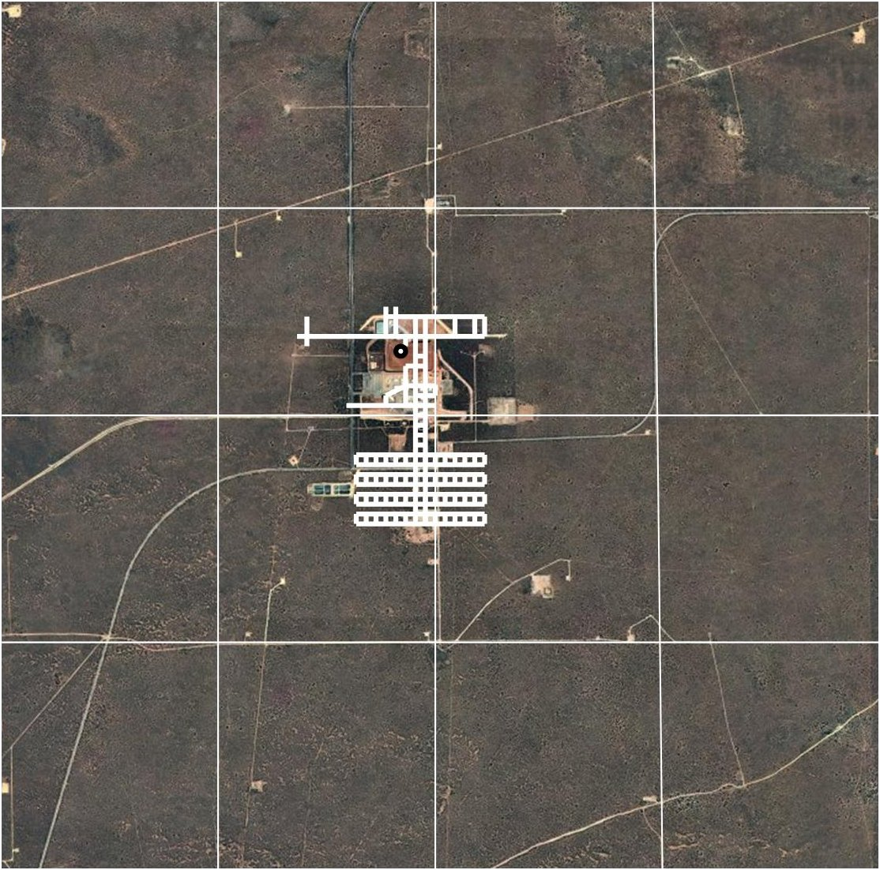
Waste Disposal Footprint in Salt
Final footprint of WIPP will be only 1 mile² out of 16 set aside for nuclear waste disposal by the the 1992 Land Withdrawal Act
February 2014 minor release of < 200 g (only 1.8 Bq/m³ to surface, quickly dropped to <0.01 Bq/m³. WIPP resumed in 2017.

Slide 49
Waste Disposal Footprint in Salt
Footprint of an expanded WIPP to include HLW as RH-TRU, with interim storage for SNF, would be less than 3 mile² out of the 16 set aside for nuclear waste disposal by the the 1992 Land Withdrawal Act and would save about $200 billion

Slide 50
Repository Costs (DOE millions 2007$) for 83,000 MTHM of HLW (excluding SNF)
Component Yucca Mt tuff WIPP salt granite/basalt
Development and 9,488 800 11,006
Characterization
Surface and 24,053 7,187 27,901
Subsurface facilities
Waste Package and 19,164 1,250 8,700
Barriers/Shields
Performance 3,273 926 3,797
Confirmation
Regulatory, Infrastructure 4,687 2,030 5,436
And Mgmt. Support
Program Integration 6,821 3,708 7,912
QA/QC, NRC, other
Transportation 9,434 7,000 6,500
Institutional costs 6,604 6,604 6,604
Financial assistance
TOTAL $83,524 $29,505 $77,856

