Slide 1
Guidelines for Operating an Interim On-Site Low Level Waste Storage Facility, Revision 2
Karen Kim
Sr. Technical Leader
EPRI Nuclear Radiation Safety Program
kkim@epri.com
Low-Level Radioactive Waste Forum Spring Meeting
April 16-17, 2018

Slide 2
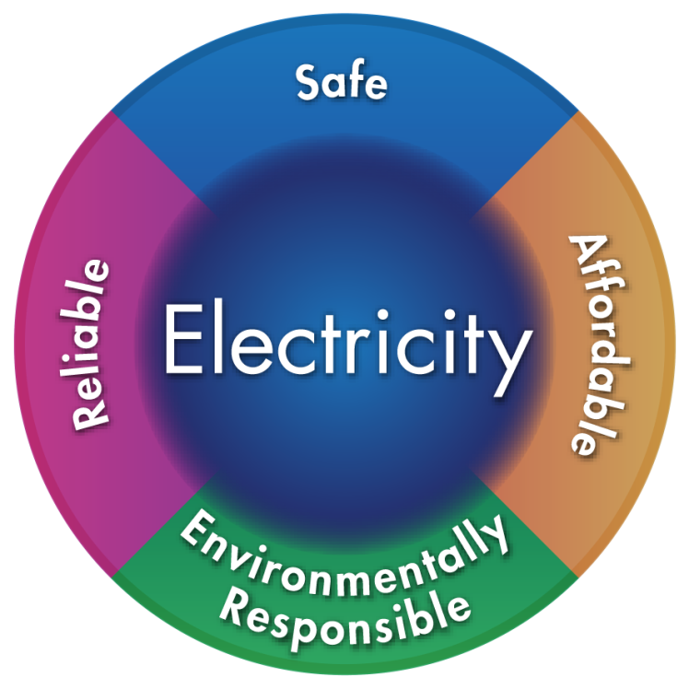
EPRI’s Mission
Advancing safe, reliable, affordable and environmentally responsible electricity for society through global collaboration, thought leadership and science & technology innovation

Slide 3
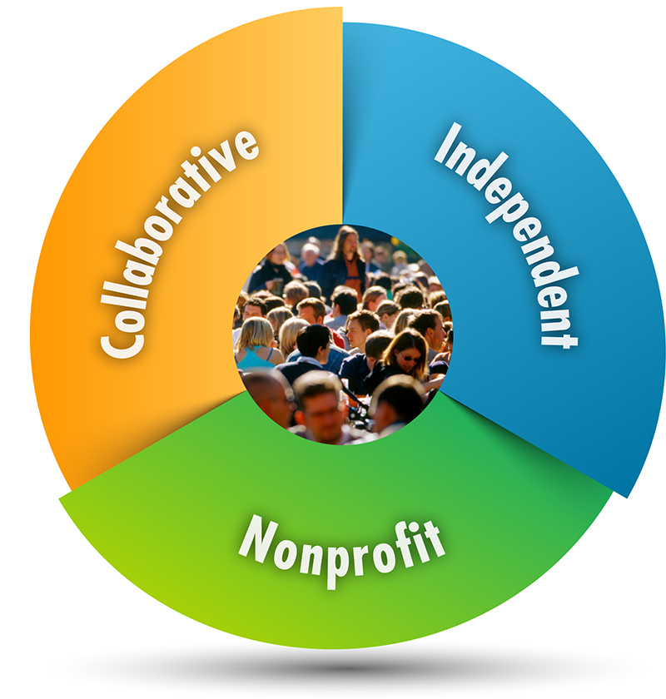
Three Key Aspects of EPRI
Independent Objective, scientifically based results address reliability, efficiency, affordability, health, safety, and the environment
Nonprofit Chartered to serve the public benefit
Collaborative Bring together scientists, engineers, academic researchers, and industry experts

Slide 4
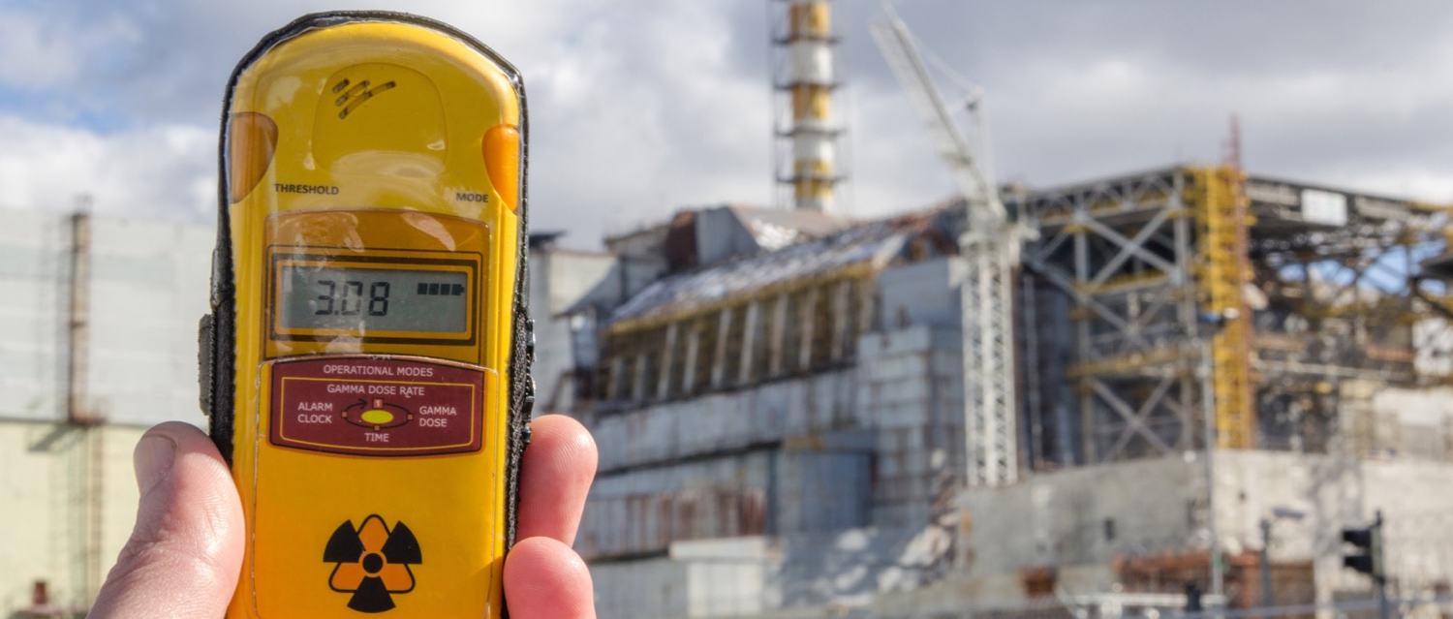
Radiation Safety
Radiation Safety Program

Slide 5
Radiation Safety Program
Program Objectives:
Develop tools, technologies, and improvements to operational practices
Enhance public and worker safety
Reduce risks associated with waste management
Four technical areas addressed in program:
Three Technical Strategy Groups:
Radiation Management and Source Term TSG
Low Level Waste TSG
Groundwater TSG
Technical Strategy Groups (TSG) provide a peer-to-peer forum for:
Exchanging benchmarking information,
Gaining insights on application of EPRI research,
Learning about technology updates,
Sharing management strategies and ideas
Carola Gregorich, cgregorich@epri.com
Radiation Management & Source Term
Radiological Environmental Protection
Karen Kim, kkim@epri.com
Low Level Waste
Low Dose Radiation Health Effects
Low Dose Health Effects
Karen Kim, kkim@epri.com
Decommissioning
Notes:
TSGs:
Tailored by members
Typically includes
Recognize importance of peer to peer interactions of professionals dealing with specialized issues--- TSG webcasts provide that forum, regulatory compliance issues, application of tech., e.g. WCS invited to convey licensing issues to LLW community, e.g. vendor bring forth new processing technology
Site Assessment: Focus is on application of EPRI research (tech transfer), help plants more quickly obtain benefits from EPRI research-→ generic lessons learned get put back into base research program--- provide examples: on site storage GL, BC Waste reduction guide, ALARA assessment lead to development of scaffolding guide
Develop tools, technologies, and improvements to operational practices that can
Enhance public and worker safety
Reduce risks associated with waste management
Work encompasses 4 major technical area:
Radiation Management: Development of tools, techniques, and work practices to minimize radiation fields and radiation exposure to workers
Low Level Waste: International waste characterization, enhanced disposal options for high activity resin, risk analysis of LLW disposal site designs
Radiological Environmental Protection: Work on effluent pathways and accurate dose determinations, maintenance of Groundwater Guidelines
Low Dose Program: Focused on advancing the science of radiation risks and informing stakeholder discussions of risks and regulations
And overall the research portfolio for the next two years are divided into 5 active research focus areas. We actually have 8 research focus areas total but will not be able to conduct any work in the next 2 years on the last three areas due to funding constraints.
ALARA Strategies
Reduce dose to plant personnel. Combines the tools developed to reduce source term with typical ALARA tools such as shielding and better work planning to provide a comprehensive strategy for reducing dose to workers.
Radioactivity Generation and Control
This focus area is large and encompasses the majority of the projects related to source term reduction that have a direct impact on activity generation and control. However, not only does it include technologies and strategies for minimizing plant radiation fields, it also includes strategies for treating and controlling radwaste and effluent releases.
Radiation Safety Guidance
This area involves the development and maintenance of guidelines, guides and sourcebooks for radiation protection, source term reduction, radiological environmental protection (which includes groundwater), and low level waste. These products are often the culmination of multiple years of research on a particular topic that is packaged in such a way that makes it easier for the sites to implement and use.
Accurate Dose Reporting for Workers and the Public
The work mentioned above is focused on reducing exposure to radioactive materials, this area is focused on improving the accounting of that exposure. The issue here is that the industry still uses very conservative models and assumptions when calculating dose to workers and members of the public. We have seen that in some cases, worker dose could be over reported by as much as 50%.
Benchmarking and Trending
The last focus area is on maintaining our benchmarking and trending databases. We have two that we maintain. One is for monitoring industry radiation fields and the other is on radwaste performance.

Slide 6
EPRI Low Level Waste Research
Characterization
Waste Minimization
Safe Storage
Disposal Flexibility

Slide 7
Guidelines for Operating an Interim On-Site Low Level Waste Storage Facility, Revision 2

Slide 8
Scope & Purpose of “On-Site Storage Guidelines”
Provide guidance for developing and implementing safe & efficient interim low level waste storage
Interim storage (period of years) pending availability of final disposal pathway
Not temporary storage pending shipment of waste to disposal site
Risk informed approach to inspections
Waste needs to be stored in a manner and form that
Maintains the integrity and safety of waste/waste packages
Maintains the safety of workers, the environment and the public
Is acceptable for final disposal
Facilitates transport to a final disposal site in the future
Developed in collaboration with subject matter experts and a committee of nuclear power plant low level waste management professionals.

Slide 9
On-Site Storage Guidelines Contents
Storage Facility Start-up
Records and Recordkeeping for Extended Storage
Waste Containers for Extended Storage
Waste Forms for Extended Storage
Monitoring and Inspection for Extended Storage
Greater than Class C Storage Considerations
End of Storage Considerations

Slide 10
On-Site Storage Guidelines History
EPRI developed several on-site storage guidance in the 1990’s.
In 2009 published Guidelines for Operating an Interim On-Site Low Level Radioactive Waste Storage Facility, Revision 1 and supporting document Low Level Waste On Site Storage Guidelines Operating Guidelines – Supplemental Information Manual
NRC Regulatory Information Summary (RIS) 2008-32 Interim Low-Level Radioactive Waste (LLRW) Storage at Nuclear Power Plants recognized Revision 1 of the Guidelines as an acceptable method for recordkeeping, determining waste forms and waste containers, and monitoring and inspecting the interim long term storage of LLW.
In 2011, EPRI developed Recommended Changes to Guidelines for Operating an Interim On-Site Low Level Radioactive Waste Storage Facility – For NRC Review.
Includes revised, technically justified, and risk informed inspection strategy.
In 2012, Regulatory Guide 4.22 “Decommissioning Planning During Operations” includes provisions for developing risk-informed inspection frequency based on likelihood of radiological risk from container failure.
Technical bases for chosen frequencies to be documented.
Notes:
Licensees are required to conduct radiological surveys of containers to meet 10 CFR 20.1501(a)(2) requirements. Container inspections should be performed to verify that container integrity meets 10 CFR 20.1406(c) requirements. Licensees should develop a container inspection program based on the likelihood of radiological risk from container failure. There are no regulatory requirements for a specific inspection frequency. Containers having a higher radiological risk significance may need to be inspected on a more frequent basis (e.g., quarterly, semi-annually, or annually), and containers with less radiological risk significance may be inspected on a less frequent basis (e.g., yearly or longer time interval inspection may be appropriate). The basis for selecting the inspection frequency should be documented. Factors to consider when developing a container inspection program include the:

Slide 11
Revision 2 of On-Site Storage Guidelines EPRI Report 3002010640
Combine three previous documents (Revision 1, Supplemental Information Manual, Recommended Changes)
Enhanced international applicability
Incorporated international operating experience
Recent technical developments
Recent regulatory / policy developments:
Regulatory Guide 4.22 provisions for risk informed inspections of stored wastes.
Revised US NRC 10CFR37 “Physical Protection of Category 1 and Category 2 Quantities of Radioactive Material”
Revision 2 has not been reviewed or endorsed by NRC or other industry organization
Incorporates guidance from the historical Revision 1 of the Guidelines and Supplemental Information Manual and continues to represent an acceptable storage methodology.

Slide 12
Practical Storage Facility Start-Up Evaluations
Location considerations
Inside fenced security area
Fire/smoke detection and fire suppression systems
Collection and sampling of liquid drainage
Protection from environmental conditions (e.g., hurricane, tornado, flooding, freezing weather, etc.)
Protection of the environment (e.g., collection of drainage in berms so as not to impact groundwater.)
Provisions for future retrieval and any needed reprocessing for disposal
Radiological survey considerations
Off-site dose considerations
Worker dose exposure considerations
Total stored activity limits
Specific considerations for dry and solidified and wet solid waste storage.

Slide 13
Records and Record Keeping for Extended Storage
Specific Guidance on Stored Waste Container Records
Container manufacturer, type, model number, external volume, manufacturer serial number
Date of packaging
Reference Decay Date
Date placed in storage
Container storage location
Physical form of container and waste contents
External radiation and contamination survey
Chemical form
Total Activity
Radionuclide Identify and Quantity
Total weight percentage of chelating agents
Sorbing or solidification media
Waste Class

Slide 14
Risk Informed Inspection Frequencies
Original inspection frequency was once a quarter.
EPRI Guidelines
Provides inspection frequency guidance based waste form, waste packages, and risk evaluation results
Technical basis provided in report
Provides criteria for performing container risk evaluation for each container in storage
The more conservative of a container that is oldest or a container that has been assigned the elevated risk ranking should be inspected.
Recognizes that High Integrity Containers (HICs) can be safely inspected less frequently that carbon-steel containers.
Source: Guidelines for Operating an Interim On-Site Low Level Radioactive Waste Storage Facility, Revision 2. EPRI, Palo Alto, CA: 2017. 3002010640.

Slide 15
EPRI Guidelines Inspection Frequencies
Waste Type/Container | Criteria/Conditions | Inspection Frequency
Solidified, Thermally Volume Reduced, or Encapsulated Waste |  | At least one container the first year, THEN one container every 10 years
Raw Dewatered Wet Solid Waste in HICs | Dewatered to freestanding liquid <1% by volume Stored in facilities or modules that can 100% of the liquid and solid contents can be contained. | At least one container the first year, THEN one container every 5 years (2% of 300 year HIC life.)
Raw Dewatered Wet Solid Flowable Waste in Any Container not meeting above two criteria (e.g., steel liner) |  | In10% of stored inventory or one container per year, whichever is greater.
Dry Solid and Wet Filter Waste in Steel Waste Containers | Stored inside or outside in modules | 10% of the stored inventory or one container every two years, whichever is greater.
Dry Solid Waste in Steel Waste Containers | Stored outside with no enclosure or other environmental protection | 5% of the stored inventory per quarter

Slide 16
End of Storage Considerations
Example Guidance:
Inspect and repair all support utilities and equipment used to inspect, handle, repackage, process and load waste.
Determine if each package meets the requirements for transportation regulations, disposal site waste acceptance criteria (WAC), and the site process control procedure (PCP.)
All set solid LLW will require additional reprocessing before shipment off-site
Ensure each LLW package meets applicable disposal site WAC for freestanding liquid and gas generation
Verify internal void space is in compliance with disposal site WAC
For solidified LLW verify no freestanding liquid (due to rain, condensation) on top of the monolith inside the container

Slide 17
Summary and Conclusions
Waste needs to be stored in a manner and form that
Maintains the integrity and safety of waste/waste packages
Maintains the safety of workers, the environment and the public
Is acceptable for final disposal
Facilitates transport to a final disposal site in the future
Provide guidance for developing and implementing safe & efficient interim low level waste storage including risk informed approach to inspection frequency.
Revision 2 of the Guidelines incorporates previous guidelines and guidance, recent technical developments, regulatory/policy developments and international operating experiences
Revision 2 has not been reviewed or endorsed by NRC or other industry organization, but is based on reviewed Revision 1 and continues to represent an acceptable storage methodology

Slide 18
EPRI International Low Level Waste Conference and Exhibit Show
June 19-21, 2018
Hyatt Regency Savannah
Please contact Karen Kim (kkim@epri.com) for more information.

