Slide 1
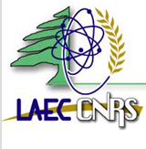
Lebanese Atomic Energy Commission
Spring 2018 LLW Forum Meeting
Removal Campaigns and Activities
Related to Improving Storage Facility
operations and oversight
April 16-17, 2018
Hyatt Regency Airport Hotel - San Francisco, California, USA
Muzna Assi, Technical Advisor, Director’s Offices- LAEC
massi@cnrs.edu.lb

Slide 2
Presentation Outline
Radiation sources practices and inventory
Radioactive Waste Inventory
Mandate of Lebanese Atomic Energy Commission
RWM in Lebanon, in LAEC and relevant decrees
Detection system on borders and orphan radioactive pieces found
Current radioactive waste store room in LAEC
Establishment of the new RWM national store in LAEC
IAEA assistance: INT 9182 and repatriation missions

Slide 3
Radioactive Sources Practices In Lebanon
Medical use (cancer therapy unit, blood irradiator, cyclotron, nuclear medicine, X-ray based diagnostic equipments, accelerators)
Gauging systems (thickness, density and level)
NDT (X-Ray radiography)
Elemental analyzers (radioisotopes and X-ray tubes)
There are No Nuclear Facilities in Lebanon

Slide 4
Radioactive Sources Inventory Summary In Lebanon
9 Radiotherapy facilities (11 Linear Accelerator and 3 Brachytherapy)
4 Blood irradiators (Cs-137)
2 Cyclotron to produce F-18
22 Nuclear medicine centers (using radiopharmaceuticals products such as iodine-131, Generators of Tc-99m, Gallium-67, Fluor-18, Tallium-201…)
10 RIA Laboratories using of Iodine-125
Many industrial factories using gauges for thickness, density and level

Slide 5
Radioactive Waste Inventory Summary in Lebanon
1 radiotherapy source (1 Cobalt-60)
13 nuclear gauges (10 Cs-137; 2 Co-60; 1 AmBe-241)
2 cyclotrons to produce F-18
About 174 orphan sources and contaminated pieces in the temporary radioactive waste management storage room in the Lebanese Atomic Energy Commission - LAEC

Slide 6
Mandate of Lebanese Atomic Energy Commission - LAEC
The LAEC was established in 1996 with the full support and assistance of the IAEA to:
Encourage and develop the peaceful use of atomic energy in the country and spread the Safety and Security Culture for the use of radiation sources
Make applied research using nuclear techniques and technologies
Establish the national infrastructure for radiation protection including the preparation of the necessary legislations for protecting the public, workers and environment against ionizing radiation

Slide 7
Radioactive Waste Management in Lebanon
Institutions and organizations involved in RWM in Lebanon are:
Regulatory Body: The ministry of health with LAEC Authorization Department
Services: LAEC performs different waste conditioning and on-site disposal services for facilities upon request; it is also responsible for the construction and management of a national site for radioactive waste.
Users: Users of radioactive waste work in different fields (medical, industrial, research…etc).
Scrap Yards: Different orphan sources are being found in scrap yards as they are present with scrap material for export. These sources are discovered on the borders prior to leaving the country. These sources are brought to LAEC for temporary storage.

Slide 8
Radioactive Waste Management Work in LAEC
The following services have been covered in the work of radioactive waste management in LAEC for the past years:
Receipt of orphan sources, condition them when possible, and temporarily store them
Manage and organize temporary store in LAEC (present sources, equipment, lists)
Prepare and retain archive for inventory of waste, relevant lists and forms, mission, projects, certificates, reports…)
Carry out necessary trainings for involved staff

Slide 9
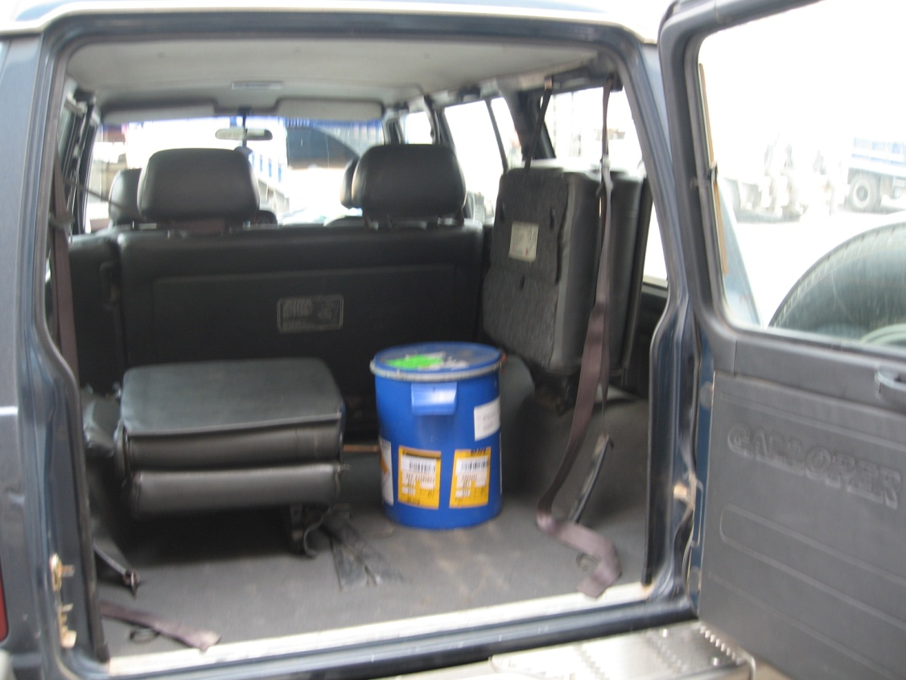
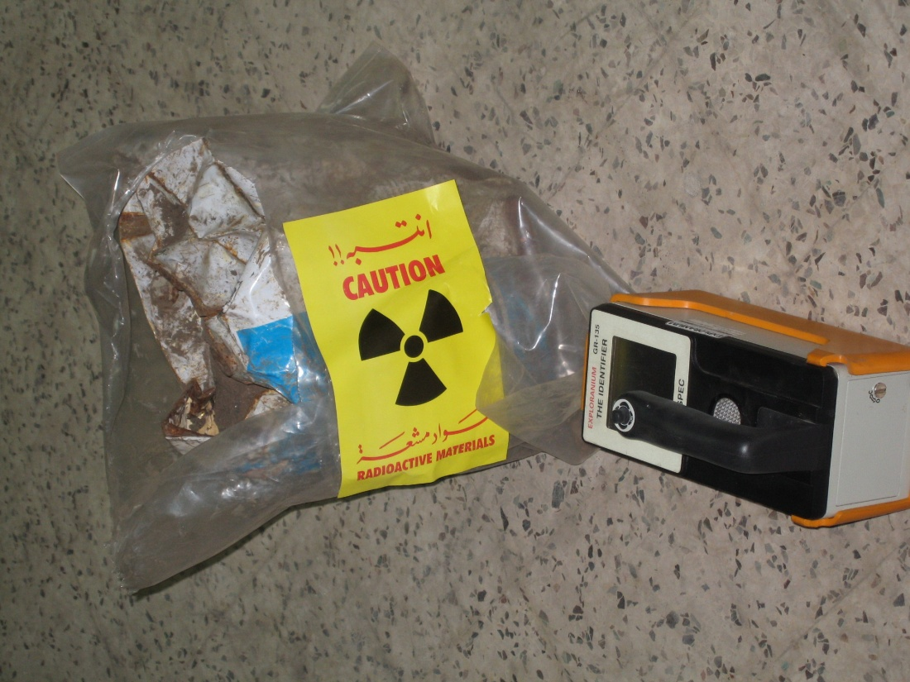
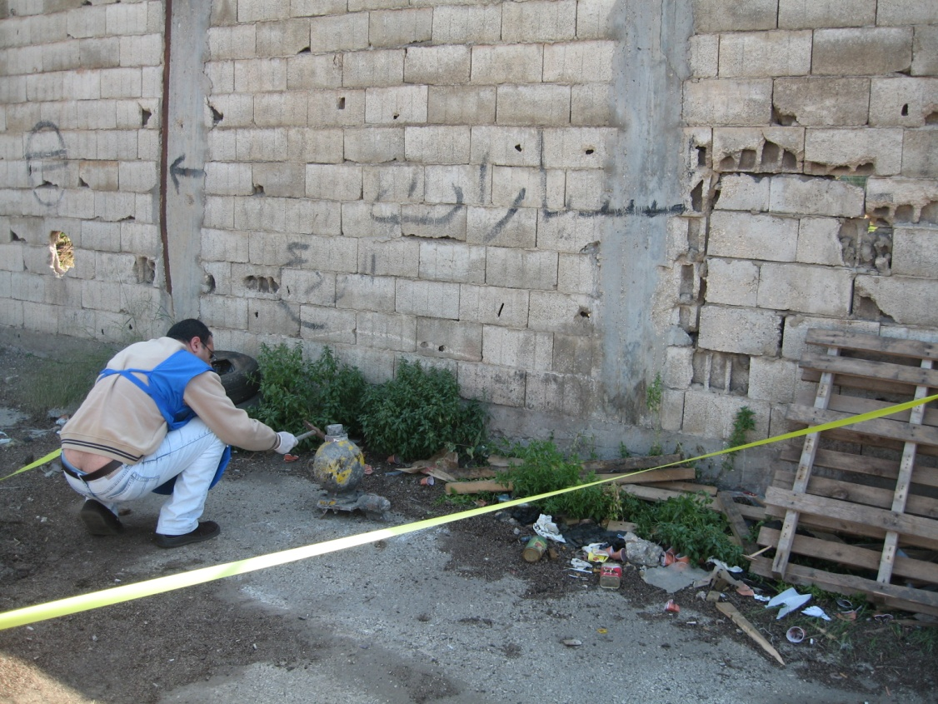
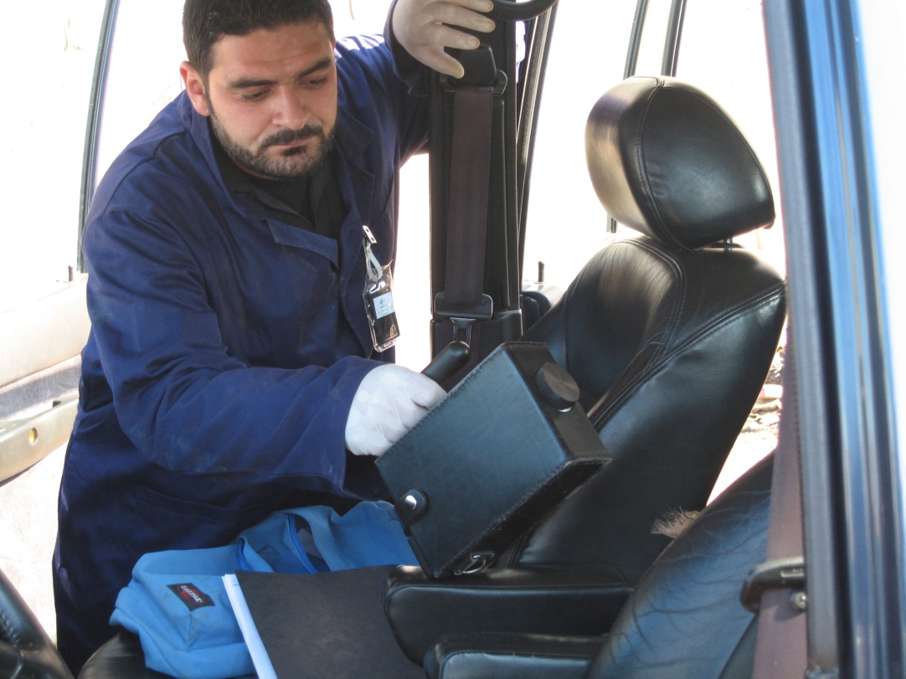

Slide 10
Radioactive Waste Management Work in LAEC
Radioactive waste management services in LAEC started, practically, upon finding the first orphan source in 2001.
This source was found during the monitoring of exported scrap metal on Beirut Port, and then brought to LAEC for conditioning and temporary storage.
Since then, the temporary radioactive waste store has received different orphan sources and contaminated material located mainly in scrap material.
These sources have been identified and brought to LAEC for necessary laboratory measurements, then stored safely in the storage rooms present.

Slide 11
Relevant Decrees
1996-Decision of the Council of Ministers: LAEC is appointed to do the necessary to ensure the protection against the ionizing radiation including inventory of radiation sources and Individual dose monitoring
1997-Decision of the Council of Ministers: Adherence of Lebanon to the model project on upgrading national radiation protection infrastructure.
1999-Decision of the Council of Ministers: LAEC is appointed for radiation control for imported steel and imported/exported metal scrap at all Lebanese check points

Slide 12
Detection Measures in Lebanon
Lebanese Customs, in cooperation with LAEC, are monitoring Radiation Portal monitors RPMs at some borders crossing points.
The customs perform the primary check and the LAEC perform the secondary check.
In addition to this, LAEC perform regular inspection for scrap yards and try to raise awareness.

Slide 13
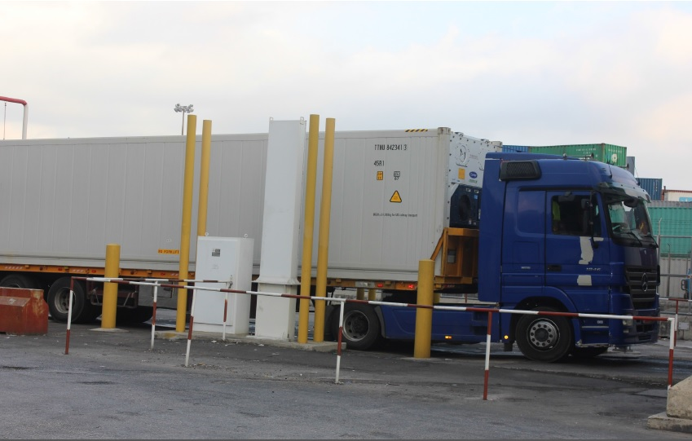
Detection Measures in Lebanon on Borders
…example: Beirut Port Entrance

Slide 14
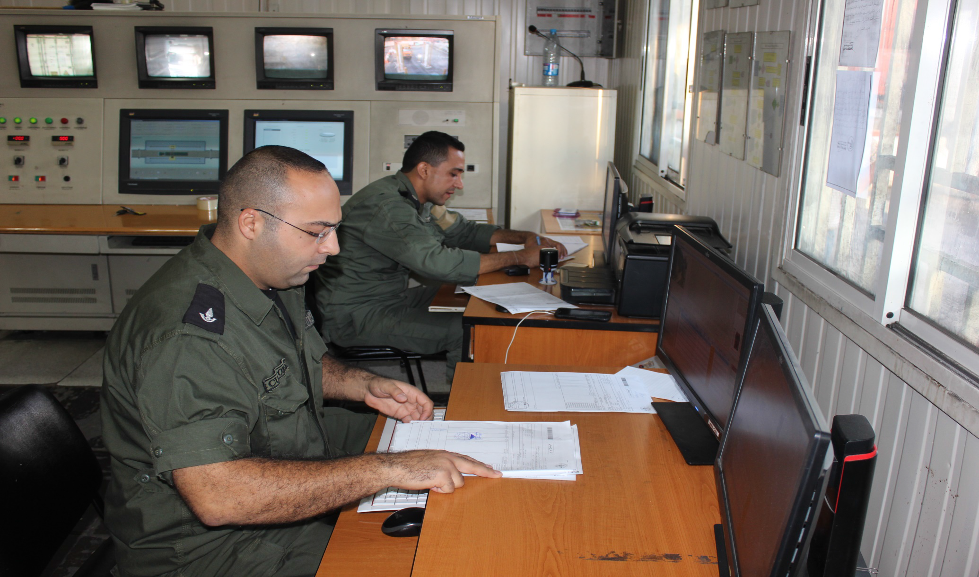
Detection Measures in Lebanon on Borders

Slide 15
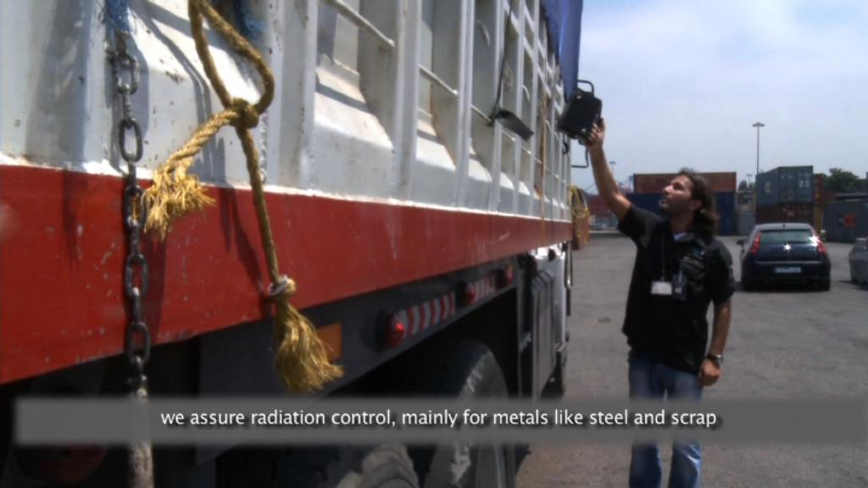
For imported metals like steel and exported scraps, LAEC is still assuring radiation control, even after passing through RPM

Slide 16
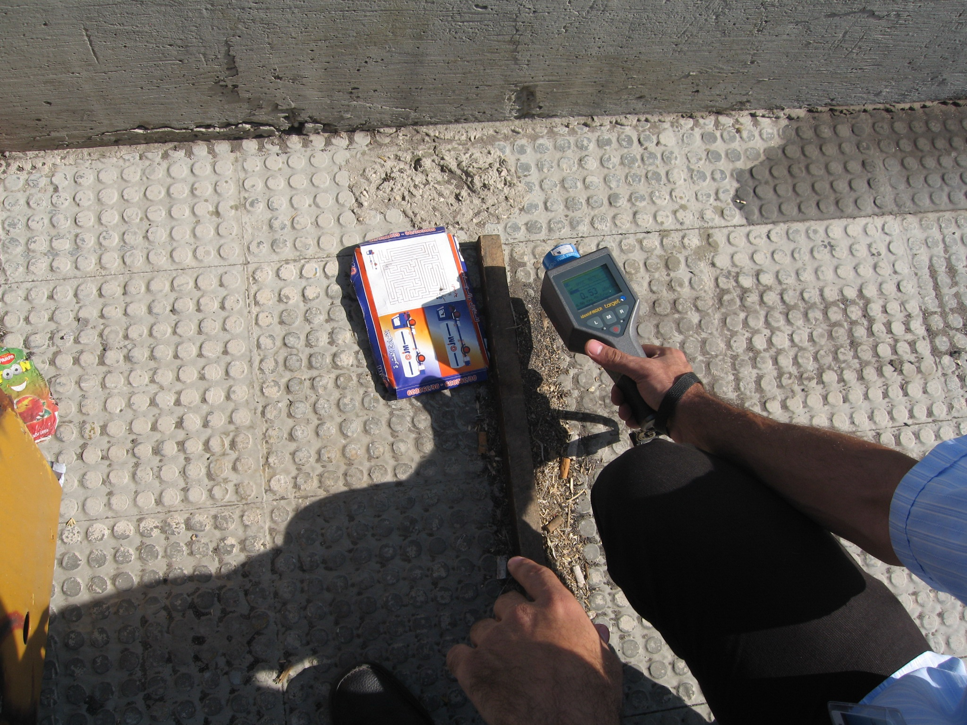
RS found in a scrap activity at Tripoli port

Slide 17
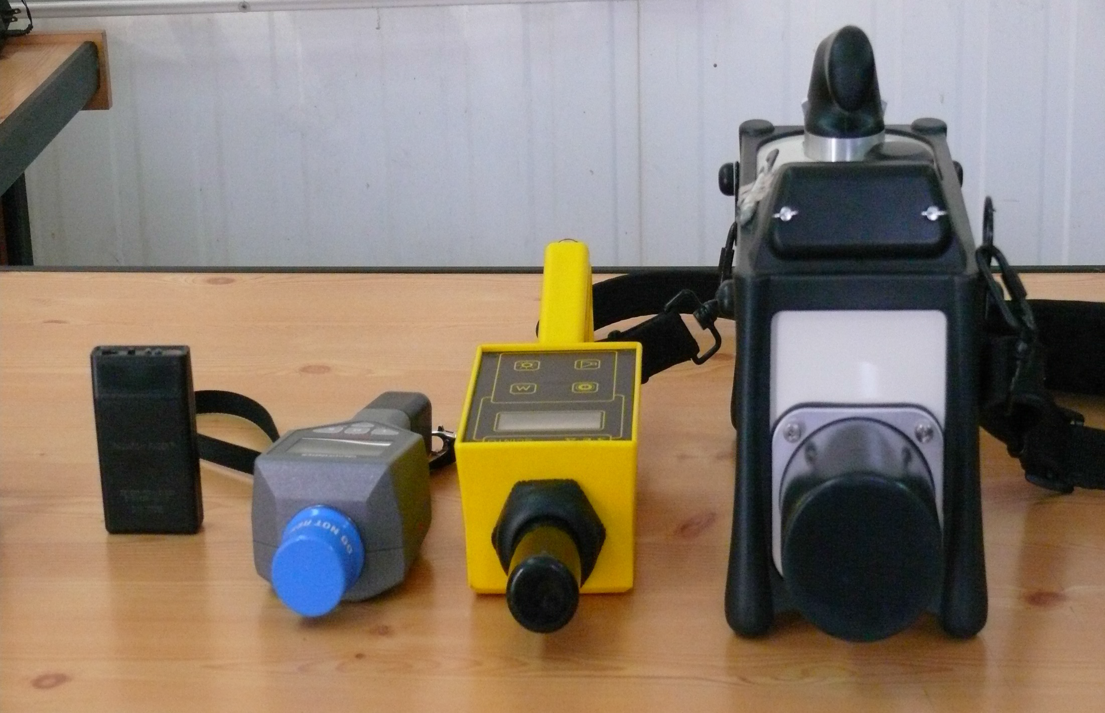
Detection Equipment

Slide 18
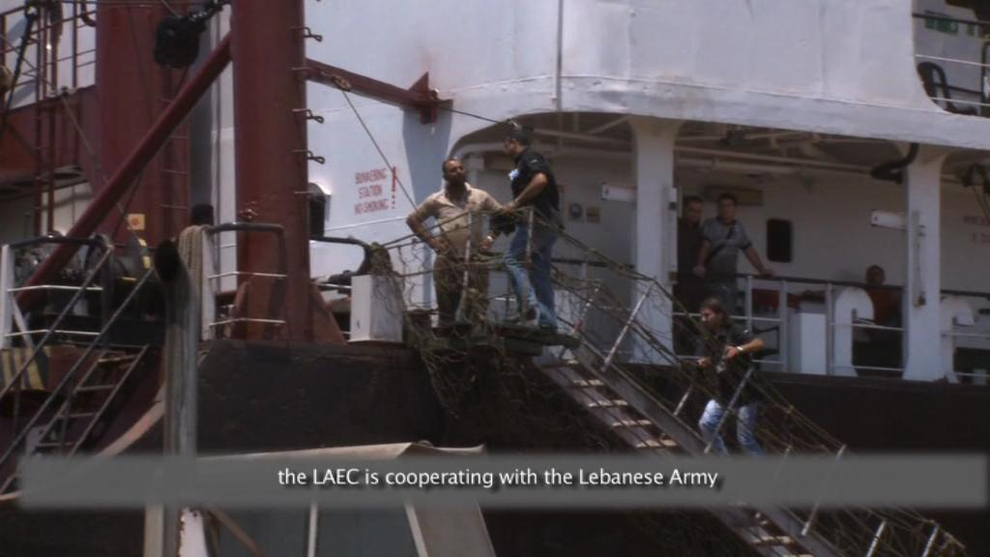
Intervention on one on the ships in Beirut Port

Slide 19
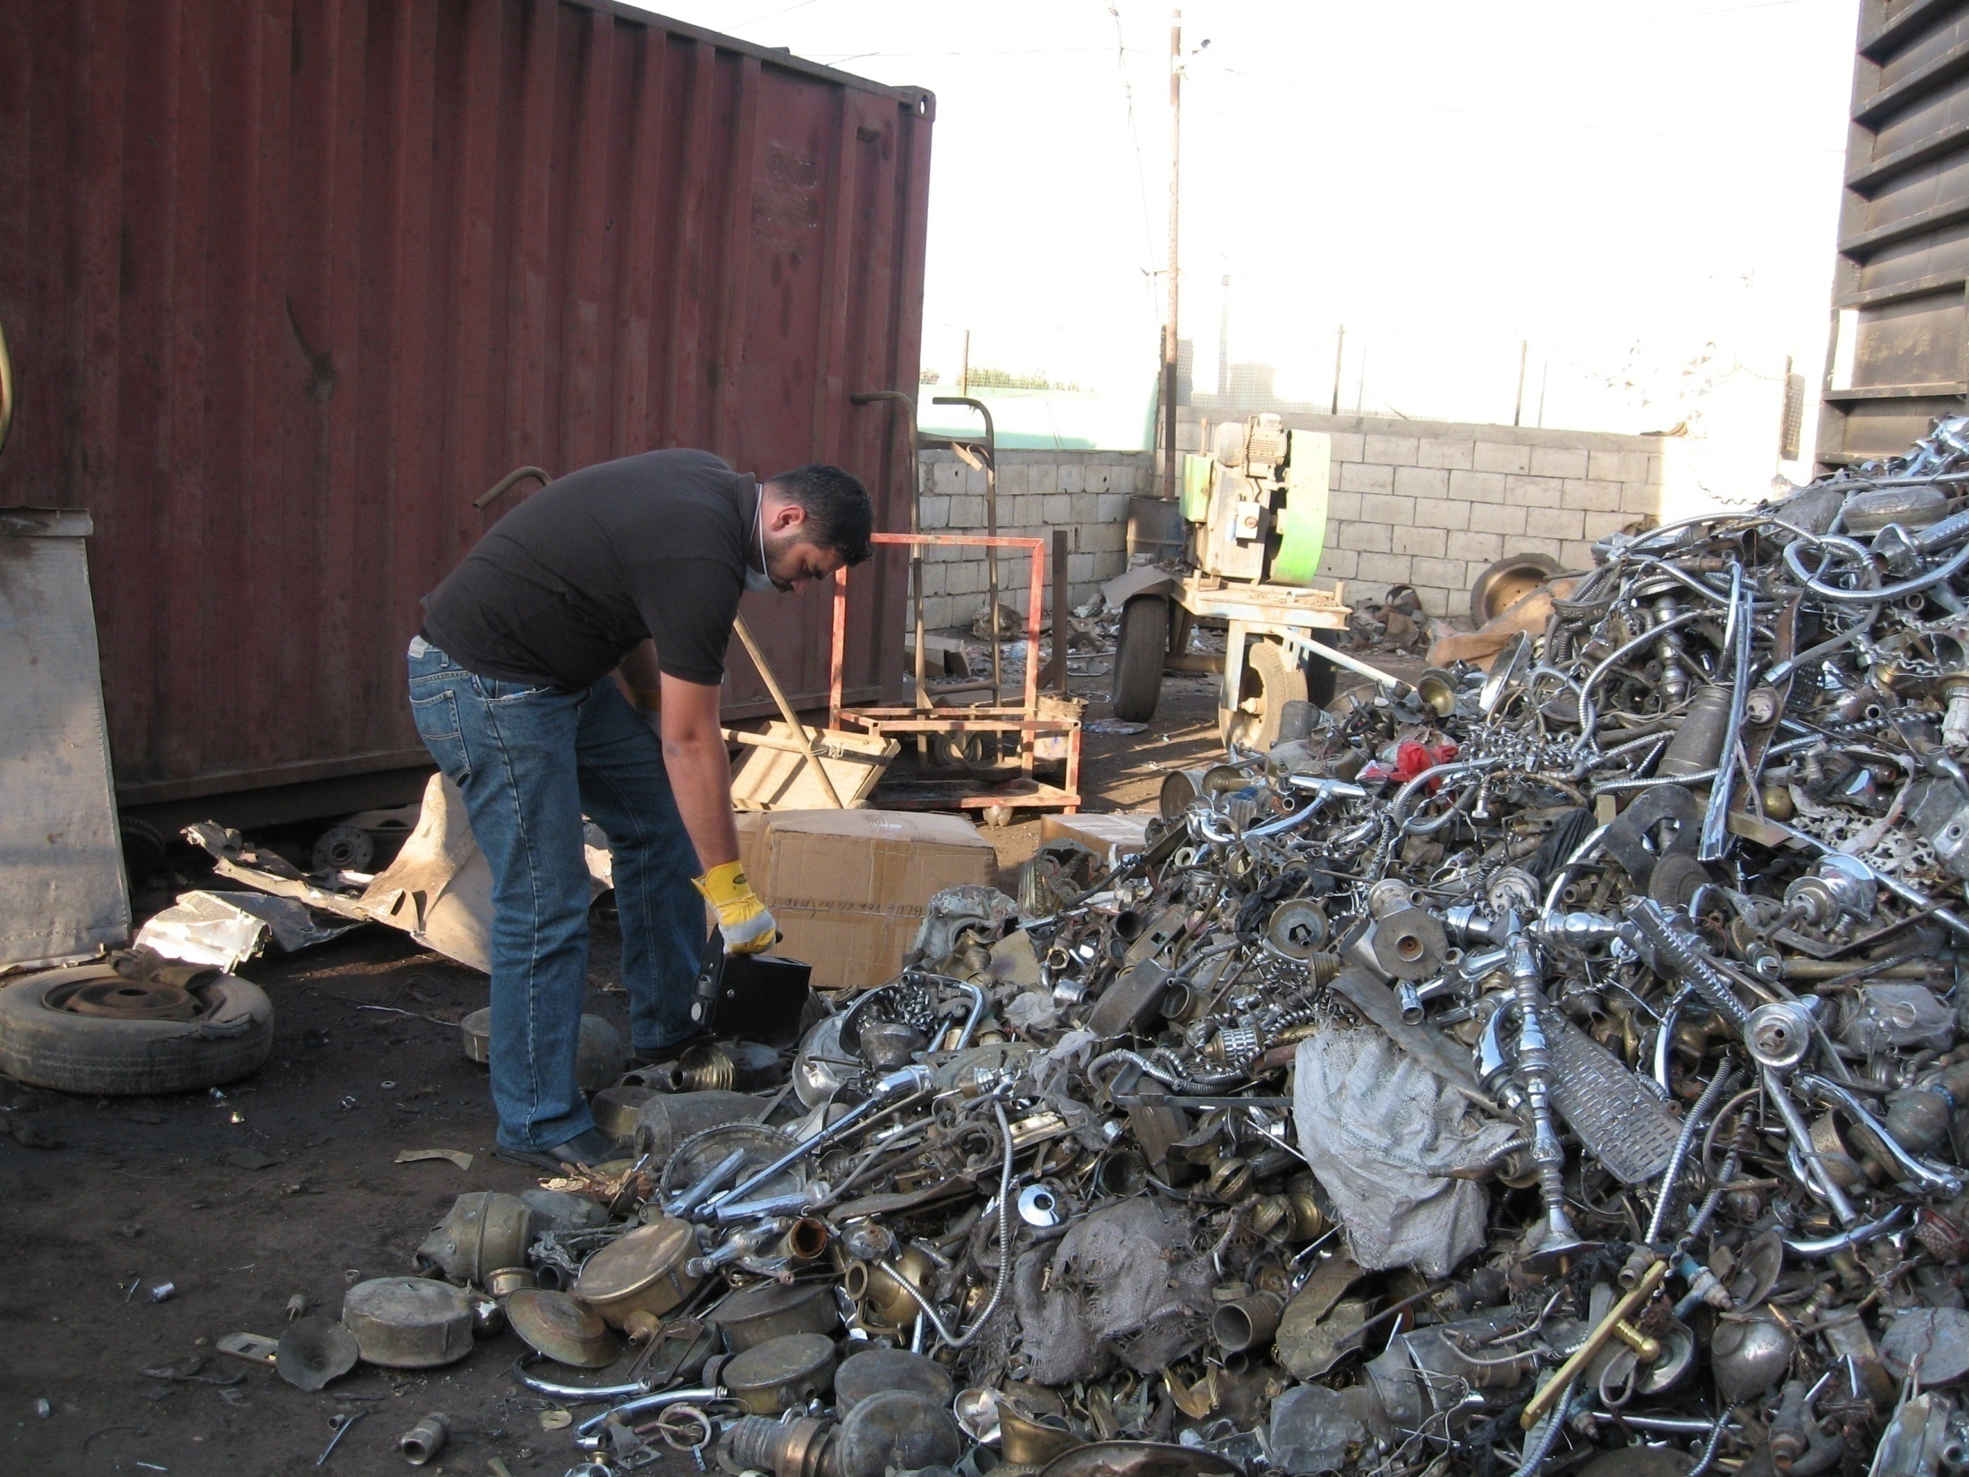
Inspection

Slide 20

Cesium source found in a scrap yard at Tripoli

Slide 21
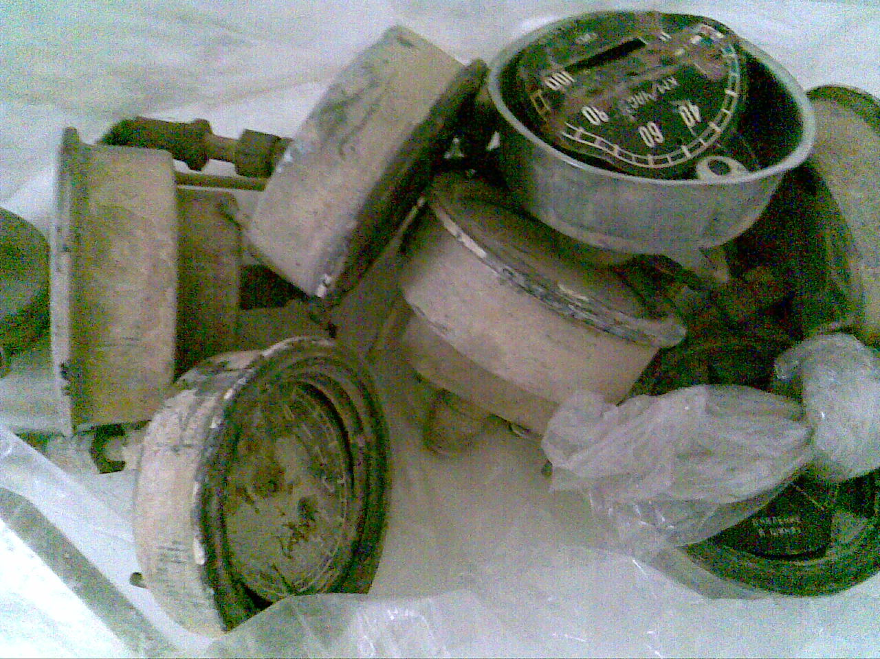
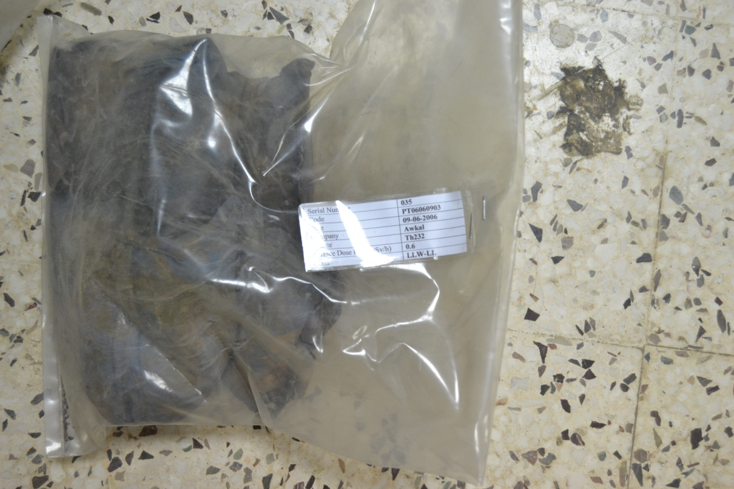
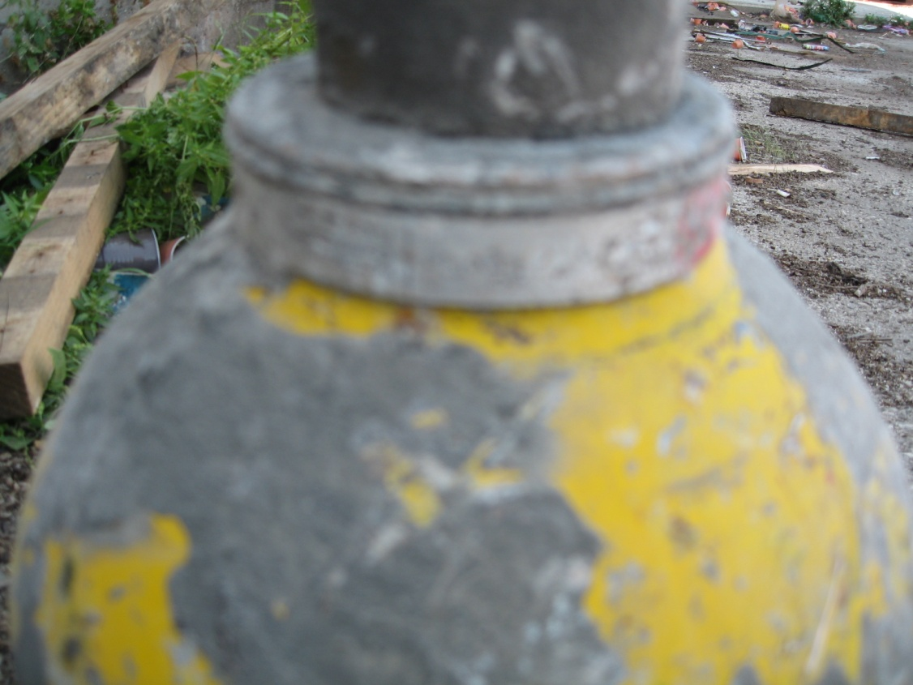
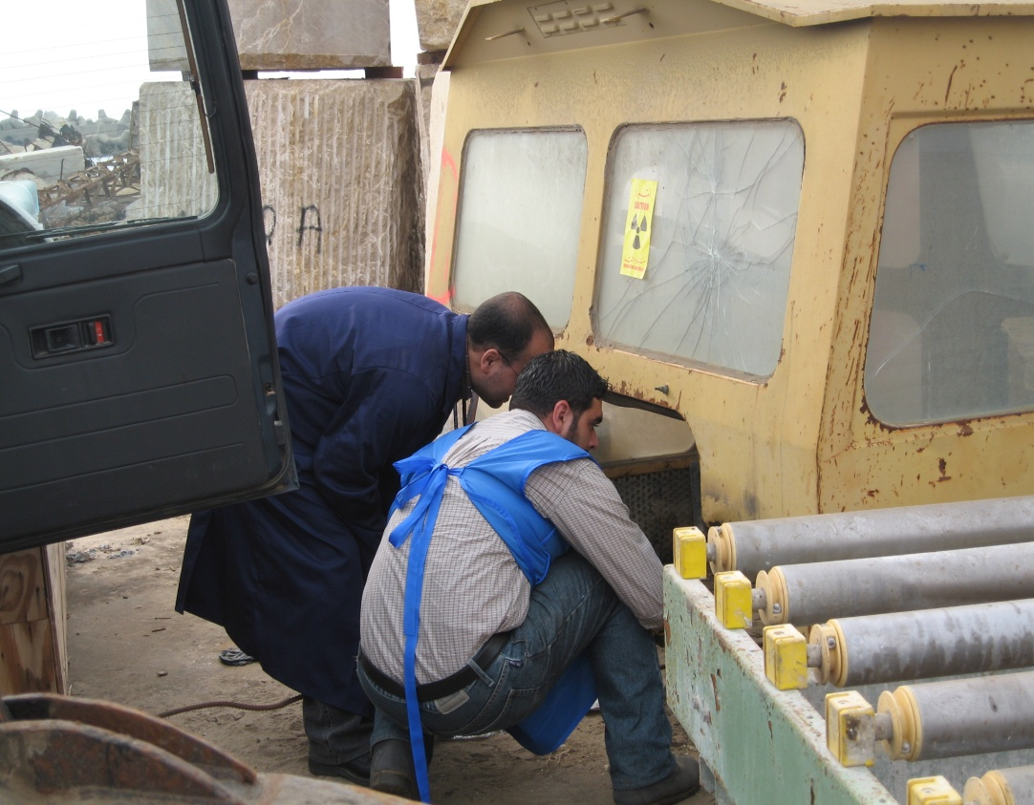

Slide 22
Current Radioactive Waste Storage Rooms in LAEC
Due to the presence orphan sources and contaminated pieces found repeatedly on the borders during monitoring of exported scrap metals, a temporary storage room was established at LAEC in 2001 and equipped with primitive tools to shield and store these pieces.
Since then, more than 174 incidents, involved mainly unauthorized disposal of radioactively contaminated pieces or orphan sources, were detected, seized and transported to LAEC storage room. These incidents were reported to the ITDB.

Slide 23
Current Radioactive Waste Storage Rooms in LAEC
This storage room is very primitive located in the 2nd basement in LAEC and contains the following:
Equipment and tools: Some primitive tools to work with radioactive materials found and shield them. An identifier detector…
Contaminated pieces and sources present so far. The RW present include radioactive sources, contaminated pieces and NORM waste and the radionuclides are: Ra-Be, Am-BE, Cs-137, Sr-90, Co-60, Fe-55, Ra-226, Th-232, Am-241, U-238, etc…

Slide 24
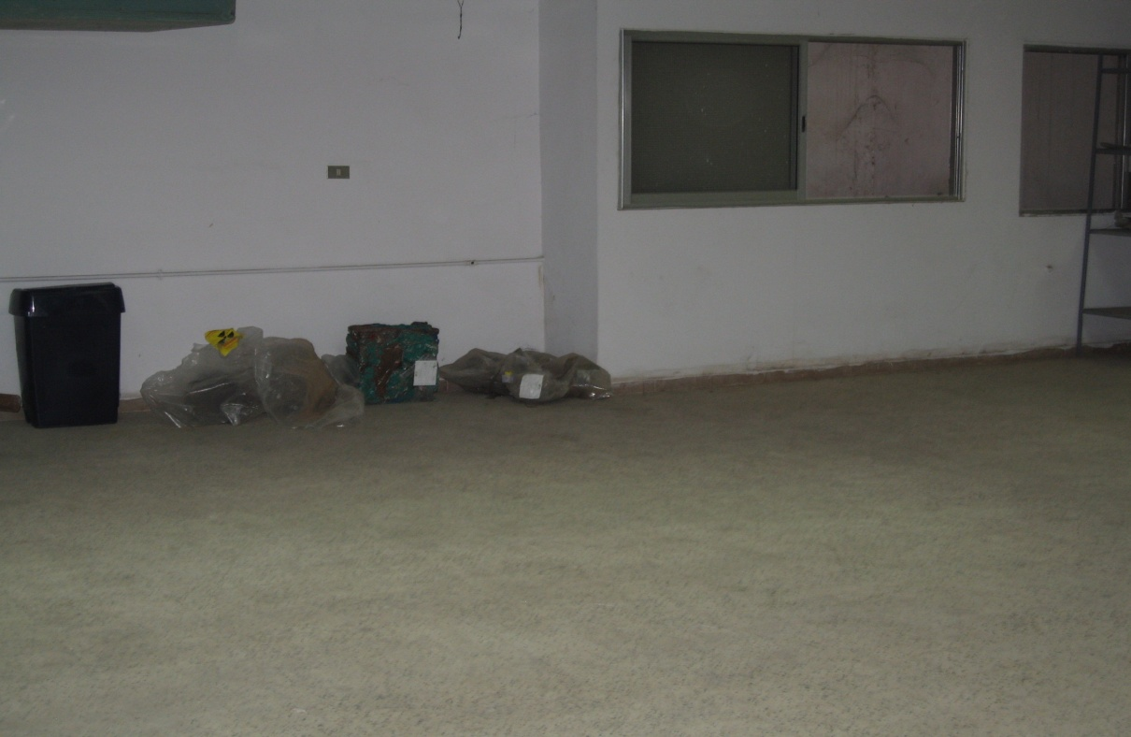
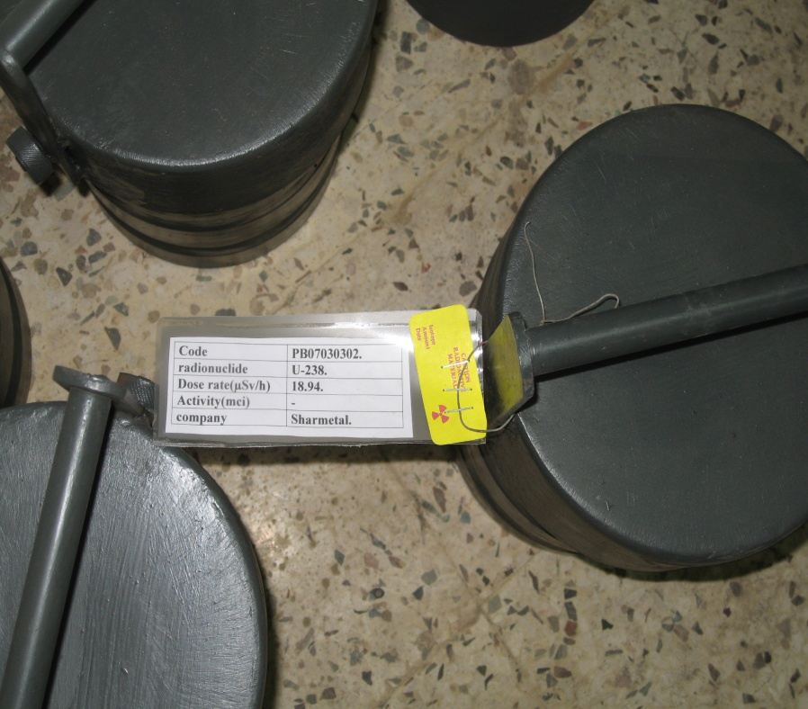
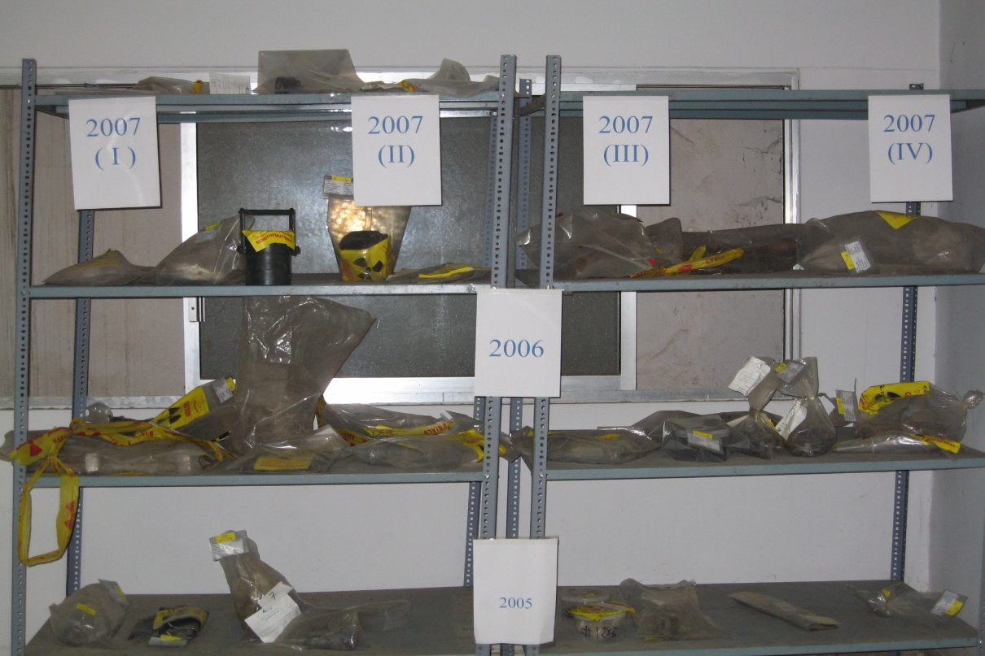
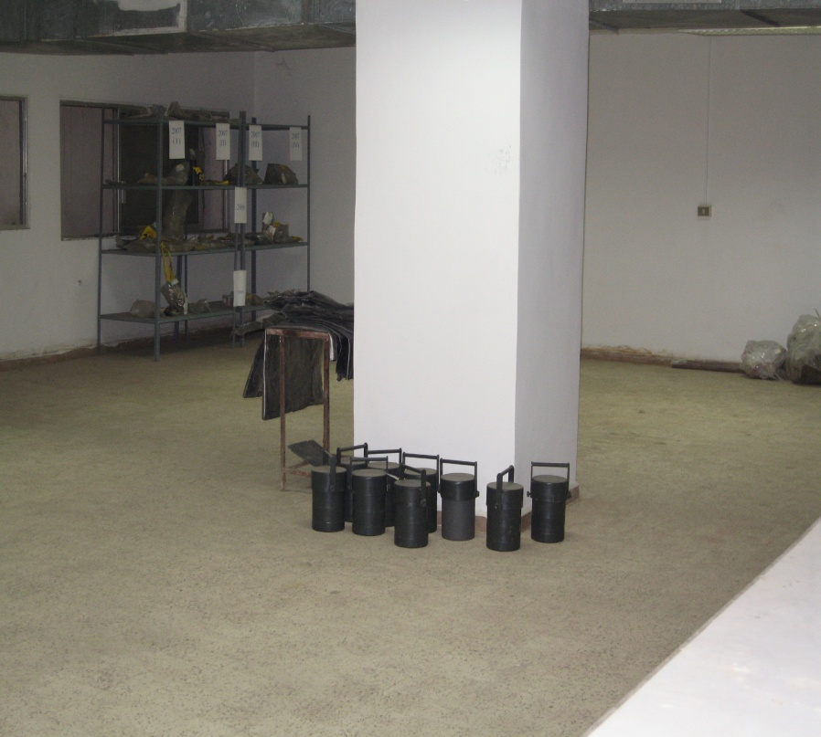
Temporary storage room in LAEC

Slide 25
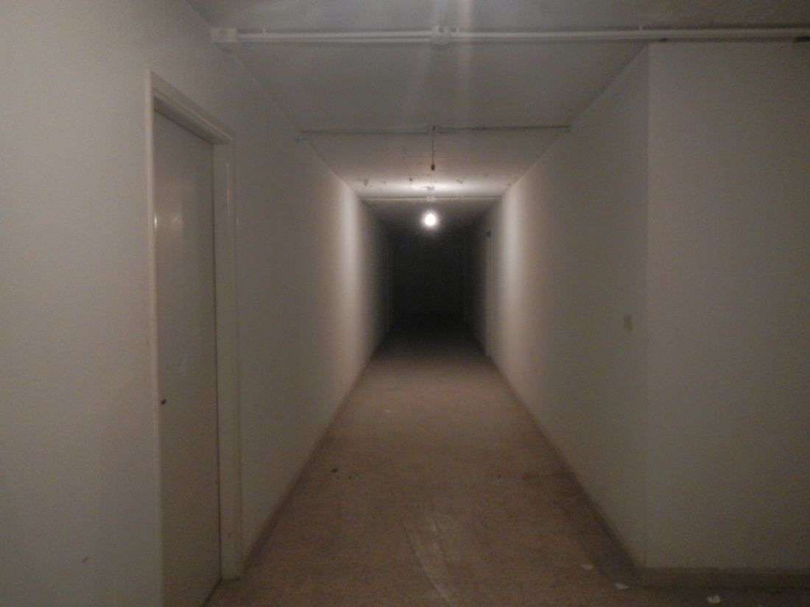
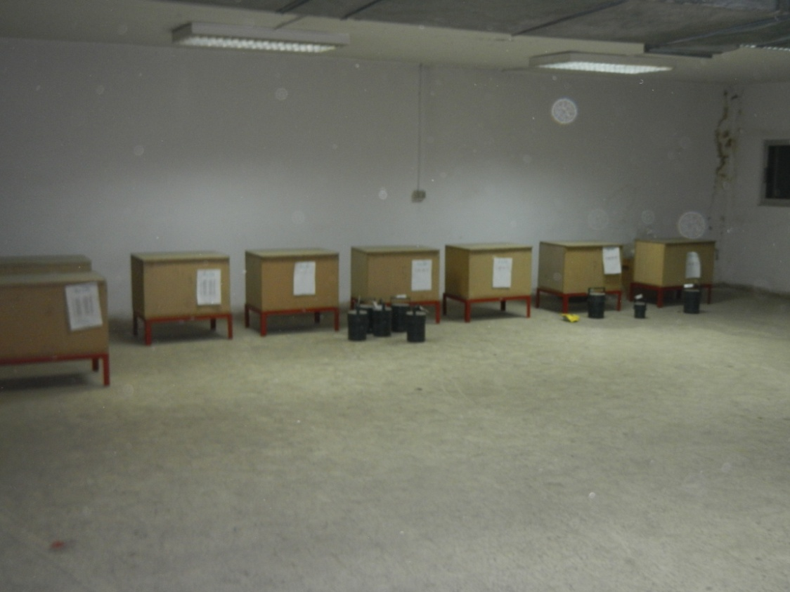
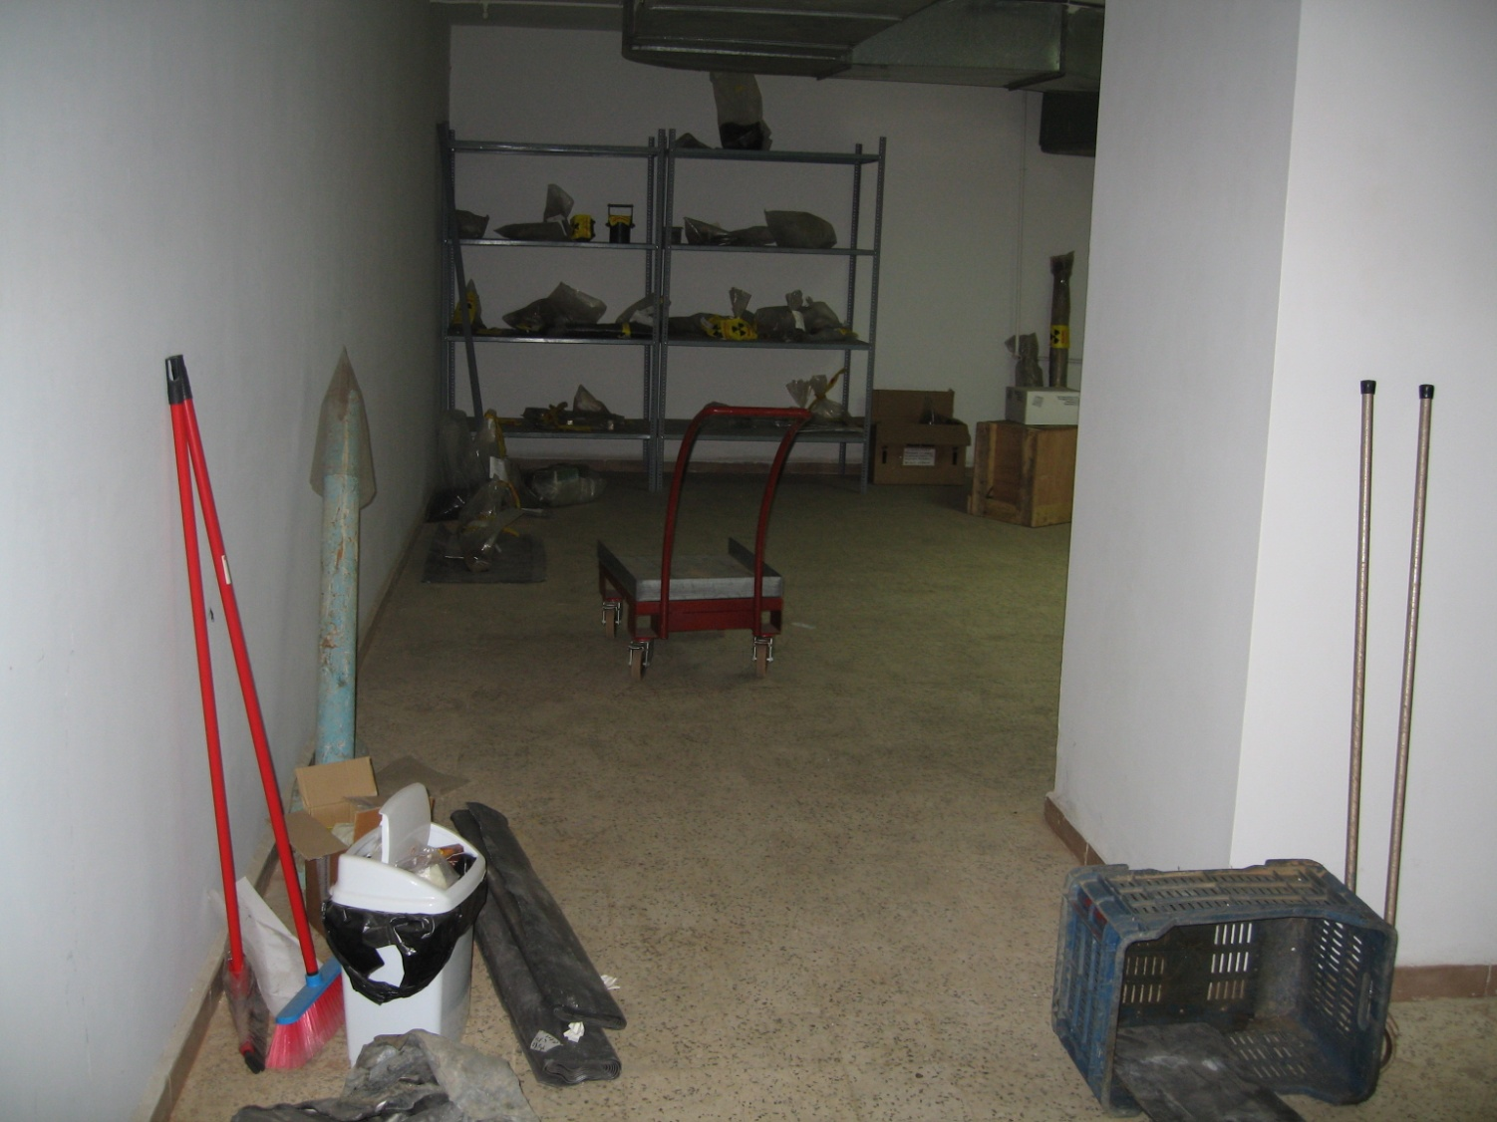
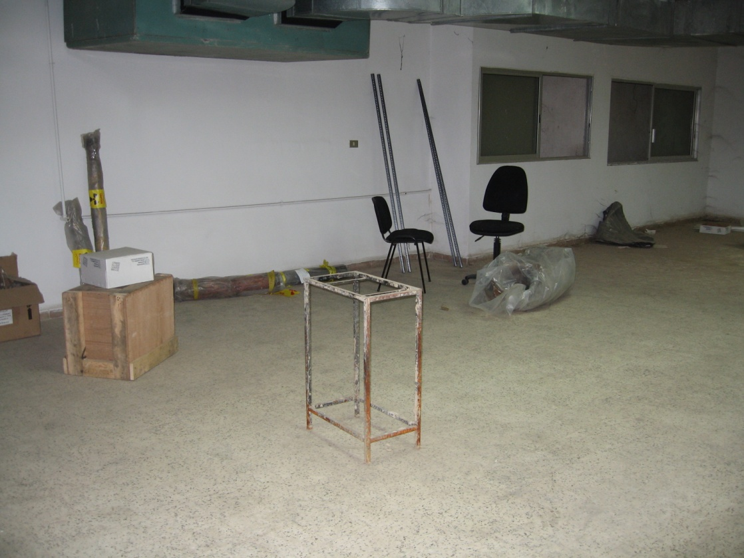
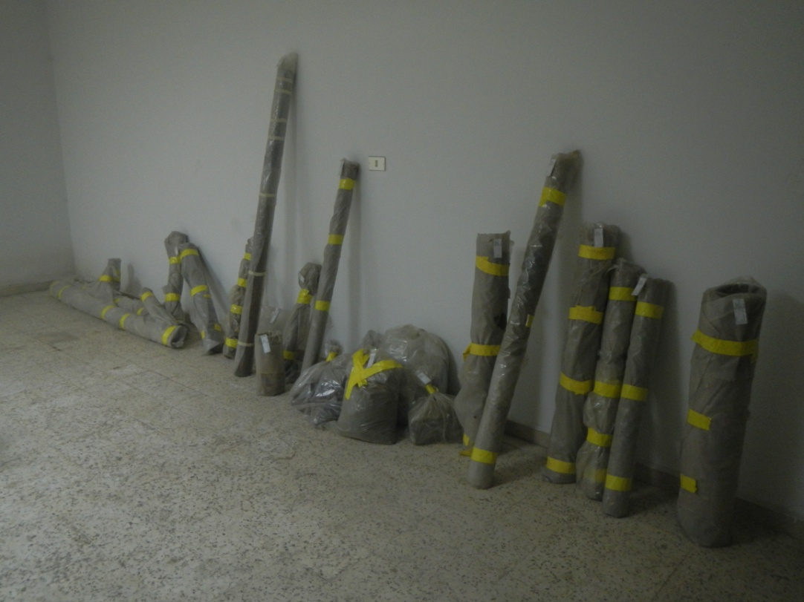

Slide 26
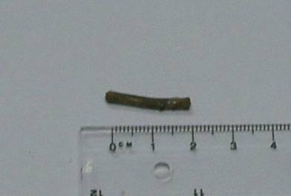
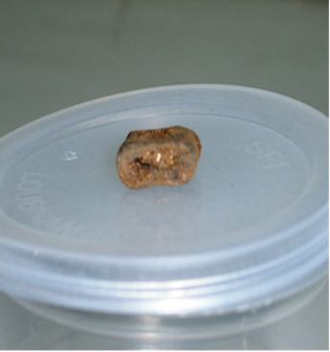
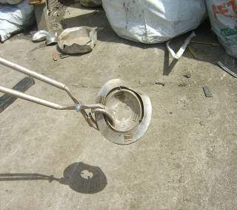
Examples of OS found in scrap (60Co, 90Sr, 226Ra)

Slide 27
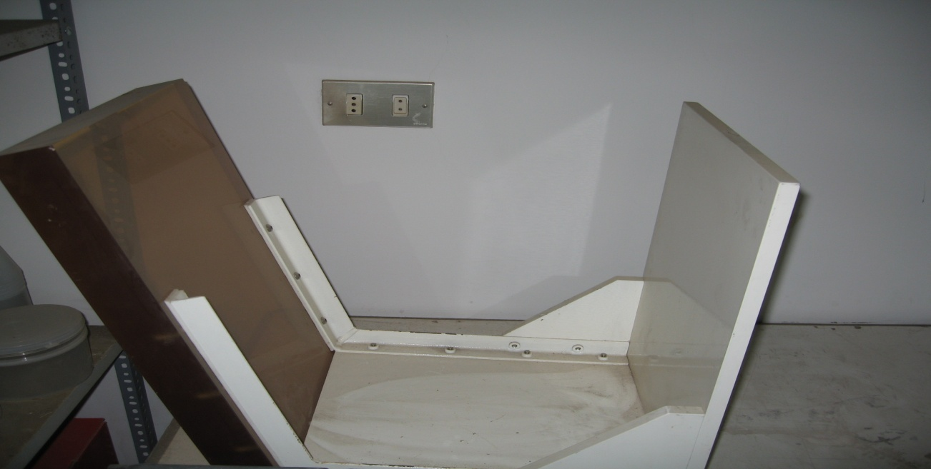
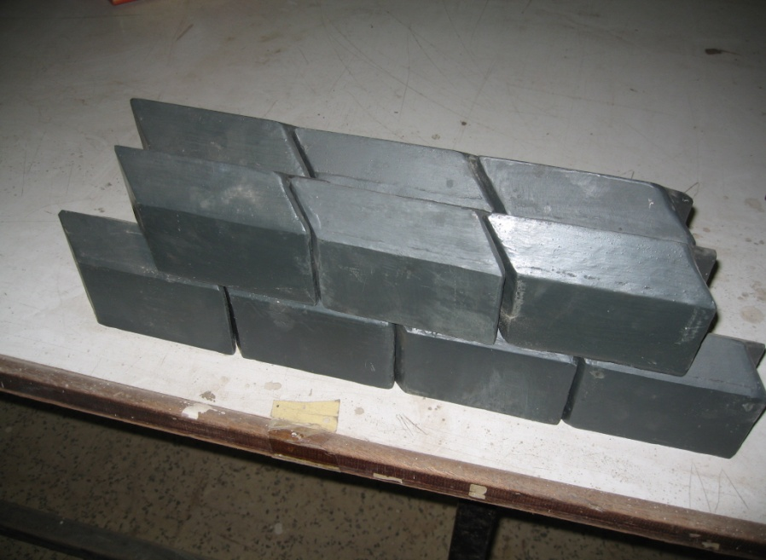
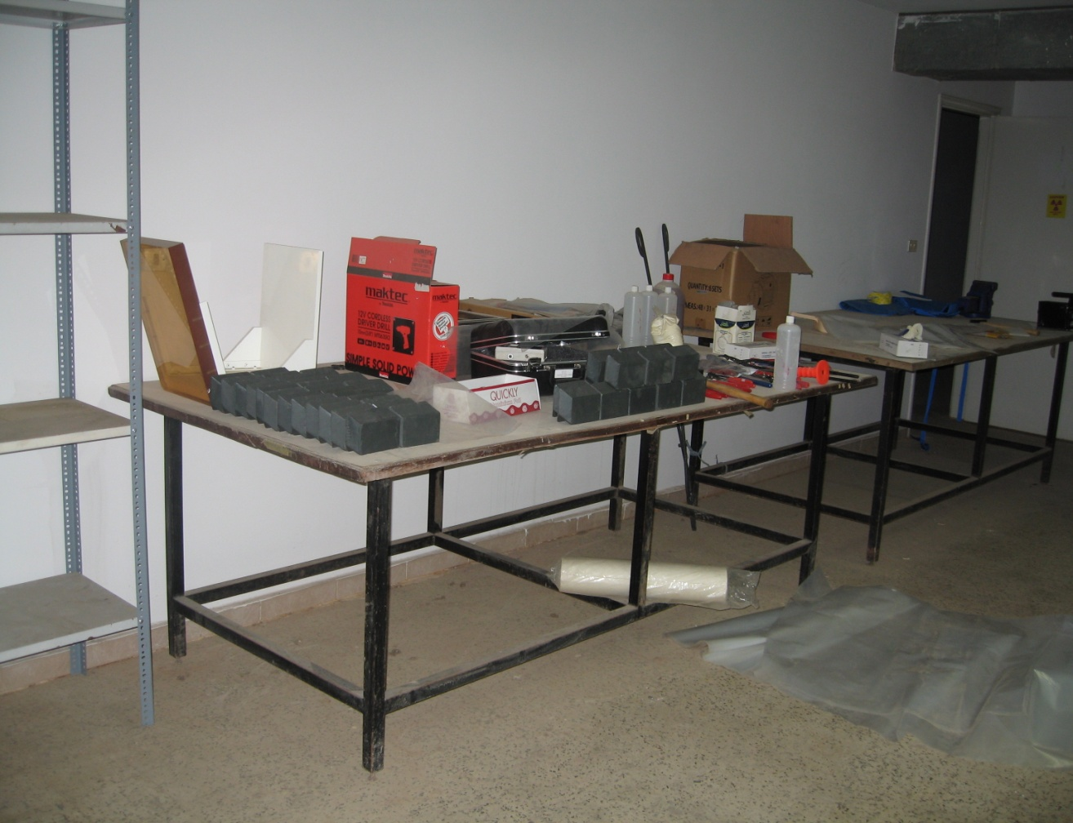
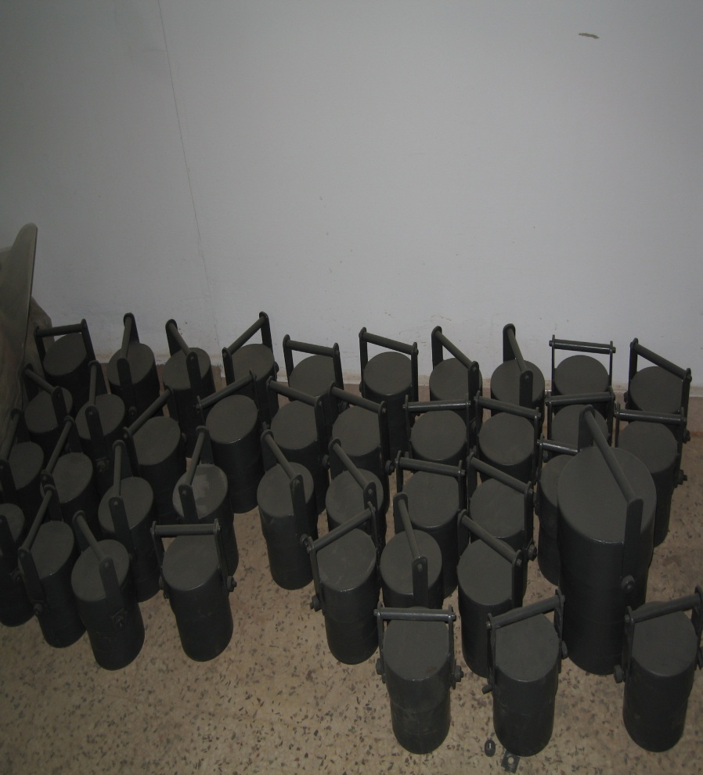

Slide 28
Current Radioactive Waste Inventory Summary in LAEC
174 Pieces in Total as of March 2018 in LAEC
Year | 2001 | 2002 | 2003 | 2004 | 2005 | 2006 | 2007 | 2008 | 2009 | 2010 | 2011 | 2012 | 2013 | 2014 | 2015 | 2016 | 2017 | 2018
No of Pieces | 1 | 1 | - | - | 15 | 27 | 24 | 6 | 14 | 10 | 9 | 18 | 13 | 6 | 3 | 3 | 22 | 2
Beirut Port: 41 Pieces Tripoli Port: 26 Pieces

Slide 29
Establishment of a New Radioactive Waste Store
With the assistance of the NSNS-IAEA and US, a new store is under establishment in the 2nd and 4th basement in LAEC that complies with IAEA safety and security recommendations.
The capacity of the store has been considered upon the design and it depends on the inventory of sources for waste as well as for radioactive sources still in use.
It is also important to mention that it is likely that the radium needles from the 2 Lebanese facilities conditioned on July, 25, 2001 as well as the left disused cobalt source be stored in the future store (Category II source).
Biological wastes containing radioactive material are not accepted as they need an incinerator.

Slide 30
USA Contribution to Establish the New Radioactive Waste Store
Discussions was made through with the US through the Office of Radiological Security (ORS) as well as Sandia Laboratories, which concluded that the US would fund a safe and secure conditioning and storage rooms in LAEC.
The SoW stated clearly that the Lebanese Atomic Energy Commission (LAEC) seeks to continuously improve its security infrastructure. To this effect, the LAEC is in need of a facility to secure disused and/or orphan sources. As such, Sandia National Laboratories (SNL) is seeking to help fulfil this need by organizing a project for upgrading the civil works in the facility used to store disused/orphaned radioactive sources.
The USA selected the Lebanese company BTECOM to do the work and currently communication is being done to finalize the offer to be submitted by the company.

Slide 31
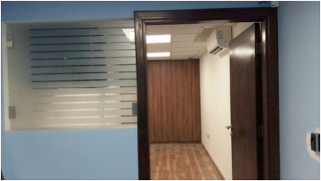
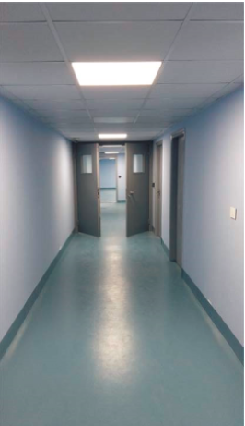
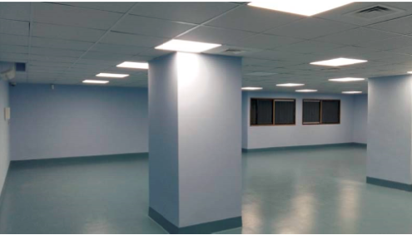
Present Works at the New Radioactive Waste Store

Slide 32
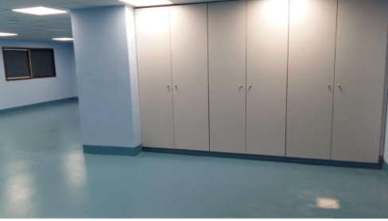
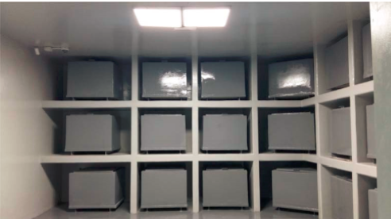
Present Works at the New Radioactive Waste Store

Slide 33
IAEA Assistance
Lebanon is participating in the IAEA Interregional INT/9182 Sustaining Cradle to Grave Control of Radioactive Sources Project which main objective is to protect the people and the environment from potential adverse effects of ionizing radiation while enabling and fostering the safe and secure use of radioactive sources to promote sustainable socioeconomic development.
Lebanon has received assistance from the IAEA through the Division of Nuclear Fuel Cycle, Waste Technology and Research Reactor and the Division of Nuclear Security in repatriating high activity disused sources.

Slide 34
IAEA Assistance on Repatriation Missions
2009-2018: IAEA Repatriation Missions
Repatriation of 36 cobalt sources from Agricultural Research Center- a mission that was completed in August 2009
Repatriation of a cobalt source from the American University Hospital- a mission that was completed in November 2010
Repatriation of a cobalt source from Notre Dame de Bon Secours Hospital completed in March 2015
Repatriation of a cobalt source from Hotel Dieu de France Hospital completed in August 2016
Repatriation of three cobalt sources from Hotel Dieu de France Hospital, Rizk Hospital and North Hospitalization Center completed in January 2018

Slide 35
IAEA Assistance on Repatriation Missions
2009: IAEA Repatriation Mission I
Repatriation of 36 cobalt sources from Agricultural Research Center completed in August 2009

Slide 36
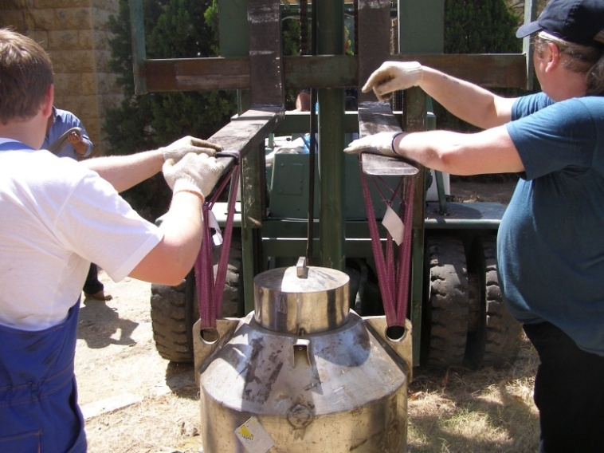
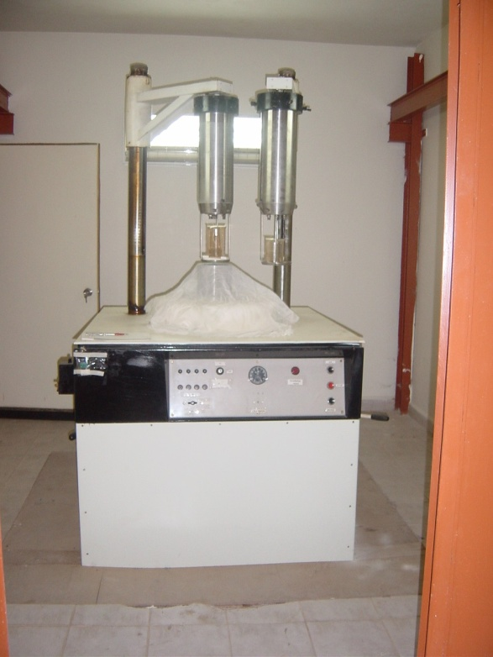
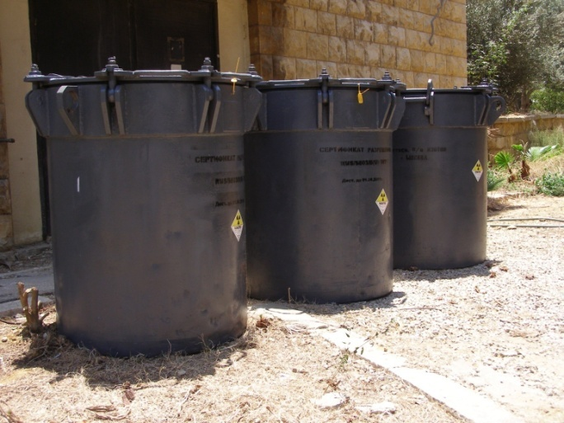
IAEA Assistance on Repatriation Missions
Repatriation of 36 cobalt sources from Agricultural Research Institute- mission accomplished August 2009

Slide 37
IAEA Assistance on Repatriation Missions
2010: IAEA Repatriation Mission II
Repatriation of a cobalt source from the American University Hospital completed in November 2010

Slide 38
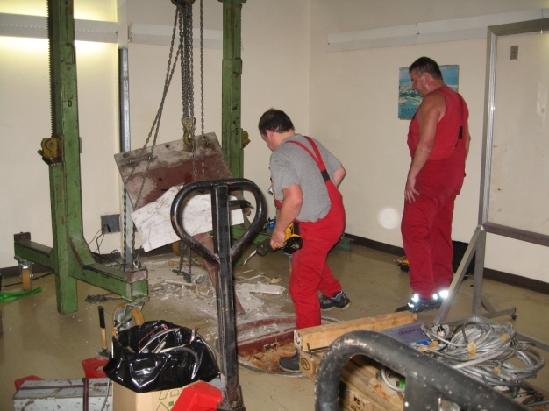
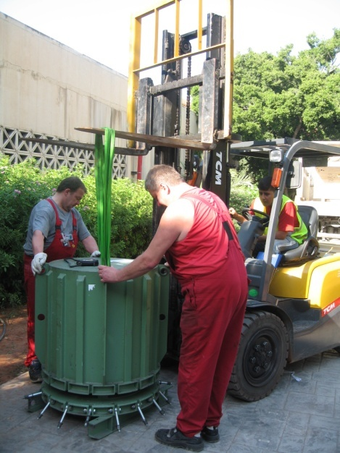
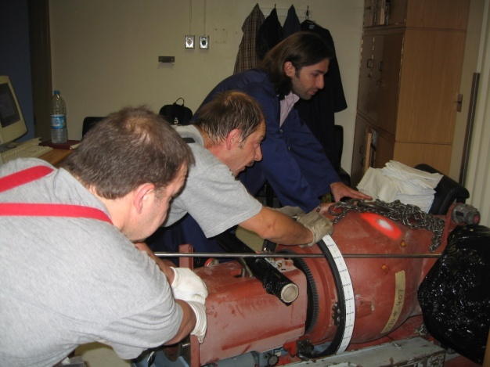
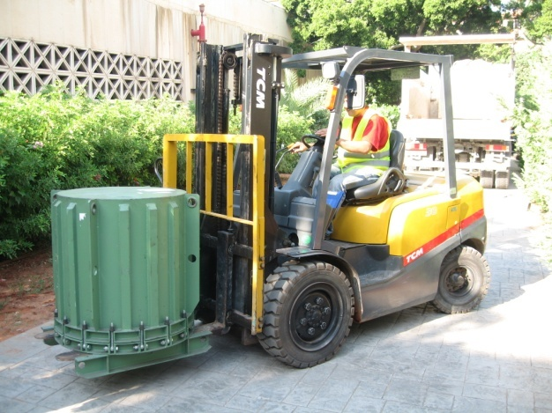
IAEA Assistance on Repatriation Missions
Repatriation of a cobalt source form American University Hospital a mission that was completed in November 2010

Slide 39
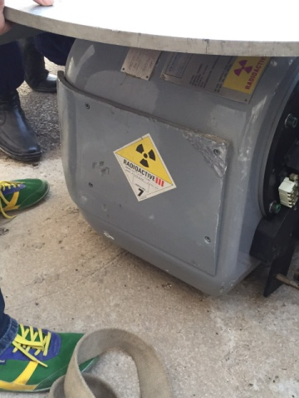

IAEA Assistance on Repatriation Missions
2015: IAEA Repatriation Mission III
Repatriation of a cobalt source from Notre Dame de Bon Secours Hospital completed in March 2015

Slide 40
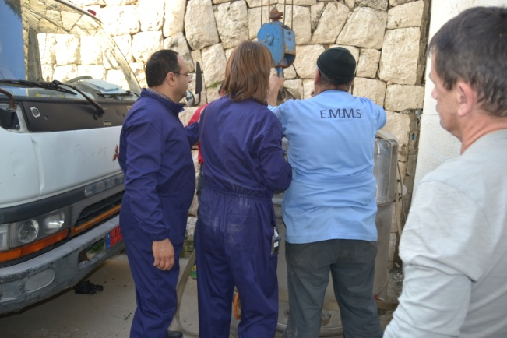
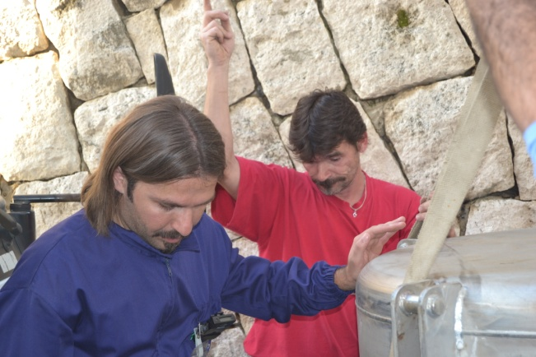
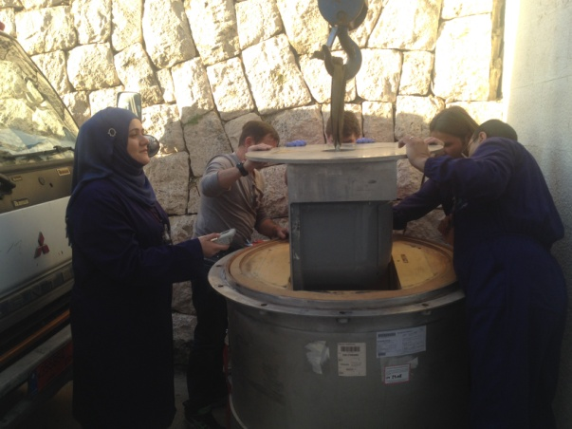
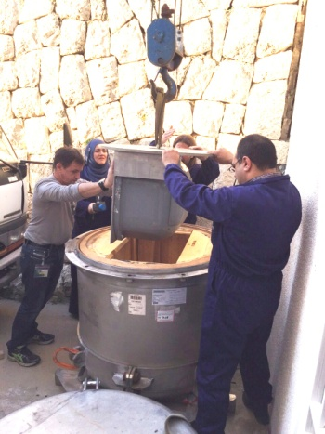
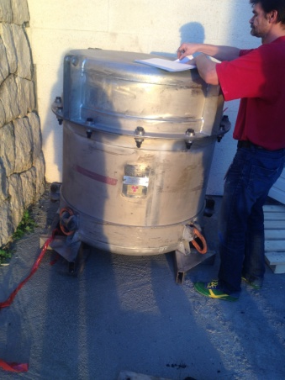
IAEA Assistance on Repatriation Missions
Repatriation of a cobalt source from Notre Dame de Bon Secours

Slide 41


IAEA Assistance on Repatriation Missions
2018: IAEA Repatriation Mission IV
Repatriation of 3 cobalt sources from Hotel Dieu de France Hospital, Rizk Hospital and North Hospitalization Center completed in January 2018

Slide 42



IAEA Assistance on Repatriation Missions
Repatriation of 3 cobalt sources from Hotel Dieu de France Hospital, Rizk Hospital and North Hospitalization Center accomplished January 2018

Slide 43
Presentation Wrap up
This presentation addressed the following:
The present used and disused radioactive sources in Lebanon
Radioactive Waste Management in Lebanon and present capabilities
Establishment of the new RWM national store in LAEC
IAEA assistance: INT 9182 and the repatriation missions

Slide 44
… Challenges
Challenges include the following:
The current establishment process of the new RWM store in LAEC
Further equipping of the new store
Training of the personnel
Conditioning and shielding orphan pieces
Setout of the Policy and strategy for RWM
Identification of the capacity of the future temporary store and radioactive waste acceptance criteria
Assistance with the preparation or update of the different documentation related to Quality Management System

Slide 45







