Slide 1
Disposal of the Lovelace
Blood Irradiator
September 27, 2017

Slide 2
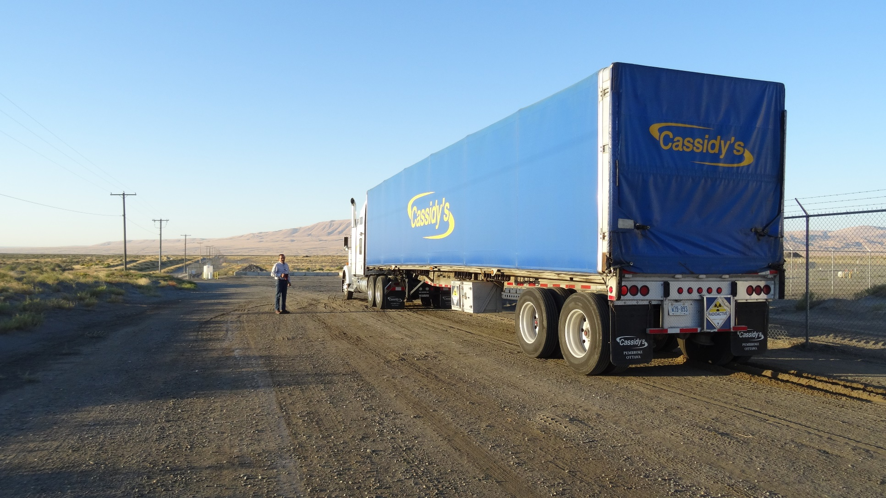
Arrival at the LLRW Disposal Site

Slide 3
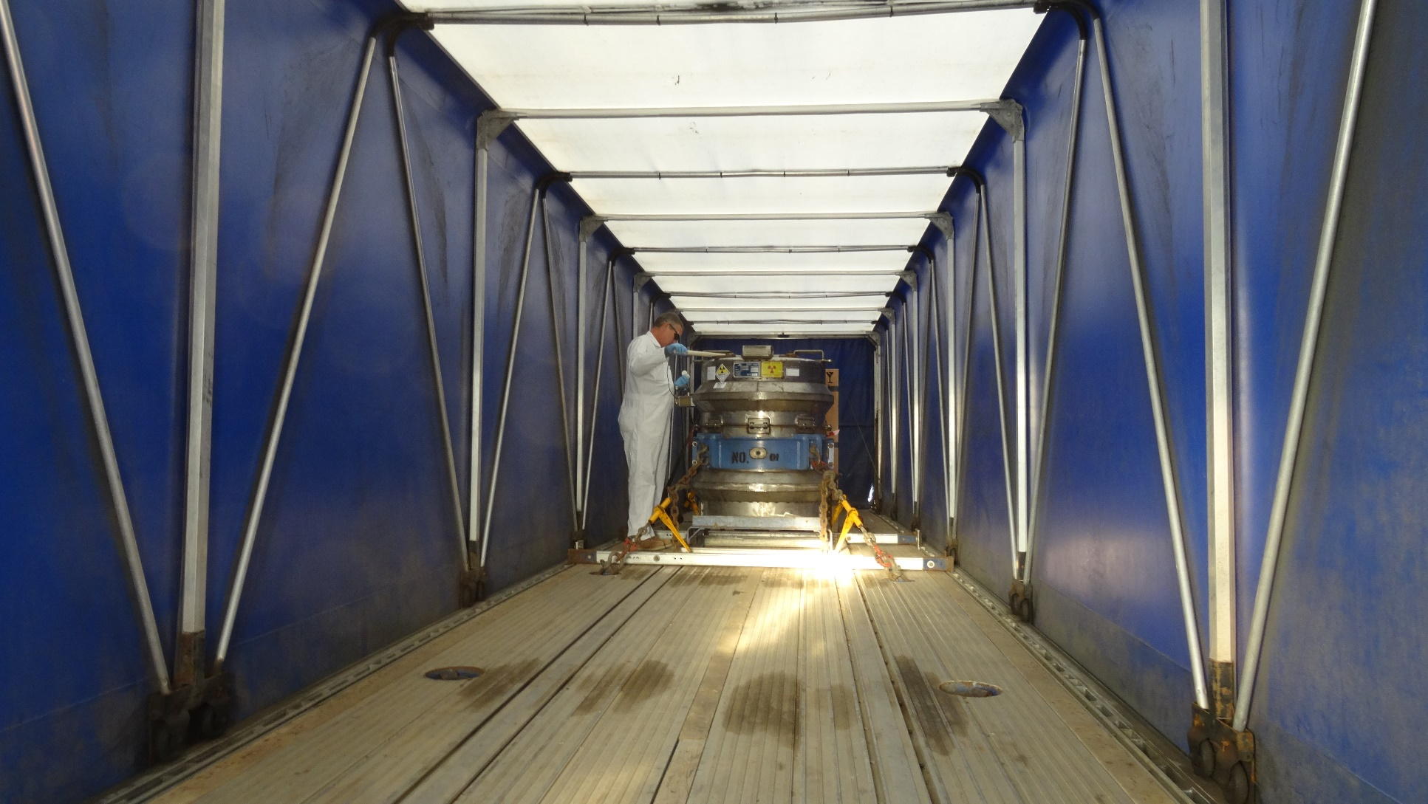
One and only package

Slide 4
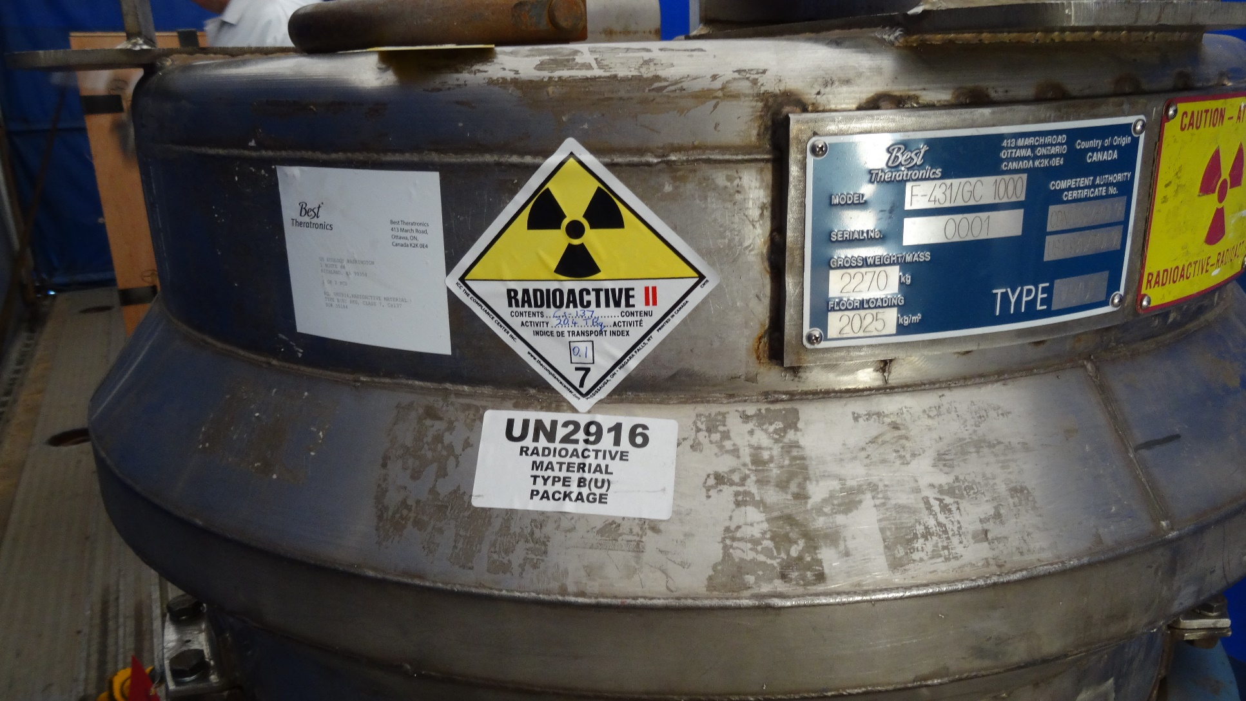
DOT marking and labeling

Slide 5
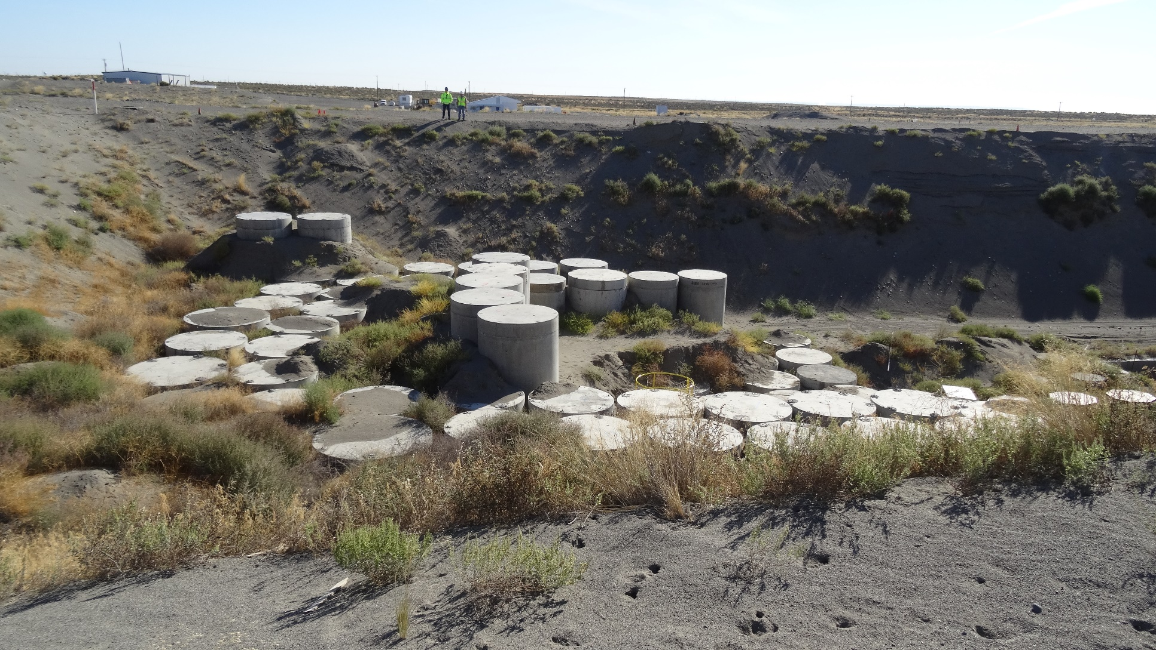
Home sweet home (forever)

Slide 6
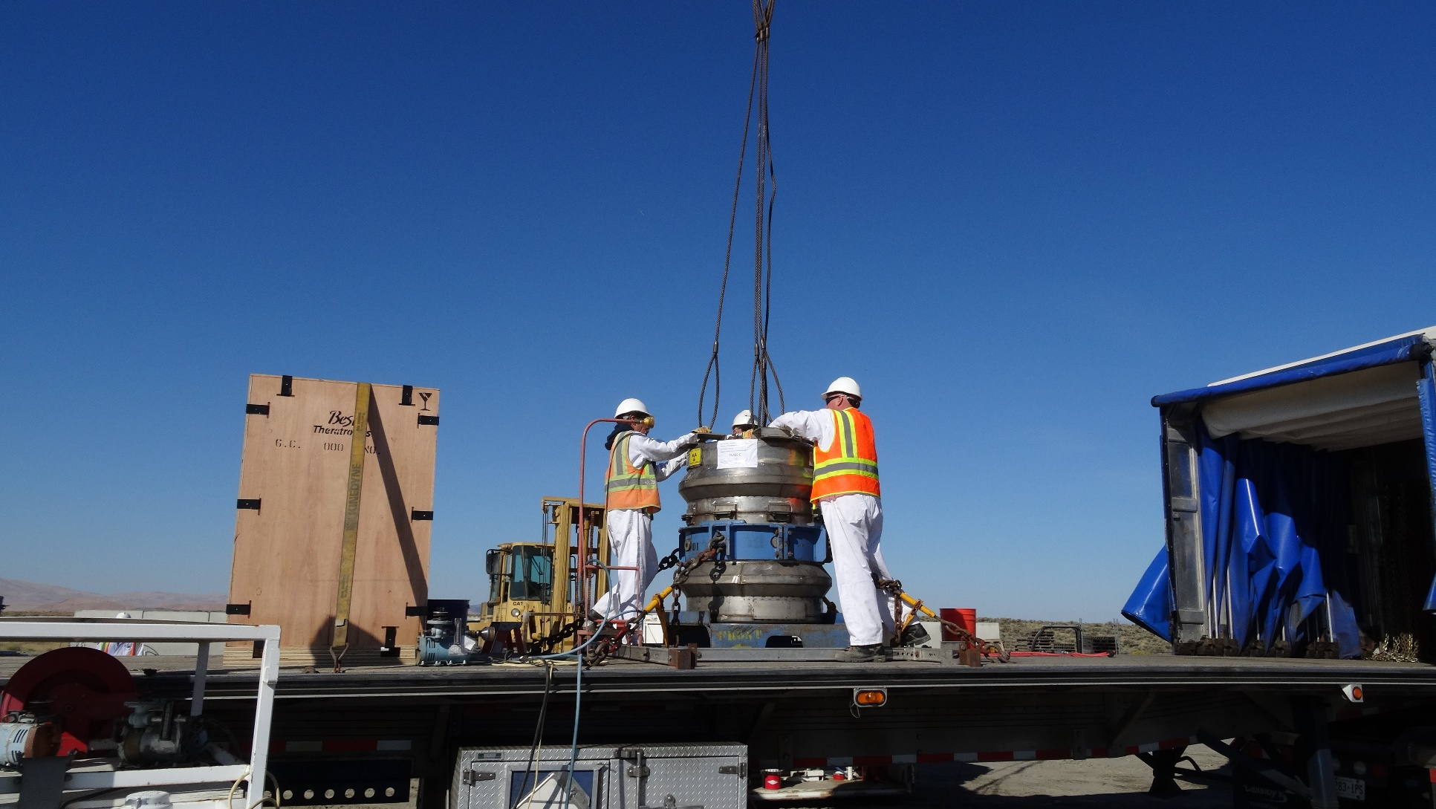
Attaching crane rigging

Slide 7
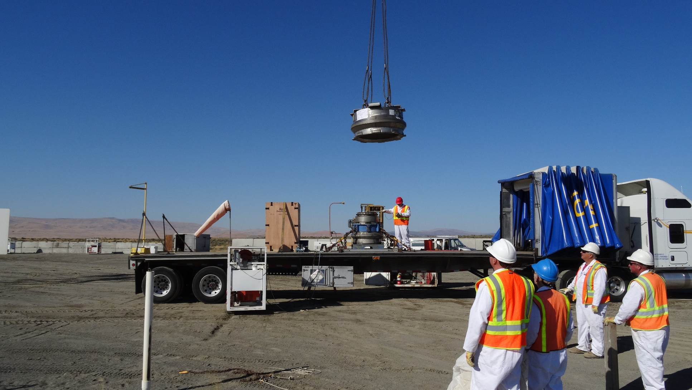
Off comes the lid

Slide 8
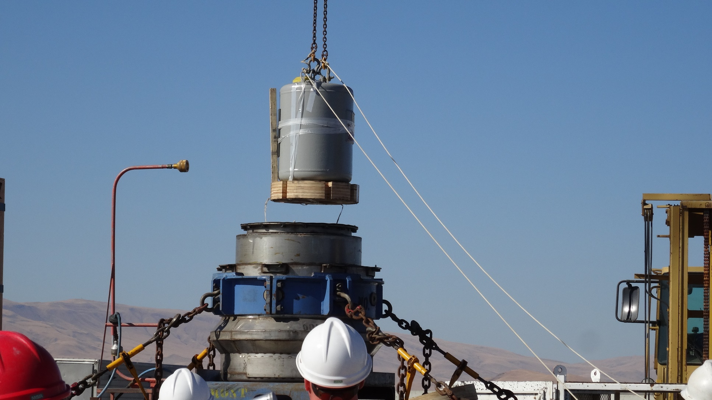
The irradiator

Slide 9
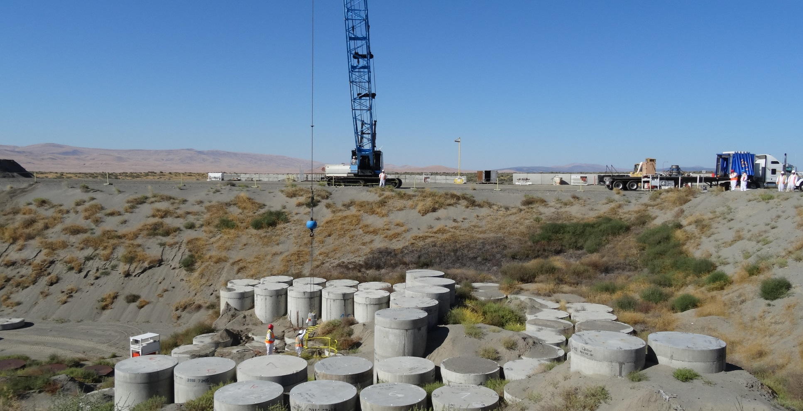
Irradiator nearing the ECB

Slide 10
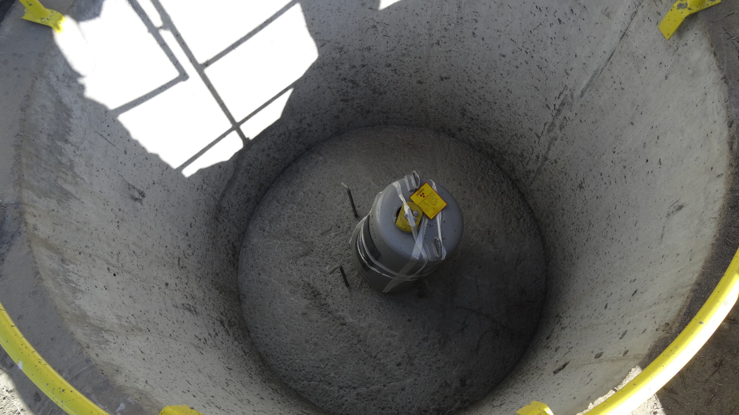
Sitting in the ECB

Slide 11
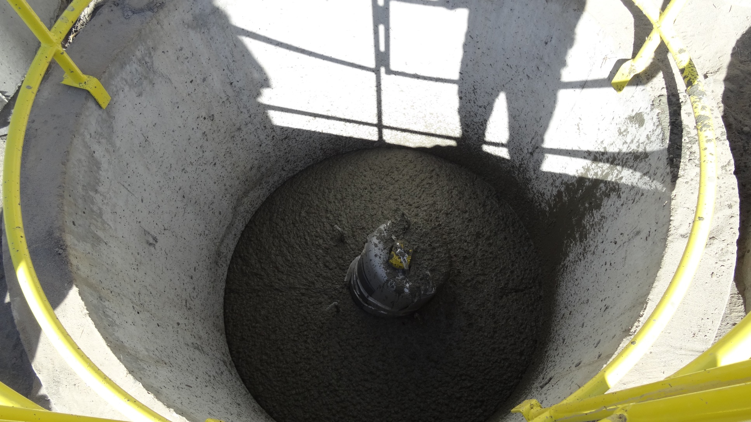
Concrete burial

Slide 12
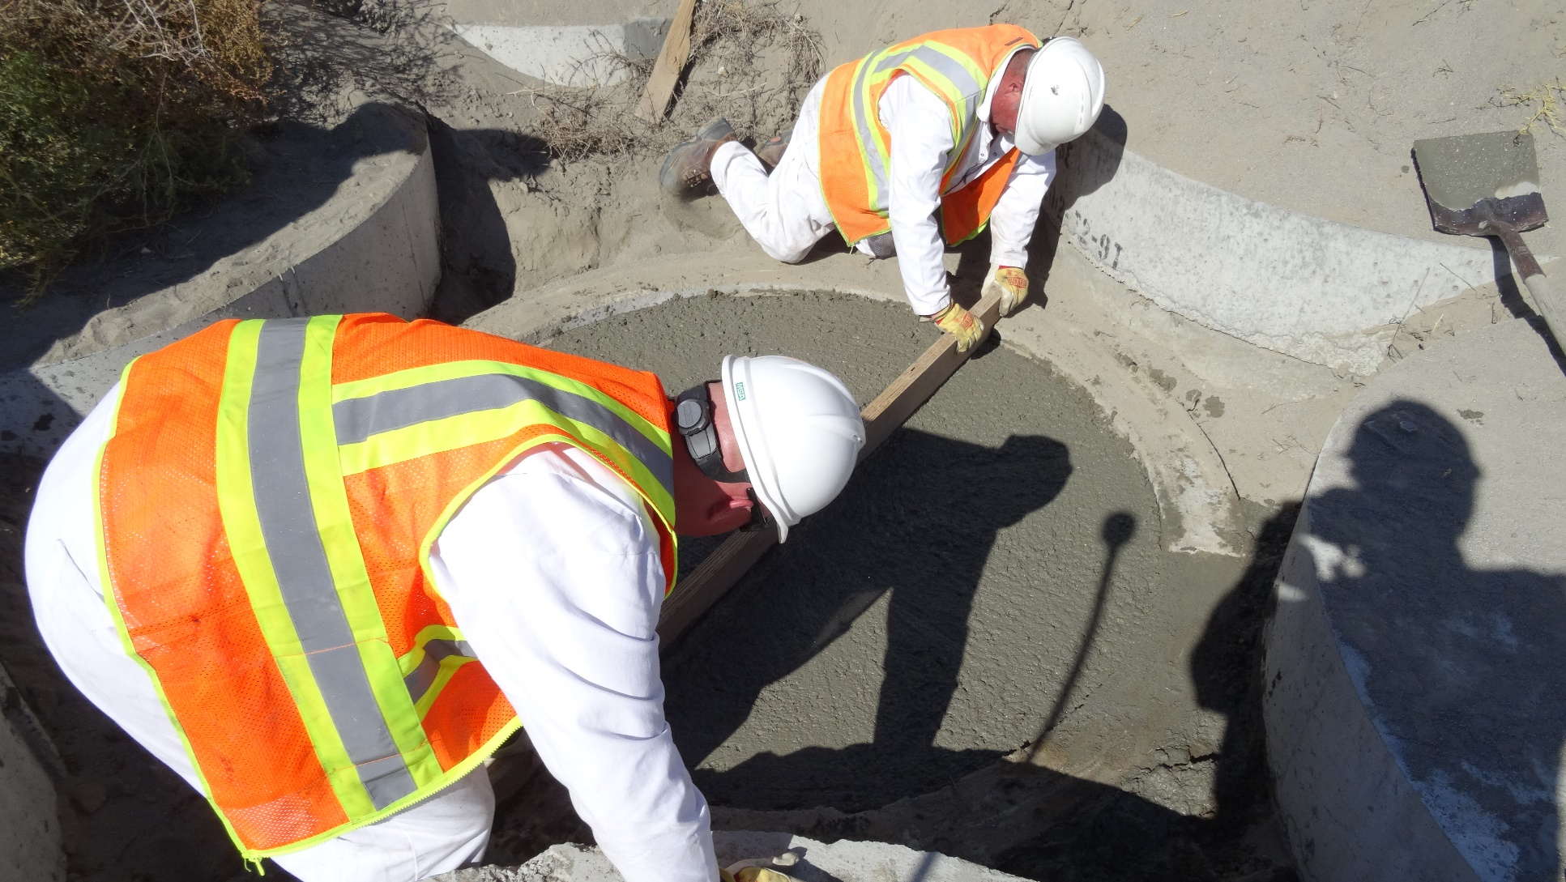
ECB filled to the brim

Slide 13
Questions
Mike Ault, General Manager
US Ecology LLRW Disposal Facility
mike.ault@usecology.com
509-377-2411
Earl Fordham, Deputy Director
Washington Dept of Health
Office of Radiation Protection
earl.fordham@doh.wa.gov
509-946-0234

