Slide 1
The Relative Risk From Oilfield NORM
Alan Fellman, Ph.D., C.H.P
LLW Forum Fall Meeting October 2017
Alexandria, VA

Slide 2
Oil and Gas Industry TENORM Hazards
Doses less than 10% of annual limits (so nobody goes home feeling sick)
PADEP Study
very little potential for external doses exceeding the 100 mrem/yr public limit
Drill cuttings typically < 20 uR/h
Sludges up to 150 uR/h
Equipment surfaces in processing facilities typically 5 – 100 uR/h, but occasionally several thousand uR/h

Slide 3
External Exposure
IAEA – “external dose rates from NORM…are usually so low that protective measures are not needed.”
Well heads 10 – 2,250 μR/h
Production lines 30 – 400 μR/h
Separators up to 1,500 μR/h
From IAEA Report – Radiation Protection and the Management of Radioactive Wastes in the O&G Industry

Slide 4
So Is The Risk Real or Imagined?
According to LNT…increased lifetime cancer risk
1 per 1,000 per rem (BEIR VII)?
According to science…perhaps not
Evidence of threshold
Evidence of hormesis

Slide 5
Real Risk To Real People
OSHA Severe Injuries, 1/1/15 – 12/31/16
Amputations, hospitalizations, broken bones, unspecified traumatic injuries, etc.
19,937 reported – sample of employers:
Dick’s Sporting Goods
Health Care Services Group
Russell Stover Candies
Halliburton Energy Services

Slide 6
Upstream Oil and Gas Industry
503 of the 19,937
General feeling among H&S experts that injuries are underreported
but this doesn’t include the 21 states that report to a state agency, including California, Utah, Wyoming
A little progress?
27 per month in 2015
20 per month in 2016

Slide 7
Compared To Other Industries
Oil and gas has the highest rate of severe injuries among all industries employing more than 100,000 people
Oil and gas second only to “General Medical and Surgical Hospitals; however
250,000 O&G industry workers
More than 3 million general medical workers

Slide 8
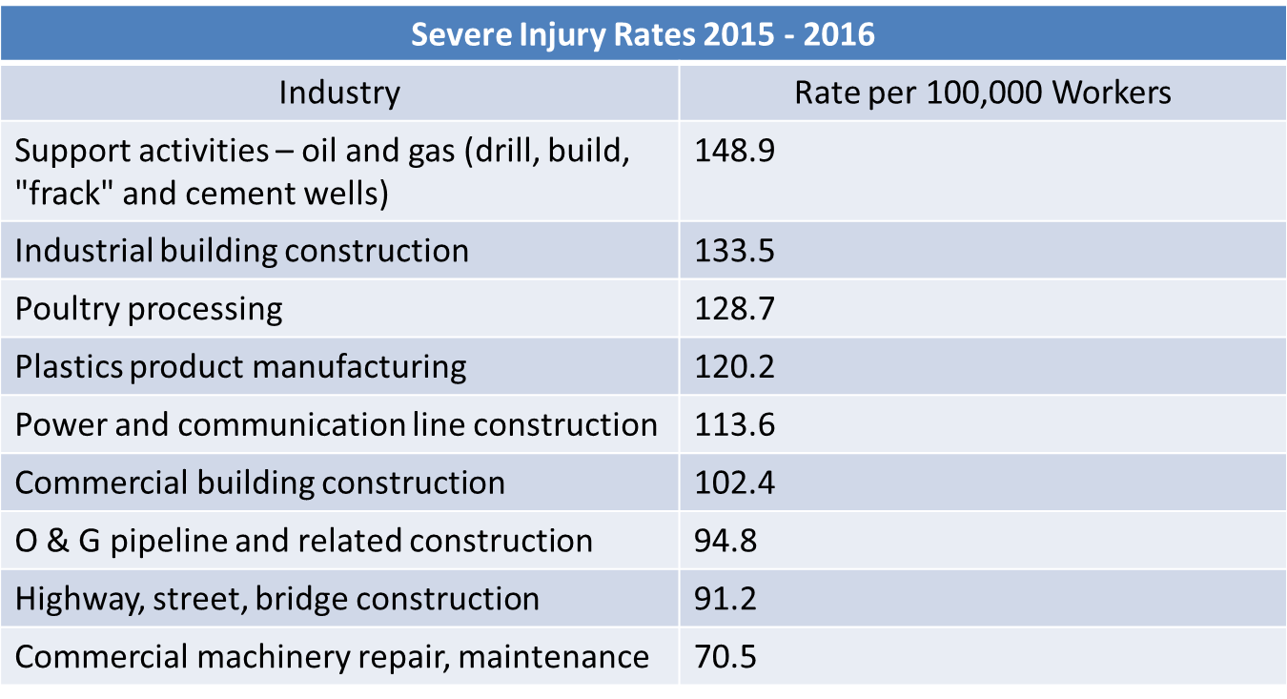
Compared To Other Industries

Slide 9
Fatalities
From Energy Wire (12/23/2016):
Upstream oil and gas operators last year achieved their lowest rate of workplace fatalities since 2009, but the extraction business is still five times deadlier than general industry, according to internal calculations by the Occupational Safety and Health Administration.
What kind of numbers?

Slide 10
Oil and Gas Industry Fatalities
From 2003 – 2010, 803 O&G workers killed on-the-job
Similar to fatality rates since early 1990s
Causes
Transportation Accidents (42%)
Struck-By/ Caught-In/ Caught-Between (25%)
Explosions and Fires (14%)
Exposure to Electric Current or Chemical Exposures (9%)
Falls, Slips, Trips (8%)

Slide 11
Intelligencer/Wheeling News-Register
Looked at Marcellus region accidents, 2010-2015
Root causes include lightning, landslide, gas leaks, corrosion, mechanical failure, pipeline integrity
In addition to worker injury/fatalities, impacts
Severe damage to residences
Evacuations
Environmental damage

Slide 12
Examples of Hazards Activities
Manual tank gauging and sampling at O&G extraction sites (hydrocarbon exposure)
Well drilling and servicing (falls, slips, trips, heavy equipment related)
Hydraulic fracturing operations (silica exposure)
Mobile engines/auxiliary motors (ignition of vapors)

Slide 13
Things To Consider
How many O&G workers have been, or will be killed by radiation from TENORM?
How many O&G workers have been, or will be made sick by radiation from TENORM?
What is the lost work-day rate due to the presence of TENORM at O&G industry sites and facilities?
What is the appropriate level of resources that O&G companies should commit to TENORM radiation safety?

Slide 14
Contact Information
Alan Fellman, Ph.D., C.H.P.
Senior Health Physicist
Alan.fellman@nv5.com

