Slide 1
Radium Contamination at Non-Military Sites
LLW Forum Meeting
October 17, 2017
Alexandria, Virginia
David Misenhimer, Project Manger
Division of Decommissioning, Uranium Recovery and Waste Programs (DUWP)
Office of Nuclear Material Safety and Safeguards (NMSS)

Slide 2
Acronyms
AEA- Atomic Energy Act
CT- State of Connecticut
DoD- U.S. Department of Defense
EPA-U.S. Environmental Protection Agency
EPAct- Energy Policy Act of 2005
ORNL- Oak Ridge National Laboratory
mrem/yr- millirem per year
NARM- Naturally-occurring and accelerator-produced radioactive material
NY- State of New York

Slide 3
Overview
Background
Identifying historic radium sites
Results of site identification work
Outreach
Initial Site Visits
Results
State Interactions
3

Slide 4
Background
Radium-226 half-life is ~1600 years therefore historic radium sites could still pose a hazard to the public
Energy Policy Act of 2005 amended the AEA to add discrete sources of radium-226 to the existing definition of “byproduct material,” thereby giving NRC the authority to regulate such sources
NARM Rule of 2007 implemented the radium-226 related provisions of the EPAct and defined “discrete source”
NRC gained jurisdiction over radium-226 in all non-Agreement States in late 2009
Phased implementation from 2007-2009
4

Slide 5
Background
Initial efforts focused on defining NRC’s jurisdiction over military radium
During late 2013 staff became aware of 2 non-military sites undergoing remediation for radium contamination – Great Kills Park (NY) and Waterbury Clock Factory (CT)
This prompted NRC staff to consider its regulatory authority over non-military sites with historical radium contamination
From 2014-2015, NRC staff hired a contractor to research sites with historical radium contamination
5

Slide 6
Identifying Historic Radium Sites
Given Great Kills Park, Waterbury + other clock sites, NRC considered it reasonable for more sites to exist
NRC contracted with ORNL to conduct research on historic radium sites
Three general objectives:
Identify locations where radium was used/processed
Gather available site information (nature and extent of contamination etc.)
Develop methodology to prioritize sites based on potential hazard to public
6

Slide 7
Objective 1: Identify Locations of Use
Radium was used to help illuminate products (i.e., dials, gauges, compasses, switches, watches)
In addition to its industrial uses, in the early 20th century radium-226 was a popular additive in consumer products due to its supposed beneficial health properties
Identified historic applications or products containing radium-226 as a method to backtrack to its manufacturing source
Using historical records, databases, literature searches etc., identified factory locations were radium-226 was used
7

Slide 8
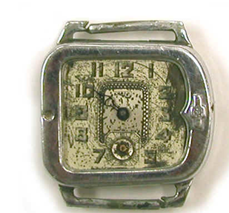
Historic Radium Uses - Luminescent Devices
8
Image source: Buchholtz and Cervera, 2008

Slide 9
Historic Radium Uses - Irradiation Sources
9
Image source: Buchholtz and Cervera, 2008
Notes:
Used for weld inspection

Slide 10
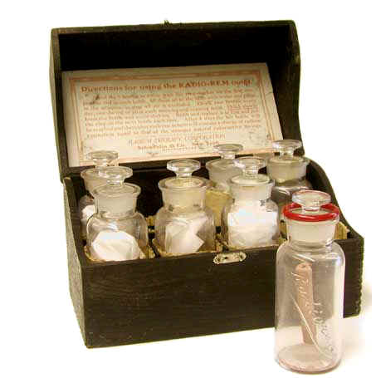
Historic Radium Uses - Emanators
10
Image source: Buchholtz and Cervera, 2008

Slide 11
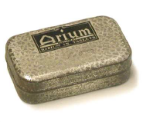
Historic Radium Uses - Tablets
11
Image source: Buchholtz and Cervera, 2008

Slide 12
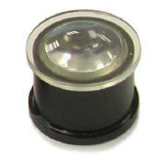
Historic Radium Uses - Toys / Novelties (Spinthariscope)
12
Image source: Buchholtz and Cervera, 2008

Slide 13
Objective 2: Site Data Collection (if available)
Site Reports:
Focused on non-Agreement State sites
Description of the site
Current structures/site condition
Existing site controls
Operational history
Any past remediation activities
Nature and extent of contamination
Proximity of populations to the site
Past and current State and Federal involvement
13

Slide 14
Objective 3: Site Prioritization
ORNL instructed to notify NRC staff of any sites that potentially require immediate attention
A prioritization methodology was developed for NRC follow-up actions; 4 Tiers of sites were developed:
Tier 1, 2, and 3 sites are those sites where radium-226 was historically present at the site
Tier 1 sites potentially have the highest levels of human exposure to radium-226 contamination (and thus risk); site access is not controlled
Tier 2 sites have a lower potential for human exposure to radium-226 contamination than Tier 1 sites; site access is weakly controlled
Tier 3 sites are unlikely to have the potential for human exposures to radium-226 contamination due to strong access controls
Sites in Tier 4 are sites where the NRC suspects that radium-226 was historically present.
14

Slide 15
Excluding Sites for Follow-up
The NRC staff excluded:
Sites with a current NRC license
Sites where the NRC does not have jurisdiction
Sites where cleanup has already been completed
Sites where cleanup is or will be addressed under another program (either under NRC or other oversight, such as the Formerly Utilized Sites Remedial Action Program)
15

Slide 16
Results of Site Identification Work
ORNL identified 29 historic radium use sites for potential NRC follow-up
47 individual site owners are associated with the 29 historic radium sites
Some original buildings are still in use today
Historical uses included: Manufacturing of radium-226 items (switches, toilet flushes, radium gauge repair, radium watches)
Current uses include: mainly industrial or office use; storage use; and in limited cases, residential use
16

Slide 17
Outreach
NRC began formal outreach activities with the States and local governments in July 2016
Awareness
Whether any additional information available
In October 2016, NRC staff sent letters to identified site owners and began scheduling site visits
In November 2016, NRC staff began performing initial site visits at properties to determine whether residual radium-226 from historic operations existed
17

Slide 18
Initial Site Visits
Inspection Procedures: Temporary Instruction 2800/043
Details how initial site visits are conducted
Threshold for immediate controls associated with the public dose limit of 100 mrem/yr for current site uses
Communications approaches
Site-specific Fact Sheets in English and Spanish
Dose Assessment Technical Basis Document
Defines the criterion for determining whether or not a site meets 25 mrem/yr and requires remediation for future use
18

Slide 19
Results
NRC staff has contacted all site owners where an initial site visit is needed
To date, initial site visits have been performed at 32 unique site owner properties
Radium-226 contamination has been identified at about 43% (14) of the sites visited
A majority of the initial site visits have not identified contamination above the NRC staff’s proposed action level of 100 mrem/yr
19

Slide 20
Results
Of the 32 initial site visits performed to date, 14 unique site owner properties have been identified with radium-226 contamination that is above background
Of these 14, 4 unique site owner properties were identified that exceeded the NRC staff’s action levels for recommending access controls (radiation levels equivalent to 100 mrem/yr assuming eight hour occupancy)
To date, it is estimated that 6 sites need to perform cleanup
20

Slide 21
Results
2 cleanup plans have been received
NRC has been working collaboratively with the State and EPA at 1 site with contamination where the owner would have difficulty funding cleanup
21

Slide 22
State Interactions
Continuing coordination and communications with Agreement and Non-Agreement States
Regular OAS updates
Sharing lessons learned
Providing support to Agreement State information requests
NRC staff has provided additional information on Agreement State sites, at their request
22

Slide 23
Questions ?

