Slide 1
NRC Export and Import Licensing 10 CFR Part 110
LLW Forum Meeting
October 17, 2017
Alexandria, Virginia
Andrea Jones
Sr. Licensing Officer
Export Controls and Nonproliferation Branch
Office of International Programs

Slide 2
Objective
Present an overview of import/export activities; including the definition of radioactive waste, exclusions to the definitions, general licensed imports vs specifically licensed imports/exports and a summary of recent adjudicatory matters specific to waste exports.
2

Slide 3
Key Information
There are two types of licenses for low-level radioactive waste – General and Specific.
OIP processes applications for specific licenses to export and import radioactive material including, in some cases, low-level waste.
Require Federal Register notices - public has up to 30 days to respond
OIP Licensing Officers coordinate the review and obtain input needed.
OIP requests technical assistance from the NRC’s Low-Level Waste Branch for radioactive waste.
Licensing decisions are made in consultation with input from the technical offices (e.g. NMSS), the Executive Branch, and the Office of General Counsel. Comments from external stakeholders are also considered.
Commission review of an application may be warranted if significant policy issues are raised.

Slide 4
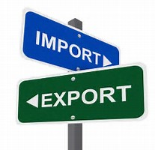
Relevant Regulations
Part 110 Export and import of nuclear equipment and material;
110.21-23 General License for Export of Special Nuclear Material, Source and Byproduct Material, not Waste;
110.27 General License for Import of Radioactive Material, not Waste;
Radioactive Waste (with six exceptions) requires a specific license;
110.31 Application for Specific License;
110.32 Application Contents/NRC Form 7; and
Import and export licensing review criteria, specifically at Subpart D of Part 110.

Slide 5
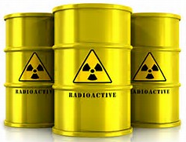
Definition of Radioactive Waste
Radioactive waste, for the purposes of this part, means any material that contains or is contaminated with source, byproduct, or special nuclear material that by its possession would require a specific radioactive material license in accordance with this Chapter and is imported or exported for the purposes of disposal in a land disposal facility as defined in 10 CFR part 61, a disposal area as defined in Appendix A to 10 CFR part 40, or an equivalent facility; or recycling, waste treatment or other waste management process that generates radioactive material for disposal in a land disposal facility as defined in 10 CFR part 61, a disposal area as defined in Appendix A to 10 CFR part 40, or an equivalent facility. Radioactive waste does not include radioactive material that is—[covered in the following 6 exclusions] ”
Per July 28, 2010 revision of Part 110.
Amended to align licensing of imports and exports more with the U.S. domestic licensing program.

Slide 6
Specific License Requirements for Radioactive Waste
Specific license required if a specific radioactive material license is required to possess the material domestically.
Specific license required if it is exported or imported for:
disposal in a land disposal facility defined as defined in 10 CFR Part 61 or in an Appendix A to Part 40 disposal area, or an equivalent facility; or
recycling, waste treatment or other waste management process that generates radioactive material for disposal in a land disposal facility defined in Appendix A to Part 40 or an equivalent facility

Slide 7
Exclusions
Of U.S. origin and contained in a sealed source, or device.
A contaminant on any non-radioactive material if goal is recovery and reuse of non-radioactive material.
Exempted from regulation by NRC or Agreement State.
Generated or used in U.S. government R&D.
Being returned by or for U.S. government to authorized facility.
Imported for recycling, not waste management

Slide 8
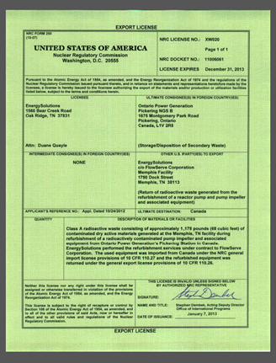
Specific Licenses for Exports (con’t)
If favorable responses are received from the Executive Branch, State(s) and Waste Compact(s), the license is drafted and reviewed by applicant before issuance.
Licenses authorizing the export the material or equipment:
Are signed by OIP Deputy Director;
Name parties, identify end users and end uses;
Identify commodities and amounts authorized for export
Set expiration dates; and
Can be amended and renewed prior to expiration date.
Applications may be returned without action or withdrawn
Licenses may be issued or denied.

Slide 9
General Licenses
In most cases, imports are covered under NRC’s general license provisions for byproduct material.
The general license allows entities that are authorized to receive and possess material to import it without a specific license, so long as (1) the shipment contains no more than 100 kg of source and/or special nuclear material in the form of irradiated fuel, (2) the imported material does not constitute radioactive waste under the NRC’s definition, or (3) if the imported material does constitute radioactive waste under the NRC’s definition, the imported material meets any of six exclusions applying to radioactive waste.
The NRC will not accept for review license applications to import byproduct material or low level radioactive waste that meet the requirements for import under a general license under 10 CFR Part 110.
Cannot be used if the contaminated material is imported
“for the purposes of disposal in a land disposal facility as defined in 10 CFR part 61, a disposal area as defined in Appendix A to 10 CFR part 40, or an equivalent facility”, unless one of the six exclusions is satisfied.
If imports of radioactive contaminated material do not meet one of the six exclusions in 10 CFR Part 110.2.
The public will still have the opportunity to comment on export applications for the U.S. consignee to return to the country of origin material that is imported under general license

Slide 10
Recent Petitions Received
Perma-Fix Northwest
September 2016, member of public requested extension to file public comments and request for hearing to amend and renew existing import and export to request hearing to intervene.
October 2016, import and export applications returned due to incomplete information (e.g. wrong description of waste).
Application to export material resubmitted with correct classification. Note: license to import was not required because the proposed import met requirements for general import license.
Export license issued on June 28, 2017.
Diversified Scientific Services, Inc.
May 2017, export application submitted, application requested change in point of contact, removal of waste classifications, change in foreign supplier name and remove references to change date of expiration.
August 2017, petition to intervene on export application received.
Adjudicatory action for export application still under review by the Commission attorneys.
UniTech Service Group
October 2017, export and import license application received for the decontamination and return of radioactive waste to originating country.
March 2017, import application retuned without action, import authorized under general license.
May 2017, petition to intervene on export application received.
Adjudicatory action for export application still under review by the Commission attorneys.

Slide 11
NRC Export/Import and Contact Information
Public Website https://www.nrc.gov/about-nrc/ip/export-import.html
Contact Licensing Officers at IPresource@nrc.gov
My contact Information
Andrea.Jones2@nrc.gov
301-287-9072

