Slide 1
Prevent, Counter & Respond – A Strategic Approach to Reduce Global Nuclear Threats
John Crapo
National Nuclear Security Administration
U. S. Department of Energy

Slide 2
DOE/NNSA - Applying Technical Capabilities to National Security Challenges
Notes:
DOE/NNSA makes full use of all the resources at its disposal to fulfill its Nuclear Threat Reduction mission by:
Developing and implementing policy and technical solutions to eliminate proliferation-sensitive materials and limit or prevent the spread of materials, technology, and expertise related to nuclear and radiological weapons and programs around the world.
Providing expertise, practical tools, and technically informed policy recommendations required to advance U.S. nuclear counterterrorism and counterproliferation objectives.
Maintaining essential components of the U.S. capability to respond to nuclear or radiological crises and manage the consequences (domestically or internationally) of civilian radiation exposure resulting from a nuclear or radiological incident, especially those involving terrorism.

Slide 3
Nuclear Proliferation & Nuclear/Radiological Terrorism Threat Spectrum
Notes:
DOE/NNSA applies its nuclear nonproliferation, counterterrorism, counterproliferation, and emergency response capabilities across the entire nuclear threat spectrum, from intent through crisis response, by following three general philosophies :
Prevent non-state actors and additional countries from developing nuclear weapons or acquiring weapons-usable nuclear materials, equipment, technology, and expertise; and prevent non-state actors from acquiring radiological materials for a radiological threat device.
Counter the efforts of both proliferant states and non-state actors to steal, acquire, develop, disseminate, transport, or deliver the materials, expertise, or components necessary for a nuclear or radiological threat device or the devices themselves.
Respond to nuclear or radiological terrorist acts, or accidental/unintentional incidents by searching for and rendering safe threat devices, components, and/or radiological and nuclear materials; conducting consequence management actions following an event to save lives and protect property and the environment; and enabling the provision of emergency services through close coordination and operational integration with the Department of Energy’s emergency management enterprise system.

Slide 4
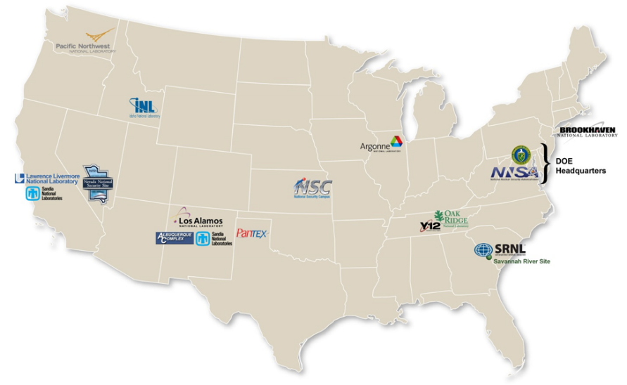
Enterprise Approach to the Nuclear Threat Reduction Mission
Notes:
The DOE complex of national laboratories, plants, and sites are central to DOE/NNSA’s ability to prevent proliferation and nuclear terrorism. The DOE complex provides the science, technology, engineering, and manufacturing capabilities that are the tools by which DOE/NNSA solves the technical challenges of combating nuclear terrorism and proliferation, verifying treaty compliance, and guarding against threats posed by nuclear technological surprise. All parts of the DOE scientific enterprise contribute to the DOE/NNSA nonproliferation and counterterrorism mission. Additionally, the national laboratories, sites, and plants of the NNSA Nuclear Security Enterprise (NSE) have unique and extensive science, technology, engineering, and manufacturing capabilities developed over decades of nuclear weapons research, development, and stockpile management, which enables the DOE complex to play a critical role in the nation’s ability to understand nuclear proliferation and terrorism threats worldwide. The elements of the NNSA NSE are also U.S. national assets, contributing directly to the missions of DOD, DOS, DHS, the U.S. Intelligence Community, and other agencies and government entities. They also support broader international efforts through Mutual Defense Agreements (MDAs) and agreements with other countries as part of the collective goal to ensure nuclear deterrence and reduce the threat of nuclear terrorism.
The DOE scientific complex and NNSA NSE will only become more important in the future as DOE/NNSA faces the evolving technical challenges of verifying treaty compliance under more complex treaty obligations, assessing foreign nuclear weapons activities that are more easily hidden and enabled in today’s information environment, combating ever-adapting tactics and pathways to nuclear terrorism and proliferation, and guarding against technological surprise.

Slide 5
Interagency Strategic Partners
Department of State
Department of Defense
Department of Homeland Security
U. S. Intelligence Community
U. S. Nuclear Regulatory Commission
Federal Bureau of Investigation
Federal Emergency Management Agency
White House-led Interagency Policy Committee (IPC) and Sub-IPC meetings
Program-level interagency working groups
Notes:
As the U.S. leader in nuclear security, DOE is a primary U.S. Governmental department for implementing the U.S. nuclear nonproliferation agenda and works in partnership with other U.S. Governmental agencies involved in nuclear nonproliferation and nuclear counterterrorism activities

Slide 6
International Engagements
International Atomic Energy Agency (IAEA)
Multi-lateral consultations
Nuclear Security Summits
Global Initiative to Combat Nuclear Terrorism (GICNT)
G7 Global Partnership Against the Spread of Weapons & Materials of Mass Destruction (GP)
Bi-lateral Cooperation Coordination Bodies
U.S.-European Atomic Energy Community (EURATOM) Joint Coordination Committee
U.S.-Japan Nuclear Security & Emergency Management Working Group
Notes:
The U.S. national security strategy makes international cooperative partnerships a critical and necessary element in achieving U.S. nuclear/radiological security objectives. DOE/NNSA is the U.S. lead or co-lead in many key international engagements to cooperatively strengthen the global nuclear security regime. These partnerships extend the reach of DOE/NNSA programs and play a key role in demonstrating international support for action against the global nuclear proliferation and terrorism threat. Further, this broader and ongoing engagement helps establish a level of confidence and trust that bolsters DOE/NNSA’s ability to quickly engage the support of regional partners whenever a transformative event suddenly occurs.
Further, U.S. foreign partners recognize NNSA and other parts of DOE as possessing world-leading expertise and infrastructure for strengthening nuclear security around the globe, and thus share the cost of program actions in pursuit of common nuclear security objectives and priorities with NNSA. Since 2005, DOE/NNSA has had Congressional authorization to receive direct financial contributions from foreign partners. Nuclear nonproliferation programs have received nearly $95 million (in U.S. dollars) for designated projects from eight foreign countries, enabling DOE/NNSA programs to implement cooperative nuclear security work that advances the mutual nonproliferation objectives of both the foreign partner and the United States.

Slide 7
Cm Assets/capabilities

Slide 8
Responding to Nuclear/Radiological Threats & Terrorism

Slide 9
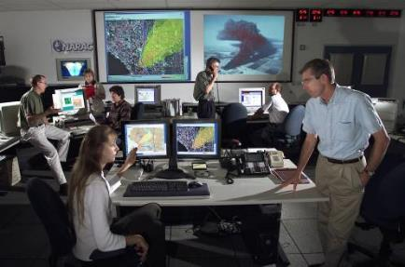
Model
National Atmospheric Release Advisory Center(NARAC)
Transport and diffusion models simulate the release and predict the extent of the hazard.
3-D modeling system with continuous representation of terrain.
Combines the model with data collected from the field and real-time meteorological conditions.
The Interagency Modeling and Atmospheric Assessment Center (IMAAC) is responsible for the production, coordination, and dissemination of consequence predictions for atmospheric hazardous material releases during actual or potential incidents requiring Federal coordination. The IMAAC generates the single Federal prediction of atmospheric dispersions and their consequences utilizing the best available resources from the Federal Government. NARAC is the primary provider of radiological/nuclear plume modeling for the IMAAC
Notes:
National Atmospheric Release Advisory Center (NARAC)
Overview:
The NARAC's mission is to provide timely and accurate real-time assessment advisories to emergency managers for rapid decision-making, during an emergency response involving a nuclear or chemical release. The NARAC’s computer-based system provides realistic plots and maps of radiation dose and exposure assessments, and estimates the amount of radiation contaminants released into the environment.
What they provide:
Transport and diffusion models simulate the release and predict the extent of the hazard.
The NARAC uses a 3-D modeling system with continuous representation of terrain.
NARAC is able to combine the model with data collected from the field and real-time meteorological conditions to refine the model.
This is an iterative process that will eventually end when the model represents the actual condition on the ground.
Rough number of responders:
As few as less than five responders and up to approximately twenty.
When they get there:
NARAC is a remote response asset. They are available in the first hours of the response.
How they fit into the BIG picture:
NARAC folds into FRMAC operations.
Where to find more information:
http://nnsa.energy.gov/aboutus/ourprograms/emergencyoperationscounterterrorism/respondingtoemergencies/consequencemanagem-2

Slide 10
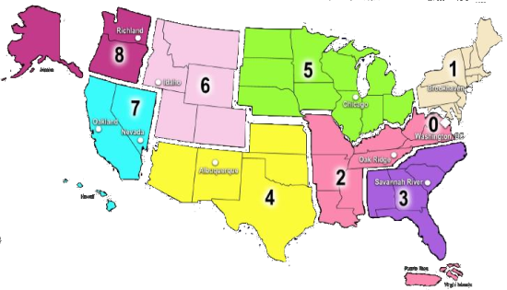
Measure/Preliminary Assessment
Radiological Assistance Program (RAP)
Regionally-based asset located at 9 DOE and NNSA sites throughout the country
Provides advice and radiological assistance for incidents involving radioactive materials that pose a threat to the public or the environment.
Provides field deployable teams of health physics professionals equipped to conduct radiological search, monitoring, and assessment activities.

Slide 11
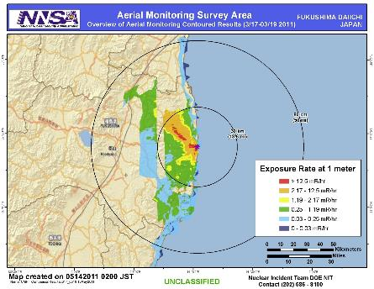
Measure
Aerial Measuring System (AMS)
The fixed-wing aircraft are deployed with the radiation detection system to collect information and determine the location of ground contamination.
The helicopters are used to perform detailed surveys of ground contamination.
Scientists are then able to rapidly develop maps of the radiological materials deposited on the ground and the potential radiation exposure to personnel in the affected areas.
Notes:
Aerial Measuring Systems (AMS)
Overview:
AMS provides specialized airborne radiation detection systems to provide real-time measurements of low levels of air and ground contamination.
What they provide:
The fixed-wing aircraft is deployed with the radiation detection system to collect information and determine the location of ground contamination.
The helicopters are used to perform detailed surveys of ground contamination.
Scientists are then able to rapidly develop maps of the radiological materials deposited on the ground and the potential radiation exposure to personnel in the affected areas.
Rough number of responders:
As few as three responders and up to approximately twenty.
When they get there:
The fixed wing aircraft could be onsite during the first day, and the rotary wing would follow (potentially could arrive on day two).
How they fit into the BIG picture:
AMS folds into FRMAC operations.
Where to find more information:
http://nnsa.energy.gov/aboutus/ourprograms/emergencyoperationscounterterrorism/respondingtoemergencies/consequencemanagem-0

Slide 12
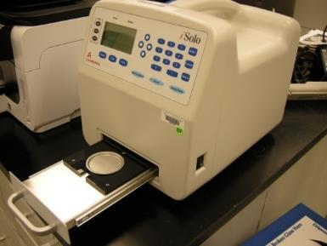
Measure
On-Site Radioanalytical Support for
Health & Safety Measurements
Sample Screening & Prioritization
LIMITED sample analysis
Analytical Capabilities:
Gamma Spectroscopy
Gross Alpha/Beta Counting
NO Radiochemistry capabilities
Acceptable Matrices:
Gamma Spec – Any sample size/geometry
α/β – Air Filters, Swipes, Soil (limited)
Fly Away Laboratory
(FAL)
Notes:
Fly Away Laboratory (FAL)
Overview:
The FAL fills an additional gap that is complementary to the EPA’s mobile lab. It can get to the scene faster (since it can be flown in) and begin processing samples before the EPA mobile lab arrives on scene. Once the EPA mobile lab arrives, the FAL will assist with the sample load.
What they provide:
Equipment is capable of analyzing samples for
Alpha, beta, and gamma-emitting radionuclides
Low energy beta-emitters such as Tritium.
Able to process multiple matrices including but not limited to:
Soil, air filters, swipes, and liquid samples
Rough number of responders:
As few as six responders and up to around twenty.
When they get there:
The FAL can be flown in component pieces on commercial air, and could arrive on site as early as day two of the response.
How they fit into the BIG picture:
The FAL folds into FRMAC operations.
Where to find more information:
No websites have been created as of yet for the FAL. Additional information can be obtained through the FRMAC contacts listed during this training.

Slide 13
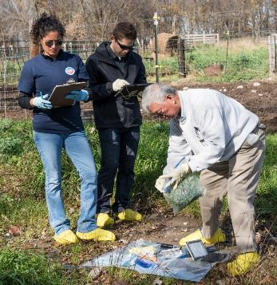
Measure/Sample/Assess
Consequence Management Response Team (CMRT)
Assessment scientists to assist in creating data products
Geographical Information Systems (GIS) equipment and personnel for creating map products
Health & Safety for supporting the FRMAC responders
Monitoring & Sampling personnel and equipment to support FRMAC field teams.
Laboratory Analysis equipment and personnel
Logistics support for FRMAC teams
A Consequence Management Advance Command (CMAC) deploys in advance of the CMRT to provide for early assessment and leadership
Notes:
Consequence Management Response Team (CMRT)
Overview:
CMRT consists of technical and management personnel that provide support with radiation sampling and monitoring as well as analysis of data collected.
What they provide:
Assessment scientists to assist in creating data products
Geographical Information Systems (GIS) equipment and personnel for creating map products
Health & Safety for supporting the FRMAC responders
Monitoring & Sampling personnel and equipment to support FRMAC field teams.
Laboratory Analysis equipment and personnel
Logistics support for FRMAC teams.
Rough number of responders:
CMRT, like all of the FRMAC components, is scalable. As few as 25, and more than 100 (with augmentation) could support a response.
When they get there:
CMRT is activated in several phases.
Phase I deploys within 4 hours
Phase II can deploy within 12 hours
Augmentation would follow as needed.
How they fit into the BIG picture:
CMRT folds into FRMAC operations.
Where to find more information:
http://nnsa.energy.gov/aboutus/ourprograms/emergencyoperationscounterterrorism/respondingtoemergencies/consequencemanagem-1

Slide 14
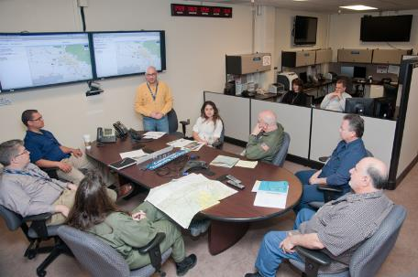
Assess
Remote Sensing Lab (RSL)
Technical and Federal Team Leaders
Bridge Line Coordinators
Operations Specialists
GIS Specialist
eFRMAC Home Team Admin
AMS HT Scientist
Product Scientists
Logistics specialists
LLNL/NARAC Support
Assessment Scientists from
Sandia National Laboratories
Lawrence Livermore National Laboratory
Los Alamos National Laboratory
Consequence Management Home Team (CMHT)
Notes:
Consequence Management Home Team (CMHT)
Overview:
CMHT assists other NNSA field assets in the support of federal, state, tribal, and local response organizations with modeling, radiological operations planning, field monitoring techniques, and the analysis, interpretation and distribution of radiological data.
CMHT folds into FRMAC operations.
What they provide:
Conference line to coordinate communications
Technical guidance
Data and GIS map products that give meaning to the current and projected radiological conditions
Atmospheric plume and deposition modeling (via NARAC)
Event status, logistics, and contact information to authorized personnel
Rough number of responders:
CMHT can be scaled to the response. There can be as few as two or three team members and, in a large response, up to around one hundred (with support from across the country).
When they get there:
CMHT is a remote response asset. They are available in the first hours of the response.
How they fit into the BIG picture:
CMHT supports all of the various components of the response. This includes headquarters, the FRMAC responders in the field, all of the other federal agencies, and the state and locals, among others. They provide access to data and create products. They also provide a central bridge line for coordinating communications with responders that may be in many locations.
Where to find more information:
http://nnsa.energy.gov/aboutus/ourprograms/emergencyoperationscounterterrorism/respondingtoemergencies/consequencemanagem-1

Slide 15
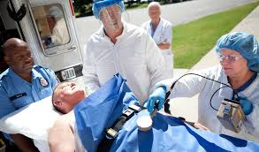
Medical
Advice and possible medical care in cases of human radiation exposure.
Retrospective dose assessment
Facilitating and creating a network of available equipment and staff specializing in human radiopathology.
Assisting in the development of medical emergency plans to address large-scale radiation incidents.
Assisting in the preparation of relevant documents and guidelines.
Radiation Emergency Assistance Center/Training Site (REAC/TS)
Notes:
Radiation Emergency Assistance Center/Training Site (REAC/TS)
Overview:
REAC/TS’s mission is to maintain 24 hour response operations to provide assistance and/or deploy personnel and equipment for provision of direct medical care in support of a radiological emergency. In addition, they provide consultative services over the telephone or via email (reacts@orau.gov). The team supports federal, state, and local government organizations
What they provide:
Advice and possible medical care in cases of human radiation exposure.
Facilitating and creating a network of available equipment and staff specializing in human radiopathology.
Operating the REAC/TS Cytogenetic Biodosimetry Laboratory (REAC/TS CBL)
Assisting in the development of medical emergency plans to address large-scale radiation incidents.
Assisting in the preparation of relevant documents and guidelines.
Maintaining a stockpile and registry of internal dose countermeasures.
Maintaining a radiation accident registry pertaining to the medical response and treatment of victims.
Rough number of responders:
The responders to the scene could be less than five people and expand as needed.
When they get there:
REAC/TS can be onsite during the first day of the response.
How they fit into the BIG picture:
REAC/TS folds into FRMAC operations.
Where to find more information:
http://nnsa.energy.gov/aboutus/ourprograms/emergencyoperationscounterterrorism/respondingtoemergencies/consequencemanagem-3

Slide 16
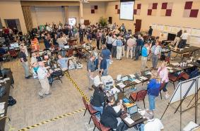
Asset Response Timeline
6-12
0-6
12 – 24
24 – 48
CMRT
EPA
HRF
Advisory Team
FRMAC Established
CMAC
REAC/TS
CERFP
AMS
State/Local
RAP
CST
AMS - CMHT - | Aerial Measuring System Consequence Management Home Team
CMAC - | Consequence Management Advance Command
CMRT - | Consequence Management Response Team
NARAC - | National Atmospheric Release Advisory Center
REAC/TS - | Radiation Emergency Assistance Center/Training Site
RAP - | Radiological Assistance Program
CERFP - | CBRNE Enhanced Response Force Package
CST - | Civil Support Team
HRF - | Homeland Response Force
CMHT
NARAC
Remote Advisory Team
REAC/TS
Notes:
Give general overview of timeline
Define the teams at each level (names and a general description of each)
CMHT
Consequence Management Home Team – staffed by technical and logistics personnel from DOE. Responsible for deploying other DOE CM assets to support a FRMAC and/or RAP. Responds within 1 – 2 hours after notification and capable of providing:
Radiation dose assessment
Atmospheric modeling via NARAC (who will be described in more detail shortly)
Map product support
Aerial data reachback support
Connectivity with other federal home teams
Advisory Team for the Environment, Food, and Health (A-Team)
Combination of federal agencies who authored several regulatory and guidance documents
FDA
USDA
CDC
EPA
Can provide recommendations to the states and locals for their decision making processes
CMHT can reachback to the A-Team to connect responders with additional guidance until the on-site team arrives or in the case there are not enough A-Team staffers to support every operations center involved in a response
REAC/TS
Radiation Emergency Assistance Center/Training Site – group out of Oak Ridge, TN who serve as medical advisors during radiological emergencies. REAC/TS members are trained physicians, nurses, and other medical professionals who can provide guidance related to prophylactic medications available to potential victims of contamination and treatment for overly exposed individuals.
RAP – Radiological Assistance Program (will be covered later)
CST
Civil Support Teams – National Guard teams who receive specialized training in WMD response. These are state assets which can be called upon to support at the request of a governor. Can work with FRMAC teams if allowed.
CMRT I/II
Consequence Response Teams I and II – these are DOE response teams deployed from Las Vegas, NV and are the on-site version of the CMHT. They maintain a full complement of field team support and equipment as well as laboratory analysis and sample collection resources. Phase I
25 personnel (management team, field team members (up to 5 teams), GIS, assessment scientists, and database specialists. With a few thousand pounds of equipment. Wheels up within 4 hours of request. This team is on recall 24/7/365.
Phase II
38 personnel (augmentation of the above mentioned staff plus lab analysis and hotline support)
20,000 lbs of equipment
Can be recalled and wheels up within 12 hours.
CERFP and HRF
DoD support assets which boasts a number of field assets as well as additional command control staffers
EPA
Environmental Protection Agency – responsible for radiation support as well as other hazards during the event (consider Fukushima: near the plant there were several other large production companies along the coast whose materials were at risk. Chemical and other fuels potentially could have been carried away in flood waters creating additional hazards.)

Slide 17
Data and Technical Products

Slide 18
GOALS
Model
Predictions
Measure
Ground truth
Refined decision making
Map
Scale and scope
Early decision making
Situational awareness of the radiological environment

Slide 19
Data Flow
RadResponder Network
https://www.radresponder.net/
Mobile app
Email to: cmht@nnsa.doe.gov
Fax to CMHT at 702-794-1039
Call in data on CMHT bridge line
Radiological Response Data Portal
FRMAC Radiological Assessment & Monitoring System (RAMS)
AMS Reachback
Notes:
national standard and Whole Community solution for the management of radiological data.
collaboration between Federal Emergency Management Agency (FEMA), Department of Energy (DOE) / National Nuclear Security Administration (NNSA), and the Environmental Protection Agency (EPA)
flexible architecture enables organizations to rapidly and securely record, share and aggregate large quantities of data while managing their equipment, personnel, interagency partnerships, and multijurisdictional event space.
Can be accessed on smartphones, tablets, and via the web

Slide 20
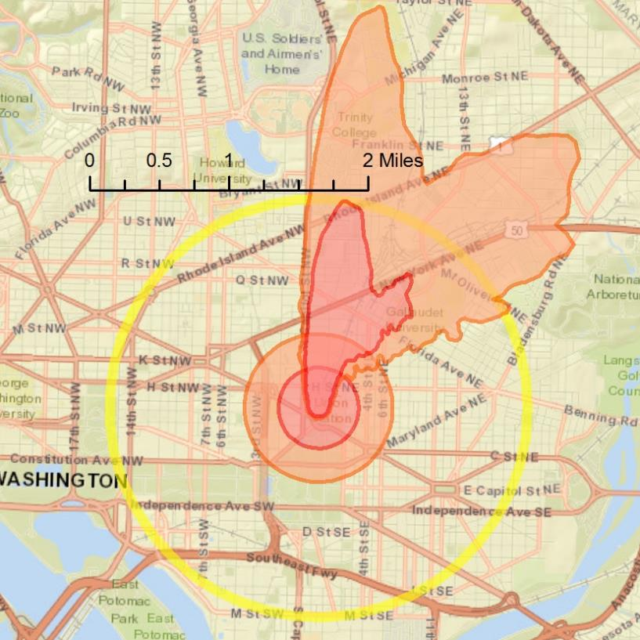
Post-detonation product
Immediate Shelter-in-place and Life-saving Activities Needed Following a Nuclear Detonation Impacting over 80,000 in Washington DC
Severe Damage Zone: Survival unlikely. Pop: 1,250
Lethal fallout radiation: Shelter-in-place for 12-24 hours for greatest chance of survival. Pop: 3,140
Moderate Damage Zone: Focus life saving operations to mitigate blast injuries Pop: 8,100
Dangerous fallout radiation:
Initiate life saving operations to minimize radiation exposure
Direct population remain sheltered for 12-24 hours. Pop: 19, 600
Light Damage Zone: Triage and treat injured. Pop: 81,200
Model prediction at 12 hours post-detonation
No measurements available yet
Model assumes 1kt yield
Blast damage est. 1.5 miles from detonation location
Population and areas are cumulative and include all smaller areas
Notes:
Factors to Consider: Immediately post-event, it may be more effective to shelter-in-place initially than evacuate the area until a safe corridor can be established with decontamination areas.

Slide 21
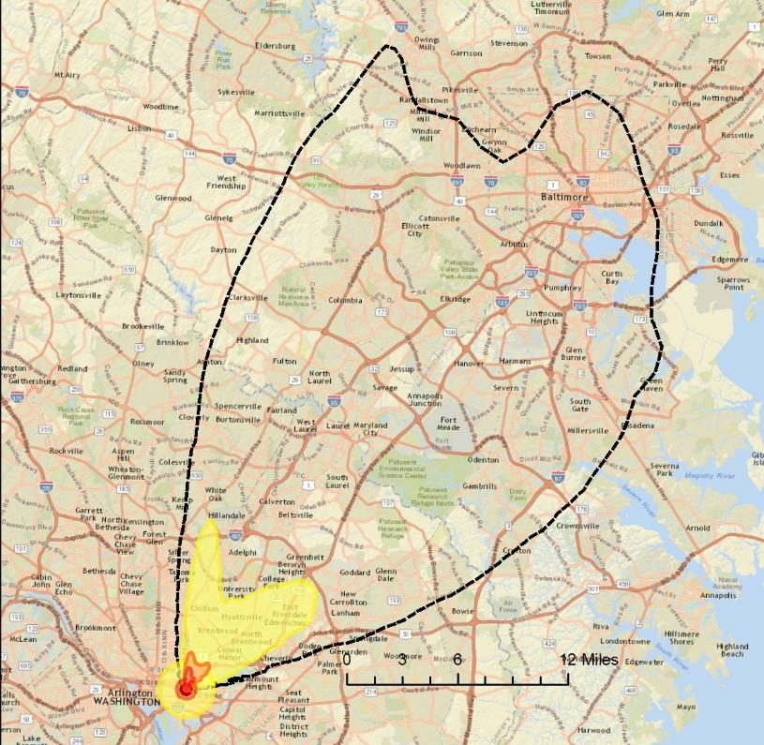
Regional Impacts Product
Consider precautions to reduce exposure to fallout radiation; Advise public
12 hours Post-Detonation of Nuclear Detonation
Elevated Cancer Risk from Fallout:
Shelter-in-place for 12-24 hours
Evacuation subject to confirming measurements and balancing of risks caused by evacuation itself (over 200,000 people, 32 sq. miles )
Lower-risk Precautionary Area:
Consider and weigh risks, benefits and costs of implementing precautions that reduce public exposure to fallout radiation
This area will shrink significantly each day (see accompanying map)
Focus initial protective actions on smaller, higher risk areas nearer the incident
Over 1.5 Million people, 600 sq. miles
Appropriate protective actions for the public are to be determined and directed by state and local public health and safety officials
Model based on 1kt yield
No measurements available yet
Population and areas are cumulative and include all smaller areas
Notes:
Comments to possibly still address:
Agricultural monitoring and water monitoring areas may be different…still need to evaluate this
Use of the “Lower Risk Area”, AKA “Hot Zone”, is problematic. Initially (first day) the Hot Zone may be impractically large for it’s intended use, both as a controlled area and sheltering/evacuation area. Second, for the shelter area, it is initially much larger than the “Elevated Cancer Risk from Fallout Area”...so, the two areas give conflicting guidance on areas where sheltering is needed. This seems to be an issue unique to an IND, with high initial fallout radiation that rapidly decays, so the logical place to resolve it may be and update to the Federal Planning Guidance for Response to a Nuclear Detonation. Showing how the Hot Zone quickly shrinks (see later slide) can help with this.
However, some indication of the size of the areas with lower risk, and with measurable radiation, is likely going to be needed. How to communicate this the public is being studied in a FEMA-DOE NIRT project.
Maybe we want to make the Lower-Risk Hot Zone plot a field-staff-only product. Even then, should the controlled area be chosen based on the predicted Hot Zone at H+24hrs or other time, in order to be more representative of the quickly shrinking size of the Hot Zone.
There is a need for senior leaders to understand how many responders are required to actually do the work during a real event.

Slide 22
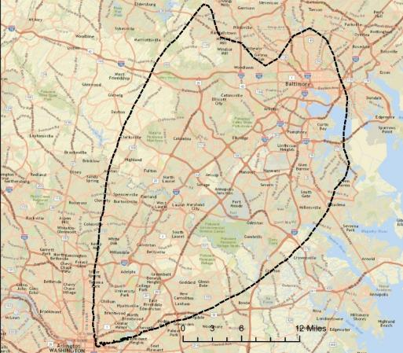
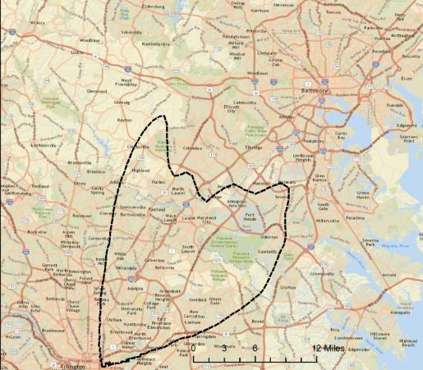
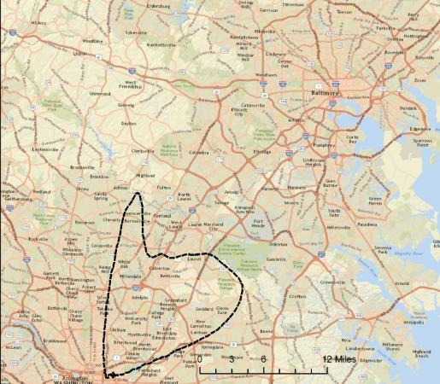
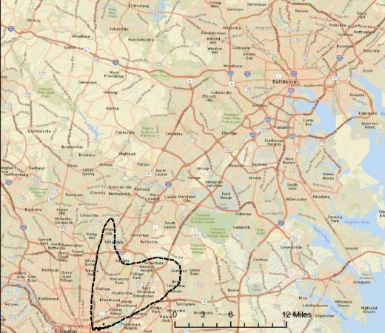
Regional Impacts Product
Lower-risk Area Shrinks With Time Due to Decay of Fallout Radioactivity
12 hours after detonation
24 hours after detonation
Lower-risk Precautionary Area:
Consider and weigh risks, benefits and costs of implementing precautions that reduce public exposure to fallout radiation
This area will shrink significantly each day
Focus initial protective actions on smaller, higher risk areas nearer the incident
2 days after detonation
4 days after detonation
Appropriate protective actions for the public are to be determined and directed by state and local public health and safety officials
Model based on 1kt yield
No measurements available yet
Population and areas are cumulative and include all smaller areas
Notes:
Comments to possibly still address: Do we want to pick the time step which shows MAXIMUM extent? First quadrant might be tailored to depict the maximum downwind extent (which will vary according to the ambient conditions at the time of the detonation) prior to the “shrinkage” of the downwind fallout zone (due to the rapid radiological decay of the fallout isotopes). The maximum downwind extent will not necessarily occur at 12 hours post-detonation.

Slide 23
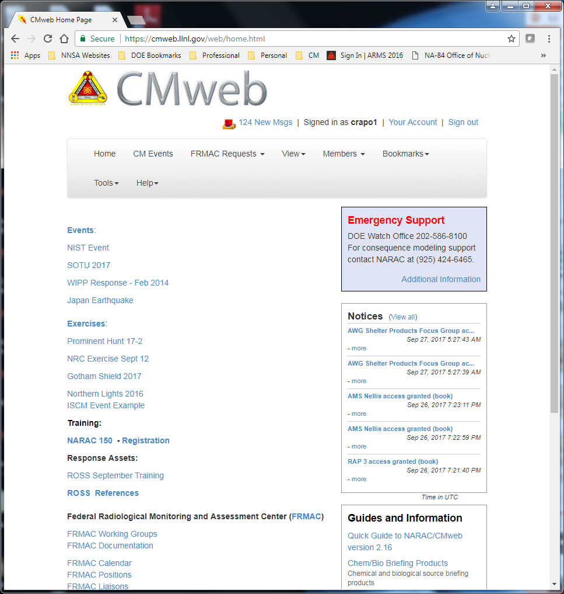
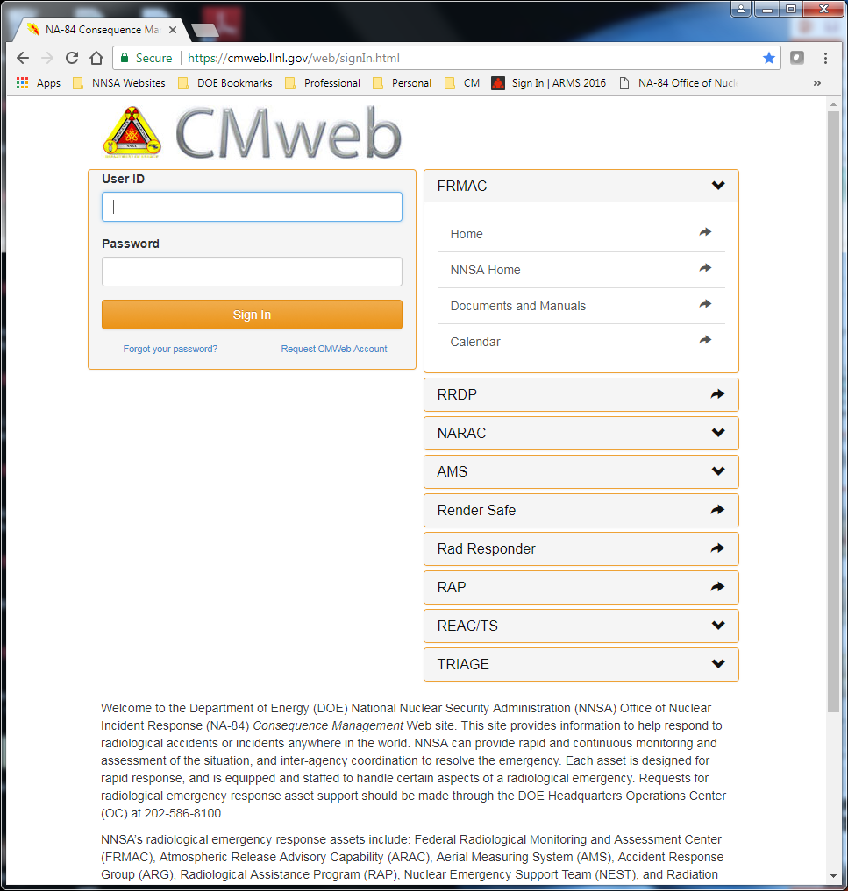
Distribution of Products
Notes:
Data ownership:
DOE will collect the data
The state/local organizations are ultimate owners and have say about sharing on the local level
Markings/Classification
In most cases CM responses are unclassified
In the rare cases where an upgrade of classification must be made considerations must be given about how to protect the data

Slide 24
How to Request Assistance
DOE Watch Office: 202-586-8100 (Primary)
Radiological Assistance Program Regional Offices:
Region 0 (Washington, DC): 1-800-405-1140
Region 1 (Brookhaven, NY): 1-631-344-2200
Region 2 (Oak Ridge, TN): 1-865-576-1005
Region 3 (Savannah River, GA): 1-803-725-3333
Region 4 (Albuquerque, NM): 1-505-845-4667
Region 5 (Chicago, IL): 1-630-252-4800
Region 6 (Idaho Falls, ID): 1-208-526-1515
Region 7 (Livermore, CA): 1-925-422-6306
Region 8 (Richland, WA): 1-509-373-3800
NARAC Operations: 1-925-424-6465
Notes:
All paths lead to FRMAC, there is no “right” or “wrong” way here

Slide 25
Additional Questions
Daniel Blumenthal
Daniel.Blumenthal@nnsa.doe.gov
202-287-5269
John Crapo
John.Crapo@nnsa.doe.gov
202-287-1035
Alvin Morris
Alvin.Morris@nnsa.doe.gov
702-794-1539

