Slide 1
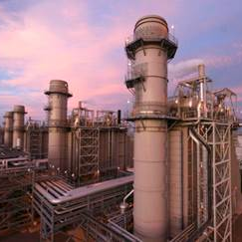
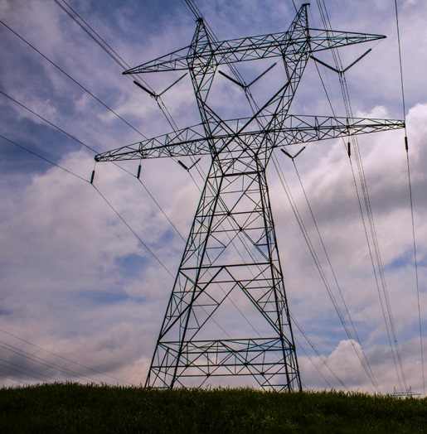
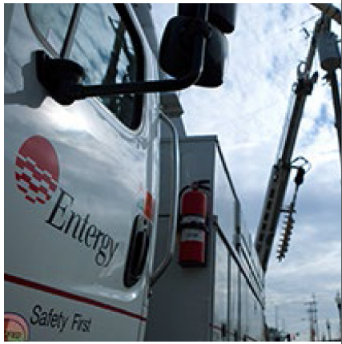
Decommissioning Planning –
Shutdown to Fuel on Pad
October 16, 2017
Jeff Wagner, PMP
Manager – Site Closure and Restoration
Nuclear Decommissioning Org.
Low-Level Radioactive Waste Forum
Alexandria, VA

Slide 2
Discussion Topics
Pre-Shutdown Planning
Engineering Analyses
Regulatory Changes
Facility Modifications
Organizational Changes
Accelerated Dry Fuel Storage

Slide 3
Pre-Shutdown Planning
Decommissioning Planning Organization (Shutdown – 12 months)
  12-15 Subject Matter Experts relieved of most station obligations and dedicated to planning
  Charged to the Nuclear Decommissioning Trust (3% planning costs)
  Establish plans, schedules, and budgets to transition the station from operation to decommissioning
  Planning horizon is all fuel on pad and Protected Area reconfigured to ISFSI footprint (3-5 years depending on site)
Governance and Oversight provided by the Nuclear Decommissioning Organization
  7 SMEs from VY DPO, 3 SMEs from Corporate work streams

Slide 4
Engineering Analyses
Zirconium Reduction Fire – Offsite Emergency Plan
Spent Fuel Pool Shine – Site Boundary Dose (Wet Fuel Storage)
Reactor Vessel and Internals Activation Analysis – Waste Classification and quantity of Greater-Than-Class-C Waste
ISFSI Shine Calculation – Site Boundary Dose (Fuel on Pad)
Final Safety Analysis Report/Decommissioning Safety Analysis Report Bounding Accidents
System Reclassification – Downgrade from Safety Class to Commercial Grade
Fire Hazard Analysis – Required fire detection/suppression systems
Program Simplification or Elimination – Maintenance Rule, Fire Protection, Etc.

Slide 5
Regulatory Changes
Approximately 45 Licensing Actions required several of which should be eliminated through Decommissioning Rulemaking
Early and continuing actions to establish Licensing Basis appropriate for the changing site configuration
Transition from Operational EPlan to Permanently Shutdown EPlan (Zirc Reduction Fire) to Permanently Defueled EPlan (eliminate off-site support requirements) to ISFSI Only EPlan
Security Plan changes to reflect changing conditions for Wet Fuel Storage Period and all fuel in ISFSI with reduced Protected Area
Transition from Final Safety Analysis Report to Decommissioning Safety Analysis Report
Transition from Corporate QAPM to Site Specific QAPM that reflects configuration of the station

Slide 6
Facility Modifications
Removal of non-essential buildings to optimize security response strategy. Allows drawdown of security force.
Abandon and drain systems to reduce energy, hazards, and environmental risks. Eliminate outside storage of radioactive water (Torus as surge volume for SFP eliminates need for 500K gallon above ground storage tank)
Eliminate need for redundant systems
Re-stack remaining staff to optimize building habitability needs
“Cool & Dim” excess buildings/work space.

Slide 7
Organizational Changes
Organizational Design/Staffing based on regulatory requirements, primarily EPlan and Security Plan
Culture Change from Operational Excellence to Protect the Environment and Prudent Financial Management
Detailed planning for Employee Transitions
  Retirement
  Absorption Planning
  Staffing Decommissioning Organizations
  Outplacement of voluntary/involuntary separations
Entergy Leadership consistently reinforced treating the employees with Respect and Dignity during each transition

Slide 8
Accelerated Dry Fuel Storage
Cask vendors have advanced their technology to the point where fuel can be placed in dry storage with approximately 2 years of cooling.
Majority of costs during Wet Fuel Storage period are labor with Security becoming the dominant cost after Zirc Reduction Fire period.
Accelerating dry fuel storage and Protected Area reconfiguration can result in significant savings.

