Slide 1
Clive 2017 Disposal Update presented by Dan Shrum October 16, 2017
LL Forum Meeting Alexandria, VA

Slide 2
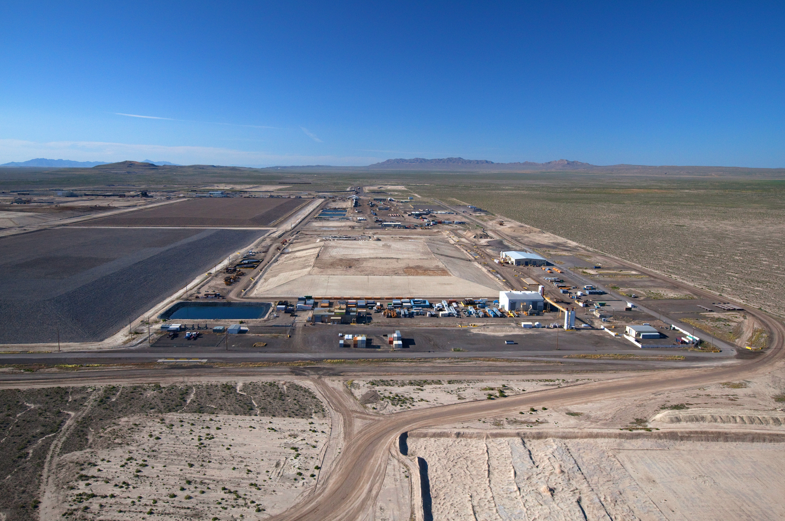
Clive Disposal Facility
World’s Largest Commercial Radioactive Waste Disposal Facility

Slide 3
Corporate Values
We always put Safety first
We build Trust by
  always telling the truth
  making our Customer’s success our success
  being the best in the World at what we do
  and delivering results
We care deeply about our Employees and want them to be happy and successful
We listen to our Internal and External Stakeholders and Partners

Slide 4

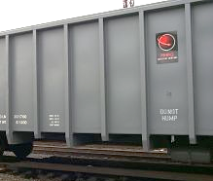
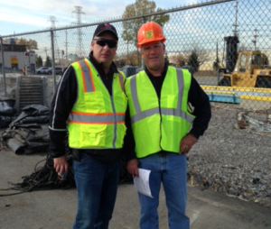
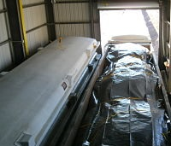
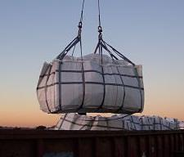
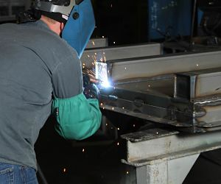
Safety
Industrial Safety
  Awarded VPP status on September 14, 2017
  Total Case Incident Rate = 0 since 2013 (below national average of 4.9)
  1,857,440 work hours since last Lost Workday case (November 2010)
  827,350 work hours since last OSHA Recordable Injury (October 2013)
  2010 through 2016 Annual NSC Awards for Safety
Radiation Safety
  ALARA - Average radiation worker individual TEDE 30.9 mrem/year
  Highest general public fence-line CEDE 0.03 mrem/year
  Highest general public effluent exposure dose 0.04 mrem/year

Slide 5
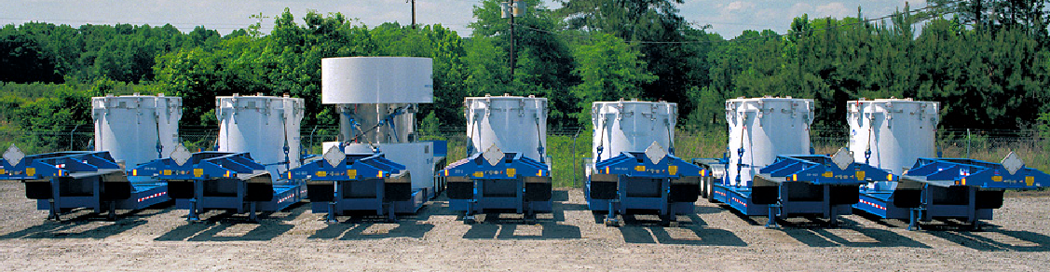
Proven Experience
Over 29 years of proven experience treating and disposing of radioactive waste
Unique bulk and containerized waste facilities
  Radioactive Material Licenses (LLRW & 11e(2))
  RCRA Permit (treatment & disposal of MW)
  TSCA Permit (PCB waste streams)
  SNM Exemption (concentration-based limits)
Over 11 miles of onsite rail for efficient and cost-effective waste handling
Long-term federal and commercial contracts

Slide 6
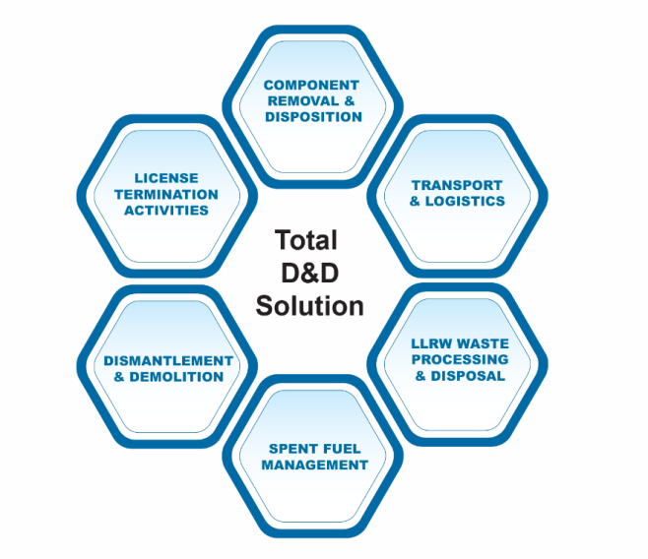
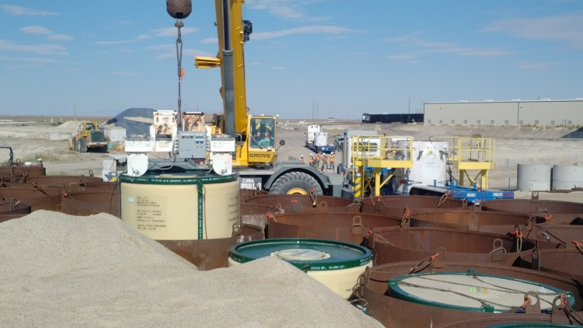
Decommissioning and Disposal
Decommissioning
  Zion License Stewardship
  LaCrosse Decommissioning
  SEFOR Decommissioning
  SONGS Decommissioning
Disposal
  Largest commercial radioactive waste disposal facility for Class A LLRW in the U.S.
  Operate the LLRW disposal facility in Barnwell, SC to dispose of Class A, B, and C LLRW from Atlantic Compact states

Slide 7
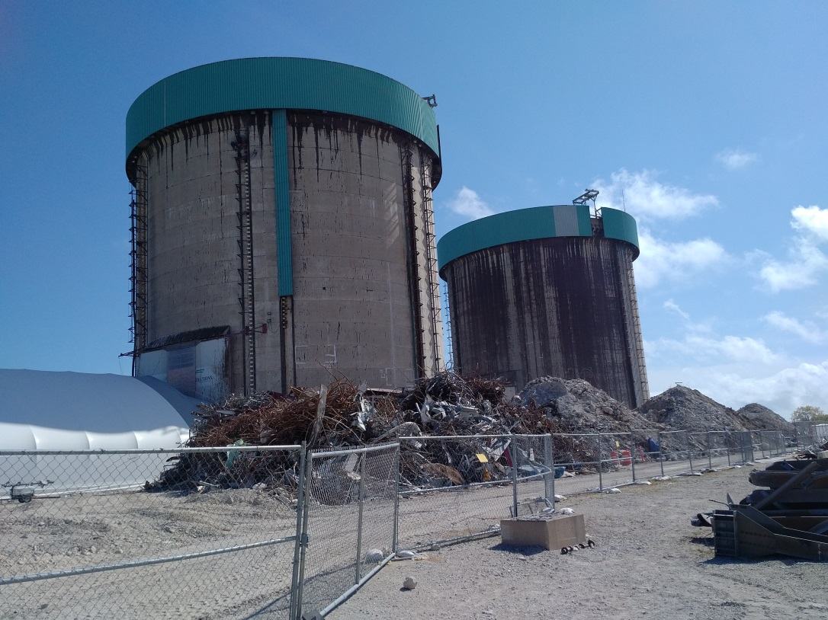
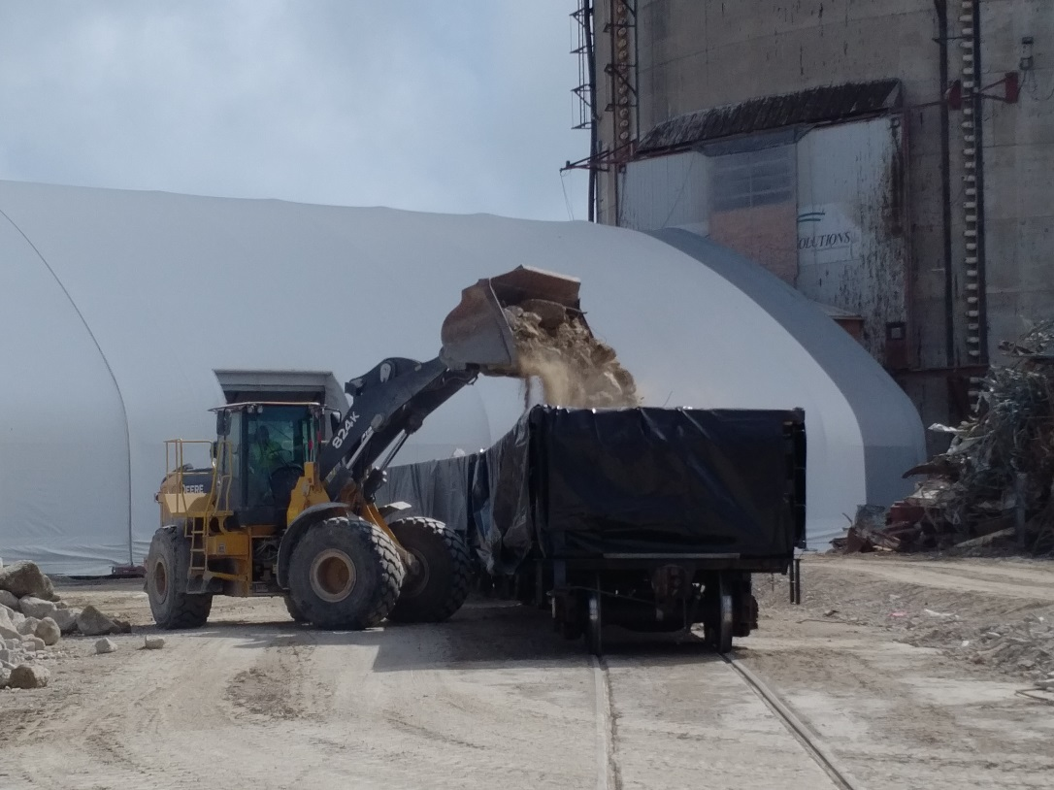
Zion Decommissioning

Slide 8
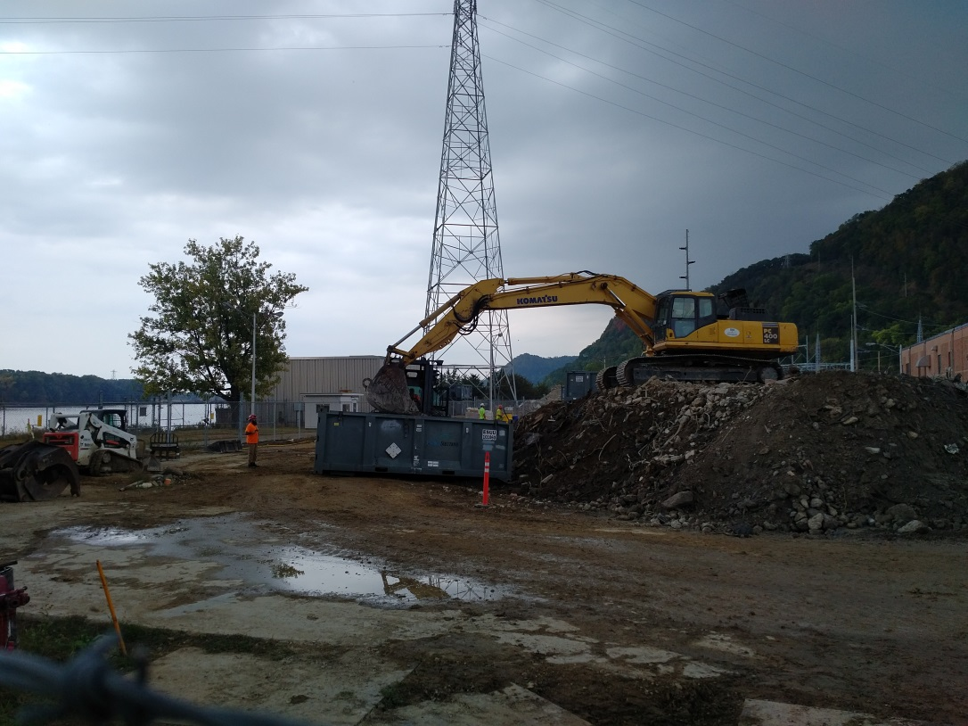
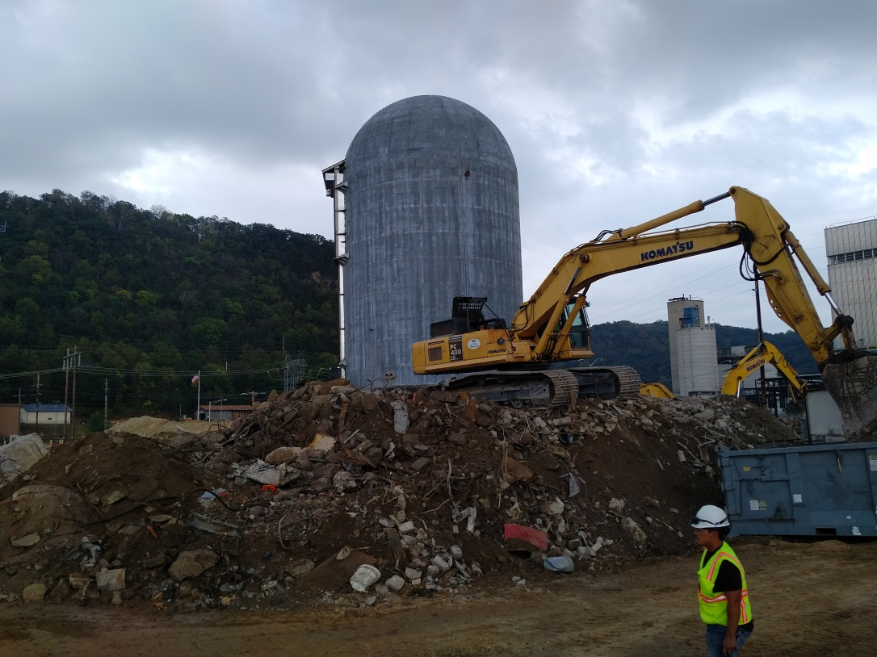
LaCrosse Decommissioning

Slide 9
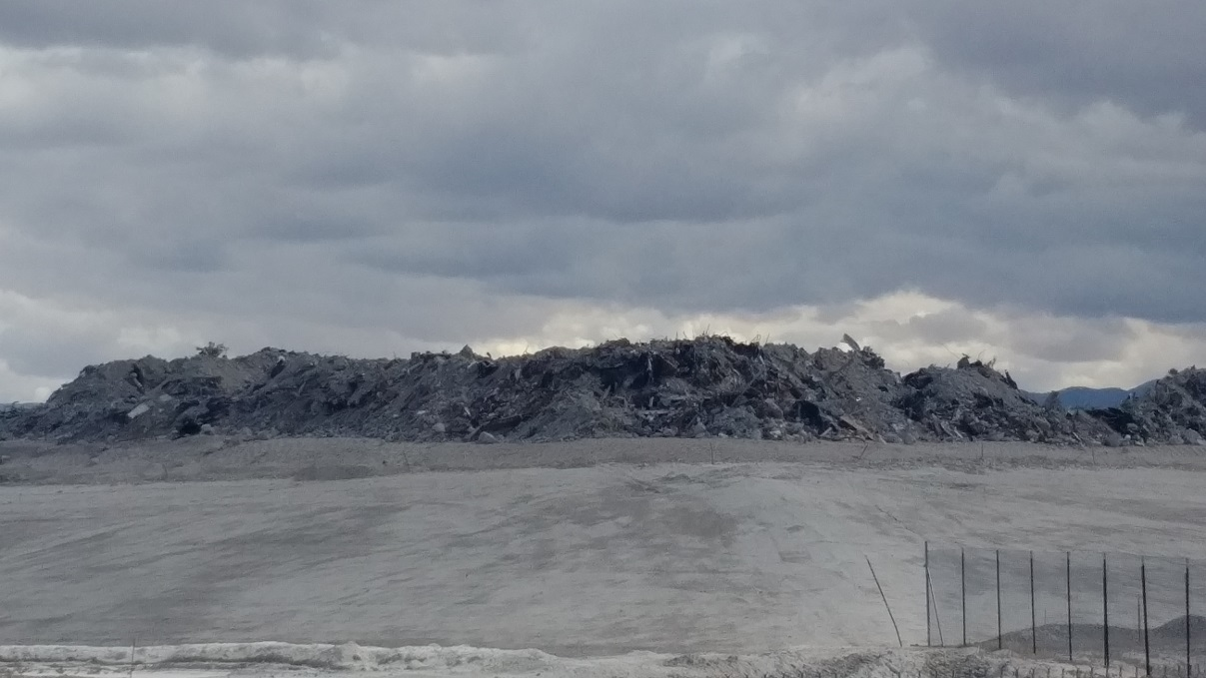
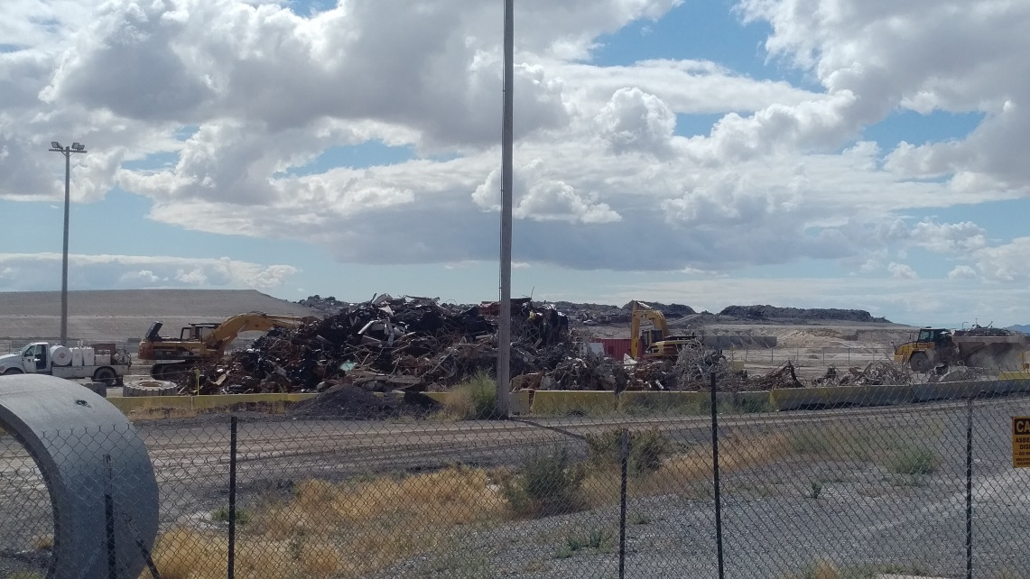
Decommissioning Waste

Slide 10
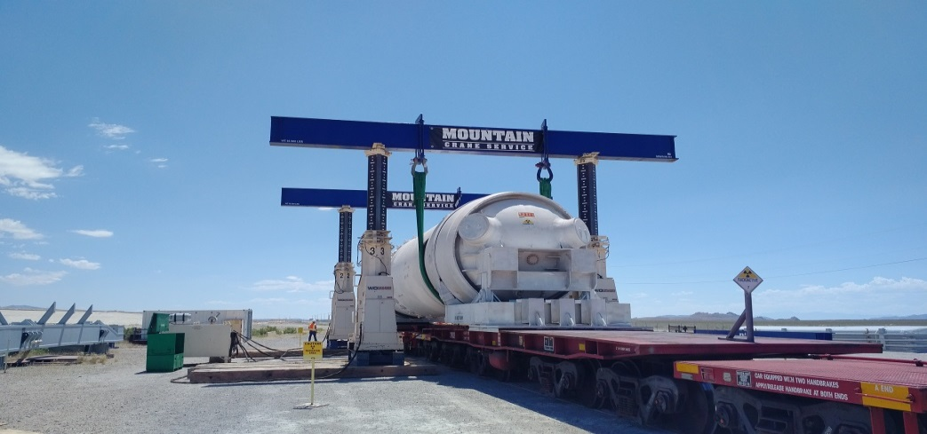
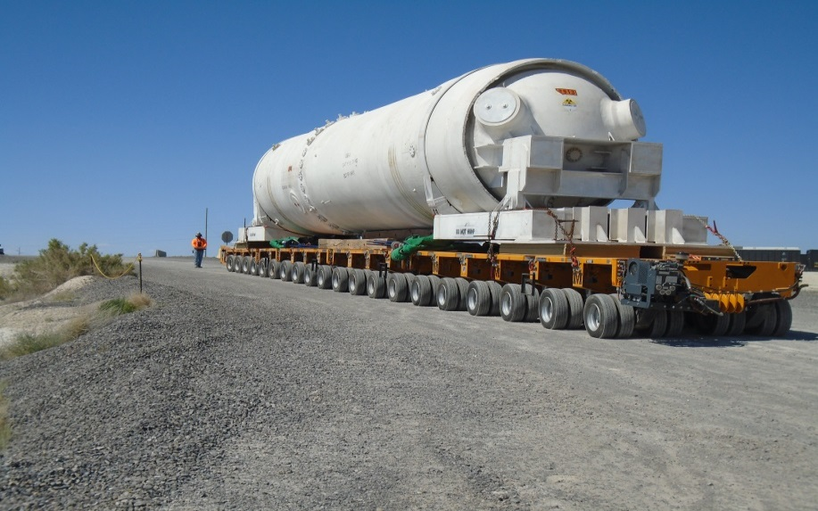
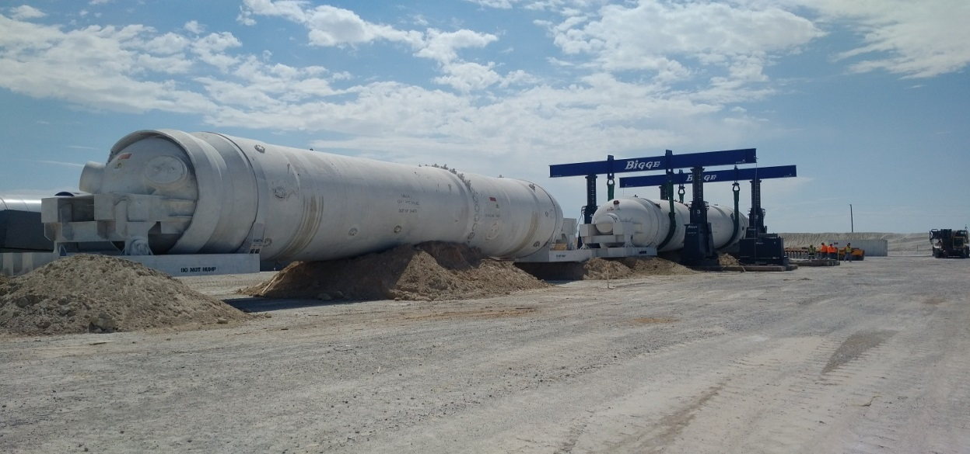
Large Component Disposal

Slide 11
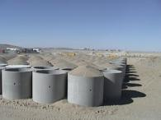
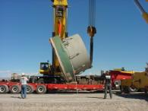
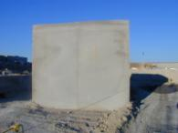
Licenses and Permit Status
RML 2300249 Low-Level
  Under “timely renewal”
  Renewal application Oct 2012
  Projected to be renewed January 2018
RML 2300478 11e.(2)
  Under “timely renewal”
  Renewal application March 2003
  Projected to be renewed Dec 2017 – currently out for public comment
State-issued Part B Permit
  Under “timely renewal”
  Renewal application Oct 2012
  Projected to be renewed December 2018 – in-cell Macro
GWQDP
  Active
  Renewed 2014

Slide 12
Clive’s Disposal Available Capacity
Proposed Federal
Cell
Class A West
(112,000,000 ft³)
11e.(2)
(92,600,000 ft³)
LARW
(closed)
VITRO
(closed)
Mixed Waste
(9,600,000 ft³)
North

Slide 13
Disposal Volume History

Slide 14
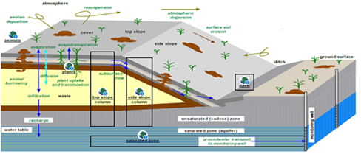
Depleted Uranium Authorization
Utah Moratorium passed June 1, 2010
  May not receive or dispose of significant quantities of concentrated DU until PA approved
  PA, revision 0 submitted June 2011
  PA, revision 4 submitted November 2015
Regulatory review underway
Decision projected for …….

Slide 15
WCS Acquisition
On June 21, 2017 the U.S. District Court for the District of Delaware announced its decision to block the acquisition of Waste Control Specialists (WCS) by EnergySolutions, Inc.
EnergySolutions maintains its belief that its acquisition of WCS would have been in the best interest of the long-term waste disposal needs for the nuclear industry.
EnergySolutions and the parent company of WCS decided to not appeal the Court’s decision and have terminated the purchase agreement.

Slide 16

EnergySolutions Conference

Slide 17
Thank You

