Slide 1
Leigh Ing, Executive Director
Presented at:
Low-Level Radioactive Waste Forum
Saratoga Springs, New York
November 2016

Slide 2
Presentation Overview
About our Compact
Imports and Exports Overview
Fillable Forms and Automating Our Process
The Management Rule
Workshops

Slide 3
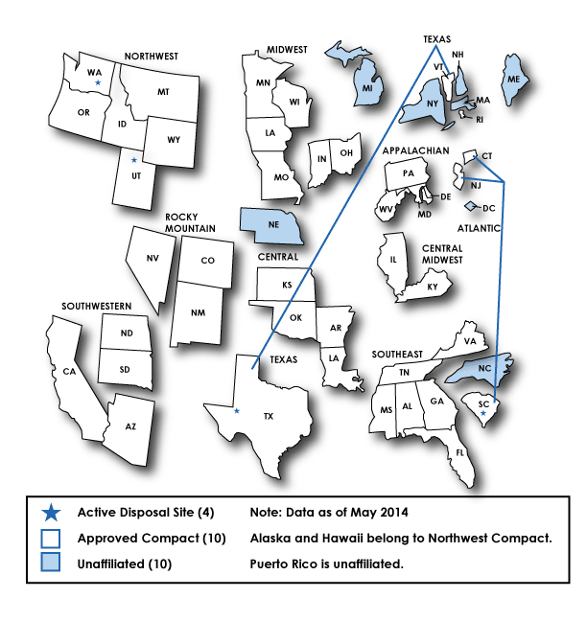
Low-Level Radioactive Waste Federal Compacts
http://www.nrc.gov/waste/llw-disposal/licensing/compacts.html

Slide 4
Texas Low-Level Radioactive Waste Disposal Compact Commission
In spite of the name, our compact includes the very important state of VERMONT.
In spite of the name, we are not a State of Texas agency.
The TLLRWDCC is a “legal entity separate and distinct from the party states…”
The TLLRWDCC must comply with its federal compact law.
We protect the capacity of the Compact Facility for Texas and Vermont generators.

Slide 5
What Our Compact Does Not Do
The Compact does not own or operate the Compact Facility; it is owned by State of Texas, operated by WCS.
The Compact does not set surcharges or charge fees of any type.
The Compact does not determine licensing requirements nor license the facility. The Texas Commission on Environmental Quality (TCEQ) licenses the Compact Facility and approves waste streams.

Slide 6
Outside Commission’s Purview
High Level Waste
Transuranic Waste
Greater Than Class C Waste
Spent Fuel Storage
NORM or TENORM
Site Operations at the Compact Waste Facility (TCEQ)
Waste Shipments (TCEQ & DSHS)

Slide 7
What Our Compact Does – Imports and Exports
Authorize imports and exports in alignment with Texas policy and law and ensure protection of capacity.
For imports, the Commission has developed an approach based on:
A policy to ensure maximum disposal of allowed Curies.
The need for flexibility based on the regulatory and industry hurdles generators/brokers encounter.
A need for a fair and unbiased allocation of Curie availability.
The Commission supports exports for good cause.

Slide 8
Imports
Given irradiated hardware gobbles up curies, the Commission will continue to approve import applications as it always has with the exception of irradiated hardware.
Irradiated hardware must be submitted as a separate import application.
All requests over 15,000 curies, if approved, will be issued conditionally.
Once the generator submits documentation that substantiates volume, curies and shipment date, the Commission will release conditionally authorized curies, if available. (first come-first serve)
The approach has been adopted as policy and is on our website.

Slide 9
Forms and Automation
The rules require the Import Application Form a.k.a. “Annex A” be used. It is currently available as a pdf on our web-site.
Our Export Application Form is available as a pdf on our web-site.
Our Generator Authorization Form is also available on our web-site.
We are beginning work to automate import and export processing. This will require the import and export forms to be fillable.

Slide 10
A Rule for Management of Low-Level Waste
Commissioner Morris chairs the committee to draft rules for management of low-level radioactive waste in our Compact.
These rules will have applicability in Vermont.
The scope of the rule will likely include only reporting requirements.
The rulemaking will include an informal comment period before instituting the formal process.

Slide 11
Compact Commission Workshops
The Compact conducted its first workshop in Burlington, VT in September. It was geared toward Vermont generators.
We are considering doing a similar workshop for Texas generators, particularly small generators.
We are considering workshops for larger generators as may be needed.

Slide 12
The Texas Compact Commissioners
Chair, Brandon Hurley- TX
Vice-Chair, John Salsman– TX
Peter Bradford – VT
Judge Richard Dolgener - TX
Linda Morris – TX
Richard Saudek – VT
Clint Weber – TX
Robert C. Wilson - TX
Jane O’Meara Sanders – VT Alternate

Slide 13
http://www.tllrwdcc.org/
Leigh Ing, Executive Director : 512-217-8045
Andrew Tachovsky, Deputy Executive Director: 512-791-7576
leigh.ing@tllrwdcc.org or andrew.tachovsky@tllrwdcc.org

