Slide 1
NRC’s 10 CFR Part 37 Program Review of Radioactive Source Security
Duncan White
Office of Nuclear Materials Safety and Safeguards
November 8, 2016

Slide 2
Background for Program Review
Section 403 of Public Law 113-235, “Consolidated and Further Continuing Appropriations Act, 2015,” December 2014
GAO-12-925, “Nuclear Nonproliferation: Additional Actions Needed to Improve Security of Radiological Sources at U.S. Medical Facilities,” September 2012
GAO-14-293, “Nuclear Nonproliferation: Additional Actions Needed to Increase the Security of U.S. Industrial Radiological Sources,” June 2014
SECY-16-0021, “Discontinuation of Rulemaking Activities,” February 2016

Slide 3
Program Review Areas
Inspection results - first 2 years of rule implementation
Nuclear Material Events Database & Security Incident Database
Trustworthiness and reliability program
Aggregation definition as it applies to well-logging sources
Adequacy of NRC and Agreement State inspector training
Enhanced tracking and accounting of radioactive sources
International Regulations and Standards
Independent Assessment
Public Outreach

Slide 4
Inspection Results First Two Years of Rule implementation
Reviewed the number, type, and severity of findings identified and reviewed them to identify trends indicative of a need to enhance the rule, guidance, or take other action (e.g., issuance of a generic communication)

Slide 5
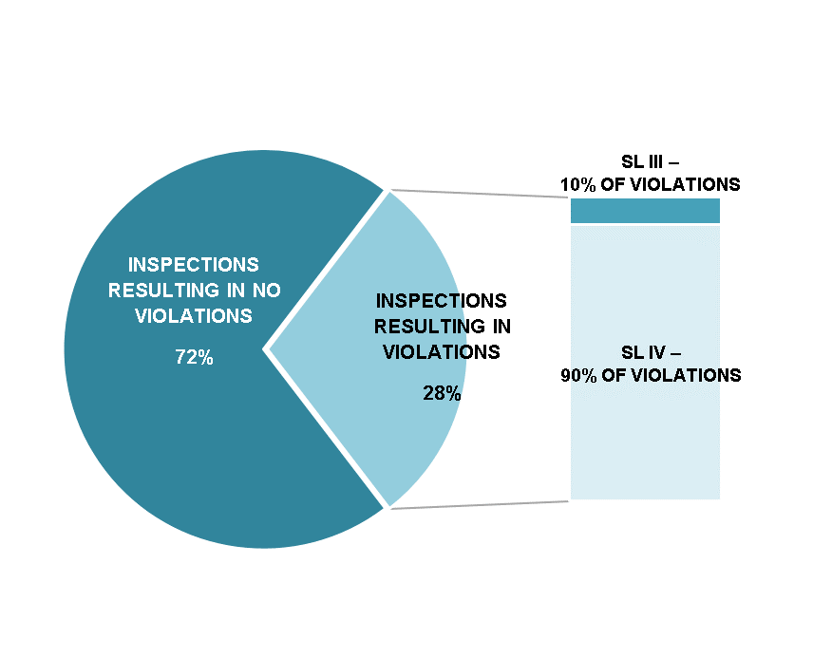
In-depth Analysis of Inspections Conducted
NRC Enforcement Actions:
10 CFR Part 37 Oversight (march 2014-March 2016)

Slide 6
Part 37 Violations Breakdown March 2014 – March 2016

Slide 7
Most Frequent Violations
37.23(f) Access Authorization Procedures
Licensee must develop, implement, and maintain access authorization procedures
37.43(b) Security Program Procedures
Must develop and maintain written security procedures
Documents how physical protection requirements of Subpart C and security plan will be met

Slide 8
Enforcement
Overall, good performance
Majority of violations were administrative
Implementation challenges
Licensees still meeting the Increased Controls requirements and failing to document how the program meets Part 37

Slide 9
Nuclear Material Events Database (NMED) & Security Incident Database (SID)
Evaluated theft and diversion incidents since issuance of the Orders for gaps in the rule
Analyzed other reportable events, e.g., “lost in shipping,” to assess potential security nexus

Slide 10
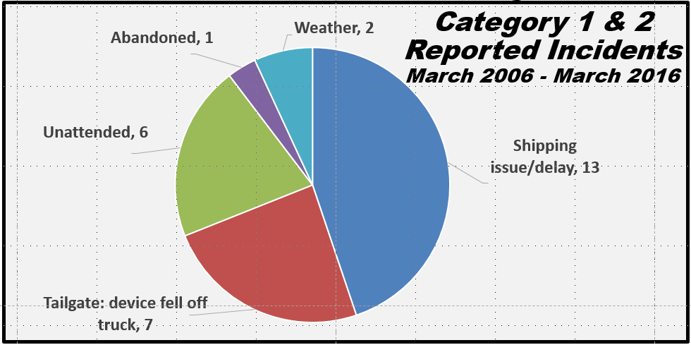
No Gap in Security Regulations Based on Non-theft Event Evaluation
10
10
Notes:
10

Slide 11
Trustworthiness and Reliability (T&R) Program
Assessed process to approve unescorted access to Category 1 and 2 radioactive material
Evaluated if T&R process provides reasonable assurance against insider threats (NRC commitment in GAO-14-293)
Considered revision of the T&R process to provide specific guidance to licensees on how to review an employee’s background
Reviewed disqualification factors in federal regulations
Bureau of Alcohol, Tobacco, Firearms and Explosives
Centers for Disease Control and Prevention
Transportation Security Agency
Issued TI 2800/042, “Evaluation of Trustworthiness and Reliability Determinations,” to gather information to determine T&R program adequacy

Slide 12
Aggregation Definition: Well-logging Sources
Reviewed aggregation definition for sources stored in single storage area and secured separately (Recommendation in GAO-14-293)
Evaluated licensee storage of sources and inspector experience with aggregation of sources
Reviewed “Checklist to Address Requests for Risk-Significant Radioactive Material”

Slide 13
NRC and Agreement State Inspector Training
Examined effectiveness of qualification program to prepare inspectors to conduct materials security inspections

Slide 14
Enhanced Tracking and Accounting of Radioactive Sources
Evaluated possible enhancements to the tracking and accounting of radioactive materials
Assessed stakeholder feedback and results of a marketing firm survey

Slide 15
Regulatory Comparison with International Standards and Guidance
Reviewed national material security guidance and requirements from IAEA, Australia, Canada, Finland, France, and Spain
Evaluated differences between Part 37 and other nations and the IAEA security programs

Slide 16
Independent Consultants
Evaluated the clarity of the rule and guidance, and reviewed past radioactive materials events and incidents
Evaluated the NRC’s early implementation (i.e., rollout) of Part 37
Evaluated the completeness and thoroughness of the staff’s assessment

Slide 17
Stakeholder Outreach
Published Federal Register notice (81 FR 13263) with questions
Conducted 4 webinars and a public meeting
Issued questionnaires and conducted interviews with stakeholders
NRC and Agreement State staff
8 Federal licensees and 9 non-Federal NRC licensees (8 of each of the licensees were interviewed)
National Nuclear Security Administration

Slide 18
Conclusions
Specific areas were identified to further enhance the clarity of the regulations and licensees’ implementation of security measures
Revisions to the rule
Revision of guidance
Enhanced communication efforts with licensees

Slide 19
Response to Congress
Commission Paper
Draft Congressional Report Regarding the Effectiveness of Part 37 of Title 10 of the Code of Federal Regulation (Enclosure 1),
Summary Report: NRC Staff Program Review of 10 CFR Part 37 (Enclosure 2)
Due to Congress on December 16, 2016

