Slide 1
Emergency Preparedness During Decommissioning
David Daigle
Project Manager/Emergency Preparedness Specialist
Fall 2016 Low-Level Radioactive Waste Forum
Saratoga Springs, New York
November 7, 2016

Slide 2
Overview of the EP Transition
Previous Licensing Actions
Transition process has evolved to include:
Post-Shutdown License Amendment Request (LAR)
Permanently Defueled LAR
Regulatory Exemption Request (Based on precedent from above plants)
ISFSI-Only Emergency Plan LAR
Humboldt Bay – 7/2/1976 | Trojan – 11/2/1992
La Crosse – 4/30/1987 | Haddam Neck – 7/22/1996
Rancho Seco – 6/7/1989 | Maine Yankee – 12/6/1996
Fort St. Vrain – 8/18/1989 | Zion – 2/21/1997
Yankee Rowe – 10/1/1991 | Big Rock Point – 8/29/1997

Slide 3
Recent and Announced Shutdowns
2013
Kewaunee / Crystal River Unit 3 / San Onofre Units 2 & 3
2014
Vermont Yankee
2016
Fort Calhoun
2017
FitzPatrick / Clinton
2018
Quad Cities Units 1 & 2
2019
Pilgrim / Oyster Creek
2024-2025
Diablo Canyon Units 1 & 2

Slide 4
Decommissioning Emergency Plans
Objective
Continue to maintain public health and safety
While also…
Maximizing use of decommissioning funds
How are these objectives met?
The scope of the Emergency Plan is commensurate with the radiological risk at each phase of the transition

Slide 5
Example Staffing Reductions

Slide 6
Difficulties
Emergency Planning regulations do not distinguish between an operating plant and a permanently shutdown plant
Over 15 years since last plant shutdown
Absence of existing guidance
Regulatory exemption criteria
September 11 and Fukushima
Stewardship of the decommissioning trust fund

Slide 7
Emergency Plan Transition
Post-Shutdown
Emergency Plan
Permanently Defueled
Emergency Plan
ISFSI-Only Emergency Plan
PSEP
PDEP*
IOEP
Approximately 16 - 18 Months
Fuel Transfer to ISFSI
Reactor Permanently Defueled
Zirc Fire Milestone
All Fuel in ISFSI
* Implementation of the PDEP is based on NRC approval of Regulatory Exemption requests.

Slide 8
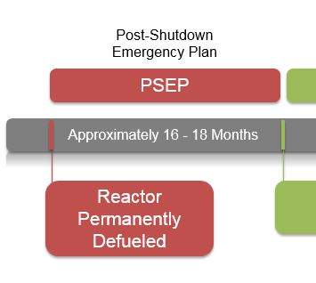
Post-Shutdown Emergency Plan
Continue to meet regulatory requirements for an operating plant
On-shift staffing changes
Emergency Response Organization staffing (ERO) changes
Evaluation of potential impact on Offsite Response Organizations (OROs)
Emergency Action Level (EAL) changes can be addressed in this submittal or in a separate request
Notes:
On-Shift Staffing Changes
Staffing is reduced from normal operating levels to levels needed to safely store spent fuel at the facility
Primary justification is provided by an on-shift staffing analysis
Able to cope with the spectrum of remaining credible events
B.5.b/10 CFR 50.54(hh)(2) SFP inventory makeup strategies are required until all spent fuel is transferred to dry storage
On-shift staff typically consists of 3 personnel:
Shift Manager
Non-Certified Operator
Radiation Protection Technician
ERO Shift Staffing Changes
ERO Task Analysis
Is a specific task still required?
Is the position performing a required task being eliminated?
If so, which remaining position will perform the task?
ERO typically consists of two (2) augmented responders within two (2) hours of an Alert
Technical Coordinator
Radiation Protection Coordinator
Impact on ORO
Objective evidence that proposed changes will not impact the licensee’s ability to interface with State and local officials or impact the ability of the State and local agencies to implement their emergency plans
Documentation of discussions with State and local officials
Not concurrence unless the proposed changes impact the offsite REP plans
If REP plans are impacted, then FEMA review is needed
EAL Changes
Licensees will continue to use a standard EAL scheme
Their operating plant EAL current scheme will be modified to reflect the permanently defueled condition
Changes would be limited to those that reflect:
Operating Modes that are no longer applicable
Plant Conditions that are no longer applicable
Equipment that is no longer required

Slide 9
Pre-Implementation Drill
OROs should be provided the opportunity to participate in the validation drills
NRC and FEMA provided an opportunity to observe

Slide 10
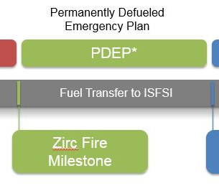
Regulatory Exemptions
From 10 CFR 50.47 and Appendix E
NSIR/DPR-ISG-02, “Emergency Planning Exemption Requests for Decommissioning Nuclear Power Plants”
Traditional accidents that dominate operating plant risk are no longer applicable
Risk to public is primarily associated with the spent fuel stored in the Spent Fuel Pool (SFP)
Risk of a SFP accident is lower than accident risk in an operating plant
Accident Analyses
Notes:
ISG-02 Provides guidance to NRC staff on requests for exemptions and review of changes to the Emergency Plan reflecting the exemptions, as granted
SFP at atmospheric pressure
Fuel is subcritical
Heat source is low
Emergency Planning regulations do not distinguish between an operating plant and a permanently shutdown plant
Accident Analyses
Remaining Applicable Design Basis Accidents
Typically a Fuel Handling Accident in the SFP
Adiabatic Heat Up Analysis
>10 hours is available before any fuel cladding temperature reaches 900ºC from the time all cooling is lost
Loss of SFP Water Inventory
Results in radiation exposure at the Exclusion Area Boundary and Control Room
Site-Specific Seismic Hazard Assessment
Evaluation demonstrating a high confidence of a low probability of seismic failure of the SFP, or
Analysis demonstrating natural air flow is sufficient in a completely drained pool to maintain peak cladding temperature below 565 degrees Celsius

Slide 11
Permanently Defueled Emergency Plan
Operating Reactor(s) | Decommissioning Site
Focused on response to a variety of emergencies related to an operating reactor | Focused on SFP events (permanently shutdown/defueled reactor)
Formal offsite REP plans Emergency Planning Zone Alert and Notification System | Comprehensive (all hazards) planning Coordination with firefighting, medical, law enforcement responding onsite
Event Classification Unusual Event, Alert, Site Area Emergency, General Emergency | Event Classification Unusual Event, Alert
Notification of Event Declaration 15 minutes (State and local) | Notification of Event Declaration Prompt (designated agencies)
Dedicated on-and offsite facilities | Onsite “Command Center”
Joint, biennial exercises | Onsite biennial exercise OROs invited to participate
Notes:
Implements exemptions, as approved by the NRC
No additional analyses is needed to support the PDEP beyond what would be provided to the NRC in the EP Exemption Request
Elimination of EPZs
No prompt alert and notification system
No evacuation time estimates
No periodic public information
No potassium iodide
No offsite pre-planned protective actions
No 15 minute notification time requirement
Emergency Classifications
Limited to Unusual Event and Alert
No 15 minute classification time requirement
Elimination of Emergency Response Facilities
No Emergency Operations facility
No Technical Support Center
No Operational Support Center
No alternate facilities
Emergency Exercises
No offsite participation biennial exercise
No submittal of exercise scenarios
No 8-year exercise cycle requirements
No wide-spectrum of events including hostile action requirement
Hostile Action Requirements
No alternate facility
No hostile action exercise
No onsite protective actions for hostile action
Some EP requirements for security-based events are maintained
Security EALs are maintained
Licensees are required to maintain the SFP mitigation strategies

Slide 12
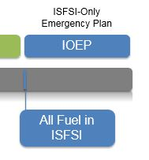
ISFSI-Only Emergency Plan
Continues to meet regulatory requirements, as previously exempted
Requirements similar to those required by Part 72.32(a)
No additional exemptions are required
Emergency Plan address the permanent removal of fuel from the SFP to dry cask storage
Changes to on-shift and ERO staffing
EALs for ISFSI only
Notes:
Staffing Changes
Reduced from normal operating conditions to levels commensurate with the need to store spent fuel
On-Shift Staffing is typically reduced to an ISFSI Shift Supervisor (ISS)
ERO typically consists of:
1. Resource Manager
In contact with ISS/Emergency Director within two (2) hours of an Alert declaration
Assists in assessing the emergency condition and coordinating resources
Response can be accomplished remotely
2. Individual trained in radiological monitoring and assessment
Reports to ISFSI within four (4) hours of an emergency declaration for an event involving radiological consequences
EAL Changes
Eliminate EALs associated with:
SFP operation
Radiological effluents not associated with the ISFSI
Administrative controls would be established during dismantlement activities
Security conditions associated with aircraft

Slide 13
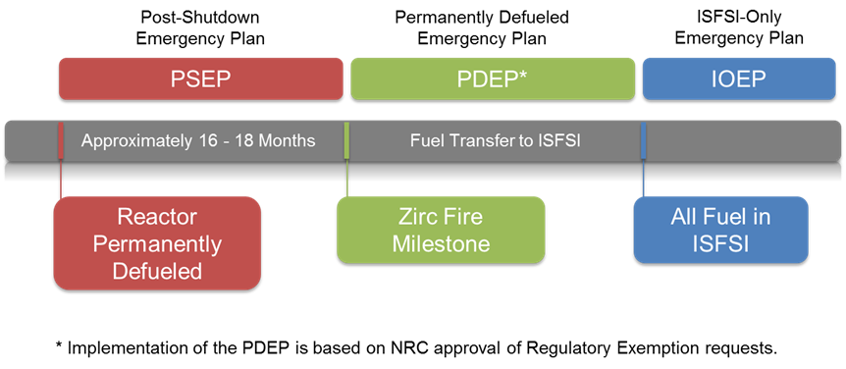
Summary
Transition Consists of:
Post-Shutdown Emergency Plan
Permanently Defueled Emergency Plan
Based on NRC-approved regulatory exemptions
ISFSI-Only Emergency Plan

Slide 14
Questions
David Daigle
Project Manager/
Emergency Preparedness Specialist
(813) 962-1800 ext. 602
ddaigle@enercon.com

