Slide 1
Nuclear Power Plant Decommissioning
Transition from Operations to Decommissioned Status
Janet R. Schlueter
Senior Director, Radiation and Materials Safety
Nuclear Energy Institute
LLW Forum Meeting, Park City, UT
April 2016

Slide 2
Overview
Decommissioning and its Phases
Current Plant Status and Licensing Actions
NRC’s Advanced Notice of Proposed Rulemaking and Industry Position
Decommissioning Wastes
Conclusions

Slide 3
Decision to Decommission
Decision to Permanently Cease Operations Requires Plant be Decommissioned by:
  Removing it from Service
  Cleaning Radioactively Contaminated Plant Systems and Structures
  Removing Nuclear Fuel from Reactor Vessel and Typically Storing it on Site
  Reducing Residual Radioactivity to Permit Termination of Operating License

Slide 4
3 Phases of Decommissioning
Initial Activities:
Submit Written Certification to NRC:
  Within 30 Days of Licensee Decision to Permanently Cease Operations
  When Nuclear Fuel is Permanently Removed from Reactor Vessel
  Within 2 Years of Submitting Closure Certification, Submit a Post-Shutdown Decommissioning Activities Report (PSDAR)
Major Decommissioning Activities:
Licensee May Begin Major Decommissioning Activities--Without Specific NRC Prior Approval--90 Days After NRC Receives PSDAR

Slide 5
3 Phases of Decommissioning (continued)
License Termination Activities:
Submit License Termination Plan Within 2 Years of License Termination Date as Estimated by Licensee. Plan Must Address:
  Site Characterization
  Remaining Site Dismantlement Activities
  Site Remediation Radiation Surveys Prior to Site Release
  Updated Estimates of Remaining Decommissioning Costs
  Supplemental Information to Environmental Report

Slide 6
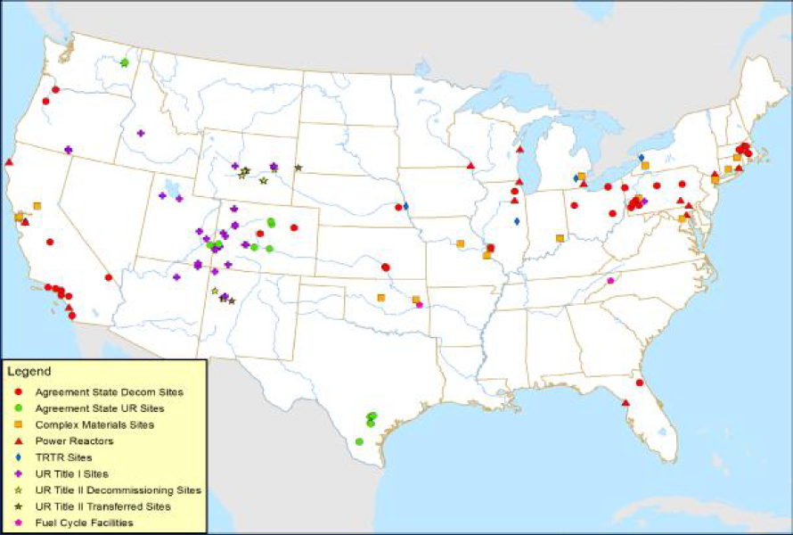
Decommissioning Status
10 power reactors completed decommissioning
  Between 1995 and 2009
18 power reactors currently undergoing decommissioning
  13 in SAFSTOR
    Including Crystal River 3, Kewaunee, & Vermont Yankee
  5 in Active DECON
    Humboldt Bay, Zion 1&2, and SONGS 2&3
3 announced near-term shutdown
  Fitzpatrick in early 2017
  Pilgrim by June 1, 2019
  Oyster Creek in December, 2019
5 power reactors shut down
  Since 2013
  Crystal River 3, Kewaunee, & Vermont Yankee, and SONGS 2&3
  These plants encountering an uncertain regulatory environment
  NRC and Industry are working to improve regulatory predictability

Slide 7
Licensing Actions
Exemptions and/or License Amendments are Required When:
Transition Points | What is Transitioning
Permanently Defueled | Emergency Preparedness (EP), Security, Work Hours, Staffing/Training, Use of Trust Fund for Spent Fuel Expenses
Permanently Defueled – with qualifying SFP analysis | EP, Insurance
All Fuel in Dry Storage | EP, Security, Staffing/Training, Foreign Ownership
All Fuel Removed from Site | EP, Security

Slide 8
Exemptions and Rulemaking
Numerous Exemption Requests to NRC
Exemption Process is Burdensome and Costly
  12-18 Months Each to Complete (>$1.5M) + Unnecessary Compliance Costs (>$1M/Month)
NRC’s Advance Notice of Proposed Rulemaking (Nov 2015) on Regulatory Improvements for Plant Decommissioning
  Scope Too Broad; Timeline Too Long

Slide 9
Timeline
Kewaunee Closes
San Onofre
Closes
Planned Closures
of Fitzpatrick, Pilgrim,
and Oyster Creek
Crystal River Closes
Vermont Yankee Closes
2013
2014
2015
2016
2017
2018
2019
NRC’s Current Rulemaking Target
Commission directs staff to complete Decommissioning Rulemaking by 2019
NEI Requests staff release SECY responding to Commission
ANPR responses (3/18/16)
NRC ANPR considers broad scope rulemaking
NEI requests targeted scope rulemaking
SECY released – staff says schedule “challenging”

Slide 10
Industry Position on ANPR
NRC Should:
  Focus Resources on Timely Issue Resolution for Plants Currently in Transition
  Pursue Limited Scope Rulemaking to Address Only Current Transition Inefficiencies and to Provide More Predictable and Stable Regulatory Framework
    Granted Exemptions and License Amendments Could Provide Regulatory Basis
NEI Provided Detailed, Limited Scope Rulemaking Proposal in its March 18, 2016 Comment Letter

Slide 11
Decommissioning Wastes
Much of Decommissioning Wastes is Likely Not Contaminated
Radioactive Wastes Might be Analyzed Onsite or Shipped Offsite to Licensed Facilities for Further Analysis, Processing, Conditioning, Packaging and Transportation
Four Licensed Burial Sites Available for Commercial Low-Level Radioactive Waste Disposal

Slide 12
Estimated Waste Volumes (cu. ft.)
Plant | Class A | Class B | Class C | GTCC
PNL Reference PWR* | 626,000 | 215 | 18 | 133
Kewaunee | 133,498 | 2,207 | 341 | 58
SONGS 2&3 | 3,652,641 | 15,200 | 8,190 | 1,882
Crystal River 3 | 136,858 | 876 | 462 | 1,785
Vermont Yankee | 664,829 | 1,002 | 505 | 357
* “Technology, Safety, and Costs of Decommissioning a Reference Pressurized Water Reactor Power Station” Pacific Northwest Laboratory, September 1984.

Slide 13
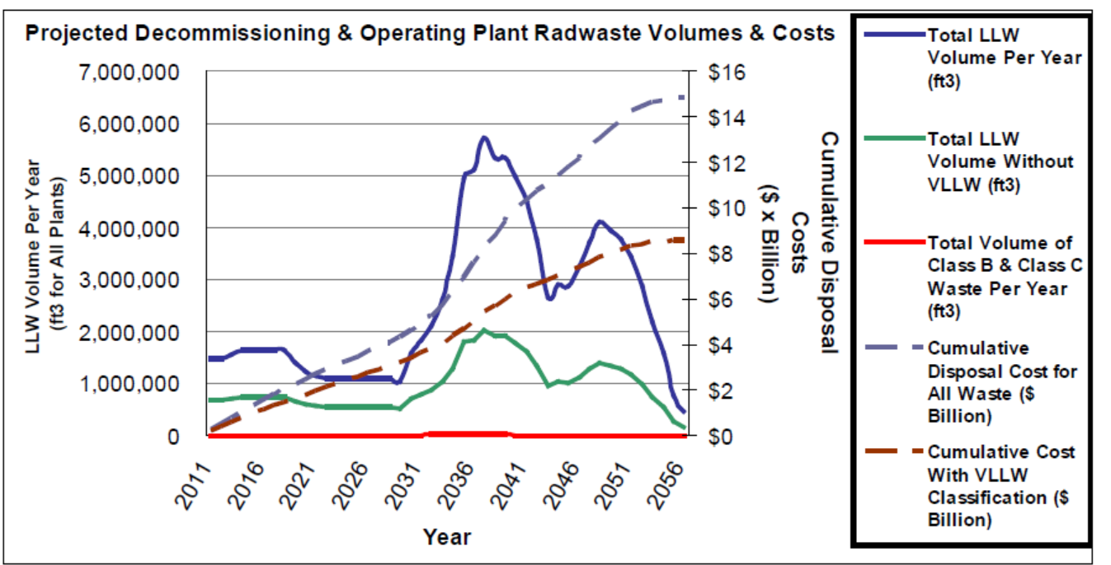
Projected Decommissioning & Operating Plant Radioactive Waste Volumes & Costs (ref: EPRI)

Slide 14
Conclusions
Decommissioning is Part of Nuclear Plant Life Cycle and Radioactive Wastes Generated are Safely Managed
18 Plants in Process of Decommissioning and 3 More Announced Near-Term Shutdowns
Limited Scope Rulemaking is Needed to Provide Regulatory Stability and Predictability, and Facilitate More Effective and Efficient Decommissioning Process

Slide 15
THANK YOU
Questions?

