Slide 1
Fall Low Level Waste Forum Meeting
Comments and Input
on NRC’s New Proposed Part 61 Rule
Chicago, Illinois
October 22, 2015

Slide 2
Background
The Low-Level Radioactive Waste Forum is a non-profit organization of representatives appointed by Governors and compact commissions that seeks to facilitate state and compact implementation of the Low-Level Radioactive Waste Policy Act of 1980 and its 1985 amendments, as well as to promote the objectives of regional low-level radioactive waste disposal compacts.
In 2012, the LLW Forum formed the Part 61 Working Group (P61WG), which is comprised of representatives from the four sited-states of South Carolina, Texas, Utah and Washington, as well as a representative from the Commonwealth of Pennsylvania.
The Working Group developed and submitted 56 comments in July 2015.

Slide 3
Working Group Members
Brad Broussard – Radioactive Materials Division, Texas Commission on Environmental Quality
Earl Fordham – Washington State Department of Health
Rich Janati – Pennsylvania Department of Environmental Protection
Susan Jenkins – South Carolina Department of Health and Environmental Control
Rusty Lundberg – Waste Management and Radiation Control Board, Utah Department of Environmental Quality

Slide 4
Important Area of Agreement
The P61WG agrees with statements made by the NRC during public meetings that the current 10 CFR Part 61 regulations ensure public health and safety at all of the currently operating commercial low-level radioactive waste disposal.

Slide 5
Federal Register Notice Statements:
“The regulations in 10 CFR Part 61 are risk-informed and performance-based, and ensure public health and safety are protected in the operation of any commercial LLRW disposal facility.”
“Regardless of whether the assumptions regarding the LLRW, operational practices, facility design, or site characteristics of the reference LLRW disposal facility are consistent with current facilities, the NRC believes that the 10 CFR Part 61 LLRW classification system remains protective of public health and safety for the LLRW streams that were analyzed in the development of the regulations because of the reasonably conservative nature of the analysis used to develop the LLRW classification system.”

Slide 6
Federal Register Notice Statements (continued):
“Because of the conservative nature of the assumptions used in the original 10 CFR Part 61 regulatory basis to develop the LLRW classification, the LLRW classification system is expected to be protective of public health and safety as long as LLRW disposal facilities operate within the regulatory basis of the original 10 CFR Part 61 regulations.”

Slide 7
The P61WG agrees with the following changes to 10 CFR Part 61 as proposed by NRC:
The 1,000-year technical analysis compliance period and explicit requirements for a site specific analysis using modern dose methods.
New site-specific technical analysis for the protection of inadvertent intruders that would include a 5 mSv/yr dose limit.
Providing licensees and regulators flexibility by allowing waste acceptance criteria to be developed using site-specific analysis.

Slide 8
The P61WG agrees with the following changes to 10 CFR Part 61 as proposed by NRC (Continued):
Use of the total effective dose equivalent in § 61.41 and the dose limit of 0.25 mSv/yr.
Allowing the use of the International Commission on Radiation Protection dose methodologies in a site-specific performance assessment.

Slide 9
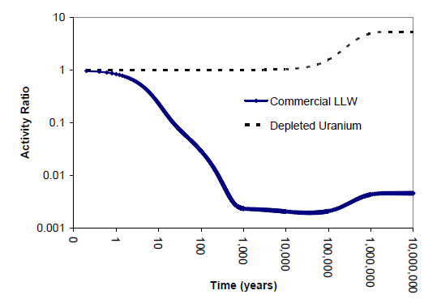
Waste Decay Characteristics
Requiring stability for 10,000 years at traditional sites seems excessive when you consider the waste will decay to approximately 1% in 500 years.

Slide 10
Proposed Alternative Approach The Part 61 Working Group member states of South Carolina, Utah, Pennsylvania and Washington recommend the following alternative approach:
Maintain current 10 CFR Part 61 regulations as written for traditional waste steams.
Develop a new stand-alone § 61.60 or a new Subpart H to address new unanticipated waste streams.

Slide 11
Reasons to Keep the Current Part 61 Regulations as Written for Traditional Waste Streams
NRC has stated that all four operating sites are in compliance with Part 61 and protective of public health and safety.
NRC believes that the 10 CFR Part 61 LLRW classification system is protective of public health and safety for traditional LLRW streams.
NRC’s belief that the proposed rule will balance the consideration of the risks from the disposal of large volumes of long-lived LLRW is not necessary for sites that only take traditional waste streams.

Slide 12
Reasons to Keep the Current Part 61 Regulations as Written for Traditional Waste Streams (Continued)
The current classification system establishes concentration limits for all of the LLRW sites and involves using an analysis that demonstrates the safe decay of waste within 500 years, using concentrations and quantity limits for long-lived isotopes.
The current system has been used successfully in this country and has the advantage of effectively mitigating the questions of long-term performance uncertainties.
NRC’s Integrated Materials Performance Evaluation Program audits found all sites adequate to protect the public health and safe.

Slide 13
Resource Web Page for Part 61WG http://part-61.org

Slide 14
Questions/Comments Contact Information:
Todd D. Lovinger, Esq. Project Director Part 61 Working Group
(754) 779-7551
Llwforuminc@aol.com
Gary Robertson
Technical Consultant
Part 61 Working Group
(360) 402-0370
glr0303@aol.com

