Slide 1
Status of Disposal Capabilities for Greater-Than-Class C (GTCC) Low-Level Radioactive Waste
Theresa J. Kliczewski
GTCC EIS Document Manager Office of Disposition Planning & Policy Office of Environmental Management
April 13, 2016

Slide 2
Relevant Legislative Drivers
Currently there is no disposal pathway for GTCC LLRW or GTCC-like
waste.
Congressional Mandate
Low-Level Radioactive Waste Policy Amendments Act of 1985 (Public Law #99-240)
Deems the Federal Government responsible for the disposal of LLRW with concentrations of radionuclides that exceed the limits established by the Nuclear Regulatory Commission (NRC) for Class C radioactive waste (e.g. GTCC LLRW). DOE was the agency that was later assigned that responsibility.
Requires disposal of GTCC LLRW at a facility licensed by NRC.
Energy Policy Act of 2005 (Public Law #109-58)
Requires DOE to submit a Report to Congress on the GTCC EIS disposal alternatives and await action by Congress before issuing a Record of Decision selecting a GTCC disposal alternative.

Slide 3
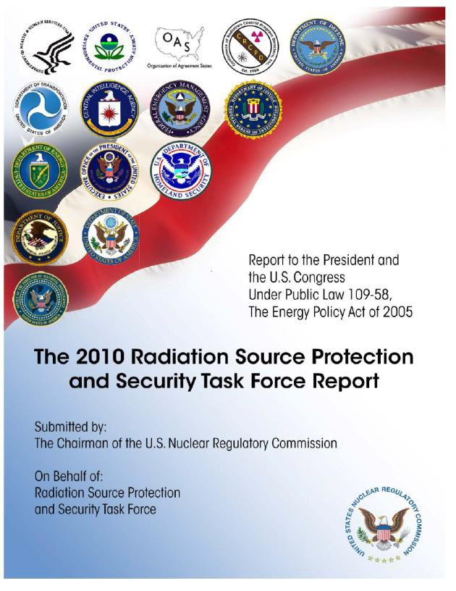
Other Drivers
Responds to National Security Concerns
Potential for disused sealed sources to be used in a radiological dispersal devices (e.g., dirty bomb)
Disposal need highlighted in Inter-Agency Task Force Reports on Radiation Source Protection and Secuirty to President Obama and Congress
Supports Future U.S. Programs
Medical isotope production (molybdenum-99)
Production of radioisotope power systems in support of space exploration (DOE NE’s plutonium-238 project)
Provides Environmental Stewardship
Statutory mission and DOE cleanup commitments for the West Valley Site in New York

Slide 4
Overview: GTCC LLRW Waste &
GTCC-Like Waste
GTCC LLRW:
o A formal, defined waste classification in federal law and regulations
Generated from Nuclear Regulatory Commission (NRC) or Agreement State licensed activities
The most hazardous class of LLRW as defined by the NRC in 10 CFR 61
…“waste that is not generally acceptable for near-surface disposal… for which form and disposal methods must be different, and in general more stringent, than those specified for Class C waste”
Must be disposed of in a geologic repository, as defined by NRC, unless proposals for disposal in a site licensed pursuant to 10 CFR 61 are approved by the Commission
GTCC-Like Waste:
Not a formal waste classification by rule or DOE order; rather, a descriptive category created for purposes of the EIS
DOE owned or generated LLRW or transuranic (TRU) waste with
characteristics similar to GTCC LLRW and with no identified disposal path
Primarily non-defense TRU waste from clean up activities at the West Valley Demonstration Project in New York

Slide 5
Overview: GTCC LLRW Waste & GTCC-Like
Inventory
Waste Inventory
The combined GTCC LLRW and GTCC-like waste inventory is about 12,000 m³ (420,000 ft³) and contains a total activity of about 160 million curies (MCi)
8,800 m³ (310,000 ft³ ) or 75% is GTCC LLRW (commercial)
2,800 m³ (99,000 ft³ ) or 25% is GTCC-like (DOE owned)
Waste Groups (GTCC LLRW and GTCC-like waste):
Group 1: Wastes from currently operating facilities. This includes wastes that are currently in storage or are expected to be generated from these operating facilities.
Group 2: Projected wastes from proposed facilities and/or actions. Some of this
waste may never be generated.
GTCC LLRW Waste Types
Activated metals: Primarily from commercial nuclear power plants
Most of this waste will not be generated for decades, but represents over 98 percent of the total curies.
Sealed sources: Used in hospitals, industries, and universities through out the
U.S.
Other waste: From environmental cleanup and isotope production (Missouri University Research Reactor in MO, WVDP, BWTX in VA, WCS in TX)
GTCC-like Waste Types (same waste types as for GTCC LLRW)
Waste from DOE clean up and other mission activities (WVDP, INL, BWTX in VA, ORR, LANL)

Slide 6
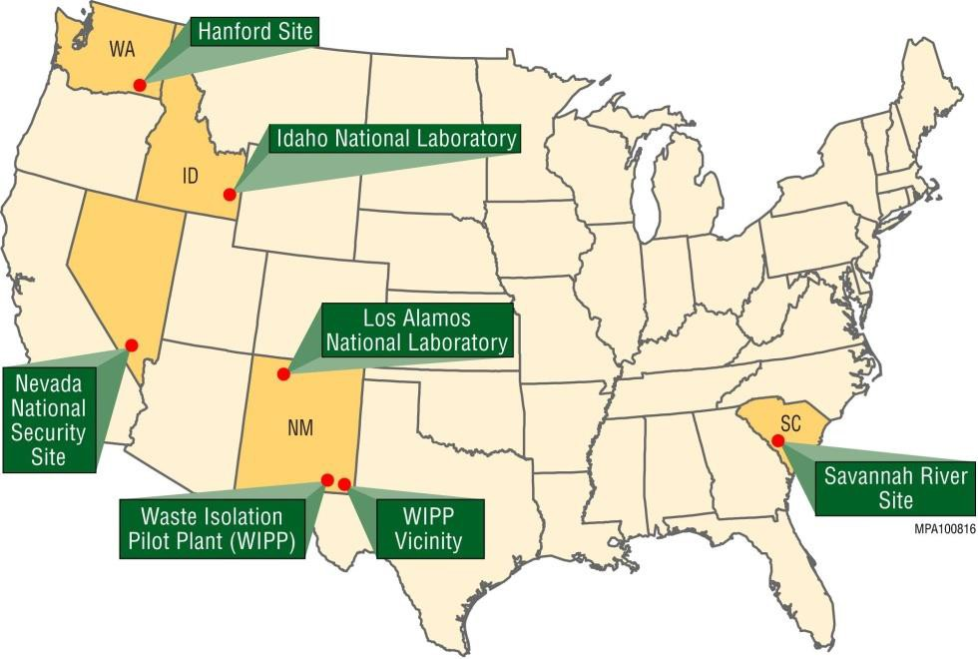
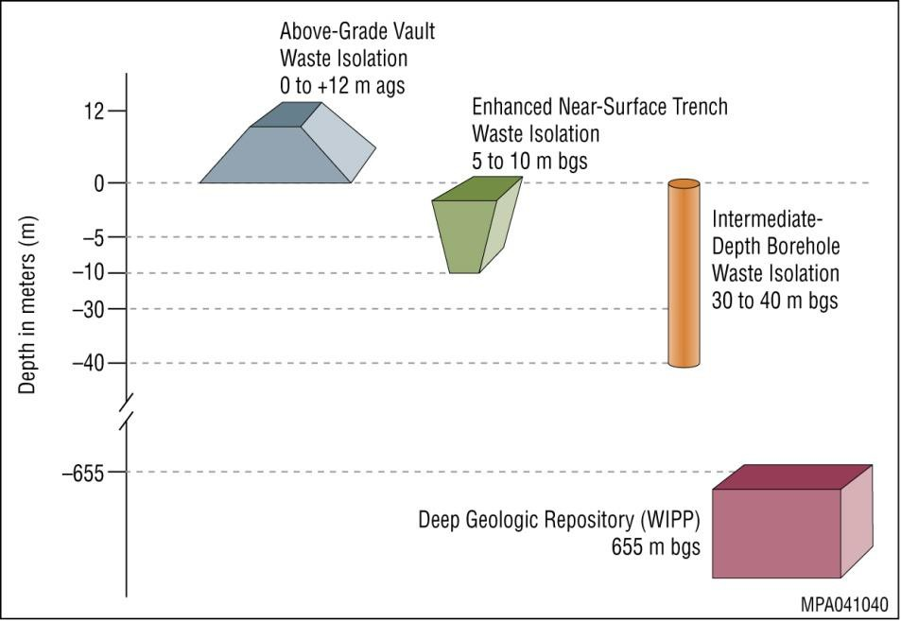
Overview: GTCC Disposal Alternatives
Evaluated
No Action: Continue current storage/management practices
Geologic Repository: At Waste Isolation Pilot Plant (WIPP)
Intermediate-Depth Boreholes: At Hanford, Idaho National Laboratory (INL), Los Alamos National Laboratory (LANL), Nevada National Security Site (NNSS), WIPP Vicinity, and generic commercial location in Region IV (west)
Enhanced Near-Surface Trenches: At Hanford, INL, LANL, NNSS, Savannah River Site (SRS), WIPP Vicinity, and generic commercial location in Regions II and IV (southeast and west)
Above-Grade Vaults: At Hanford, INL, LANL, NNSS, SRS, WIPP Vicinity, and generic commercial location in Regions I-IV (northeast, southeast, midwest, and west)

Slide 7
Final EIS Document
Overview
Evaluates 11 environmental resource areas as well as potential cumulative impacts at seven sites.
Resource Areas Evaluated
in Final EIS
Climate, Air Quality, and Noise
Geology and Soils
Water Resources
Human Health
Ecology
Socioeconomics
Environmental Justice
Land Use
Transportation 10.Cultural Resources 11.Waste Management
12. Cumulative Impacts
Evaluates geologic disposal and land disposal in enhanced near surface trenches, boreholes, or above-grade vaults.
Evaluates land disposal at generic commercial sites in NRC Regions I-IV.
Evaluates potential long-term human health impacts (calculated over 10,000 years).
For each alternative the analysis assumes that the total waste inventory would be disposed of at a single disposal site. Depending on the selected option for disposal, decisions can be made to dispose of the waste at more than one location.
Structured so that decisions on disposal method(s) or site(s) could be made by waste type.

Slide 8
Factors Considered During the Development
of the Preferred Alternative
Public comments provided on the Draft GTCC EIS: Over 4,000 public comments were submitted on the Draft GTCC EIS. DOE addresses those comments in the Comment Response Document section of the Final GTCC EIS.
Disposal site: Potential human health impacts (including those from transportation and cumulative impacts), cultural resources and tribal concerns, laws, regulations, and other requirements
Waste type: Radionuclide inventory/characteristics, waste form stability,
physical characteristics, and availability for disposal
Disposal method: Inadvertent human intrusion, construction and operational
experience, post-closure care, and cost
Programmatic factors

Slide 9
Preferred Alternative
The Final GTCC EIS includes a preferred alternative: WIPP geologic repository and/or land disposal at generic commercial facilities.
DOE has determined that the preferred alternative would satisfy the needs of the Department for the disposal of GTCC LLRW and GTCC-like waste.
These land disposal conceptual designs at generic commercial facilities could be altered or enhanced, as necessary, to provide optimal application at a given location.
There is presently no preference among the three land disposal technologies (e.g. intermediate-depth borehole, enhanced near-surface trench, and above-grade vault) at the generic commercial facilities.
The preferred alternative has the potential to enable disposal of the entire waste inventory analyzed in the Final GTCC EIS.

Slide 10
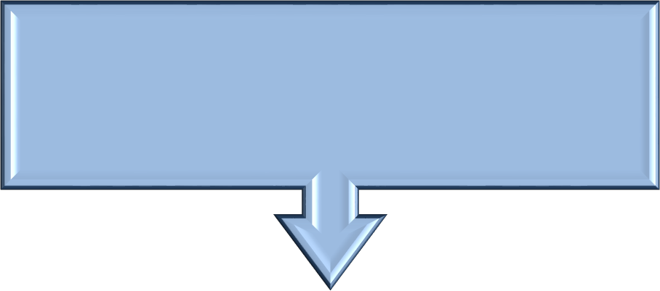
Remaining Steps for Fulfilling Statutory Responsibility
In accordance with Section 631 of the Energy Policy Act of 2005 (including requirements outlined in Section (3)(b)(3) of Low-Level Radioactive Waste Policy Amendments Act), the Report to Congress will:
Propose actions to ensure safe disposal of such identified radioactive wastes
Describe alternatives under consideration
Identify the Federal and non-Federal options for
disposal
Describe projected costs
Identify options for ensuring that the beneficiaries of the activities resulting from the generation of GTCC waste bear all reasonable costs of disposing of such wastes
Identify statutory authority required for disposal of GTCC waste
Submit Report to Congress
Await Congressional Action
Issue Record of Decision
10

Slide 11
To view the Final GTCC EIS electronically go to:
http://www.gtcceis.anl.gov/
To request hard copies of the Final GTCC EIS:
http://www.gtcceis.anl.gov/documents/order/in
dex.cfm
11

