Slide 1

State Regulatory Issues and Activities Involving TENORM
Gary Forsee
Conference of Radiation Control Program directors

Slide 2
Acknowledgements
CRCPD Task Force to Review the TENORM Aspects of the Oil and Gas Industry
  Jared Thompson, Chair
  Arkansas Department of Health
  Radiation Control Section
  Ruth McBurney, CHP
  CRCPD Office of the Executive Director
  Executive Director

Slide 3
Background
Awareness in state radiation control programs of technologically enhanced naturally occurring radioactive material (TENORM) for over 40 years
Primary isotopes of concern: Radium and daughters
Need for uniform regulatory position
  Use
  Decontamination
  Disposal of wastes

Slide 4
Types of Processes Enhancing NORM
Oil and Gas Production
  Scales
  Sludge
Phosphate fertilizer production and phosphogypsum
  Tailings
  Filters
Water treatment facilities
  Filters and resin beds

Slide 5
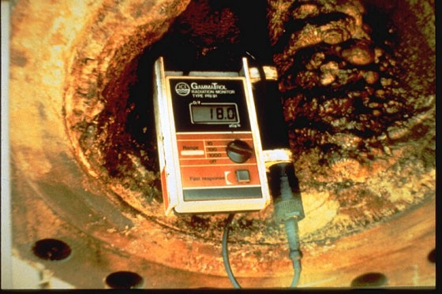
Pipe Scale
Early concerns from:
Contaminated pipe in scrap yards
and for recycling into other uses
Contaminated soil in pipe cleaning
and storage yards
Concentrations
Average: 3.7 kBq/g
Upward range to: 3.7 MBq/g
Notes:
Initially started with pipe scale

Slide 6
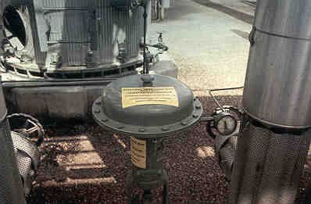
Contaminated Oil Production Equipment
Worker awareness and protection issues involved in cleaning and maintenance
Notes:
Evolving concerns with lead/polonium and pigging wastes

Slide 7
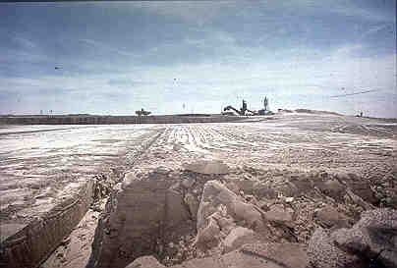
Phosphogypsum
Large areas of diffuse material
Average concentration of radium:
1.1 Bq/g (30 pCi/g)
Notes:
There has been some regulatory development

Slide 8
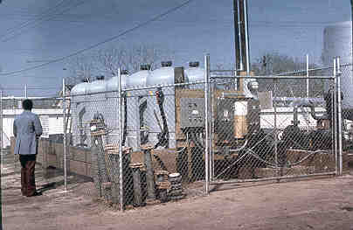
Water Treatment Systems
Filtration systems concentrate radionuclides from drinking water
Example: Average Illinois
municipal sludge concentration: Approx. 1kBq/kg combined radium
(50% Ra-226, 50% Ra-228)
Average 56,000 tons per year
Notes:
Industries known to contribute TENORM are requiring uniform regulatory approaches due to economic, regulatory, perception, and radiation protection barriers.
27 pCi/g landfilled, 18 pCi/g land applied. 30,000 tons of each annually.

Slide 9
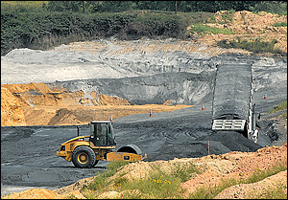
Other Sources of TENORM
Additional Industries:
Chemical production facilities
Geothermal wastes
Paper/pulp industry
Rare earth mining
Other Waste Forms:
Flowback/Formation Waters
NPDES Outfalls (liquid discharges)
Radon from landfill gas systems
Pb-210/Po-210 airborne particulates
Varying State Limits:
Fly Ash
Municipal wastewater sludges
Drill cuttings
Refractory material
Notes:
So, not only does the amount of TENORM generated within a state depend upon the type of industry presence – it depends upon recognition of TENORM in the waste streams and the threshold at which it is being brought into the regulatory fray.

Slide 10
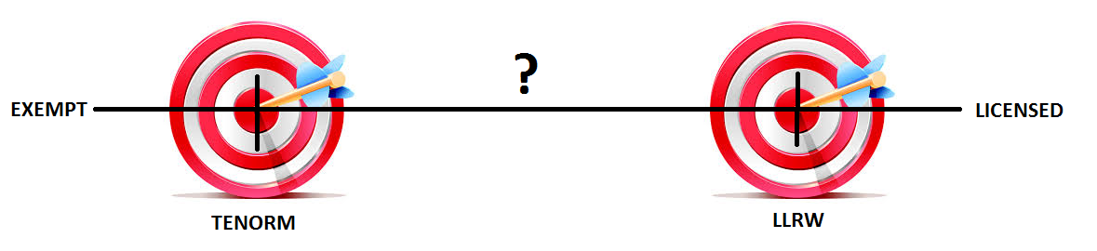
Moving Targets
Regulatory oversight of these wastes vary by state
Not only does the lower level at which TENORM is differentiated from exempt material vary, the upper level at which TENORM is considered low level radioactive waste is a moving target.
As a consequence, wastes that may be completely unregulated in one state may require licensure and handling/disposal as low level radioactive waste in another.
Notes:
From a regualtory standpoint, both regulators and industry are dealing with varying thresholds at which a waste is differentiated from NORM and potentially regulated – and the upper bound at which a waste may require licensed handling and disposal as low level radioactive waste.
The numbers for the lower bound of TENORM range from MDC to unlimited. The numbers for LLRW range from 5 pCi/g to 2000 pCi/g.
What’s worse – most of the numerical limits available are only for radium (except when dealing with uranium) and when looking to existing regs, there is no exempt quantity for some of the NORM radionuclides.

Slide 11
Consistent Regulatory Framework Needed
Inconsistencies in handling TENORM and varying thresholds at which TENORM becomes LLRW
  Unclear regulatory picture for industry
  No clear disposal guidance for state SW and RAM decision makers
  Inconsistent protective standards for the environment and the public
  Worker protection standards range from non-existent to licensed personnel
  Differences in waste acceptance criteria drive these wastes across state lines and compact commissions.

Slide 12
Current SSR Part-N
Ongoing push since mid 1990’s (and before) for a nationally consistent TENORM regulatory framework.
Product of decades of CRCPD work
1982-1990’s Multiple drafts circulated and commented on by states, industry, and public
  1985 – SR-5 Committee Draft 2
  1987 – Draft 5
  1988 – Draft 6
  1991 – Proposed Part N
  1993 – “Final Part N” – Distributed to States
  1997 – NORM Commission Draft
  1998 – Substantial Rewrite
  2003 – Implementation Guidance
  2004 – Revised Draft
Notes:
There was a push in the mid 1990’s (and before) for a nationally consistent TENORM regulatory framework – which has been under the CRCPD’s Part N.

Slide 13
Features of Model Regulations for NORM
Scope limited to TENORM (as defined)
Dose-based exemptions
Basic radiation protection standards applied
  Occupational limit of 0.05 Sv
  Public limit of 1 mSv
  Decommissioning criteria of 0.25 mSv
Licensing Provisions
  General license
  Specific license
Disposal Options
Land application up to 370 Bq/kg
50 μR/hr release limit for scrap
Focus on radium
Notes:
Components of the Current Part N.

Slide 14
Definition of TENORM in Current Part N
Naturally occurring radioactive material whose radionuclide concentrations are increased by or as a result of past or present human practices. TENORM does not include background radiation or the natural radioactivity of rocks or soils. TENORM does not include "source material" and "byproduct material" as both are defined in the Atomic Energy Act of 1954, as amended (AEA 42 USC §2011 et seq.) and relevant regulations implemented by the NRC.
Part N
Notes:
What Part N currently encompasses. Note that it primarily addresses radium, and licenses all persons not otherwise exempt.

Slide 15
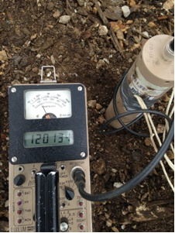
Implementation Guidance
Environmental exposure pathways and scenarios
Suggested computer assessment programs
Appropriate instrumentation for radiation
measurements
Appropriate methodology for conducting,
documenting and analyzing measurements
Provides action items for future review…
Notes:
Implementation guidance released in 2004 with recommendations for further review.

Slide 16
CRCPD E-42 TASKFORCE
  CRCPD Executive Board formed the E-42 Task Force in May 2012.
  Charge:
    Publish a “White Paper” that examines and reviews the TENORM radiological, environmental, regulatory and health and safety issues observed since the publication of the CRCPD E-4 report (1994) and the E-36 Implementation Guidance (2003).
Notes:
Additionally, the advent of high volume hydraulic fracturing and technological developments in the oil and gas industry prompted additional review on TENORM.

Slide 17
CRCPD E-42 TASKFORCE
  The “White Paper” was to summarize at least the following TENORM issues:
    Provide assessment and propose recommendations for the following:
      TENORM Radiation Exposure Issues- Occupational/ Public exposures included but not limited to regulatory impacts and health and safety.
      TENORM Environmental Impacts from technologies included but not limited to, disposal options for various types of TENORM waste
    Assess and evaluate TENORM Worker Awareness Training and general Public Awareness Information.

Slide 18
Environmental Impact and Waste Management Conventional/Unconventional Drillings

Slide 19
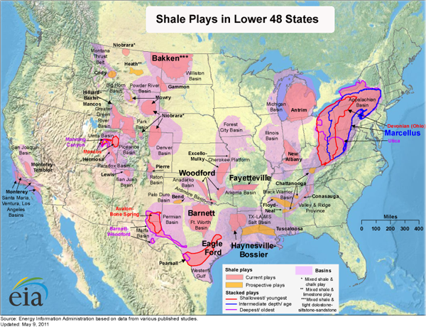

Slide 20
TASK FORCE ACTIVITIES
Over a 2.5 year time period, the “White Paper” evolved and became a 119-page report
Report provides a limited summary of the TENORM issues since 2003
International and national data and literature on TENORM reviewed
Additional issues of concern arose during report development
Common disposal scenarios for TENORM materials containing the estimated source term were modeled using RESRAD to produce dose estimates

Slide 21
TASK FORCE ACTIVITIES
E-42 Task Force Members/Advisors:
  Twelve State Members
  3 TENORM Industry Consultants
  2 Federal Government Reps (EPA & NRC)
  A Peer Review was performed on the Task Force Report by 5 individuals, including Gary Robertson, LLW Forum.

Slide 22
CRCPD Task Force Report
The emphasis of this report is on the need for nationwide scientific consistency in a more standard regulatory framework to ensure public health and protection of the environment.
Report completed in June 2015

Slide 23
Task Force Recommendations
Establish a more consistent definition of TENORM
Review the acceptance criteria in SSRCR Part N for adequacy, using a consistent dose and regulatory approach
Partner with NCRP on the criteria development for trigger levels
Further evaluate the extent and quantification of Lead-210 (Pb-210) and Polonium-210 (Po-210) contamination and exposure to radon for radiation protection of oil and gas workers
Incorporate TENORM assessment in the early phases of oil and gas permitting

Slide 24
Task Force Recommendations
Amend existing regulatory programs, including SSR Part N, to include an assessment of TENORM.
Collect and maintain a compendium of state regulations and guidelines pertaining to the management and disposition of TENORM.
Compile and maintain a database of the concentrations volumes and radiation fields associated with the oil and gas operations and activities.

Slide 25
CRCPD BOARD ACTIONS
  The CRCPD Board has recently taken the following actions regarding the Recommendations made by the Task Force:
  CRCPD Executive Director will prepare a letter to the National Council on Radiation Protection (NCRP)requesting to work jointly on TENORM issues related to Acceptance Criteria and the Quantification/Clarification of Pb-210 and Po-210 as described in the E-42 Task Force Report – Review of TENORM in the Oil and Gas Industry. CRCPD is seeking scientific and technical assistance in the development of these two recommendations from the Task Force.

Slide 26
CRCPD BOARD ACTIONS
  Establish the E-45 Committee on TENORM which is a continuous Committee that will report to the Board at least annually.
  The primary charges will be:
To review and provide a report to the CRCPD Board on the following recommendations from the E-42 Task Force Report Review of TENORM in Oil and Gas Industry:
Assess and determine if the definition of TENORM as identified SR-N should be revised or changed as discussed in the Task Force Report. This will be completed within one year after Committee activities begin.
Review the training recommendations identified in the Task Force Report and identify training components to be implemented by SR-N.

Slide 27
CRCPD BOARD ACTIONS
Prepare a consolidated guidance document for the non-licensing nature for TENORM facilities. This guidance should be in the format of the USNRC NUREG-1556 series.
Evaluate the feasibility of CRCPD maintaining a compendium of state regulations and guidelines pertaining to the regulatory management of TENORM.
The discussions and reports related to this charges will not be limited to just the oil and gas industry, but will also evaluate other TENORM source production processes.
Industry stakeholders, consultants and representative of other professional organization should be included in the completion of this charge.
This Committee will consult, comment and make appropriate recommendations concerning TENORM issues and regulatory revisions to the SR-N Committee.

Slide 28
CRCPD BOARD ACTIONS
SSR-N working group issued a revised charge in September 2015:
Phase I – Perform Data Scoping (currently underway)
Phase II – Review of SSR-N
  Incorporate Board-approved E-42 Recommendations
  Incorporate technical solutions from E-45
  (Tentatively) Work with the NCRP and incorporate resulting work
  Provide recommendations for revision to the CRCPD Board

Slide 29
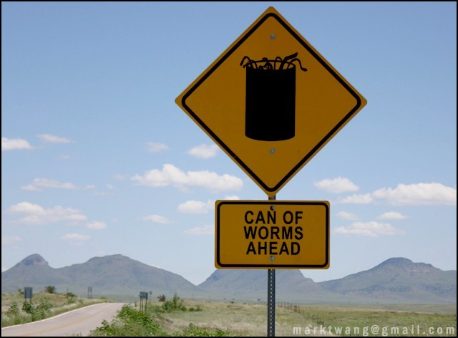
Why Revisit Part N?
Continual process to ensure Part N is responsive to
changes in industry and adequately addresses
recent technological developments
Address published guidance from other standard setting bodies
Capture regulatory changes and ensure compatibility with Federal rulemakings
Low adoption of Part N and various alternative disposal limits
Additional hazards not encompassed in Part N
Ensure Part N is effective in meeting the most up to date protective standards for the environment and the public.

Slide 30
Why Revisit Part N?
Issues Identified in the 2003 Implementation Guidance
Review the definition of TENORM
  ANSI & US EPA vs. Current CRCPD
Solid Waste Release Criteria
  Recent studies (Pennsylvania, North Dakota, EPA)
Differing Site Release Criteria (13 vs 25 mrem/year)
Dose Based Surface Contamination Values
Exemption criteria for other radionuclides
RSO Requirements
Notes:
These were items identified by the E-36 working group that required future address.
Any revisions to Part N should include these items.

Slide 31
Why Revisit Part N?
Issues Identified in the 2003 Implementation Guidance (continued)
Assessing the groundwater pathway (4 mrem/yr)
  EPA is addressing TENORM industry by industry
  Will likely vary by industry/waste form
Implementation guidance offers items for future consideration
  Assessments of operations on page 9
  Trigger levels that would move a general licensee to a specific licensee are present (operations that give rise to a dose in excess of 10% the occupational limit)
Notes:
These were items identified by the E-36 working group that required future address.
Any revisions to Part N should include these items.

Slide 32
Why Revisit Part N?
Issues Identified by the E-42 Working Group
Radon – Use in models, worker protection standards, and dose to the public
A need to formalize the notification to states for intent to be covered by a TENORM license
A need to formalize the “assessment” for dose-based exemptions
Address inconsistencies in worker training
Notes:
I’ll not get in depth here because I don’t want to encroach on Jared’s talk.

Slide 33
Why Revisit Part N?
Analysis of the 5 pCi/g exemption in light of disposal pathway
  Clarification that Part N doesn’t prohibit RCRA landfill disposal
Land application does not account for site buildup of radium
Desire for radiation protection programs and training that is commensurate with the duties/hazards present. (I.e., a “graded approach”)
International models of radon monitoring/mitigation
  IAEA Report No. 33

Slide 34
Developments since Part N and Possible Implications
ANSI N.53-2009
Drinking Water Regulations and increased radium removal
High Volume Hydraulic Fracturing Operations
Harmonization with US DOT and International Shipping Regulations
    (special permits, X10 NORM exemption)

Slide 35

Expectations
Multiyear effort with E-42 input
The RCRA vs NRC site release
  likely won’t be resolved soon.
The EPA vs NRC allowable public dose
  constraints won’t be resolved soon.
Introduce proposals to formalize the notification to the state of coverage under a license
Introduce proposals to formalize the dose assessment process
Include the groundwater pathway in models
Notes:
Gonna take a while. Going off of the comments of Tommy Cardwell, BJ Smith, Jared Thompson – its also going to take a lot of ibuprofen.

Slide 36
Expectations
Examine the utility and science behind 5 pCi/g. Is the exemption appropriate and defensible across multiple industries and all exposure scenarios?
Examine alternative field-screening methods that allow the regulated community to quickly determine compliance and allowable disposal options. These need to be tied to both a dose and a disposal pathway.
Revise the language that delineates the lower levels of TENORM that do not warrant regulatory oversight.

Slide 37
Expectations
Scope of TENORM will continue to grow
Changing definitions places an emphasis on the dose assessment process
Industry-specific guidance (“NUREG 1556-ish”)
Examine “permitting”, “exemptions”, and the AEA Licensing structure as it applies to TENORM.

Slide 38
Problems
Permitting doesn’t address contaminated legacy sites
Permitting requires multi-agency coordination
Who reviews / approves proposed dose assessments
“Trigger levels” are desired by industry. However, these are dependent upon the disposal pathway in play
Training desired for all TENORM workers. I.e., prior to licensing space. No regulatory framework outside of AEA licensing..

Slide 39
Other Organizations Looking at TENORM
National Council on Radiation Protection
Recommendations for a Uniform Approach for TENORM Waste Management and Disposal
Possible workshop being planned
Health Physics Society
EPA: Concentrated on fracking issues
Association of State and Territorial Solid Waste Management Officials (ASTSWMO): Disposal issues
Interstate Oil & Gas Compact Commission
Establishment of working relationship with CRCPD on TENORM issues

Slide 40
Conclusion
CRCPD will continue to work on the regulatory issues involved with TENORM
New E-45 committee to be a clearinghouse for emerging issues
Revision of Part N of the Suggested State Regulations for Control of Radiation
Coordinate with other organizations to create a more consistent approach to regulatory and non-regulatory control of TENORM

