Slide 1
Company Overview
John Christian
President, Logistics, Processing and Disposal

Slide 2
Safety Is Our Core Value
EnergySolutions instills in its employees a world-class safety culture
EnergySolutions provides resources necessary to operate safely at all of our facilities and protect the general public in the packaging, transportation, and disposal of radioactive and hazardous materials
EnergySolutions protects and preserves the environment by adhering to the highest standards of compliance and safety

Slide 3
Safety Topic
“Fire Protection”

Slide 4
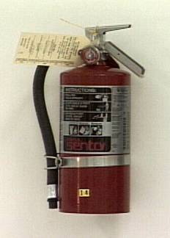
Fire Protection
CFR 1910.157 If portable fire extinguishers are provided for employee use, the employer must mount, locate and identify them so that workers can access them without subjecting themselves to possible injury.

Slide 5
Fire Protection
Must maintain in a fully charged and operable condition
Must keep in their designated places at all times except during use
Must conduct an annual maintenance check
Must record the annual maintenance date and retain this record for one year
Portable fire extinguishers are for the protection of our people not equipment

Slide 6
At a Glance
Headquartered in Salt Lake City, Utah
Owned by Energy Capital Partners (ECP), a New Jersey based private equity firm
Operations across the United States, Canada, United Kingdom, Japan, and China
Owner of the world’s largest privately owned Class A low-level radioactive waste disposal facility (Clive, Utah)
Primary customers include: nuclear utilities, medical and research facilities, US DOE, US DOD
Global workforce of more than 2,000 employees

Slide 7
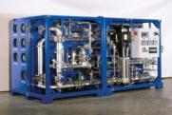
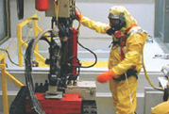
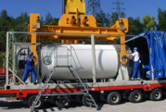
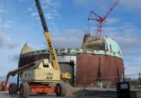
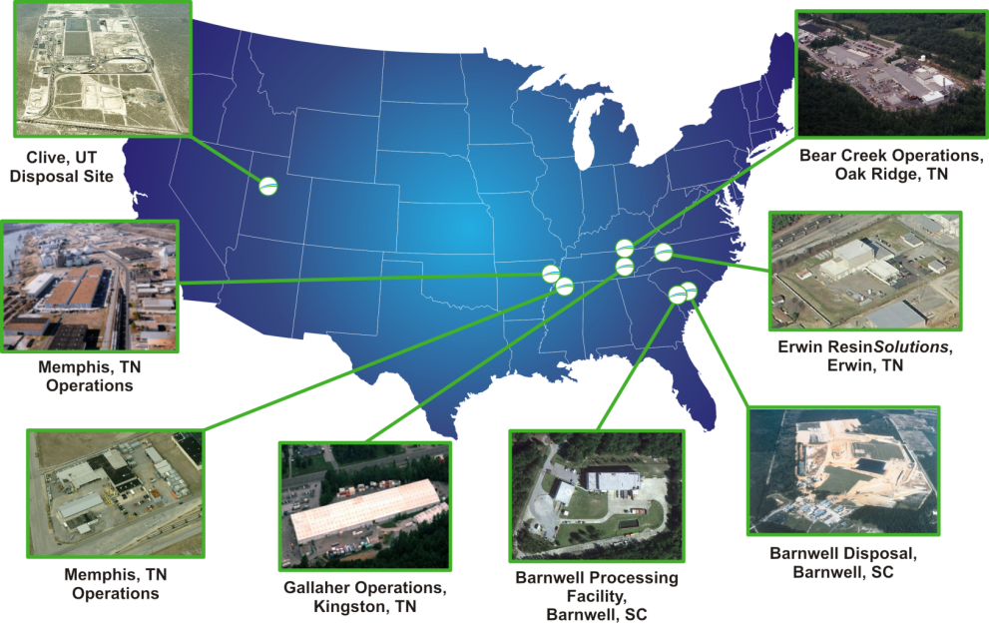
Facilities and Site Services
Onsite Liquid Waste Processing (more than 175 patents)
Casks with a Dedicated Transportation Fleet
Specialized Nuclear Services (fuel pools, tanks, etc.)
Spent Fuel Management
Decontamination & Decommissioning

Slide 8
What We Do
Logistics
Encompasses all aspects of complex planning and transportation
Dedicated fleet of tractors, trailers, railcars and containers
Processing
Owns/operates multiple processing facilities in the United States and Canada
The most diverse capabilities in the U.S. for handling, treating and processing radioactive materials
Disposal
Owns the largest commercial radioactive disposal facility for Class-A low-level radioactive waste (LLRW) in the U.S.
Operates the LLRW disposal facility in Barnwell, South Carolina pursuant to a long-term lease with the state. The facility receives Class A, B and C LLRW from the Atlantic Compact (South Carolina, New Jersey and Connecticut).

Slide 9
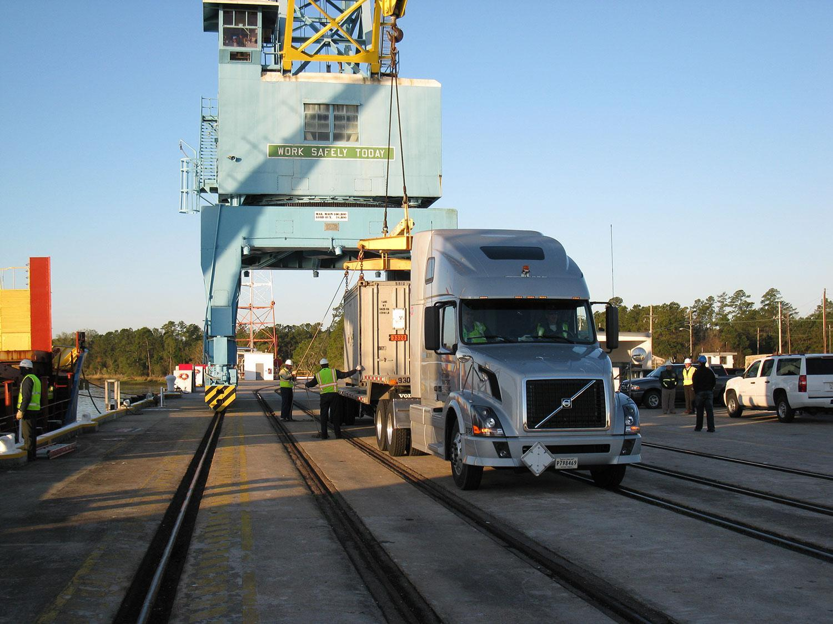
Logistics

Slide 10
Logistics
Handles all aspects of shipment, including obtaining required local and federal licenses and permits, loading and bracing shipments, conducting vehicle radiation surveys
Transports 300 radioactive shipments per month over the road
Largest fleet of shipping casks available to the nuclear industry
322 railcars include flatcars, gondolas, containers, and intermodals

Slide 11
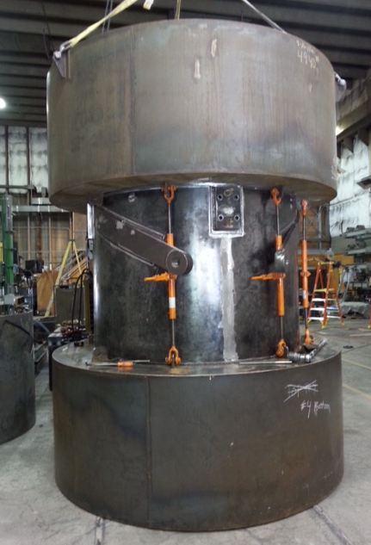
Logistics - Shipping Casks
86 Casks in fleet.
Easy to use/proven experience.
EnergySolutions owns 90% of casks currently in use.
Logged more than 70 million safe driving miles without a loss or spill of radioactive materials.
2 new 8-120A & 2 new 14-215 casks in 2013.
4 new 8-120B casks added in 2014 (total of 8).
1 new 3-60B being added in 2015.
New 8-120B during Fabrication Now in Service

Slide 12
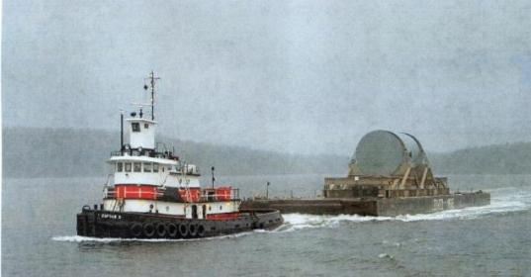
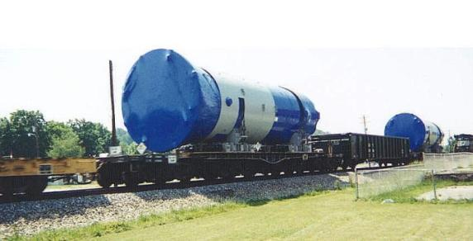
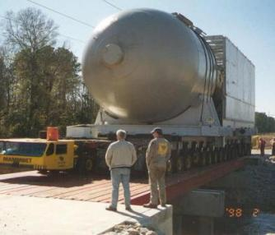
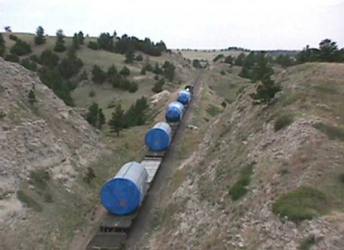
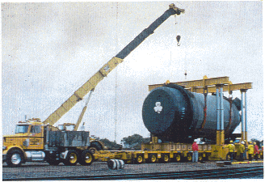
Large Component Highway, Rail & Barge Transportation
Multi-mode large component transportation capabilities
Moved over 120 used radioactive components, reactor vessels, steam generators, reactor heads, pressurizers, rotors, feedwater heaters, heat exchangers
Notes:
12

Slide 13
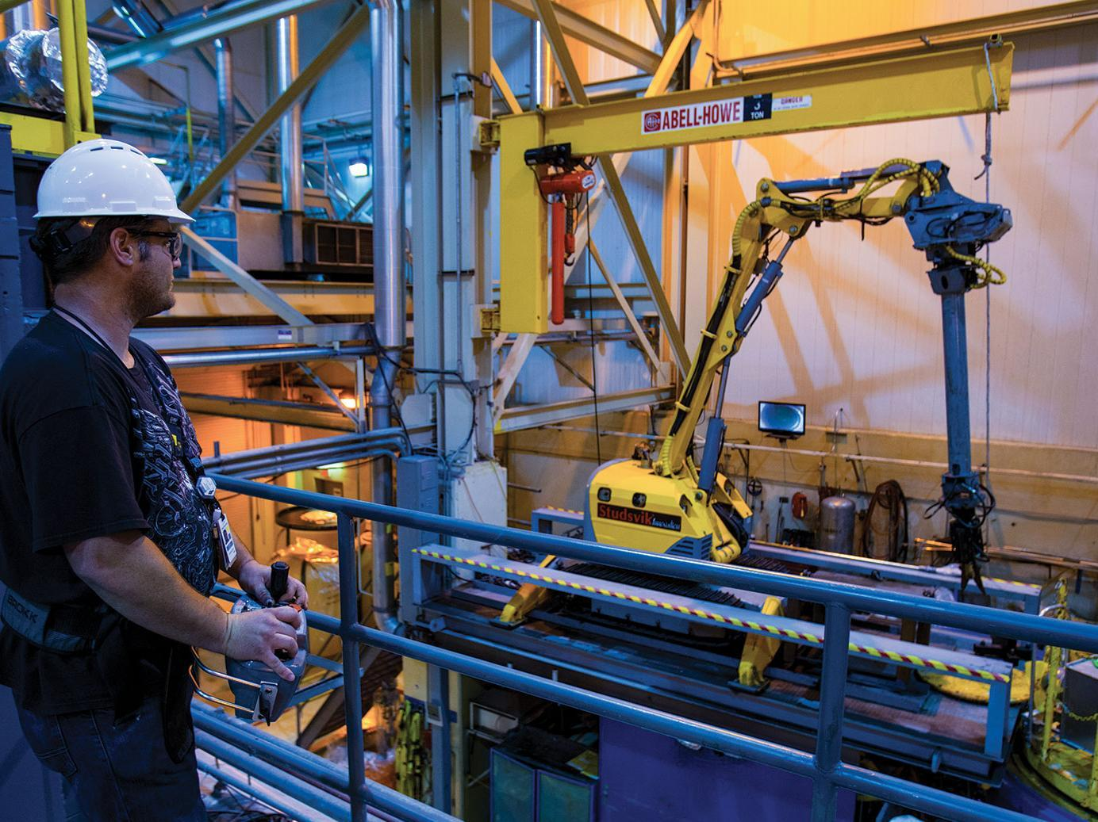
Processing

Slide 14
Radioactive & Hazardous Materials Management
Providing specialized services to a wide customer base that includes government agencies, commercial customers, and major engineering and construction companies
Decontamination
Volume reduction
Metal melt for beneficial reuse
High-activity filter processing
Vitrification
Automated sampling systems
Solidification
Thermal treatment
Encapsulation
Spent ion-exchange processing
Liquid waste processing
Remote handling systems

Slide 15
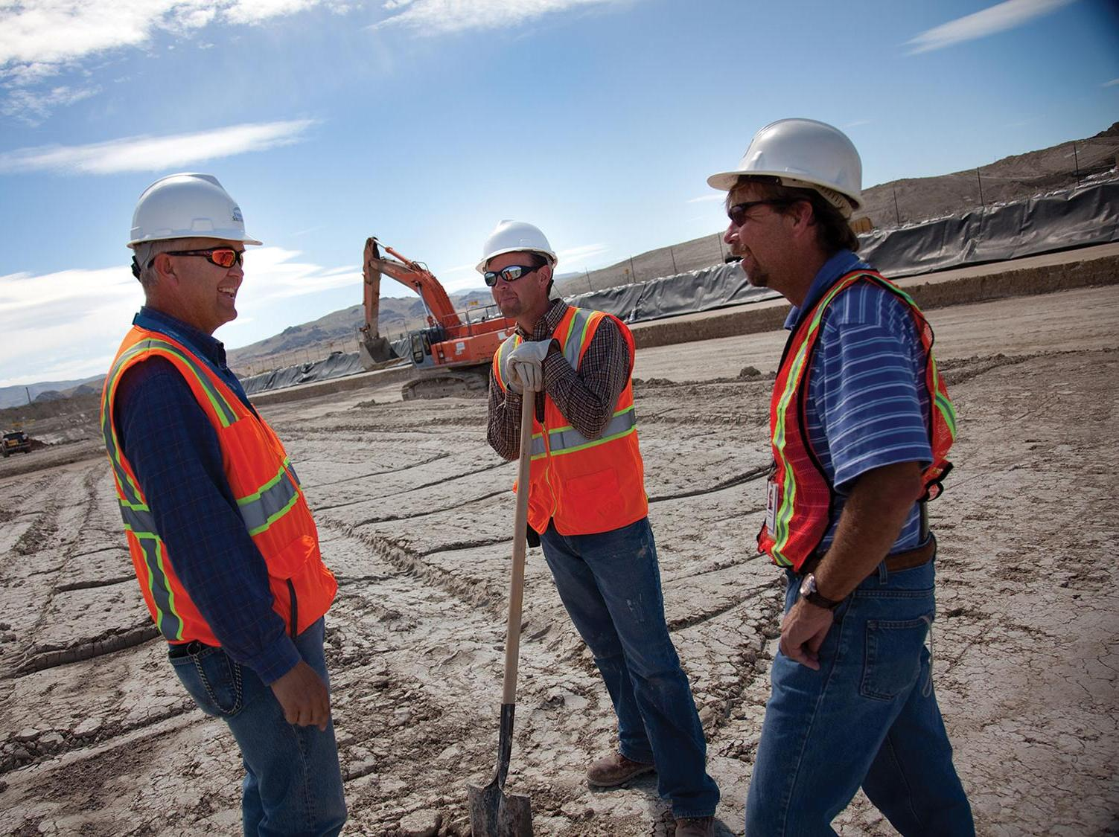
Disposal

Slide 16
Disposal Capabilities
Owns and operates Clive LLRW Disposal Facility in Utah’s West Desert that disposes of only Class A waste
Operates for the State of South Carolina the Barnwell LLRW Disposal Facility that disposes of Class A, B & C waste only from the Atlantic Compact
Material disposed:
Bulk waste disposal
Containerized Waste Facility
Large components
Mixed waste treatment
PCBs

Slide 17
Clive Disposal Volumes

Slide 18
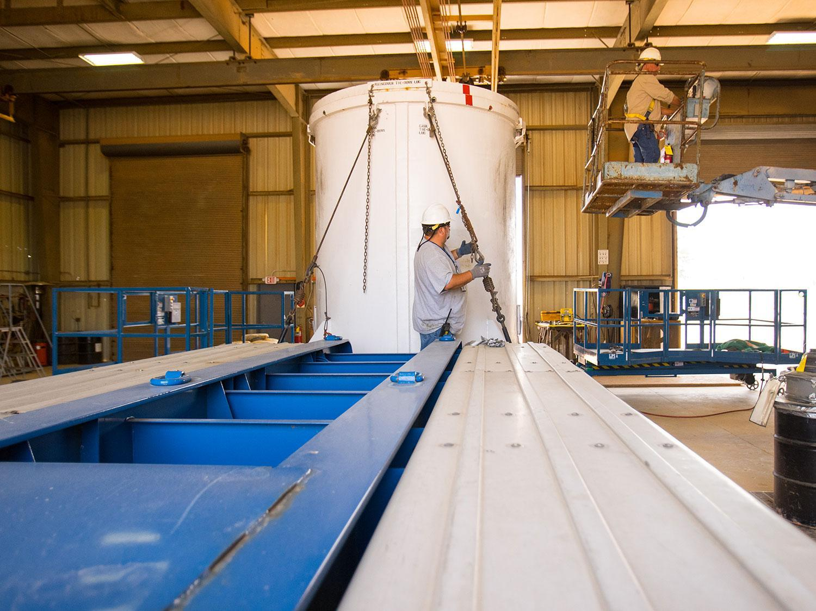
Government

Slide 19
Government Services
Customized services and solutions for U.S. DOE and Federal projects
Facility operations
Materials management
Recycling and equipment disposition
Professional engineering services
Radioactive materials preparation, profiling, processing, treatment and disposal
Transportation and logistics
Emergency response

Slide 20
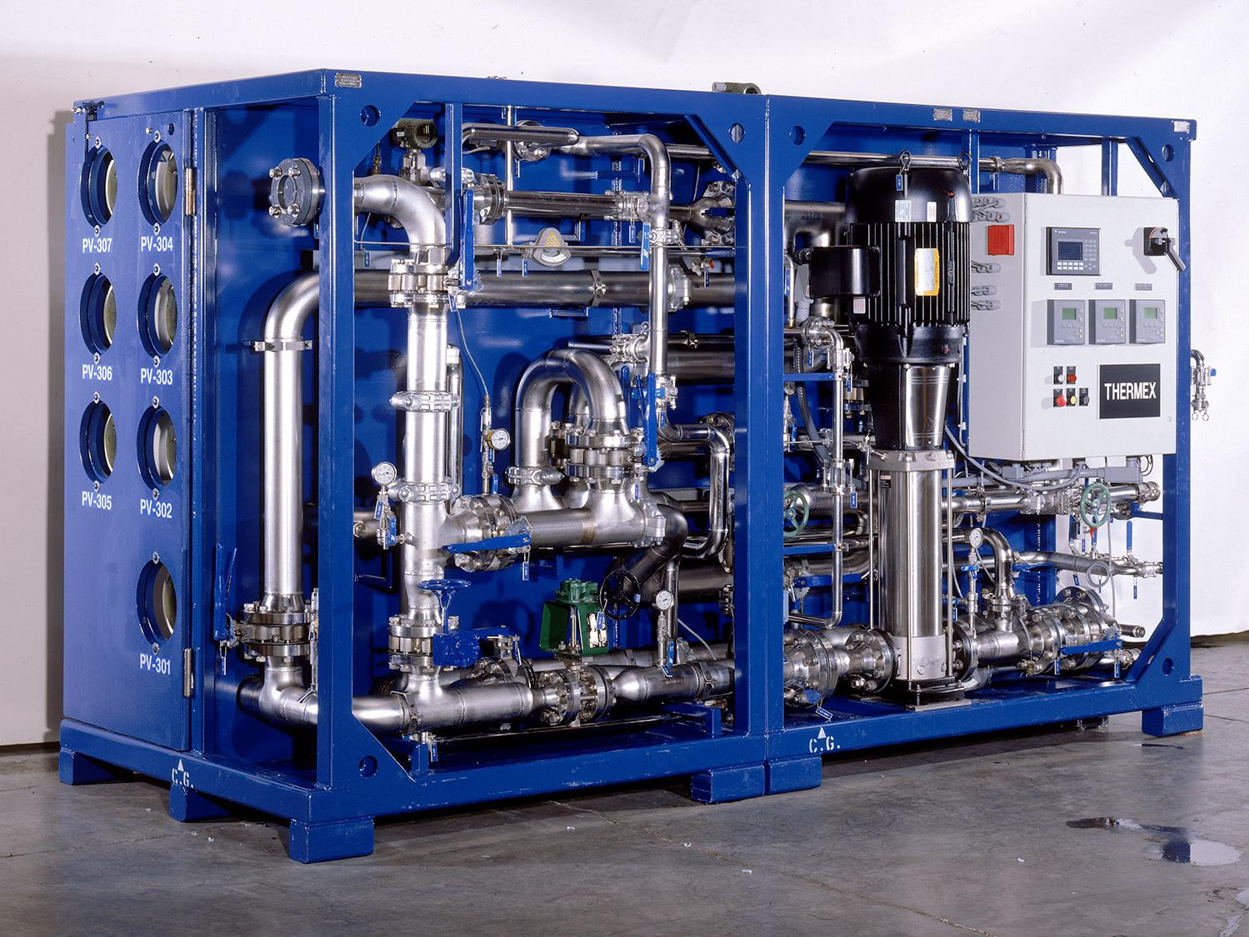
Products & Technology

Slide 21
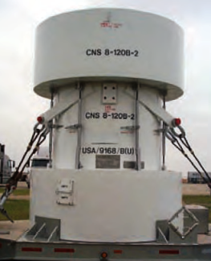
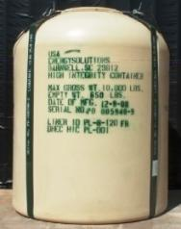
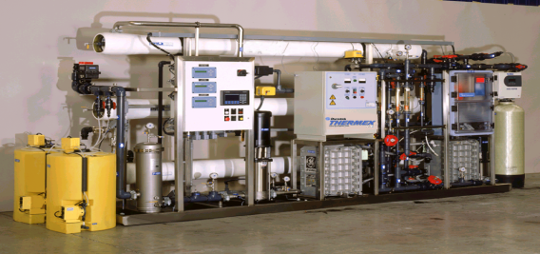
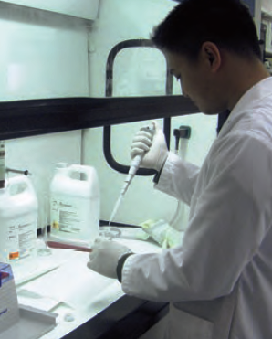
A Glance at P&T Services
Casks and Containers
Casks and Containers
Casks and Containers
Liquid Processing Equipment
Analytical Services

