Slide 1
Sealed Source Transport Review
John Christian
President, Logistics, Processing and Disposal
Mark Lewis, General Manager
Cask Division, Logistics Department

Slide 2
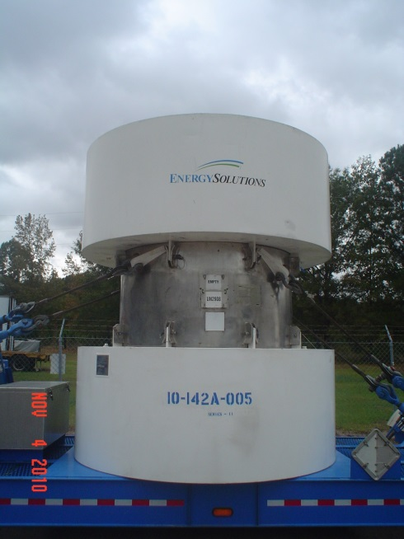
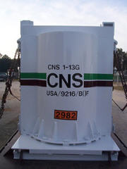
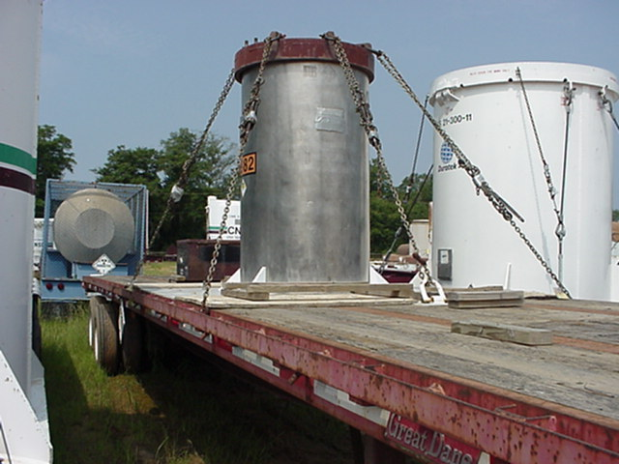
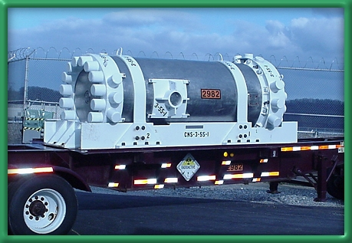
History – Pre October 1, 2008
EnergySolutions (Chem-Nuclear) Type B casks:
  1-13G with or without auxiliary shields
  1-13C (2)
  3-55 (2)
  8-120B (4)
  10-142B (3)
  10-160B
Some other non-ES Options:
  20WC-1, 2, 3, 4 ,5, 6
  6M
  Spec 55 prior to 1985
  TN-RAM
  DOE 10-160B

Slide 3
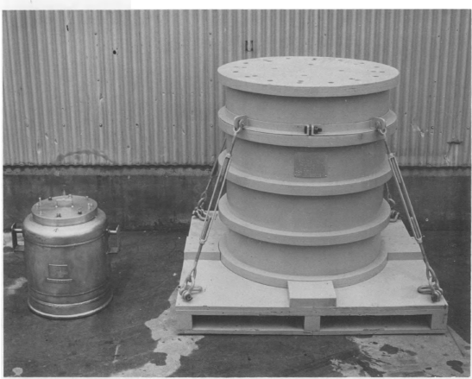
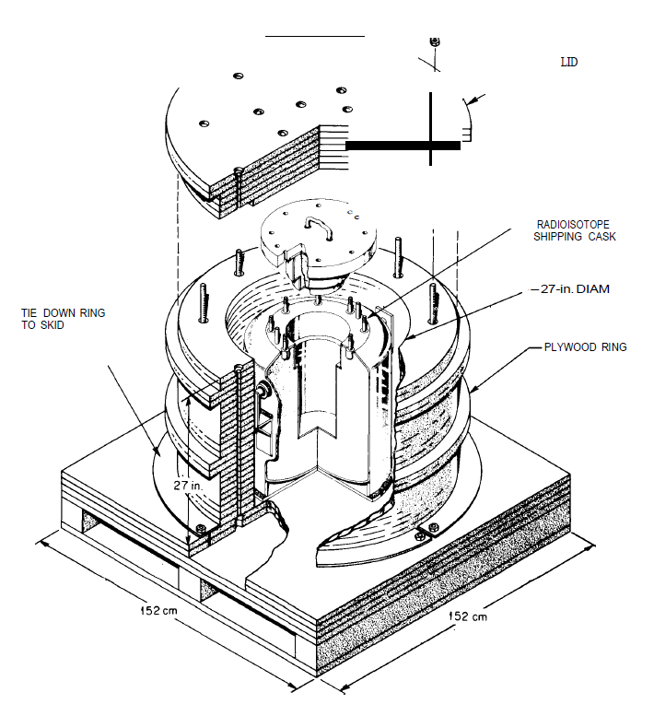
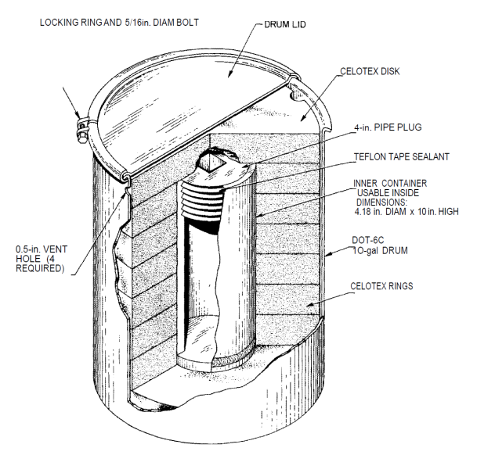
History – Pre October 1, 2008
DOT General Design Type B Packagings
20WC-4
6M

Slide 4
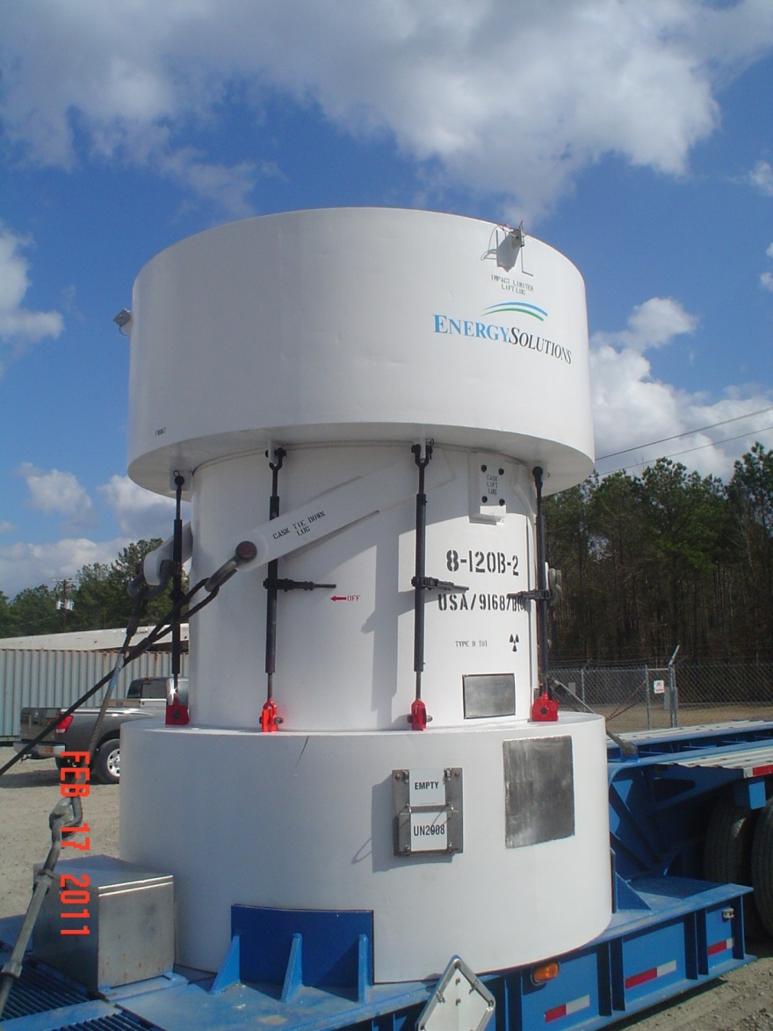
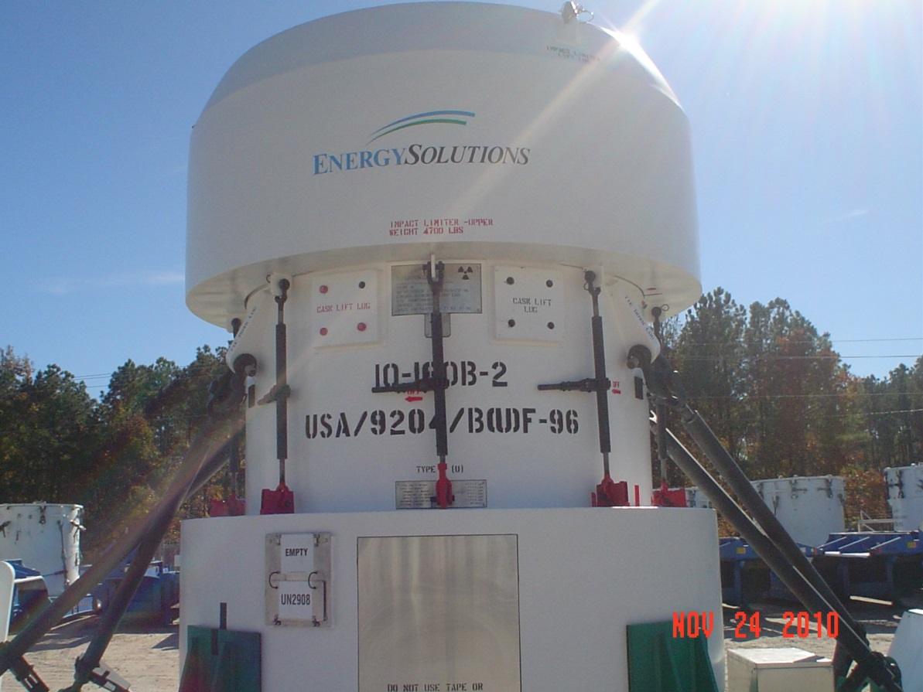
History – Pre October 1, 2008

Slide 5

History – Post September 11, 2001
Concern over future terrorist attacks
Concern of terrorists hijacking or stealing radioactive material in order to make and explode a dirty bomb
Sealed sources a likely target due to high concentration, low weight, and lack of protection
Programs put in place to protect the public:
  Off-Site Source Recovery Program (OSRP)
  RAM-QC (Quantities of Concern)
  Source Registry

Slide 6
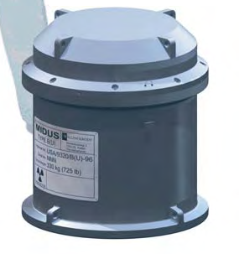
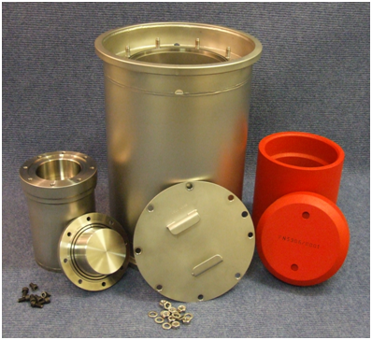
History – Pre November 2014
EnergySolutions (Chem-Nuclear) Type B casks:
  8-120B (4) w/ Aug 2012 activity restriction
  10-160B
  DOE licensed auxiliary shields for 10-160B
  Midus
Some other non-ES Options:
  Croft 3977A
  Croft 3979A
  Croft 2999A
  Croft 3940A
  TN-RAM
  DOE 10-160B

Slide 7
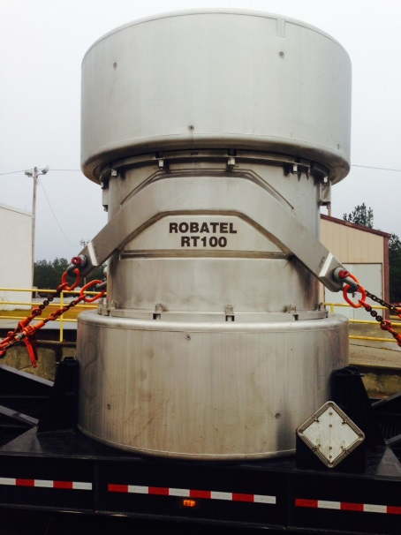
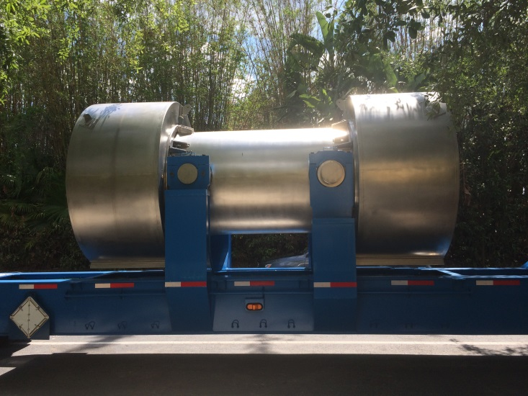
Current
EnergySolutions fabricates 4 new 8-120B
EnergySolutions (Chem-Nuclear) Type B casks:
  8-120B (8) w/ Aug 2012 activity restriction
  10-160B (license renewed on 8/14/15)
  DOE licensed auxiliary shields for 10-160B
  3-60B
  Midus
Some other non-ES Options:
  Croft 3977A, 3979A, 2999A, 3940A
  TN-RAM
  Robatel RT-100 (3)
  DOE 10-160B

Slide 8
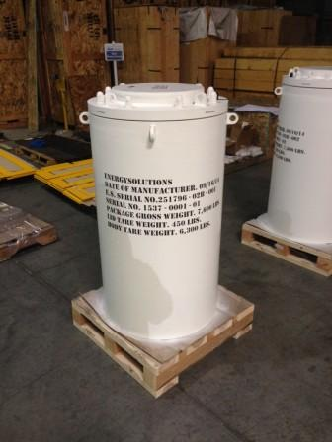
DOE Approved Auxiliary Shields
10-160B Inner Packaging Description Ship per USA/9204/B(U)F-96 (DOE) | Content Limits | Overall Physical Dimensions | DOE-Approved Cribbing Materials
Shield Inserts
Shield Insert A | 10,000 Curies of Cobalt-60 | Weight: 8,000 lbs Cribbing weight: 1500lb(w)-5000 lbs(s) Total Payload weight: 9550lb-13,000 lbs Insert Height: 44 ¼” Insert Width: 24” (diameter) | Steel/Wood
Shield Insert B | 12,970 Curies of Cobalt-60; or 40,568 Curies of Cesium-137; or 32,626 Curies of Irridium-192; or 82,988 Curies of Selenium-75; or 24,300 Curies of Strontium-90. | Weight: 8,000 lbs Cribbing weight: 1500lb(w)-5000 lbs(s) Total Payload weight: 9550lb-13,000 lbs Insert Height: 44 ¼” Insert Width: 24” (diameter) | Steel/Wood

Slide 9
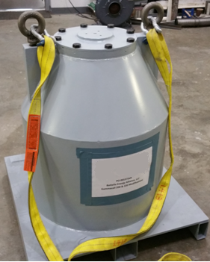
DOE Approved Auxiliary Shields
Argonne National Laboratory Source Container | 4,030 Curies of Cobalt-60; and 3.49 Curies of Radium-226-Beryllium Sources. | Weight: 11,000 lbs Cribbing weight: 1000 lbs Total Payload: 12,000 lbs Height: 52 5/8” Width: 38” (diameter) | Wood
Gammacell 200 | 9,000 Curies of Cobalt-60 Sealed Sources only; or Combinations of Cobalt-60 Sealed Sources with Cesium-137 Sealed Sources, not to exceed 138.46 Watts Thermal, or 27,700 Curies of Cesium-137 Sealed Sources only. | Weight: 5203 lbs Cribbing weight: 1350 lbs Total Payload: 6553 lbs Height: 34 ¾” Width: 32” pallet sides | Wood

Slide 10
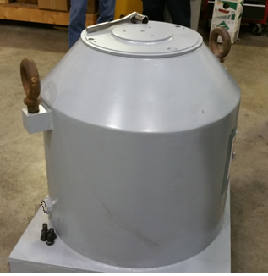
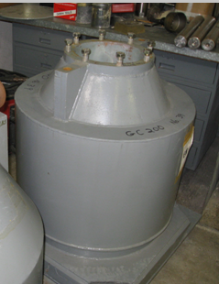
DOE Approved Auxiliary Shields
Gammacell 200 (Extra Shielding Band) | 9,000 Curies of Cobalt-60 Sealed Sources only; or Combinations of Cobalt-60 Sealed Sources with Cesium-137 Sealed Sources, not to exceed 138.46 Watts Thermal, or 27,700 Curies of Cesium-137 Sealed Sources only. | Weight: 6118 lbs Cribbing weight: 1350 lbs Total Payload: 7468 lbs Height: 34 ¾” Width: 32” pallet sides | Wood
Gammacell 220 | 13,000 Curies of Cobalt-60 Sealed Sources only; or Combination of Cobalt-60 Sealed Sources with Cesium-137 Sealed Sources, not to exceed 200 Watts Thermal; or 40,000 Curies of Cesium-137 Sealed Sources only. | Weight: 7705 lbs Cribbing weight:1350 lbs Total Payload: 9055 lbs Height: 34 ¼” Width: 32” pallet sides | Wood

Slide 11
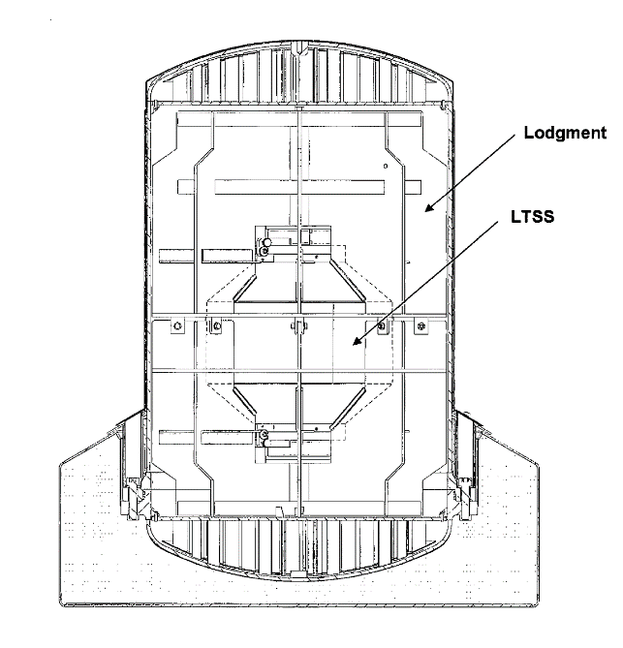
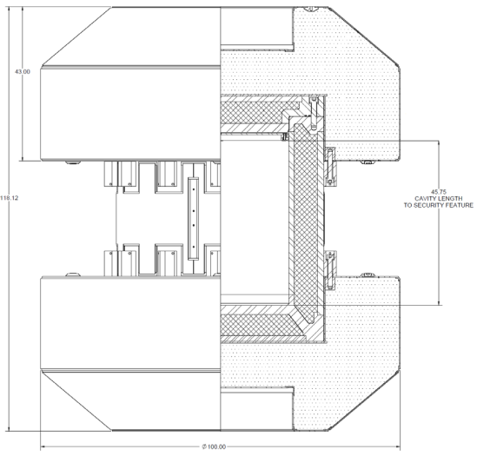
Future
EnergySolutions (Chem-Nuclear) Type B casks:
  8-120B (8) w/NRC licensed auxiliary shields
  10-160B w/ NRC licensed auxiliary shields
  DOE licensed auxiliary shields for 10-160B
  Midus
Some other non-ES Options:
  Croft 3977A, 3979A, 2999A, 3940A
  TN-RAM (2)
  DOE 10-160B
  WMG cask similar to 8-120B
  OSRP 435-B
  OSRP 380-B

