Slide 1
Global
Threat
Reduction
Initiative
Type B Container Development

Slide 2
Issues- Regulatory Changes
In a January 2004 rulemaking, NRC adopted revised regulations to harmonize with the 1996 edition of the IAEA regulations. Many of the Type B packages designed several decades ago and did not meet these new international standards.
Packages that match IAEA regulations only fit a small number of devices (<10%) and are expensive to use due to limited availability.
By 2009, there were little to no developments for new general-use packages but rather reliance on device-specific packages for transport.
Type B packages that met the new standards are expensive to lease or buy, and are available only in limited quantities or are in high demand, making availability uncertain.
Other limitations include weight or volume restrictions, payload activity limits are too low, and restrictions on form of materials.
Notes:
OSRP Activities
GTRI/OSRP has a backlog of about 130 excess and unwanted sources/devices that must be shipped in Type B containers.
Most GTRI/OSRP recoveries (~80%) involving Type B quantities of Cs-137 or Co-60 was completed using the now expired DOT Specification 20WC containers.

Slide 3
GTRI Solutions
International
Design and construct an unshielded leak tight container, used primarily in conjunction with the International Atomic Energy Agency (IAEA) Transportable Hot Cell, to ship teletherapy and/or irradiator sources using the IAEA Long Term Storage Shield (LTSS) as an inner container.
Domestic
Design and construct a large shielded container capable of transporting a majority of the GTRI/OSRP high-activity, beta/gamma device backlog.

Slide 4
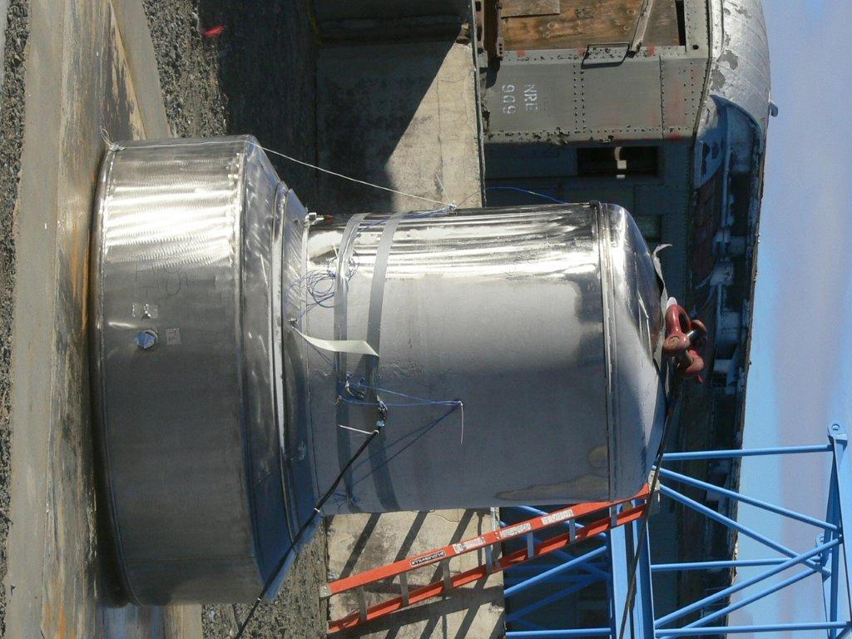
435 B “Little B”
Unshielded, leak tight container designed for use with IAEA LTSS.
Package Description
Empty weight 4,940 lbs (~2,225 Kg)
Total weight 10,100 lbs (~4,535 Kg)
Shielded devices w/ Cs-137 or Co-60, internal container max weight 3,500 lbs (~1,590 Kg)
LTSS Payload: Cs, Sr, Ir, Se Ra, Am Pu and small neutron sources
LTSS Payload Activities: 12,970 Ci (~480 TBq) Co-60 and 14,000 Ci (~520 TBq) Cs-137, 200 W limit
External dimensions: 83 in (209 cm) H x 70 in (179 cm) OD at base
Internal Cavity: 60 in (152 cm) H x 43 in (110 cm) in ID
Transport by truck, rail, ship, air
Certificate of Compliance issued June 2014.
Notes:
These devices are similar and/or we have extensive drawing for them. All of the details on this device is not needed for this audience.

Slide 5
Next Steps
Obtain a CoCA for the 435B from DOT
Provide copies of the SAR and design drawings to IAEA making container available internationally
Including additional content/devices to the 435B
Fabrication and use of 435B anticipated in 2015
Devices Currently Certified as Payload
Gammator 50B, B, B34, G-50-B
Gammator M34
Gammator M38
Gammacell 1000 (GC-1000) - Models A through D - Elite A through D, Type I and Type II
Gammacell 3000 (GC-3000) - Elan A through C, Type I and Type II
Gammacell-40 (GC-40 Exactor)
IAEA LTSS

Slide 6
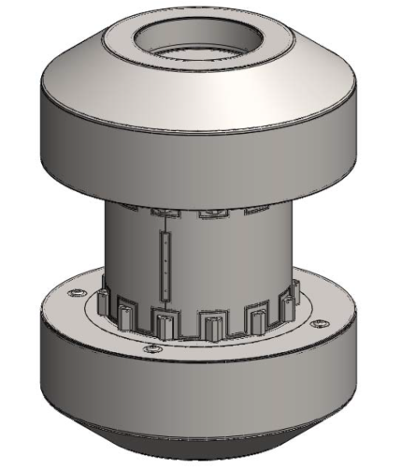
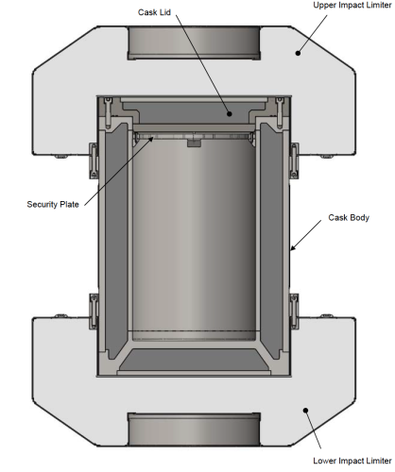
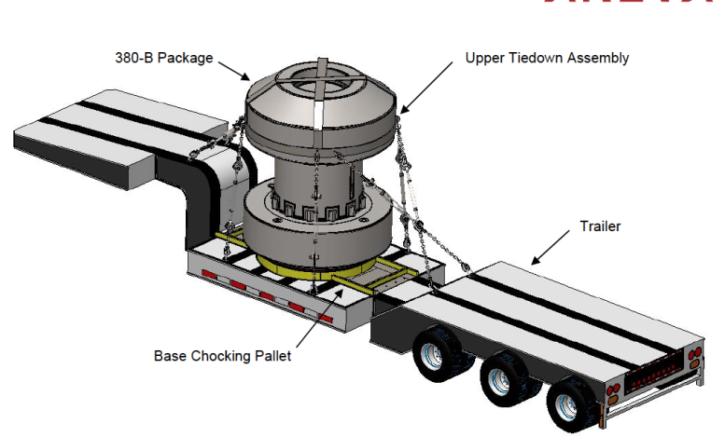
380 B “Big B”
Shielded transport container designed for shipping irradiating devices that are not certified payload in any other container and documentation (QA) is not available.
Proposed Design Parameters
Payload weight 4,535 Kg
Co, Cs, Sr, Ir, Ra Am Pu and Depleted Uranium
Approximately 275 TBq Co-60
Leak tight – NCT and HAC
Transport by truck, rail, ship, air
External dimensions 330 cm H x 254 cm OD
Internal Cavity 162 cm H x 113 cm ID
Empty weight 35,835 Kg
Half Scale testing began the week of August 18th.
We anticipate submittal of the Safety Analysis Report (SAR) to the NRC in third quarter of 2015 and receipt of the CoC by mid 2016.

Slide 7
Packaging Course
In an effort to increase the number of service provides that are licensed to prepare devices for transport, GTRI has begun working with Southwest Research Institute (SwRI) to develop a course with associated training materials.
A CRCPD Task Force was recently formed to investigate the license requirements and reciprocity agreements necessary for service providers to perform this work.
The initial courses will focus on Pharmalucence, JL Shepherd, and MDS Nordion/Best Medical devices.
Continuing education credits are being investigated for this course.

Slide 8
Contacts
Temeka Taplin
Federal Program Manager
Email: Temeka.Taplin@nnsa.doe.gov
Office: 202-586-9265
John Zarling
OSRP Program Manager
Email: jcz@lanl.gov
Office: 505-665-3668

