Slide 1
Status of Disposal Capabilities for Greater-Than-Class C (GTCC) Low-Level Radioactive Waste
Doug Tonkay
Office Director for Disposal Operations
Office of Environmental Management
October 23, 2015

Slide 2
Relevant Legislative Drivers
Currently there is no disposal pathway for GTCC LLRW or GTCC-like waste.
Congressional Mandate
Low-Level Radioactive Waste Policy Amendments Act of 1985 (Public Law #99-240)
Deems the Federal Government responsible for the disposal of LLRW with concentrations of radionuclides that exceed the limits established by NRC for Class C radioactive waste (e.g. GTCC LLRW). DOE was the agency that was later assigned that responsibility.
Requires disposal of GTCC LLRW at a facility licensed by NRC.
Energy Policy Act of 2005 (Public Law #109-58)
Requires DOE to submit a Report to Congress on the GTCC EIS disposal alternatives and await action by Congress before issuing a Record of Decision selecting a GTCC disposal alternative.

Slide 3
Other Drivers
Responds to National Security Concerns
Potential for disused sealed sources to be used in a radiological dispersal devices (e.g., dirty bomb)
Disposal need highlighted as one of two key security challenges in Inter-Agency Task Force Reports to President Obama and Congress
Supports Future U.S. Programs
Medical isotope production (molybdenum-99)
Green energy (e.g., Gen IV Nuclear Energy Systems)
Space exploration (e.g., DOE Space and Defense Power System Programs)
Provides Environmental Stewardship
Statutory mission and DOE cleanup commitments for the West Valley Site in New York

Slide 4
Overview: GTCC LLRW Waste & GTCC-Like Waste
GTCC LLRW:
A formal, defined waste classification in federal law and regulations
Generated from Nuclear Regulatory Commission (NRC) or Agreement State licensed activities
The most hazardous class of LLRW as defined by the NRC in 10 CFR 61
…“waste that is not generally acceptable for near-surface disposal… for which form and disposal methods must be different, and in general more stringent, than those specified for Class C waste”
Must be disposed of in a geologic repository, as defined by NRC, unless proposals for disposal in a site licensed pursuant to 10 CFR 61 are approved by the Commission
GTCC-Like Waste:
Not a formal waste classification by rule or DOE order; rather, a descriptive category created for purposes of the EIS
DOE owned or generated LLRW or transuranic (TRU) waste with characteristics similar to GTCC LLRW and with no identified disposal path
Primarily non-defense TRU waste from clean up activities at the West Valley Demonstration Project in New York

Slide 5
Overview: GTCC LLRW Waste & GTCC-Like Inventory
Waste Inventory
The combined GTCC LLRW and GTCC-like waste inventory is about 12,000 m³ (420,000 ft³) and contains a total activity of about 160 million curies (MCi)
8,800 m³ (310,000 ft³ ) or 75% is GTCC LLRW (commercial)
2,800 m³ (99,000 ft³ ) or 25% is GTCC-like (DOE owned)
Waste Groups (GTCC LLRW and GTCC-like waste):
Group 1: Wastes from currently operating facilities. This includes wastes that are currently in storage or are expected to be generated from these operating facilities.
Group 2: Projected wastes from proposed facilities and/or actions. Some of this waste may never be generated.
GTCC LLRW Waste Types
Activated metals: Primarily from commercial nuclear power plants
Most of this waste will not be generated for decades, but represents over 98 percent of the total curies.
Sealed sources: Used in hospitals, industries, and universities through out the U.S.
Other waste: From environmental cleanup and isotope production (Missouri University Research Reactor in MO, WVDP, BWTX in VA, WCS in TX)
GTCC-like Waste Types (same waste types as for GTCC LLRW)
Waste from DOE clean up and other mission activities (WVDP, INL, BWTX in VA, ORR, LANL)

Slide 6
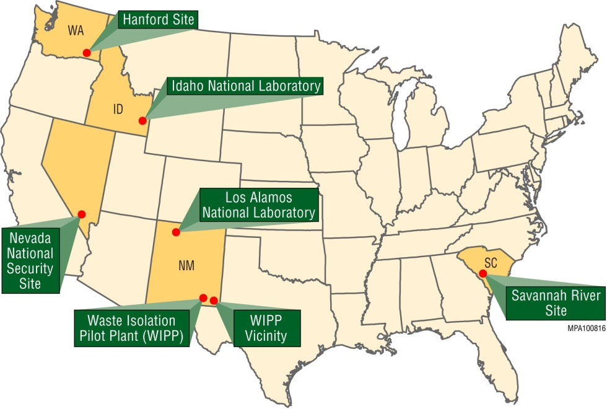
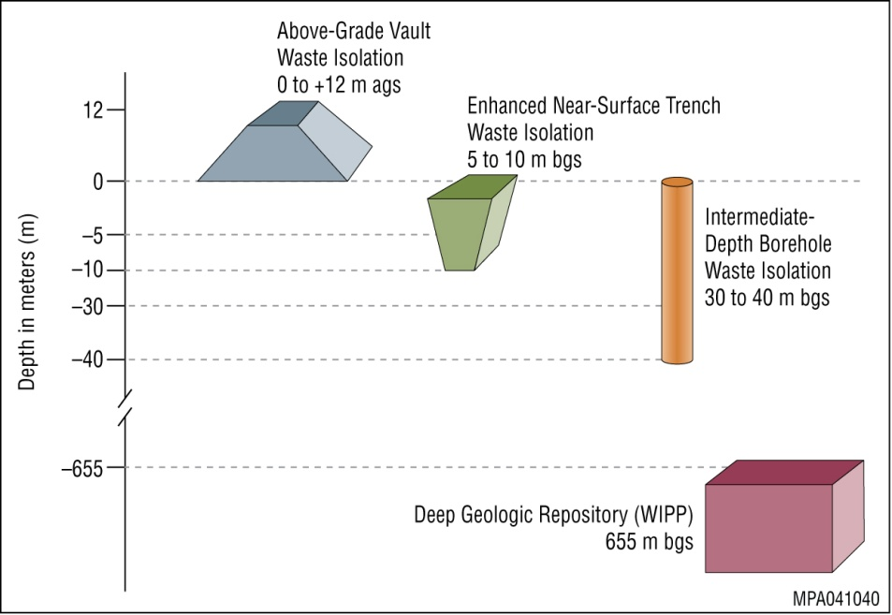
Overview: GTCC Disposal Alternatives Evaluated
1. No Action: Continue current storage/management practices
2. Geologic Repository: At Waste Isolation Pilot Plant (WIPP)
3. Boreholes: At Hanford, Idaho National Laboratory (INL), Los Alamos National Laboratory (LANL), Nevada National Security Site (NNSS), WIPP Vicinity, and generic commercial location in Region IV (west)
4. Trenches: At Hanford, INL, LANL, NNSS, Savannah River Site (SRS), WIPP Vicinity and generic commercial location in Regions II and IV (southeast and west)
5. Vaults: At Hanford, INL, LANL, NNSS, SRS, WIPP Vicinity, and generic commercial location in Regions I-IV (northeast, southeast, midwest, and west)
Draft GTCC EIS did not contain a preferred alternative but DOE anticipates a preferred alternative to be included in Final GTCC EIS).

Slide 7
Final EIS Document Overview
Evaluates 11 environmental resource areas as well as potential cumulative impacts at seven sites.
Evaluates geologic disposal and land disposal in enhanced near surface trenches, boreholes, or above-grade vaults.
Also evaluates land disposal at generic commerical sites in Nuclear Regulatory Commission (NRC) Regions I-IV.
Evaluates potential long-term human health impacts (calculated over 10,000 years).
For each alternative the analysis assumes that the total waste inventory would be disposed of at a single disposal site. Depending on the selected option for disposal, decisions can be made to dispose of the waste at more than one location.
Structured so that decisions on disposal method(s) or site(s) could be made by waste type.
Resource Areas Evaluated
in Final EIS
Climate, Air Quality, and Noise
Geology and Soils
Water Resources
Human Health
Ecology
Socioeconomics
Environmental Justice
Land Use
Transportation
Cultural Resources
Waste Management
Cumulative Impacts

Slide 8
Public Feedback Captured in the Comment Response Document
Over 4,000 public comments were submitted on the Draft GTCC EIS. DOE addresses those comments in the Comment Response Document section of the proposed Final GTCC EIS.
Comments on Disposal Alternatives
General public opposition to all alternatives, except State/local support for WIPP
WIPP supporters: NM State Government officials and City of Carlsbad officials
Numerous environmental groups and citizens oppose WIPP especially those within NM
General call for DOE to re-issue a revised Draft EIS that analyses hardened onsite storage and a new geologic repository [environmental groups]
Northwest community [EPA Region 10, Yakama Nation, Heart of America, and local citizens] challenged the viability of GTCC disposal at Hanford due to potential cumulative impacts
Comments on Technical Considerations
Transportation analysis is insufficient/doesn’t present specific routing [environmental groups]
Technical assumptions need to be better defined and supported [NRC et al.]
Challenged validity of model input parameters, approach, and results [NRC, Yakama Nation, Institute for Energy and Environmental Research, et al.]

Slide 9
Factors Considered During the Development of Preferred Alternative
Public comments provided on the Draft GTCC EIS
Disposal site: Potential human health impacts (including those from transportation and cumulative impacts); cultural resources and tribal concerns; laws, regulations, and other requirements
Waste type: Radionuclide inventory/characteristics, waste form stability, physical characteristics, and availability for disposal
Disposal method: inadvertent human intrusion, construction and operational experience, post-closure care, and cost
Programmatic factors
Preferred alternative could be a combination of two or more alternatives, based on the considerations above

Slide 10
Remaining Steps for Fulfilling Statutory Responsibility
Prepare Final EIS
Issue Final EIS
Submit Report to Congress
In accordance with Section 631 of the Energy Policy Act of 2005 (include requirements outlined in Section (3)(b)(3) of Low-Level Radioactive Waste Policy Amendments Act), the Report to Congress will:
Propose actions to ensure safe disposal of such identified radioactive wastes
Describe alternatives under consideration
Identify the Federal and non-Federal options for disposal
Describe projected costs
Identify options for ensuring that the beneficiaries of the activities resulting from the generation of GTCC waste bear all reasonable costs of disposing of such wastes
Identify statutory authority required for disposal of GTCC waste
Await Congressional Action
Issue Record of Decision

Slide 11
Path Forward
DOE is currently finalizing the proposed Final GTCC EIS.
The proposed Final GTCC EIS is anticipated to include a preferred alternative. Once the EIS is approved by DOE formally, DOE will share the preferred alternative.
GTCC EIS publication and distribution estimated in the next 6 months or so, contingent on DOE formal review.

